Slide 1

Exception Handling
Written by Rachel J. Morris, last updated Aug 25, 2017

Slide 2

About
When we are writing structures that can be re-used across multiple programs, we will also want to add in error handling. But how do we handle errors that we detect? – That’s where Exception Handling comes in!

Slide 3

Topics
1. Error codes
2. What kinds of errors are there?
3. Listening &
repsonding
4. Exception safety
5. Throwing exceptions
6. Listening for exceptions with try/catch
7. Creating your own exception class

Slide 4
1. Error codes

Slide 5
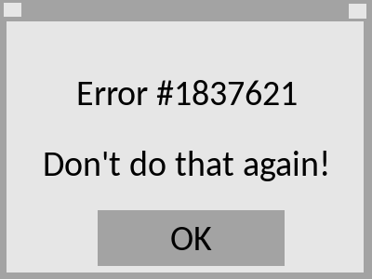
1. Error codes
Have you ever been using a program, and when it crashed all it gave you was some number code that wasn’t helpful at all in diagnosing the problem?
(<number>/48)

Slide 6
1. Error codes
Have you ever been using a program, and when it crashed all it gave you was some number code that wasn’t helpful at all in diagnosing the problem?
Passing around error codes used to be how programmers would find the errors in a program – though not much use to the user, or some other programmer using a library that throws codes!
(<number>/48)

Slide 7

1. Error codes
This is why C++ programs “return 0” at the end – traditionally, if something went wrong, you would return some number other than 0 to represent what error occurred.
If your program returns 0, then it means “everything is OK.”
(<number>/48)

Slide 8
1. Error codes
This isn’t a great way to handle errors, though, and languages have since evolved to have more built-in error handling.
This is where exception handling comes in!
(<number>/48)

Slide 9
2. What kind of errors are there?

Slide 10
2. What kind of errors are there?
What kinds of errors do we need to look out for, especially when it comes to structures built to be used in multiple programs?
Think of times your programs have crashed during runtime – out-of-bounds access to an array, de-referencing a bad pointer, doing some bad math, and so on…
When we’re writing a structure, we will want to make sure anyone using our structure won’t have the ability to crash the program with it.
(<number>/48)

Slide 11

2. What kind of errors are there?
The C++ Standard Library has a family of exception types, so while you can have an error message passed as a string (human-readable), you can also pass a specific type of exception (program-readable).
Then, when the program using your structure detects the exception, it can look at what type of error happened, and respond appropriately.
(<number>/48)

Slide 12
2. What kind of errors are there?
The C++ Exception classes are:
exception
logic_error
runtime_error
invalid_argument
out_of_range
overflow_error
underflow_error
length_error
range_error
You can view additional information about exceptions at the cplusplus.com page:
http://www.cplusplus.com/doc/tutorial/exceptions/
(<number>/48)

Slide 13
2. What kind of errors are there?
logic_error | “reports errors that are a consequence of faulty logic within the program such as violating logical preconditions or class invariants and may be preventable.” From http://en.cppreference.com/w/cpp/error/logic_error
invalid_argument | “reports errors that arise because an argument value has not been accepted.” From http://en.cppreference.com/w/cpp/error/invalid_argument
length_error | “reports errors that result from attempts to exceed implementation defined length limits for some object.” From http://en.cppreference.com/w/cpp/error/length_error
out_of_range | “reports errors that are consequence of attempt to access elements out of defined range.” From http://en.cppreference.com/w/cpp/error/out_of_range
(<number>/48)

Slide 14
2. What kind of errors are there?
runtime_error | “reports errors that are due to events beyond the scope of the program and can not be easily predicted.” From http://en.cppreference.com/w/cpp/error/logic_error
overflow_error | “report arithmetic overflow errors (that is, situations where a result of a computation is too large for the destination type)” From http://en.cppreference.com/w/cpp/error/logic_error
range_error | “report range errors (that is, situations where a result of a computation cannot be represented by the destination type)” From http://en.cppreference.com/w/cpp/error/logic_error
underflow_error | “report arithmetic underflow errors (that is, situations where the result of a computation is a subnormal floating-point value)” From http://en.cppreference.com/w/cpp/error/logic_error
(<number>/48)

Slide 15
2. What kind of errors are there?
There are additional types of exceptions, including exception types added in the 2011 and 2017 updates to C++. You can view a full list at:
http://en.cppreference.com/w/cpp/error/exception
(<number>/48)

Slide 16
2. What kind of errors are there?
exception
logic_error
runtime_error
invalid_argument
out_of_range
overflow_error
underflow_error
length_error
range_error
You can also write a class that inherits from any of these,
to make your own exception type.
(<number>/48)

Slide 17
3. Listening and responding

Slide 18
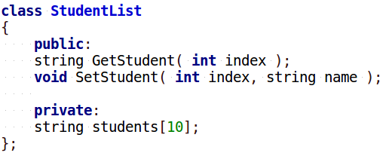
3. Listening and responding
For example, let’s say we are writing a structure to store Students which contains an array to store data. The array has space for 10 elements, so indexes 0 through 9 are valid.
We also have functions to Get and Set student names, allowing the user to pass in an index.
(<number>/48)

Slide 19

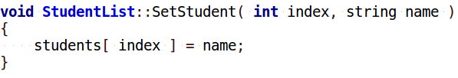
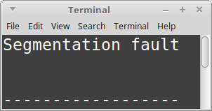
3. Listening and responding
Without any error checking, something can call the GetStudent or SetStudent functions, passing in an invalid index (less than 0, or greater than 9).
When the program goes to try to access a student at an invalid index, the program would crash.
(<number>/48)

Slide 20
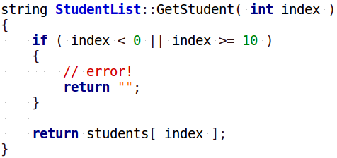
3. Listening and responding
At the same time, a basic error check isn’t always sufficient, such as this function that returns a value. If the user passes in a bad index, what do we return as the required string? Nothing? “Error”?
How do we communicate with the caller to let it know something went wrong?
(<number>/48)

Slide 21
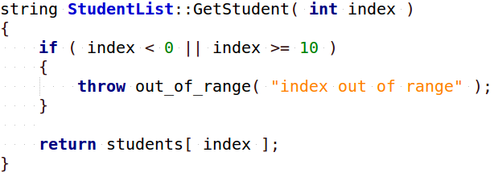
3. Listening and responding
Instead of trying to return some default value and otherwise not doing very good error reporting, instead we can use the throw command and throw some type of exception – in this case, an out_of_range exception that’s part of C++’s standard library – and we can include a string message with that exception to give more information on what went wrong, in a human-readable way.
(<number>/48)

Slide 22
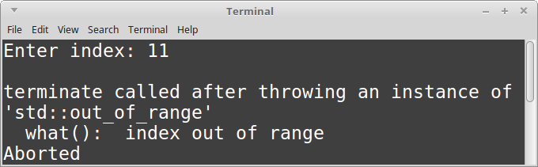
3. Listening and responding
If the exception is thrown and nothing in the program catches that exception, it will at least be reported and then the program will exit.
However, we can also write code to catch an exception, resolve it, and move on so the program continues working properly.
(<number>/48)

Slide 23
4. Exception safety

Slide 24
4. Exception safety
When errors are encountered in a piece of software, crashing and exiting isn’t always an option.
If your video game crashes and exits in the middle of a competitive multiplayer, it is inconvenient but not life-threatening. A crash here is acceptable. However, if software is driving your car, or controlling the amount of radiation a cancer patient is receiving, errors need to be taken care of. It is best to deal with the exceptions, make sure the program is still in a valid state, and continue running after cleaning up.
When we’re writing functions, we can specify some exception guarantee to let users of our work know how safe any given function is.
(<number>/48)

Slide 25
4. Exception safety
The levels of exception safety are:
No-throw guarantee, also known as failure transparency: Operations are guaranteed to succeed and satisfy all requirements even in exceptional situations. If an exception occurs, it will be handled internally and not observed by clients.
Strong exception safety, also known as commit or rollback semantics: Operations can fail, but failed operations are guaranteed to have no side effects, so all data retain their original values.
Basic exception safety, also known as a no-leak guarantee: Partial execution of failed operations can cause side effects, but all invariants are preserved and there are no resource leaks (including memory leaks). Any stored data will contain valid values, even if they differ from what they were before the exception.
No exception safety: No guarantees are made.
From https://en.wikipedia.org/wiki/Exception_safety
(<number>/48)

Slide 26
5. Throwing exceptions

Slide 27

5. Throwing exceptions
Notes
#include <stdexcept>
to use exceptions!
Inside function:
throw exceptions
Outside function:
Try function,
Catch exceptions.
There are two parts of working with exceptions:
Inside (Inside a function that may have an error)
Detect an error, then throw an exception.
Outside (Calling the function)
Try to call the function,
and catch any exceptions that occur.
(<number>/48)

Slide 28
5. Throwing exceptions
Notes
#include <stdexcept>
to use exceptions!
Inside function:
throw exceptions
Outside function:
Try function,
Catch exceptions.
When should you add an exception throw to your function?
When you’re doing error checking!
You might not be in the practice of checking for errors (such as bad user input, bad pointer address, or other things), but we will have error checking in our data structures.
(<number>/48)

Slide 29
5. Throwing exceptions
Notes
#include <stdexcept>
to use exceptions!
Inside function:
throw exceptions
Outside function:
Try function,
Catch exceptions.
Whether your code is being re-used across multiple programs, or you’re working with multiple people in one program, or even working alone, you should get into the habit of checking for errors and handling them appropriately!
(<number>/48)

Slide 30
5. Throwing exceptions
Notes
#include <stdexcept>
to use exceptions!
Inside function:
throw exceptions
Outside function:
Try function,
Catch exceptions.
Some examples of errors to look out for are…
Validate function inputs
Are the parameters within a valid range?
What do you do if something’s wrong?
Validate objects are initialized
With dynamic arrays, is it pointing to nullptr or is it initialized?
Has a file been opened already for reading, or is it closed?
Are we outside of bounds?
Is the index to be accessed within a valid range?
Is it OK to free the memory?
Don’t use delete on nullptr
Are we about to divide by zero?
Check denominator values prior to doing a computation
(<number>/48)

Slide 31
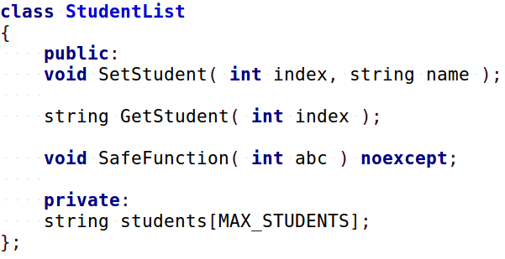
5. Throwing exceptions
Notes
#include <stdexcept>
to use exceptions!
Inside function:
throw exceptions
Outside function:
Try function,
Catch exceptions.
To implement throwing exceptions, declare your functions as normal. If you’re 100% sure that a function won’t throw an exception (including via other functions being called within your function), you can mark it as noexcept.
(<number>/48)

Slide 32
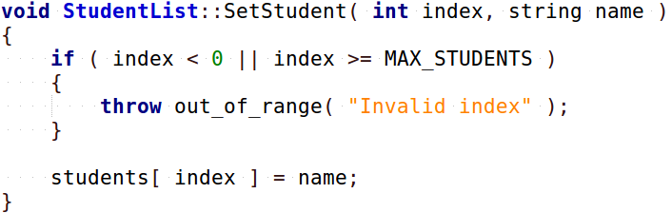
5. Throwing exceptions
Notes
#include <stdexcept>
to use exceptions!
Inside function:
throw exceptions
Outside function:
Try function,
Catch exceptions.
In the function definition, do some error checking, and if you detect an error, use the throw command.
To use the exception family of classes, you will need to
#include <stdexcept>
(<number>/48)

Slide 33
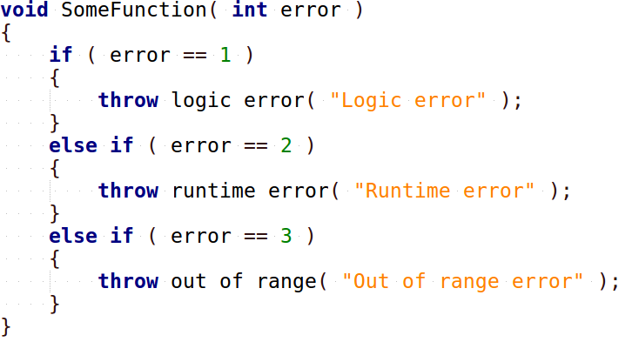
5. Throwing exceptions
Notes
#include <stdexcept>
to use exceptions!
Inside function:
throw exceptions
Outside function:
Try function,
Catch exceptions.
Your functions can also throw multiple different types of exceptions as well, based on what you are detecting.
(<number>/48)

Slide 34
5. Throwing exceptions
Notes
#include <stdexcept>
to use exceptions!
Inside function:
throw exceptions
Outside function:
Try function,
Catch exceptions.
When creating a function that can throw exceptions, we might want to add a specifier to that function.
In C++03 (the version from 2003), you could specify what kind of exception would be thrown:
This function declaration specifies that it may throw an out_of_range error.
However, the throw() function specifier has been deprecated as of C++11; this means that you can still use this, but it may be removed or replaced in future versions of C++.
(<number>/48)

Slide 35
5. Throwing exceptions
Notes
#include <stdexcept>
to use exceptions!
Inside function:
throw exceptions
Outside function:
Try function,
Catch exceptions.
noexcept specifier shows that a function won’t throw any exceptions.
In C++11, instead of specifying
what kind of exception this function may throw,
we instead specify
whether this function may throw an exception
with the noexcept specifier.
This function declaration specifies that this won’t throw an exception.
The function that may throw an exception has no extra specifier.
(<number>/48)

Slide 36
6. Listening for exceptions with try/catch

Slide 37
6. Listening for exceptions with try/catch
Notes
#include <stdexcept>
to use exceptions!
Inside function:
throw exceptions
Outside function:
Try function,
Catch exceptions.
It isn’t enough to just throw an exception when you detect an error. When a function that might cause an exception is called, the caller needs to listen… if the exception is thrown, the external code needs to catch it.
Just like we can throw different types of errors, we can also catch the different types of errors – and even catch multiple types of exceptions coming from one or more functions.
(<number>/48)

Slide 38
6. Listening for exceptions with try/catch
Notes
#include <stdexcept>
to use exceptions!
Inside function:
throw exceptions
Outside function:
Try function,
Catch exceptions.
In order to detect exceptions, we must wrap a portion of code within a try/catch block.
We can have as many catch blocks as we need, one catch per exception type, but there will be just one try per try/catch block. You can still have multiple try/catch statements in your program, though.
(<number>/48)

Slide 39
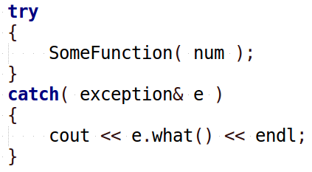
6. Listening for exceptions with try/catch
Notes
#include <stdexcept>
to use exceptions!
Inside function:
throw exceptions
Outside function:
Try function,
Catch exceptions.
When we are working with a function that may throw an exception, we can wrap it within the try/catch block.
This function may throw an exception.
If any exceptions are thrown within the try {} block, then the code within the catch {} for the corresponding exception type is executed.
The base exception class contains a what() function, that returns a
c-string of the error message.
(<number>/48)

Slide 40
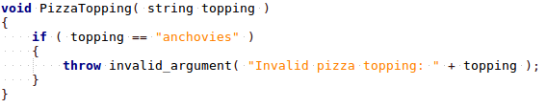
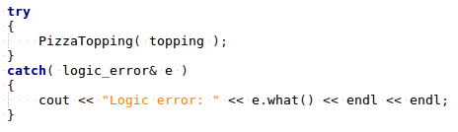
6. Listening for exceptions with try/catch
If we don’t have a catch for a specific exception that will be thrown by the function, the exception can be caught by that exception’s parent or ancestor.
Notes
#include <stdexcept>
to use exceptions!
Inside function:
throw exceptions
Outside function:
Try function,
Catch exceptions.
This function throws invalid_argument exceptions
But the caller only detects logic_error exceptions.
(<number>/48)

Slide 41
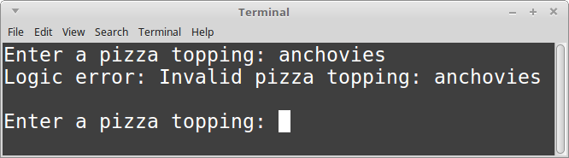
6. Listening for exceptions with try/catch
If we don’t have a catch for a specific exception that will be thrown by the function, the exception can be caught by that exception’s parent or ancestor.
Notes
#include <stdexcept>
to use exceptions!
Inside function:
throw exceptions
Outside function:
Try function,
Catch exceptions.
This function throws invalid_argument exceptions
But the caller only detects logic_error exceptions.
The exception
was still caught!
(<number>/48)

Slide 42
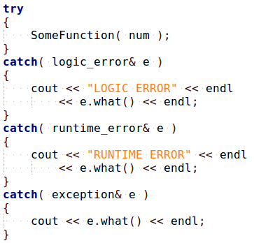
6. Listening for exceptions with try/catch
Because exceptions are part of a family tree, you can use the parent exception as the default catch, if none of the other catch statements grab the exception.
However, make sure you put the more generic exception types after the more specific ones;
catch( exception& e )
should go on the bottom so it doesn’t preempt the more specific exception handlers.
Notes
#include <stdexcept>
to use exceptions!
Inside function:
throw exceptions
Outside function:
Try function,
Catch exceptions.
(<number>/48)

Slide 43
7. Creating your own exception class

Slide 44
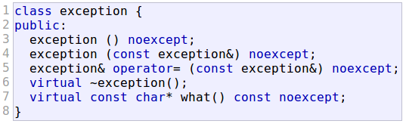
7. Creating your own exception class
Using inheritance, you can also create your own exception class by inheriting from exception, or any of its children.
Notes
#include <stdexcept>
to use exceptions!
Inside function:
throw exceptions
Outside function:
Try function,
Catch exceptions.
from http://www.cplusplus.com/reference/exception/exception/
(<number>/48)

Slide 45
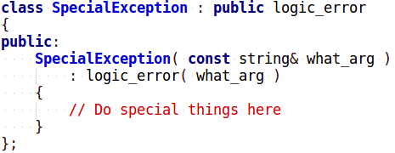
7. Creating your own exception class
Creating a custom exception, inheriting from logic_error
Notes
#include <stdexcept>
to use exceptions!
Inside function:
throw exceptions
Outside function:
Try function,
Catch exceptions.
First, you create an exception class
(<number>/48)

Slide 46
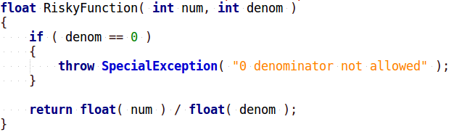
7. Creating your own exception class
Creating a custom exception, inheriting from logic_error
Notes
#include <stdexcept>
to use exceptions!
Inside function:
throw exceptions
Outside function:
Try function,
Catch exceptions.
This function throws invalid_argument exceptions
Then you can throw it from a function
(<number>/48)

Slide 47
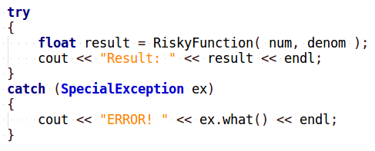
7. Creating your own exception class
Creating a custom exception, inheriting from logic_error
Notes
#include <stdexcept>
to use exceptions!
Inside function:
throw exceptions
Outside function:
Try function,
Catch exceptions.
This function throws invalid_argument exceptions
Catching the special exception
And catch the special exception in a try/catch.
(<number>/48)

Slide 48
Conclusion
Data Structures class is all about writing structures that store, maintain, and organize data. These aren’t standalone classes that would just be used in a single project, but something to be used across multiple programs. Therefore, we need to make sure our structures are stable.
Additionally, you need to know how to listen for exceptions, as functions from other libraries (including the STL) will throw exceptions in some cases.

