Slide 1

Wrapping a static array
Written by Rachel J. Morris, last updated Aug 26, 2017

Slide 2

About
Early on when starting with C++, we cover static arrays. Later on, we create dynamic arrays by using pointers.
To introduce some of the basic ideas of making a data structure, we are going to start with wrapping a static array, then a dynamic array.

Slide 3

Topics
1. Review: Static arrays
2. Pitfalls of a static array
3. Making a “smart” static array

Slide 4
1. Review: Static arrays

Slide 5

1. Review: Static arrays
Notes
Just in case it’s been a while since you’ve done some programming with static arrays, let’s look at how they’re used.
(16/17)

Slide 6
1. Review: Static arrays
Notes
Static arrays…
Must have a defined size at compile-time
Cannot be resized while the program is running
Have the risk of crashing the program if you go out of bounds of the array
Static arrays…
Size must be known at compile time
Cannot be resized
Problems happen if you go outside of bounds
(16/17)

Slide 7
1. Review: Static arrays
Notes
Static arrays…
Elements of the array are stored contiguously in memory
C++ arrays don’t keep track of their amount of elements; we have to track that ourselves, or use the sizeof() function – which gives size in bytes.
If you know the size of the data type the array is storing, you can figure out the amount of elements from that.
Static arrays…
Size must be known at compile time
Cannot be resized
Problems happen if you go outside of bounds
Elements are stored contiguously in memory
Arrays don’t keep track of their # of elements
0x7ffe44e2c5a0
0x7ffe44e2c5a4
0x7ffe44e2c5a8
0x7ffe44e2c5ac
Index 0
Index 1
Index 2
Index 3
(16/17)

Slide 8
1. Review: Static arrays
Notes
Each element of an array is essentially a single variable, but as part of an array we can access each of the “element variables” by their position.
The index is the numeric position in the array. The first index of arrays in C++ is always 0.
If an array is of size n, then the valid indexes are 0 through n-1.
Static arrays…
Size must be known at compile time
Cannot be resized
Problems happen if you go outside of bounds
Elements are stored contiguously in memory
Arrays don’t keep track of their # of elements
For an array of size n, valid indexes are 0 through n-1.
(16/17)

Slide 9
2. Pitfalls of a static array

Slide 10
2. Pitfalls of a static array
Notes
Let’s look at an example of using a static array in a program, and some things we have to look out for.
(16/17)

Slide 11
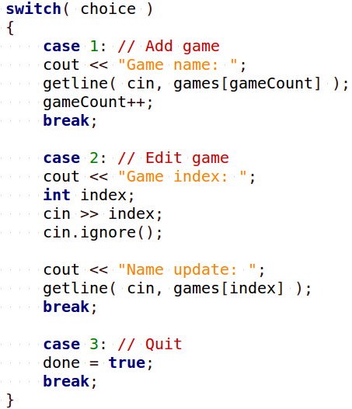
2. Pitfalls of a static array
Notes
Using a static array
1. If the array is full (gameCount > max size), this will crash.
2. If the user enters an invalid index
(index < 0 or index >= size), the program will crash.
(16/17)

Slide 12
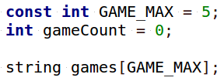
2. Pitfalls of a static array
Notes
Declaring the array
3. If we want to protect against going outside of bounds of the array, we need to keep track of both
the maximum size (the array’s size), and the element count.
(16/17)

Slide 13
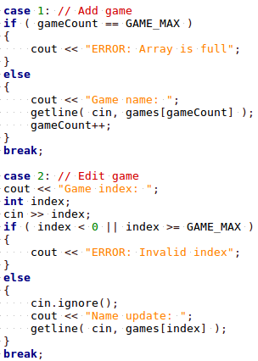
2. Pitfalls of a static array
Notes
Using just a vanilla static array, we would have to check that the array is not full, and validate any user-entered index, every time each of these happens.
This means a lot of duplicate code checking the same things if the array is used throughout the program.
Part of good program design is reducing duplicate code.
(16/17)

Slide 14
2. Pitfalls of a static array
Notes
So how do we cut down on duplicate code, and make the array easier to use?
(16/17)

Slide 15
3. Making a “smart” static array

Slide 16
2. Pitfalls of a static array
Notes
So how do we cut down on duplicate code, and make the array easier to use?
(16/17)

Slide 17
Conclusion
We did a thing.
Next time we do more things.

