Slide 1

The Standard
Template Library
Written by Rachel J. Morris, last updated Aug 6, 2017

Slide 2

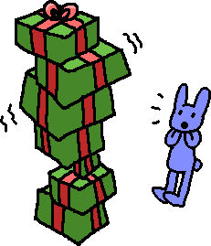
About
C++ has some data structures already pre-built and available within the standard library that we can use to get familiar a bit with how these structures work.
Before we get into the details of
implementing these data
structures, it might be useful to see
how they can actually be used first…

Slide 3

About
Wait, if data structures already exist, why are we going to spend all semester learning how to write ‘em?!

Slide 4
About
Well… learning about data structures & algorithm analysis is a big part of computer science.

Slide 5
About
Well… learning about data structures & algorithm analysis is a big part of computer science.
You also need to know the inner-workings of these structures, so that when you’re implementing solutions, you can choose the best structure for your particular problem – it isn’t one size fits all!

Slide 6
About
Well… learning about data structures & algorithm analysis is a big part of computer science.
You also need to know the inner-workings of these structures, so that when you’re implementing solutions, you can choose the best structure for your particular problem – it isn’t one size fits all!
You might need to create your own data structures down the line, or customize an existing one!

Slide 7

About
Well… learning about data structures & algorithm analysis is a big part of computer science.
You also need to know the inner-workings of these structures, so that when you’re implementing solutions, you can choose the best structure for your particular problem – it isn’t one size fits all!
You might need to create your own data structures down the line, or customize an existing one!
You’ll be asked about them during job interviews.
Interviewers love asking about data structures.

Slide 8
About
So let’s see how some of these structures work by utilizing the structures available in the Standard Template Library.
In particular…
STL Vector
STL List
STL Stack
STL Queue
STL Map

Slide 9
Topics
1. Vectors
2. Lists
3. Queues
4. Stacks
5. Maps

Slide 10

1. STL Vector
In some ways, vector objects are similar to arrays, which you may have used in previous classes.
You can access specific items of the vector with the subscript operator, [ ]
Notes
Vectors are implemented with arrays, so you can access specific elements with the subscript operator [ ].
(<number>/56)

Slide 11
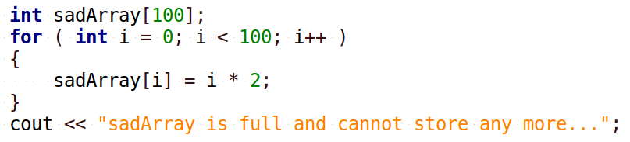
1. STL Vector
A perk of the vector object is that it handles resizing on its own.
Recall that with a static array, we had to know what its size was at compile time, and it couldn’t be resized!
Notes
Vectors are implemented with arrays, so you can access specific elements with the subscript operator [ ].
Vectors handle resizing its internal array automatically.
(<number>/56)

Slide 12
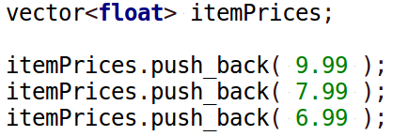
1. STL Vector
With a STL vector, it handles resizing on its own (behind-the-scenes!), so we don’t have to worry about it – we can just keep adding items on to it!
Notes
Vectors are implemented with arrays, so you can access specific elements with the subscript operator [ ].
Vectors handle resizing its internal array automatically.
push_back is the function used to insert items into the vector.
Someone else has implemented the vector for us, so that we don’t have to worry about how it works, it just does!
The vector’s push_back function is how we add items into the “array”.
(<number>/56)

Slide 13
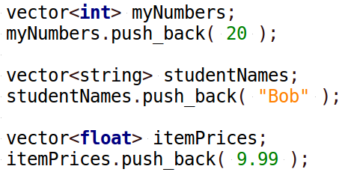
1. STL Vector
A Vector can store any data-type...
Notes
Vectors are implemented with arrays, so you can access specific elements with the subscript operator [ ].
Vectors handle resizing its internal array automatically.
push_back is the function used to insert items into the vector.
(<number>/56)

Slide 14
1. STL Vector
A Vector can store any data-type...
Notes
Vectors can contain any data-type.
The <int>, <string>, and <float> bits of code are because vector has been implemented as a template.
If you haven’t covered templates before, or don’t quite remember how they work, don’t worry – we will go over them more later on.
(<number>/56)

Slide 15
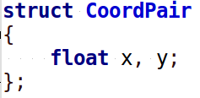
1. STL Vector
A Vector can store any data-type...
Notes
Vectors can contain any data-type.
During declaration, the data-type the vector will store goes in < >.
If we write a struct or a class, a vector can even store those!
(<number>/56)

Slide 16
1. STL Vector
Some handy functions of a vector are…
Notes
Functions:
(“T” refers to the data-type the vector stores)
void push_back
( T& item )
size_type size()
bool empty()
T& operator[]( size_type n )
void clear()
push_back
Insert an item at the end of the vector
size
Returns the amount of items in the vector
empty
Returns whether the vector is empty or not (size == 0?)
operator[]
Access an item in the vector at any index
clear
Clears out all the elements of the vector.
(<number>/56)

Slide 17
1. STL Vector
Vectors are implemented with a dynamic array, which is why we can treat them like arrays.
By using a class to wrap-around a dynamic array, we can automatically have the structure handle resizing whenever space runs out, or when the user tries to use the subscript operator [ ].
Notes
Functions:
(“T” refers to the data-type the vector stores)
void push_back
( T& item )
size_type size()
bool empty()
T& operator[]( size_type n )
void clear()
(<number>/56)

Slide 18
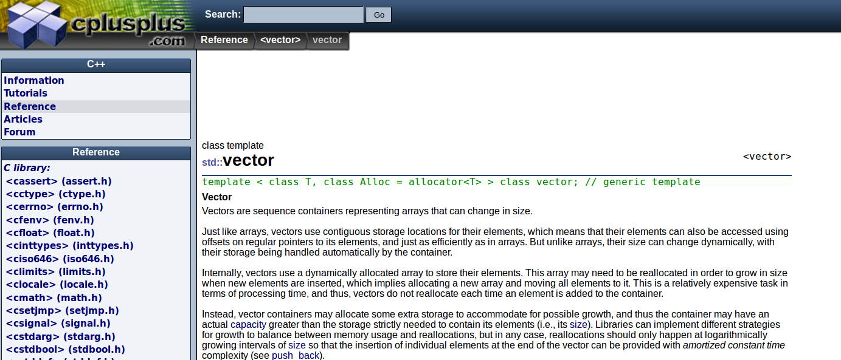
1. STL Vector
cplusplus.com has useful reference pages on all the Standard Template Library structures that you can use to get more information on the vector and its functions.
http://www.cplusplus.com/reference/vector/vector/
Notes
Functions:
(“T” refers to the data-type the vector stores)
void push_back
( T& item )
size_type size()
bool empty()
T& operator[]( size_type n )
void clear()
(<number>/56)

Slide 19

1. STL Vector
Example Time!
(<number>/56)

Slide 20
1. STL Vector
Using a Static Array…
Declaring an int array
int myNumbers[3];
myNumbers[0] = 2;
myNumbers[1] = 3;
myNumbers[2] = 6;
for ( int i = 0; i < 3; i++ )
{
cout << i << "\t" << myNumbers[i] << endl;
}
Assigning values to array
Displaying elements
of the array
(<number>/56)

Slide 21
1. STL Vector
Using a STL Vector…
Declaring an int vector
vector<int> myNumbers2;
myNumbers2.push_back( 2 );
myNumbers2.push_back( 3 );
myNumbers2.push_back( 6 );
myNumbers2[0] = 1;
for ( unsigned int i = 0; i < myNumbers2.size(); i++ )
{
cout << i << "\t" << myNumbers2[i] << endl;
}
Assigning values to vector
Overwriting value at index 0
Displaying elements
of the vector
The size() function returns an unsigned int value, which is essentially a non-negative integer. This is why my for loop uses an unsigned int for i.
(<number>/56)

Slide 22
2. STL List
Lists also store a linear series of data, but they’re a little different from vectors.
For one, you cannot randomly access data with the subscript operator [ ].
Generally, to step through a list, you have to start at the beginning and keep stepping through, one at a time.
The STL List does contain a sort() function and reverse() function, though!
Notes
Lists are also a linear data type, but you cannot randomly access items in the list because of how it is implemented.
(<number>/56)

Slide 23
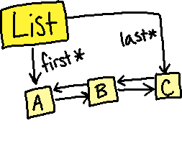
2. STL List
We cannot randomly access data in
a List because it isn’t implemented
with an array, like vector is.
STL Lists use pointers. The list keeps
track of what its starting element is,
and each element points to the next element in the list.
Therefore, unlike an array, the elements are not in contiguous memory slots.
(This is why it’s important to stay familiar with pointers for this class!)
Notes
Lists are also a linear data type, but you cannot randomly access items in the list because of how it is implemented.
Lists are implemented with Nodes that contain pointers to the previous and next items in the list.
(<number>/56)

Slide 24
2. STL List
We will discuss the pointer and
memory aspect of lists later on,
once we’re implementing linked lists.
For now…
onto the STL List functionality!
Notes
Lists are also a linear data type, but you cannot randomly access items in the list because of how it is implemented.
Lists are implemented with Nodes that contain pointers to the previous and next items in the list.
(<number>/56)

Slide 25
2. STL List
push_back
Insert an item at the end of the list
size
Returns the amount of items in the list
empty
Returns whether the list is empty or not (size == 0?)
clear
Clears out all the elements of the list.
sort
Sorts the elements of the list
reverse
Reverses the order of elements in the list.
Notes
Functions:
(“T” refers to the data-type the list stores)
void push_back
( T& item )
size_type size()
bool empty()
void clear()
void sort()
void reverse()
(<number>/56)

Slide 26
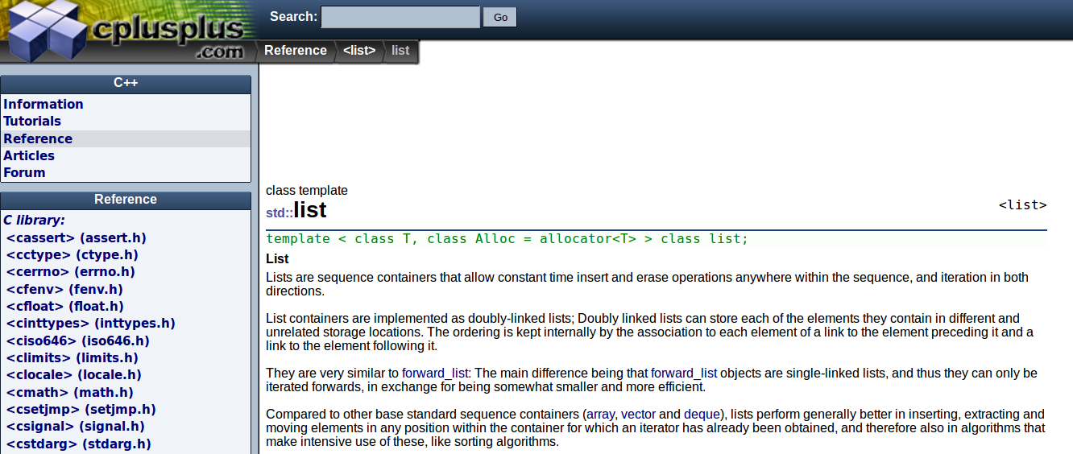
2. STL List
Access documentation about the STL List at cplusplus.com:
http://www.cplusplus.com/reference/list/list/
Notes
Functions:
(“T” refers to the data-type the list stores)
void push_back
( T& item )
size_type size()
bool empty()
void clear()
void sort()
void reverse()
(<number>/56)

Slide 27

2. STL List
Example Time!
(<number>/56)

Slide 28
2. STL List
Using a STL List…
Declaring a list of strings
list<string> states;
states.push_back( "Maine" );
states.push_back( "Hawaii" );
states.push_back( "Kansas" );
states.push_back( "Missouri" );
states.push_back( "Washington" );
states.push_back( "Alaska" );
states.sort();
states.reverse();
for ( list<string>::iterator it = states.begin();
it != states.end(); it++ )
{
cout << *it << endl;
}
Adding strings to the list
Sort the list
Reverse the list
Use iterators to display the contents of the list
To iterate through the STL List, we must use an iterator. You probably haven’t seen one of these before, but it’s a topic for another time.
(<number>/56)

Slide 29

3. STL Queue
A queue is a type of restricted-access data structure.
It stores its contents in a linear order, but you’re only able to remove items at the front of the queue,
and to add new items to the back of the queue.
A queue is known as a First In, First Out (FIFO) structure.
Notes
Queues are first-in-first-out.
1.
(<number>/56)

Slide 30

3. STL Queue
The first item that enters the queue, who sits at the front of the line, is the first one to get removed, just like in a grocery-store line.
Notes
Queues are first-in-first-out.
1.
2.
(<number>/56)

Slide 31
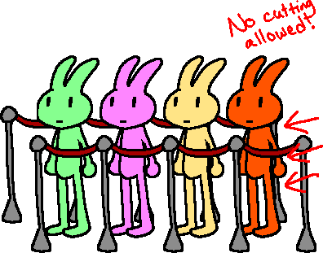
3. STL Queue
And when a new item is added to the queue, it enters at the end (or back) of the queue.
Notes
Queues are first-in-first-out.
1.
2.
3.
(<number>/56)

Slide 32
3. STL Queue
Some handy queue functions are…
Notes
Functions:
(“T” refers to the data-type the queue stores)
void push( T& item )
void pop()
T& front()
size_type size()
bool empty()
push
Pushes an item to the back of the queue.
pop
Removes an item from the front of the queue.
front
Returns the item that is at the front of the queue.
size
Returns the amount of items in the queue.
empty
Returns whether the queue is empty or not.
(<number>/56)

Slide 33
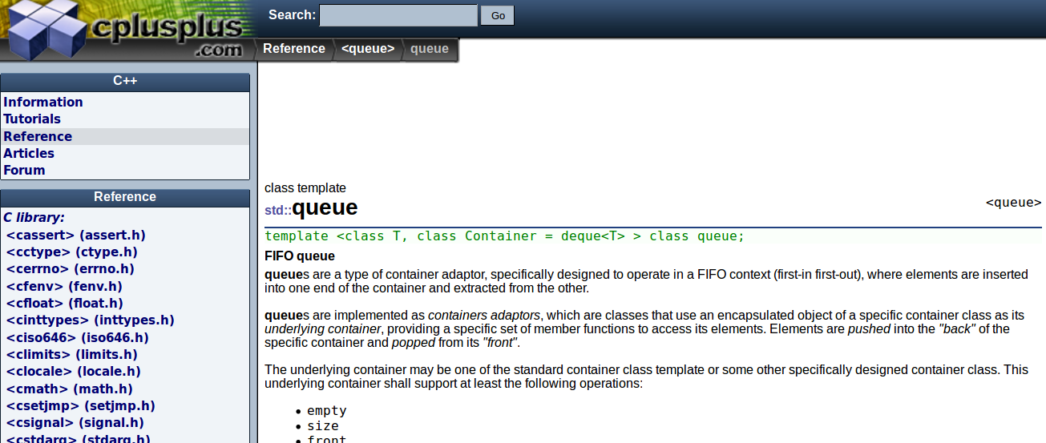
3. STL Queue
Access documentation about the STL Queue at cplusplus.com:
http://www.cplusplus.com/reference/queue/queue/
Notes
Functions:
(“T” refers to the data-type the queue stores)
void push( T& item )
void pop()
T& front()
size_type size()
bool empty()
(<number>/56)

Slide 34
3. STL Queue
Example Time!
(<number>/56)

Slide 35
3. STL Queue
Using a STL Queue…
Declaring a queue of strings
queue<string> commands;
commands.push( "mkdir newFolder" );
commands.push( "touch newFile" );
commands.push( "ping google.com -c 5" );
commands.push( "ping yahoo.com -c 3" );
while ( !commands.empty() )
{
string command = commands.front();
cout << endl << command << endl;
system( command.c_str() );
commands.pop();
}
Pushing strings into the queue
Checking if the queue is empty
Accessing the front-most item
Removing the front-most item
(<number>/56)

Slide 36
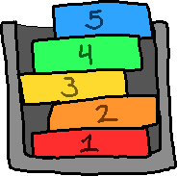
4. STL Stack
A Stack is a type of data structure that is linear, like a list or vector is, but it also restricts access to the internal data.
The main characteristic of a stack is that it is a
First In Last Out (or) Last In First Out
structure.
Notes
Stacks are a restricted-access data type that is Last-In-First-Out
(<number>/56)

Slide 37
4. STL Stack
At any time, you’re only able to access one item from the stack – the top-most item.
And, as items are pushed onto the stack, the older items are on the bottom, and the newer items are on the top.
Notes
Stacks are a restricted-access data type that is Last-In-First-Out
(<number>/56)

Slide 38
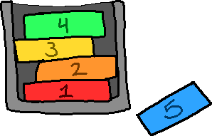
4. STL Stack
As you remove items from the stack, you pull the newest item that was added to the stack.
The first item on the stack is the last one to be removed.
Notes
Stacks are a restricted-access data type that is Last-In-First-Out
(<number>/56)

Slide 39
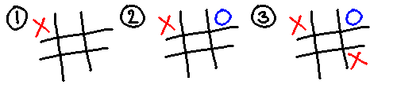
4. STL Stack
One example of using a Stack is to keep track of moves in a game of tic-tac-toe.
Notes
Stacks are a restricted-access data type that is Last-In-First-Out
(<number>/56)

Slide 40

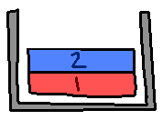
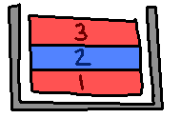
4. STL Stack
One example of using a Stack is to keep track of moves in a game of tic-tac-toe.
Notes
Stacks are a restricted-access data type that is Last-In-First-Out
Every time a move is made, we could push the game board’s current state onto a stack…
(<number>/56)

Slide 41
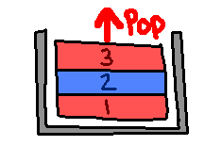
4. STL Stack
One example of using a Stack is to keep track of moves in a game of tic-tac-toe.
Notes
Stacks are a restricted-access data type that is Last-In-First-Out
Then if we want to undo a turn, we can
pop the most recent state off the stack...
(<number>/56)

Slide 42
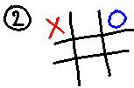
4. STL Stack
One example of using a Stack is to keep track of moves in a game of tic-tac-toe.
Notes
Stacks are a restricted-access data type that is Last-In-First-Out
Then if we want to undo a turn, we can
pop the most recent state off the stack…
And the game board reverts to the state before.
(<number>/56)

Slide 43
4. STL Stack
Some handy stack functions are…
Notes
Functions:
(“T” refers to the data-type the stack stores)
void push( T& item )
void pop()
T& top()
size_type size()
bool empty()
push
Pushes an item to the top of the stack.
pop
Removes an item from the top of the stack.
top
Returns the item that is at the top of the stack.
size
Returns the amount of items in the stack.
empty
Returns whether the stack is empty or not.
(<number>/56)

Slide 44
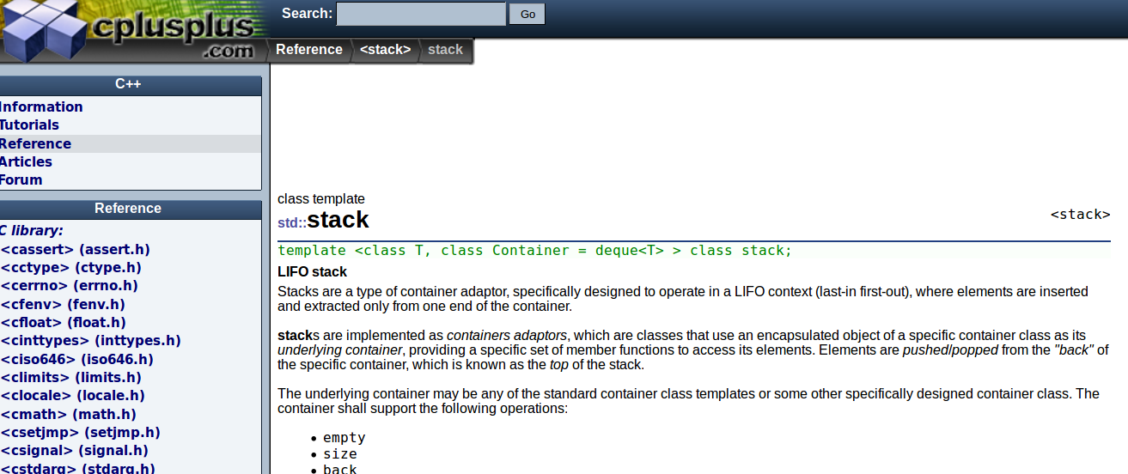
4. STL Stack
Access documentation about the STL Stack at cplusplus.com:
http://www.cplusplus.com/reference/stack/stack/
Notes
Functions:
(“T” refers to the data-type the stack stores)
void push( T& item )
void pop()
T& top()
size_type size()
bool empty()
(<number>/56)

Slide 45
4. STL Stack
Example Time!
(<number>/56)

Slide 46
4. STL Stack
Using a STL Stack…
Declaring a stack of characters
cin >> text;
stack<char> letters;
for ( unsigned int i = 0; i < text.size(); i++ )
{
cout << "Letter " << i << " = " << text[i] << endl;
letters.push( text[i] );
}
cout << endl << "Pop off stack: " << endl;
while ( !letters.empty() )
{
cout << letters.top();
letters.pop();
}
Pushing characters onto the stack
Checking if the stack is empty
Accessing the top-most item
Removing the top-most item
(<number>/56)

Slide 47

5. STL Map
When we’re using a plain-old array, we have a series of elements in order, starting at 0, going until (size – 1).
Notes
A map is also known as a dictionary or hash table.
A map contains key-value pairs.
7 items in the array
=
Index 0 through 6 is valid
(<number>/56)

Slide 48
5. STL Map
A value of 0, 1, 2, 3, 4, 5, or 6, which specifies an element’s position, is known as an index, but we can also think of it like a “key”,
which helps us locate the value we want
Notes
A map is also known as a dictionary or hash table.
A map contains key-value pairs.
Key
Value
(<number>/56)

Slide 49
5. STL Map
But with a data structure like a map, our keys don’t have to just be integers, and they don’t have to be array indices.
The key can be any data type, and it can point to a value of any data type as well.
Notes
A map is also known as a dictionary or hash table.
A map contains key-value pairs.
(<number>/56)

Slide 50
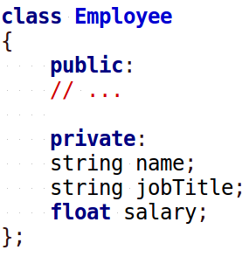
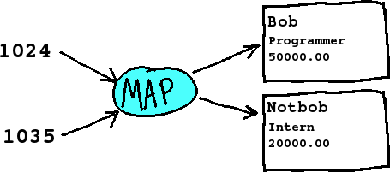
5. STL Map
For example, think of an employee ID, that points to an employee object in a program…
Notes
A map is also known as a dictionary or hash table.
A map contains key-value pairs.
Value
Key
(<number>/56)

Slide 51
5. STL Map
Maps are built in a special way so that we can access elements by key, and it will access it quickly – search algorithm not required.
Notes
A map is also known as a dictionary or hash table.
A map contains key-value pairs.
Value
Key
(<number>/56)

Slide 52
5. STL Map
Some handy map functions are…
Notes
Functions:
(“T1” and “T2” refer to the key and value data-types)
T2& operator[]
( const T1& key )
size_type size()
bool empty()
operator[]
Access an element of the map, using a key
empty
Returns whether the map is empty or not
size
Get the amount of elements in the map
(<number>/56)

Slide 53
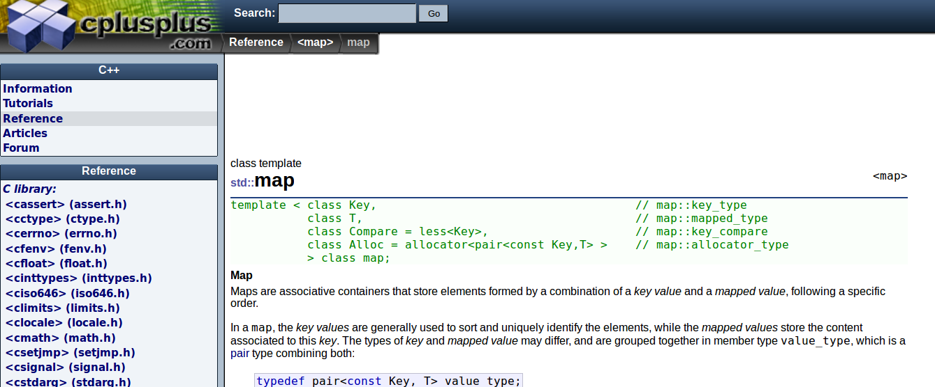
5. STL Map
Access documentation about the STL Map at cplusplus.com:
http://www.cplusplus.com/reference/map/map/
Notes
Functions:
(“T1” and “T2” refer to the key and value data-types)
T2& operator[]
( const T1& key )
size_type size()
bool empty()
(<number>/56)

Slide 54

5. STL Map
Example Time!
(<number>/56)

Slide 55
5. STL Map
Using a STL Map…
Declare a map, with string keys and int values
map<string, int> employees;
employees["Harry"] = 1024;
employees["Ron"] = 256;
employees["Hermione"] = 512;
string key;
cout << "Enter an employee name: ";
cin >> key;
cout << "That employee ID is "
<< employees[ key ] << endl;
Adding key-value pairs
Accessing a value, given some key
(<number>/56)

Slide 56
Conclusion
We will eventually implement each of these structures ourselves to learn how these work, but sometimes it can be handy to view new concepts from the outside→in to begin with.
Data structures are all about writing structures (i.e., classes) to store data. Structures need a way to add data, access data, and remove data. We will be writing lots of add, access, and remove functions this semester!

