Slide 1


Data Analysis In the Business Context
Applied Data Analysis Training
By / Mariam Hossam

Slide 2

Hotel Business Problem
A mid-sized hotel faces challenges in managing bookings from various channels, including Online Travel Agencies (OTAs), direct bookings through the hotel's website, and traditional travel agents. The hotel's management aims to better understand these financial impacts to optimize their channel strategy, reduce costs, and enhance profitability.

Slide 3
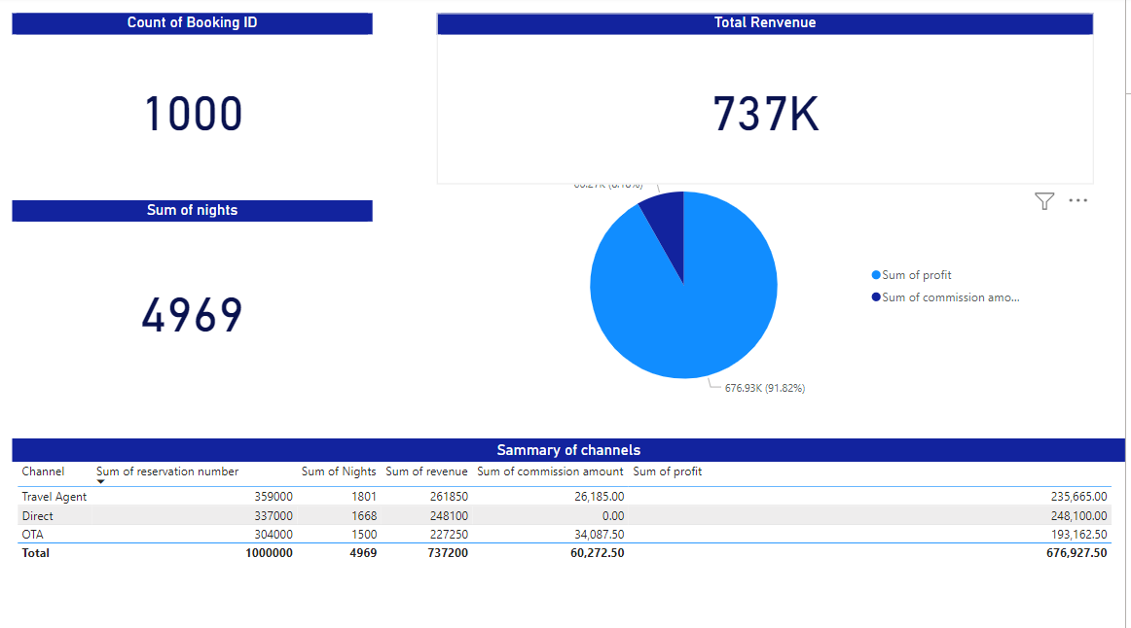
Sammary sum of data
Insights:
Sum of records of booked reservation
sum of booked nights
know What is total revenue , commissions amount and profit

Slide 4
Sammary of channels
Insights:
How many How each number of reservation per channel
Sum of profits per channels , rooms

Slide 5
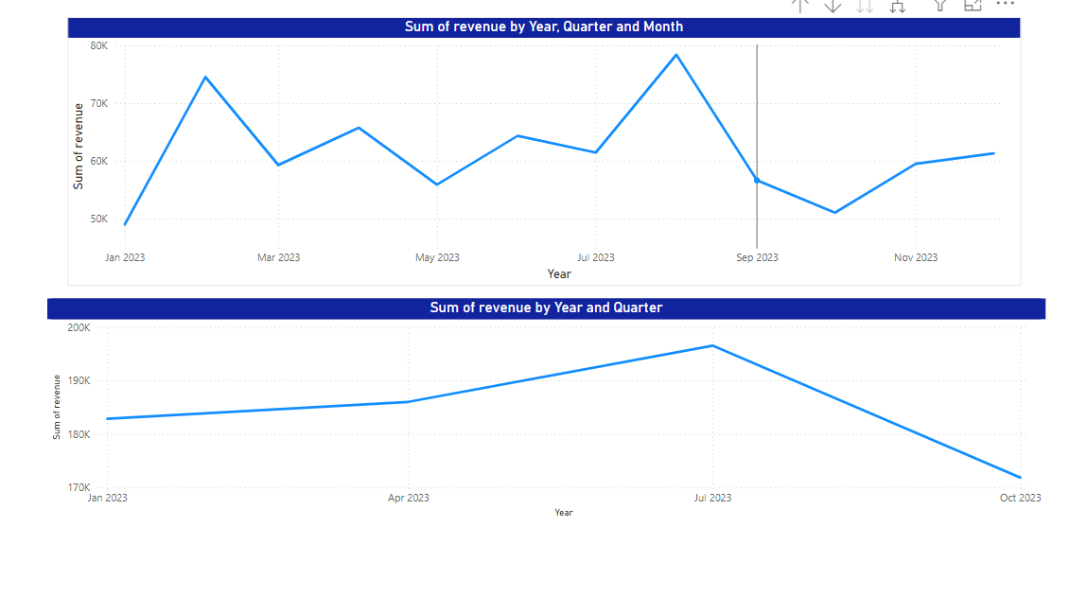
Date analysis
Recommandations:
In august , February make some offers to get more people
Make discount on not busy months to attract more people

Slide 6
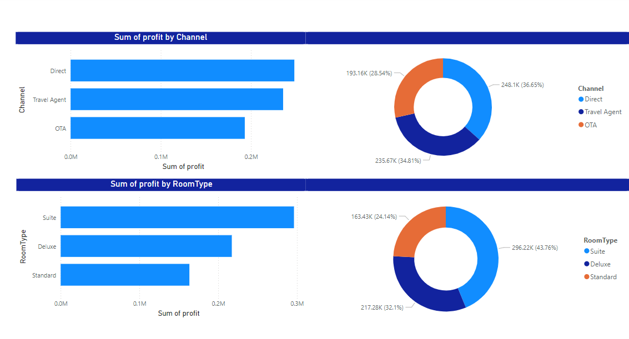
Insights:
The cite category is the most profitable
Recommandations :
Increase number of suite room type because it is the most booked
Increase ads on social media

