Slide 1
Clinic System

Slide 2
Our team
Marwa Ahmed Abdo section (15)
Mariam Hossam Diab section (15)
Mariam Mohamed Zahran section (15)
Wafaa Mohamed Mostafa section (17)
Heba Walid Mohamed section (17)
Yara Khaled Abd El Fatah section (17)

Slide 3
Description
❖ The Remote clinic system is software developed to simplify the communication process between the doctor and patients.IT is very useful for patients , because they can use you anywhere and anytime. Patients can easily diagnose and deliver medication .It is important in the current situation .Effortless patients management system for your clinic that keeps your patients date well organized and right at your fingertips when you need it . Preventing the transmission of the disease by reducing the need for patients to travel.
❖ The software would be operated by three users Admin, patient and Doctor . ❖ Admin would be responsible for adding the others users and can view the profile of each (new doctor, doctor, consultation , revelation) including personal details like (id, name, address, phone, etc...). He would be responsible for adding patients and assigning token numbers to the patient visiting the clinic and save it in the database along with their details. These token numbers along with respective patient details are sent to doctor.

Slide 4
❖ the doctor is doctor has come before ,so only writing username and password in the page of login. New doctor is doctor is the first to come ,the page of login will be opened to write (ID, name, address, phone , email ,Data of birth data ,specialty ,studying ,salary).
❖New doctor/ The doctor can thus view patient details and after checking up the patient, the prescription which is the recommended medicines for the particular patient is fed into the database by the doctor and is sent to patient he can then view the prescription of patient “that is about patient history” and also can get treatment and feed into the database.
The consultation is patients have come before ,so only writing username and password ,then the page will be opened with his history.
The revelation is patients are the first to come , the page of login will be opened to write ( patient_id,name,phone,e_mail,address,symptom,data,national_id,treat_id,diag_id,doctor_id)

Slide 5

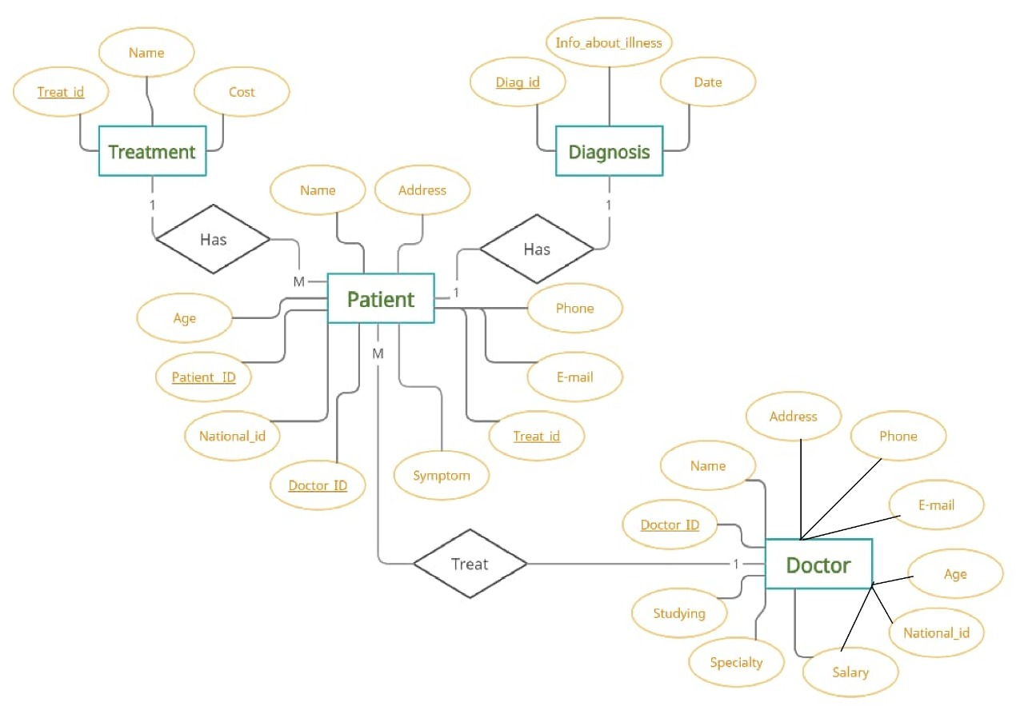
ER Diagram

Slide 6
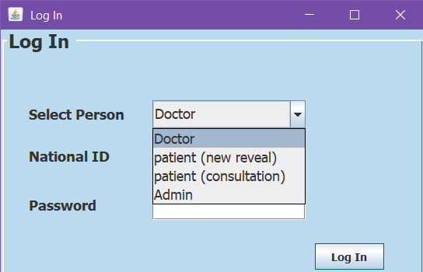
Login Frame
To select user
National Id of any user
Password To Dr & Admin
To login the next page if the data is true

Slide 7
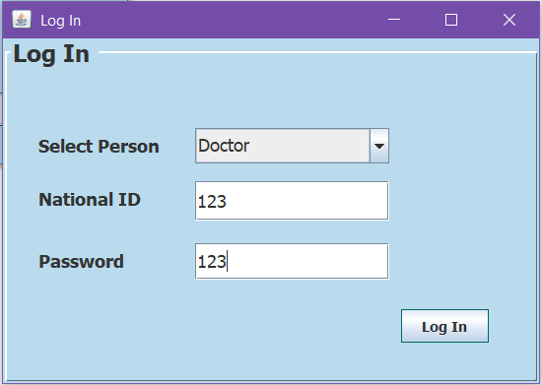
First user
He should enter right data

Slide 8
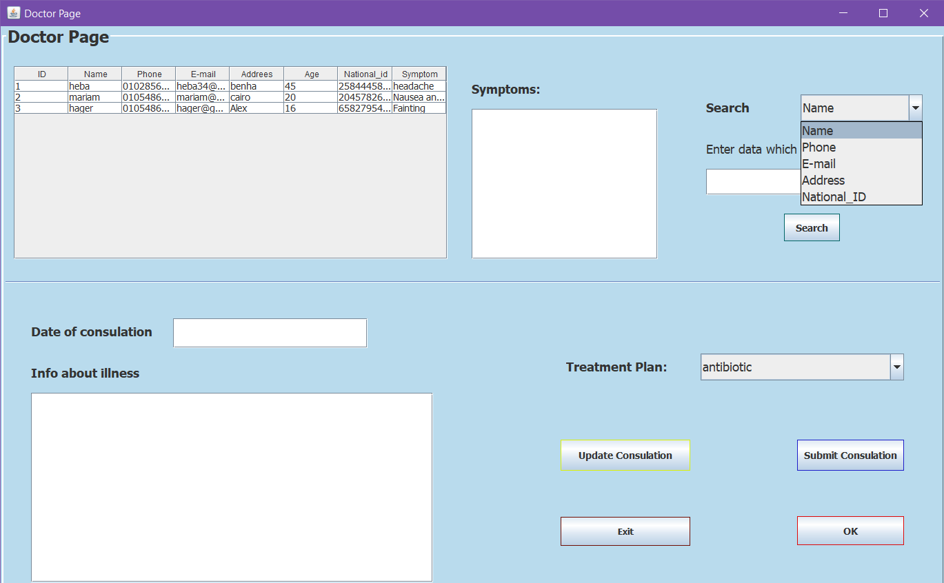
Doctor page Frame
If doctor would like to
Search about patient
If he selected patient from the table or search he will get symptoms
To show patient info
kind of Treatment
Modify something
Doctor can write here Diagnosis of patient

Slide 9
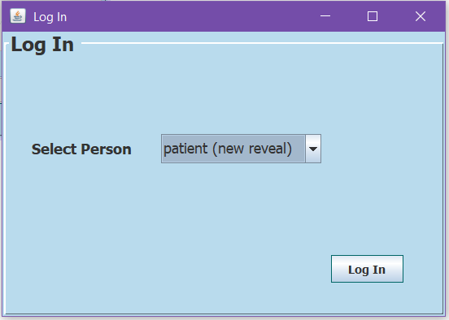
Second user
If user want to make a new reveal

Slide 10
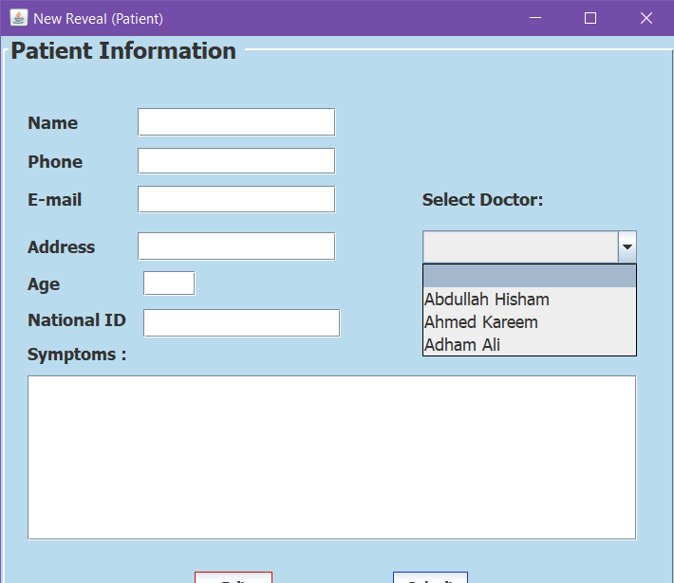
New Reveal Frame
The new patient should fill out all these details
To select doctor he would like to ask
Submit
Exit

Slide 11
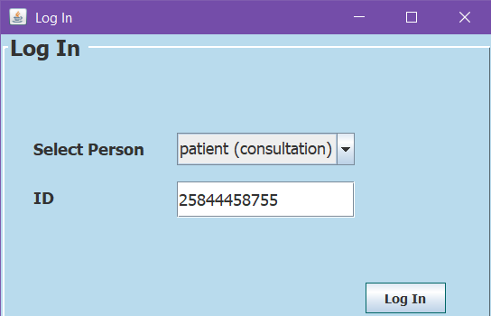
Third user
If he would like to receive treatment or update info
His national id
If data is true ,next page

Slide 12
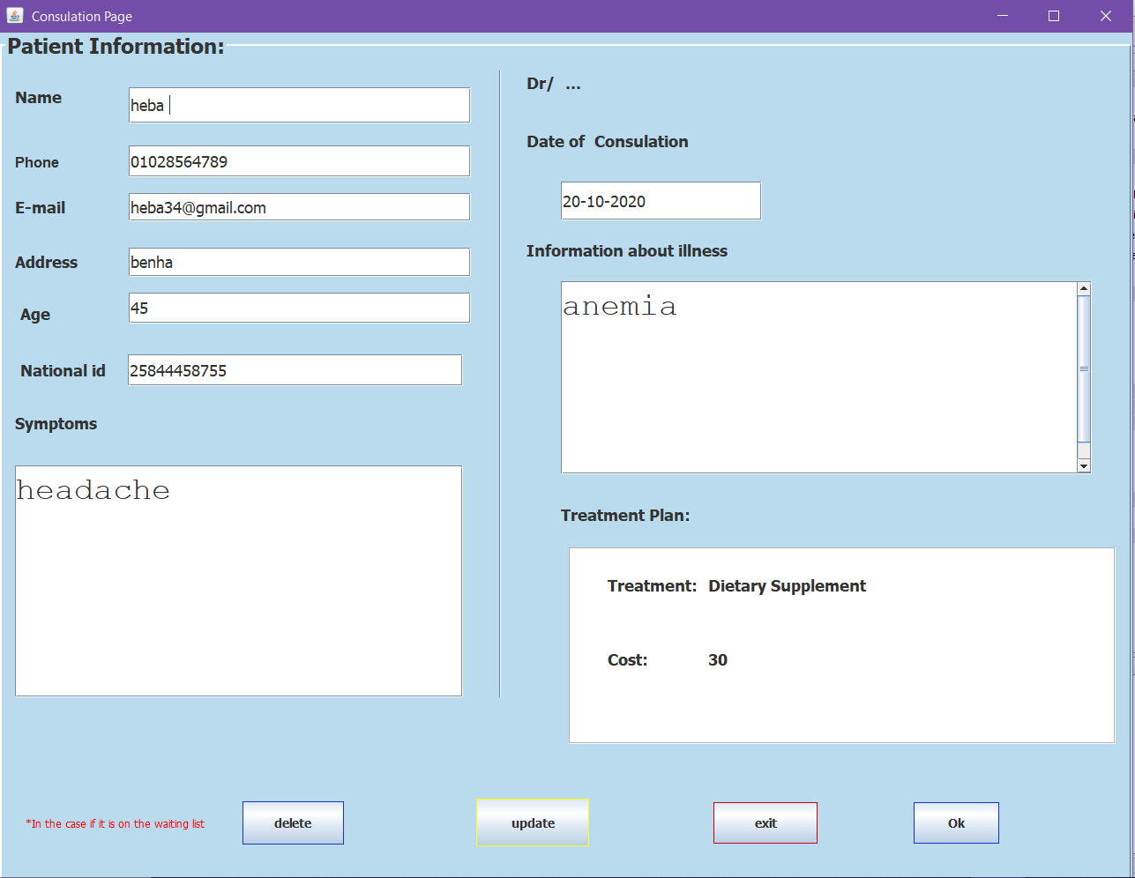
From this page the patient can see the doctor response about his illness and required treatment
If he would like to update info before doctor seeing symptoms
Patient can delete his details only if doctor didn’t answer

Slide 13
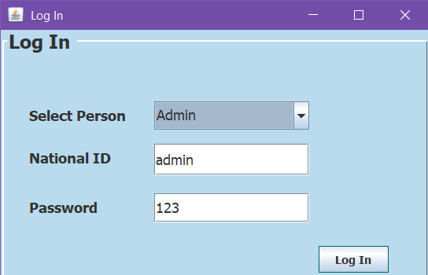
Admin
If he input data ,he will get reports

Slide 14
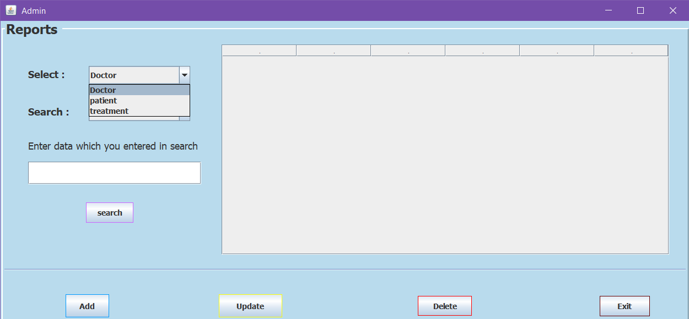
Admin Frame
1
From this page the Admin can select what he need from combo box in addition to he can he can add or update or delete or exit.

Slide 15
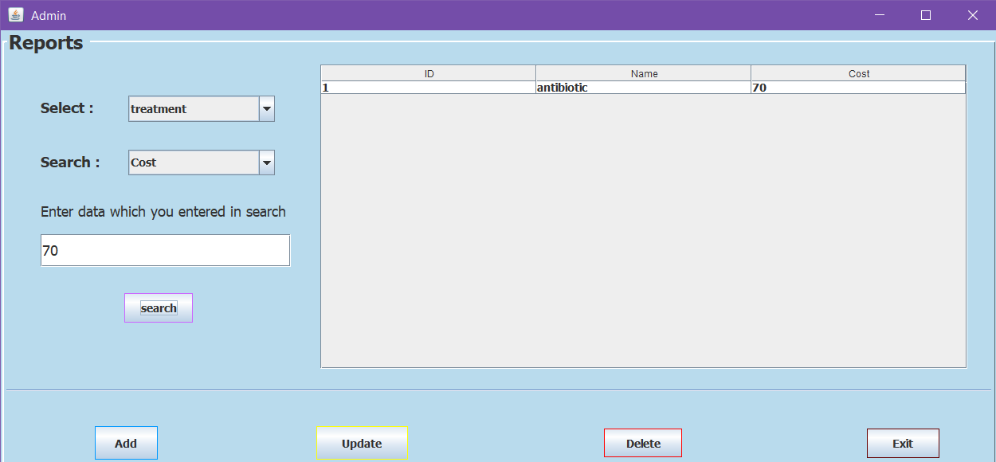
Doctor page Frame
We did search by cost ,we got treatment

Slide 16
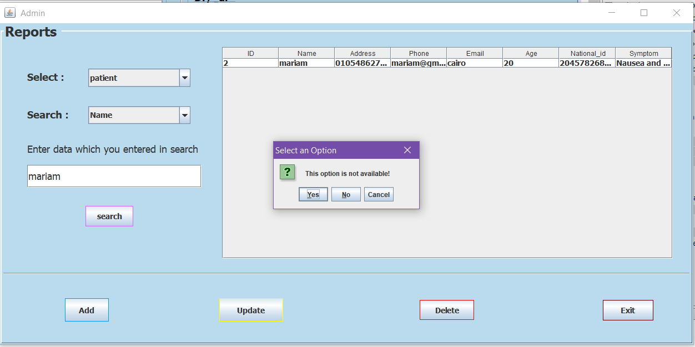
Note : Admin can’t add patient ,he only can add new doctor or new treatment
To make update on any item after deleting
To make update on any item after seleceting
16

Slide 17
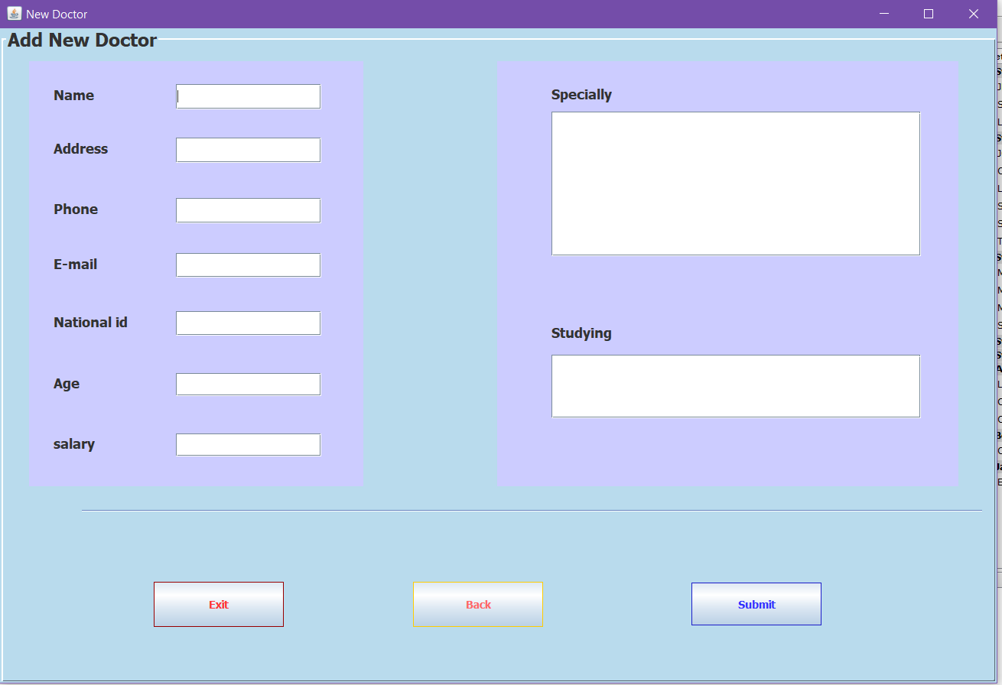
Admin can add new doctor here
Admin can submit data

Slide 18
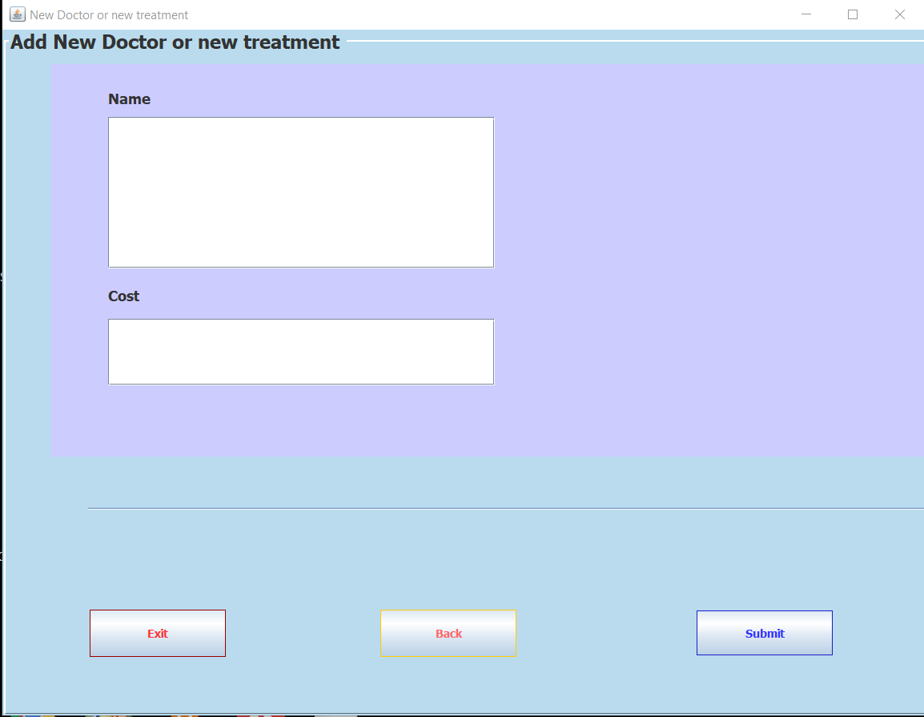
Admin can add new treatment
Exit or Log in again
Submit New treatment
Back to previous page

Slide 19
Thanks!
Any questions?

