Slide 1

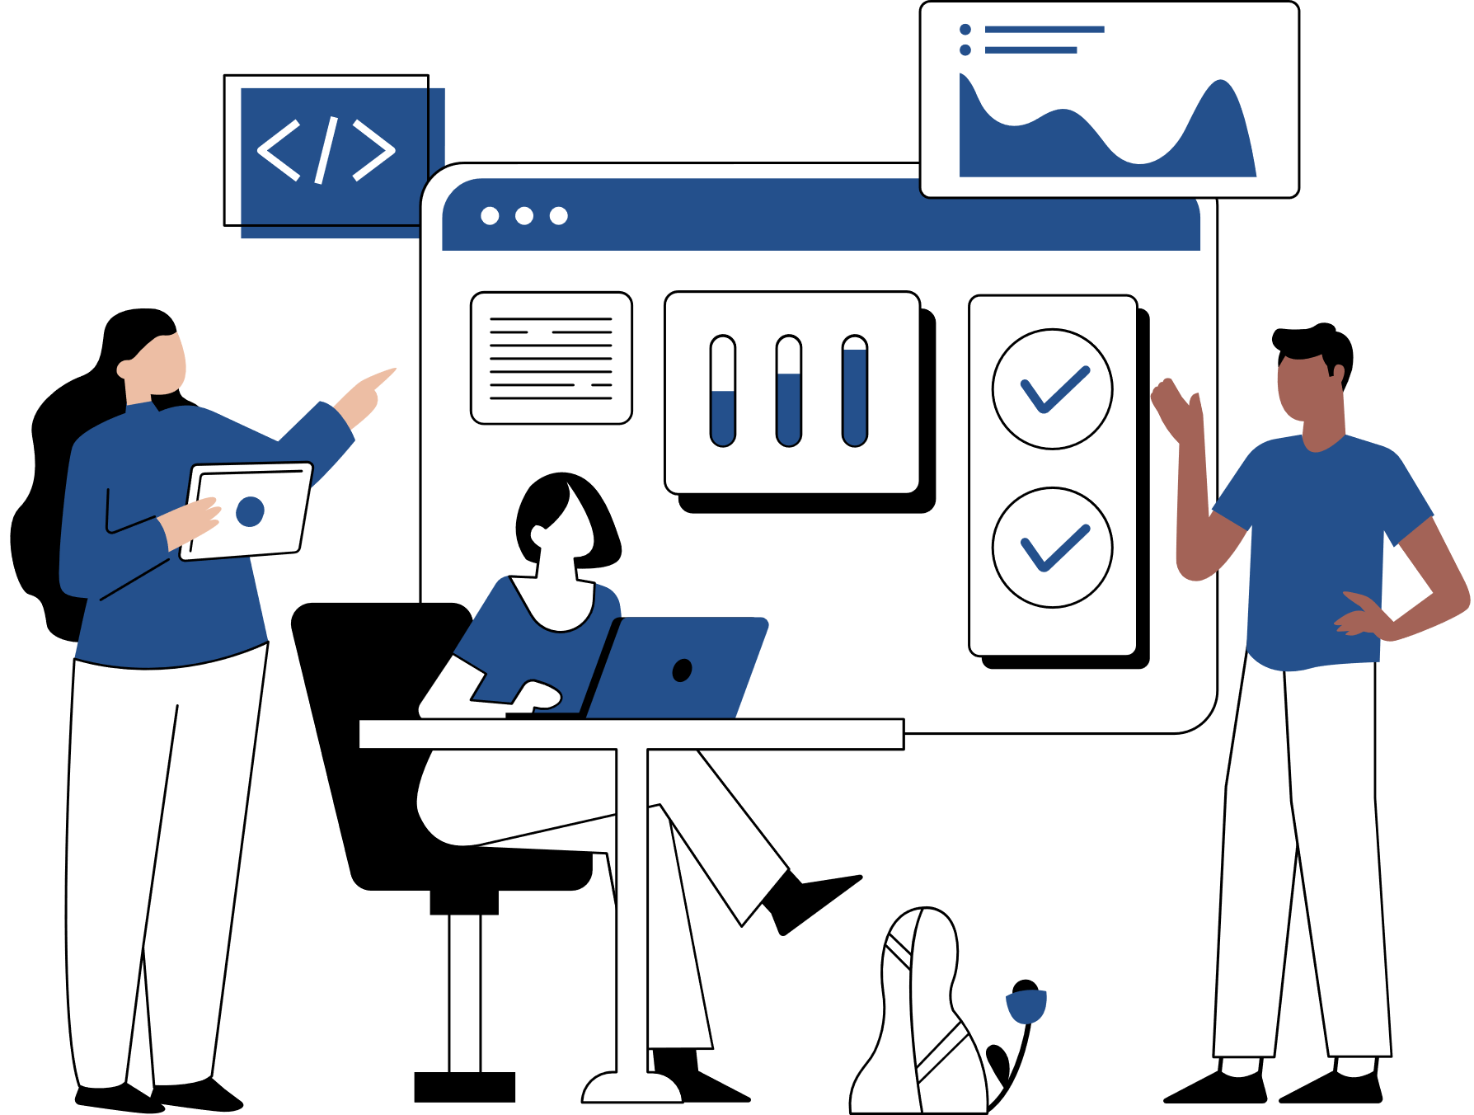
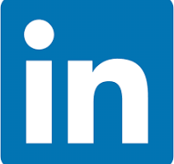
Digital MARKETING
PLAN
By: Mariam Hossam

Slide 2
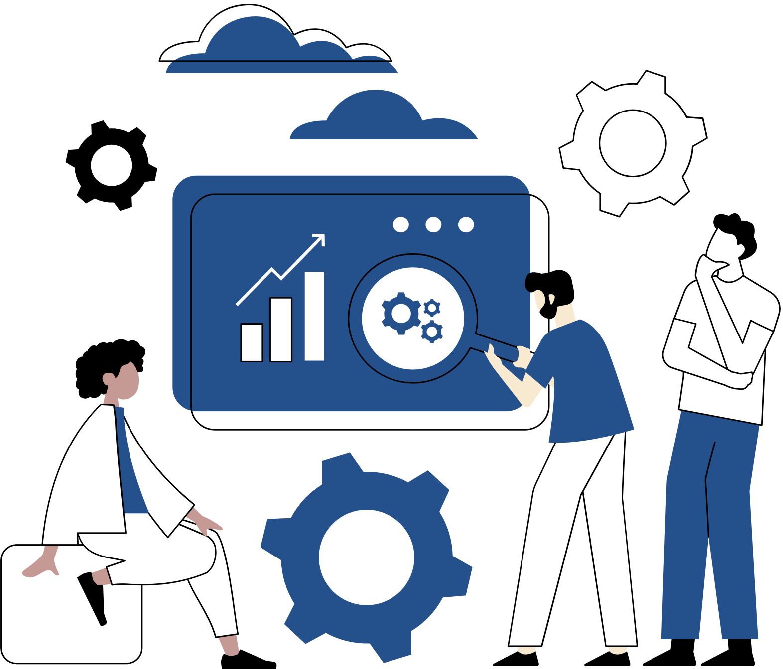
Problem Statement
Which means have the best results for each marketing purpose ? For example, to get new customers, do we market through Facebook or LinkedIn ? Taking into account all the advantages and disadvantages, such as cost, etc

Slide 3
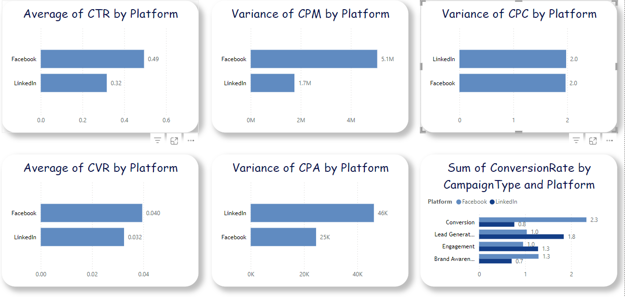
DASHBOARD

Slide 4
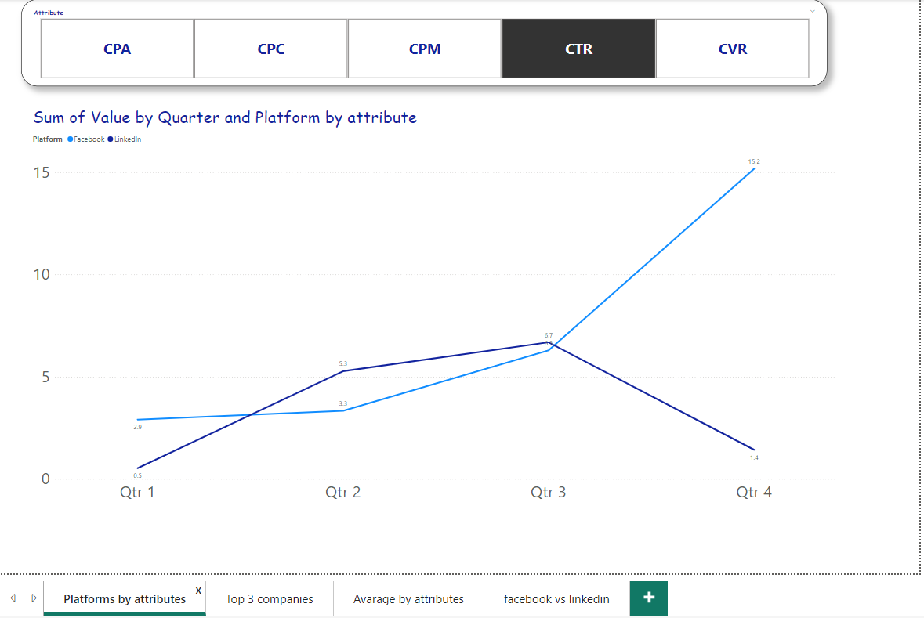
DASHBOARD

Slide 5
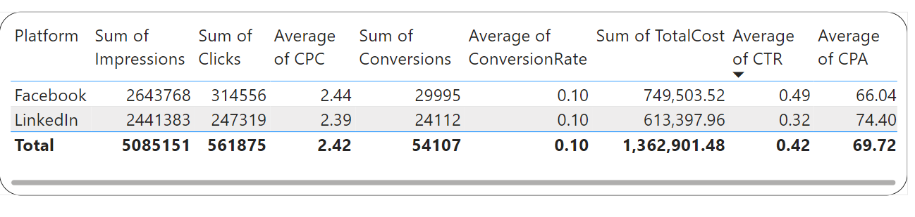
DASHBOARD
Total Impressions: The number of times the ad was displayed.
Facebook: 2,643,768
LinkedIn: 2,441,383
Insight: Facebook has a slightly higher reach in terms of total impressions.
Total Clicks: The number of times the ad was clicked.
Facebook: 314,556
LinkedIn: 247,319
Insight: Facebook has more clicks, indicating higher engagement.

Slide 6
DASHBOARD
Avg CPC (Cost Per Click): The average cost for each click.
Facebook: $2.44
LinkedIn: $2.39
Insight: LinkedIn has a slightly lower CPC, making it slightly cheaper to get clicks.
Total Conversions: The number of times the desired action was completed.
Facebook: 29,995
LinkedIn: 24,112
Insight: Facebook has more conversions, suggesting it may be better at driving actions.

Slide 7
DASHBOARD
Avg Conversion Rate: The percentage of clicks that led to a conversion.
Facebook: 10.02%
LinkedIn: 10.44%
Insight: LinkedIn has a slightly higher conversion rate, indicating a higher efficiency in converting clicks to actions.
Total Cost: The total amount spent on the campaign.
Facebook: $749,503.52
LinkedIn: $613,397.96
Insight: Facebook had a higher overall spend, but also higher engagement and conversions.

Slide 8
DASHBOARD
Avg CTR (Click Through Rate): The percentage of impressions that resulted in a click.
Facebook: 0.495%
LinkedIn: 0.316%
Insight: Facebook has a higher CTR, suggesting better ad performance in attracting clicks.
Avg CPA (Cost Per Acquisition): The average cost to acquire a customer.
Facebook: $66.04
LinkedIn: $74.40
Insight: Facebook has a lower CPA, making it cheaper to acquire a customer.

Slide 9
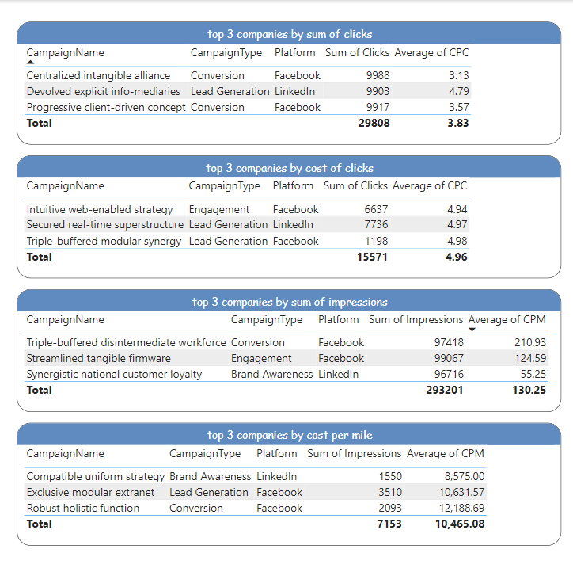
DASHBOARD
Insight: 3 top companies sum of clicks don’t require the most cost per click

Slide 10
DASHBOARD
Insight: 3 top companies sum of impressions don’t require the most cost per mile

Slide 11
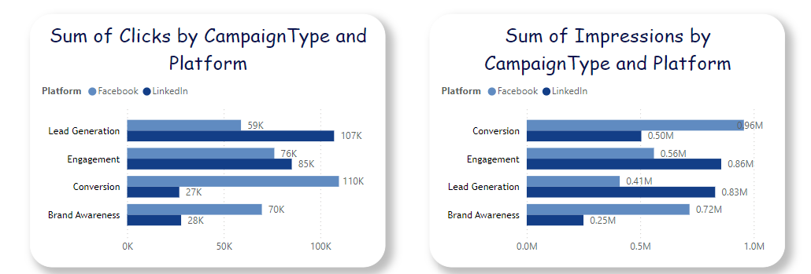
BEST PLATFORM FOR COMPAIGN TYPE
Lead Generation: LinkedIn is better for both clicks and impressions.
Engagement: Facebook is better for clicks, LinkedIn is better for impressions.
Conversion: LinkedIn is better for both clicks and impressions.
Brand Awareness: Facebook is better for both clicks and impressions.

Slide 12
RECOMMANDATIOMS
To Acquire New Customers: Facebook is the better platform due to its lower CPA and higher total conversions.
For Cost Efficiency and Conversion Rate: LinkedIn can be a good choice if the primary goal is to optimize conversion rate and cost per click.
To Maximize Reach and Engagement: Facebook, with higher impressions, clicks, and CTR, can be more effective.
In summary, for acquiring new customers with a focus on cost-effectiveness, Facebook is the recommended platform. However, if the goal is to maximize conversion efficiency and potentially reduce CPC, LinkedIn might be preferable.

Slide 13
RECOMMANDATIOMS
Optimize for Lower CPC Platforms:
Focus more on platforms like Facebook, which shows a lower average CPC in the highest click
campaigns ($3.13 and $3.57).
Consider reallocating budget from LinkedIn to Facebook, especially since LinkedIn's CPC is
higher ($4.79 in high-click campaigns, $4.97 in high-cost campaigns).
Emphasize High-Performance Campaign Types:
Conversion campaigns on Facebook seem to perform well with lower CPCs and high clicks.
Shift focus towards Conversion-type campaigns rather than Engagement or Lead Generation,
which have higher CPCs.
Leverage High Click-Through Campaigns:

Slide 14
RECOMMANDATIOMS
The top-click campaigns have a combined total of 29808 clicks with an average CPC of $3.83. Ensure these campaigns are optimized and possibly scale up to leverage the high click rates at a relatively lower cost.
Adjust Strategies Based on Campaign Type Performance:
Engagement campaigns (like the Intuitive web-enabled strategy) have a high CPC ($4.94). This might indicate that engagement-focused campaigns are more expensive and less cost-effective.
Lead Generation campaigns are showing varying results, with LinkedIn having a high CPC. Adjust strategies to focus on platforms where Lead Generation is cheaper, or negotiate better rates.
A/B Testing and Continuous Monitoring:
Continuously test different campaign types and platforms to find the most cost-effective combinations.
Regularly monitor CPC and performance metrics to make data-driven adjustments swiftly.

Slide 15
SUMMARY
Customer Acquisition: Facebook is more cost-effective with a lower CPA ($66.04 vs. $74.40).
Engagement: Facebook has higher clicks and a better CTR, indicating more effective ad engagement.
Cost Efficiency: LinkedIn has a slightly lower CPC and higher conversion rate, making it more efficient in converting clicks to actions.
Overall Conversions: Facebook leads in total conversions.

