Slide 1


Marketing Campaign Effectiveness
Presented By : Mariam Hossam
The analyst| 2024

Slide 2
1
The Business Problem
Anjum Hotel has been running various marketing campaigns to increase room bookings and enhance brand visibility. Despite investing significantly in these campaigns, the hotel management is unsure which channels yield the highest return on investment (ROI) and which campaign strategies are most effective. They want to optimize their marketing spend and maximize bookings and revenue.

Slide 3
2
Questions
1
Sum of bookings ,Impressions , clicks per channel.
2
Comparison between spend and revenue per channel.
3
Profit analysis and top 4 campaigns

Slide 4
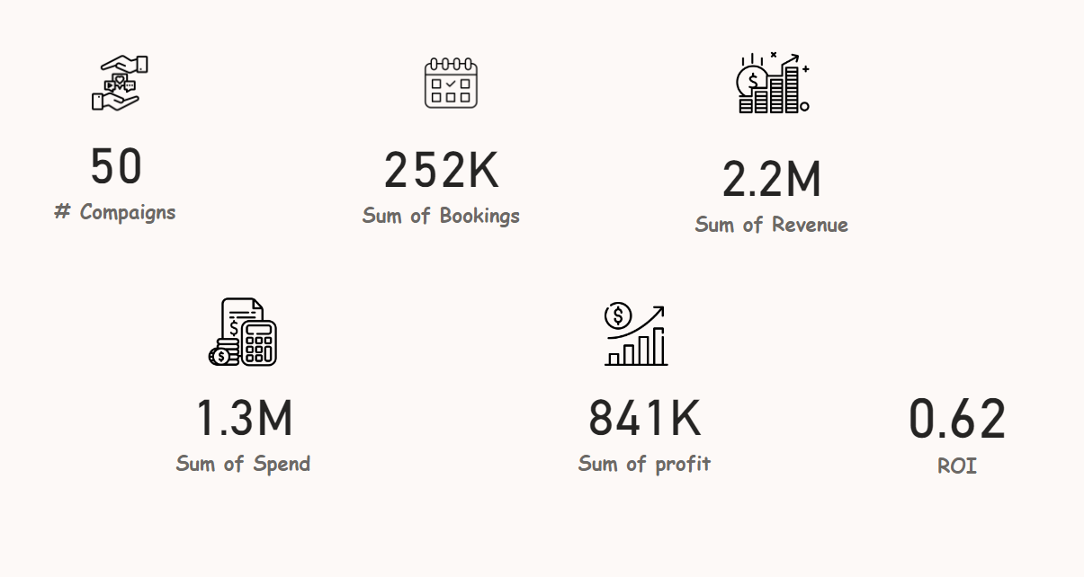
Overview
3

Slide 5
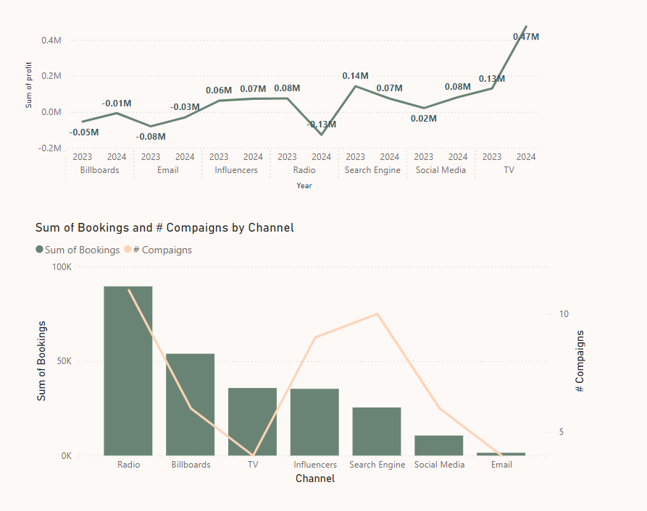
4

Slide 6
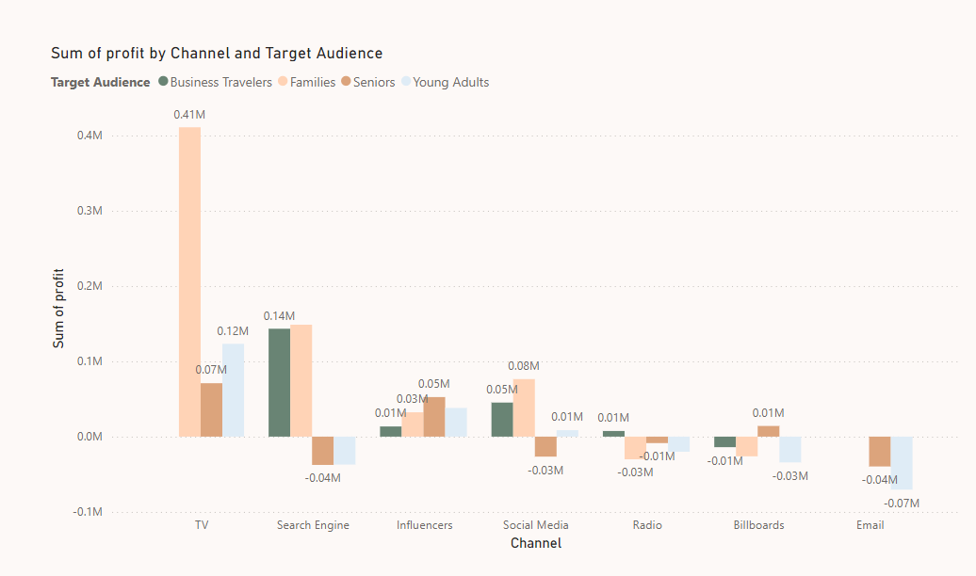
5
TV and Families audience has the greatest profit

Slide 7
6
2024 is better than 2023

Slide 8
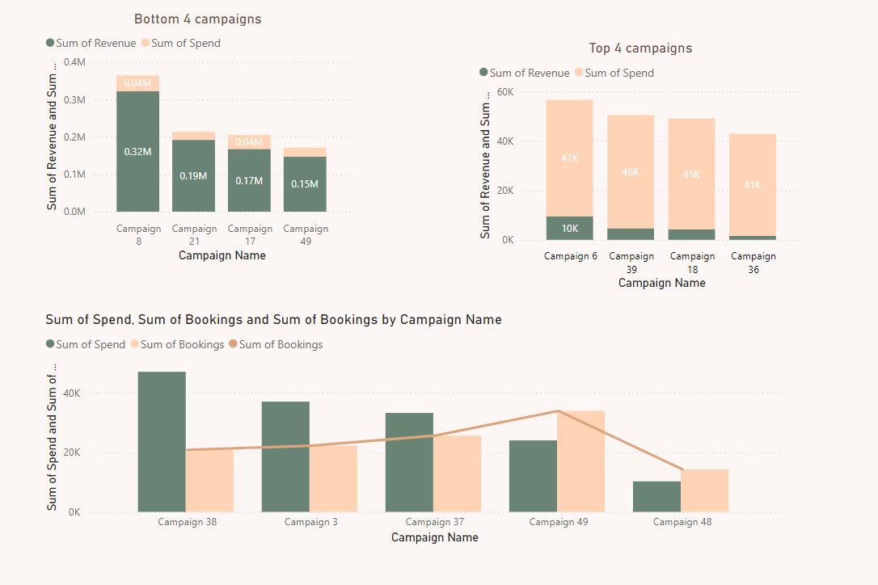
7

Slide 9
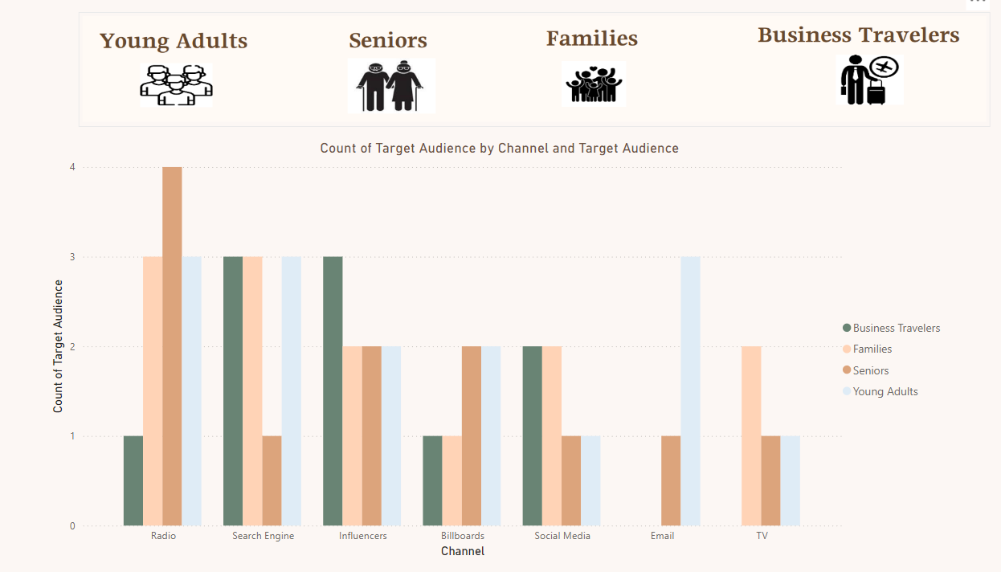
7

Slide 10
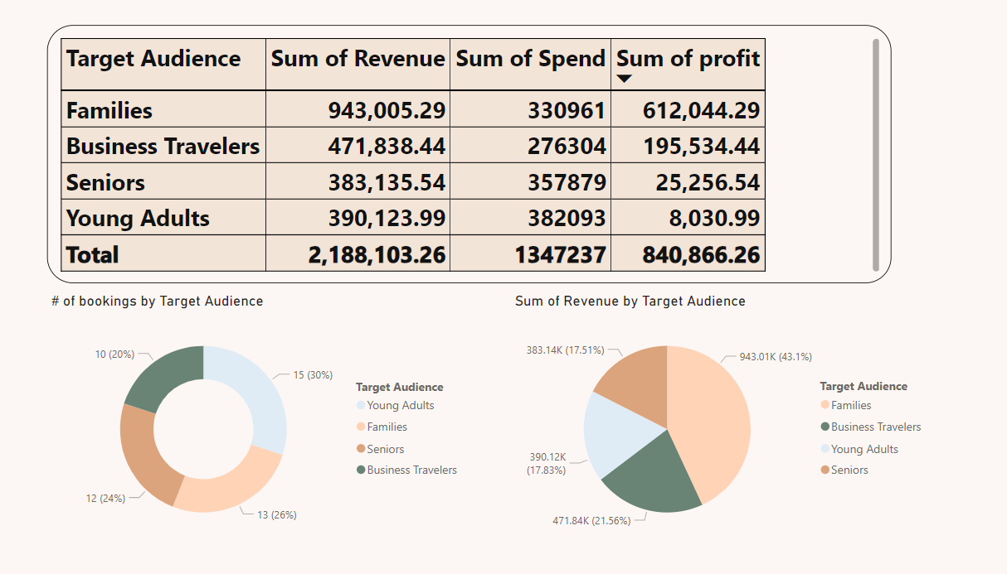
7

Slide 11

8
Limiation
There are some channels don’t make a profit
And Progress slowly

Slide 12
RECOMMENDATION
9
Enhance marketing and support efforts for channels that generate the most valuable customers.
reducing funds from Radio, Billboards, and Email campaigns, which are currently unprofitable
New offers for campaigns targeting families because it is the most making profit
Maximize Influencer and Social Media Marketing
❑ Apply top 4 campaigns strategies
Refine Targeting:
Track and Measure Consistently

Slide 13
THANK YOU

