Slide 1

ECG 5000
Maria Miguelez
Ann Christin Vietor

Slide 2
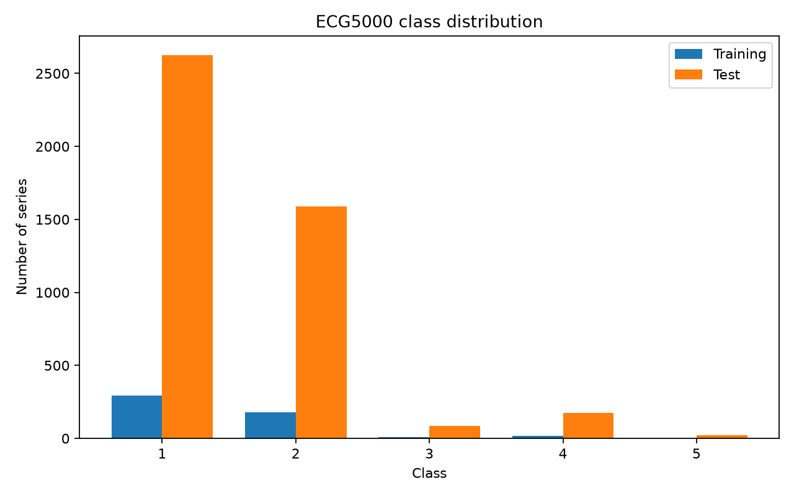
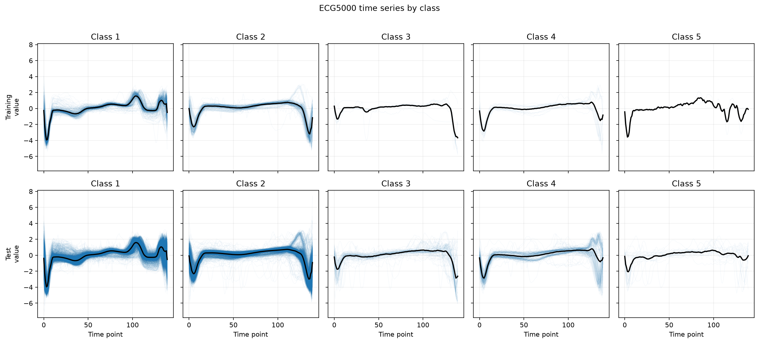
Dataset description
Type of data: Time-series ECG scan
Task type: univariate time-series classification
Train shape:
samples: 500,
time steps: 140
Test shape:
samples: 4500
time steps: 140
Number of classes: 5 (1 healthy, 5 conditions)
Challenge: imbalanced classes

Slide 3
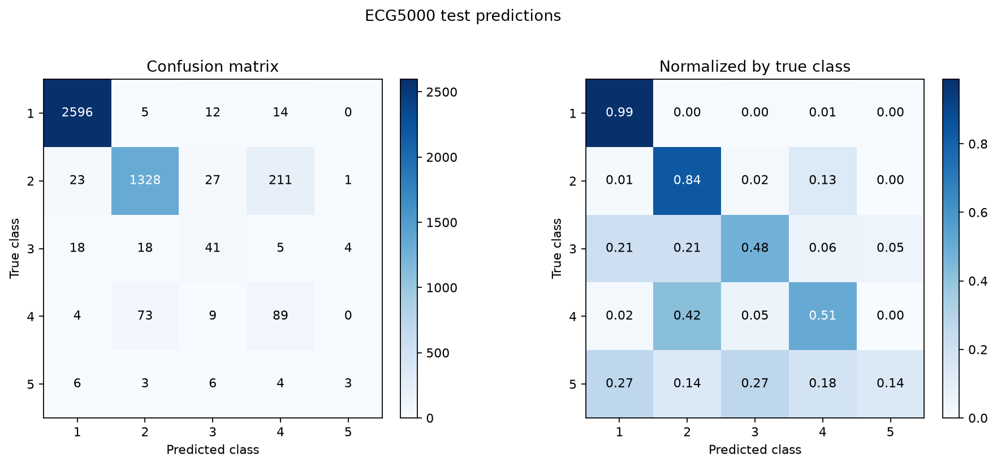
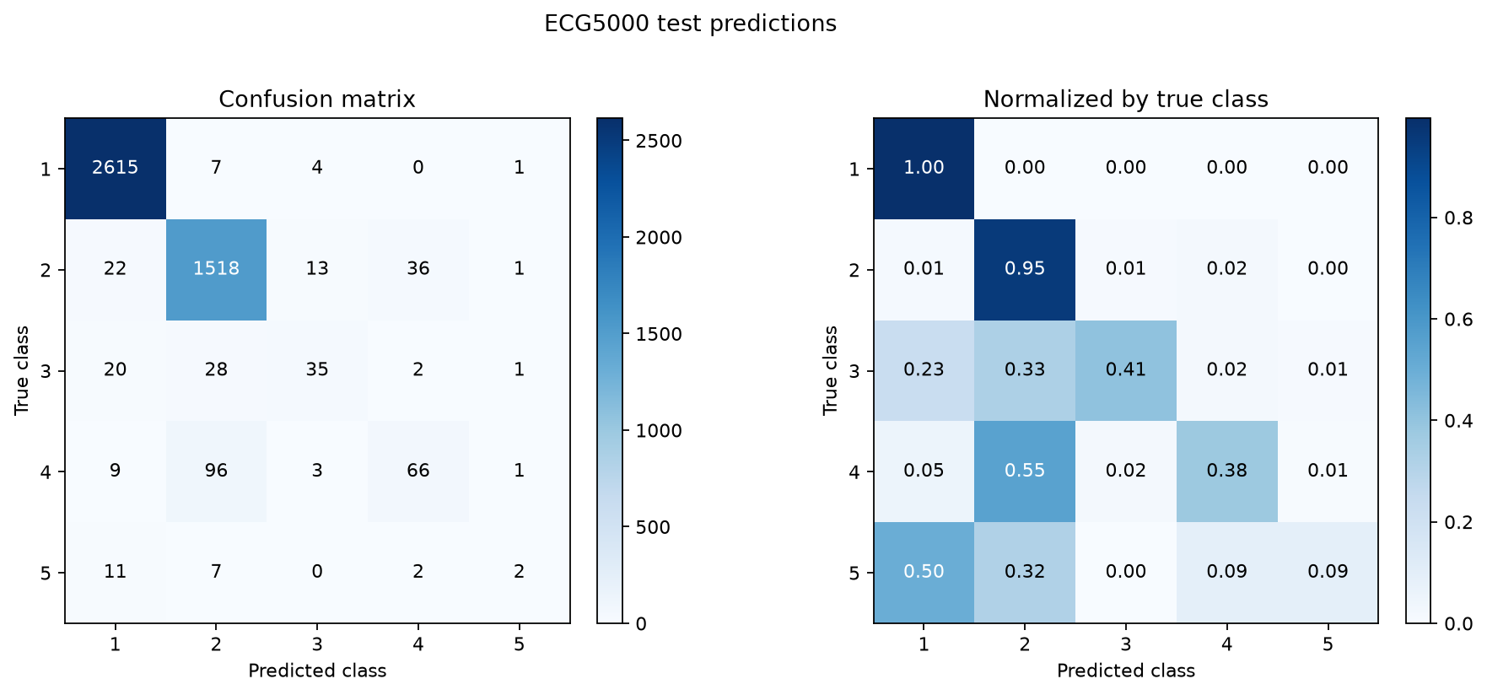
Baseline performance
Metrics | Random Forest | Logistic Regression | LSTM | Transformer (encoder)
accuracy | 0.935 | 0.901 | 0.930 | 0.941
Recall-macro | 0.50 | 0.59 | 0.55 | 0.57
Precision-macro | 0.69 | 0.60 | 0.61 | 0.70
F1-macro | 0.540 | 0.575 | 0.574 | 0.606
Logistic regression
Transformer

Slide 4
What we tried so far …
Feature engineering
Classification task
Triple: only classes 1 to 3
Different train/test split
HPO: transformer
Modeling
xLSTM (m and s)
Foundation model: MantisV2
Data approach
More data exploration
Binary: healthy vs disease

Slide 5
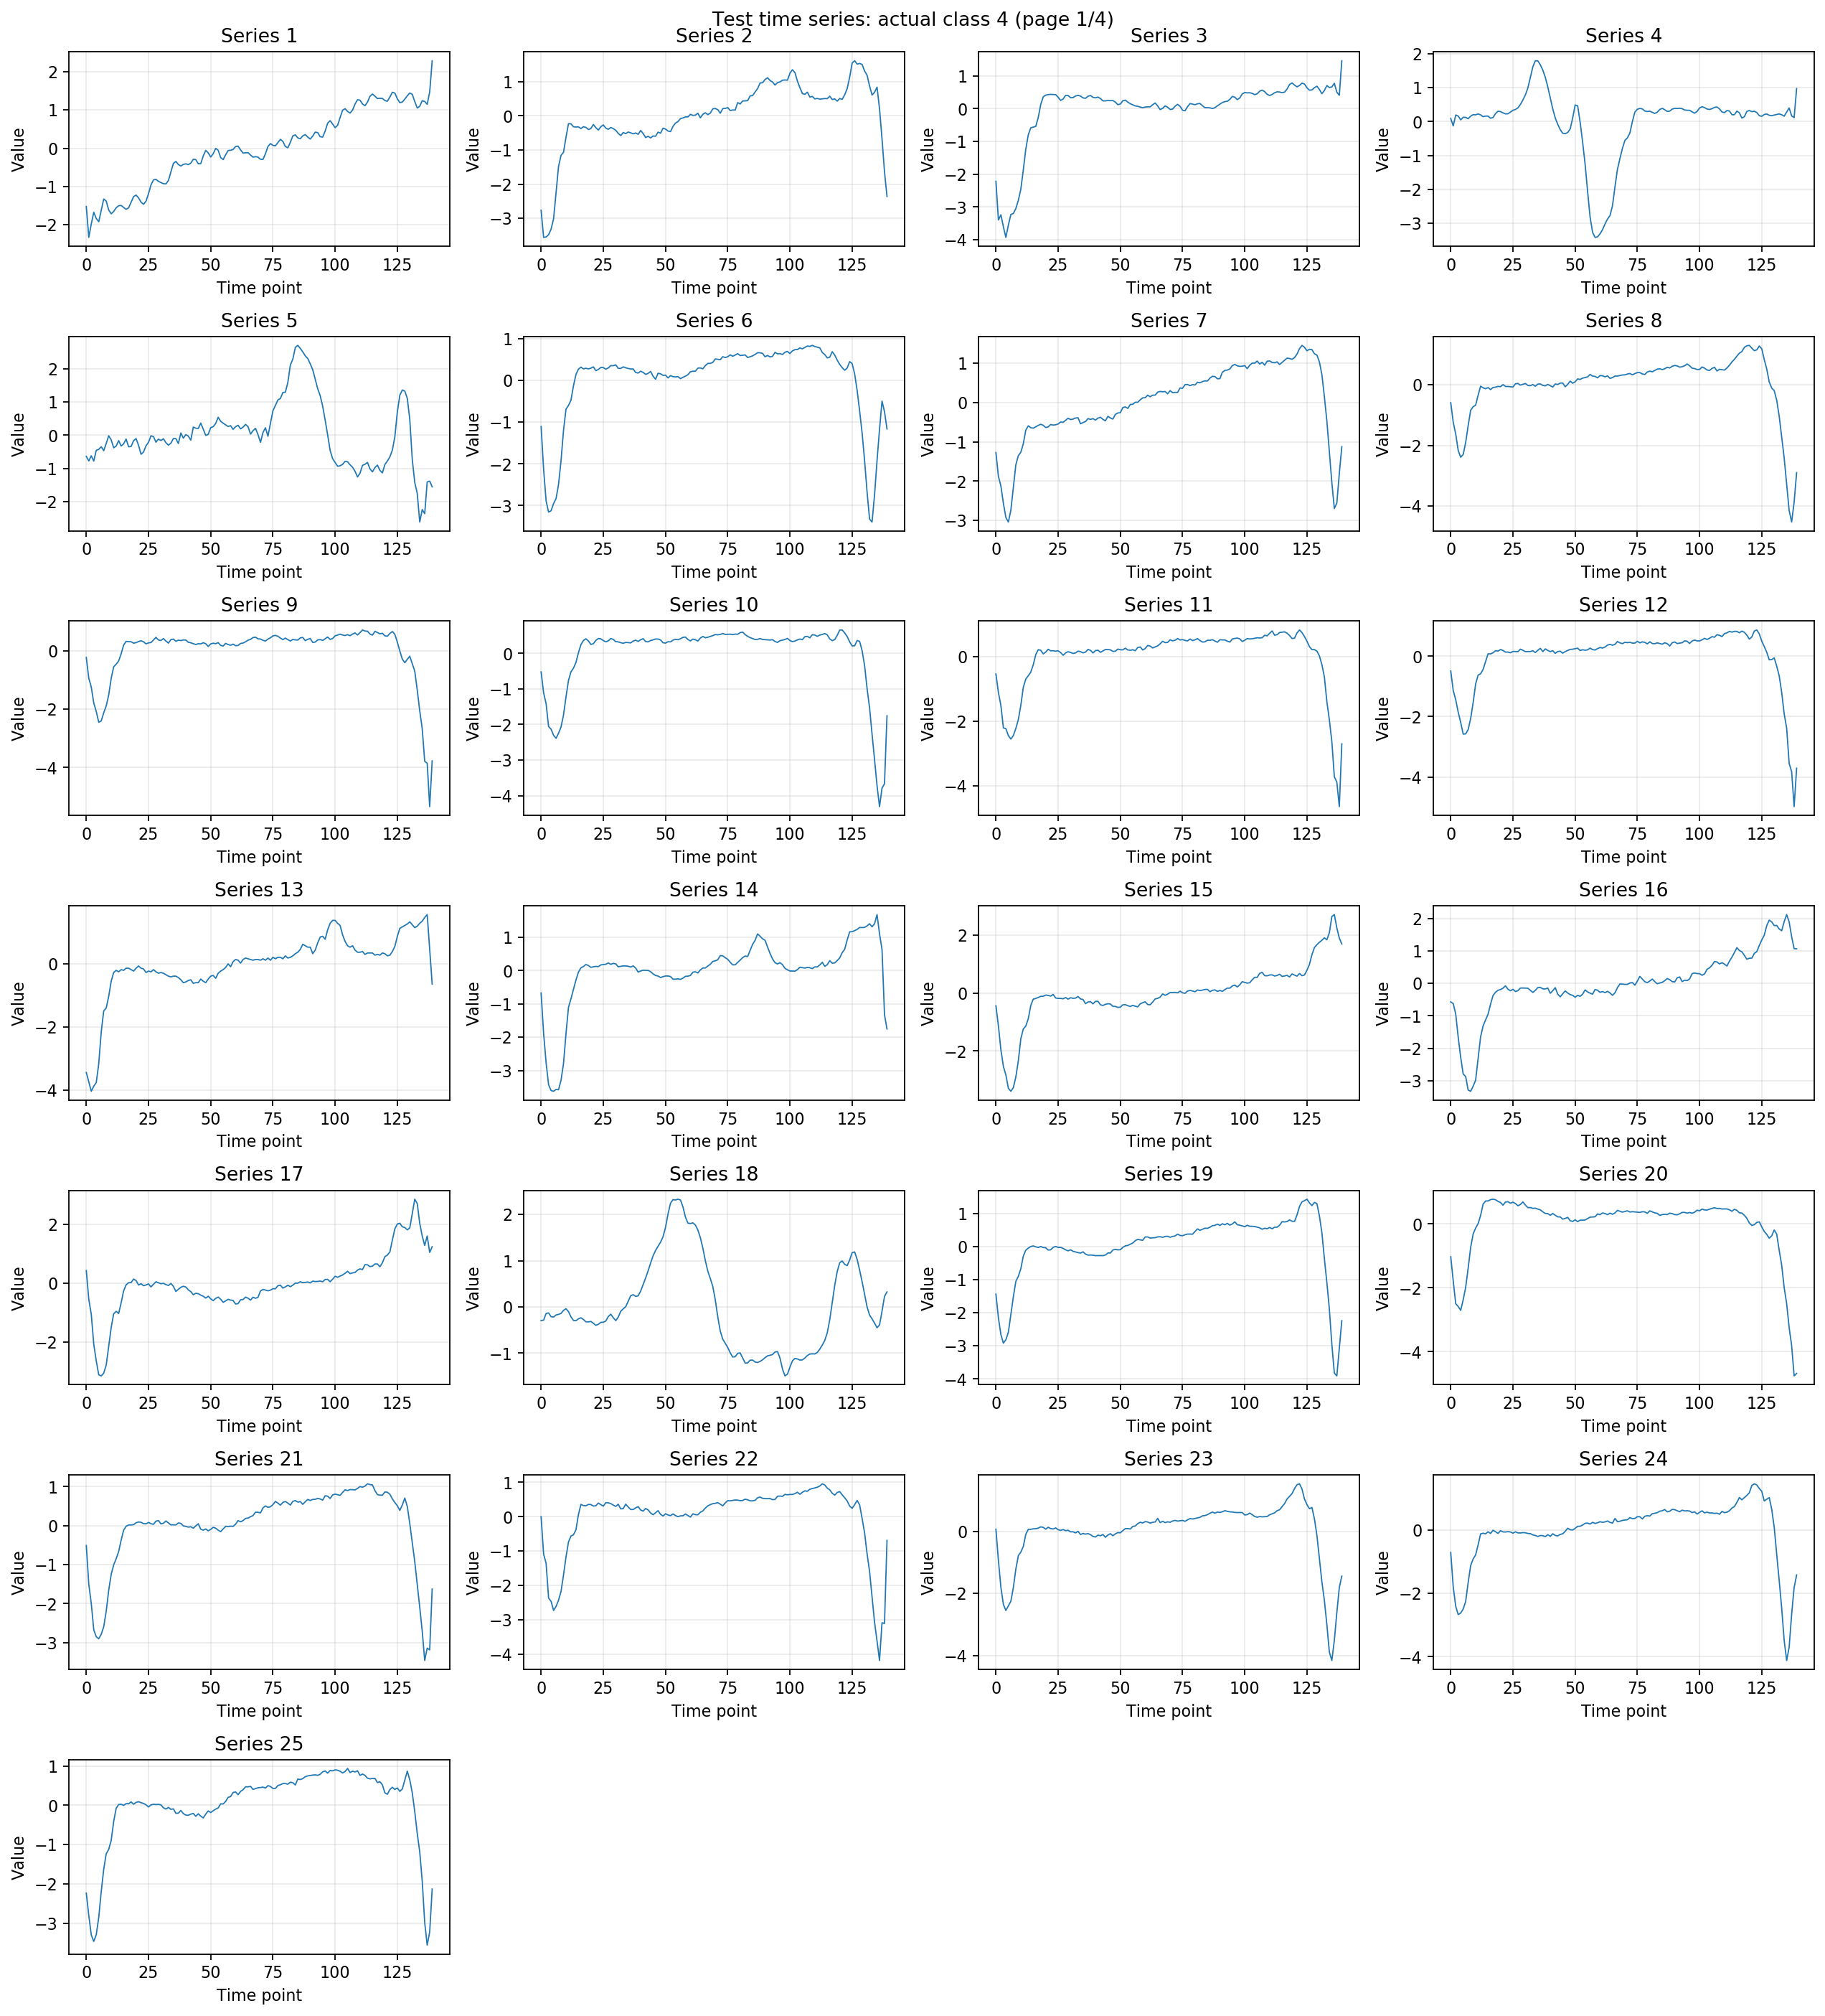
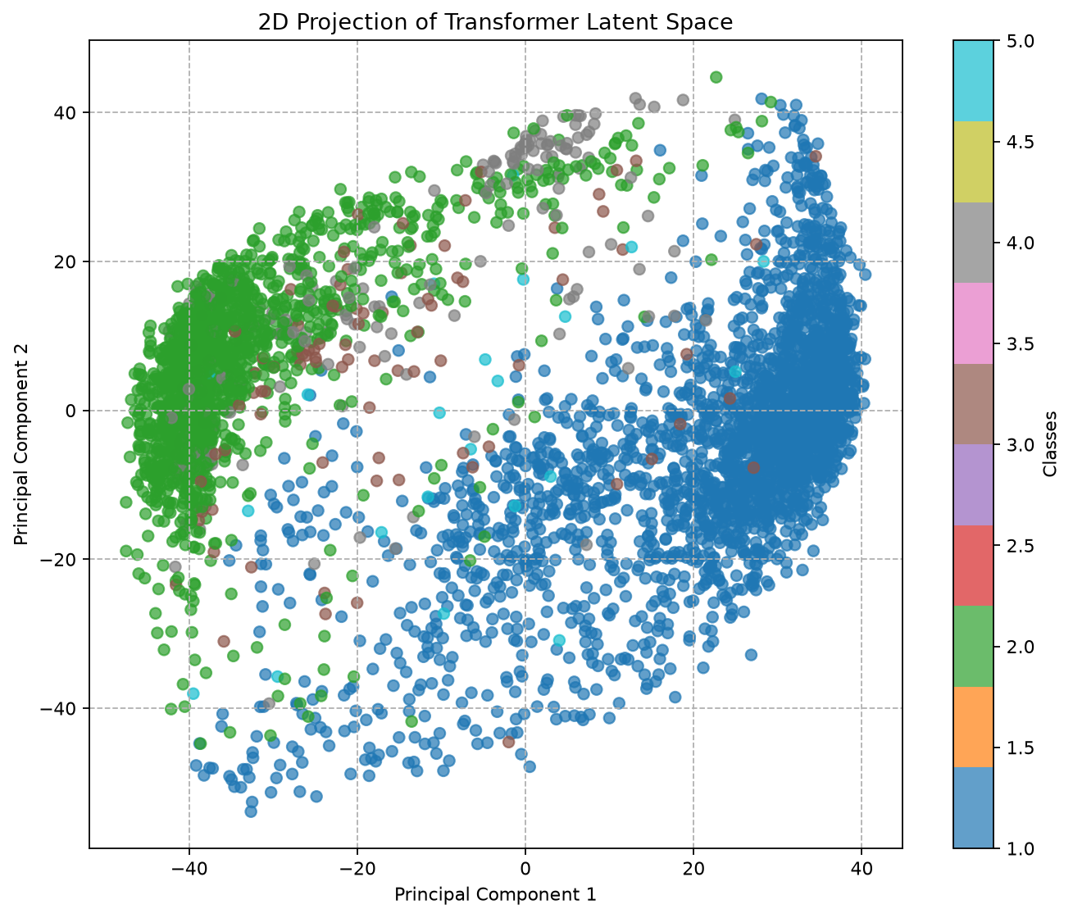
Data approach: Data exploration
PCA xLSTM latent space
Examples of class 4

Slide 6
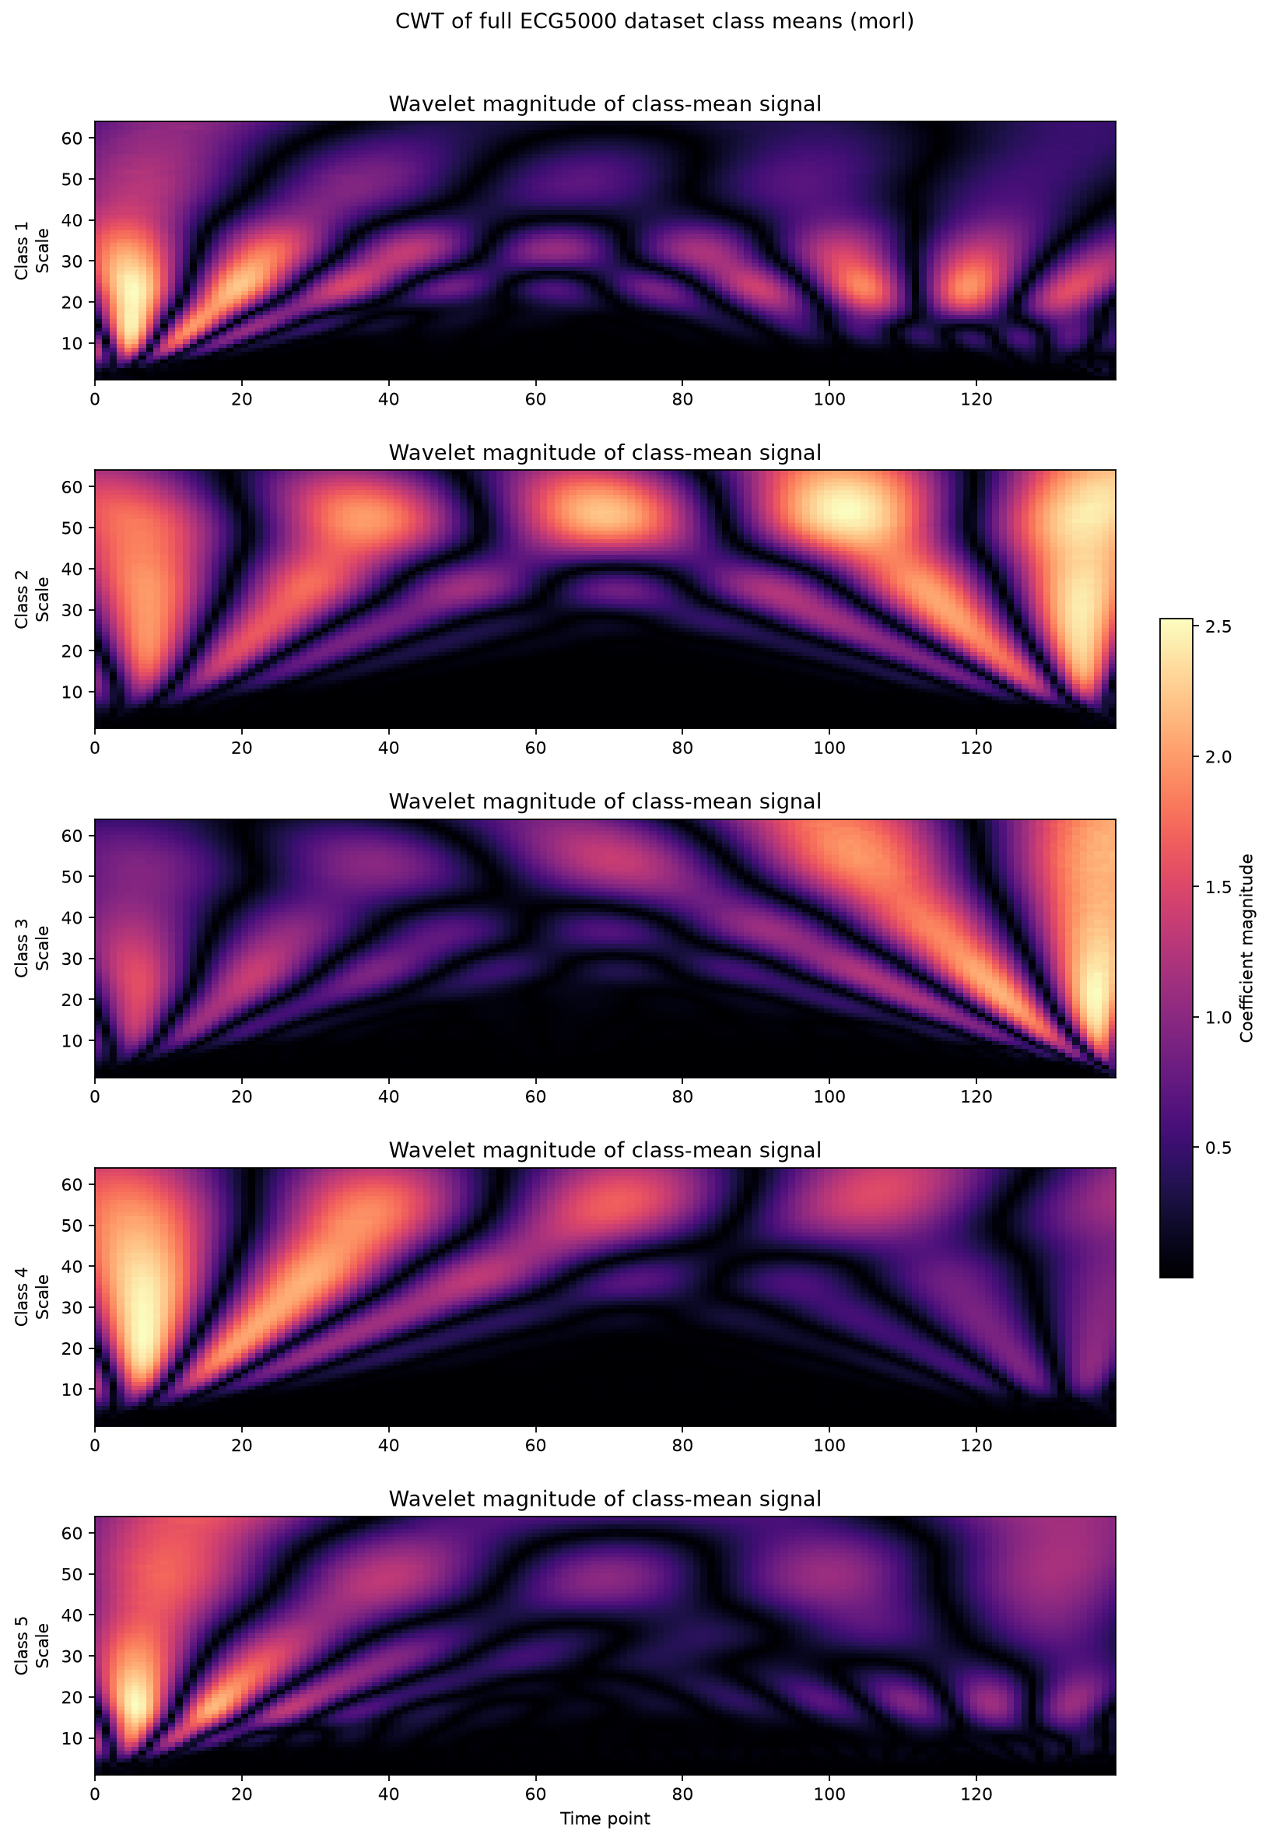
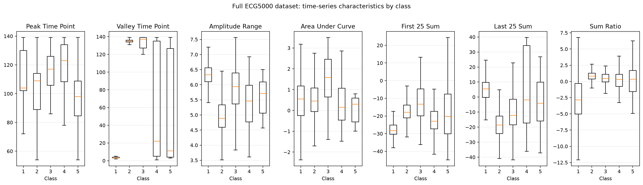
Wavelet transform
Data approach: Feature engineering
7 New parameters

Slide 7
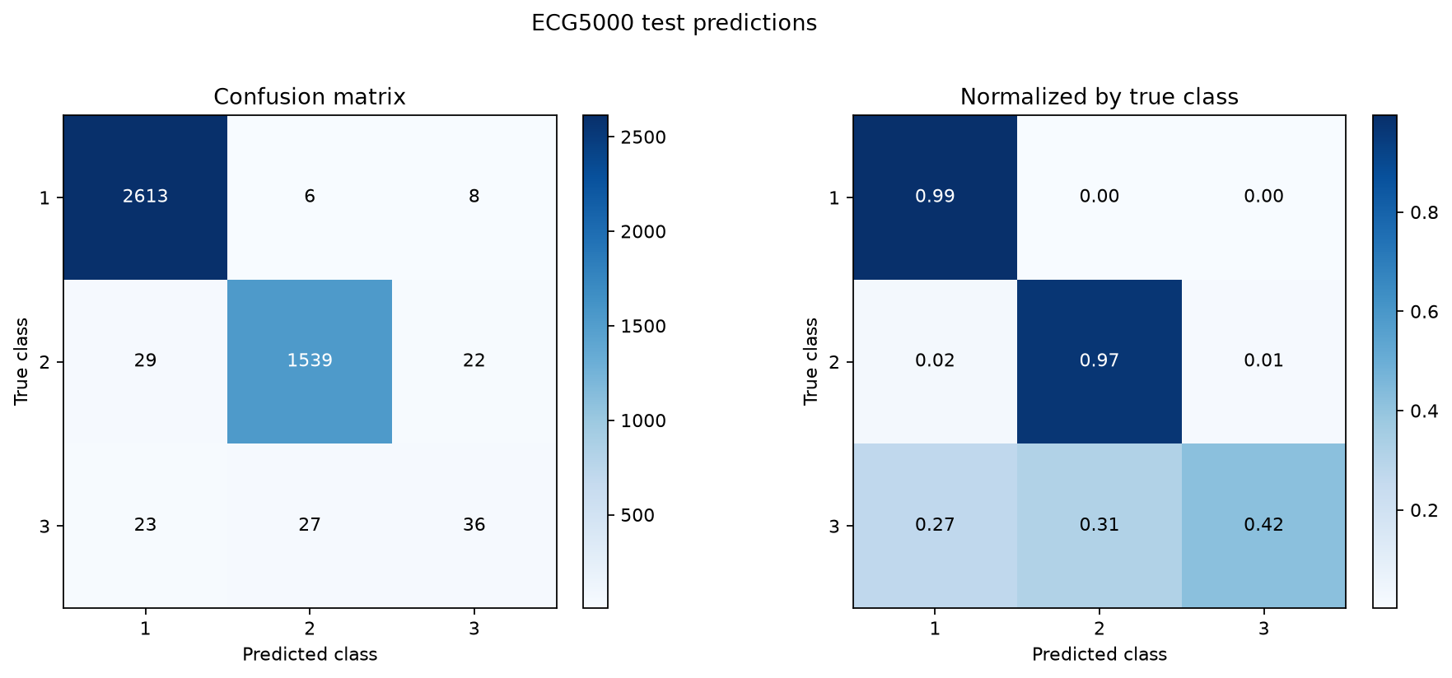
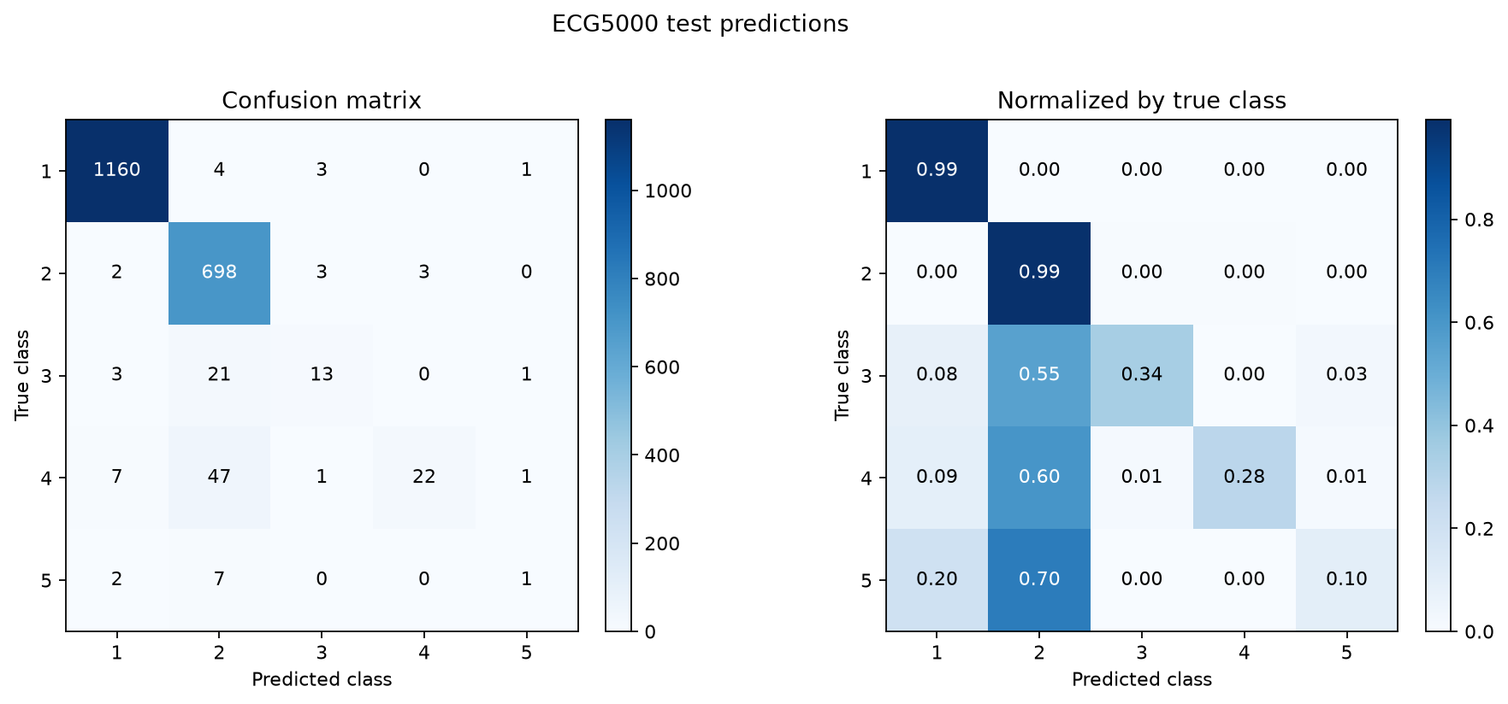
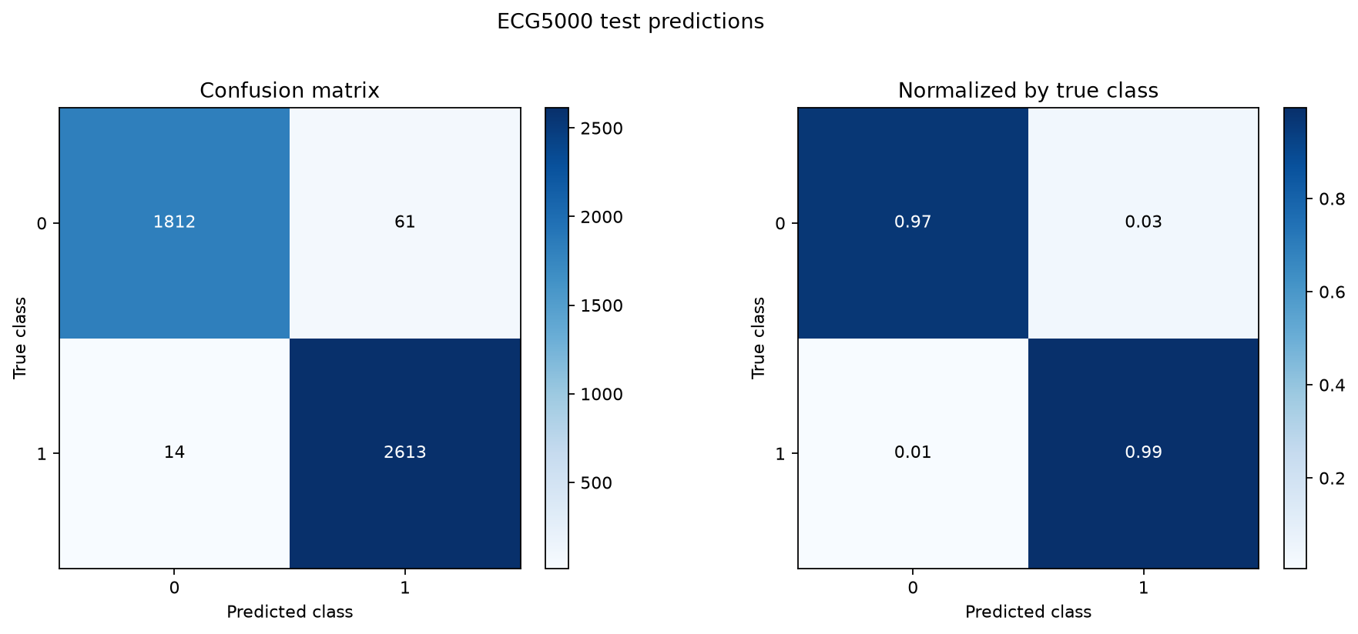
Triple class:
Classes 1 to 3
Classification task:
Model: transformer
Different train/test split:
50/50 split
F1 score: 0.82
Binary class:
Healthy vs disease
F1 score: 0.59
F1 score: 0.98

Slide 8
Modelling: HPO
Model: transformer (encoder)
Early stopping: 20 epoch
Cross-Validation:
Stratified per class
0.1 split
5 fold
Parameters | old | new
learning_rate | 0.001 | 0.000156
batch_size | 200 | 123
d_model | 64 | 120
dim_ff | 128 | 185
n_heads | 4 | 5
n_layers | 2 | 1
CrossEntropy weights | [0.2, 0.2, 0.2, 0.2, 0.2] | [0.46, 0.1, 0.156, 0.165, 0.389]

Slide 9
Modelling:
Performance
 | BASELINE |  | ADVANCED MODELS
Metrics | Logistic Regression | Transformer (encoder) | Transformer Optimized (encoder) | xLSTM | Foundation model (Mantis V2)
Parameters | 705 | 111.877 | 111.877 | 108.685 | 4.189.957
accuracy | 0.901 | 0.941 | 0.938 | 0.94 | 0.9351
Recall-macro | 0.59 | 0.57 | 0.57 | 0.55 | 0.67
Precision-macro | 0.60 | 0.70 | 0.70 | 0.80 | 0.52
F1-macro | 0.575 | 0.606 | 0.608 | 0.582 | 0.549

Slide 10
What worked…
Feature engineering
Classification task
Triple: only classes 1 to 3
Different train/test split
HPO: transformer
Modeling
xLSTM (m and s)
Foundation model: MantisV2
Data approach
More data exploration
Binary: healthy vs disease

Slide 11
Limitations
Class similarity: Healthy and disease are distinguishable but not disease class
Computing: Currently only running on MacBook
Time to try more …
Poor generalization and robustness:
Single patient → Data should be collected from multiple patients
Single center → Not generalizable for different machines or possible noise

Slide 12

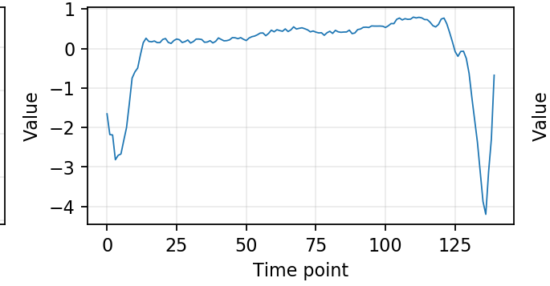
Conclusion
Class 2
Class 4
Multiclass Classification is not the best suited task for this data set → Anomaly detection
Higher model complexity doesn’t translate into better performance.
Biggest performance gain obtained by modifying the Cross Entropy loss weights.

