Slide 1

ECG 5000
Maria Miguelez
Ann Christin Vietor

Slide 2
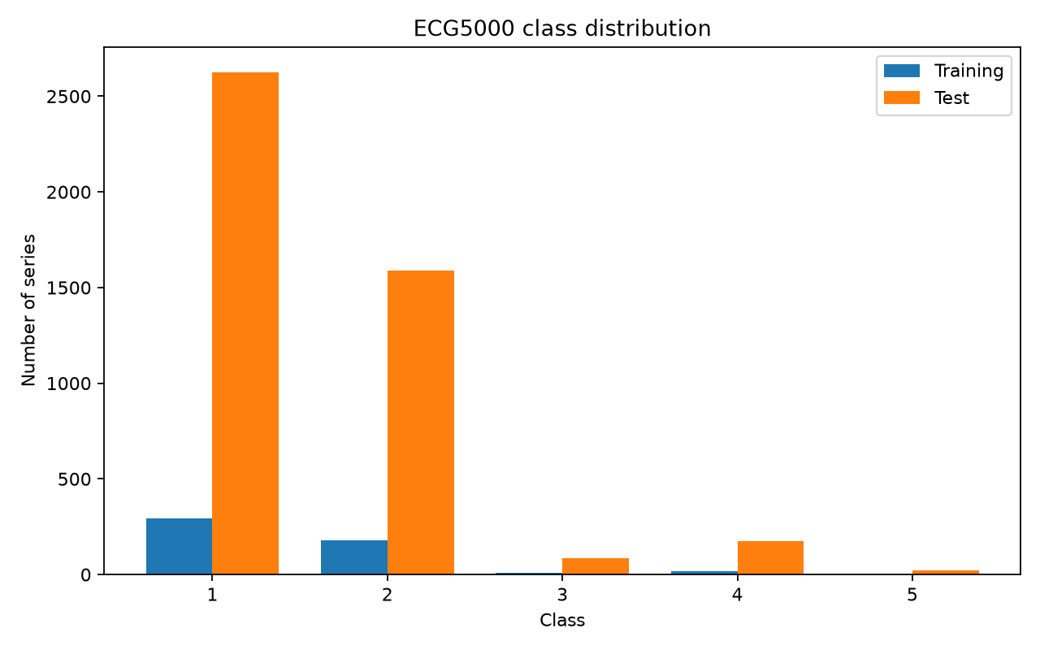
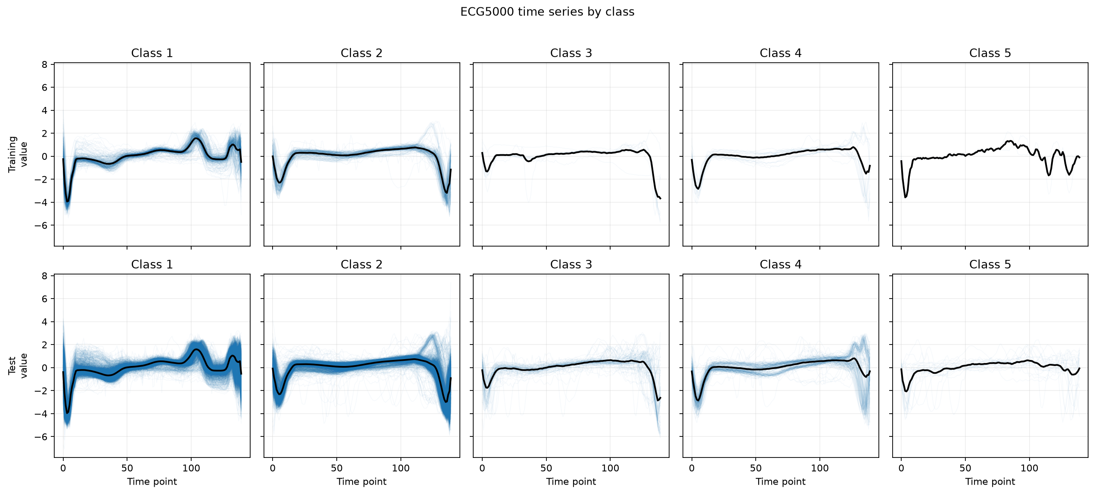
Dataset description
Type of data: Time-series ECG scan
Task type: univariate time-series classification
Train shape:
samples: 500,
time steps: 140
Test shape:
samples: 4500
time steps: 140
Number of classes: 5 (1 healthy, 5 conditions)
Challenge: imbalanced classes

Slide 3
Baseline parameters
Model | # parameters | Scaling (Standard scaler) | Loss weights (CrossEntropy) | Hyper parameters
Random Forest | - | FALSE | - | trees = 100
Logistic Regression | 705 | TRUE | CrossEntropyLoss with L2 regularization Inverse to class frequency [0.004, 0.038, 0.02, 0.35, 0.58] | -
LSTM | 17.477 | TRUE | CrossEntropyLoss Uniform per class [0.2, 0.2, 0.2, 0.2, 0.2] | Learning_rate = 0.001 hidden_size=64 n_layers=1 batch_size = 500 context_length = 140 (all)
Transformer (encoder) | 111.877 | TRUE | CrossEntropyLoss Uniform per class [0.2, 0.2, 0.2, 0.2, 0.2] | Learning_rate = 0.001 d_model = 64 dim_ff = 128 n_heads = 4 n_layers = 2 batch_size = 200 context_length = 140 (all)
Machine Learning
Deep Learning

Slide 4
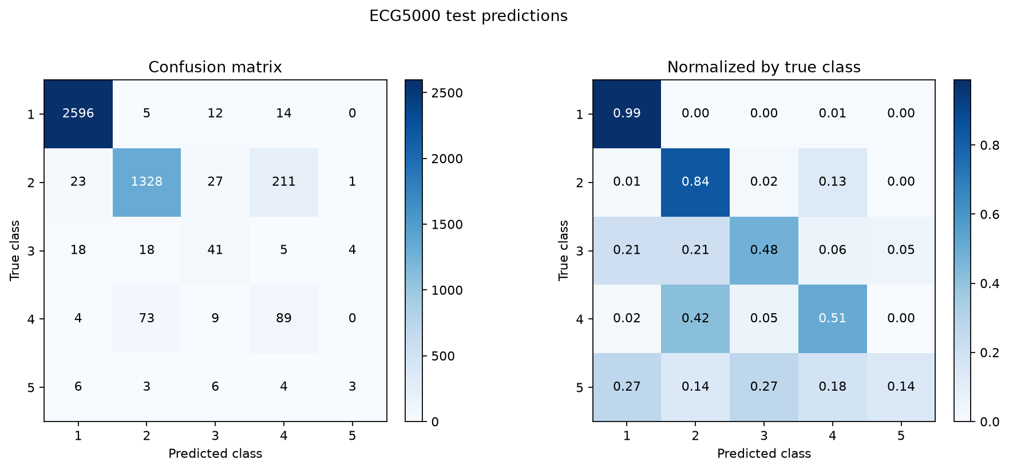
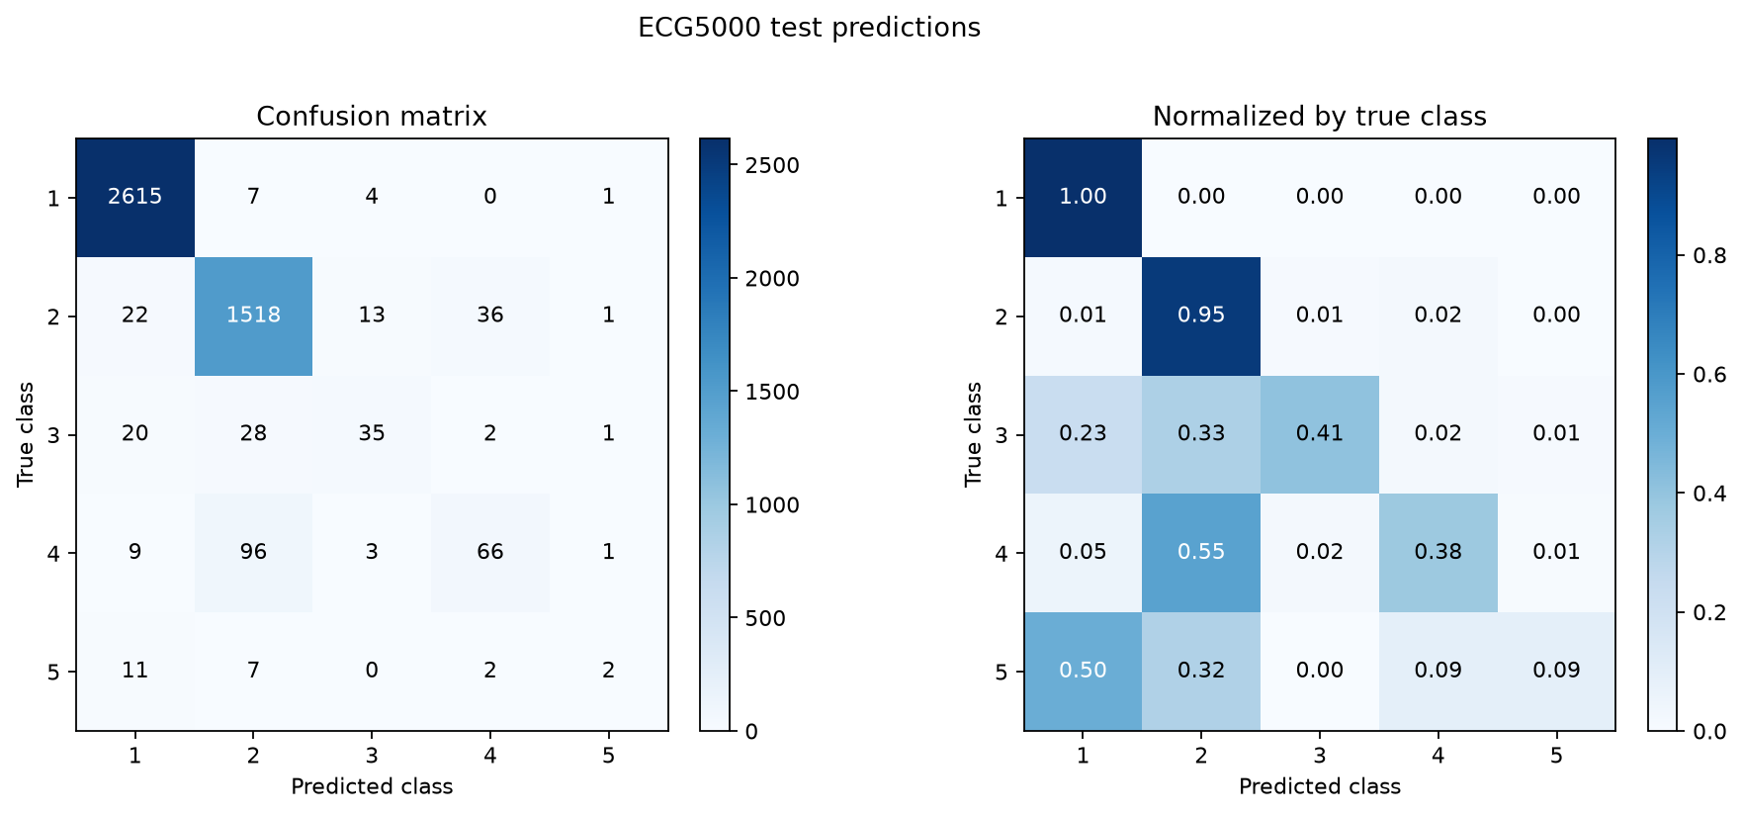
Baseline performance
Metrics | Random Forest | Logistic Regression | LSTM | Transformer (encoder)
accuracy | 0.935 | 0.901 | 0.930 | 0.941
Recall-macro | 0.50 | 0.59 | 0.55 | 0.57
Precision-macro | 0.69 | 0.60 | 0.61 | 0.70
F1-macro | 0.540 | 0.575 | 0.574 | 0.606
Logistic regression
Transformer

Slide 5

Future steps
Strategies to improve performance:
HPO + Cross-Validation: Class-balanced split in CV
Try different model architectures:
Explore and optimize attention use
Plot the latent space to identify class overlap
Feature engineering
Test LAVAE-Net
New metric:
AUC
PRC curves per Class

