Slide 1


PREMIER LEAGUE MATCHES ANALYSIS
PRESENTED BY : MARIAM KHALID

Slide 2



INSTRUCTION
AGENDA
1.DATASET OVERVIEW
2.MAIN QUESTIONS
3.OVERVIEW ON DASHBOARD
4.INSIGHTS AND FINDINGS
5.CONCLUSION / Q&A

Slide 3



1.DATASET OVERVIEW
Dataset Name : Premier League Matches from seasons 2019/20 to 2023/24.
Rows Before Cleaning : 4788
Rows After Cleaning : 3800
Columns : 24
Key Columns Used :
-Team , Season
-Position , Poss , SOT , SH
-GF , GA , XG , Result

Slide 4

2.MAIN QUESTIONS
INSTRUCTION
1- Man City Stats to win 4 titles in a row
2- How Team Formation Affects Performance
3- Expected Goals V.S Goals Scored
4- Shots on Target V.S Goals Scored
5- General Stats Per Team In Each Season
(avg. possession / team position / clean sheets)

Slide 5

3.DASHBOARD OVERVIEW

Slide 6

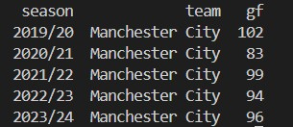
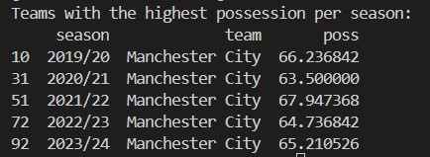
4.INSIGHTS AND FINDINGS
INSTRUCTION
Man City Won The Title 4 Seasons In A Row !
Based on these findings Man City is the Top Scoring Team for all 5 seasons and they have the Highest Possession Rate too.
Most consecutive PL title wins 4 Manchester City (2020/21-2023/24)
Man City is the 1st team in English Football to win 4 PL in a row.

Slide 7
4.INSIGHTS AND FINDINGS
Having more clean sheets doesn’t guarantee a season win
Higher possession can lead to win but not a must.
Switching formation too many times leads to unstable results (ex: Arsenal season 2019/20)

Slide 8

5.CONCLUSION / Q&A
INSTRUCTION
Any Questions ?!

Slide 9

THANKS FOR LISTENING !!
END

