Slide 1
What’s your Intent? A way to Effortlessly Configure High Performance Networks for Science
Energy Sciences Network (ESnet)
Lawrence Berkeley National Lab
TNC 2017
Mariam Kiran
(Research Scientist)
Other Contributors:
Eric Pouyoul, Anu Mercian,
Brian Tierney, Inder Monga

Slide 2
Talk Agenda
Current challenges in network provisioning and scheduling file transfers
Why use Intent-based networking?
Solution: ESnet’s INDIRA tool for intent rendering
Uses natural language processing (semantic ontology)
Provisions network tools by rendering complex commands
Current state – interaction with NSI and Globus tools
Architecture: Discussion on how it works and looks
Evaluation
Discussions points for future potential of intent (Open Discussion)

Slide 3
ESnet Background (Brief) www.es.net
R&E networks for science (CERN, LHC, and more)
Provide reliable robust network connections to enable science workflows
Investigate research and techniques to help build better networks
Guarantees for our scientists for network needs (users)

Slide 4
Set the Stage – What we deal with everyday!
universities
Network
engineer
Network
engineer
Network
engineer
R&E
DoE
networks
ESnet
facilities
scientist
scientist
Network
engineer
I want to do a bulk transfer as soon as possible
instruments
scientist
I want to stream the big data directly into the cache of my super computer
scientist
I want to see my real time high resolution big data visualization
Science Applications have complex workloads
Network behavior tailored for my application ‘intent’
Difficult to fulfill these diverse set of needs
Learning curve is huge and complex
Difficult to specify needs in ‘english’
Specify in high-level language, portable, multi-domain
Notes:
Imagine this scenario:
Dedicated links with specific QoS and are scheduled
Various actors involved: Scientists->network engineers->IT->Scientists
Manual provisioning
Gathering requirements – understanding and communication
Moving large files to certain endpoints
Make sure they have arrived in time

Slide 5
Current infrastructure (example tools used)
NSI (Network Service Interface) for multi-domain connectivity
Science workflows (using NSI or OSCARS)
Multi-domain provisioning
Some level of automation
Necessary for complex instruments and collaboration
Designed for a specific science
Transfer tools (using Globus)
Ease of use
Reliable
Designed for end users.
R&E Networks support big data oriented services (using ScienceDMZ)
Bandwidth on demand, loss free.
Isolation.
Network virtualization
Designed for network engineers and networking automation.

Slide 6
Setup Paths for the Individual: Intent
Traffic paths provisioned with basic QoS values
What if traffic can be optimized for ‘end-users’ to make experience better
Networks can understand users
Network says: “Tell me what do you want!”
Example:
Scientist> Can you set up a connection between Berkeley and Argonne.
Network> Do you want guaranteed bandwidth?
Scientist> Sure!
Network> OK! Ill get this setup for you.

Slide 7
INDIRA for Intent-based networking in action….
ESnet Research

Slide 8
Introducing iNDIRA... “Hello! Im iNDIRA”
(Intelligent Network Deployment Intent Renderer Application)
User:
“ I want to send data to my SuperComputer at NERSC by 5:00pm today”
NLP, OWL, “AI”
Network engineering
intent
iNDIRA
Network:
“ Ok ill reconfigure the network to make this possible!”
Network state
Language processing to take intent input
Renderer translates intent
Understand English (e.g. transfer, connect)
Check conditions are correct
Ask for any further details
Check conflicts and permissions
Render input into network commands like bandwidth, time schedule, topology
Provision/optimize the network
Return success or failure to user

Slide 9
iNDIRA’s working: Top level view
Act as a intent parser engine
Knowledge base
Topology
Project profiles
Semantics – Data dictionary
Network services and conditions
No platform dependence
Multi-layer provisioning
Multi-tool connectivity
User interface
Virtual layer
Physical layer
Current demo

Slide 10
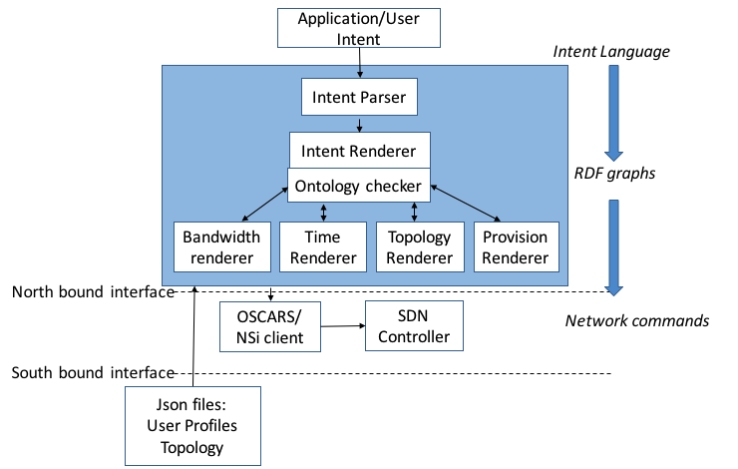
iNDIRA’s working: Inside view
Intent is given
Initial semantic and condition checks
Convert intent into network using profiles and topology information
Layer 2/3 provisioning:
Call network service Multi-domain (NSI)
Call File Management System (Globus)
1
2
3
4
3
Globus
Notes:
- No need to say “python user interface”. Just say “user interface”

Slide 11
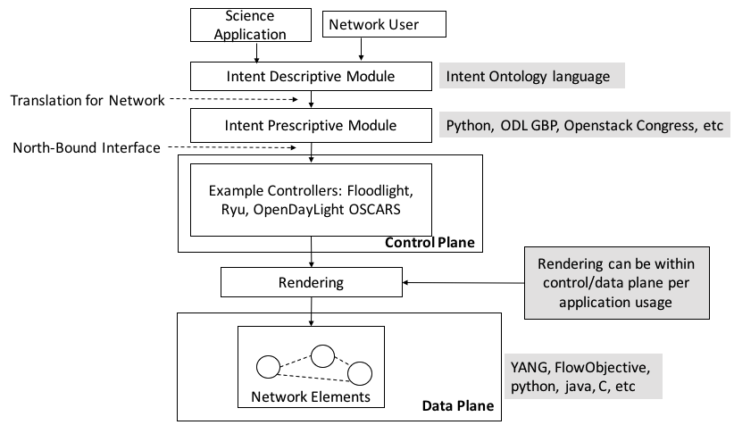
Intent filters down onto network elements
Users are the Applications
Develop intent ontology
Link multiple renderers

Slide 12
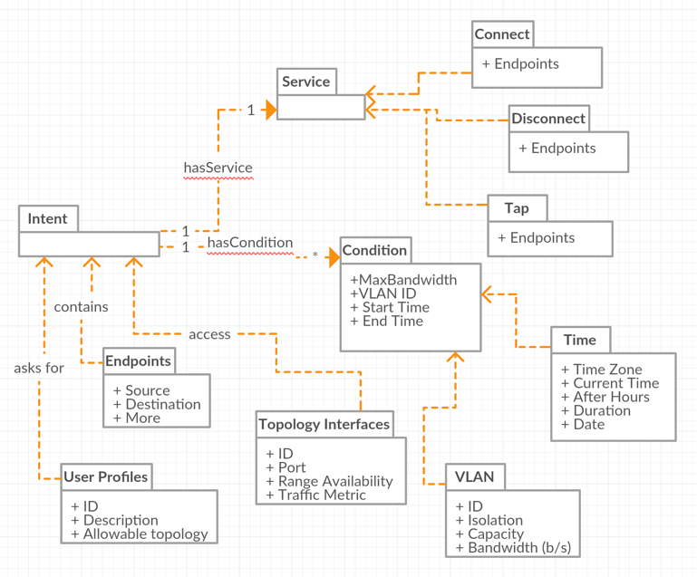
UML Description of iNDIRA’s language
Notes:
Perhaps try to make it larger, bolder font ?

Slide 13
iNDIRA’s Ontology Example
Uses RDF and OWL ….and a data dictionary!
Intent:
“For Project1 connect anl lbl condition nobwlimit nolimit starttime now”
Notes:
Hard to read

Slide 14
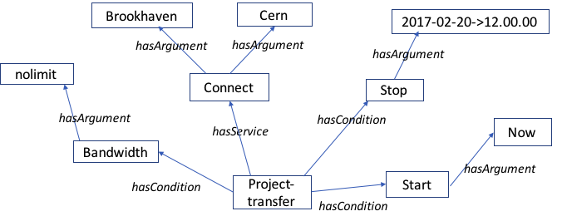
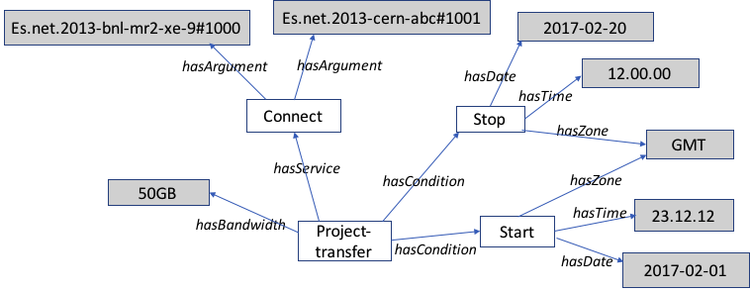
Intent rendered as RDF
Input Intent
As a RDF graph
As a string
Rendered: Mapping each service to network API
Addresses updated
Bandwidth changed
Time zones assigned

Slide 15
What about negotiating dialogues?
INDIRA> Hello and welcome! Tell me your project name?
Scientist> Bob
INDIRA> Is ‘Bob’ your project username? Y/N
Scientist> N
INDIRA> What is your project username
Scientist> Project1
INDIRA> Tell me what want the network to do? Hint “I want to [connect] [disconnect] services
Scientist> I want to transfer files from LBL to ANL
INDIRA> Do you have any time constraints with the transfer from LBL to ANL?
Scientist> No
INDIRA> Ok. Give me the link to the file to be moved.
Scientist> project_test@LBL/datasource1 to project2@ANL/dataset
INDIRA> Do you have any bandwidth requirements?
Scientist> Yes Maximum
INDIRA> Sorry, you have only 5Mb/s allowable to use. Do you want to use all of this?
Scientist>No
INDIRA> Thank you. Please contact the network administrator to allow you more bandwidth, as you don’t have permission to go above 5Mbps
Notes:
The answer should not be “I want to connect from lbl to anl”, but I want to transfer files from lbl to anl. I know indira does both because it aims to both end user and network engineer, but I think the message is stronger for the end user, at least for an oral presentation.
The answer “yes maximum” is excellent. You are going to have laugh there.
I wonder if finishing up the conversation with a negative is good. Sounds like sorry, come back later. Should show a successful conversation

Slide 16
What about negotiating dialogues?
INDIRA> Hello and welcome! Tell me your project name?
Scientist> Bob
INDIRA> Is ‘Bob’ your project username? Y/N
Scientist> N
INDIRA> What is your project username
Scientist> Project1
INDIRA> Tell me what want the network to do? Hint “I want to [connect] [disconnect] services
Scientist> I want to transfer files from LBL to ANL
INDIRA> Do you have any time constraints with the transfer from LBL to ANL?
Scientist> No
INDIRA> Ok. Give me the link to the file to be moved.
Scientist> project_test@LBL/datasource1 to project2@ANL/dataset
INDIRA> Do you have any bandwidth requirements?
Scientist> No
INDIRA> Thankyou. I am configuring your transfer to start ‘now’ at 5GB/s…
….....
Congratulations....All Done!
Notes:
The answer should not be “I want to connect from lbl to anl”, but I want to transfer files from lbl to anl. I know indira does both because it aims to both end user and network engineer, but I think the message is stronger for the end user, at least for an oral presentation.
The answer “yes maximum” is excellent. You are going to have laugh there.
I wonder if finishing up the conversation with a negative is good. Sounds like sorry, come back later. Should show a successful conversation

Slide 17
No changes to other tools
No changes introduced to production tools NSI or Globus
Indira is able to ’converse’ with users and translate their needs to NSI/Globus
Uses natural language processing and semantics (RDF, OWL)
Can find available links and provision these
Schedule transfers in the future
Introduce bandwidth control and topology awareness
Demonstration
Provisioning network links using NSI
Schedule file transfers in the future with Globus with dedicated QoS

Slide 18
Evaluation
Comparing to current efforts Boulder, NEMO, ONOS intent, NIC and more:
High-level language to input intent similar to English commands
Based on ontology engineering to identify services and arguments using RDF specifications. Can be extended further with other network semantic tools.
Use graph theory to identify conflicts, check rules and policies.
Communicates network status back to users.
Can be integrated with other tools to allow higher level of QoS translation.
Notes:
(Others have long configuration steps)
(There is no standard, so we are creating this)
(Not done in other approaches)
(Important for monitoring and satisfaction)
(other tools are very tied to the infrastructure they are being written for)

Slide 19
Conclusions and Potential Future work
Vision forward: How can we optimize network behavior for their individual needs?
Multi-client capability to cater to multiple scientists at one time through web-server interaction
Advanced intent dashboard: monitor your intents
Adding intelligence level to predict user needs in advance
Add fault tolerance to understand and re-provision for future if current needs might fail
….and more exploiting:
the modular approach
and ontology building and a data dictionary

Slide 20
Thankyou
Demo video available on ESnet website
(https://www.es.net/network-r-and-d/intent/)
Feel free to get in touch:
<Mkiran@es.net>

