Slide 1
Classifying Elephant and Mice Flows in High-Speed Networks
Mariam Kiran
Anshuman Chabbra (NSIT)
Anirban Mandal (Renci)
Presented at INDIS 2017
ESnet, LBNL
Funded under DE-SC0012636

Slide 2
Talk Agenda
Current challenges in Elephant and Mice flows: Why bother?
Unsupervised machine learning techniques: Why?
Solution: Development of a learning classifier system using GMM
Current state – lessons learned and exploitation of classification results
Evaluation and Future work

Slide 3

Myth not in Networks! “Elephants scared of Mice”
Data centers and networks get a mixture of flows:
Elephant flows:
Large size
Long-lived
Large data transfers
Throughput-sensitive
Mice Flows:
Smaller bursty traffic
Short-lived
Latency-sensitive
Scientific networks versus data center traffic
Majority flows: Elephant flows (Big data files)
Gobbles up network buffers causing queuing delay to mice flows
Challenges of adaptive routing: Changing paths on-the-go
Links also have to be optimized: multi-objective problem

Slide 4
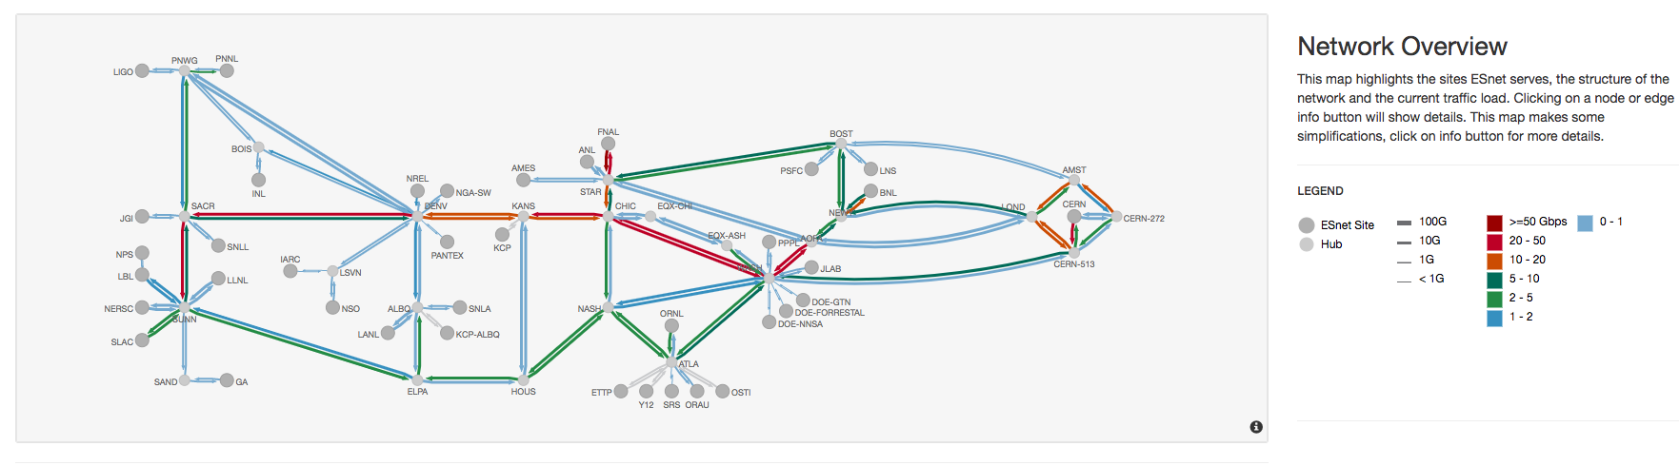
Why should we understand flows?
Our networks is very dynamic.
Losing data or jeopardizing applications prevents us to achieving our mission!
Goal is to detect and then manage

Slide 5
Previous work
Classify traffic for intrusion detection and traffic profiling
Number of packets transferred, flow duration, file size
Papers link tools to perform dynamic traffic steering
Isolating traffic streams
Based on size, rate, duration, burstiness, or combination
However real-time detection is a challenge!
Online (as flow arrives) versus offline analysis (periodic)
S. Shirali-Shahreza et al. Traffic statistics collection with Flexam, in: Proceedings of 2014 ACM SIGCOMM.
T. Zizhong Cao et al. Traffic steering in software defined networks: planning and online routing, SIGCOMM workshop on Distributed cloud computing.
Z. Yan et al. A network management system for handling scientific data flows, Journal of Network and Systems Management 24 (2016) 1–33.
Notes:
Isolate science data from general flows
Alpha flows (size and bursitness)
size (elephant/mice), rate (cheetah/snail), duration (tortoise/dragonfly), burstiness (porcupine/stingray)

Slide 6
Lets use Netflow Records
(TCP, UDP)
throughput, loss, utilization
ANL
PT
PT
CRN
LBL
Netflow: Collected every 5 minutes (aggregated flows)
Perfsonar: active testing for health
Every site is unique: traffic received
FNL
Flow first seen Duration Protocol Source IP:Port Destination IP:Port Packets Bytes Flows
2017-04-15 00:00:23.040 TCP 50.127.55.32:3455 -> 137.243.29.226:23 0 40 1
2017-04-15 00:00:23.040 UDP 120.129.253.114:9788 -> 121.127.238.102 0 42 1
2017-04-15 00:00:23.850 UDP 120.129.253.114:9433 -> 121.127.151.25 0 42 1
Site (1 month) | Mean (size) | Max (size) | Mean (duration)
ROne | 0.15 | 25.6 | 23.19
RTwo | 0.03 | 36.4 | 4.14
RThree | 0.02 | 72.5 | 6.63
6

Slide 7
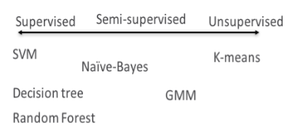
Finding elephants and mice in flows
Exploring Netflow data
Cluster traffic into TWO groups with NO prior knowledge
Unsupervised learning: Organize data into clusters based on attribute values:
Find patterns, relationships, similarity across data

Slide 8
K-means results
Cluster data based on distance
Start with no knowledge and find centroids with closest data points
Target: Form 2 clusters based on size and bytes/s
Results:
Overlapping data points in clusters
Algorithm fails due to different density and data size in flows
We need some knowledge in the algorithm
RSite3

Slide 9
Gaussian Mixture Model (Semi-supervised)
Scikit-learn python library for GMM-EM (Expectation maximization)
Only 30 lines of code
Semi-supervised: Initialize with some knowledge
Assume 10% elephant and 90% mice and then refine µ_{e}=0.1, µ_{m}=0.9
Compute probability of flow belonging to cluster and update µ_{e}, µ_{m}
Compute mixture coefficients per site
Repeat process until converge to a local optimum.
NetFlow data
(per Rsite) Flow size, flow rate
GMM-EM Algorithm 1. Initialization 2. Expectation
3. Maximization
Two Cluster: Elephants and Mice

Slide 10

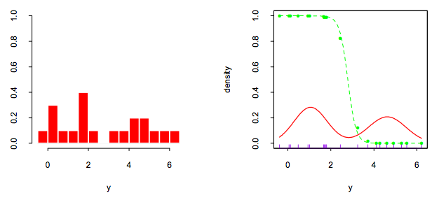
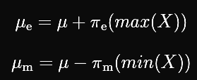
Working of GMM-EM algorithm
Flow characteristics are dependent:
Per site
Per time of the day
GMM assumes there is a Gaussian distribution of mixture of classes
Data set is a mixture of elephant and mice flows
Initialization Step: 10% flows are elephant in my traffic (0.1,0.9)
Expectation Step: Compute belonging to a cluster based on Gaussian equations
Maximization Step: Keep re-iterating till converge
Maximum likelihood fit to Gaussian density (red)
Observation data set (green) also called responsibility

Slide 11
Use Classification to build a LCS
LCS = Learning Classifier System
Each site is different, and flow characteristics change over time
Classifier will find different characteristics of elephants and mice:
Not have a predefined definition e.g. thresholds
(Classifier)
Knowledge Base
learn
Rule-based trigger
Environment
Apply Actions

Slide 12
Results

Slide 13
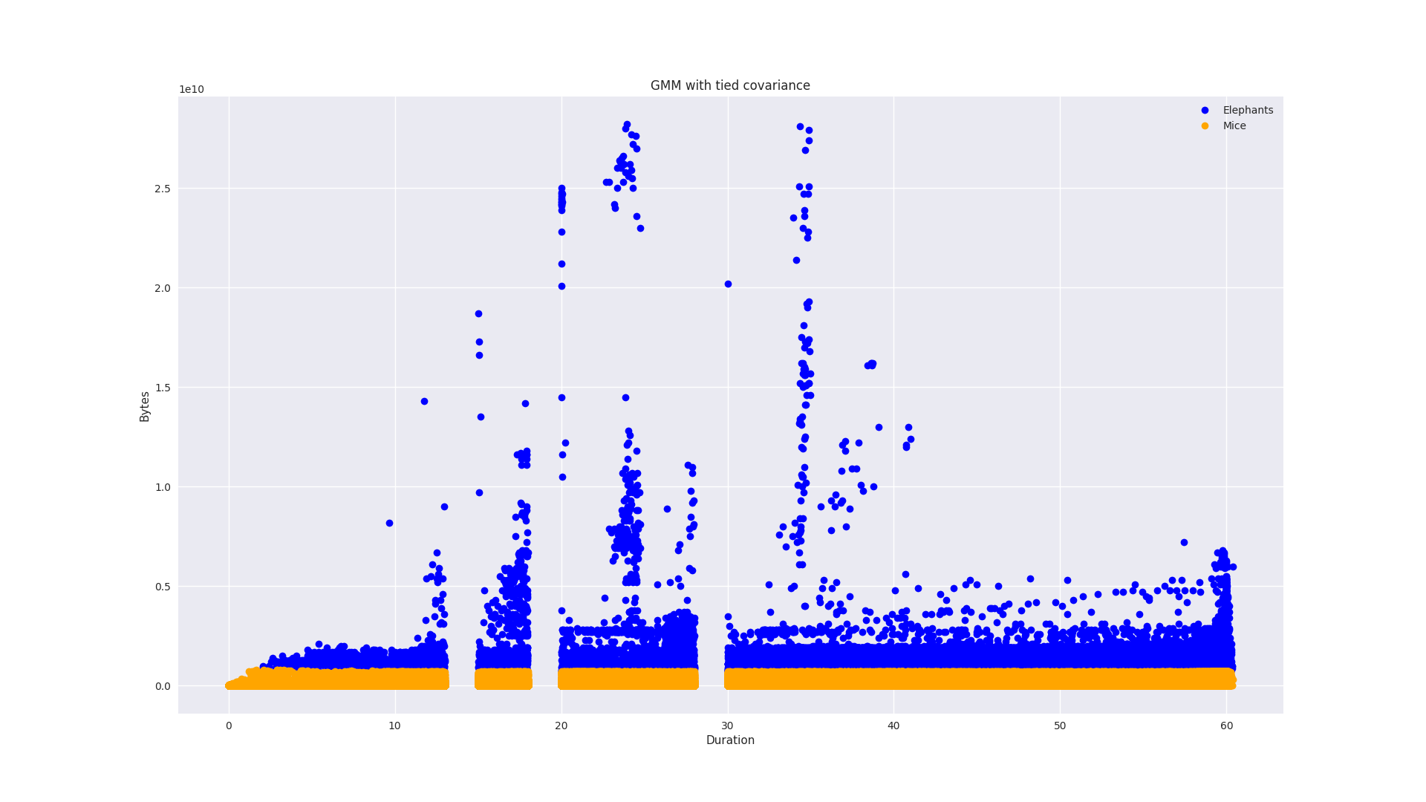
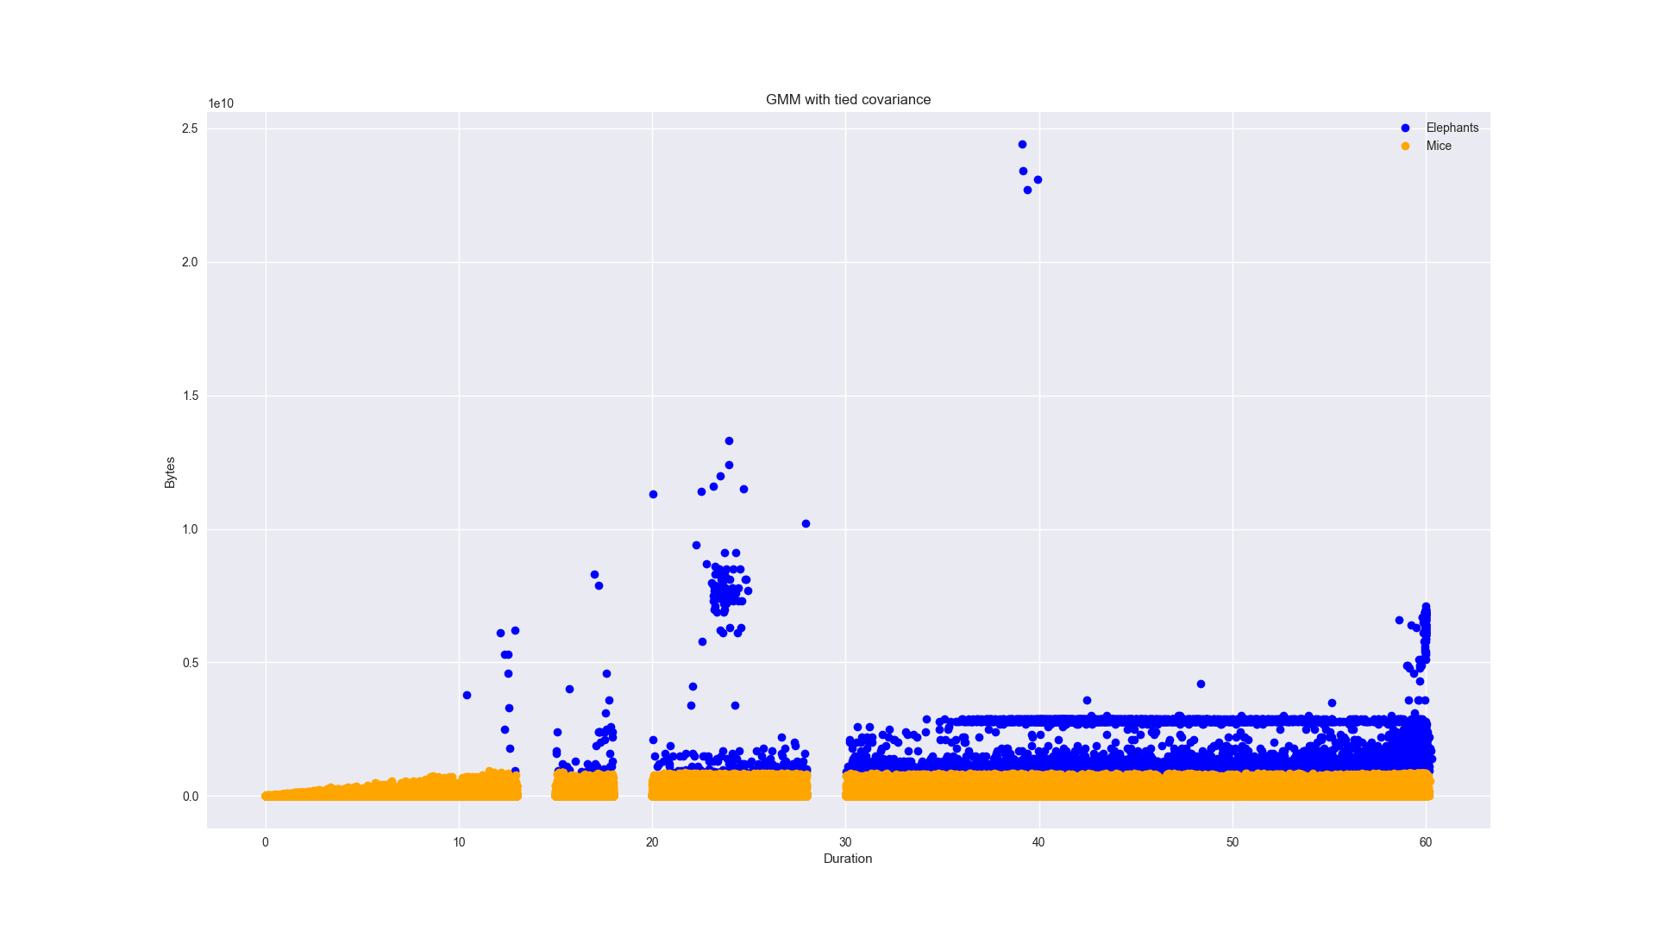
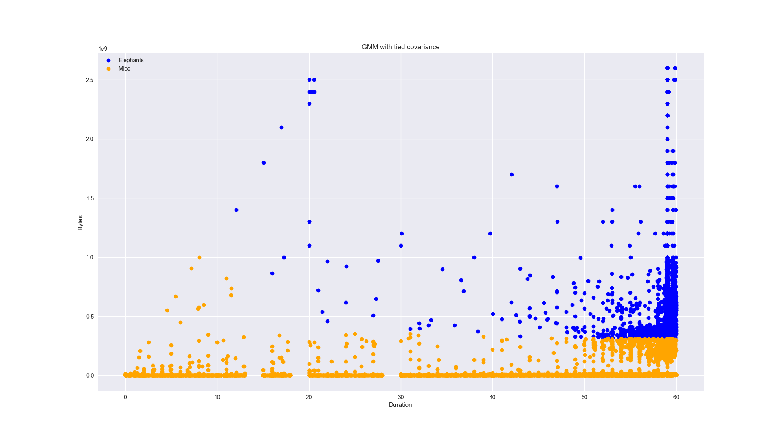
Semi supervised gives better results
Clear clusters found!
Each site cluster has different characteristics
Blue = Elephant, Orange = Mice
Rsite1 more Elephants flows compared to Rsite2/Rsite3 (higher duration)
Mice flow ranges are different for Rsite3 (based on flow size)
Rsite1
Rsite2
Rsite3

Slide 14
What lessons did we learn?
Clustering leads to more statistical analysis on what elephants/mice are
Too much Noise in data:
First few netflow records contained Perfsonar tests,
being classified as elephant flows, had to be cleaned
Needed some knowledge for semi-supervised:
Leads to skewed results of elephants lying in top 10% size and rate
Need an independent verification with ground truth data
E.g. Simulating GridFTP transfers to see if recognized as elephants
ML BlackBox problem:
Using ML libraries does not expose internal algorithm workings
Propose building ‘open’ libraries

Slide 15
Is Netflow enough?
(Classifier)
Knowledge Base
learn
Rule-based trigger
Environment
Apply Actions
Initial idea was:
Can we to Active Traffic Steering using identified clusters?
There is Noise: difficult to recognize
Link testing data
No track of congestion on link
Bad configuration
Sampling rate can be altered
Additional infrastructure required
Sflow: Expensive but is it worth it?
More end-to-end data
Whether flows captured belong to same stream? Interface/port data
I/O data
Notes:
If flow parallelized that flow data not tell us.. Go through different ports .. Network doesnt know, but know if we had data from endpoints

Slide 16
Building Learning classifier system
Knowledge base
Training
Learn
Classify
Predict
Flow record
(1…10)
Action
Divert traffic
Active steering: Netflow data is past data
Thresholding mechanisms are good approaches!
Needs more testing for how flows can be isolated
Not do active steering but learn about sites
how heavy traffic is?
Add more links, add more infrastructure, fault management
Notes:
Learns features probabilities where is think data falls into clusters

Slide 17
Conclusion
Overall was easy to implement but has its caveats
Focused on online training and learning per site: Unique compared to existing works in area
Processing time is fairly fast
Next steps
Working through the GMM algorithm to plot how Gaussian mixture changes
Run real-time tests to see if we can isolate traffic streams based on netflow classification
Understand flow behavior across sites

Slide 18
Thankyou
Any Questions?
We do have an open PostDoc position (ML in Networks)
Please reach out
<mkiran@es.net>

