Slide 1




Golden Shoes

Slide 2
Challenges Golden Shoe face
The challenges the company are facing are the following:
Website: The website is very old and not a lot of development has been made to it since it was made and it is not a modern website. Furthermore it does not follow the modern technology that is available currently such as a mobile application.
Online Customer Service Experience: Enquiries such as returning products, delivery dates and times, a product being in or out of stock can be discussed on the phone only which is a restriction as there is no online contact that can be done.
Revenue: The revenue has decreased and is one of the main issues of why the company is not progressing
Business strategies: The company are aware of business strategies and what benefits it can provide such as agile methodology, however the concern to not use it is the current workforce do not have experience in using different kind of methodologies for different projects. Moreover, to convince the leadership team is another point to look at.
Marketing strategy: Another challenge the company are facing is the way they promote the products. There can be a huge impact if the marketing strategy is improved. Although they have online presence it is not much active as it is not monitored. The vouchers they include are limited to use only within a store which makes it difficult to increase the revenue.

Slide 3
Solutions to the Challenges
Website- Since the website has not been developed from the time it has been built, it would be beneficial to develop a new modern website and to make it look simple yet effective and user friendly so the customers can use the site on any device such as desktop or mobile.
Online customer service experience- The website can be more active for example using a virtual assistant or contact a member of the company by using a contact form of their details and emailing the company.
Revenue- The profit can increase if the company uses different marketing strategies to persuade the customers to buy product from the online stores, this could include using promotional offers.
Business Strategy- As the company are aware of the agile methodology, however they are not confident is introducing it therefore to introduce different methodologies which will benefit the company a IT Consultant can work with the developer and they can train the current workforce into developing the skill of knowing when to use what methodology for what project.
Marketing Strategy- This will make a huge impact on the company. If the company make their socials active and website more active by promotional offers and keeping a monitor on the social media platform it will help the business gain revenue.

Slide 4
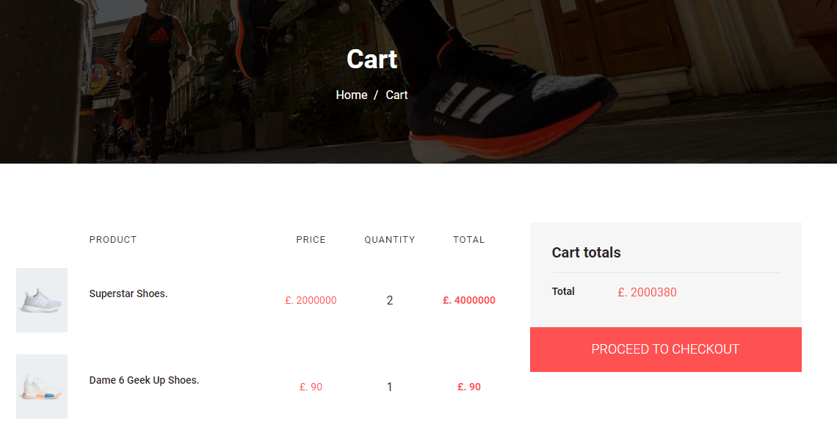
Demo

Slide 5
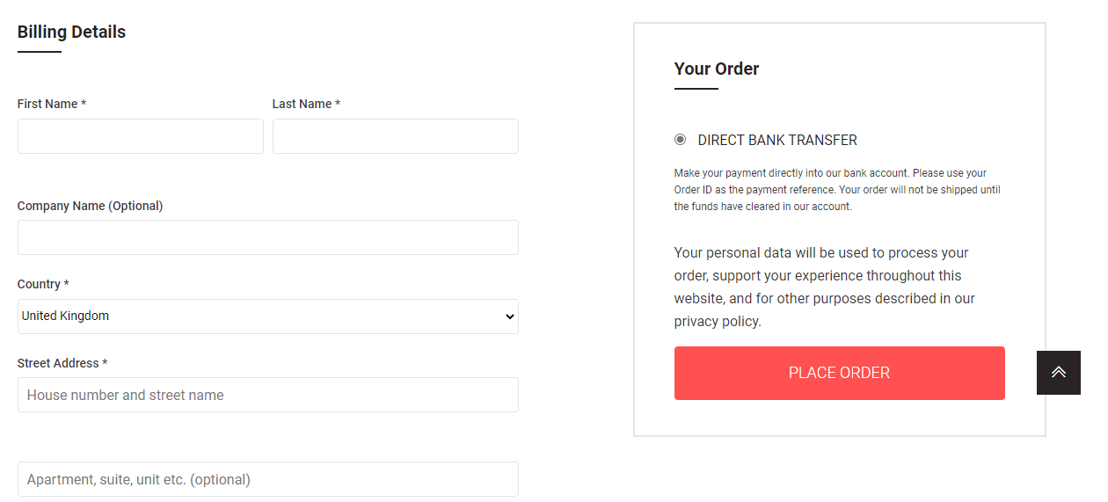
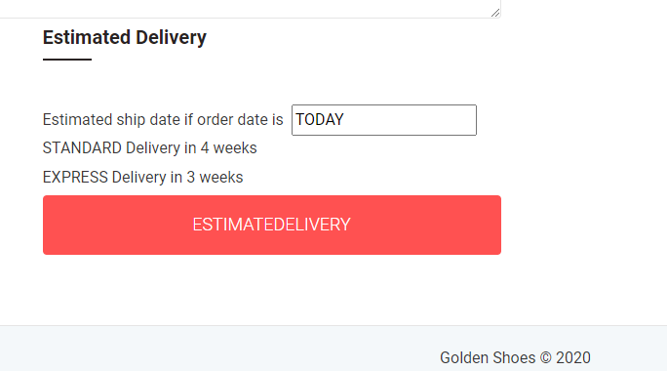
Demo

