Slide 1
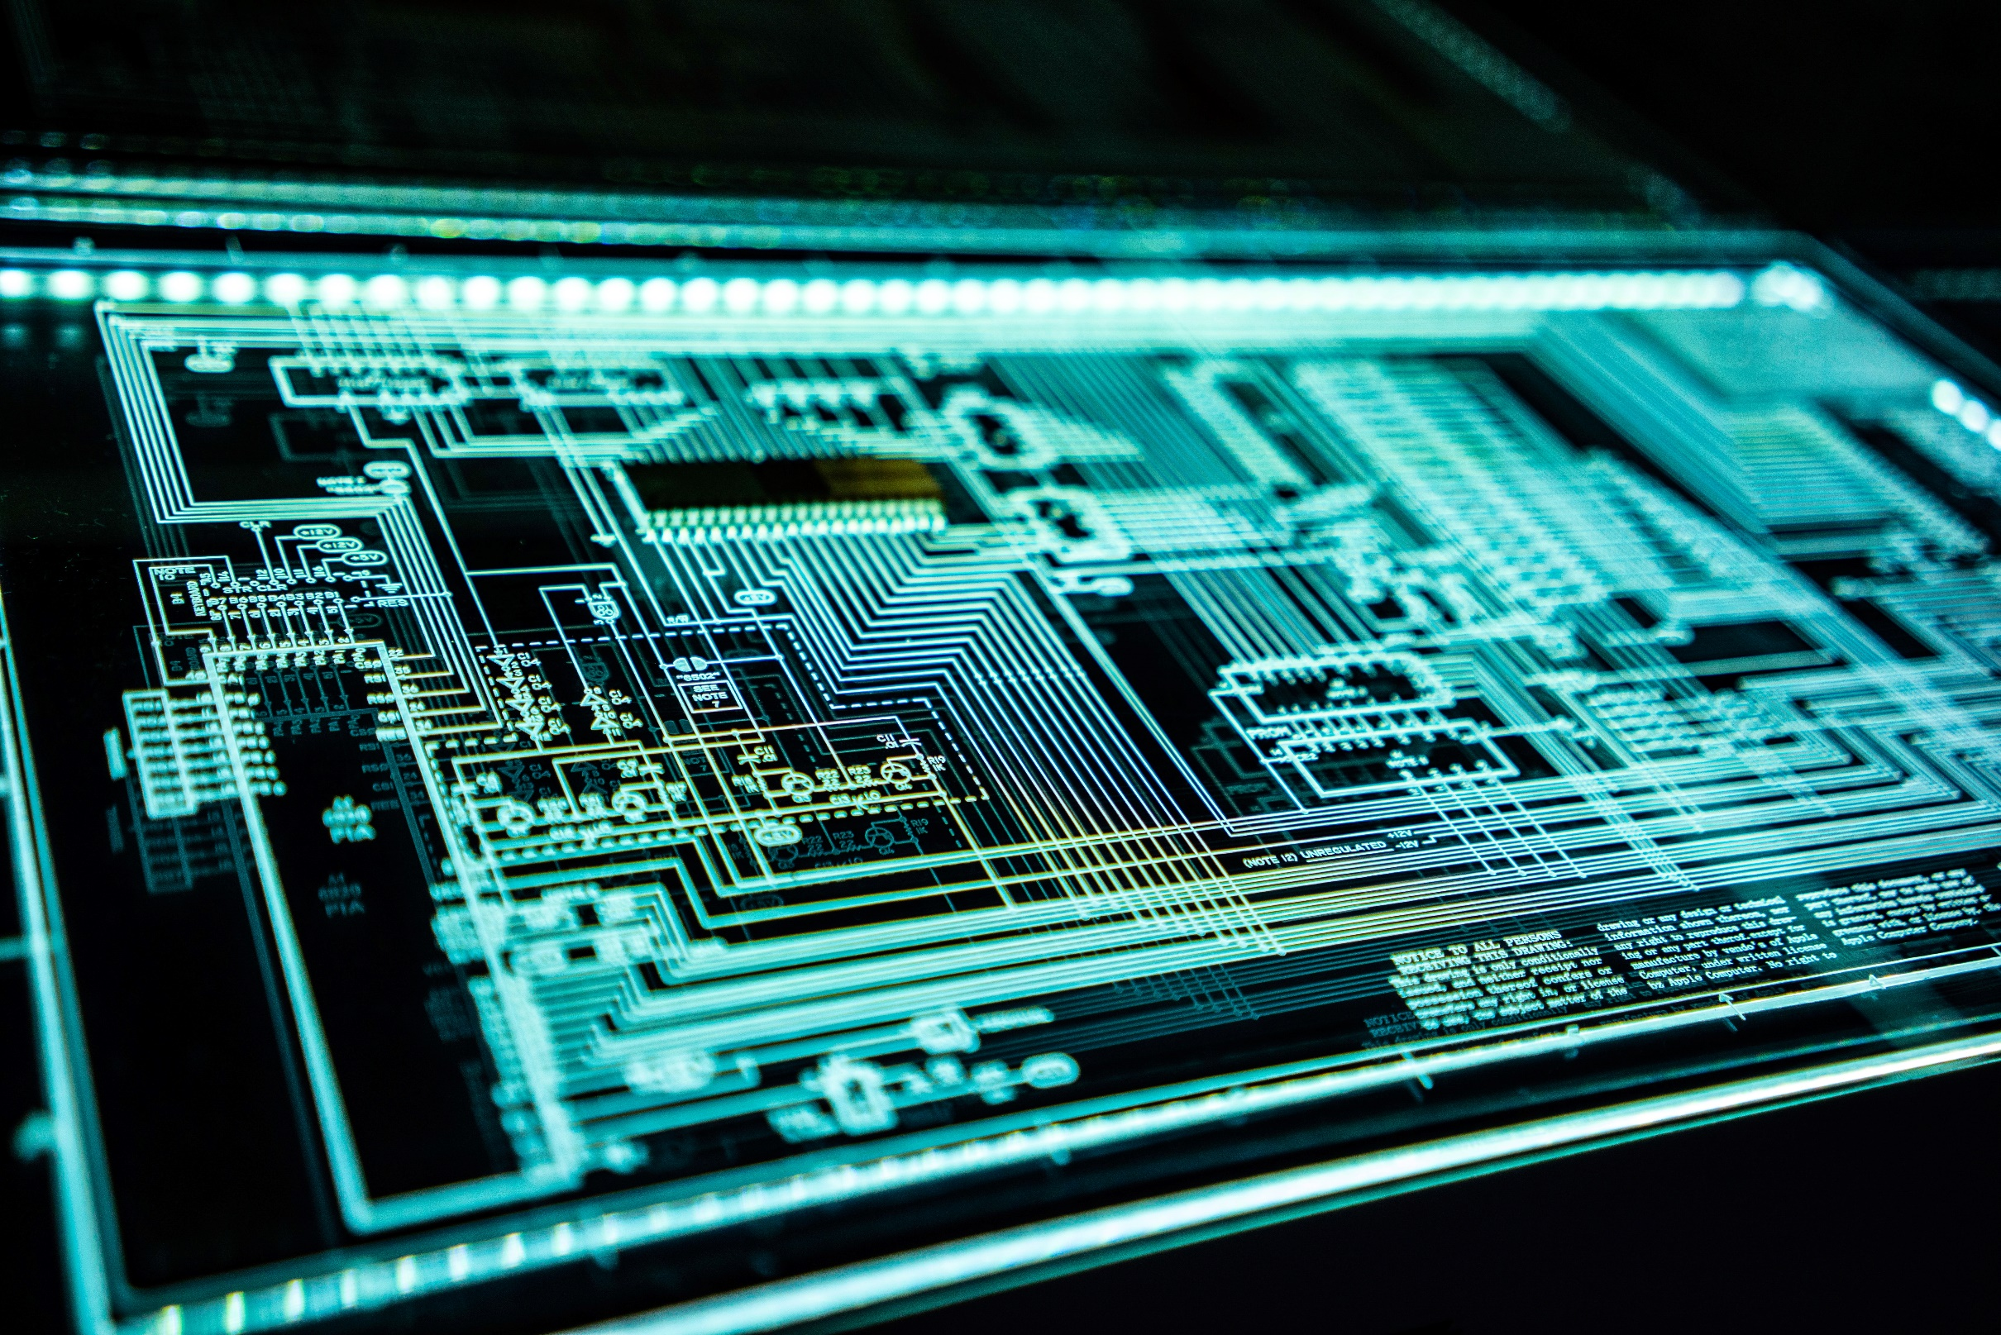
Smart Home
Team 4
Mohamed Salah Mariam Mohamed Reem Salah

Slide 2
Content
Intro. About Smart home system.
Description of project.
Flow-chart of project.
Hardware component that used.
Layers and drivers.
Code of door, temp. & fan.
Code of LDR.
Code of button & 7-Segment.

Slide 3
Smart Home
A smart home allows homeowners to control appliances, thermostats, lights, and other devices remotely using a smartphone or tablet through an internet connection.
Smart homes can be set up through wireless or hardwired systems.
Smart home technology provides homeowners with convenience and cost savings.
Smart homes allow you to have greater control of your energy use, all while automating things like adjusting temperature, turning on and off lights, opening and closing window treatments, and adjusting irrigation based on the weather.

Slide 4
Project Description
Firstly, the user enter user no. then password.
If user entered incorrect password, there’re 2 trial to enter password again.
When the door (servo motor) open, the user can check temperature degree by using (LM35 sensor) and light intensity by using (LDR sensor).
If the temperature degree >=26 , the fan (DC motor) opened.
LDR effects the no. of led that will display.
We used UART communction protocol to connect between 2 MCU.

Slide 5
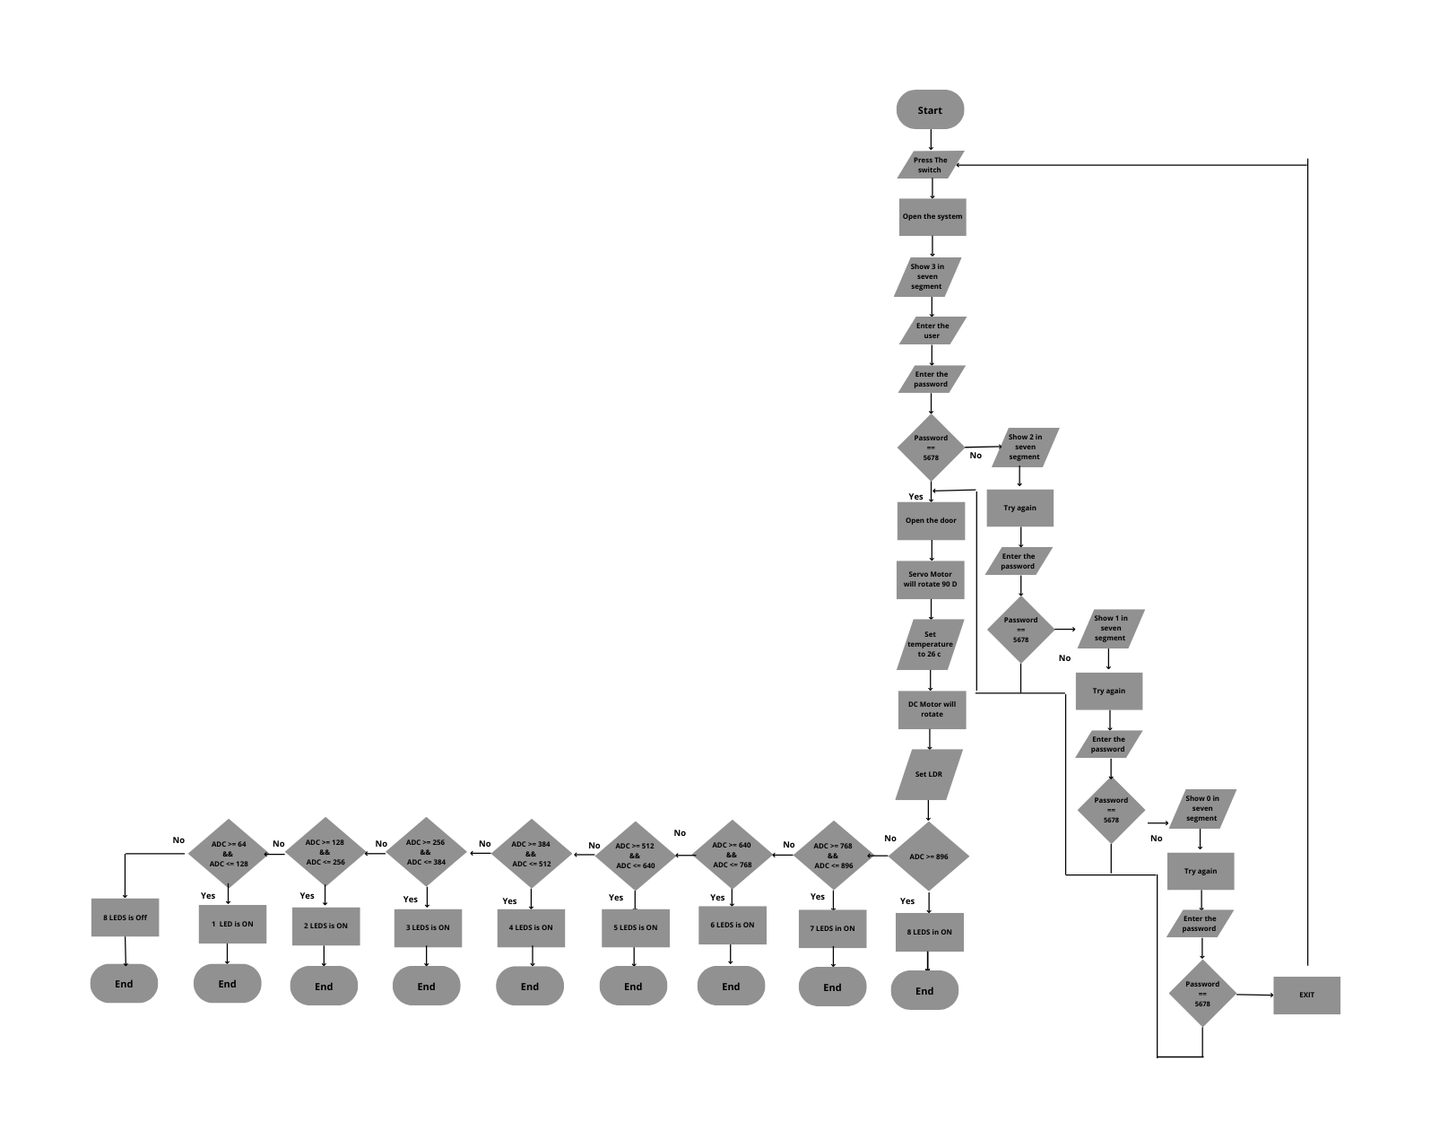

Slide 6
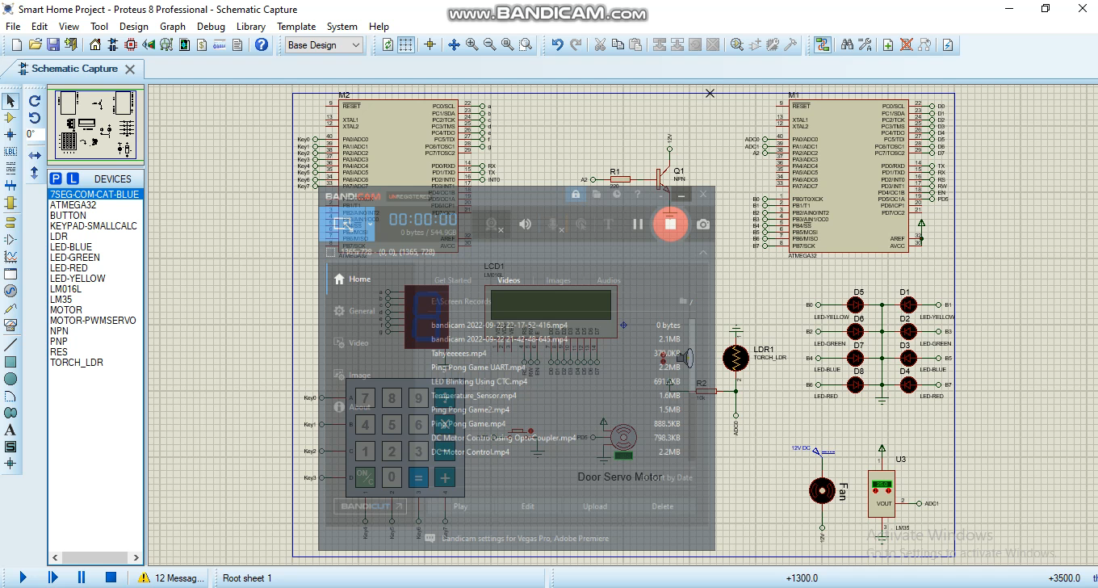
Hardware Components
2 MCU (Atmega32).
LCD (16*2).
7-Segment.
Keypad.
DC motor
Servo motor.
LDR sensor.
Lm35 sensor.
8-LEDs.
Button switch.
Resistance(220 ohm).
NPN transistor.

Slide 7
Layers & Drivers
MCAL
HAL
APP
FAN
LCD
Servo
Keypad
7-Segment
Button
LDR
LM35
DIO
ADC
Timer1
UART
Main1
Main2

Slide 8
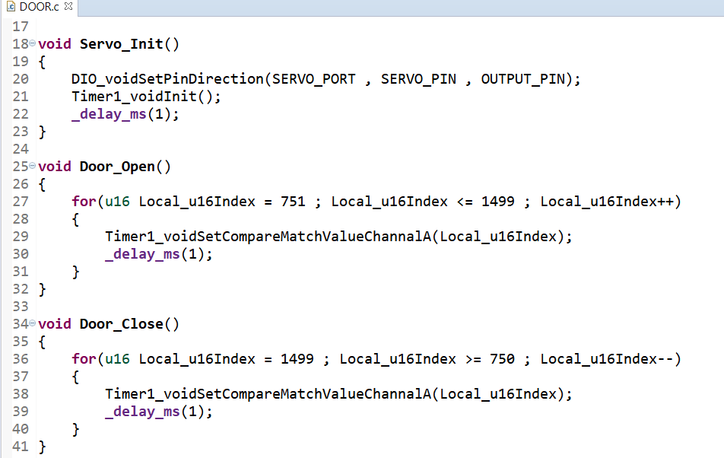
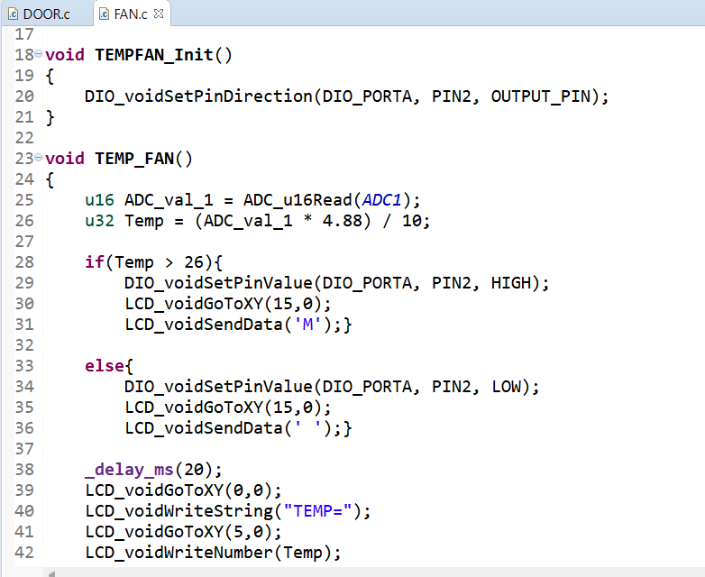
Door, Temp & Fan

Slide 9
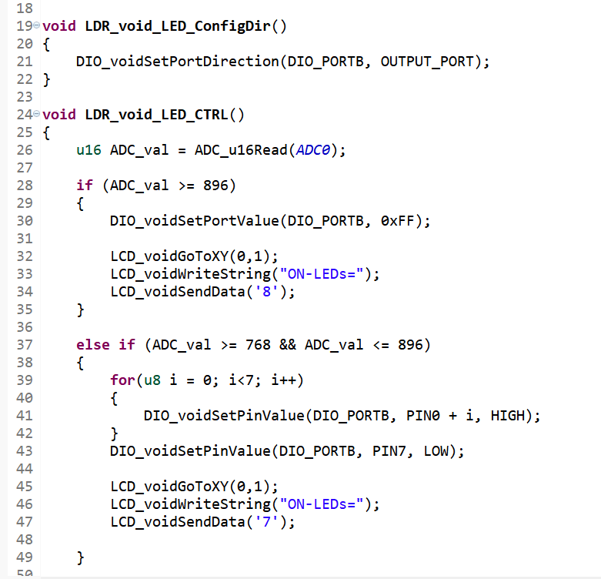
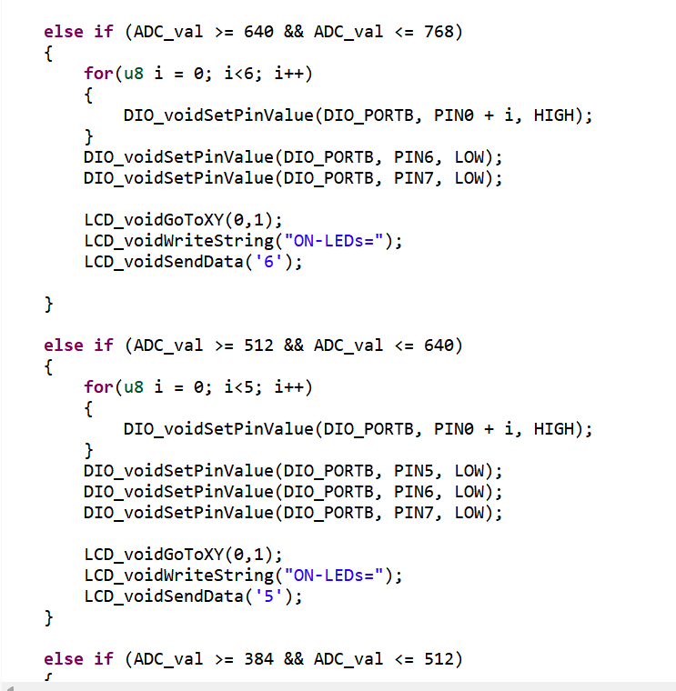
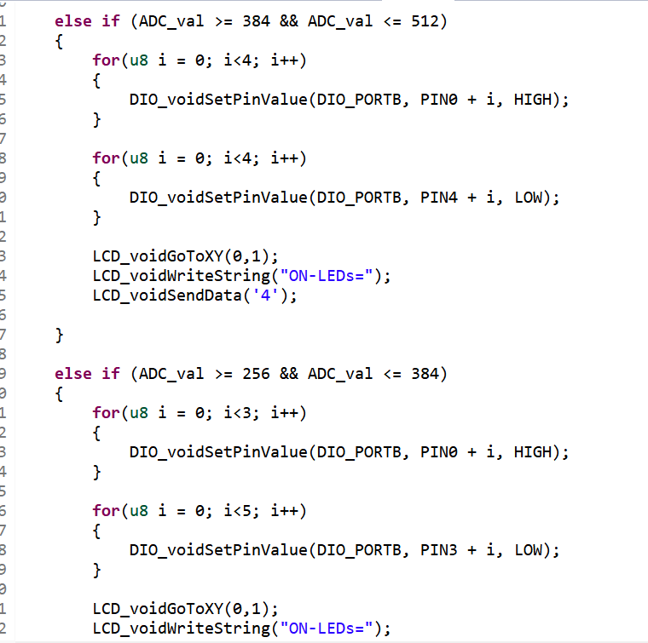
LDR

Slide 10
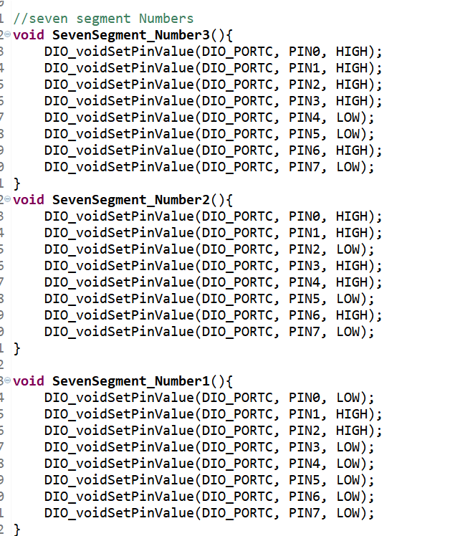
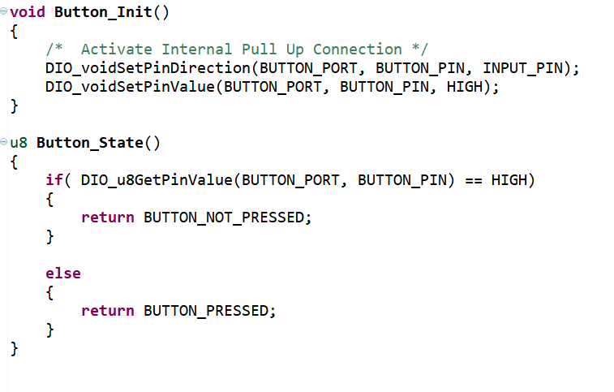
Button & 7-Segment

