Slide 1
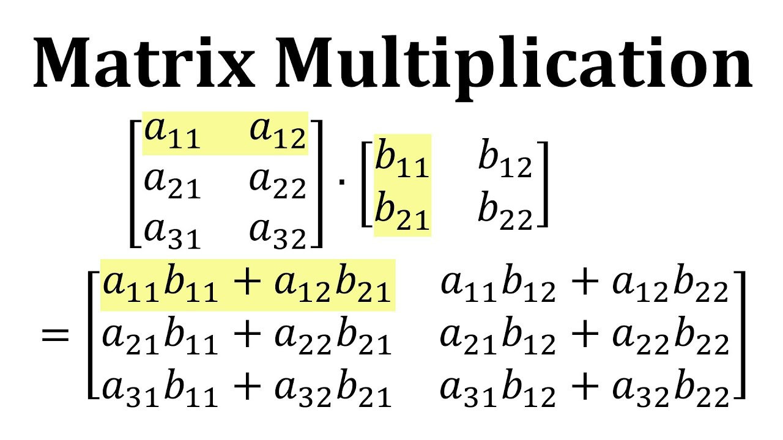
Parallel Matrix Multiplication
Mariam Namgaladze
CSC 429

Slide 2
Introduction
Matrix multiplication is widely used
Slow for large matrices
Parallel computing improves performance
MPI is used to divide the work
Goal: compare execution time

Slide 3
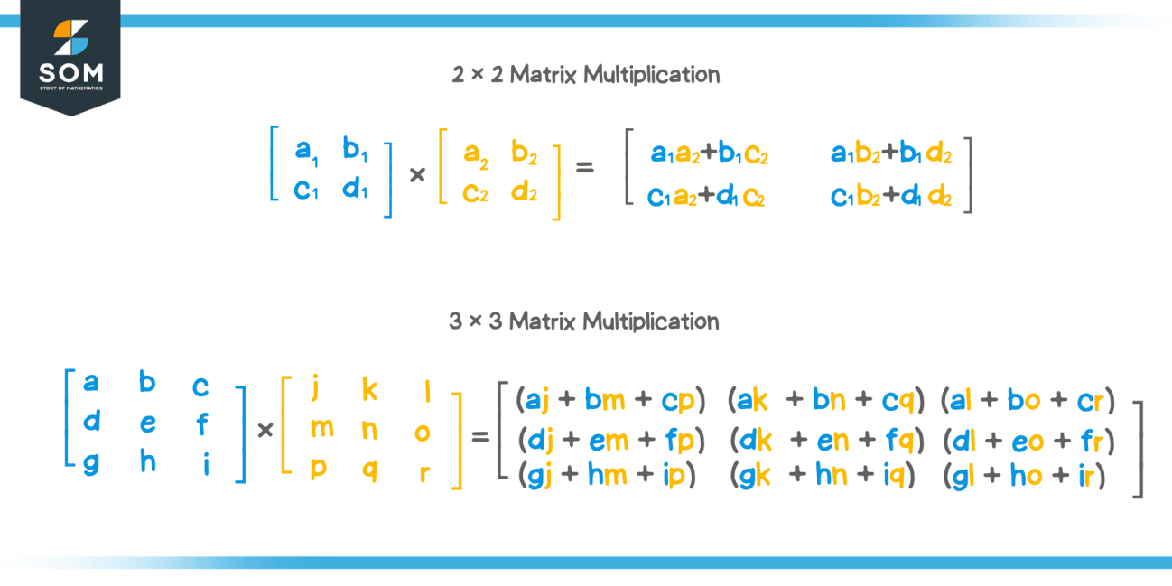
What is Matrix Multiplication?
Multiply rows by columns
Each element = sum of products
Result matrix is formed

Slide 4
Sequential Algorithm
In The Sequential Approach, Matrix Multiplication Is Performed Using A Single Processor. Each Element Of The Result Matrix Is Computed Using Row And Column Multiplication Through Three Nested Loops. The Time Complexity Of This Method Is O(N³), Which Makes It Inefficient For Large Matrices. In This Project, The Sequential Version Is Represented By Running The Program With One Processor (Np = 1), Where No Communication Is Required.
One processor
Computes all rows
Time complexity: O(N³)
Uses 3 nested loops
Slow for large matrices

Slide 5
Parallel Algorithm
In The Parallel Algorithm, The Computation Is Divided Among Multiple Processors. Processor 0 Distributes Matrix B And Rows Of Matrix A To Other Processors. Each Processor Computes Its Assigned Rows Independently, And The Results Are Sent Back And Combined. This Reduces Execution Time, Although Communication Introduces Some Overhead.

Slide 6
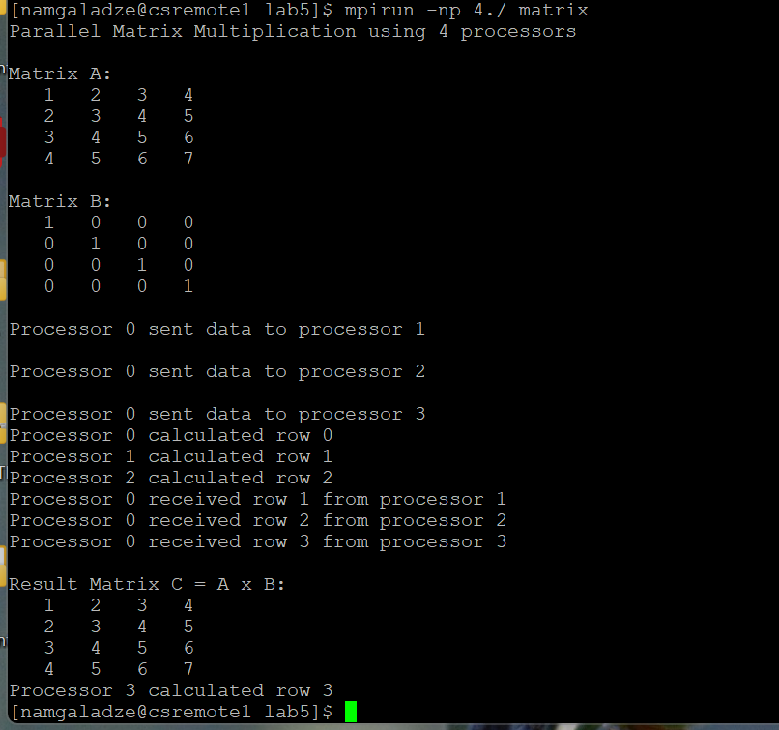
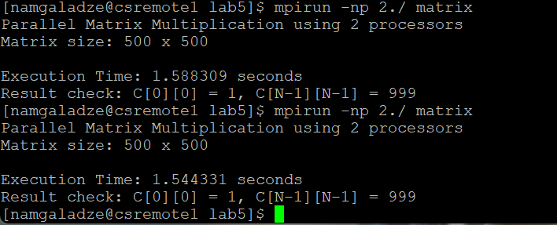
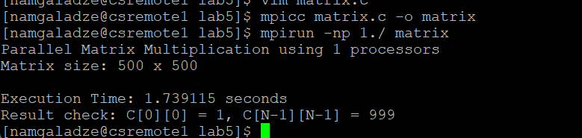
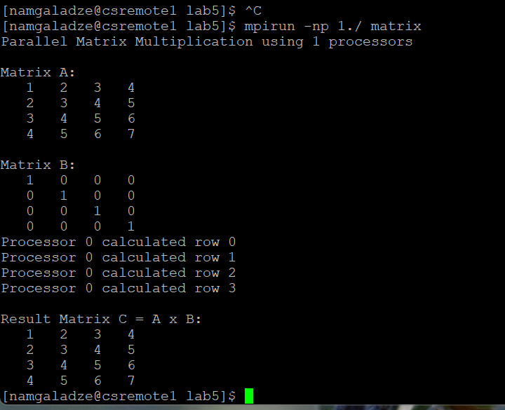
Experimental Results
The program was tested with a matrix size of N = 500 using 1, 2, 4, 5, and 10 processors. Execution time was measured using MPI _ Wtime(), and average values were recorded for accuracy.

Slide 7
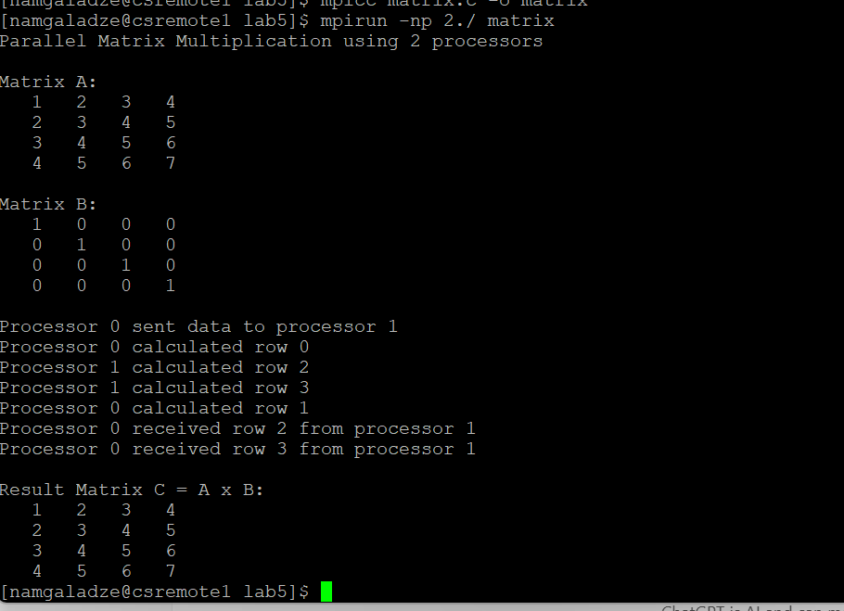
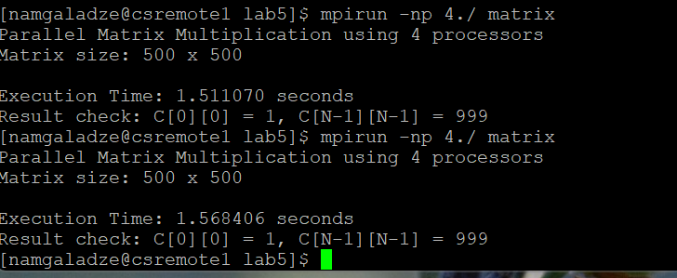
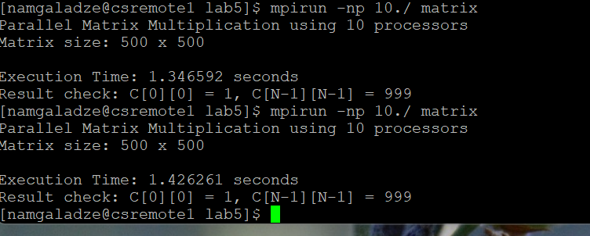
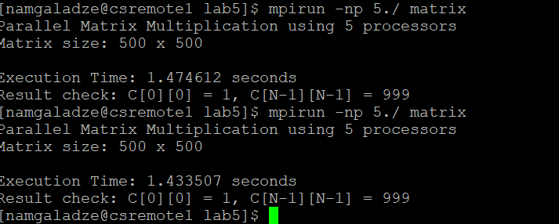

Slide 8
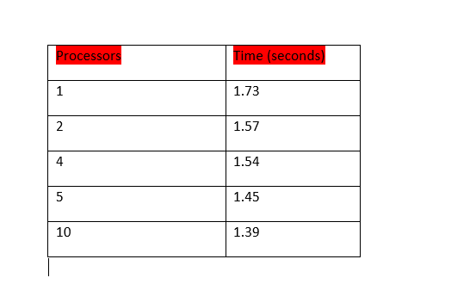
Performance Analysis
Execution Time decreases as processors increase
Speedup increases with more processors
Efficiency decreases due to overhead

Slide 9
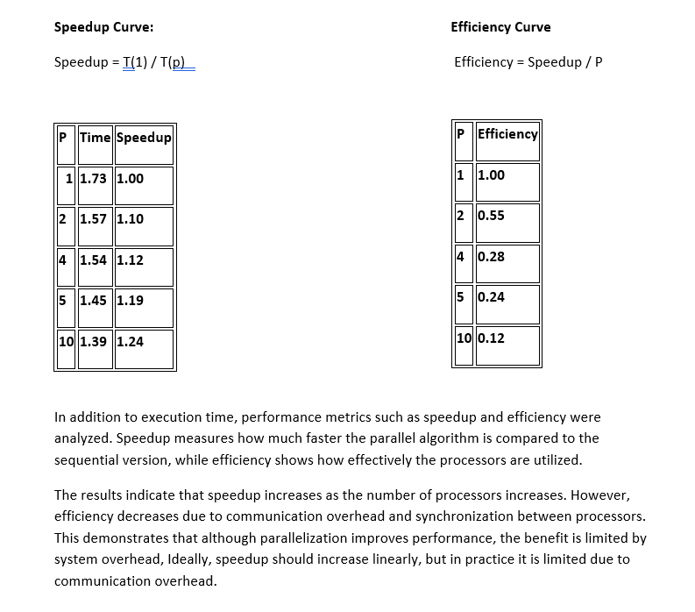

Slide 10

Conclusion
Parallel computation improves performance
Execution time decreases as processors increase
Speedup increases, efficiency decreases Limited by communication overhead

Slide 11


