Slide 1

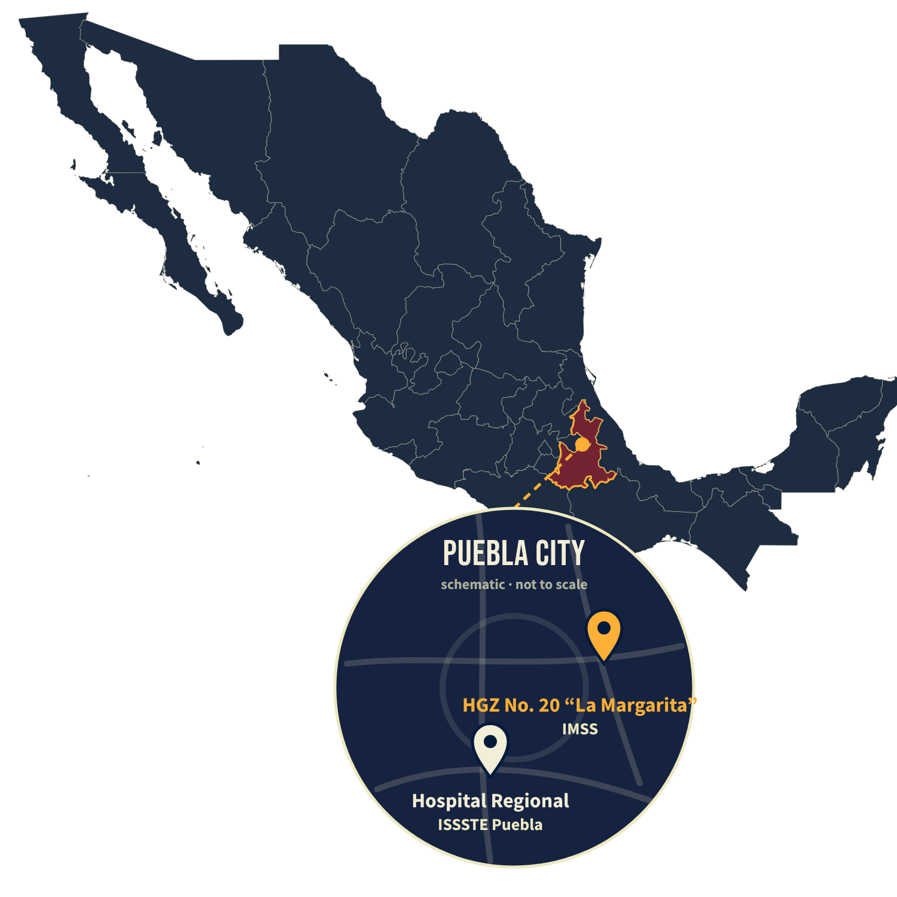








NEUMA · HUMAN PRACTICES
DIAGNOSIS CULTURE IN MEXICO (PUEBLA)
Interpretive paradigm · Qualitative approach
25
2
3
20
8
clinical
specialists
public
hospitals
focus
groups
voices
biosensor
experts
Hospitals IMSS HGZ No. 20 “La Margarita” · ISSSTE Puebla
Experts INAOE · UNAM · industry
CONTEXT
77.6%
of the population is publicly insured
Commonwealth Fund, 2026
82%
of NSCLC cases are diagnosed at a metastatic stage
Añorve Bailon et al., 2024
“Culture is an object of interpretation”
Our lens, after Geertz (1973)
Interview / focus
group photo
only with image consent
Interview / focus
group photo
only with image consent
Interview / focus
group photo
only with image consent
Human Practices · wiki
Map: svg-maps/mexico (CC BY 4.0), schematic inset
Notes:
Sources: Commonwealth Fund (2026), 77.6% of the population covered by public insurance; Añorve Bailon et al. (2024), ~82% of NSCLC in Mexico diagnosed at a metastatic stage; Geertz (1973), culture as 'webs of significance' analysed by an interpretive science in search of meaning.
Photos: replace the three placeholders only with people marked as consenting in the Notion table.
QR: https://2026.igem.wiki/puebla/human-practices

Slide 2




NEUMA · HUMAN PRACTICES
WHAT WE HEARD
Late diagnosis is systemic, not a lack of education
THE SYSTEMIC ICEBERG
THE PATIENT PATHWAY (PUBLIC INSURANCE)
LATE DIAGNOSIS
First-level care
Internal medicine
Pathology
Pulmonology & oncology
3 to 8 months
IN THEIR WORDS AND OURS
CULTURE MAP · SIMPLIFIED
Economic pressure
“Just a little cough”
The patient is the family’s provider
Cost
Motivation
Referral times
3 to 8 months to a diagnosis
No national lung cancer screening program
FAMILY
“It happens to smokers”
“Diagnosis” sounds like a “verdict”
Beliefs
Routines
First-level gaps
People act when someone they trust tells them to
Family pays · pushes · receives the result
Result delivery
Fear
Diagnosis culture: shared beliefs, expectations and routines
“I feel sick, but I’ll go tomorrow because I have to work; otherwise, what will my family eat?”
Jorge Jiménez Vargas · Nurse, HGZ No. 20
“A strategy as such? No… it is almost always a finding rather than an early detection.”
Dr. Gilberto Pérez Luna · Epidemiology, ISSSTE
“Now everyone is prone.”
Focus group 3 · working adults, Puebla
Notes:
Findings and quotes come from the NEUMA Human Practices interviews (HGZ No. 20 and ISSSTE Puebla) and the three focus groups. 3 to 8 months: Internal Medicine, ISSSTE (Dr. Ana Cabrera). No national screening program: Pulmonology HGZ No. 20 (Int. 17), Epidemiology ISSSTE. Named quotes are from stakeholders who allowed the use of their names. Quotes translated from Spanish.

Slide 3
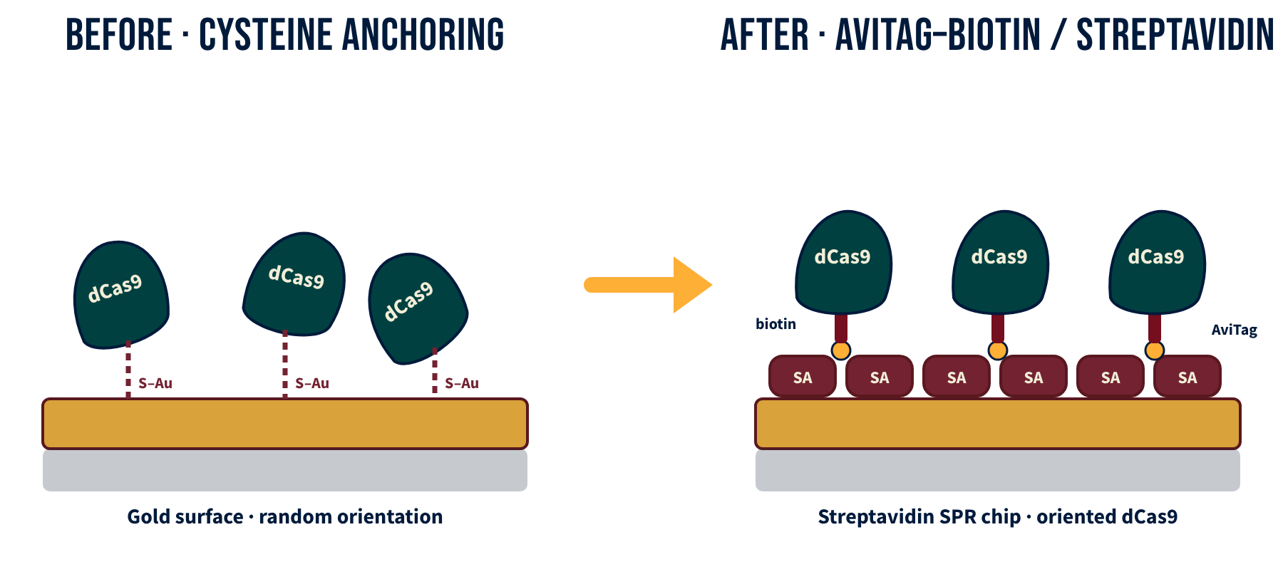
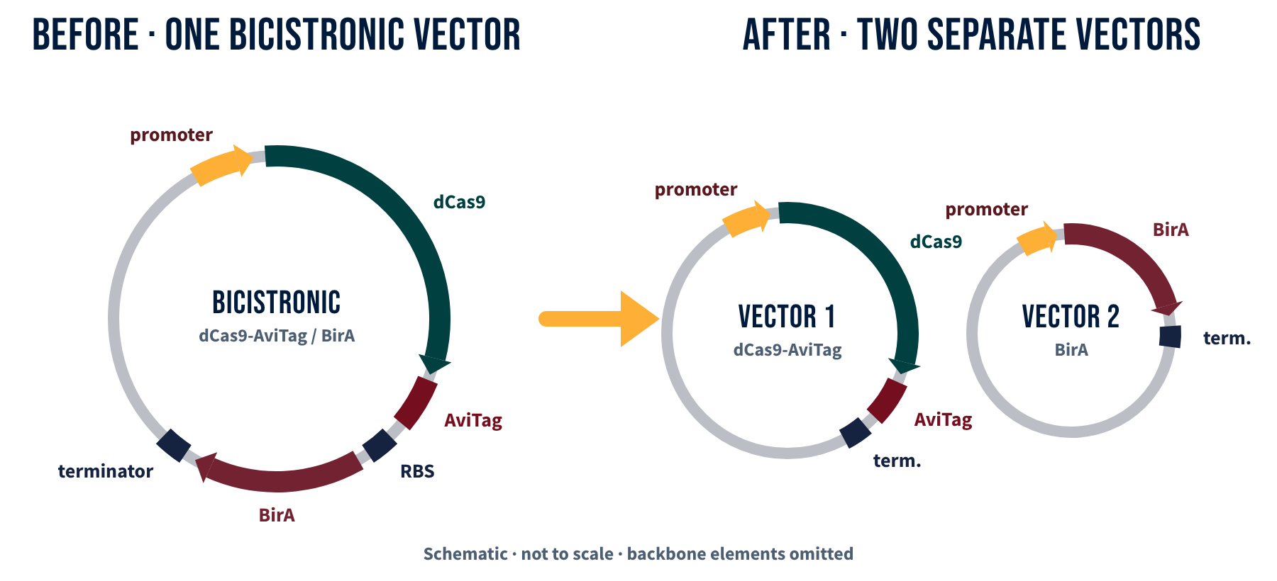
NEUMA · HUMAN PRACTICES
HP REACHED THE BENCH
Every requirement has a name
INAOE · JUNE–JULY 2026
UNAM · SEPTEMBER 2026
Immobilization redesigned
Cys–S–Au
Biotin–SA
Expression redesigned
1 vector
2 vectors
INAOE Cysteine anchoring on gold → AviTag-biotin and streptavidin · validated streptavidin SPR chips
UNAM Bicistronic dCas9-AviTag/BirA → two separate vectors · in vitro biotinylation
HP IN LAB · REQUIREMENT → TECHNIQUE → WHO RAISED IT
Requirement | Lab technique | Raised by
Reliable | Three controls · several gRNAs screened | Dr. Irma Cruz Solís (controls) · biosensor workshop experts (gRNAs)
Specific | dCas9 recognition checked per target | Biosensor workshop experts
Reproducible | Standardized expression and purification | Biosensor workshop experts · Dr. Armando Hernández García, UNAM
Affordable | Simpler, cheaper SPR chip | Workshop experts (6 of 8) · nursing and internal medicine, HGZ No. 20
Low burden | Single blood sample · ctDNA liquid biopsy | Dr. Gilberto Pérez Luna, ISSSTE · focus group 2
Notes:
INAOE (June–July 2026): immobilization moved from cysteine anchoring on gold to AviTag-biotin on streptavidin SPR chips. UNAM, Instituto de Química (21–25 September 2026): dCas9 did not express from the bicistronic dCas9-AviTag/BirA construct; Dr. Hernández García's lab advised two separate vectors and in vitro biotinylation (designed and checked in silico). Stakeholders per requirement are taken from the Human Practices record (workshop form, Dr. Cruz Solís interview, clinical interviews and focus groups).

