Slide 1
Re-analysis of Corral Lopez (2026)
Network inference intermediate results
Notes:
À faire: interpréter les résultats et voir s’ils sont cohérents avec la littérature + analyses précédentes dans d’autres articles (Science et les originaux d’où les datasets proviennent)

Slide 2
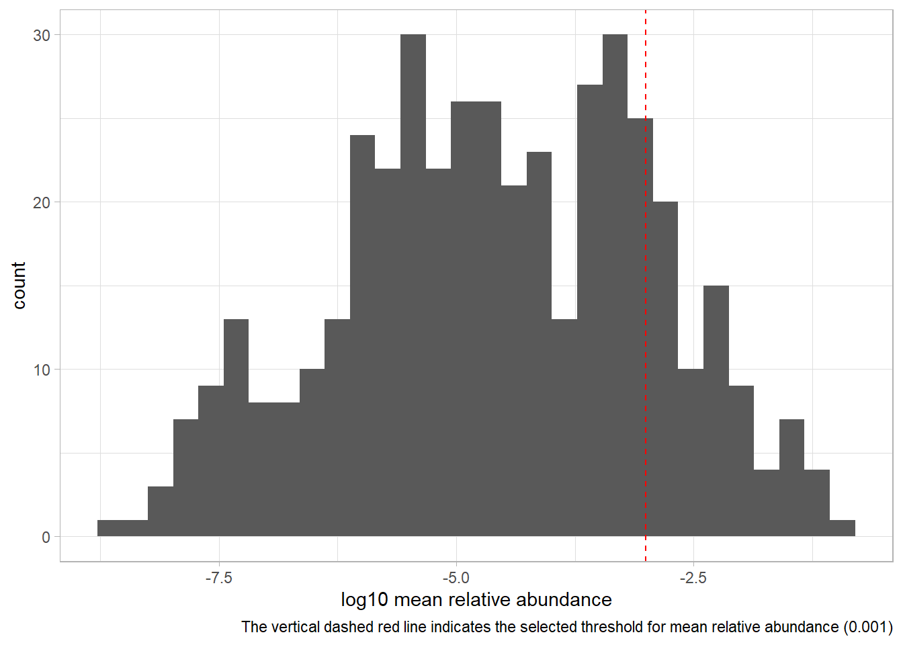
IBD network inference with FlashWeave
Network construction with all taxa
This dataset was not rarefied since we do not have raw counts (and thus library size) to do so.
Number of samples and taxa: 432 features x 1630 samples
For control samples: 428 samples
For diseased samples: 1202 samples
Prevalence filtering (5%):
Number of bootstrap iterations: 100
Subsampling percentages: 60% - 70% - 80%
Network construction with top taxa
Abundance filtering (top 1%):
For control samples: 74 features
For diseased samples: 80 features
Number of bootstrap iterations: 100
Subsampling percentages: 60% - 70% - 80%

Slide 3
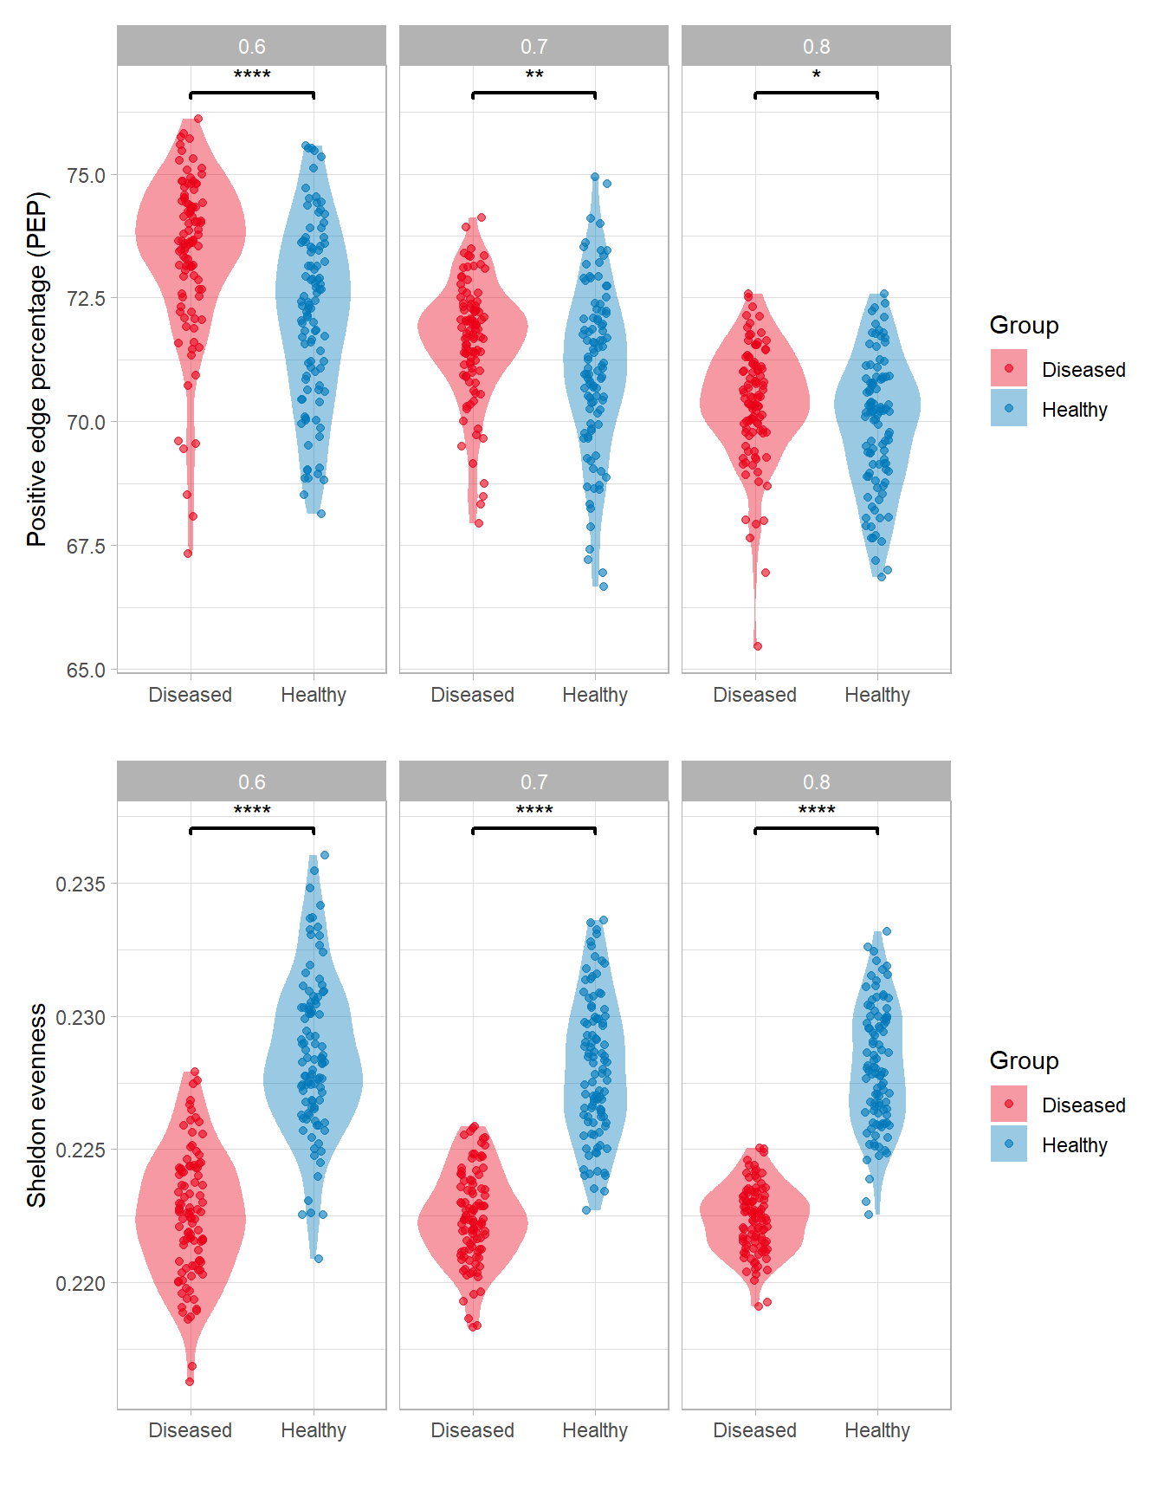
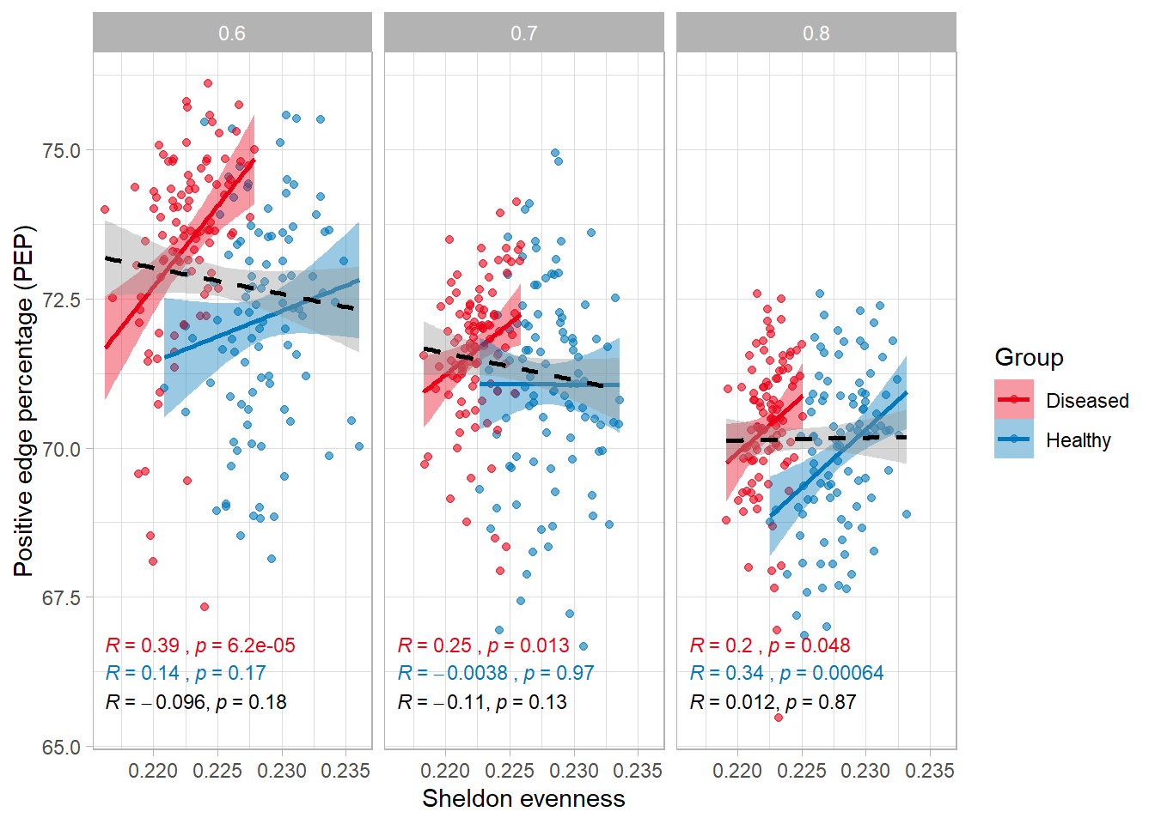
IBD network inference with FlashWeave
A small significant difference in PEP for 80% subsampling, with PEP constantly higher for D group.
By group, there is a significant positive correlation between PEP and Sheldon evenness, but no significant correlation between groups.
In healthy cohorts (at least for the gut microbiota), we expect higher evenness, so the results make sense.

Slide 4
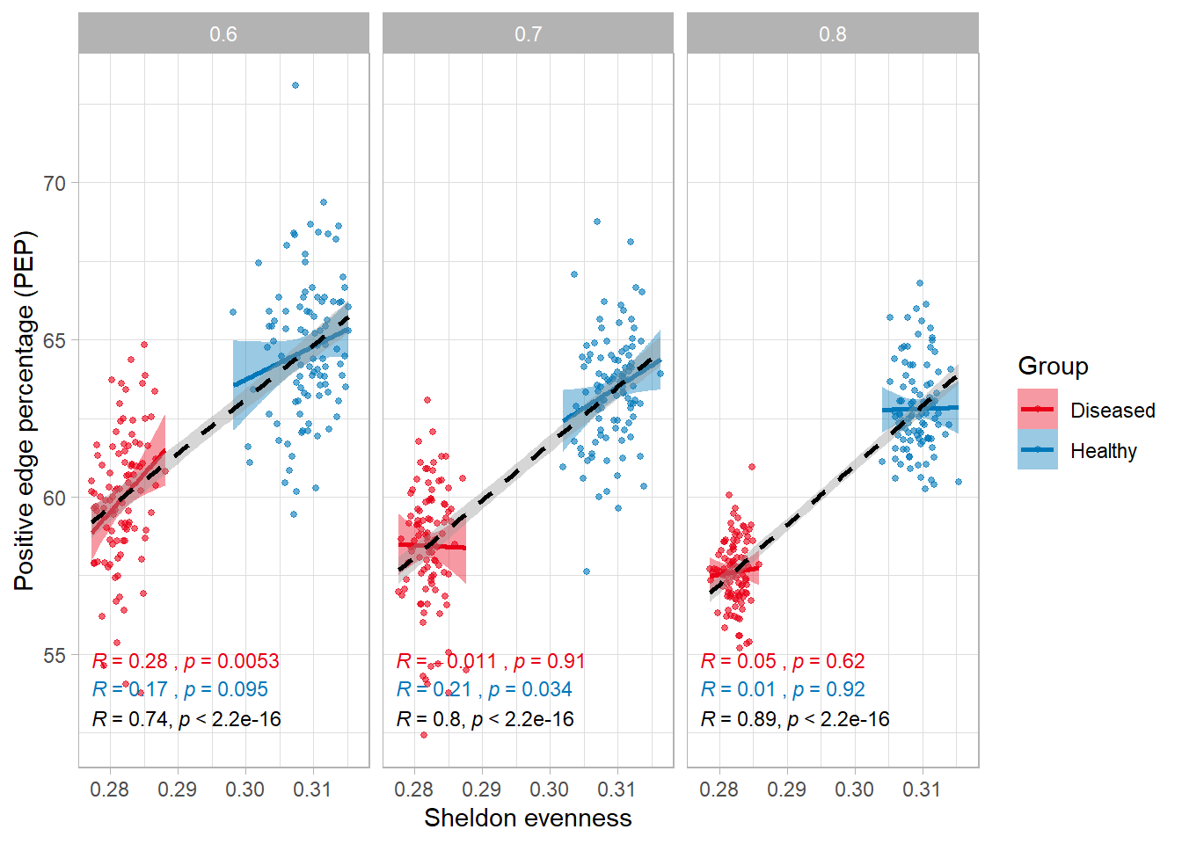
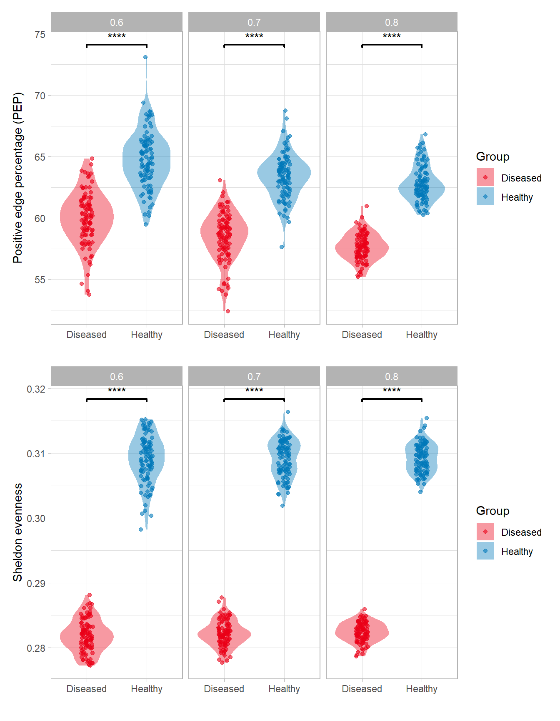
IBD network inference with FlashWeave (for top taxa)
Trend in PEP is inverted when taking top taxa, suggesting that positive interactions occur between rare taxa (is it corroborated in literature, I am not sure)
This time, correlation between groups is statistically significant, but positive (and not negative as we expected),
Also, correlation intra-group between PEP and evenness is not significant anymore.
Difference in evenness is exacerbated when considering top taxa.
Notes:
Hypothesis: Changes in PEP are due to negative interactions that occur between rarer taxa, lost in uneven data.
My guess is that rare taxa have negative interactions with dominant species, and positive interactions between themselves (with cross-feeding, for example).
This would reinforce their findings, since if we had enough sequencing depth, we might have been able to spot more rare taxa and thus the PEP for diseased would have been higher.
TODO: Find another IBD dataset and run the network again.

Slide 5
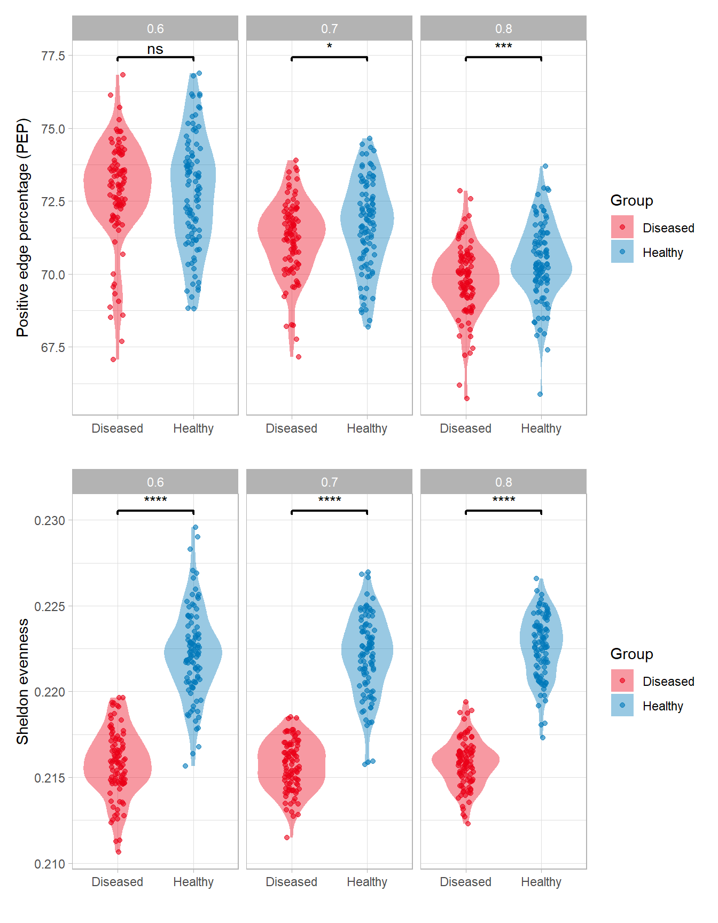
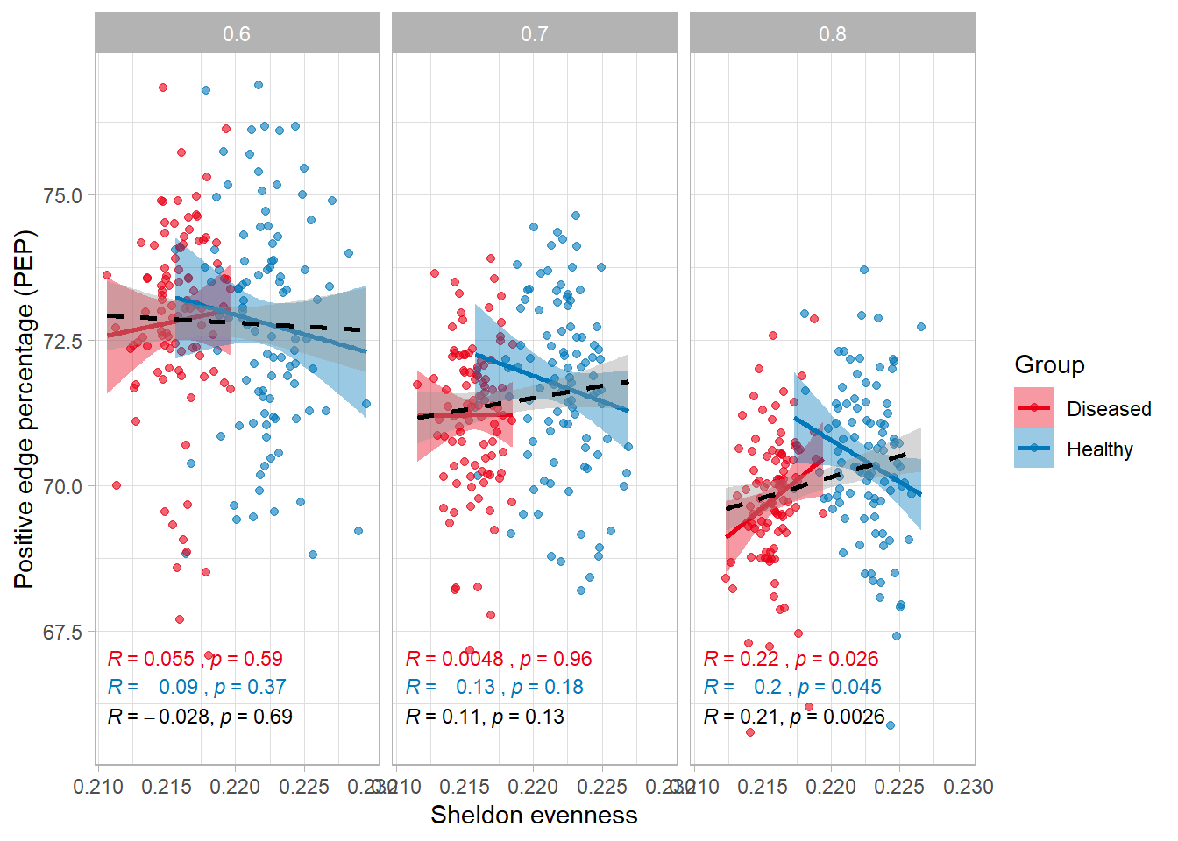
IBD network inference with FlashWeave – prevalence inside loop
Higher PEP for healthy, but not constantly significant across subsampling
No significant correlations between intra-groups and inter-groups
In healthy cohorts (at least for the gut microbiota), we expect higher evenness, so the results make sense.

Slide 6
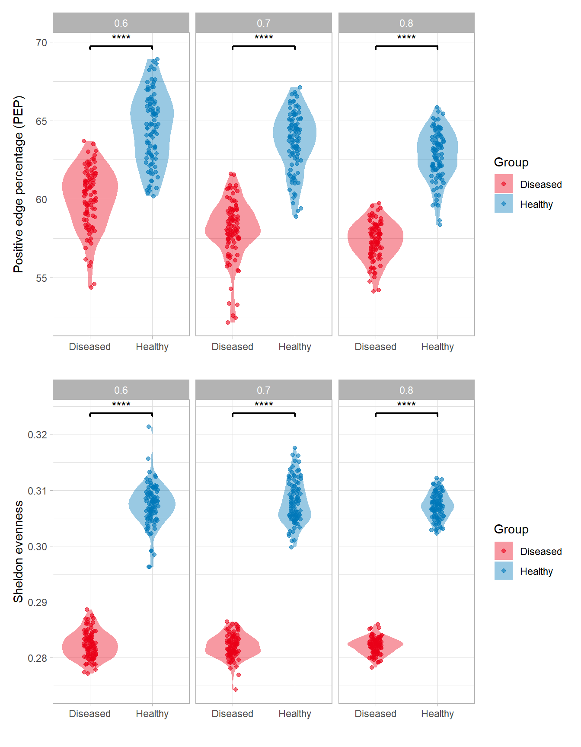
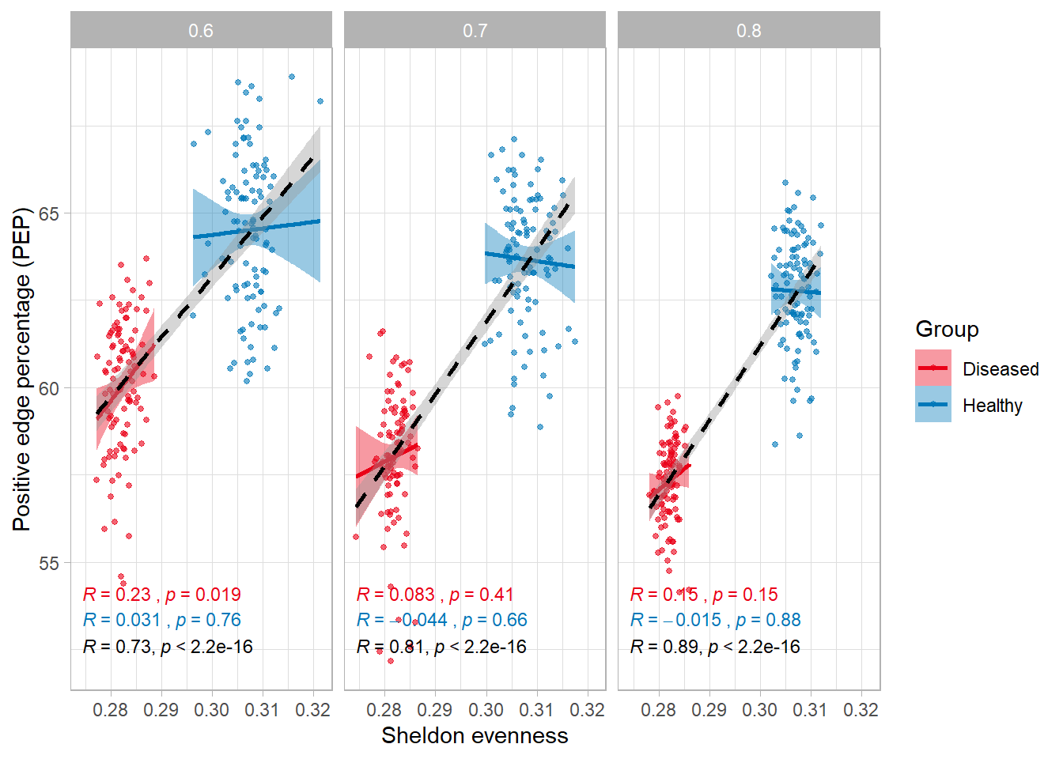
IBD network inference with FlashWeave (for top taxa) – prevalence inside loop
PEP is lower for D when taking top taxa, which is consistent with the first analysis.
This time, correlation between groups is statistically significant, but positive (and not negative as we expected),
Also, correlation intra-group between PEP and evenness is not significant anymore.
Difference in evenness is exacerbated when considering top taxa.
Notes:
Hypothesis: Changes in PEP are due to negative interactions that occur between rarer taxa, lost in uneven data.
My guess is that rare taxa have negative interactions with dominant species, and positive interactions between themselves (with cross-feeding, for example).
This would reinforce their findings, since if we had enough sequencing depth, we might have been able to spot more rare taxa and thus the PEP for diseased would have been higher.
TODO: Find another IBD dataset and run the network again.

Slide 7
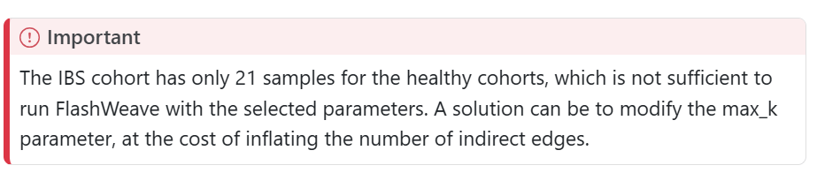
IBS network inference with FlashWeave
Network construction with all taxa
Number of samples and taxa before rarefaction:
For control samples: 598 features and 21 samples
For diseased samples: 598 features and 41 samples
Prevalence filtering (5%)
Number of bootstrap iterations: 100
Subsampling percentages: 60% - 70% - 80%
They managed to get results for IBS, though…
But…

Slide 8
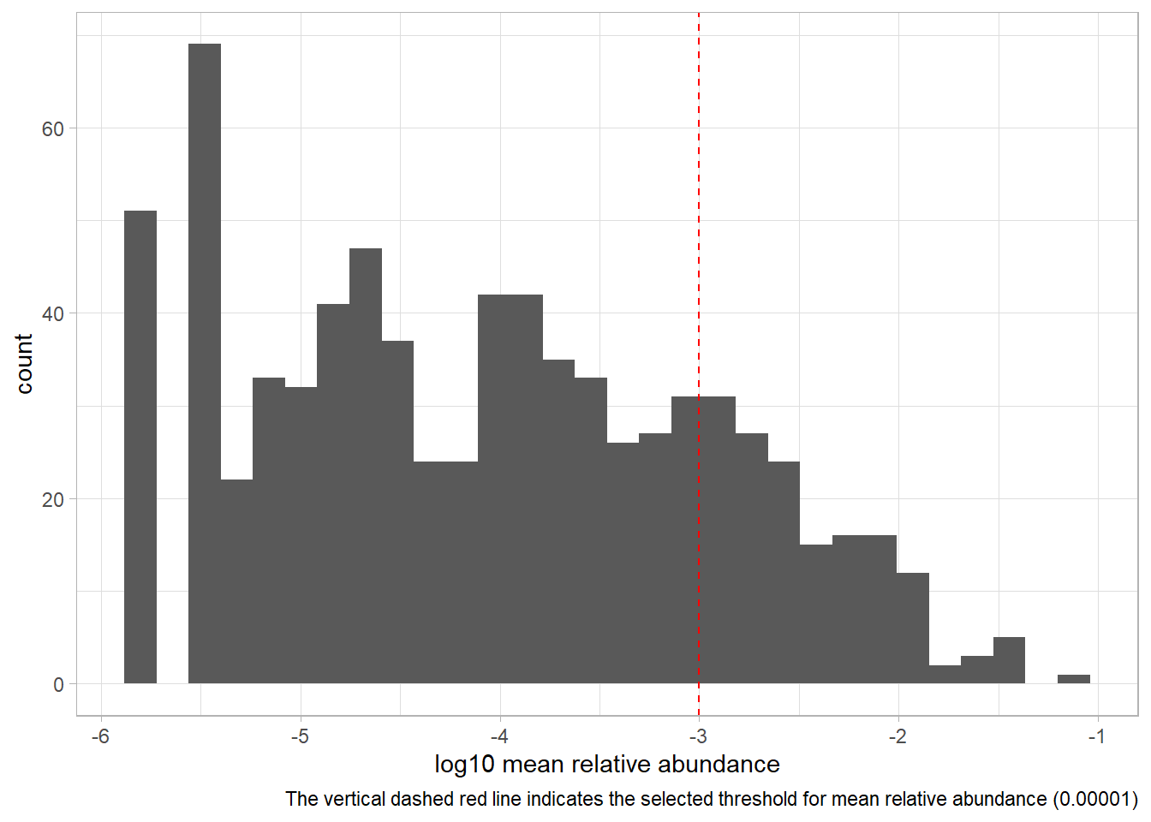
CDI network inference with FlashWeave
Network construction with all taxa
Number of samples and taxa after rarefaction:
For control samples: 868 features and 132 samples
For diseased samples: 868 features and 234 samples
Prevalence filtering (5%)
Number of bootstrap iterations: 100
Subsampling percentages: 60% - 70% - 80%
Network construction with top taxa
Abundance filtering (top 1%):
Number of bootstrap iterations: 100
Subsampling percentages: 60% - 70% - 80%

Slide 9
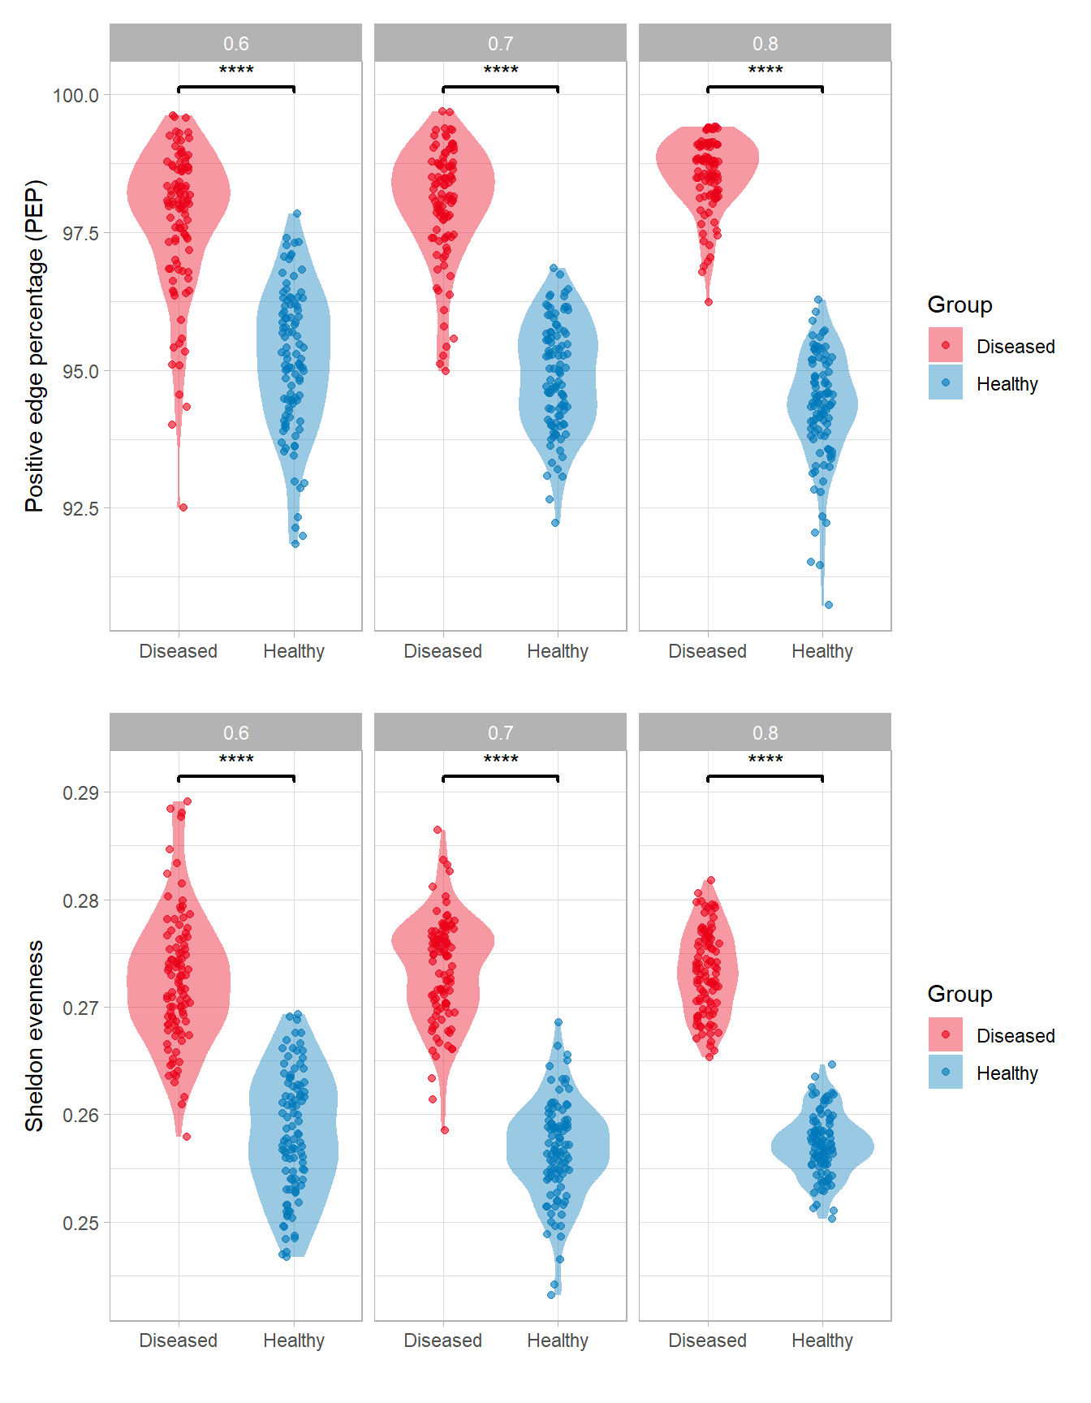
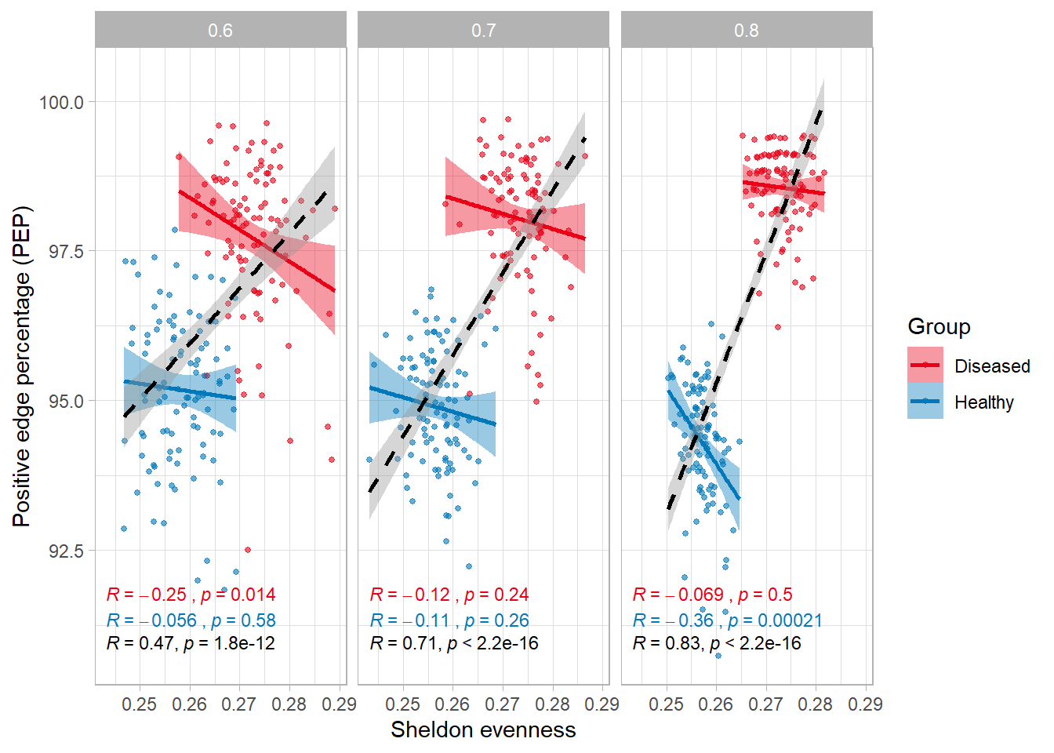
CDI network inference with FlashWeave
In here, PEP is higher for D, consistent with the Science paper
Significant positive correlation between groups
We see a higher evenness for CDI samples, why?

Slide 10
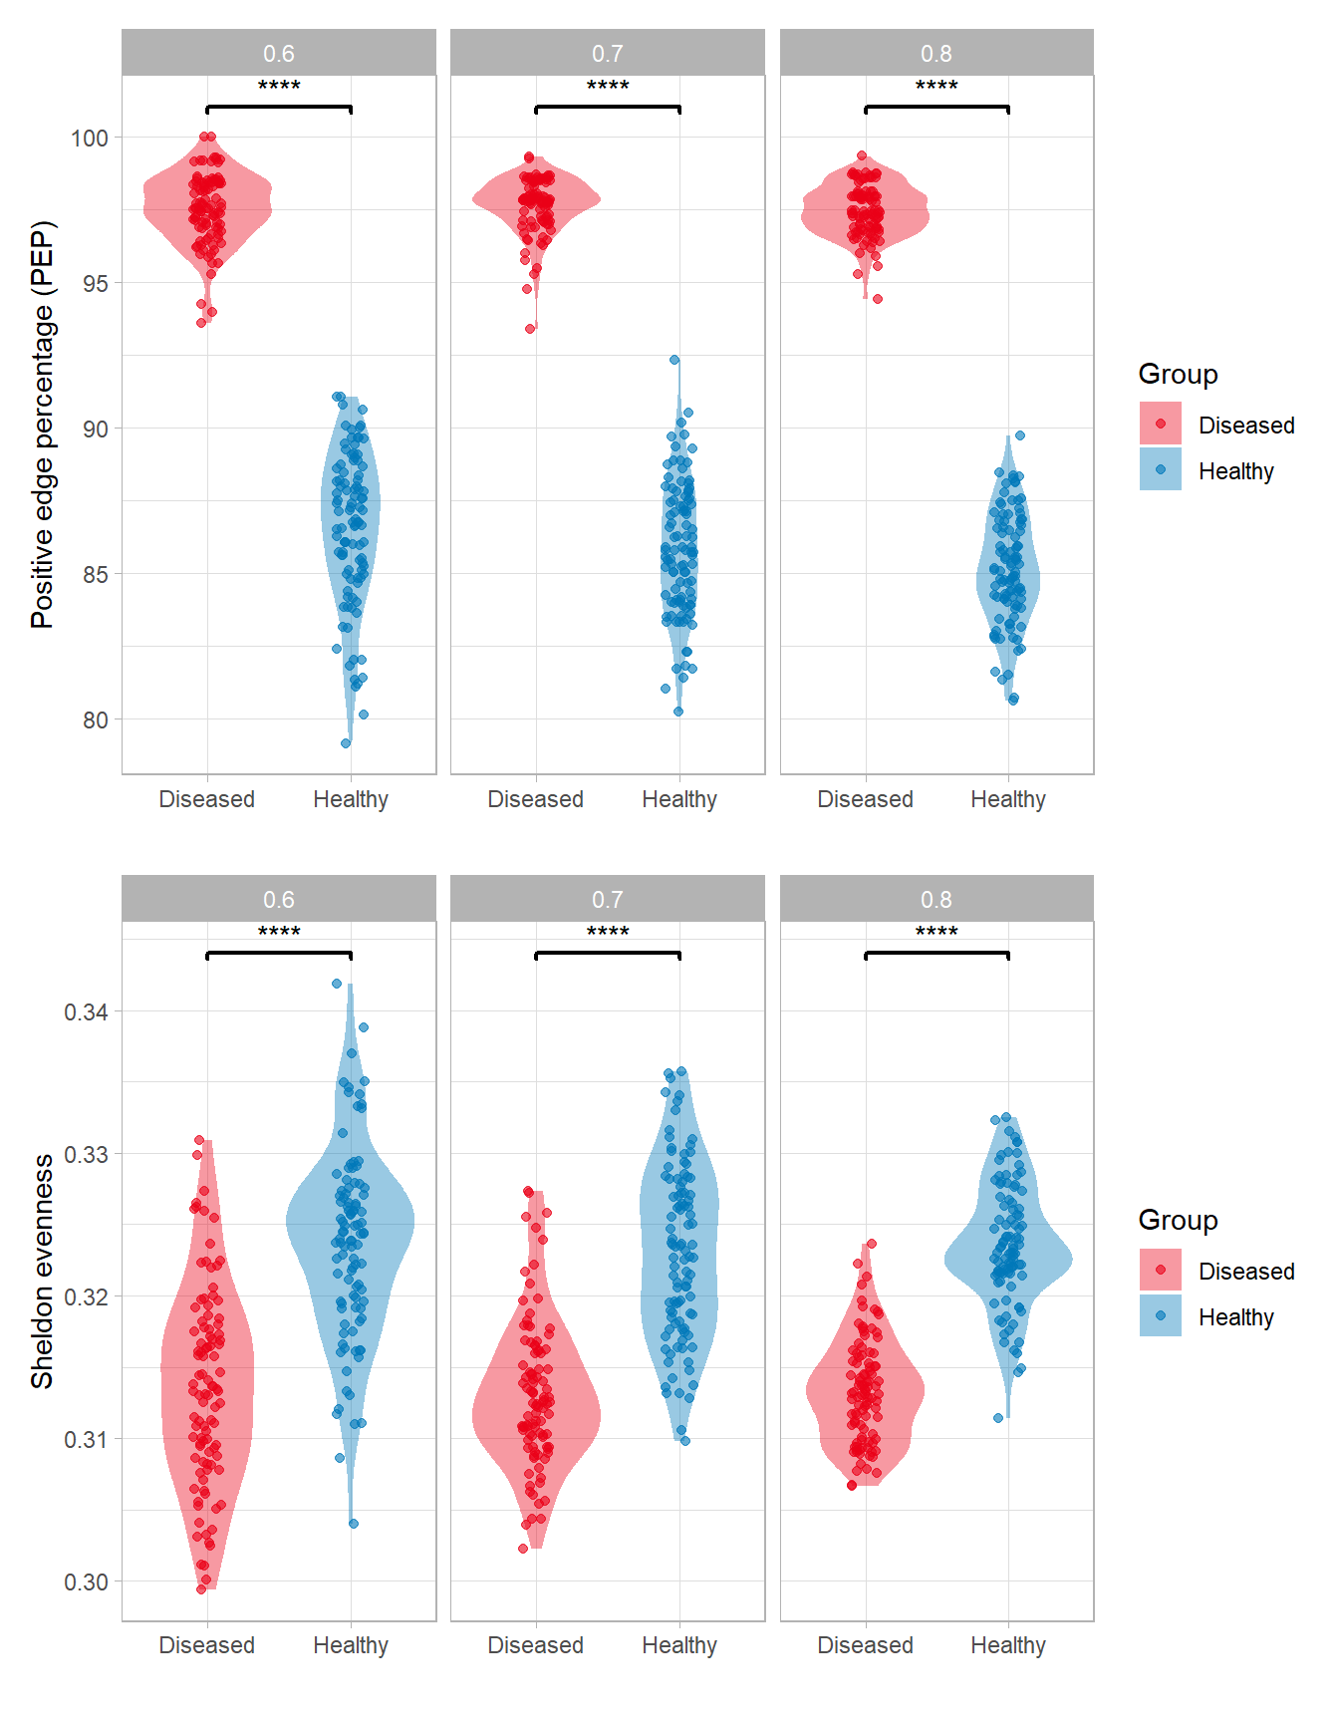
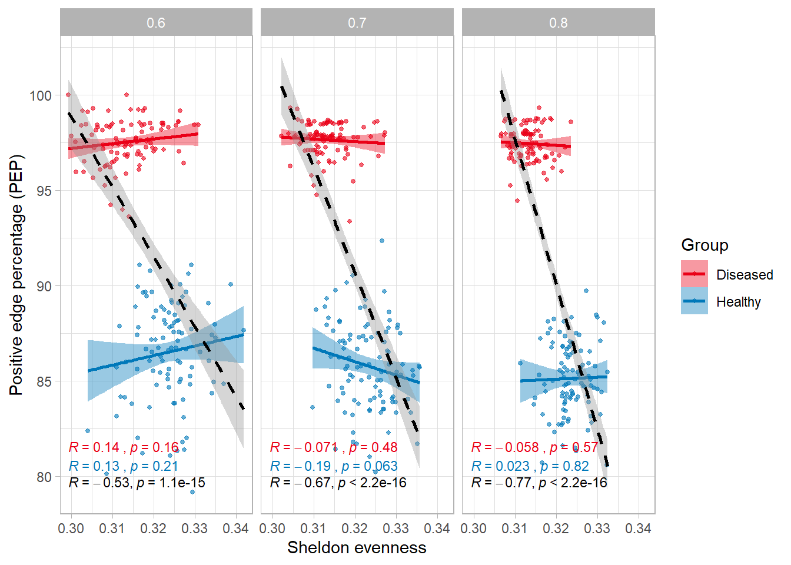
CDI network inference with FlashWeave (top taxa)
PEP is higher when considering top taxa, consistent with our hypothesis
Negative and significant correlation between groups
Now, evenness is lower for D when taking top taxa; does that make sense?

Slide 11
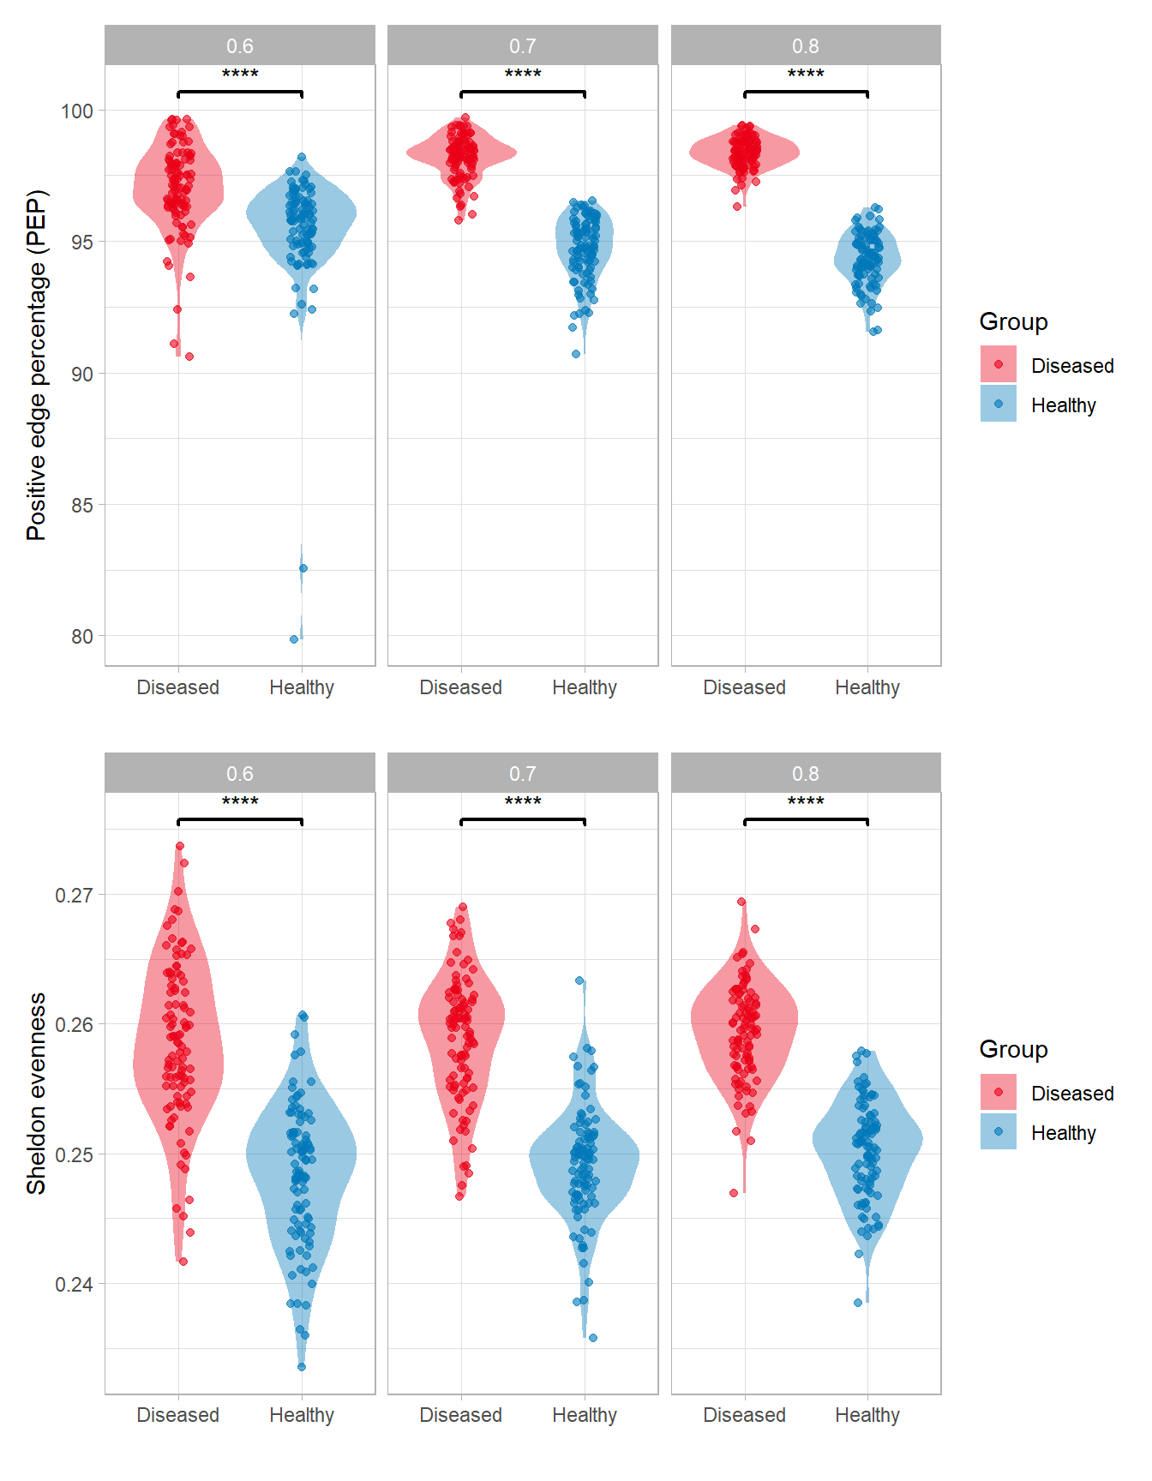
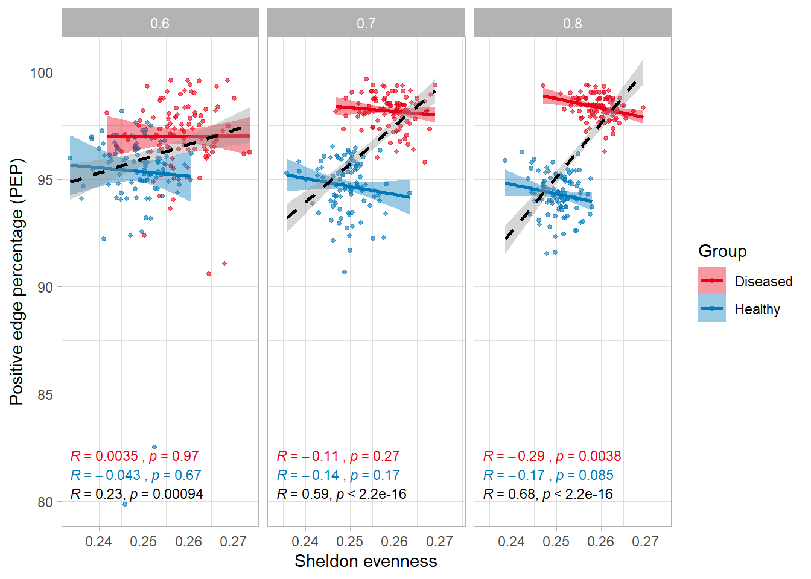
CDI network inference with FlashWeave – prevalence inside loop
PEP is still higher for D group.
We also have a significant positive correlation between groups
Sheldon evenness still consistent with the previous analysis

Slide 12
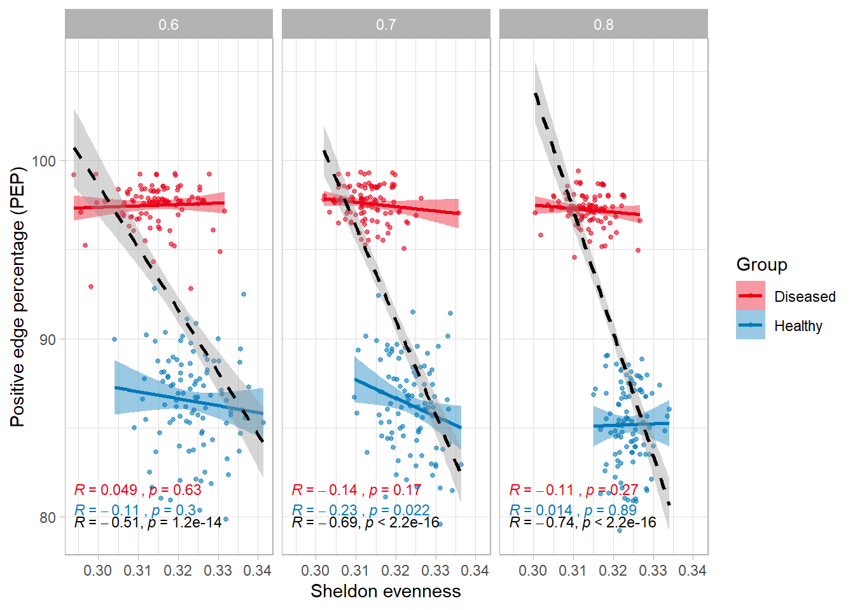
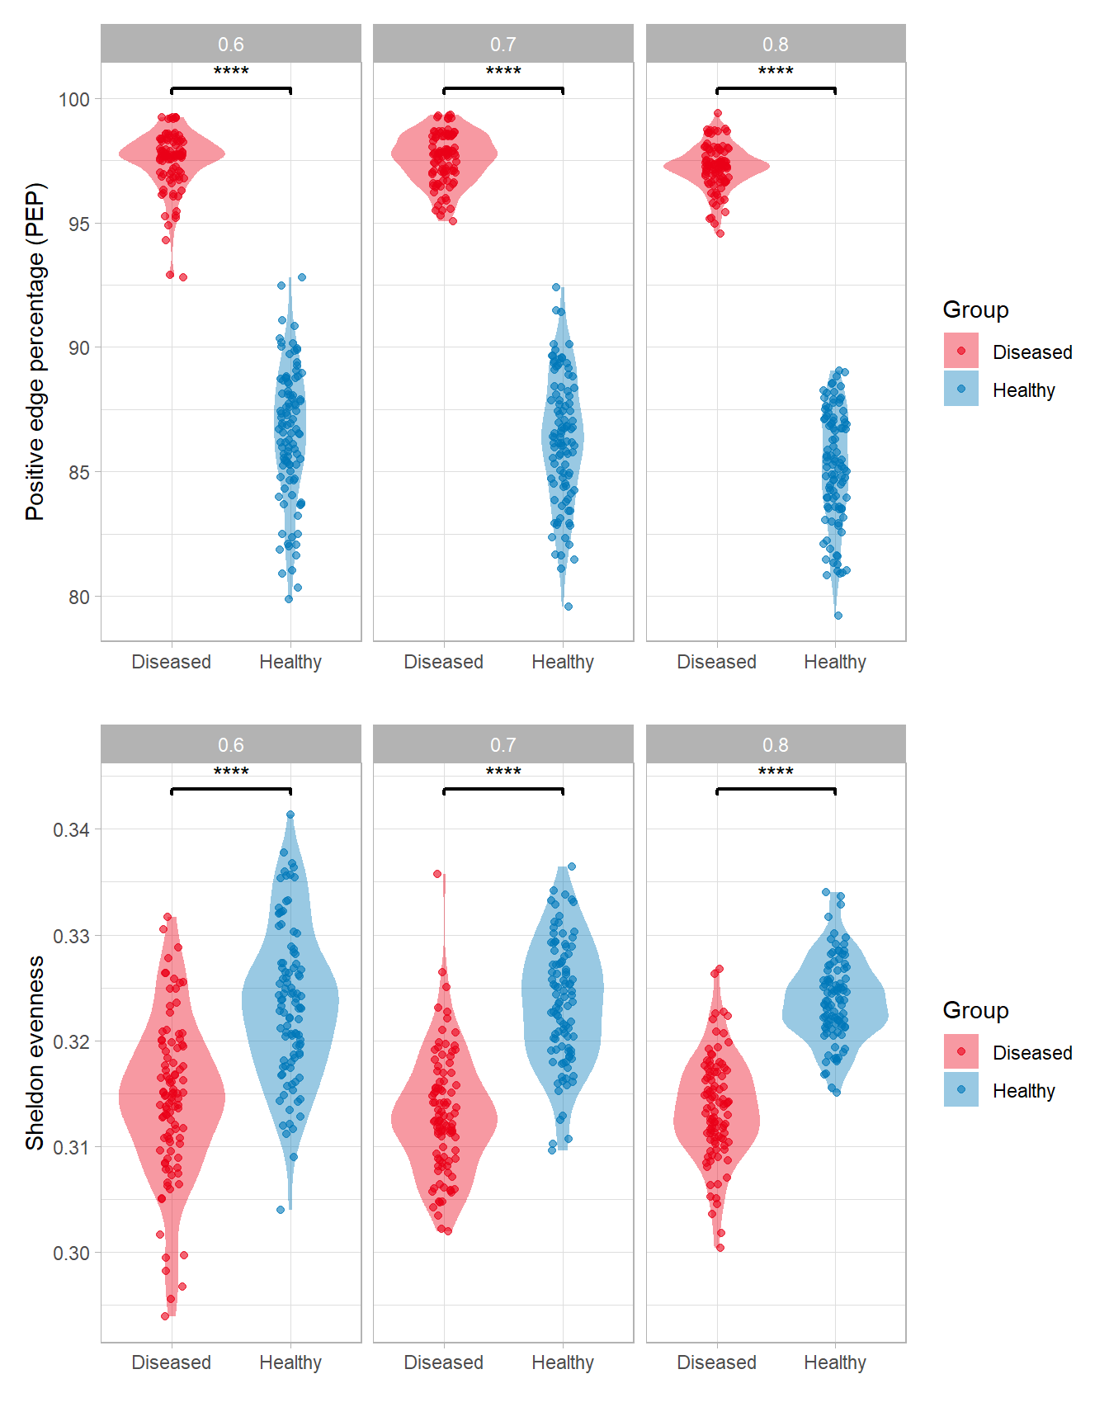
CDI network inference with FlashWeave (top taxa) – prevalence inside loop
PEP is still higher for D group.
Negative and significant correlation between groups
Sheldon evenness still consistent with the previous analysis

Slide 13
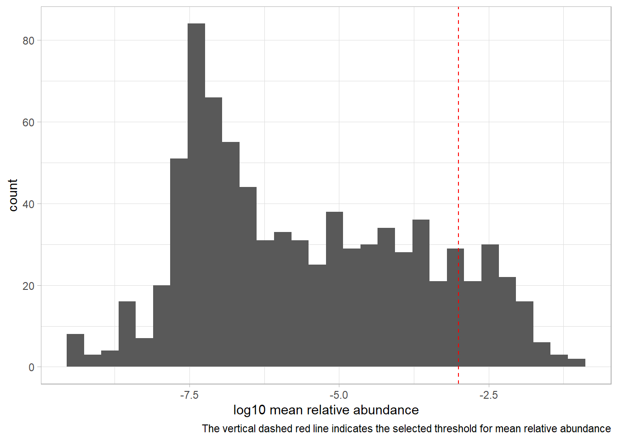
CRC network inference with FlashWeave
This dataset was not rarefied since we do not have raw counts (and thus library size) to do so.
Network construction with all taxa
Number of samples and taxa:
For control samples: 837 taxa and 251 samples
For diseased samples: 837 taxa and 324 samples
Prevalence filtering (5%):
Number of bootstrap iterations: 100
Subsampling percentages: 60% - 70% - 80%
Network construction with top taxa
Abundance filtering (top 1%):
Number of bootstrap iterations: 100
Subsampling percentages: 60% - 70% - 80%

Slide 14
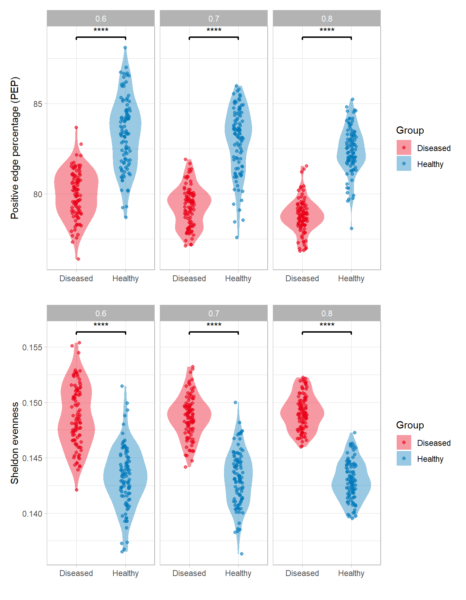
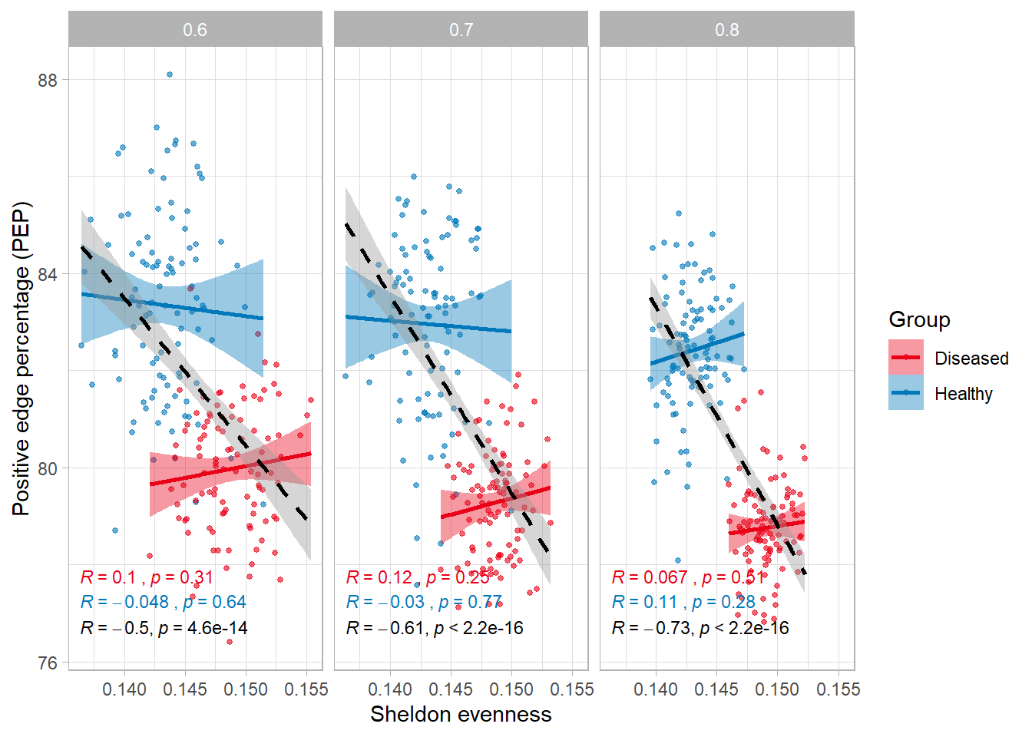
CRC network inference with FlashWeave
PEP is lower in D, as in IBD dataset
Negative significant correlation between groups, but with PEP from healthy higher and evenness lower (does it make sense?)
Evenness is higher in D

Slide 15
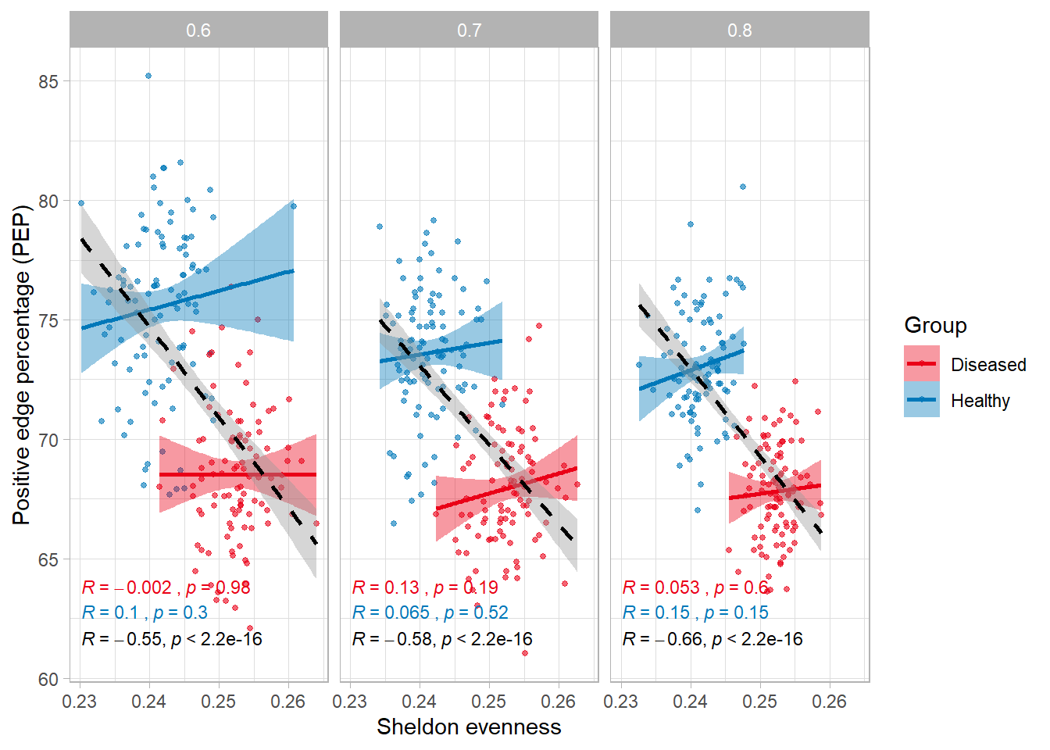
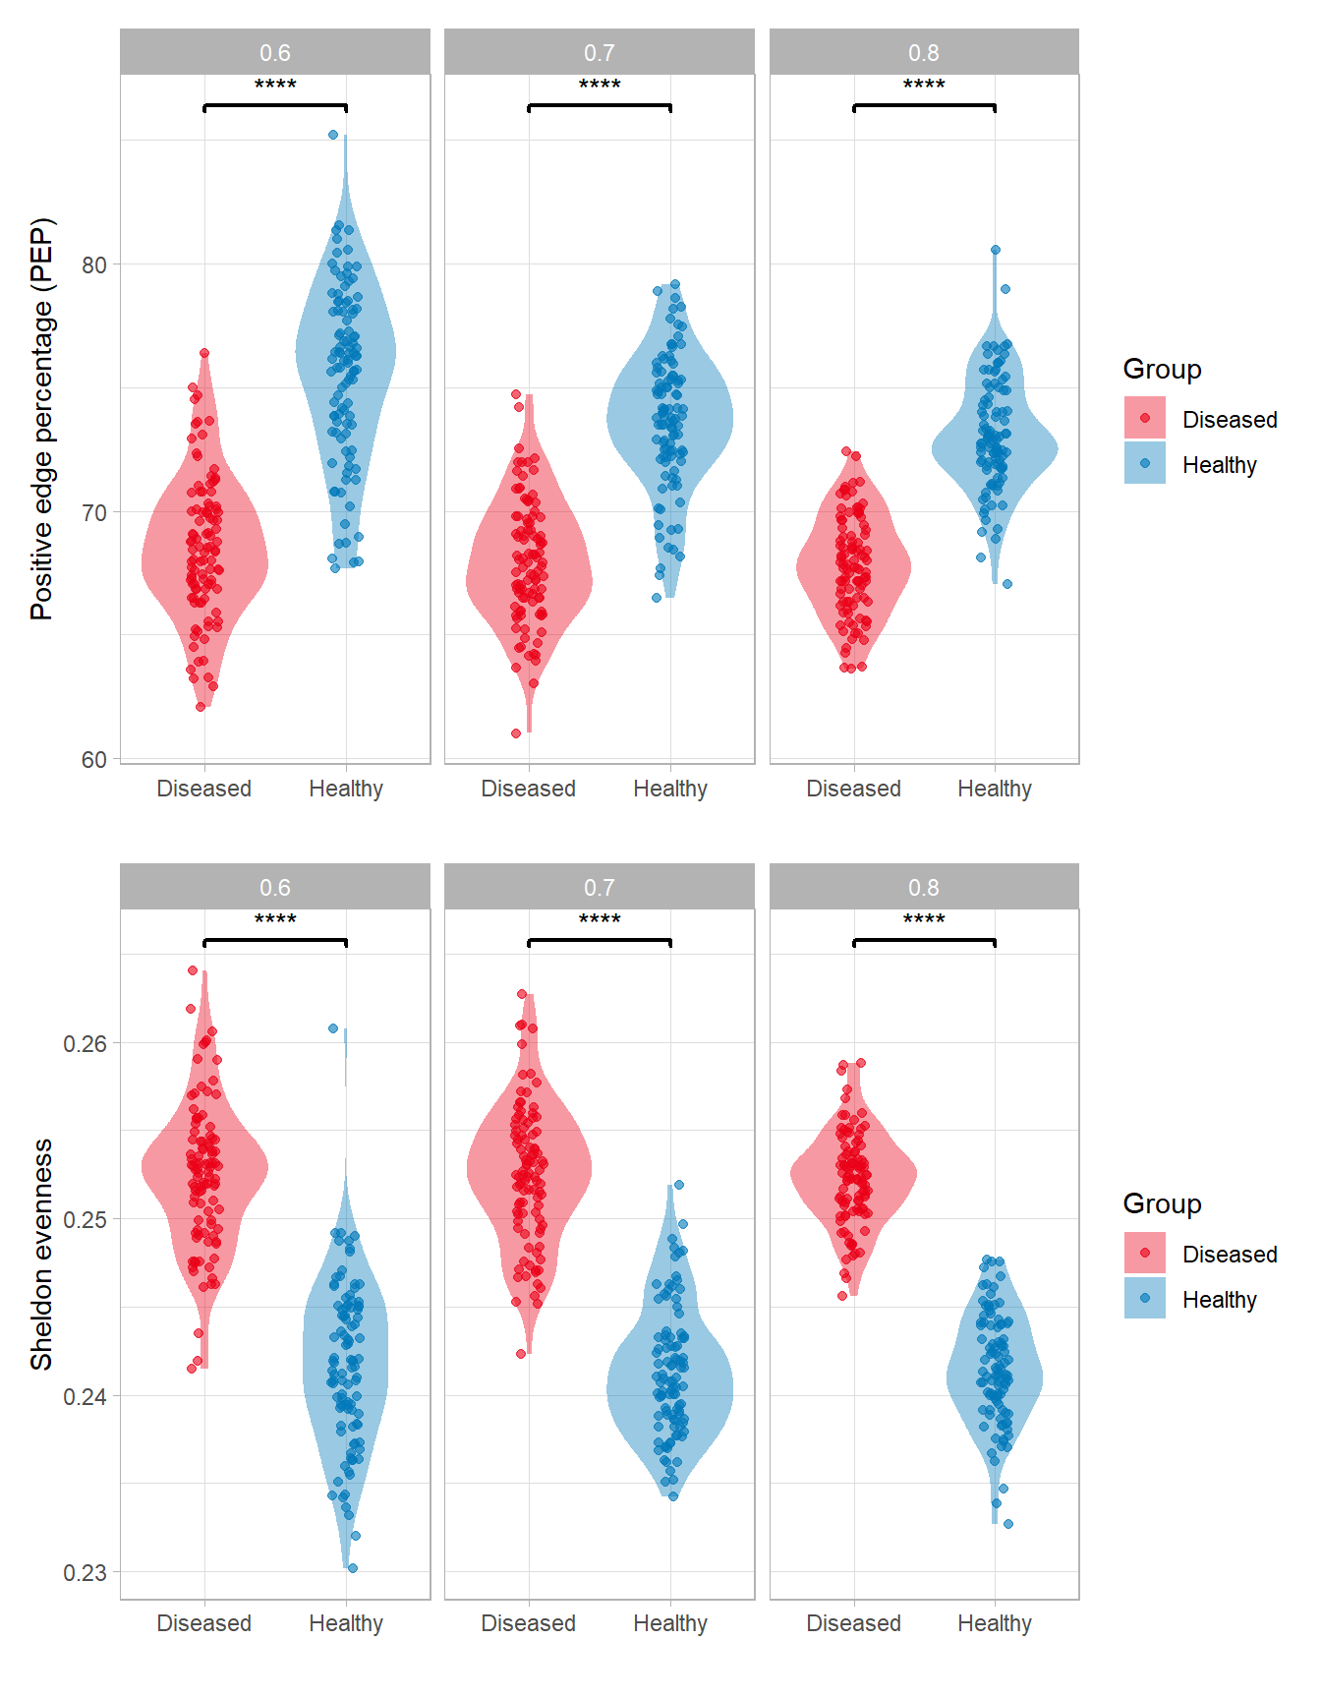
CRC network inference with FlashWeave (top taxa)
PEP is still lower in D, but lower compared to CRC with all taxa
Same trend when taking top taxa
Evenness is still higher in D

Slide 16
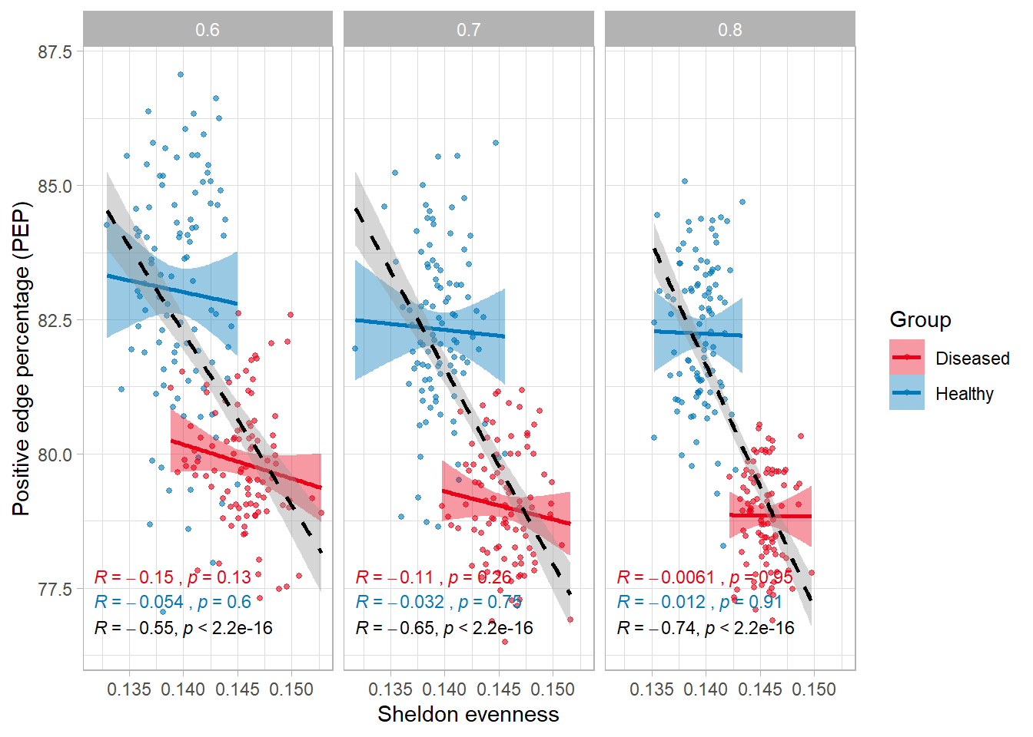
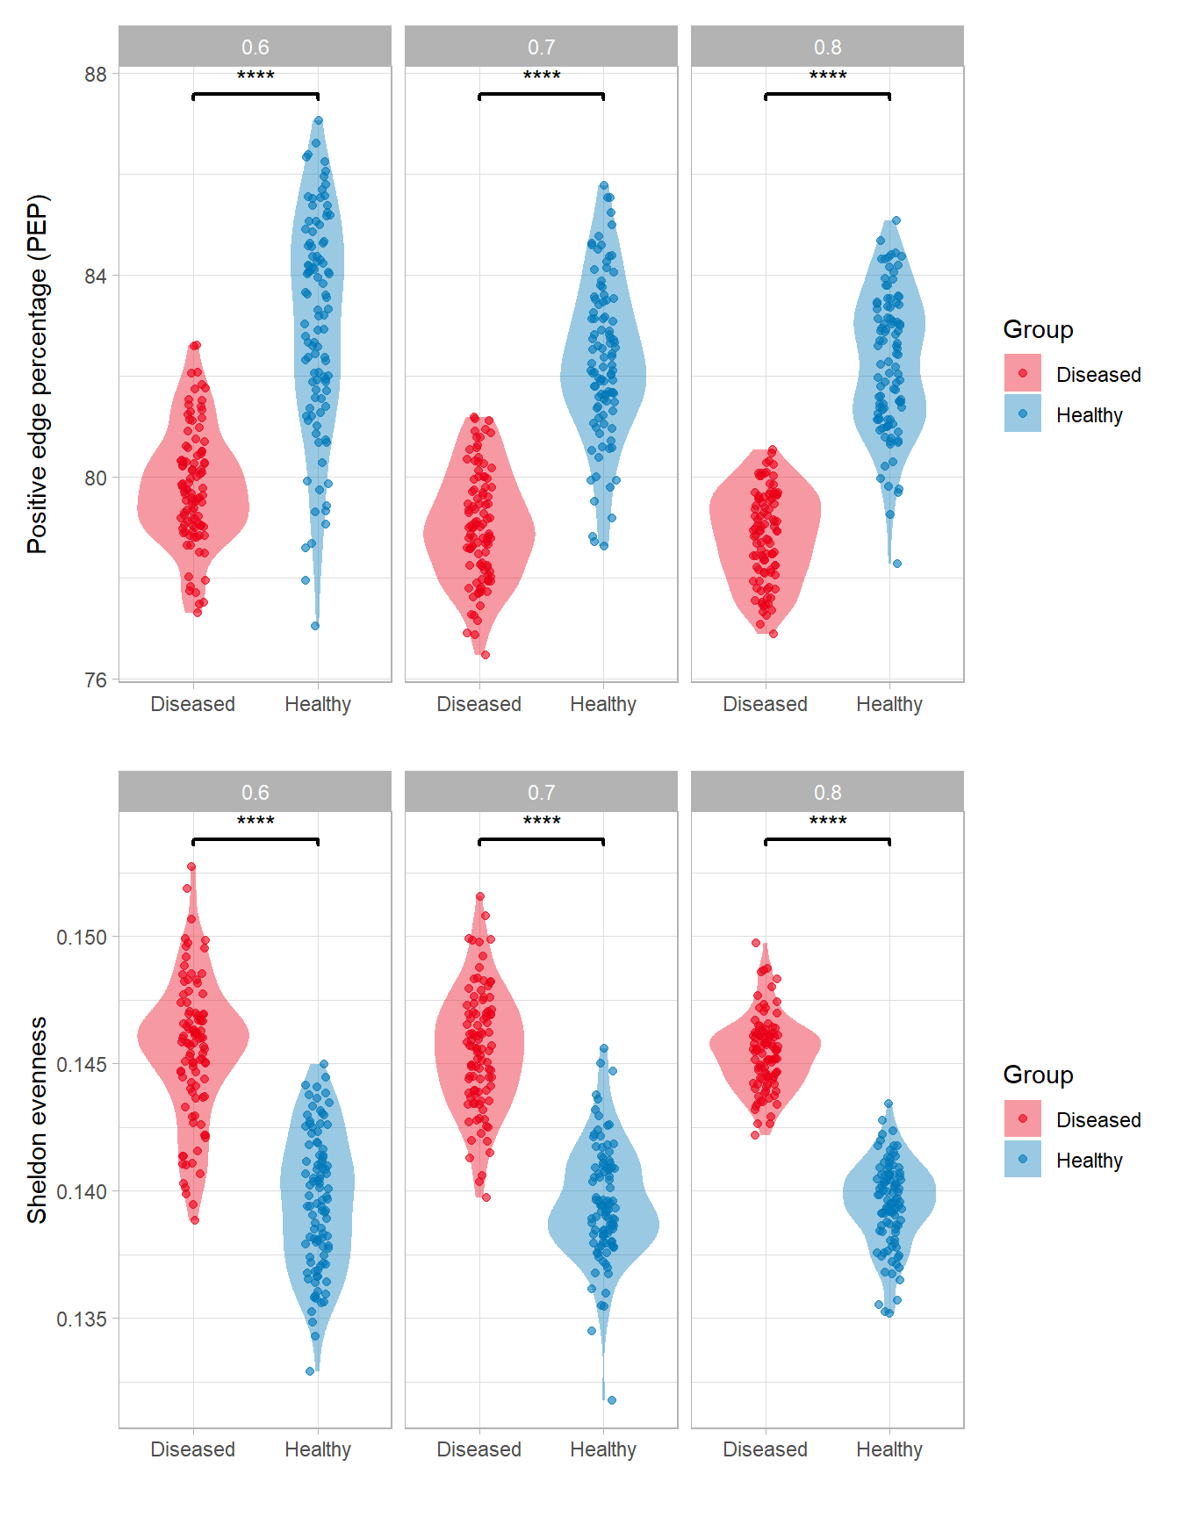
CRC network inference with FlashWeave – prevalence inside loop
Same trend as without prevalence inside the loop

Slide 17
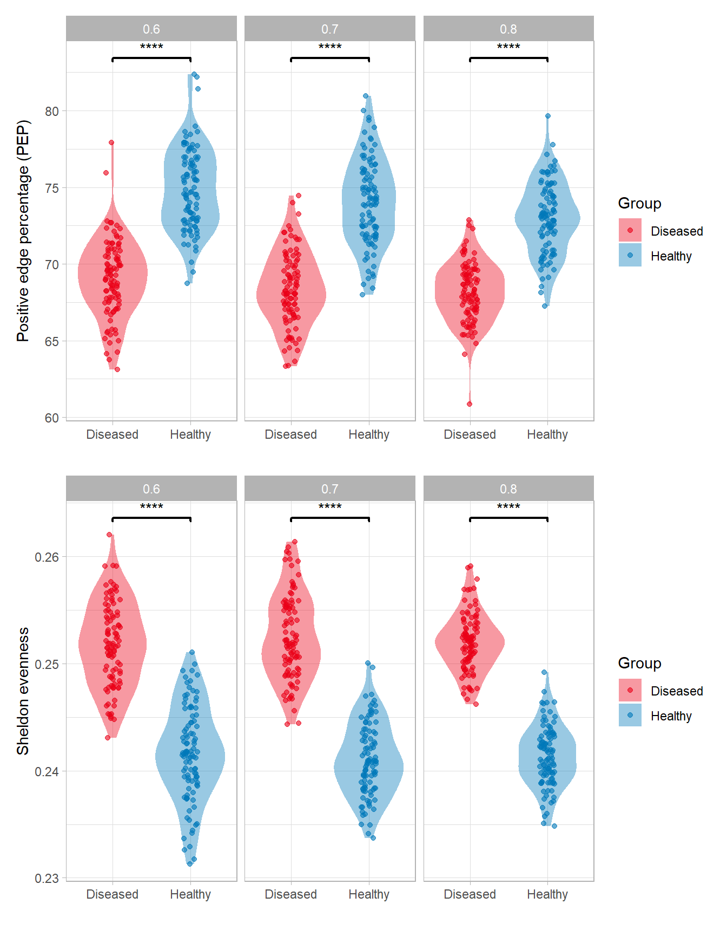
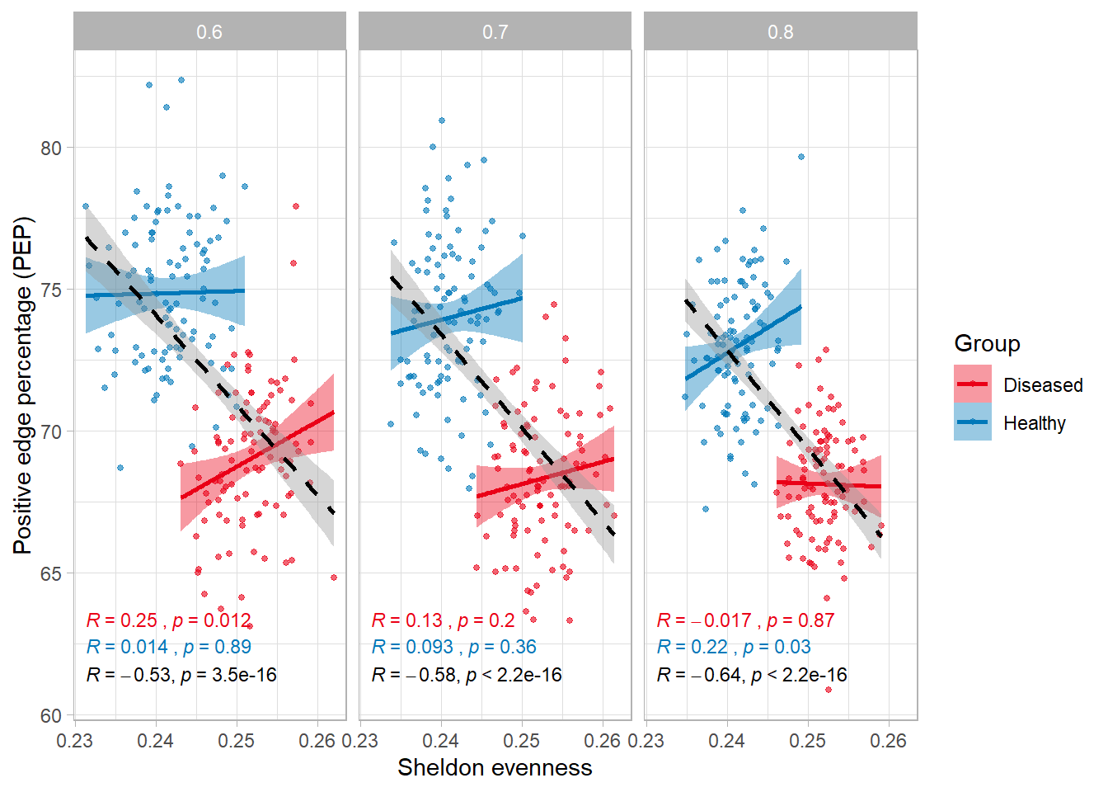
CRC network inference with FlashWeave (top taxa) – prevalence inside loop
Same trend as without prevalence inside the loop

Slide 18
Supplementary notes and questions
They did not mention the parameters they used for FlashWeave, nor the preprocessing steps before using FlashWeave (prevalence, abundance filtering)
For the two other tools, it is mentioned, but for BEEM only a general function exists, for which they did prevalence filtering of 30% and abundance filtering of 1% for all datasets.
For healthy cohorts, I did not find preprocessed datasets for Harfvarson (2019, Nature), only metadata in Supplementary Material

