Slide 1

Selected2_project_prasention
كيرلس اسعد شملول فكري
202000678
مريم وجيه عجيب سمعان
202000887
ساره مرجان مسعود
202000374
بيشوي عصام فاروق
202000218
مصطفي محمد مصطفي محمد السيد الشناوي
202000917
معاذ سلامة سعودي
201900837

Slide 2
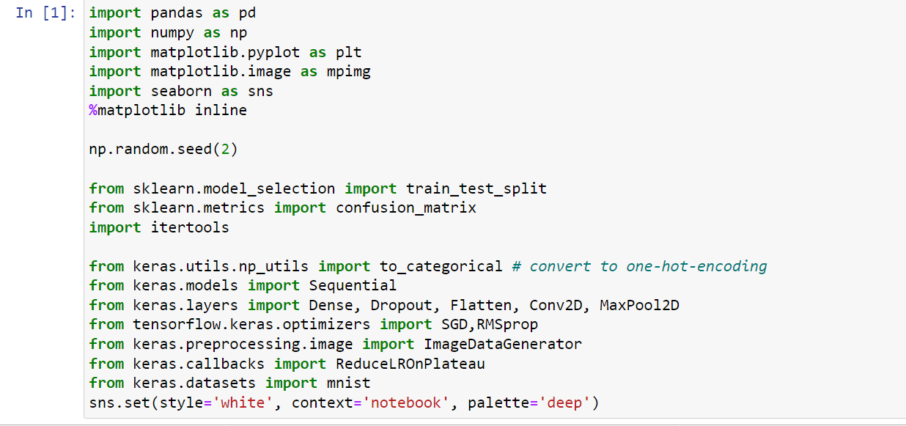
1-Import libraries
Numpy: is a very popular python library for large multi-dimensional array and matrix processing, with the help of a large collection of high-level mathematical functions,random_no.
Scikit-learn:one of the most popular ML libraries for classical ML algorithms.
Ex:model.fit
TensorFlow:It can train and run deep neural networks that can be used to develop several AI applications. TensorFlow is widely used in the field of deep learning research and application. is a very popular open-source library for high performance numerical computation developed by the Google Brain team in Google
Keras: provides many inbuilt methods for groping, combining and filtering data.Keras is a very popular Machine Learning library for Python. One of the best thing about Keras is that it allows for easy and fast prototyping.
Pandas:is a popular Python library for data analysis Ex:read_dataset
Matplotlib:a very popular Python library for data visualization
Seaborn:is a library that uses Matplotlib underneath to plot graphs. It will be used to visualize random distributions.

Slide 3
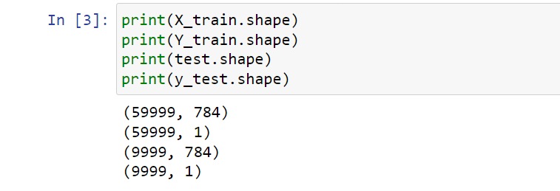
2-Read_dataset
X:Input_data(actual||predict)
Y:output_data(actual||predict)
3-print shape of row&col
1- 59999 row(sample) &784 col(feature)
2-59999 row & 1 col (output)
3- 9999 row&784 col
4- 9999 row&1 col
train
test

Slide 4
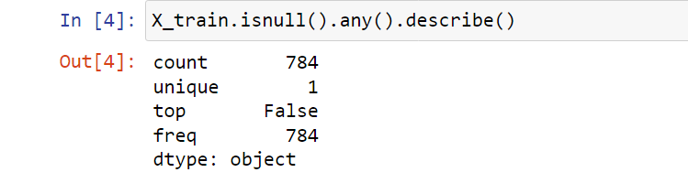
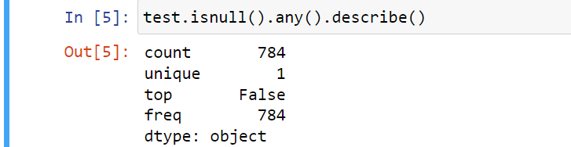
3-Check dataset files(preprosessing)
X_train.isnull():checks each element of the DataFrame if it
is null or missing.
X_train.isnull().any() :returns a boolean Series that indicates whether each column of X_train contains any null values.
X_train.isnull().any().describe(): calculates some summary statistics of the boolean Series returned by X_train.isnull().any(), specifically the count, mean, standard deviation, minimum, and maximum.
Count:number of non-null values returned by X_train.isnull().any() 784 col.
Unique: The number of unique values.
top: The most frequently occurring value is false.
freq: The frequency of the most frequently occurring(top).
Dtype:object is not related to the code you provided previously but it is likely the result of executing some other code in a Python program or console.dtype stands for data type, and object is a data type in Python that represents a string or any other Python object.

Slide 5

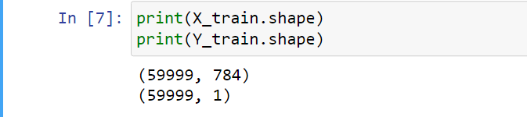
X_train / 255.0: This divides each element in the DataFrame X_train by 255.0, which is a normalization
technique commonly used with image 255.0 the pixel values of the image are scaled to the range [0, 1], which can improve the performance (classification or regression) of certain machine learning algorithms.
print(X_train.shape): This prints the shape of the X_train array. specifies the number of rows and columns in the object.

Slide 6
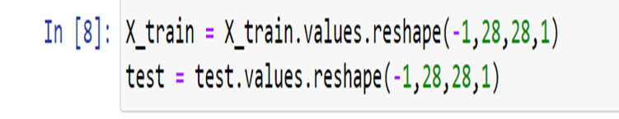
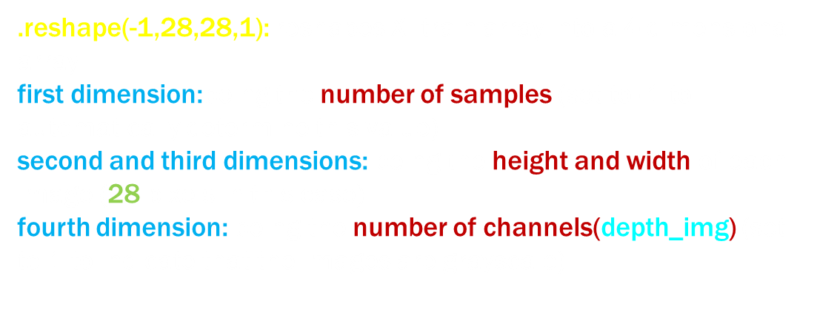

Slide 7
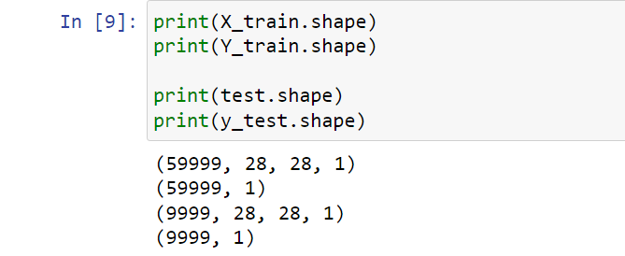
X_train.shape: prints shape of the X_train array specifies the number of rows and columns in the object. The output will be in the format (number of samples, height, width, channels)”which made reshape”.
Y_train.shape: prints shape of the Y_train array specifies the number of rows and columns in the object. The output will be in the format (number of samples, number of classes)”which don’t made reshape”.
check the dimensions of your dataset and ensure that it matches the expected shape for model.

Slide 8
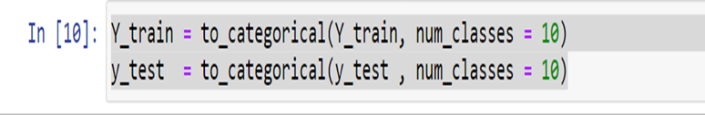
to_categorical(Y_train, num_classes = 10): converts the Y_train array into a one-hot encoded matrix with num_classes columns (in this case, num_classes is set to 10). A one-hot encoded matrix is a binary matrix where each row represents a categorical variable and each column represents a possible category value.
For example, Y_train contains the values [0, 1, 2, 3,4,5,6,7,8,9], then to_categorical(Y_train, num_classes = 10) would return a matrix where the first row is [1, 0, 0, 0,0,0,0,0,0,0], the second row is [0, 1, 0, 0,0,0,0,0,0,0], and so on.
After executing, Y_train and y_test will be one-hot encoded matrices that used as target variables for a model, to perform classification tasks.

Slide 9
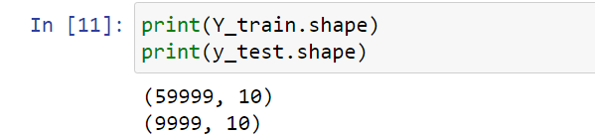
print(Y_train.shape): prints shape of the one-hot encoded Y_train array. The output will be in the format (number of samples, number of classes).”before than it was 1 & after category was 10”.
ensure that they match the expected shape for your model.

Slide 10
train_test_split(X_train, Y_train, test_size = 0.1, random_state=4): This function splits the X_train and Y_train arrays or DataFrames into training and validation sets for cross-validation purposes.
test_size parameter:specifies the proportion of the dataset to include in the validation set (in this case, 10%).
random_state parameter: sets the seed value for the random number generator used to shuffle the data before splitting “useful for made random state every time constance =4 without seed random ”.
“shuffling the data can help ensure that the training and validation sets contain a representative sample of digits from 0 to 9, rather than a block of images of the same digit”.

Slide 11
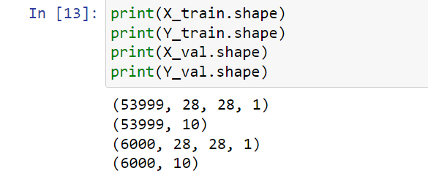
check the dimensions of your training and validation sets and ensure that they match the expected shape for machine learning model.

Slide 12
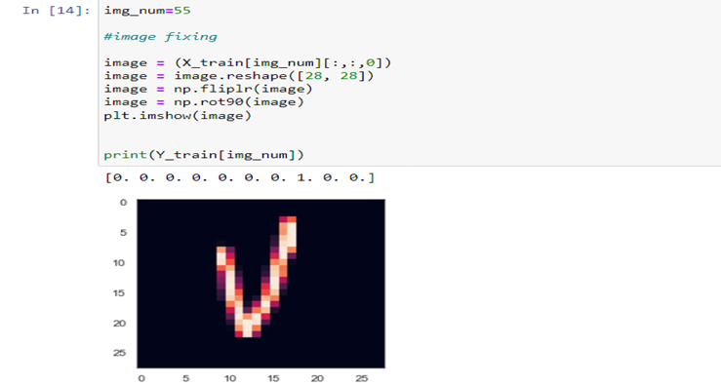
img_num=55: the variable img_num to 55, which corresponds to the index of a sample in the training set.
image = (X_train[img_num][:,:,0]): This selects the img_num-th sample from the X_train array, which is a 28x28 grayscale image” represented by a single channel, as opposed to color images”. The [:,:,0] indexing selects the first (and only) channel of the image, since it is grayscale.
image = image.reshape([28, 28]): reshapes image from a 28x28x1 array to a 28x28 array, which is the format expected by the plt.imshow() function.
image = np.fliplr(image): flips the image horizontally.
image = np.rot90(image): rotates the image 90 degrees counterclockwise.
plt.imshow(image): displays the image using the plt.imshow() function from Matplotlib.
print(Y_train[img_num]): prints the label of the img_num-th sample from the Y_train array.

Slide 13
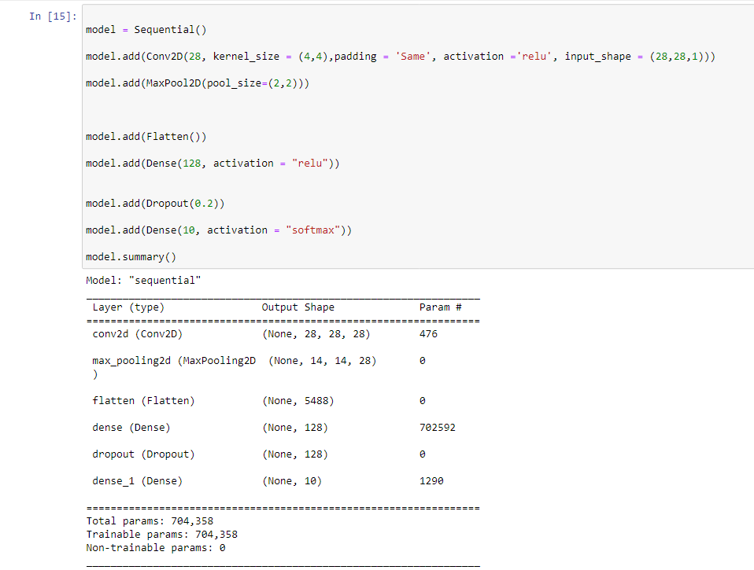
4-cnn model
model = Sequential(): This code initializes a sequential model in Keras, allows you to easily add layers to the model one at a time in sequential order .
Conv2D layer: with 28 filters, kernel size of 4x4, same padding, and ReLU activation function. This layer takes an input shape of (28,28,1), which means the input is a grayscale image of 28x28 pixels.
MaxPool2D layer: with a pool size of 2x2, which downsamples the feature maps obtained from the previous convolutional layer by taking the maximum value in each 2x2 window.
Flatten layer: which flattens the output of the previous layer into a 1D vector.

Slide 14
Dense layer: with 128 units and ReLU activation function.
Dropout layer: with a rate of 0.2, which randomly drops out 20% of the neurons in the previous layer during training to prevent overfitting.
Dense layer with 10 units and softmax activation function, which outputs a probability distribution over the 10 possible classes.
The model.summary(): function prints a summary of the model architecture, including the layer types, output shapes, and number of trainable parameters.
Dense layer | Conv layer
dense layer, also known as a fully connected layer, connects every neuron in the current layer to every neuron in the previous layer. | a convolutional layer applies a set of filters or kernels to the input data, which allows the layer to learn spatial patterns and relationships between neighboring pixels in an image or features in a time series **more computationally efficient than dense layers.

Slide 15
The optimizer parameter specifies the algorithm used to update the weights of the neural network during training. In this case,
-the "adam" :optimizer is used, which is a popular algorithm for stochastic gradient descent that adapts the learning rate based on the gradient of the loss function.
-The loss parameter: specifies the objective function to be minimized during training. In this case, the "categorical_crossentropy" loss function is used, which is commonly used for multiclass classification problems with categorical labels.
-The metrics parameter: used to monitor the performance of the model during training and testing. In this case, the "accuracy" metric is used, which measures the percentage of correctly classified samples in the test set.

Slide 16
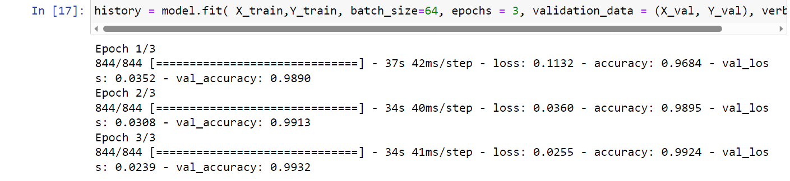
X_train and Y_train are the training data and labels, respectively.
batch_size specifies the number of samples used in each batch during training. In this case, a batch size of 64 is used, which means that the weights of the neural network are updated after processing 64 samples.
epochs specifies the number of times the entire training dataset is passed through the neural network during training. In this case, the model is trained for 3 epochs.
validation_data is a tuple of the validation data and labels, which are used to evaluate the performance of the model on a separate dataset during training.
verbose controls the amount of information printed during training. In this case, a verbosity level of 1 is used, which means that progress updates are printed for each epoch.
The fit() method returns a history object, which contains information about the training process

Slide 17
The evaluate() method :returns the test loss and test accuracy of the model on the test dataset. These metrics can be used to evaluate the performance of the model on new, unseen data and compare it to the performance on the training and validation datasets.
The variables val_loss and val_acc are used to store the test loss and test accuracy, respectively.

Slide 18
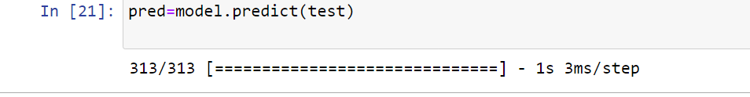

The predict() method: returns a numpy array of predicted class probabilities for each sample in the test dataset. Each row of the numpy array corresponds to a sample, and each column corresponds to a class. The predicted class for each sample can be obtained by taking the index of the column with the highest probability.
The argmax() function returns the index of the maximum value in a numpy array.
In this case, pred[3] is a numpy array containing the predicted class probabilities for the fourth sample in the test dataset
argmax(pred[3]) returns the index of the highest probability.

Slide 19
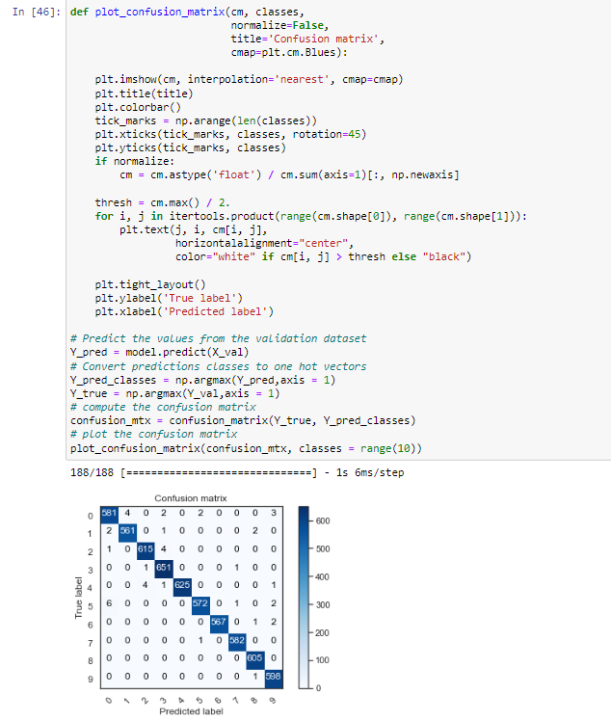
confusion matrix: The confusion matrix is a table that summarizes the performance of a classification algorithm by showing the number of true positives, true negatives, false positives, and false negatives for each class.

