Slide 1

Parallel computing
Sec.7
Eng/ Mariam Malak

Slide 2
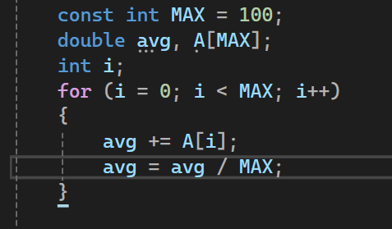
Reduction clause what happen if we can’t remove dependency??
There are some cases where we can’t remove dependency like in operations for data structures or any dependent operations.
Let’s think about calculating average problem:
The problem is this a loop carry dependency [avg] , it’s value in iteration n depends on the values of iteration n-1→can’t paralyze this loop
[reduction clause is the solution]
Each update for avg depend on the previous values.
so, if we paralyze it , it’ll depend on the value of the previous thread or the step that in another thread.

Slide 3

Reduction clause occurs often in parallel programming language that any parallel programming language worth using
How does reduction work ??
The reduction says compiler create a local copy of the variable in the list to each thread
A local copy of each list variable is made and initialized depending on the “OP”.
Updates occur on the local copy, when it’s done, it combines the local copies from each thread using the reduction operator into a single local copy.
It does it for you, you don’t have to do anything magic, it does it for you.
Then it combines it to the global copy to give you the final answer.
Local copies are reduced into a single value and combined with the original global value.
OP
list

Slide 4
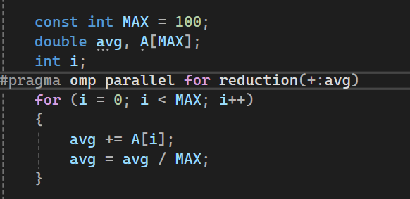
Reduction operands = Initial values many different associative operands can be used with reduction
Every thread will count average for its iterations and reduction will combine them together in the global average variable.
OP are operands that define initial value
to each local value in the list
for each thread.
Note: we can set schedule with omp_set_schedule(type)
OP | Intial
+ | 0
* | 1
- | 0

Slide 5
Synchronization how to solve race condition??
Shared-memory, parallel program correctness hinges on the ability to perform changes to shared data items in a coordinated fashion.
OpenMP provides a number of synchronization directives that serve two purposes: mutual exclusion and event synchronization.
Event synchronization is sometimes called barrier which says every thread wait at the barrier until all threads arrive, it just defines appoint in the program and says all threads stop here until everyone arrives.
Mutual exclusion defines a block of code that only one thread at a time can execute, which means define something I want to happen one at a time , one thread at a time can do the block.

Slide 6
Synchronization how to solve race condition??
Synchronization has to types of constructs:
High-level synchronization → barrier, critical, atomic, ordered
Low-level synchronization → flush, locks
Synchronization is great but if we synchronize a lot, you’ll get no performance.
How to implement good synchronization??
Pay attention to data environment
Pay attention when you share variables
Pay attention when you have a copy of a variable for each thread.

Slide 7
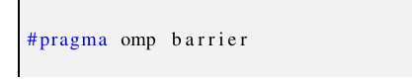
Synchronization Barrie, critical, atomic
Barrier → defines point in the program and it says all threads arrive here before any threads go on.
All threads in a team must reach the barrier directive before execution can continue beyond that point.
The barrier directive has no associated block. It is just placed inside an OpenMP work-sharing construct.
Make sure everybody is done before any of threads go on the next calculations.

Slide 8
Synchronization Barrie, critical, atomic
Critical → Allows only one thread at a time, to enter the structured block that follows.
It creates something called critical section.
Critical section says that for this block of code, I’m only going to let one thread at a time to execute this code.
So, if I’m moving along as a thread moving along through the program and hit a critical section and somebody else is already doing the computation, I’ll wait and then when that somebody is done, they will release the critical section and one of the threads waiting will start.
[a lot happening in critical section = serialization of block]

Slide 9
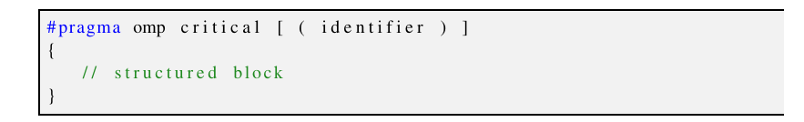
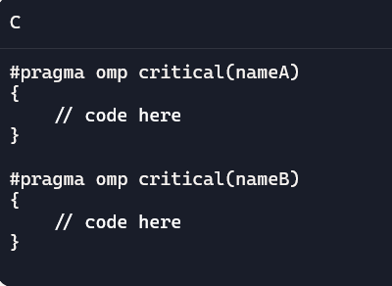
Synchronization Barrie, critical, atomic
The identifier allows the establishment of named critical sections. The identifier serves to group critical sections together: using the same identifier in different critical directives means that there can be only one thread at any time, executing any of the corresponding blocks. All critical directives without an identifier are assumed to have the same name.
That means if you have multiple #pragma omp critical blocks scattered around, only one thread can be inside any of them at a time
Threads can execute critical(nameA) and critical(nameB)
simultaneously, because they don’t block each other

Slide 10
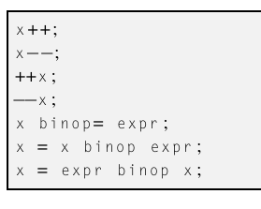
Synchronization Barrie, critical, atomic
Aromic → This is a lightweight version of the critical construct that uses platform specific atomic machine instructions (like the Intel x86 CMPXCHG Compare and Exchange) to accelerate the execution of single-statement critical sections.
Given that the statement should correlate closely with an atomic CPU instruction, the operations that can be “decorated” by an atomic directive are very limited.
binop can be one of +, *,-,/,&,^,|,<>
There are a certain constructs in hardware supported in hardware
For doing just quick updates of values in memory, this is because
Some of low-level things we do in OS and some of low-level things in
Run time systems need really really efficient mutual exclusion
Atomic says : if these HW constructs are available , use them other
wise just like a critical section for a subset of operations

Slide 11

Synchronization Barrie, critical, atomic
the update to the x variable is atomic, the update to the y variable is not, and thus it could be the possible cause of a race condition. In that case a critical directive should be used instead.

Slide 12
Exercise 5
Modify PI program to avoid false sharing

