Slide 1

Parallel computing
Sec.4
Eng/ Mariam Malak

Slide 2
Exercise 2
Create a parallel version of the PI program using a parallel construct.[pay close attention to shared versus private variables ]
Creating a parallel version of a program for calculating the integral of a function.

Slide 3
Variable scope
When a parallel region is executing, each of the threads in the team execute a copy of the designated block of statements. The question is: what kind of access do threads have to the variables declared outside the block? How about the variables that are declared inside the block? Are these variables shared or not? And if they are shared how can we coordinate access to them?
Outside the parallel regions, normal scope rules apply. OpenMP specifies the following types of variables:
Shared: All variables declared outside a parallel region are by default shared
Private: All variables declared inside a parallel region are allocated in the runtime stack of each thread. So we have as many copies of these variables as the size of the thread team. Private variables are destroyed upon termination of a parallel region.

Slide 4
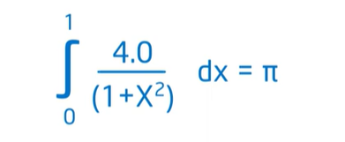
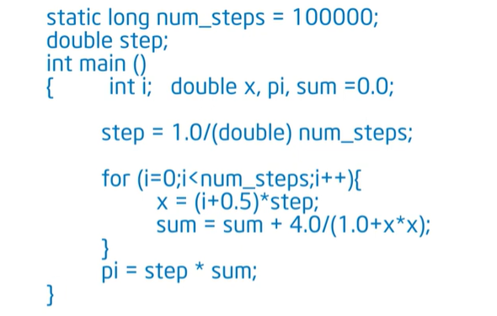
PI problem
Problem :
Sequential solution :

Slide 5
PI problem SPMD model
In here we’ll use SPMD model strategy where in It, a single program is executed simultaneously on multiple data elements. Here, each processing element (PEs) runs the same program but with different data elements, allowing for parallel processing and increased efficiency.
The idea is, I have a single program and I run multiple copies of that program , so, each thread has its own copy but it’s going to use its ID and knowledge of how many threads there are to adjust and change what it does.
[let’s code it]

Slide 6
PI problem cyclic distribution of the loop iterations & round robin
Each thread will run a specific number of iterations according to its ID value
Cyclic distribution = Rounf robin distribution
The basic idea is simple: instead of running jobs to completion, RR runs a job for a time slice (sometimes called a scheduling quantum) and then switches to the next job in the run queue. It repeatedly does so until the jobs are finished. For this reason, RR is sometimes called time-slicing.
Outside the parallel region, we’ve lost these variables inside the thread stack.
At the end of the parallel region the threads go away except for the master thread.

Slide 7
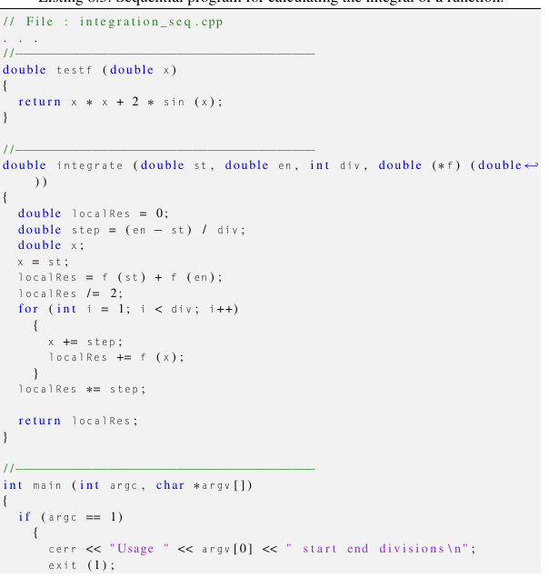
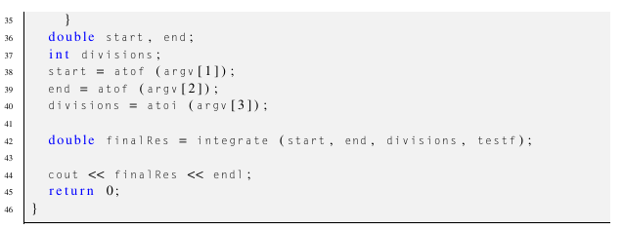
Integration problem
Sequential solution :
Let’s code parallel version

Slide 8
Exercise 2
These ways we solve problems will lead to 2 problems which are:
Race condition
False sharing

