Slide 1

Parallel computing
Sec.2
Eng/ Mariam Malak

Slide 2
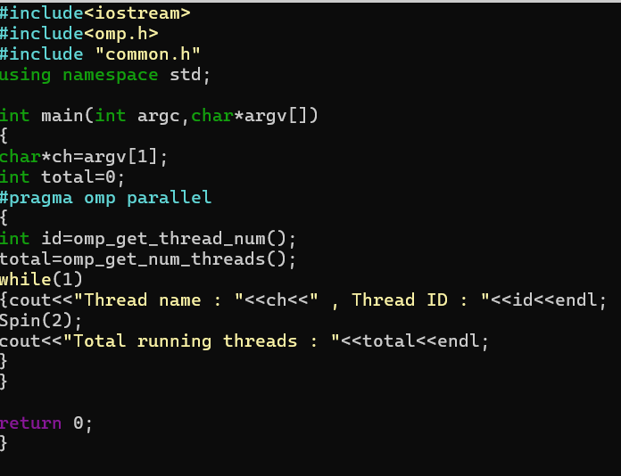
OpenMP constructs most of the constructs in OpenMP are compiler directives.
Most OpenMP constructs applied to a “ structure block ”
Structure block: a block of one or more statements with one point of entry at the top and one point of exit at the bottom
Functions, prototypes and types in the file
Ask compiler to reserve the default number of threads to open in parallel

Slide 3
OpenMP constructs most of the constructs in OpenMP are compiler directives.
Most OpenMP constructs applied to a “ structure block ”
Structure block: a block of one or more statements with one point of entry at the top and one point of exit at the bottom
Ask for thread id
Ask for getting number of threads reserved

Slide 4
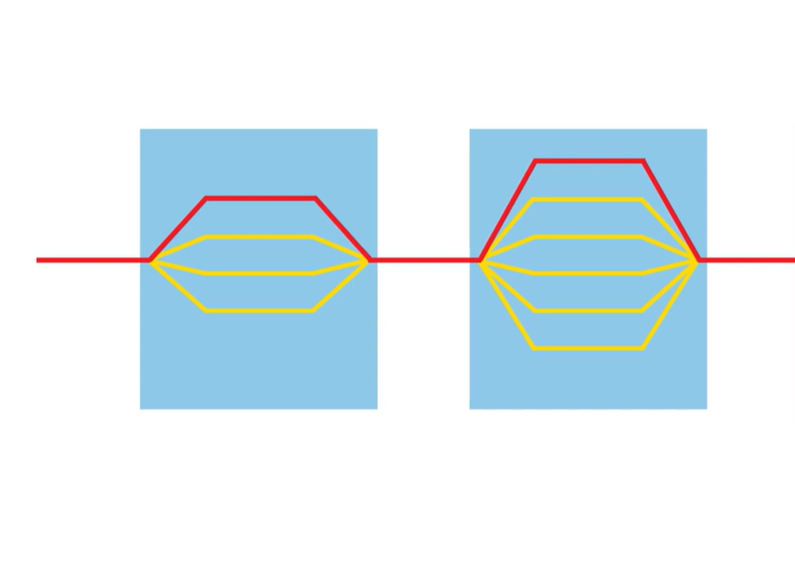
How do we create threads in OpenMP??
Fork-Join model [based on Pthreads library]
Program starts as a single thread; we’re going to call it “ master ” thread.
Master thread is working through the program then it comes to some point in the execution where additional threads could help out.
It’s going to fork a number of threads at that point [#pragma omp parallel ] converting from a serial part of program to a parallel part of program=Creating block of threads= Team of threads
They execute in parallel, when they finish, whatever it was in the program, they join back together again, and you’re left with one thread again
Join
Fork
Threads
Master
Master

Slide 5
How do we create threads in OpenMP??
Fork-Join model [based on Pthreads library]
Master thread continuous right along until it sees another portion of the problem where multiple threads make sense.
We can even nest threads, so inside a parallel region, a thread in the team could fork off its own team of threads.
Join
Fork
Threads
Master
Master

Slide 6
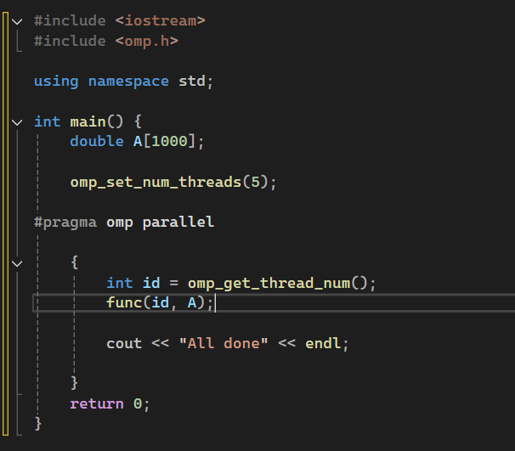
How do we create threads in OpenMP??
Fork-Join model [based on Pthreads library]
We create threads in OpenMP with the parallel constructs.
If there’s no OpenMP pragma somewhere in program, you’re not having multiple threads
Ask for specific number of threads
Fork a number of threads
I asked for
Each thread will run the code in that structure block.
Each thread will allocate an integer id.
Each thread will call omp_get_thread_num() and perforn func()

Slide 7
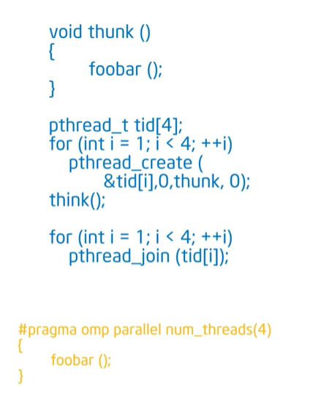
Compiler view
Pthread work
OpenMP some how is based on Pthread api.
Pthread is an API very low level.
Program lets the system deals with low-level details.
Compiler
OpenMP
First thing happen is that the compiler takes the body of the block and put it ain thunk() function .
After that, it prepares Pthread environment and run these threads with a copy of thunk() function.
In this moment master thread take id =0 and fork threads, each one with an id starting from 0 to the number of threads reserved-1, and join them again.

Slide 8
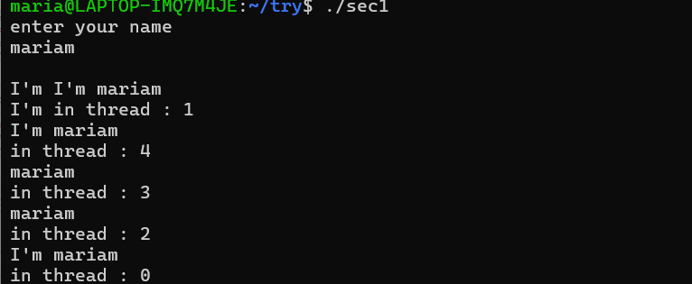
Exercise 1
Write a program that takes your id as an input.
Create 5 threads that prints your id and thread id
Output example[id not name]:

