Slide 1

Parallel computing
Sec.8
Eng/ Mariam Malak

Slide 2
Exercise 5
Modify PI program to avoid false sharing

Slide 3

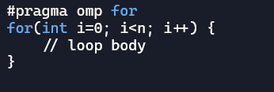
Implicit and explicit barriers where barriers are implied and where barriers are explicit?
Explicit → is where you need a barrier and put it there for you
A synchronization point that programmers deliberately insert in code.
All threads must stop and wait until every thread reaches this barrier before continuing
Here, the programmer explicitly tells the compiler: “Pause all threads here until everyone catches up.”
Implicit → A synchronization point that happens automatically at certain constructs, even if the programmer doesn’t write it.
Threads wait at the end of parallel regions, work-sharing constructs (like for , sections , single ), unless the programmer disables it
All work sharing constructs in OpenMP comes along default behavior is there’s a barrier at the end of that construct.
By default, there’s an implicit barrier at the end of this loop.
All threads finish their assigned iterations before moving forward.
Means no threads go beyond the end of that loop until all the threads have finished.

Slide 4
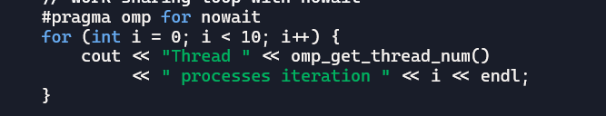
Implicit and explicit barriers barrier overhead
Any time you’re throwing synchronization constructs [barriers, critical section, atomics] these add overhead.
Remember if someone’s sitting and waiting at barrier for everyone else to finish, they’re not doing useful work that kills performance.
Sometimes, I don’t want to wait in the barrier after finishing a big calculation, I just want to continue my code.
In this case we want to disable the implicit barrier.
To do this we add no wait to the construct.
No wait clause says → don’t put that barrier at the end of this loop, skip it.

Slide 5
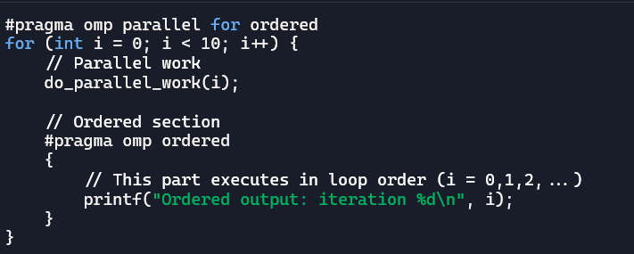
Synchronization con. Ordered , master , single , sections/section
Is used inside a parallel for region to enforce the sequential execution of the structured block it heads.
So while the iterations of a for loop may be partitioned according to the schedule clause and assigned to different threads to execute out-of-order, the ordered block has to execute as if it was done sequentially.
The consequence is that if two threads are assigned successive groups of loop iterations, the second thread will have to block at the entry of its ordered block, until the first thread completes its own ordered block(s).
Any type of schedule can be used in a parallel for that contains an ordered directive.
The only restriction is that the parallel for must have an ordered clause specified.
However, if the ordered block is executed in every iteration, a static or dynamic schedule with a chunk size of 1 should maximize the concurrency potential.
On the other hand, a guided schedule will result in a mostly sequential execution
In short: ordered is your tool when you want parallelism with controlled sequential sections

Slide 6
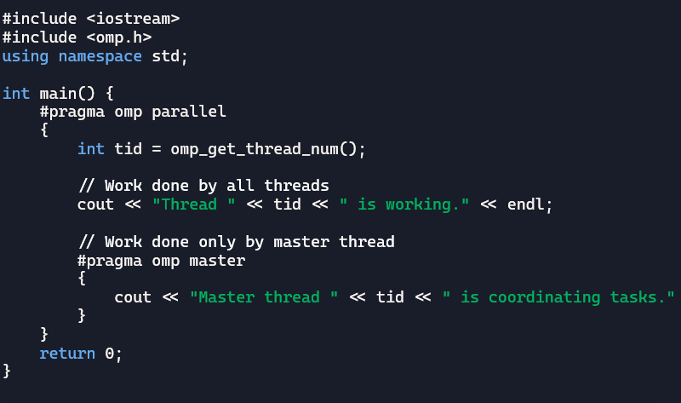
Synchronization con. Ordered , master , single , sections/section
Forces only the master thread in a parallel region to execute a block of code.
The master directive has no associated clauses and no implied barrier on entry to or exit from the corresponding block.
This means that when a thread other than the master reaches this construct, it just skips over it.
Master construct says → I’m going to have a block of code , a structured block and only the master thread will do it, everyone else will just skip it and keep right on going , there’s no synchronization implied.
We can add barrier after master to wait master thread to end and other threads start over it.

Slide 7
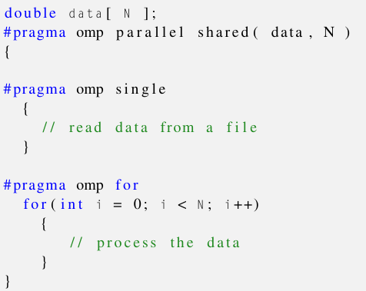
Synchronization con. Ordered , master , single , sections/section
Forces the execution of a block by one thread only.
It is similar to the master directive, but for the implicit barrier at the end of the single block, which means that the two constructs are not interchangeable in general.
The barrier can be eliminated by adding the nowait clause to the single directive.

Slide 8
Synchronization con. Ordered , master , single , sections/section
Difference between single and master:
Master → if you weren’t the master, you just skipped it and kept right on going.
Single → if you’re not that one thread that got it you’re going to wait at the barrier at the end of the single.
Aspect | single | Master
Executed by | One thread (not necessary master) | Only master thread (tid=0)
Barrier | Implicit barrier at end (unless nowait) | No implicit barrier

Slide 9
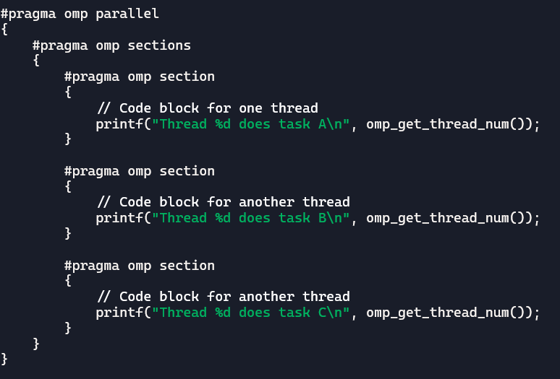
Synchronization con. Ordered , master , single , sections/section
Sections/section → it gives you a way to create sections of code and one thread does one section another thread does another section and so on.
I tell the compiler to create team of threads so always
#pragma omp parallel , then I tell the complier to expect
some section construct so I create these sections [plural]
#pragma omp sections , so now I get my curly braces
now inside these curly braces ,I’ll have the section construct
#pragma omp section

Slide 10
Exercise 6
Rewrite file to another file [avoid false sharing and race condition]

