Slide 1

Parallel computing
Sec.6
Eng/ Mariam Malak

Slide 2
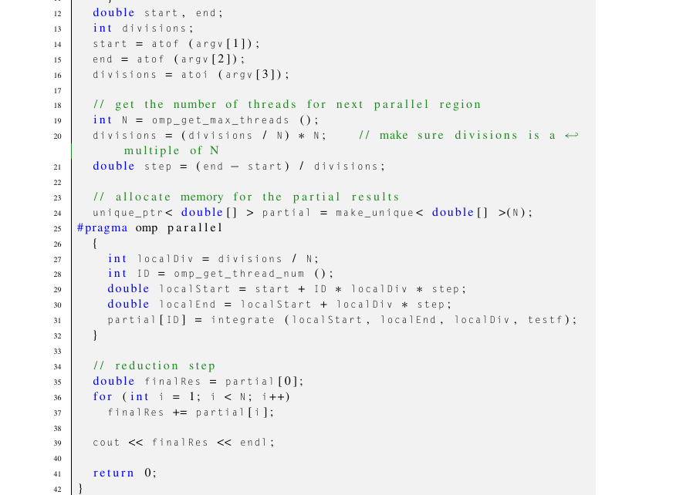
Integration problem solution

Slide 3
Work sharing
The basic pattern we work with is called SPMD → Single Program Multiple Threads.
The SPMD pattern every thread is redundantly running the same code.
Now, I have one big code and I want to divide it across threads = All threads aren’t doing the same block.
This leads to think about work sharing concept which is about take single construct and share it out across the threads [extreme important feature of OpenMP]
In OpenMp, we have a collection of work sharing constructs:
Loop construct
Section/sections construct
3. Single construct
4. Task construct

Slide 4
Work sharing loop-work sharing construct
In normal conditions, we’re trying to convert sequential code to paralyzed version, so, we get the code, look at it and trying to convert it.
But can we use the same approach on any for loop?
The answer is, unfortunately, no.
The for loop has to satisfy certain conditions, which in OpenMP jargon are called the canonical form.

Slide 5
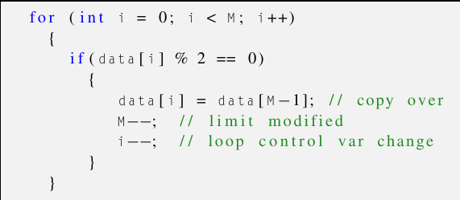
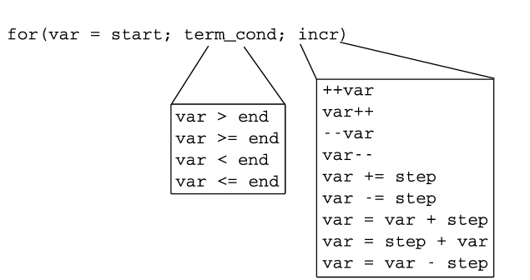
Work sharing loop-work sharing construct
Violating 2 and 3
Canonical form has restrictions :-
The loop control variable has to be an integer type (signed or unsigned), a pointer type (e.g., base address of an array), or a random access iterator (for C++). The loop control variable is made private by default, even if it is declared outside the loop.
The loop control variable must not be modified in the body of the loop.
The limit against which the loop control variable is compared against to determine the truth of the termination condition must be loop-invariant, i.e., they cannot change during the loop’s execution.
The increment/decrement step of the loop control variable must be loop-invariant.
The logical and arithmetic operators allowed in the for statement are limited.
No program logic that transfers control outside the loop body is allowed. This includes break, goto, and throw statements. One can use goto and throw only if the destination address and the exception handling, respectively, take place within the loop body.
The program is allowed to terminate from within the loop body via an exit call.

Slide 6
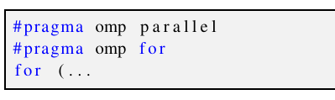
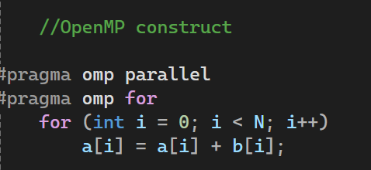
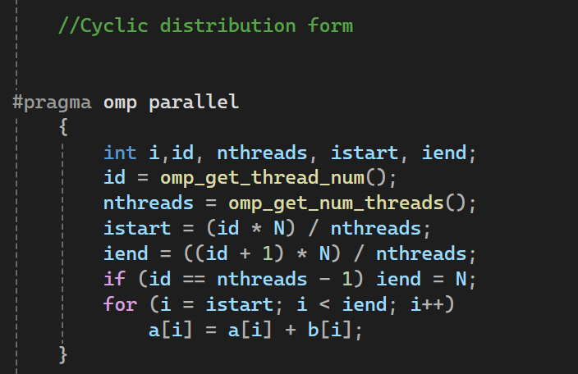
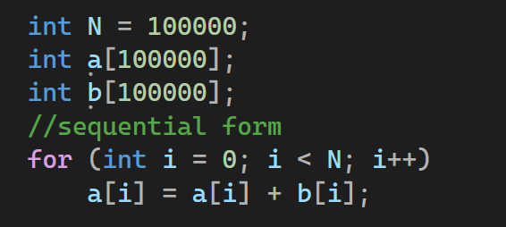
Work sharing loop-work sharing construct
We do it in code as follows:
I want to split up iterations of that for loop to different threads
[Not by hand = cyclic distribution]
For example:
even split can yield poor performance if the execution cost of each iteration is not more or less the same

Slide 7

Scheduling How are the loops mapped onto threads??
Compiler are dumb, you have to till the compiler hoe to split the loops up between threads.
Scheduling → giving information to the compiler which says how I want to break up those iterations of the loop, package them up and split then between threads.
To do this we add schedule(type[chunck_size)]) clause to the for construct.
All schemes can have a parameter called chunk_size that determines how the partitioning is done
Chunck_size → optional

Slide 8
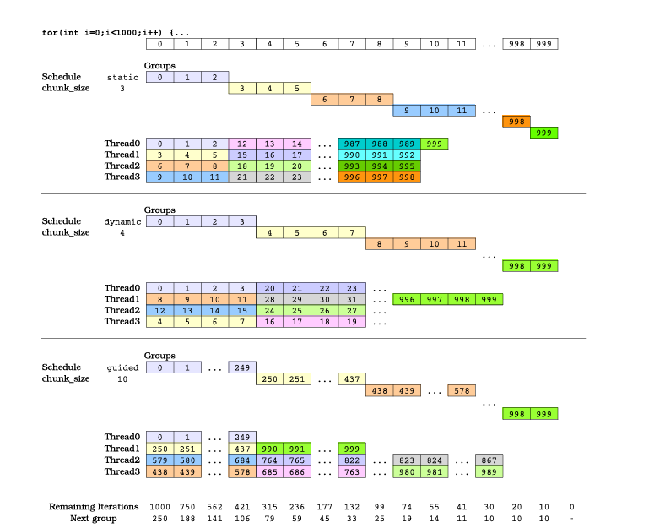
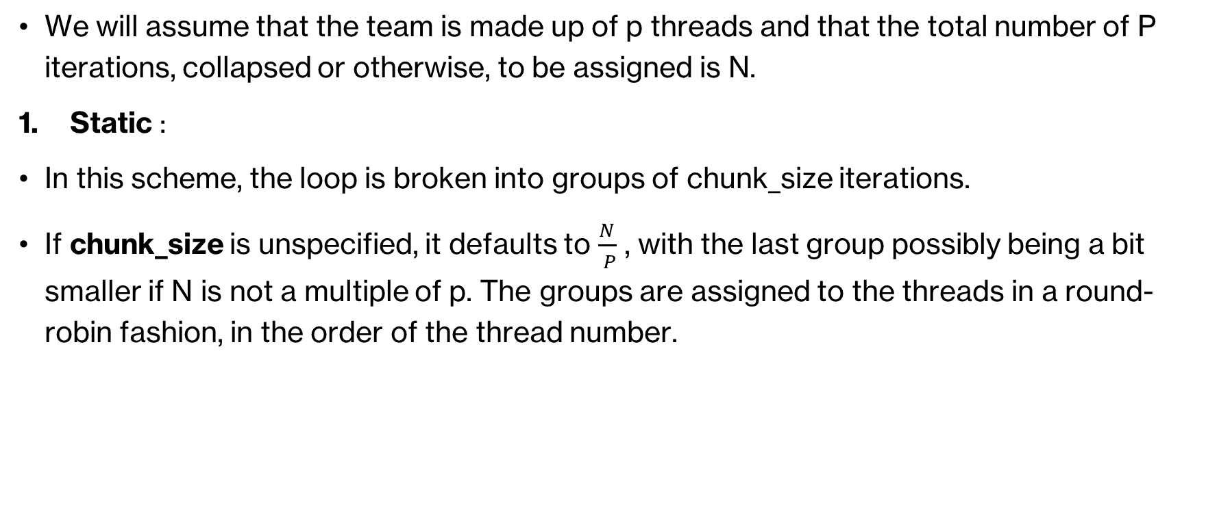
Scheduling schemes How are the loops mapped onto threads??
We will assume that the team is made up of p threads and that the total number of P iterations, collapsed or otherwise, to be assigned is N.
Static :
In this scheme, the loop is broken into groups of chunk_size iterations.
If chunk_size is unspecified, it defaults to $\frac{N}{ P}$ , with the last group possibly being a bit smaller if N is not a multiple of p. The groups are assigned to the threads in a round-robin fashion, in the order of the thread number.

Slide 9
Scheduling schemes How are the loops mapped onto threads??
We will assume that the team is made up of p threads and that the total number of P iterations, collapsed or otherwise, to be assigned is N.
Dynamic :
This scheme mimics the operation of a dynamic load balancer, where groups of size chunk_size are assigned to the threads on a first-come, first-served basis. A thread executes a group, then requests another, etc. If chunk_size is unspecified, it defaults to 1.
Take the loop iterations and put them into a logical task queue and then go off and grab on iteration block, the thread finishes the work on that iteration and then it goes back and grabs the next block.
What it’s doing is → it’s deciding at run time not compile time how it’s going to break up work between the threads

Slide 10
Scheduling schemes How are the loops mapped onto threads??
We will assume that the team is made up of p threads and that the total number of P iterations, collapsed or otherwise, to be assigned is N.
Guided :
The dynamic scheme offers flexibility, but the coordination overhead associated with requesting a new group can deteriorate performance.
The guided scheme tries to offset this overhead by using variable-sized groups that shrink over time to allow for load balancing.
The group size given out at each new request is equal to the number of unassigned iterations divided by p.
Thechunk_size specifies a lower bound for the size of a group (the very last being an exception obviously). If chunk_size is unspecified, it defaults to 1.

Slide 11
Scheduling schemes How are the loops mapped onto threads??
We will assume that the team is made up of p threads and that the total number of P iterations, collapsed or otherwise, to be assigned is N.
Runtime :
Schedule and chunk size taken from the OMP_SCHEDULE environment variable.
We use it when we’re not sure which schedule is best.
Auto :
The schedule is left up to the run time to choose [doesn’t have to be one of the above]
The compiler and/or the OpenMP runtime decide on the best partitioning scheme from the above
Give the compiler the permission to be really flexible and how it does the schedule.

Slide 12

Scheduling schemes when to use the schedule clause??
Static → pre-determined and predictable by the programmer, least work at runtime and scheduling done at runtime.
Dynamic → unpredictable, highly variable work per iteration, most work at runtime, complex scheduling logic used at runtime
Combined structure :
Setting schedule:

Slide 13
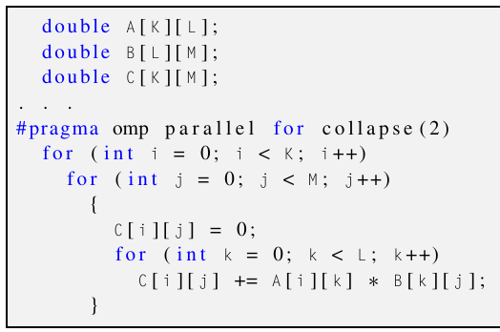
Nested loop
perfectly nested loops (i.e., with no statement between the successive for) can be parallelized in unison.
OpenMP can “collapse” multiple nested loops into a single one and then proceed to partition this derivative loop between the team of threads.
The collapse clause instructs OpenMP how many of the nested loops should be converted into a single one.
Why should we want to do the collapse in the first place??
The outer loop has too few iterations to balance the workload properly. Imagine that in our matrix multiplication code, we had K = 5, L = 1000, and M = 3000. Parallelizing the outer loop only would translate to having just five work items to give to our threads. How could we evenly distribute these to the eight threads that are the typical team size for quad-core hyperthreaded CPUs? The 15,000 work items that would be produced by the collapse are a different story though.
It is possible that the execution cost of each loop iteration is different. Collapsed loops are easier to balance in that regard

Slide 14
Loop data dependency
The basic approach of working with loops is you look at your program, and you find the loops where you’re spending most of the time.
If loop carries dependency, it means that you can’t run the iterations of this loop independently [you can’t run the loop in parallel]
Dependency means each step requires another variable to be set.
Each step depend on the earlier step.
[So how to paralyze loop in more details?? ]

Slide 15
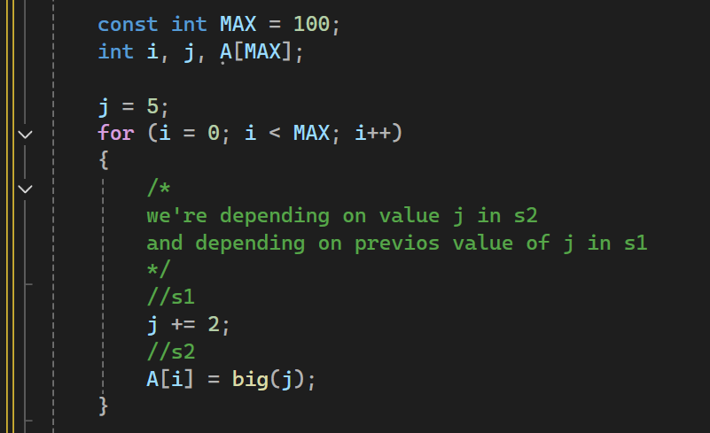
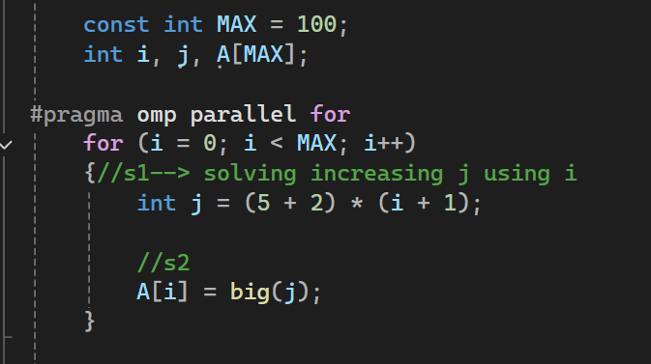
Loop data dependency
To paralyze loop :
First → find the compute intensive loop
Second → make the loop iterations independent so they can safely execute in any order without loop-carried dependency.
Third → place the appropriate OpenMP directive and test
OpenMp makes the loop control index on parallel loop private to thread→ each thread has its own indexing
We solve independent by solving the problem using loop indexing not any other variable.

Slide 16
Exercise 4
Implement insertion sort in parallel
Implement binary search for multiple keys in parallel.

