Slide 1

Parallel computing
Sec.1
Eng/ Mariam Malak

Slide 2
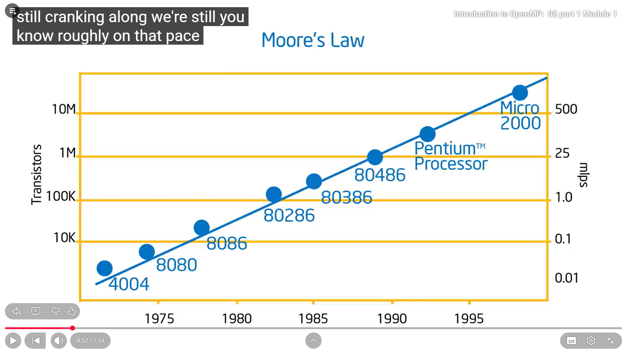
Moore’s law the number of transistors on a chip roughly doubles every two years, driving exponential growth in computing power and efficiency.
Moore's Law is an empirical observation made by Gordon Moore, co-founder of Intel, in 1965. He noted that the number of transistors on an integrated circuit (IC) had been doubling approximately every year and projected that this trend would continue for at least a decade. In 1975, Moore revised his prediction to a doubling every two years, which corresponds to a compound annual growth rate of about 41%. Importantly, Moore's Law is not a physical law but a trend based on historical data and industry experience.
This what happened over years thinking about performance would come from hardware despite the software.

Slide 3
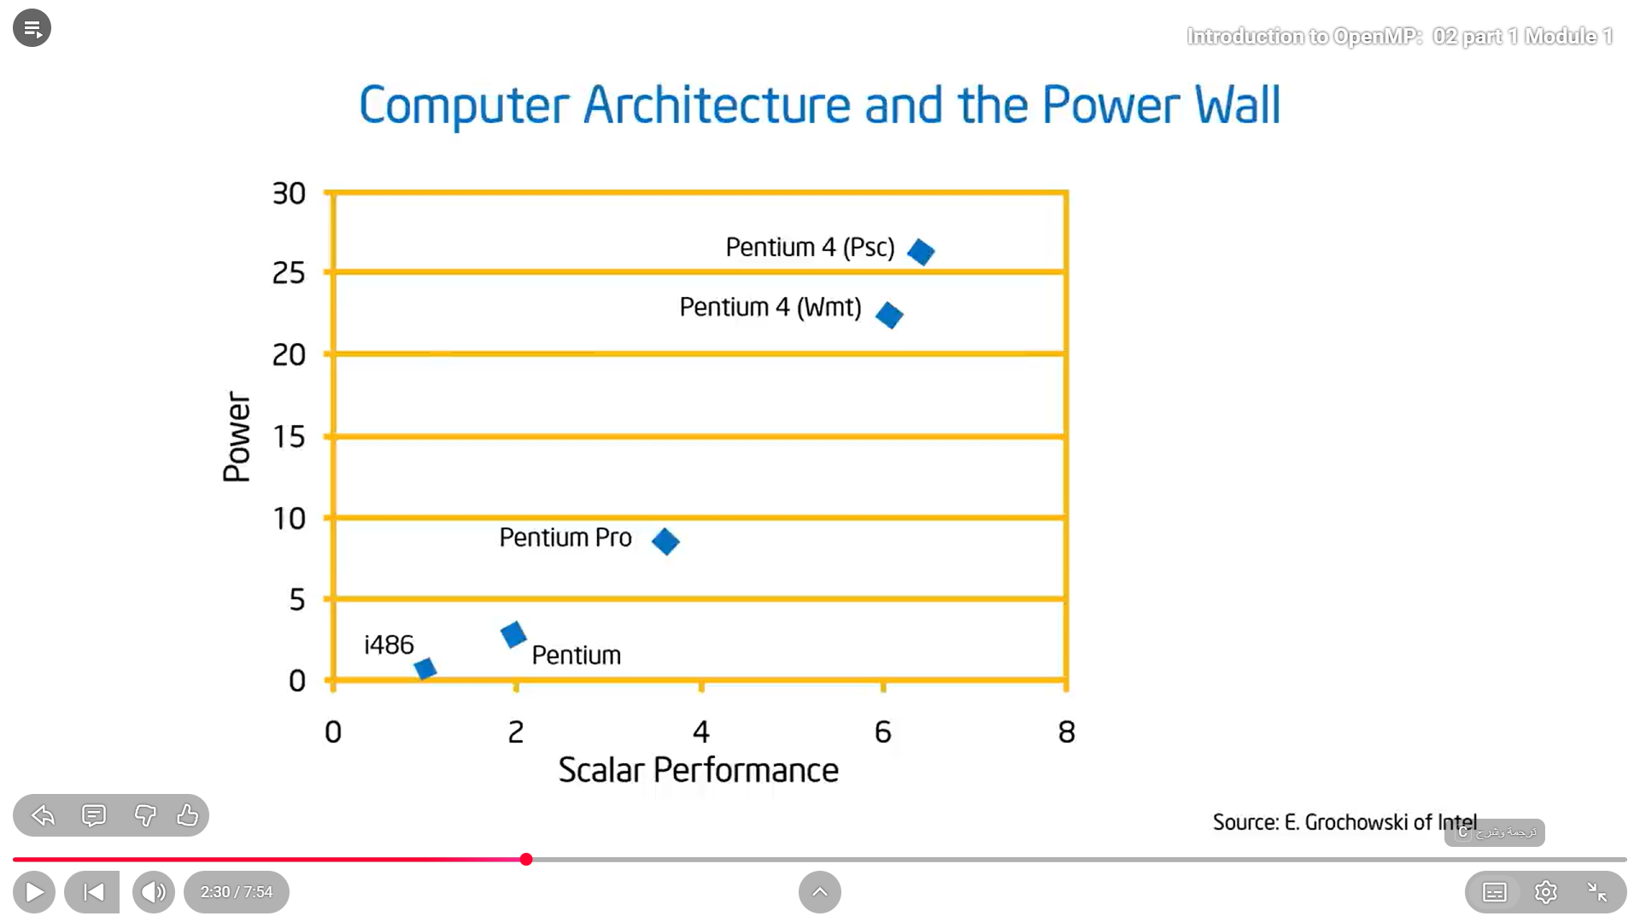
Performance vs Power in Moore’s law
Ed-grchowski research
According to moore’s low, we need more power to make transistors work with great performance.
Ed-grchowski proved that increasing in performance leads to quadritic increasing in power needed.
[power=performance*1.74]
Growth in power is unsustainable, which means we don’t want power to change or increase on each optimization, so we think in power optimization rather than performance optimization which leads to change in design of computer architecture
But now, we want to achieve greater performance with less power ??

Slide 4
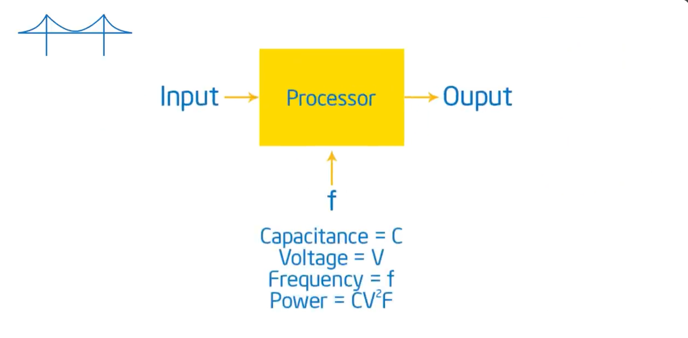
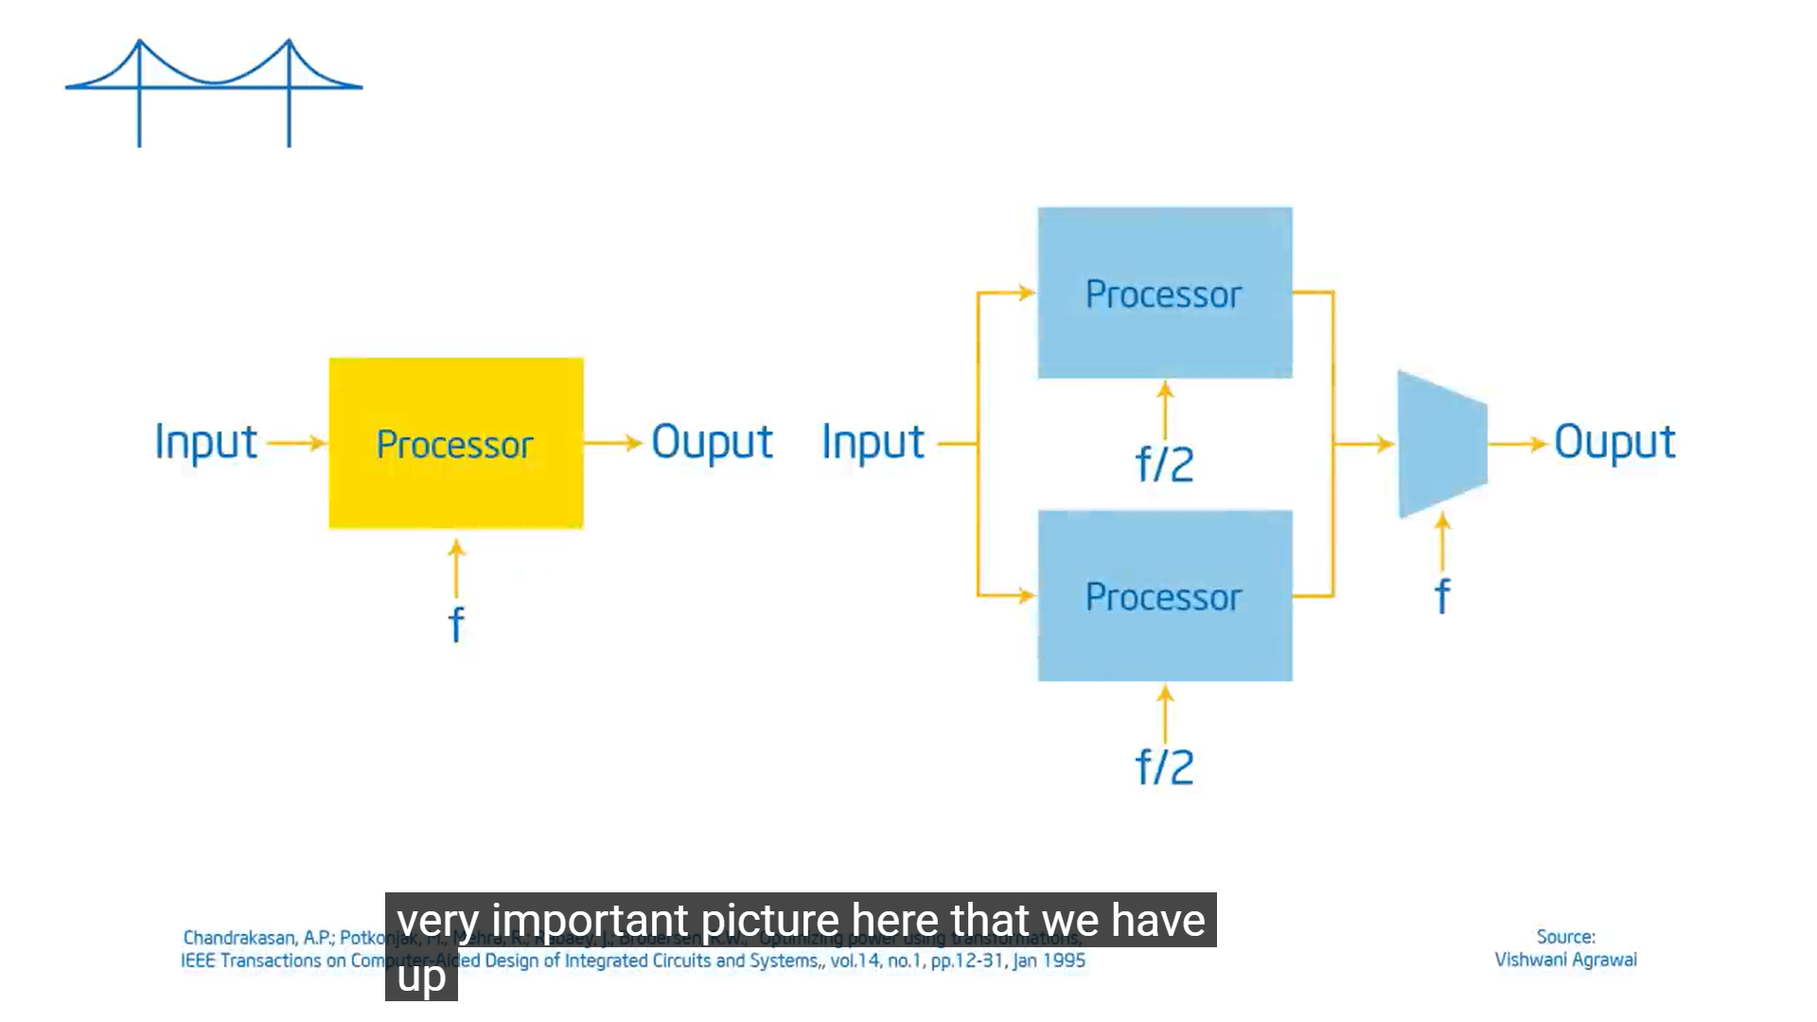

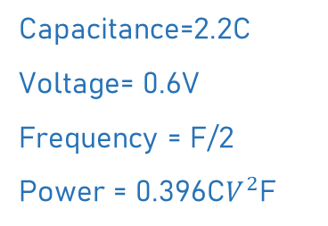
Performance vs Power in Moore’s law
Ed-grchowski research
P=C$V^{2}$F
C → capacity = ability of circuit to store energy
V → voltage
F → frequency
P → power = work overtime
optimize
Power reduced up to 40% with the same performance
With 2 cores, getting the same output, but 2 cores are getting 40% of the power
Leading to start of parallel programming
Capacitance=2.2C
Voltage= 0.6V
Frequency = F/2
Power = 0.396C$V^{2}$F

Slide 5
Parallel computing
Is a computational approach where large problems are divided into smaller tasks that are solved simultaneously by multiple processors.
Give us the ability to get same amount of work done with multiple cores at lower frequency at tremendous power
If we take this architectural change towards simpler architectures where we’re not using all these transistors to give you insane performance .
If you couple that with the fact that we’re going to be putting lots of cores on a piece of silicon, we now have a new contract between hardware and software.
[Performance comes from software]
[Performance doesn’t come from hardware]

Slide 6
Processor vs core vs thread
Concept | Definition | Scope | Example | Performance Impact
Processor (CPU) | The entire central processing unit — the physical chip that executes instructions. | Hardware level | An Intel i7 or AMD Ryzen CPU. | Determines overall computing capability; contains multiple cores.
Core | A physical processing unit inside the processor. Each core can independently execute instructions. | Sub-unit of CPU | A quad-core CPU has 4 cores. | More cores = true parallelism; multiple tasks can run simultaneously.
Thread | A virtual execution unit managed by the CPU. Threads allow each core to handle multiple tasks concurrently (via technologies like Hyper-Threading or SMT). | Software/OS level | One core with 2 threads can run two instruction streams at once. | Improves multitasking and throughput, but not as powerful as adding more cores.

Slide 7
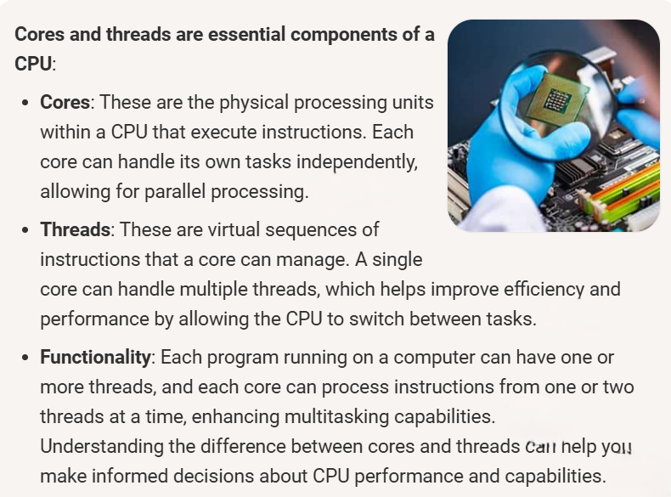
Core vs Threads

Slide 8
How They Work Together
Processor = the whole chip (like the "brain" of the computer).
Cores = physical workers inside the processor.
Threads = virtual helpers that let each core juggle multiple tasks at once.
Example
Suppose you have a CPU with 1 processor, 4 cores, and 8 threads:
The processor is the single CPU chip.
The 4 cores are the actual physical units that can run instructions in parallel.
The 8 threads mean each core can handle 2 instruction streams (thanks to Hyper-Threading), so the OS sees 8 logical processors.
[ More cores = true parallelism.
More threads = better multitasking efficiency,
but threads share the same physical core resources.]

Slide 9
Scheduling Hierarchy
Processor (CPU)
  The OS sees the entire CPU as the main resource.
  If you have multiple processors (rare in consumer PCs, common in servers), the OS decides which processor gets which workload.
Core
  Each processor contains multiple cores.
  The OS scheduler assigns tasks (processes/threads) to available cores.
  This is where true parallelism happens — multiple cores can execute instructions simultaneously.
Thread
Threads are the smallest schedulable units.
The OS scheduler decides which thread runs on which core at a given time.
With technologies like Hyper-Threading (Intel) or SMT (AMD), each physical core can handle multiple logical threads, so the OS sees more “virtual CPUs” than physical cores.

Slide 10
Concurrency vs
Parallelism
Parallelism : is a condition of a system in which multiple tasks are actually active at one time [is a subset of concurrency = you’re taking some of that concurrency and executing it at the same time]
Concurrency : is a condition of a system in which multiple tasks are logically active at one time [ they may not happen at the same time but at least they can, you have multiple things active and able to make progress at the same time ]

Slide 11
Concurrent application vs Parallel application
Aspect | Concurrent application | Parallel application
Definition | Multiple tasks progress at the same time, but not necessarily simultaneously. The system switches between tasks quickly. | Multiple tasks are executed simultaneously on different cores/threads or processors.
Analogy | One cashier serving many customers by switching between them rapidly. | Multiple cashiers serving multiple customers at the same time.
Execution | Achieved through time-slicing on a single CPU/core. | Achieved through multiple cores/CPUs running tasks truly in parallel.
Example | A web server handling thousands of requests by interleaving them. | A machine learning algorithm splitting data across cores for faster training.

Slide 12
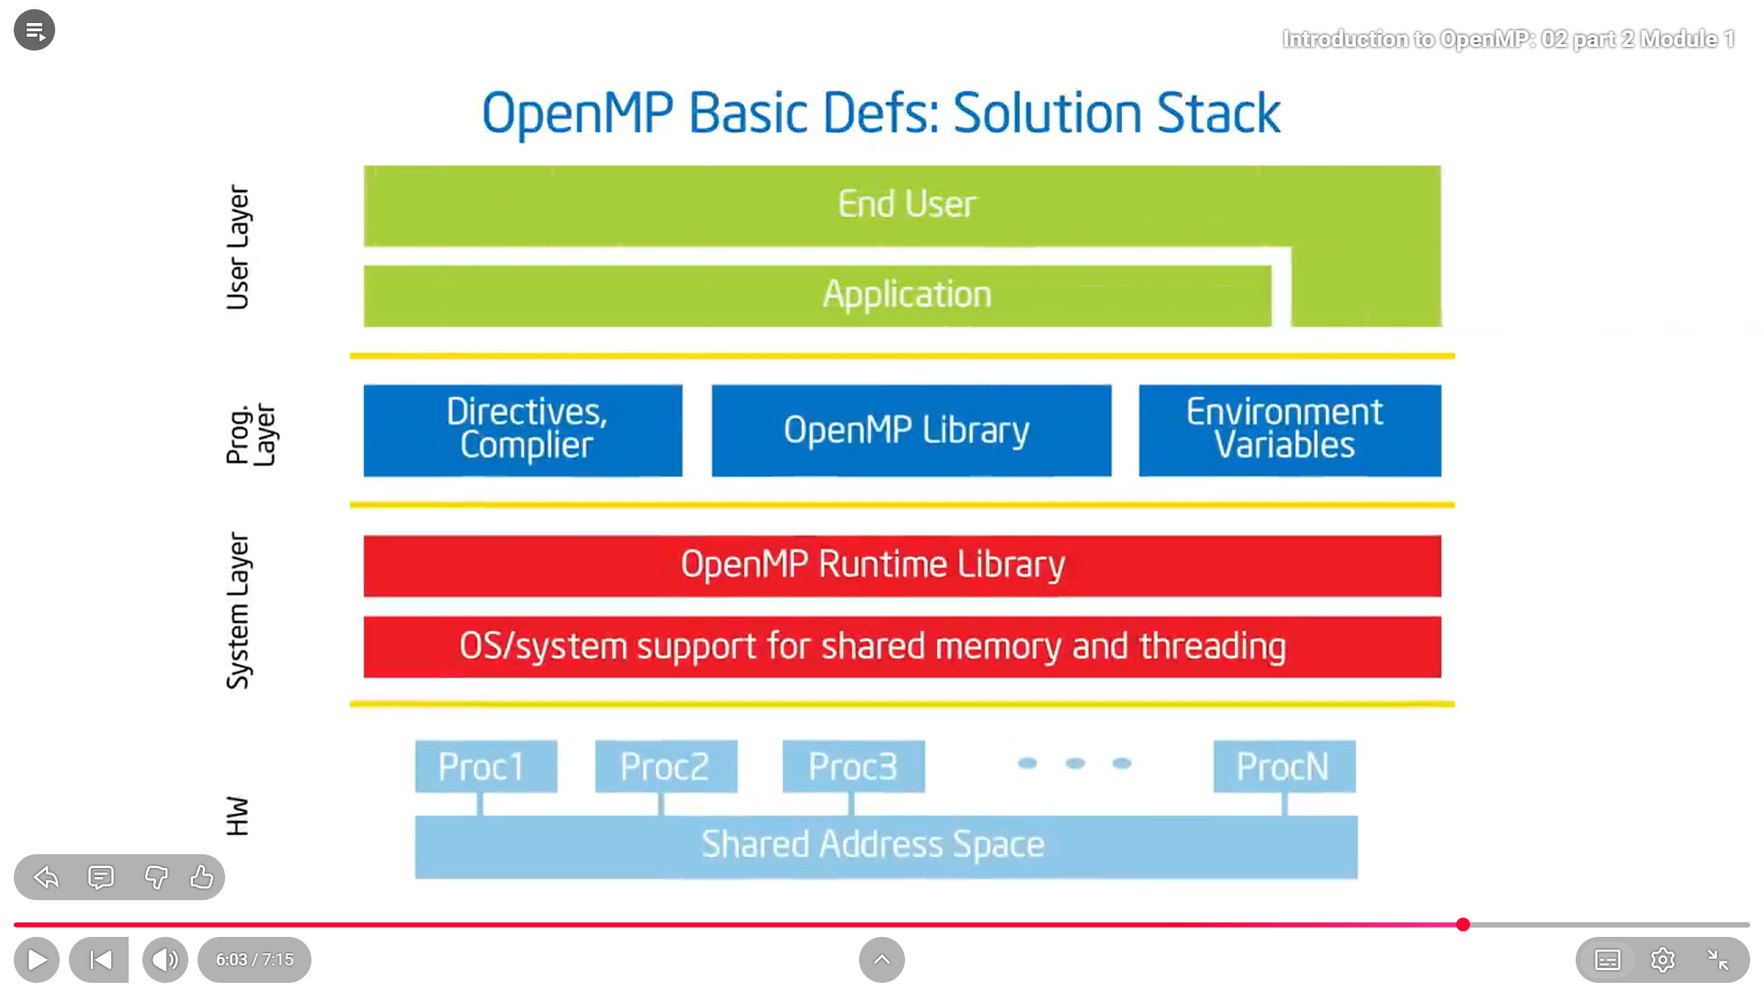
What’ll we do this time??
We’ll use OpenMP with C++ as our language and library to implement concepts.
OpenMP :
Is an API for writing multithreaded applications.
A set of compiler directives and library routines for parallel application programmer.
Greatly simplifies writing multithreaded programs in C, C++ and Fortran.
We’ll use visual studio as our IDE.
First , let’s run code in ubuntu

Slide 13
Ubuntu set up
Run power shell as administrator
Write : wsl –install
Search about ubuntu and choose it
Write on cmd : sudo apt-get update
Write : sudo apt install build-essential
Create project folder : mkdir [proj name]
Go to this folder : cd [proj name]
Create a file with .cpp : touch [file name .cpp]
Open it and write your code : nano [file name .cpp]
Debug file : g++ -o [debug file name] [filename.cpp] –Wall
Run one process : ./[depug file name] input

Slide 14
Ubuntu set up
#include<iostream>
#include<omp.h>
#include "common.h"
using namespace std;
int main(int argc,char*argv[])
{
char*ch=argv[1];
int total=0;
#pragma omp parallel
{
int id=omp_get_thread_num();
total=omp_get_num_threads();
while(1)
{cout<<"Thread name : "<<ch<<" , Thread ID : "<<id<<endl;
Spin(2);
cout<<"Total running threads : "<<total<<endl;
}
}
return 0;
}

