Slide 1

Parallel computing
Sec.9
Eng/ Mariam Malak

Slide 2
Locks what is this??
There are times you need some thing even more low-level, something where you have even greater control over how you do the synchronization.
Locks → is kind of the lowest level of mutual exclusion synchronization in concurrent programming.
How does it work??
First, if you hold the lock, you’re happy and you can go off and do what you want.
Second, if you try to grab a lock and someone else is holding it, you’re waiting until they are done then you can go and grab the lock.
Lock is a function API; you can do all sorts of low-level details with it that you can’t do with a high-level critical section
What’s the base term behind locks??

Slide 3
Base term semaphores and mutex
What is a Semaphore?
A semaphore is a software abstraction proposed by the late Dutch computer scientist Edsger Dijkstra that supports two atomic operations:
P or lock
V or unlock
At its core, a semaphore is a signaling mechanism used to control access to a common resource by multiple processes or threads in a concurrent system. Think of it as a counter that keeps track of the number of available “permits” or “slots” for a particular resource.
Semaphores are particularly useful for scenarios where you need to limit the number of threads that can simultaneously perform a certain operation or access a fixed number of identical resources (e.g., database connections, printer slots, CPU cores).
There are two basic types of semaphores:
Binary semaphore
Counting semaphore

Slide 4
Binary semaphore semaphores and mutex
A binary semaphore has a state indicating whether it is locked or unlocked.
P:If the semaphore is unlocked, it becomes locked and the call returns, allowing the thread to continue. If the semaphore is locked, then the thread is blocked and placed in a queue Q of waiting threads.
V: If the semaphore’s queue is empty, the semaphore becomes unlocked. Other wise, a thread T is dequeued from Q and allowed to continue execution
If the queue employed by a semaphore is a FIFO queue, then the semaphore is called strong. Otherwise, it is called weak. In this case, there is no priority maintained between blocked threads, which could potentially lead to an indefinite block of a thread (a phenomenon called starvation)

Slide 5
Counting semaphore semaphores and mutex
A counting semaphore (also known as a general semaphore) has a counter C as a state, indicating how many resources of some type are available (e.g., messages, file handles, buffers, etc.).
P:C is decremented. If its new value is negative, the thread is blocked and placed in the waiting-threads queue Q
V:C is incremented. If the new value is zero or negative, a thread T is dequeued from Q and allowed to continue execution

Slide 6
Semaphores problems semaphores and mutex
Semaphores are a fine-grain mechanism for controlling concurrency, and as such they offer the potential of extracting great performance but at the expense of development effort.
Not only are race conditions difficult to detect, but also the mutual exclusion required to eliminate them can produce side effects in the form of deadlocks or starvation.
A deadlock is a phenomenon involving multiple threads (two or more), where threads wait to get access to resources indefinitely, while holding and not releasing other resources
Starvation happens when the execution of a thread or a process is suspended/disallowed for an indefinite amount of time, although it is capable of continuing execution.
Starvation is typically associated with enforcing of priorities or the lack of fairness in scheduling or access to resources
To solve some of these problems we need mor restricted versions of semaphores

Slide 7
MUTEX semaphores and mutex
A mutex (coming from MUTual EXclusion) is a restricted variant of the binary semaphore which permits the lock–unlock sequence to be called by a single thread each time.
Once a thread succeeds in a lock call, it “owns” the mutex and it is the only one that can call the unlock method.
A binary semaphore on the other hand has no such restriction, i.e., one thread can call lock and another can call unlock.
MUTEX can solve race condition problem that faced semaphores, because by using a mutex to ensure atomicity to the changes applied to the shared variable
The introduction of the lock–unlock pair creates a critical section.
A critical section is a part of the program where access to the different threads is mutually exclusive, i.e., only one thread at any time can be inside it.
Critical sections allow us to safely access shared resources, without the risk of putting them in an inconsistent state when writing or getting wrong data when reading.
When do we use critical section or mutex??

Slide 8
Critical section vs MUTEX semaphores and mutex
Critical sections have to remain small in length or time duration, because they defeat the purpose of introducing concurrency by forcing threads to execute them sequentially
the introduction of the critical section forces threads to execute the corresponding code in a sequential manner.
If we factor in the overhead of acquiring and releasing the lock, we end up with a slowdown instead of a speedup.
In order to avoid a performance hit, critical sections should be minimized both in frequency (how many times they get executed) and in time duration.
A proper alternative is using mutex
So, what is the relation between mutex and locks??

Slide 9
Lock vs MUTEX API vs OS
Mutex (mutual exclusion) A mutex is the fundamental synchronization primitive provided by the operating system or threading library. It ensures that only one thread at a time can hold the lock and enter the protected section of code. Mutexes are usually system-level objects.
Lock (higher-level wrapper) A lock is often a programming-language abstraction that uses a mutex under the hood.
A mutex is the raw synchronization primitive
A lock is usually an API or wrapper that makes using mutexes safer and more flexible
Think of it like this: the mutex is the engine, and the lock is the car’s steering wheel and pedals—you’re still driving the engine, but with a more user-friendly interface
In short → A mutex is the fundamental building block for locks

Slide 10
Locks routines and variable types
Lock variables are defined in #include<omp.h>
Lock routines :
omp_lock_t → create lock type variable
omp_init_lock(omp_lock_t* lock) → initialize the lock variable
omp_set_lock(omp_lock_t* lock) → call it when I want to hold the lock and grab it
omp_unset_lock(omp_lock_t* lock) → call it when I’m done with the lock, someone else can grab it.
omp_destroy_lock(omp_lock_t* lock) → says when I’m done, I want to free up space to hold another lock
omp_test_lock(omp_lock_t* lock) → it’s a logical function and it says : is this lock available?, if It is available, it immediately returns and they can set the lock. If it’s not available, it immediately returns and tells you the lock is not available , so I can go off and do something else before I try to grab the lock.
If I call omp_set_lock() and someone else is working with it, I’m going to sit and wait until the locks available .

Slide 11
Uncontended Locks vs Contended Locks histogram example
An uncontended lock simply means a lock that is not being competed for by multiple threads at the same time
When a thread tries to acquire a lock (like a mutex), if no other thread currently holds it, the lock is uncontended
In this case, the thread can acquire the lock immediately without waiting
A Contended lock, another thread already holds the lock.
The requesting thread must wait, possibly yielding the CPU or being put to sleep until the lock is free. This adds overhead
For example, Imagine two threads trying to increment a shared counter:
If only one thread is active, every lock acquisition is uncontended
If both threads hit the counter at the same time, one thread gets the lock, the other waits → contended
In short: an uncontended lock is a lock that no one else is holding or waiting for, so it’s acquired immediately and cheaply

Slide 12
Uncontended Locks vs Contended Locks histogram example
I have a data structure; I have a histogram at the end I’ve a table tells me how many things fill into each one of the bins.
You sample some data when you sample the data you assign it to bin in the histogram and then you increment the bin in the histogram.
I want all of my threads in parallel to update the bins in the histogram .
As a result of this requirement, we’ve race conditions all over.
Note: if we use critical section as solution, we’ve serialized the whole program

Slide 13
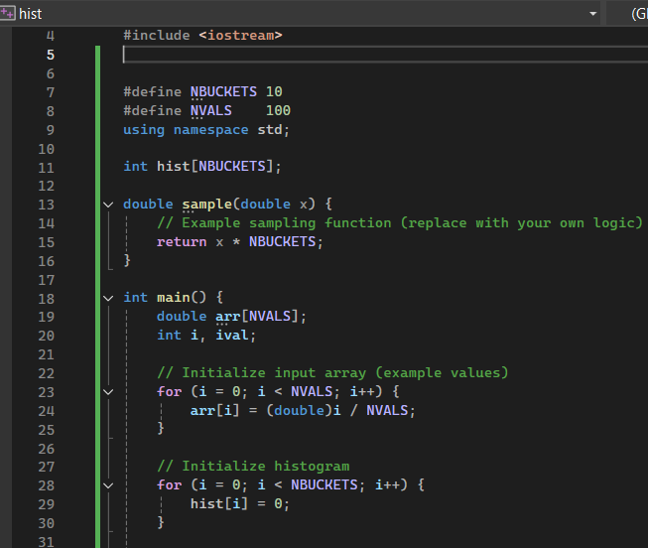
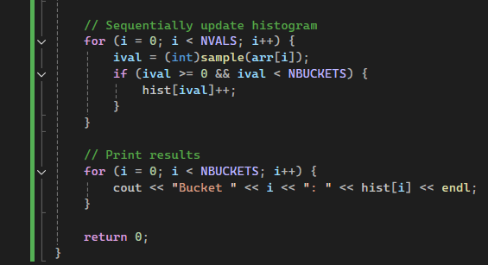
Sequential sol. histogram example

Slide 14
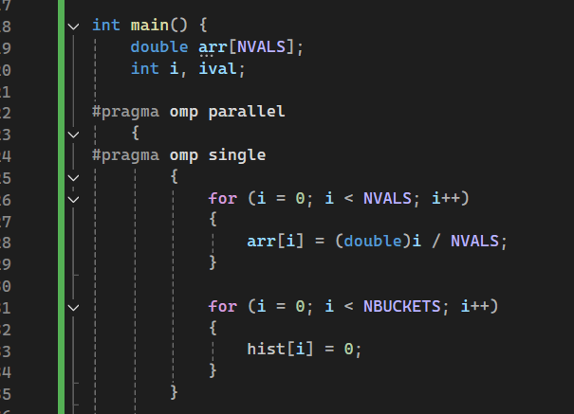
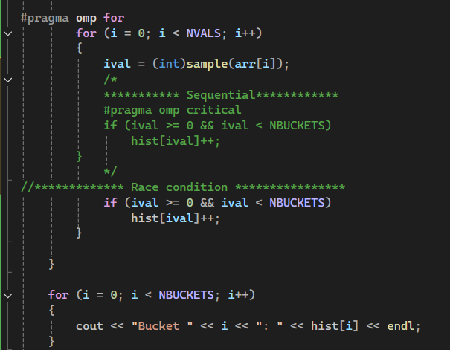
Parallel sol. with race condition histogram example
Notes:
Omp_lock_t→ lock type

Slide 15
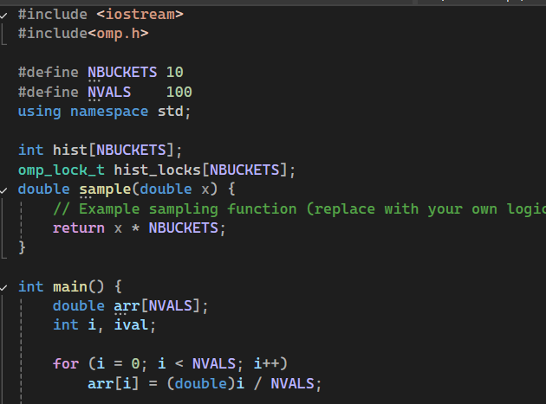
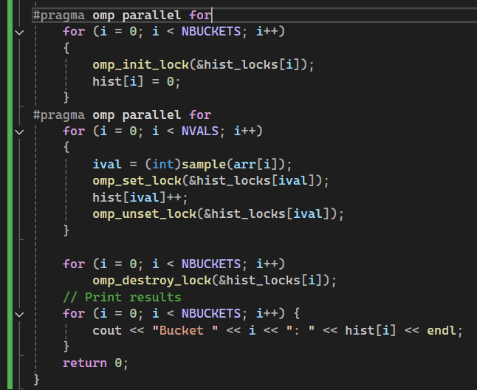
Parallel sol. without race condition histogram example
Notes:
Omp_lock_t→ lock type

Slide 16
Task routines and variable types
The task directive was originally introduced as part of the OpenMP 3.0 standard
OpenMP performs two activities related to tasks:
Packaging :creating a structure to describe a task entity.
Execution : assigning a task to a thread.
Tasks: are independent units of work and you just want to take those units of work and put them into some kind of task queue.
Tasks are composed of :
Code to execute
Data environment
Internal control variables (ICV) or thread reference → in OpenMP there are certain features of the environment that constructs control like foe example default number of threads.

Slide 17
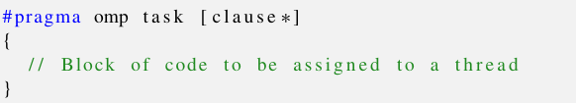
Task routines and variable types
The runtime system decides when tasks are executed
Think of it as you have some kind of queue mechanism that stores up the tasks until available threads are there to run them and then they’ll pick up a task and run them and schedule them
Task directive has no implicit barrier.
[But what is happening in parallel construct with task directive??]
[Let’s take a look]

Slide 18
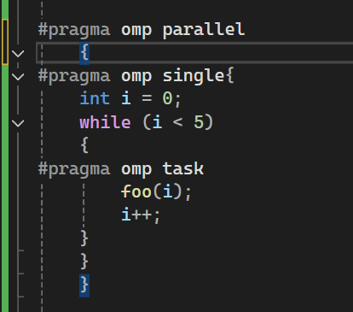
Task routines and variable types
Task creation → only one thread (the one that executes the single directive) will actually create the tasks which means other threads will wait in the barrier till the single thread create all tasks.
Task execution → once created, tasks are placed into a task pool managed by the OpenMP run time. Any thread in team (not just the one that created them) can pick up and execute those tasks. This allows load balancing between threads.
Important distinctions →
The creator thread → responsible for generating tasks
The worker threads → (including the creator itself if idle) can execute tasks.
Thread pool → A collection of pre-created worker threads managed by the runtime/OS
Task pool → A higher-level abstraction representing a unit of work (a "task") that can run asynchronously Tasks are scheduled by a Task Scheduler, which typically uses the thread pool underneath
You don’t end up with one thread doing all the work – the runtime distribute tasks dynamically

Slide 19
Task when and why the creator thread is “idle”??
The creator thread (the one inside the single region) is busy while it’s generating tasks.
Once it finishes creating tasks, it reaches the implicit barrier at the end of the single construct.
At that point: if there are still tasks waiting the pool, the creator thread can help executing tasks just like any other worker. If all tasks are already completed by other threads, the creator thread simply waits at the barrier (idle)
OpenMP’s runtime doesn’t reserve the creator thread exclusively for task creation.
After it’s done dispatching tasks, it becomes part of the pool of threads available to execute tasks
This ensure load balancing → no thread is wasted just sitting idle unless there’s literally no work left.

Slide 20
Exercise 7
Solve Fibonacci sequence using a task work-sharing construct
The readers–writers problem manifests itself whenever a shared resource is accessed by threads trying to modify it alongside threads trying to read it. In its simplest form, the problem is governed by the following two conditions: • Each writer must have exclusive access to the resource while it is modifying it. All other threads, including readers, are blocked. • If a reader is accessing the resource, other readers may do so as well. Obviously, adhering to the previous condition, writer threads cannot access the resource while a reader is doing so.

