Slide 1

Parallel computing
Sec.5
Eng/ Mariam Malak

Slide 2
Race condition when the program’s outcome changes as the threads are scheduled differently
A data race occurs when two or more threads access the same memory location and at least one of those accesses is a write. This constitutes a problem as uncoordinated modifications can lead to data corruption.
A race condition on the other hand is an abnormal program behavior caused by dependence of the result on the relative timing of events in the program. A race condition can exist even if there is no data race and the opposite is also true, i.e., a data race can exist without producing a race condition.
A race condition occurs when the behavior of a system depends on the timing or sequence of uncontrollable events, leading to unpredictable or undesirable outcomes.
A race condition occurs when two or more processes or threads access and modify the same data at the same time, and the final result depends on the order in which they run.
Without proper coordination, this can lead to incorrect or unpredictable results. For example, if two people update the same bank account simultaneously without checking each other’s changes, the final balance may be wrong

Slide 3
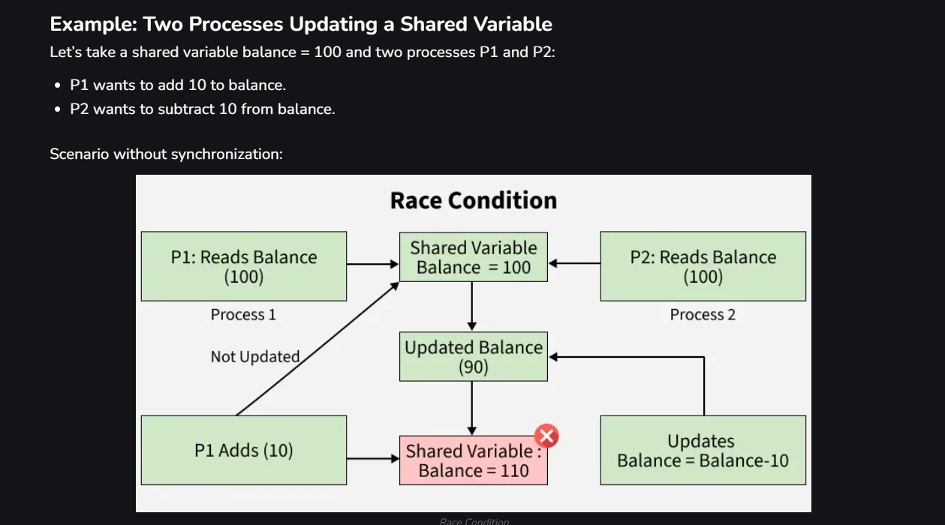
Race condition when the program’s outcome changes as the threads are scheduled differently
One of main reasons is Simultaneous Access: when two or more processes try to read or write the same shared resource at the same time.
Another reason is Shared Resource: A variable, file, memory location, or device accessed by multiple processes.

Slide 4
Race condition when the program’s outcome changes as the threads are scheduled differently
Effects of Race Conditions
Data Corruption: Shared data may become inconsistent.
Unpredictable Behavior: The output may vary every time the program runs.
Security Risks: Race conditions can be exploited, e.g., in banking transactions or authentication bypass.
System Crashes: Critical system data may get corrupted, leading to failures.
First thing to think about to solve this problem is making every thread accesses variable that other threads don’t access it.
[let’s code it]

Slide 5
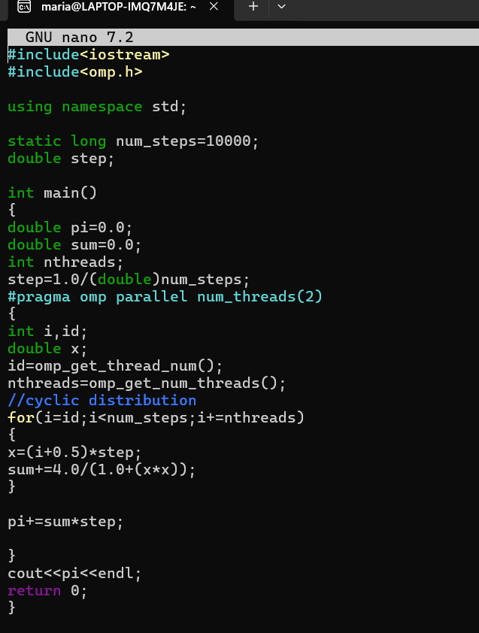
Race condition when the program’s outcome changes as the threads are scheduled differently
Code with race condition

Slide 6
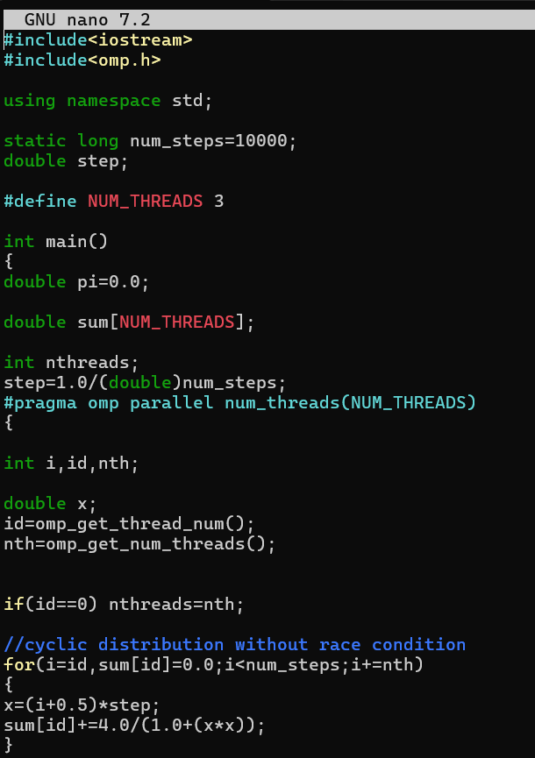
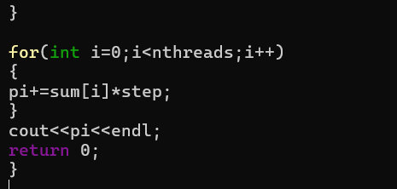
Race condition when the program’s outcome changes as the threads are scheduled differently
Code without race condition

Slide 7
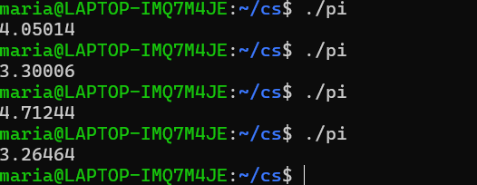
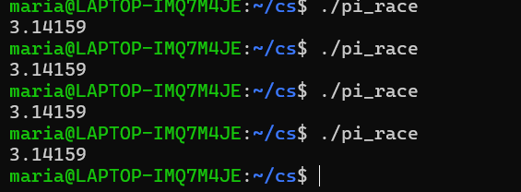
Race condition when the program’s outcome changes as the threads are scheduled differently
Output with race condition
Output without race condition
Scalability of this program sucks

Slide 8
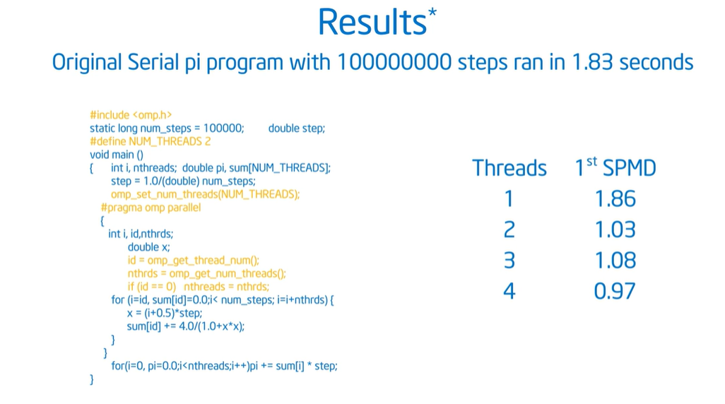
Race condition when the program’s outcome changes as the threads are scheduled differently
Performance changes every time you change number of threads.

Slide 9
Cache lines how does it go??
Cache memory speeds up access to main memory contents by holding copies of the most frequently used data.
Cache memory takes advantage of both temporal and spatial locality in data access patterns: a data item that has been referenced in the past is likely to be referenced again in the near future, along with other items in neighboring locations.
Cache memory tries to exploit spatial redundancy by fetching data from main memory in fixed-sized blocks called cache lines. The size of the cache line is architecture-specific, but a commonly used value is 64 byte
A cache line consists of the actual data, their address (so the CPU knows where they came from), and a state.
Notes:
Spatial locality is a principle of how programs typically access memory : If a program accesses one memory location, it is very likely to access nearby memory locations soon.
CPUs and caches are designed around this behavior.
Because of spatial locality, CPUs do not load a single byte from memory.
Instead they load a cache line (typically 64 bytes).

Slide 10
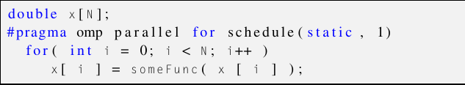
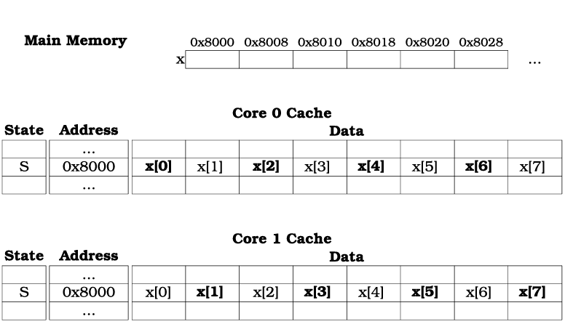
Cache lines how does it go??
This code:
The state is used to implement a coherency protocol, i.e., a mechanism that allows data stored in multiple disjoint caches to be kept in a consistent state . For example, if core 0 changes the value of x[10], core 1 should be able to read the updated value and not keep using an outdated one.
Like this in cache:

Slide 11
Cache lines how does it go??
A simple state model is MESI, an acronym standing for the four possible cache line states covered by the model: modified, exclusive, shared, and invalid
Modified: The CPU has recently changed part of the cache line, and the cache line holds the only up-to-date value of the corresponding item. No other CPU can hold copies of these data, so the CPU can be considered the owner of the data. The pending changes are supposed to be written back to the main memory according to the rules of the CPU architecture.
Exclusive: This is similar to the modified state, in that the CPU is considered the owner of the data. No change has been applied though. The main memory and the cache hold identical values
Shared: At least one more cache holds a copy of the data. Changes to the data can only be performed after coordination with the other CPUs holding copies
Invalid: This represents an empty cache line. It can be used to hold new data from the main memory

Slide 12
Cache lines how does it go??
What is of interest to us is what happens when a shared cache line is modified by one of the CPUs using it.
The CPU applying the change sends “invalidate” messages to the CPUs that have copies of the cache line and awaits “acknowledge” responses from them, before changing the state from shared to modified.
The CPUs that receive an “invalidate” message clear the corresponding cache line by changing its state to “invalid” and send back an “acknowledge” message.
This means that if they wish to access the data that got cleared, they have to either fetch it from the “owning” cache or read it again from memory.

Slide 13
Cache lines how does it go??
what happens to the state if core 0 modifies the value of x[0]? Although core 1 does not actually access this item, it shares the cache line that holds it. The resulting “invalidate” message will cause core 1 to dump the cache line and reread from the main memory the items it needs, at a substantial time overhead. This is exactly the definition of false-sharing, i.e., sharing cache lines without actually, sharing data.

Slide 14
False sharing is performance issue in multithreaded applications caused by the way modern processors handle cache lines
If independent data elements happen to sit on the same cache line, each update will cause the cache line to “slosh back and forth” between threads.
The thread zero comes in and it writes its element and then thread number two comes in writes its element happens to be in the same cache line
It has to send out a cache protocol message saying invalidate that copy because I’m about to write so what you do is you get the cache line sloshing back and forth.
It called false sharing because there truly is no sharing, there is no shared data conflict but because they happen to be in the same cache line, even though I get the right answer, I get this horrible performance hit due to bouncing the cache line back and forth.

Slide 15
False sharing How does false sharing happen??
Processor’s cache data in units called lines, typically 64 bytes in size.
When thread modifies a variable, the entire cache line containing that variable is marked as modified.
If another thread accesses a different variable within the same cache line, the cache line is invalidated and must be reloaded from memory, even though the accessed variable was not modified.
This results in increasing memory traffic and reducing performance.

Slide 16
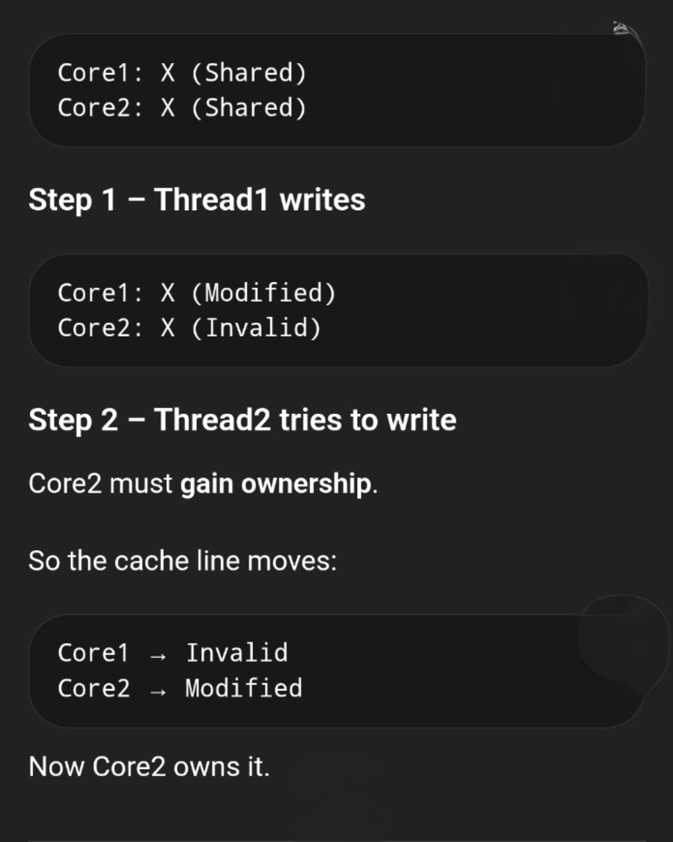
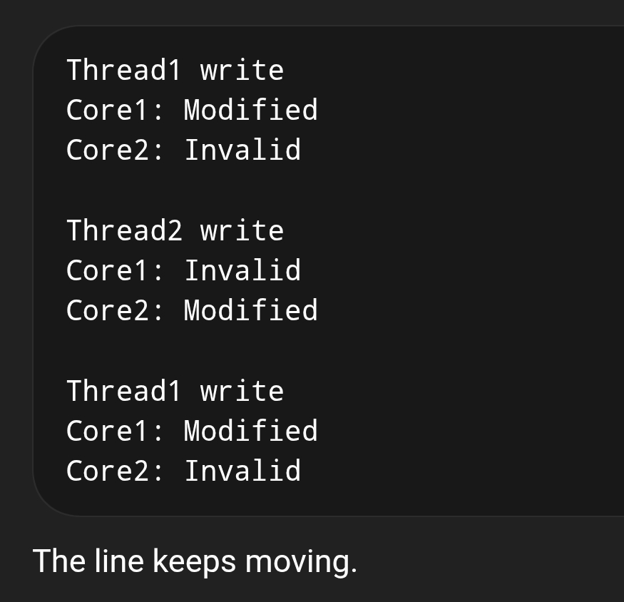
False sharing is performance issue in multithreaded applications caused by the way modern processors handle cache lines

Slide 17
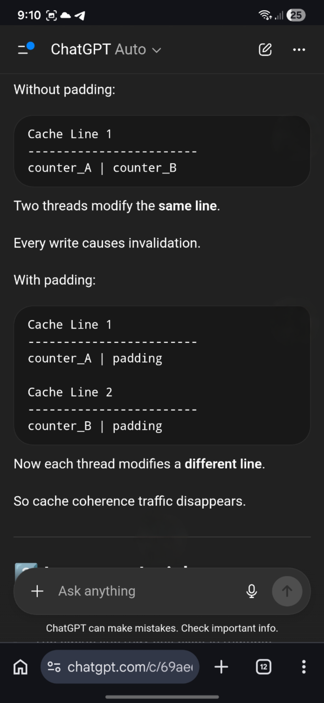
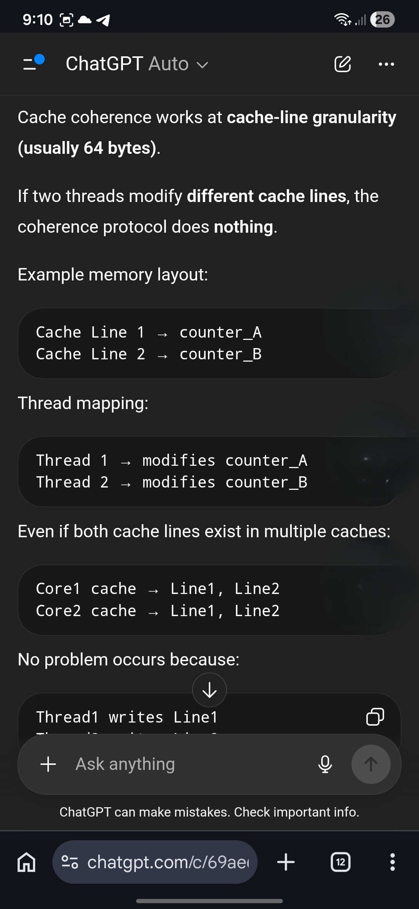
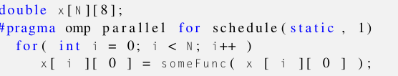
False sharing is performance issue in multithreaded applications caused by the way modern processors handle cache lines
Pad the data with extra bytes, so that distinct elements map to distinct cache lines. This is a viable option for data structures where the extra padding will not cause an extreme memory space overhead. For an array and scheduling arrangement like the one in our example, this would cause a sevenfold increase in the memory footprint of array x, which by itself would defeat the benefits of cache memory, if not starve the application of memory
so that each array row would occupy a complete cache line.
[let’s code it]
Notes:
what happens when the number of cache lines needed is larger than the cache capacity??
the CPU evicts older cache lines and reloads them later from memory when needed.

Slide 18
False sharing is performance issue in multithreaded applications caused by the way modern processors handle cache lines
Code without race condition but with false sharing

Slide 19
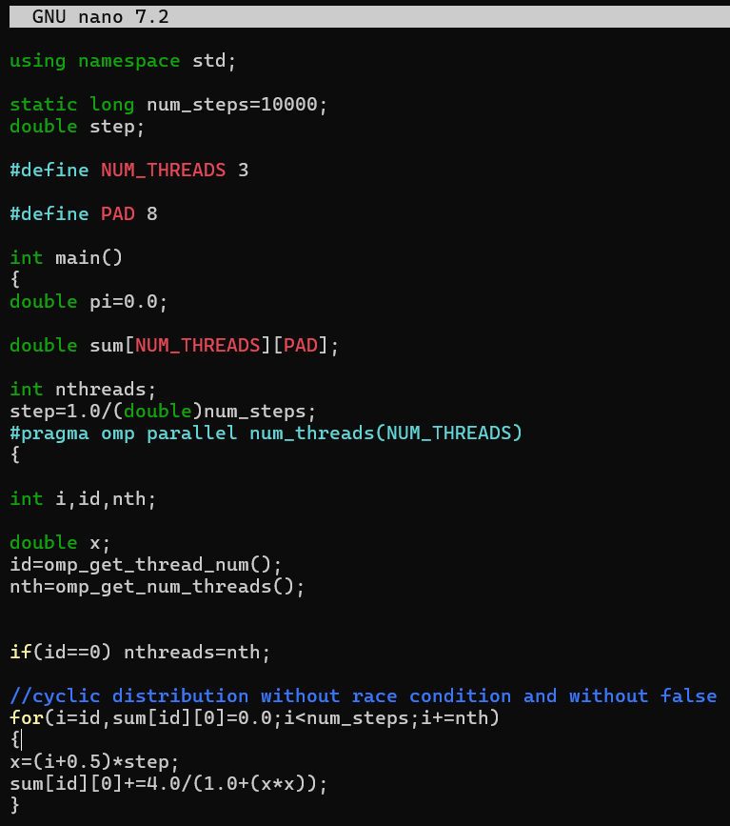
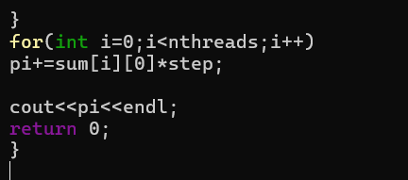
False sharing is performance issue in multithreaded applications caused by the way modern processors handle cache lines
Code without race condition and without false sharing

Slide 20
Exercise 3
Create a parallel version of the integration program using a parallel construct.[pay close attention to race condition and false sharing]
A simple OpenMP adaptation of a matrix multiplication function. Matrix A is assumed to be N×K and matrix B is assumed to be K×M in size

