Slide 1

Parallel computing
Sec.2
Eng/ Mariam Malak

Slide 2
Program vs process
what happens when a program runs?
Well, a running program does one very simple thing: it executes instructions
The processor fetches an instruction from memory, decodes it (i.e., figures out which instruction this is), and executes it (i.e., it does the thing that it is supposed to do, like add two numbers together, access memory, check a condition, jump to a function, and so forth). After it is done with this instruction, the processor moves on to the next instruction, and so on, and so on, until the program finally completes.
[Von Neumann model of computing]
The process, informally, is quite simple: it is a running program .
The program itself is a lifeless thing: it just sits there on the disk, a bunch of instructions (and maybe some static data), waiting to spring into action.

Slide 3
The abstraction : A process
The abstraction provided by the OS of a running program is something we will call
a process.
One obvious component of machine state that comprises a process is its memory. Instructions lie in memory; the data that the running program reads and writes sits in memory as well.
Thus the memory that the process can address (called its address space) is part of the process
Notes:
machine state: what a program can read or update when it is running

Slide 4
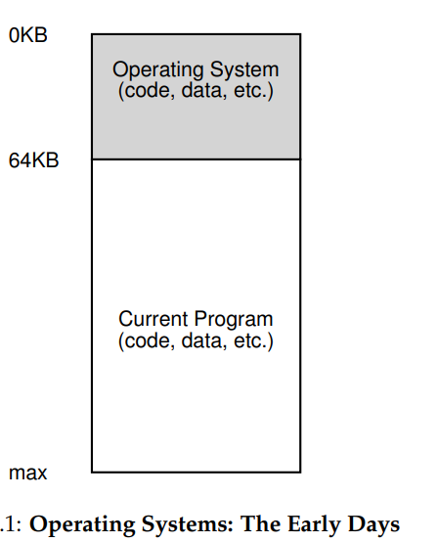










Memory view
From the perspective of memory, early machines didn’t provide much of an abstraction to users.
The OS was a set of routines (a library, really) that sat in memory (starting at physical address 0 in this example), and there would be one running program (a process) that currently sat in physical memory and used the rest of memory

Slide 5
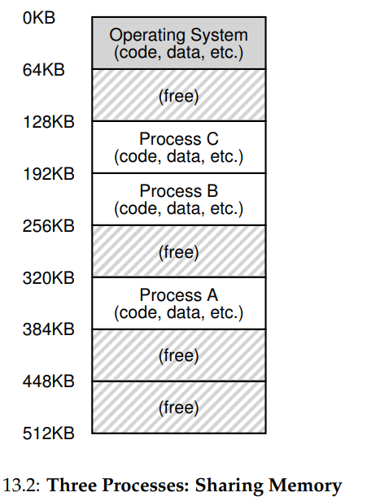
After a time, because machines were expensive, people began to share machines more effectively. Thus the era of multiprogramming was born , in which multiple processes were ready to run at a given time, and the OS would switch between them, for example when one decided to perform an I/O. Doing so increased the effective utilization of the CPU. Such increases in efficiency were particularly important in those days where each machine cost hundreds of thousands or even millions of dollars (and you thought your Mac was expensive!).
what we’d rather do is leave processes in memory while switching between them, allowing the OS to implement time sharing efficiently In the diagram, there are three processes (A, B, and C) and each of them have a small part of the 512KB physical memory carved out for them. Assuming a single CPU, the OS chooses to run one of the processes (say A), while the others (B and C) sit in the ready queue waiting to run.
[Some problems like protection raised]
[ you don’t want a process to be able to read, or
worse, write some other process’s memory ]

Slide 6
Virtualizing memory
Each process accesses its own private virtual address space (sometimes just called its address space), which the OS somehow maps onto the physical memory of the machine.
A memory reference within one running program does not affect the address space of other processes (or the OS itself); as far as the running program is concerned, it has physical memory all to itself.
The reality, however, is that physical memory is a shared resource, managed by the operating system
[what is happening here as the OS is virtualizing memory]
[Transform physical resources to a virtual form of itself]

Slide 7
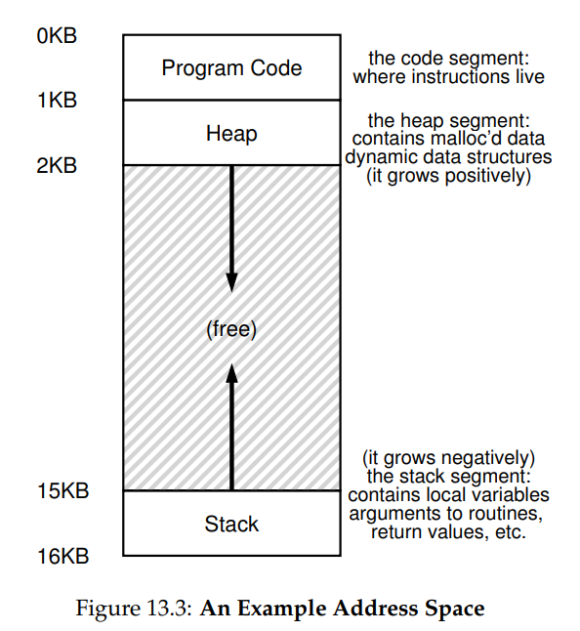
Address space
The OS creates an easy-to-use abstraction of physical memory; we call this abstraction the address space.
The address space is the running program’s view of memory in the system.
[Understanding this fundamental OS abstraction of memory is key to understanding how memory is virtualized.]
The address space of a process contains all of the memory state of the running program. For example, the code of the program (the instructions) have to live in memory somewhere, and thus they are in the address space.
The program, while it is running, uses a stack to keep track of where it is in the function call chain as well as to allocate local variables and pass parameters and return values to and from routines.
Finally, the heap is used for dynamically-allocated, user-managed memory, such as that you might receive from a call to malloc() in C or new in an object-oriented language such as C++.
Notes:
we have the two regions of the address space that may grow (and shrink) while the program runs.
Those are the heap (at the top) and the stack (at the bottom).
We place them like this because each wishes to be able to grow, and by putting them at opposite ends of the address space, we can allow such growth: they just have to grow in opposite directions. The heap thus starts just after the code (at 1KB) and grows downward (say when a user requests more memory via malloc()); the stack starts at 16KB and grows upward (say when a user makes a procedure call).

Slide 8
OpenMP
Depends on shared memory computer.
Shared memory computer: any computer compose of multiple processing elements thar share address space.
There are 2 classes of shared memory:
Symmetric multiprocessor[SMP]:
A shared address space with ’equal-time’ access for each processor, and the OS treats every processor the same way
[1. It assumes there is no special blocks in memory.
2. All memory is equally accessible at a roughly equal cost from anywhere in the machine.]
2. Non Uniform Address Space[NUMA]:
Different memory regions have different access costs, think of memory segmented into “near and far” memory.

Slide 9
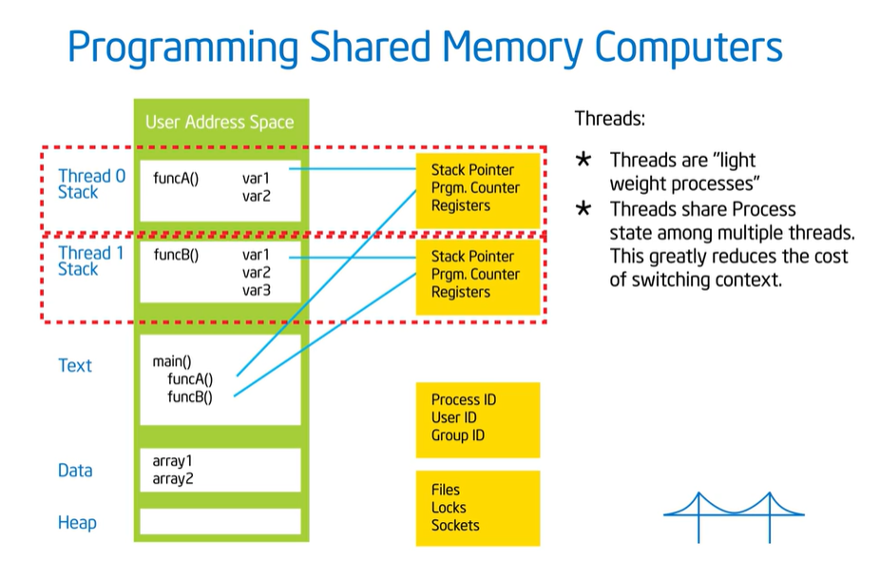
OpenMP
Depends on shared memory computer.
Shared memory computer: any computer compose of multiple processing elements thar share address space.
Based on NUMA approach, we can say :
Some address spaces are closer to processor than others.
Modern CPUs that we have are SMPs, the fact the matter is they’re not.
The fact the matter is when you think about an algorithm, you want to keep in mind that there’re a cache hierarchy behind there.
If something is setting in a cache close to the processor, it has much faster access time than if it’s setting in DRAM faraway.
The way a modern OS manages a process is it further decompose that into threads and it does that by fragmenting the stack.
So each thread has its own chunk of the stack and maintains its own program pointer and its own register set and but they share the text region(code area), the data region and the heap.

Slide 10
OpenMP
Depends on shared memory computer.
Shared memory computer: any computer compose of multiple processing elements thar share address space.
Threads have a stack which is their own little piece of memory but then they have a heap which belongs to the process and is shared between the threads.
Sharing process state among multiple threads which is greatly reduces the cost of switching context.
You may have threads more than processor cores.
An instance of a program [process]:
One process lots of threads
Threads interact through reads/writes to a shared address space.
OS schedular decides when to run which threads … interleaving for fairness
Synchronization to assure every legal order results in correct results.

Slide 11
OpenMP
Depends on shared memory computer.
Shared memory computer: any computer compose of multiple processing elements thar share address space.
Programmer have to make sure that every single way you interleave those threads gives you a correct result.
Threads communicate by sharing variables.
These variables are sitting in the heap of the process.
All threads can see that
So the threads interact by looking at those variables.
With OpenMP:
Create threads working in a shared address space
Un intended sharing that can get you into trouble with the race condition
Synchronization to have organized discipline access to shared data
Able to manage the data environment to reduce amount of synchronization

Slide 12
Exercise 2
Create a parallel version of the PI program using a parallel construct.[pay close attention to shared versus private variables ]
Creating a parallel version of a program for calculating the integral of a function.

