Slide 1

Parallel computing
Sec.12
Eng/ Mariam Malak

Slide 2
Distributed memory architecture what is this?? And what is its problem??
Distributed memory refers to a computer architecture where each processor has its own private memory, and processors communicate with each other by passing messages rather than sharing a single memory space
In a distributed address space, there is no global memory. Thus, data exchange must be performed by explicit message-passing: to transfer data from the local memory of one processor A to the local memory of another processor B, A must send a message containing the data to B, and B must receive the data in a buffer in its local memory.
To guarantee portability of programs, no assumptions on the topology of the interconnection network is made. Instead, it is assumed that each processor can send a message to any other processor.

Slide 3
Distributed memory architecture what is this?? And what is its problem??
A message-passing program is executed by a set of processes where each process has its own local data.
Usually, one process is executed on one processor or core of the execution platform.
The number of processes is often fixed when starting the program.
Each process can access its local data and can exchange information and data with other processes by sending and receiving messages.
In principle, each of the processes could execute a different program (MPMD, multiple program multiple data). But to make program design easier, it is usually assumed that each of the processes executes the same program (SPMD, single program, multiple data)

Slide 4
Distributed memory architecture communication solution
The processes executing a message-passing program can exchange local data by using communication operations.
These could be provided by a communication library.
To activate a specific communication operation, the participating processes call the corresponding communication function provided by the library.
In the simplest case, this could be a point-to-point transfer of data from a process A to a process B. In this case, A calls a send operation, and B calls a corresponding receive operation.
By far the most popular portable communication library is MPI (Message-Passing Interface)

Slide 5
MPI Message-Passing Interface
The Message-Passing Interface (MPI) is a standardization of a message-passing library interface specification.
MPI defines the syntax and semantics of library routines for standard communication patterns
The MPI standard has first been introduced in 1994
MPI is an interface specification for the syntax and semantics of communication operations, but leaves the details of the implementation open.
Thus, different MPI libraries can use different implementations, possibly using specific optimizations for specific hardware platforms.
For the programmer, MPI provides a standard interface, thus ensuring the portability of MPI programs.
Freely available MPI libraries are OpenMPI, MPICH.

Slide 6
MPI Message-Passing Interface
A significant part of the operations provided by MPI are operations for the exchange of data between processes
The most important MPI operations:
blocking operation: An MPI communication operation is blocking, if return of control to the calling process indicates that all resources, such as buffers, specified in the call can be reused, e.g., for other operations. In particular, all state transitions initiated by a blocking operation are completed before control returns to the calling process.
non-blocking operation: An MPI communication operation is non-blocking, if the corresponding call may return before all effects of the operation are completed, and before the resources used by the call can be reused. Thus, a call of a non-blocking operation only starts the operation. The operation itself is completed not before all state transitions caused are completed and the resources specified can be reused.

Slide 7
MPI Message-Passing Interface
The terms blocking and non-blocking describe the behavior of operations from the local view of the executing process, without taking the effects on other processes into account. But it is also useful to consider the effect of communication operations from a global viewpoint. In this context, it is reasonable to distinguish between synchronous and asynchronous communication:
synchronous communication: For a synchronous MPI operation, the communication between a sending process and a receiving process is performed such that the communication operation does not complete before both processes have started their communication operation. This means in particular that the completion of a synchronous send indicates not only that the send buffer can be reused but also that the receiving process has started the execution of the corresponding receive operation.
Asynchronous communication: Using asynchronous communication, the sender can execute its communication operation without any coordination with the receiving process

Slide 8
MPI Message-Passing Interface
Any MPI program should have operations to initialize execution environment and to control starting and terminating procedures of all generated processes.
MPI processes can be collected into groups of specific size that can communicate in its own environment where each message sent in a context must be received only in the same context.
A process group and context together form an MPI communicator.
A process is identified by its rank in the group associated with a communicator.
the MPI default communicator MPI_COMM_WORLD is used for the communication. This communicator captures all processes executing a parallel program.
A single program may use several communicators, which manage common or separated MPI processes.
Such a concept enables to use different MPI based parallel libraries that can communicate independently, without interference, within a single parallel program.

Slide 9
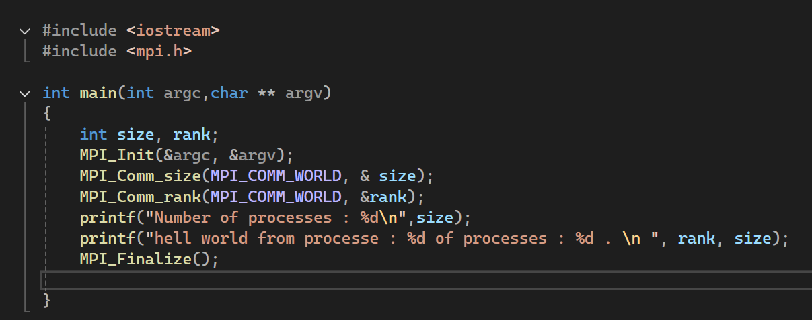

MPI code
Provides basic MPI definition of named constants, types, and function prototypes, and must be included in any MPI program
MPI_Init initializes the MPI execution environment and MPI_Finalize exits the MPI
MPI_Comm_size(MPI_COMM_WORLD, &size) returns size, which is the number of started processes.
MPI_Comm_rank(MPI_COMM_WORLD, &rank) that returns rank, i.e., an ID of each process.
To run:
-n / -cores : means number of processes to run
Notes:
MPI setup : Installing MPI on Windows and Running Your First MPI Program

Slide 10
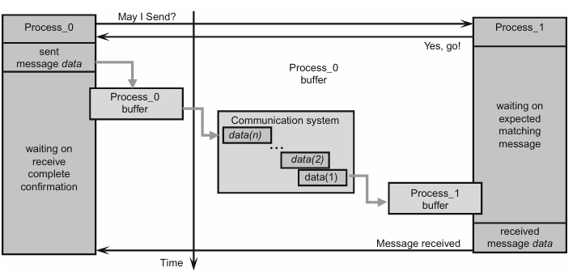
Process-to-Process Communication
The message passing model formalizes the communication between processes that have separate address spaces.
The process-to-process communication has to implement two essential tasks: data movement and synchronization of processes; therefore, it requires cooperation of sender and receiver processes.
Consequently, every send operation expects a pairing/matching receive operation
Process_0 will have to wait on the return from the previous call, before it can send a new message. On the receiver side, Process_1 can do some useful work instead of idling while waiting on the matching message reception. It is a communication system that must ensure that the message will be reliably transferred between both processes.
Although that blocking send/receive operations enable a simple way for synchronization of processes, they could introduce unnecessary delays in cases where sender and receiver do not reach communication point at the same real time. For example, if Process_0 issues a send call significantly before the matching receives call in Process_1,Process_0willstart waiting to the actual message data transfer. In the same way,processes’ idling can happen if a process that produces many messages is much faster than the consumer process. Message buffering may alleviate the idling to some extent, but if the amount of data exceeds the capacity of the message buffer, which can always happen, Process_0 will be blocked again.

Slide 11
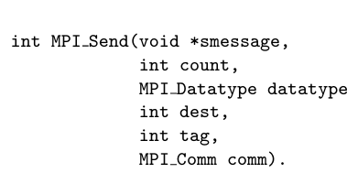
Process-to-Process Communication code
smessage : specifies a send buffer which contains the data elements to be sent in successive order;
count :is the number of elements to be sent from the send buffer;
datatype : is the data type of each entry of the send buffer; all entries have the same data type;
dest : specifies the rank of the target process which should receive the data; each process of a communicator has a unique rank; the ranks are numbered from 0 to the number of processes minus one;
tag: is a message tag which can be used by the receiver to distinguish different messages from the same sender;
comm : specifies the communicator used for the communication.
The size of the message in bytes can be computed by multiplying the number count of entries with the number of bytes used for type datatype
The tag parameter should be an integer value between 0 and 32767.
Larger values can be permitted by specific MPI libraries.

Slide 12
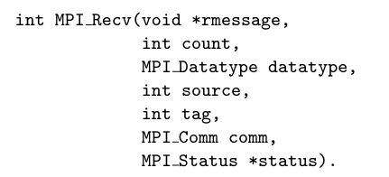
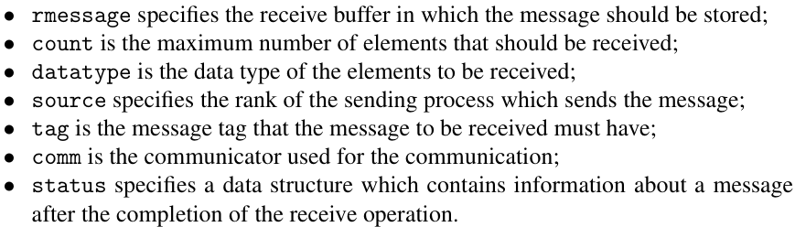
Process-to-Process Communication code
The size of the message in bytes can be computed by multiplying the number count of entries with the number of bytes used for type datatype
The tag parameter should be an integer value between 0 and 32767.
Larger values can be permitted by specific MPI libraries.

Slide 13
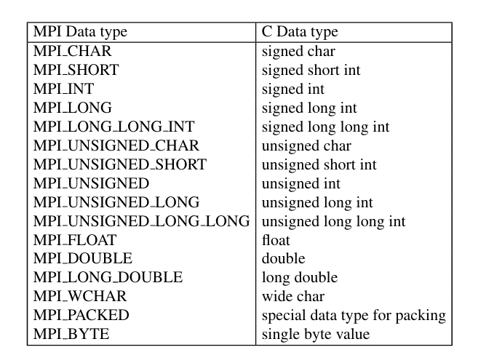

Process-to-Process Communication code
The most important predefined MPI data types and the corresponding C datatypes
By using source =MPI_ANY_SOURCE, a process can receive a message from an arbitrary other process.
Similarly, by using tag =MPI_ANY_TAG,a process can receive a message with an arbitrary tag
the status data structure contains the information, from which process the message received has been sent and which tag has been used by the sender. After completion of MPI_Recv(), status contains the following information:

Slide 14
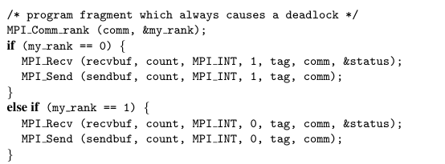
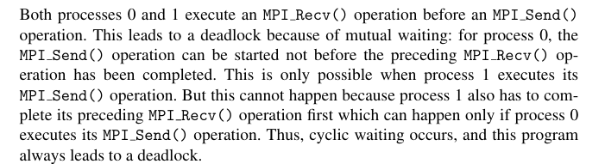
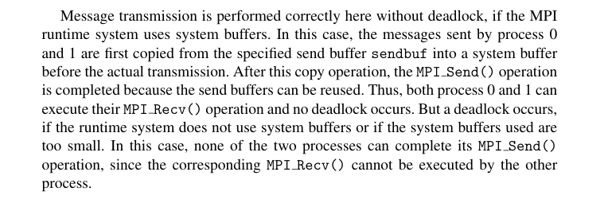
Process-to-Process Communication code
Send and receive operations must be used with care,since deadlocks can occur in I ll-constructed programs.This can be illustrated by the following example:

Slide 15
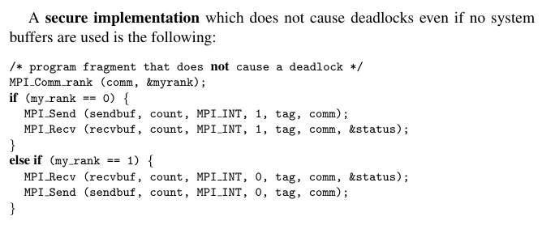
Process-to-Process Communication avoid deadlock
Send and receive operations must be used with care,since deadlocks can occur in I ll-constructed programs.This can be illustrated by the following example:

Slide 16
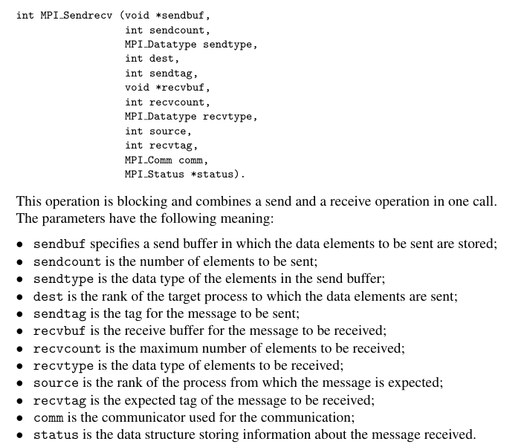
Process-to-Process Communication avoid deadlock
In many situations, processes both send and receive data.
MPI provides the following operations to support this behavior:
Using MPI_Sendrecv(), the programmer does not need to worry about the order of the send and receive operations.
The MPI runtime system guarantees deadlock freedom, also for the case that no internal system buffers are used.
The parameters sendbuf and recvbuf, specifying the send and receive buffer of the executing pro cess, must be disjoint, non-overlapping memory locations.
But the buffers may have different lengths, and the entries stored may even contain elements of different data types

Slide 17
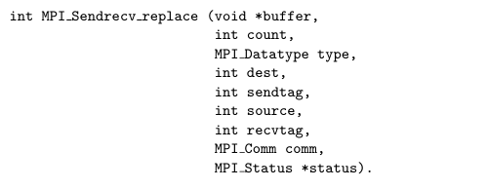
Process-to-Process Communication avoid deadlock
In many situations, processes both send and receive data.
MPI provides the following operations to support this behavior:
Here, buffer specifies the buffer that is used as both, send and receive buffer. For this function, count is the number of elements to be sent and to be received; these elements now have to have identical type.

Slide 18
Exercise 1_MPI
Perform round robin using mpi

