Slide 1
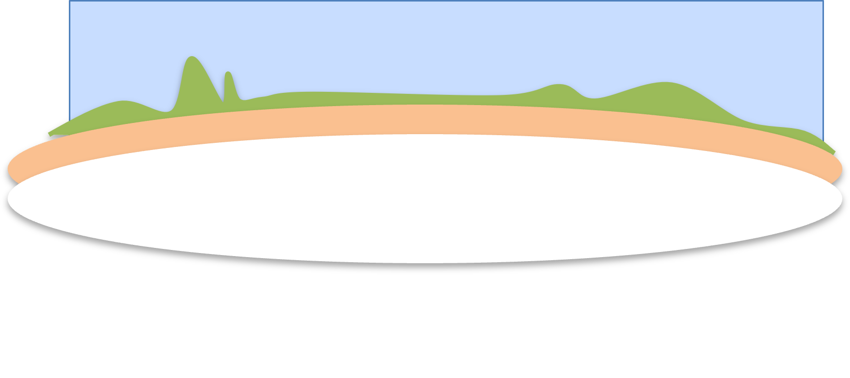


Clothing sales time series forecast
Mariana Khachatryan

Slide 2
Outline
Motivation
Modeling framework
Results
Conclusions

Slide 3
Motivation
Business Stakeholders
Executive Leadership
Strategic planning, revenue goals.
Merchandisers
Buying inventory ahead of demand.
Marketing Team
Aligning campaigns with expected demand.
Production/Manufacturing
Reducing overproduction and understock

Slide 4
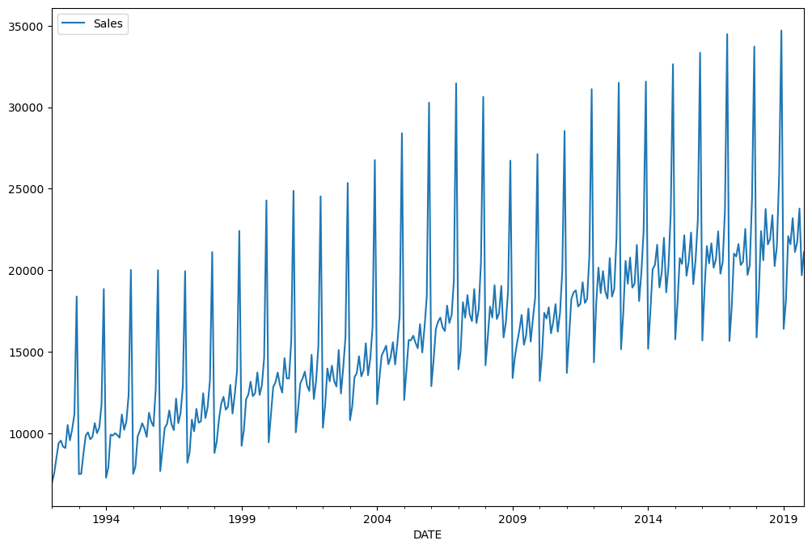
Modeling framework
Use clothing retain sale data from FRED (Federal Resale Economic Database, https://fred.stlouisfed.org/series/RSCCASN)
Do time series forecasting for sales in the units of millions of dollars
Final data set:
334 data points from 1992-2019
Test set
Split 70:30 and scale to [0,1]
1994 1999 2004 2009 2014 2019
Use two different Machine Learning models
LSTM
Linear Regression (best performance, requires feature engineering)
Training set

Slide 5
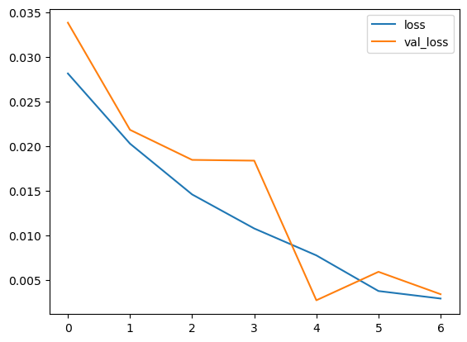
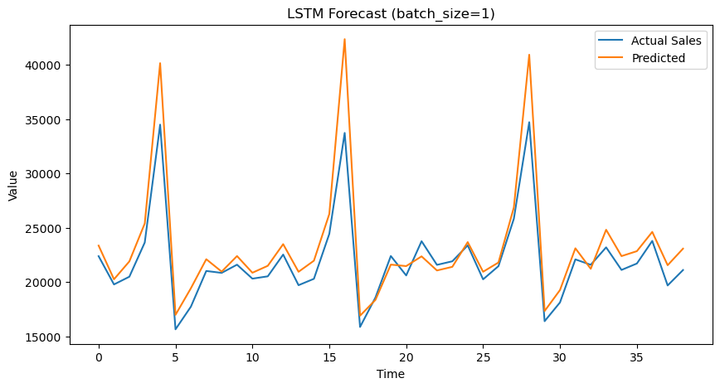
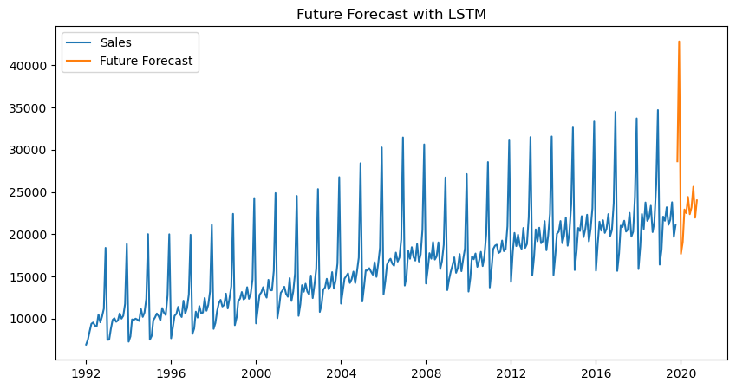
Results: LSTM
Learning Curve
LSTMs excel at capturing long-term dependencies in time series data
Easy to implement
Used early stopping based on validation loss
Loss (MSE)
Model prediction on test sample
Epochs
Forecasting to future

Slide 6
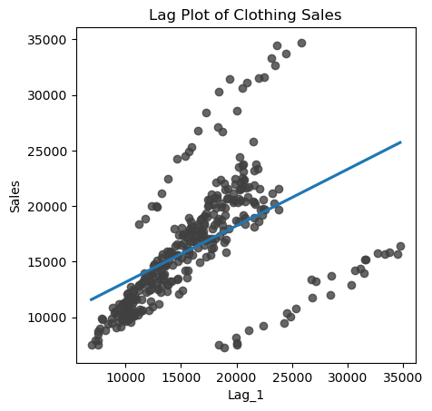
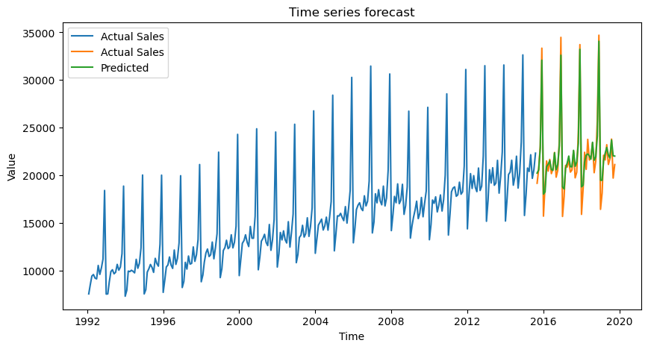
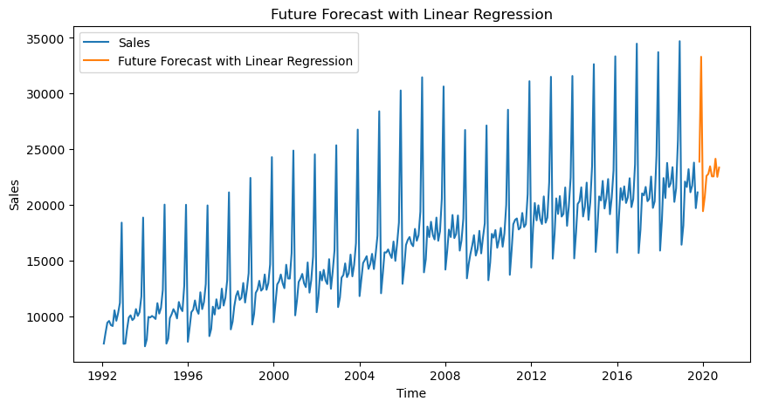
Results: Linear Regression
LAG plot
Need to do some feature engineering
Create a time-step feature to describe trend
Add lag feature (value of the time series at the previous time step) to describe autocorrelation
Add month categorical variable to describe seasonality
Model prediction on test sample
Forecasting to future

Slide 7
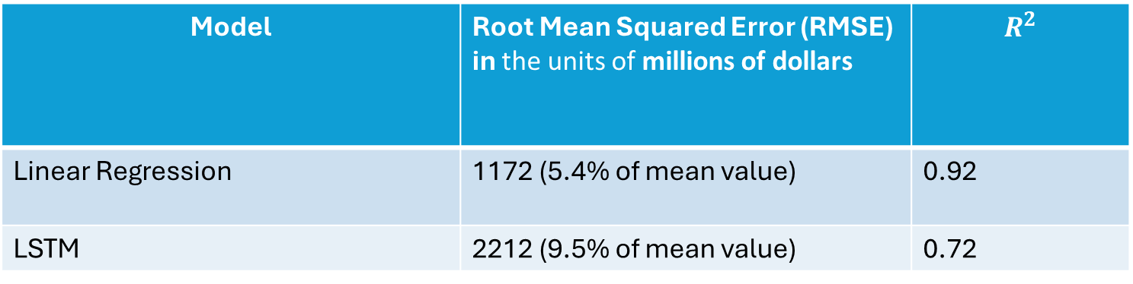
Results: Summary
Used early stopping based on validation loss for LSTM based Deep Learning model training.
Used feature engineering for Linear Regression based model.
Overall best model performance was obtained with Linear Regression. It is also a simple model and easy to interpret.
Model | Root Mean Squared Error (RMSE) in the units of millions of dollars | $$R^{2}$$
Linear Regression | 1172 (5.4% of mean value) | 0.92
LSTM | 2212 (9.5% of mean value) | 0.72

Slide 8
Conclusions
Used LSTM and Linear Regression based models for time series forecasting.
Linear Regression gives better performance, though both perform well.
When dataset is small Linear Regression is better choice.
Other models one can try
Try adding more lag features (look at partial autocorrelation)
Fit with hybrid model consisting of Linear Regression + XGBoost models.
Use statistical model called SARIMA (Seasonal Autoregressive Integrated Moving Average.)

