Slide 1




Car sales price prediction
Mariana Khachatryan, Amogh Parab, Nasim Dehghan Hardoroudi, Adreja Mondol

Slide 2
Outline
Motivation
Modeling framework
Results
Conclusions

Slide 3
Motivation
Buying and selling cars is a common experience especially among people leaving in rural areas with little or no transportation
Key Stakeholders
Individuals selling cars and car dealerships need price prediction model to set competitive and accurate prices for cars.
Dealerships want to maximize profit while ensuring quick car sales. Accurate price prediction results in competitive pricing and profitability.
Customers can use the model to estimate whether the set price is fare.

Slide 4
Modeling framework
Data processing involved:
Data cleaning
Feature engineering
One hot encoding of categorical variables
Removal of highly correlated features
Test set
Final data set:
6533 data points with 12 features
Split 80:20 and scale using Standard scaling
Use car sales data from CarDekho online marketplace
Model the relationship between car sales price and different car features
Baseline model
Linear regression
Regression models with parameters from cross validation
Polynomial regression
k-nearest neighbors
Support Vector Machines
Tree methods (best performance)
Training set

Slide 5
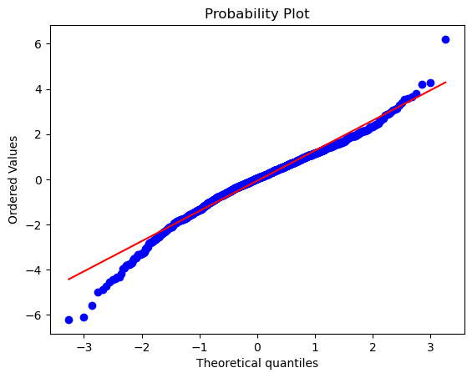
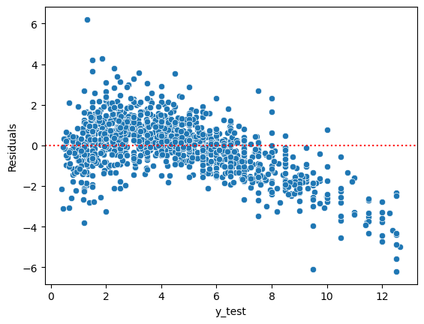
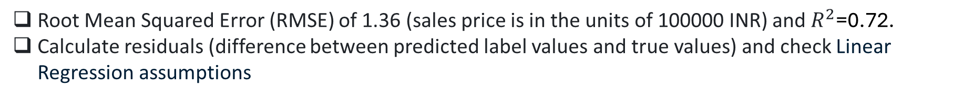
Results: Linear Regression (Base model)
Root Mean Squared Error (RMSE) of 1.36 (sales price is in the units of 100000 INR) and $R^{2}\text{=0.72}$.
Calculate residuals (difference between predicted label values and true values) and check Linear Regression assumptions
True price
The assumption of homoscedasticity is violated.
Normality is violated for lower for residual values below -3
Should consider other non-linear models.

Slide 6
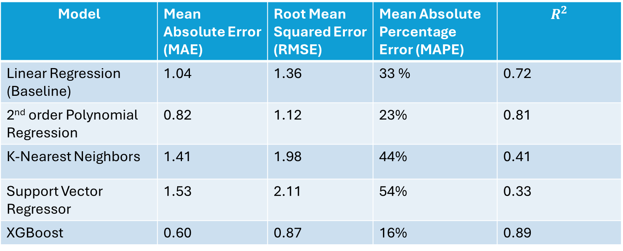
Results from non-linear models
Used Grid Search Cross-Validation to tune model parameters.
Overall best model performance was obtained with XGBoost. XGBoost outperforms SVMs and kNN because it is inherently nonlinear and is less sensitive to hyperparameter tuning. XGBoost improves performance by combining multiple trees, which enhances it's ability to model complex patterns.
It also reduces overfitting by combining multiple trees and employing shrinkage/regularization.
Model | Mean Absolute Error (MAE) | Root Mean Squared Error (RMSE) | Mean Absolute Percentage Error (MAPE) | $$R^{2}$$
Linear Regression (Baseline) | 1.04 | 1.36 | 33 % | 0.72
2nd order Polynomial Regression | 0.82 | 1.12 | 23% | 0.81
K-Nearest Neighbors | 1.41 | 1.98 | 44% | 0.41
Support Vector Regressor | 1.53 | 2.11 | 54% | 0.33
XGBoost | 0.60 | 0.87 | 16% | 0.89

Slide 7
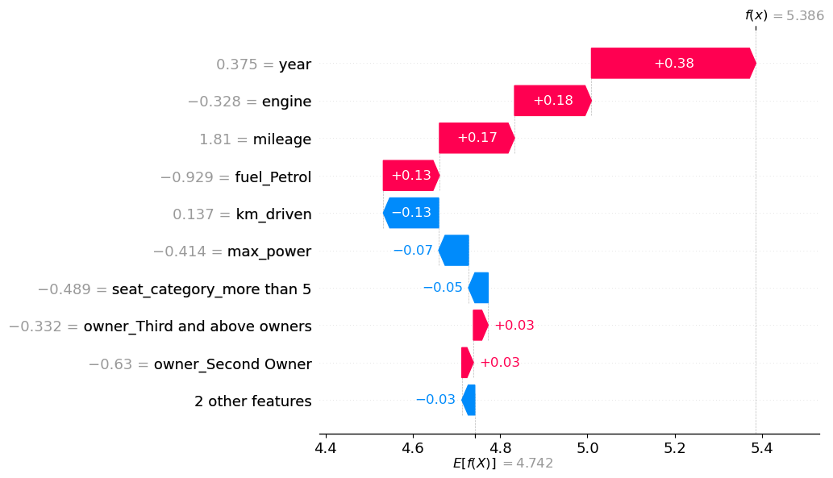
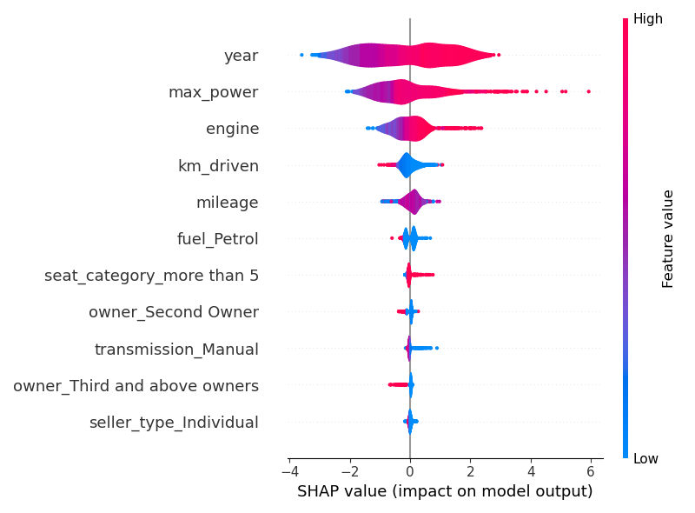
Results: SHapley Additive exPlanations (SHAP values) for describing feature importances
SHAP values:
method based on cooperative game theory
shows the contribution of each feature on the prediction of the model
SHAP values for one single observation are given by the length of the bar
The global effect of the features on model prediction
The mean of all predictions=4.742
Predicted value=5.386
Car sales price
The sum of all SHAP values will be equal to the difference between mean of all predictions and predicted value

Slide 8
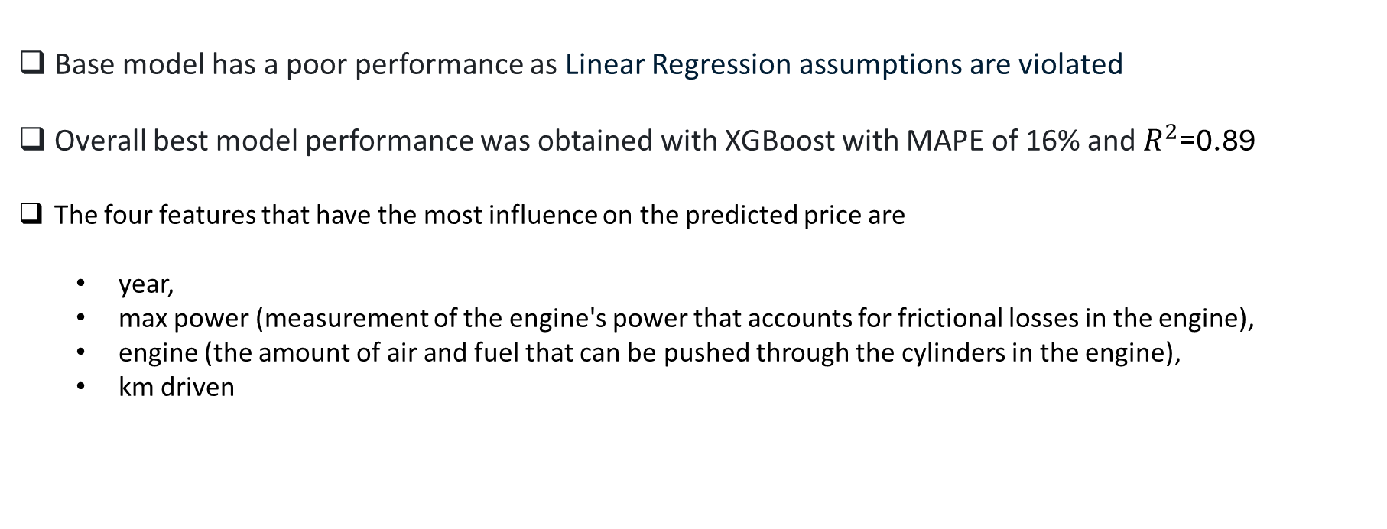
Conclusions
Base model has a poor performance as Linear Regression assumptions are violated
Overall best model performance was obtained with XGBoost with MAPE of 16% and $R^{2}$=0.89
The four features that have the most influence on the predicted price are
year,
max power (measurement of the engine's power that accounts for frictional losses in the engine),
engine (the amount of air and fuel that can be pushed through the cylinders in the engine),
km driven

