Slide 1



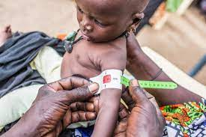
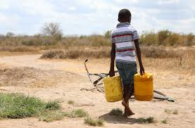
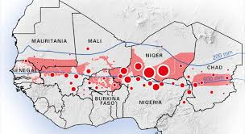

Novel Data Analytic Methods to Improve Burden Estimates for Wasting
Mayukh Ghosh and Chintan Amrit
University of Amsterdam

Slide 2
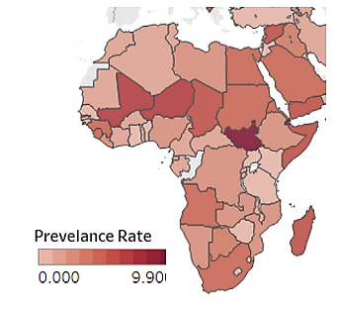
Introduction
Wasting (an acute form of malnutrition)
Increases a child’s risk of infection and death
In the absence of incidence data, the single incidence correction factor uses to estimate the burden
(Isanaka et al., 2021)
Most of the studies focus on estimating severe wasting
Only a few studies explore features that affect it
(Bulti et al., 2017; Barba, et al. 2020)
Research needs to identify the critical features associated with wasting in the Sahel region among children aged 6-59 months
"The persistent global burden of severe acute malnutrition: cross-country estimates, models and forecasts." (2020)
Notes:
Build three machine learning models to estimate the burden using both new features and those that are previously considered using in the Hotspot analysis.
Compare the efficacy of the machine learning models to predict the severity of acute malnutrition and assess the model performance compared to the current Hotspot approach used by WFP.
Perform analysis to identify the most important features that influence the predictions for each machine learning model and their commonalities across machine learning models.

Slide 3

Objectives
Analysis of the current Hotspot analysis model used by RBD* to estimate the burden
Develop Machine Learning (ML) models to predict burden of wasting
Identify important features that influence burden of wasting
Compare different ML models and current Hotspot analysis approach
* Regional Bureau of Dakar (RBD)
Notes:
Build three machine learning models to estimate the burden using both new features and those that are previously considered using in the Hotspot analysis.
Compare the efficacy of the machine learning models to predict the severity of acute malnutrition and assess the model performance compared to the current Hotspot approach used by WFP.
Perform analysis to identify the most important features that influence the predictions for each machine learning model and their commonalities across machine learning models.

Slide 4
Data Sources
Years Available
Information Level
1.
Hotspot Analysis Data
2020-2022
Administrative 2 Level
Private
Nutrition Survey Data
2012-2021
Administrative 2 Level
2.
Private
3.
INFORM Sahel*
2015-2021
Administrative 2 Level
Public
Hotspot analysis data for 2022 uses information on relevant features for 2021. For Nutrition Survey and INFORM Sahel data sources, data from 2019-2021 used for creating the final dataset
* https://data.humdata.org/dataset/the-regional-inform-sahel-model

Slide 5
A glance at Features Categories
Demographic Data: `Total Population', `Population 6 to 59 months'
Nutrition Data: ‘SAM/MAM/GAM incidence correction factor’, ‘SAM/MAM/GAM prevalence’, ‘MAM 6-59 months Prevalence’, ‘GAM rate enfants U5’, ‘Stunting rate U5’, ‘SAM U5 rate’, ‘GAM Rate FEFA’, ‘SAM/MAM/GAM burden’
Deterioration Data: `Diarrhee', `Malaria fever', `VITA', `Deworming', `Measles', `ARI Cough', `Access to health structures', `Access to sanitary facilities', `Access to drinking water not accessible', `CH-Ph 3-5', `IDPs', `Food Insecurity', `Food diversity not reached', `Frequency of meals number of meals not reached'.
INFORM Data:
INFORM Sahel - Hazard and Exposure Features
INFORM Sahel - Vulnerability Features
INFORM Sahel - Lack of Coping Capacity Component Features

Slide 6
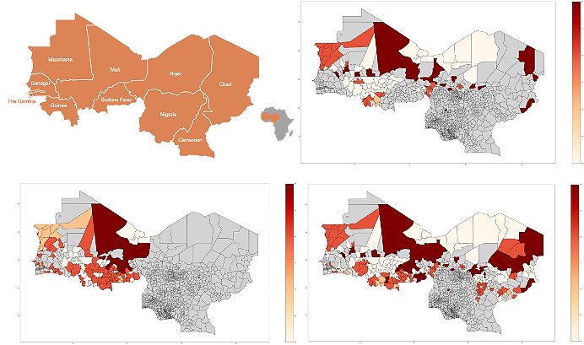
Geographical Distribution of Burden (Hotspot Analysis)
2021
2020
2022

Slide 7
Your tasks
You must produce a brief report including:
a clear and concise statement of your substantive findings
a discussion and motivation of the steps towards your final specification
an assessment of your predictive model with specifics about choice of model, evaluation metric, validation strategy and identification of factors affecting child malnutrition
a concluding section in which you discuss the implications of your findings.
You must also create a presentation that contains the gist of the above.

