Slide 1
Analysis of market attractiveness and competitive landscape of the education sector in Mexico
Specific asset to be analyzed: Universidad del Valle de México (UVM)

Slide 2
Highlights
The total number of "New Applicants" and "Enrolled students" in public institutions is larger than in private institutions. However, private institutions are attracting more “New applicants” and “Firs year students” for both onsite and online learning.
The private-onsite education market is highly concentrated, and Universidad del Valle de México (UVM) remains one of the top players.
The private-online education market is more competitive, and UVM remains one of the top players.
UVM faces an increasing demand for online learning. Also, the offered places for online learning at UVM has dramatically increased 4 times from the period 2018-2019 to the period 2019-2020.
The latter suggests that (i) UVM is attracting new applicants for online education, and (ii) UVM demonstrates ability to rapidly adapt to new market trends. Based on the recent effects of the pandemic COVID-19 on online education, we could expect that UVM will consolidate as a key player for online education in the forthcoming periods.
As a conclusion, is is recommended to purchase the asset.

Slide 3
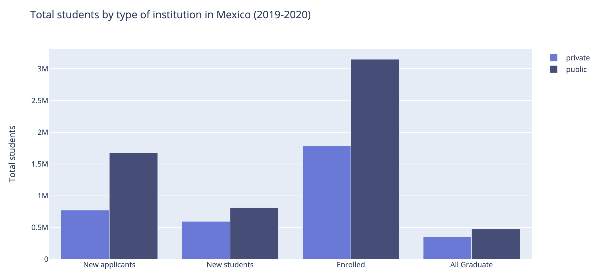
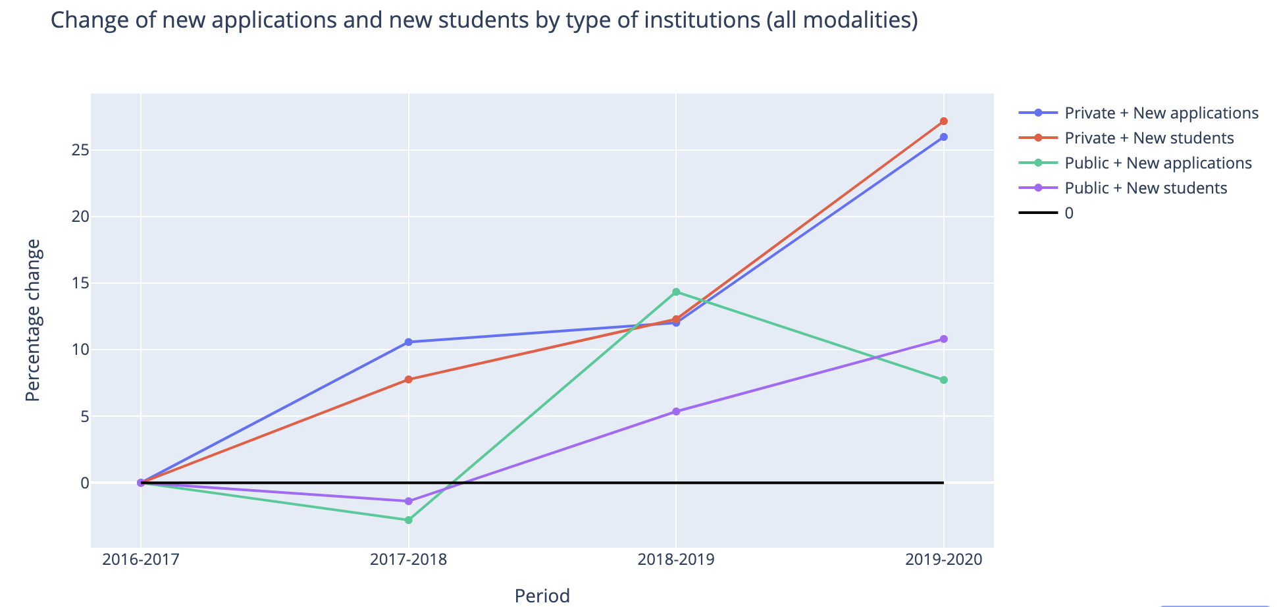
Overview of public-private and onsite-online learning
Total students by type of institution (2019-2020)
Change of new applications and new students
More students study in public institutions than in private institutions.
New applicants and new students and new students have been constantly growing for the past four periods in private institutions .

Slide 4
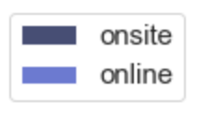
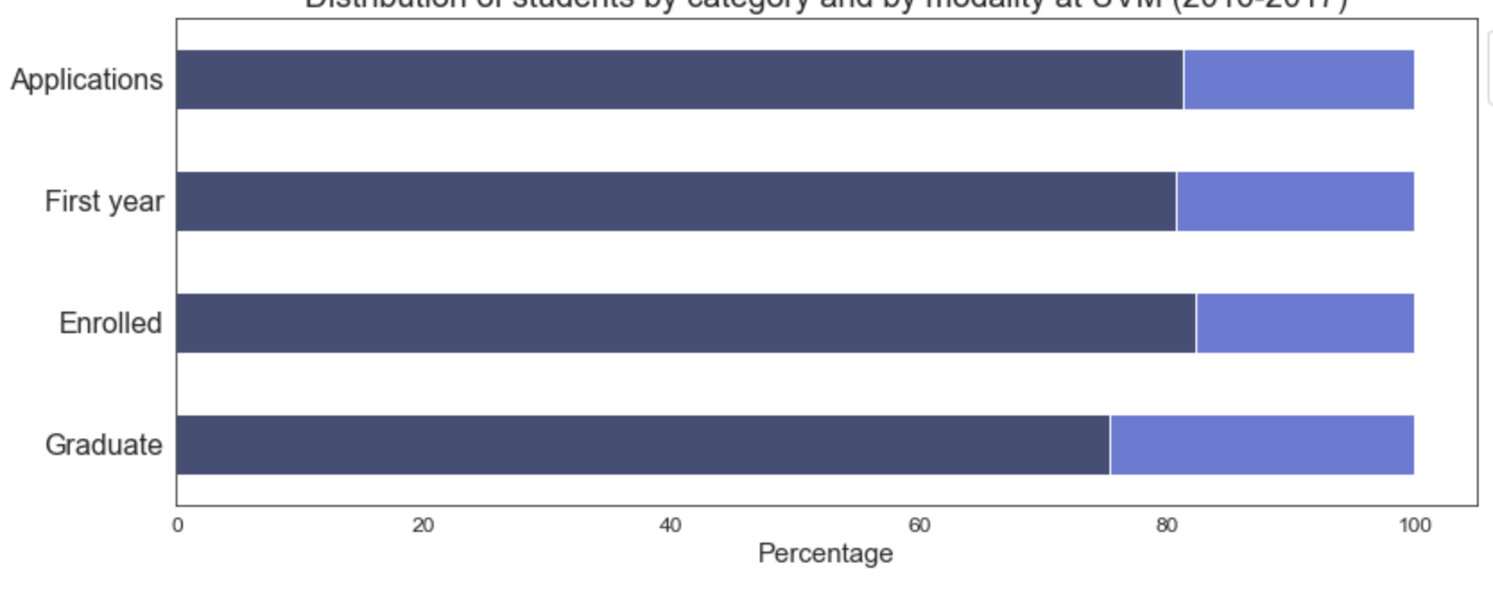
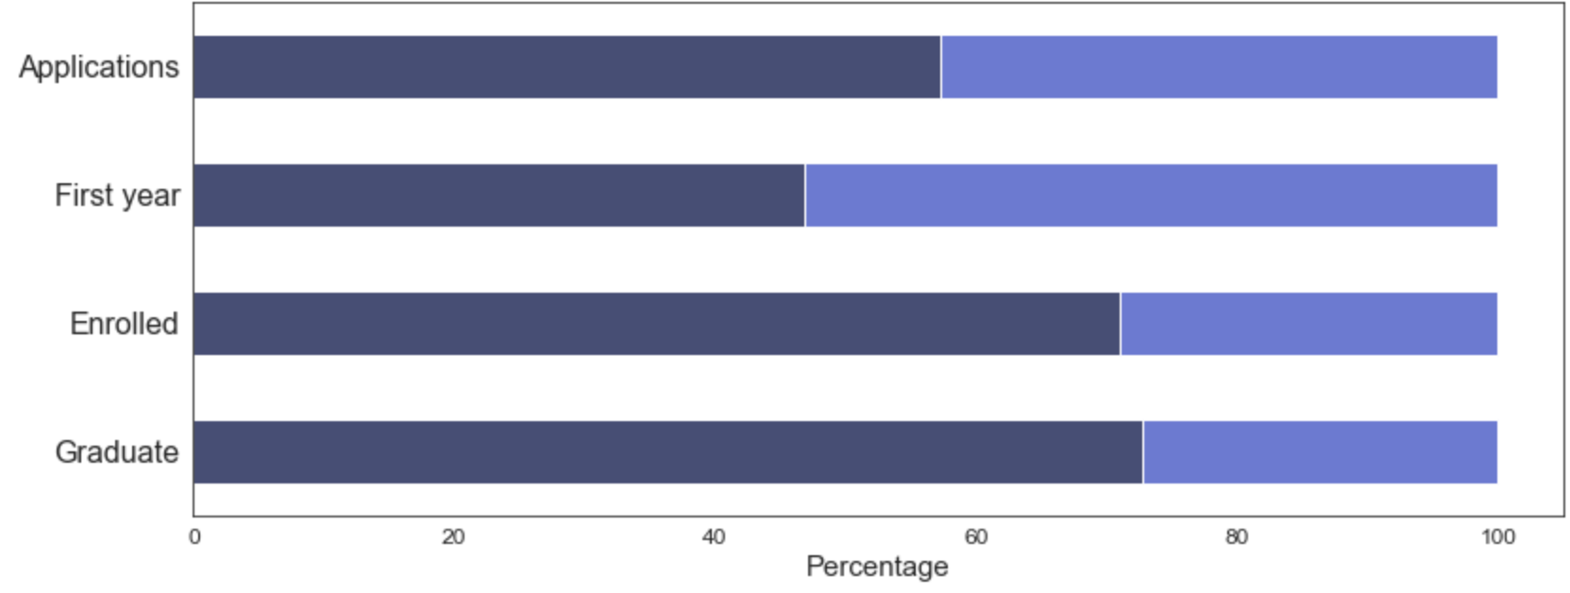
Overview of UVM
Students by category and by modality
(2016-2017)
Students by category and by modality
(2019-2020)
The proportion of students in online programs is growing.
The percentage of “New Applicants” at UVM is larger in online programs than in onsite programs.

Slide 5

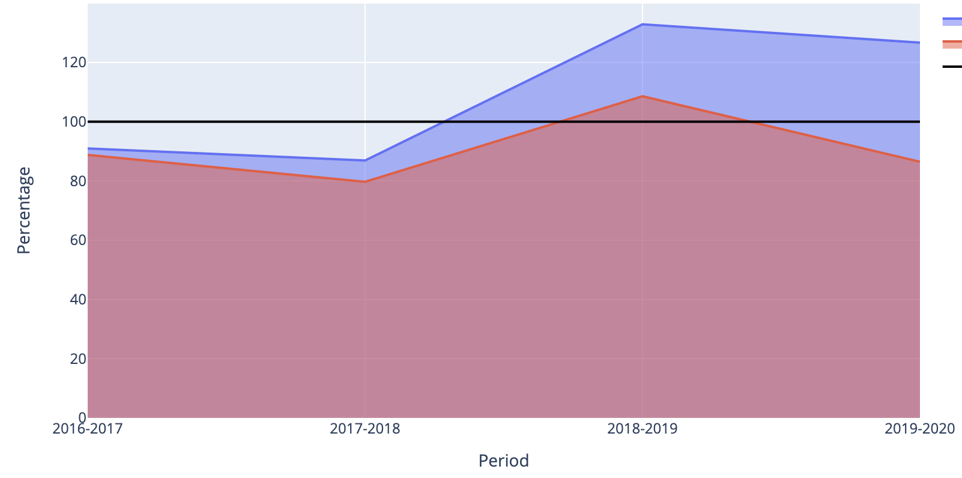
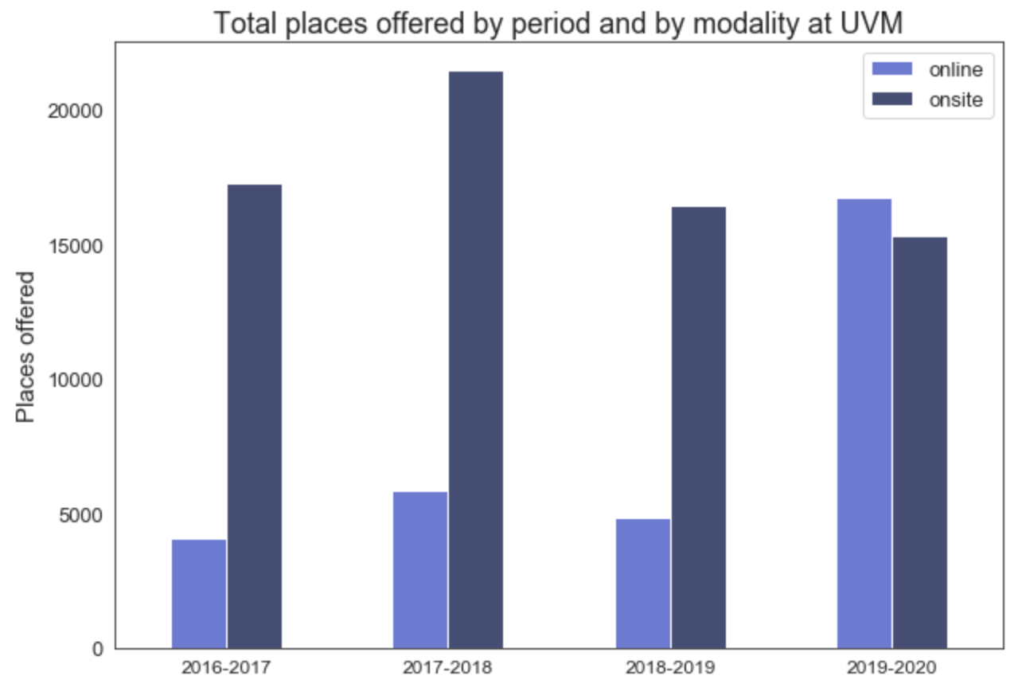
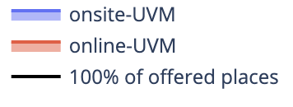
Overview of UVM
Applications as a percentage of offered places
Online and onsite offered places
The demand of onsite and online learning has been growing: UVM has received more applications than the total of places offered by the University.
On the other hand, the supply of online offered places at UVM grew between the periods 2018-2019 and 2019-2020.

Slide 6
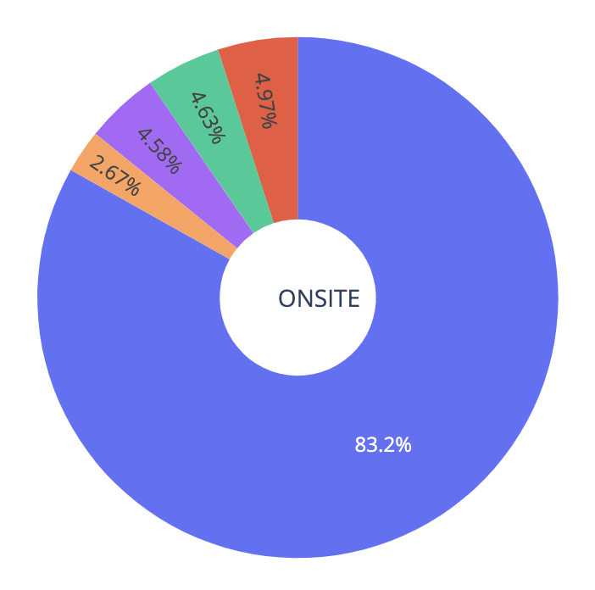
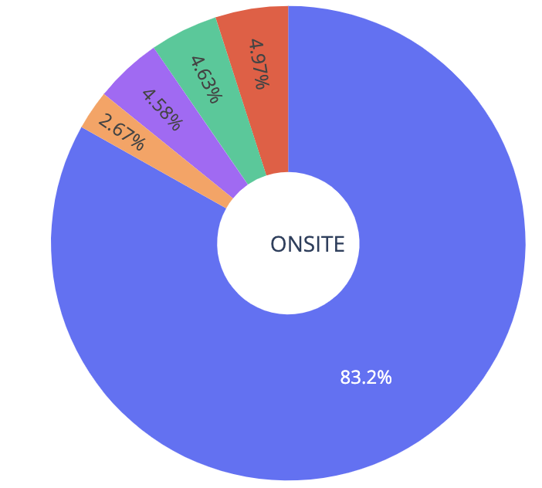
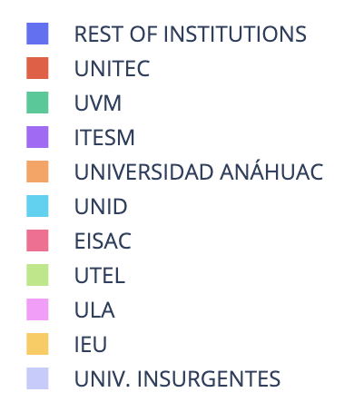
Key players in the private education market of Mexico
Distribution of enrolled students
The private-onsite education market is highly concentrated. There are 4 key players: UVM is the 2nd player (represents 4.6% of total Enrolled students in Mexico).
UVM
The private-online education market is more competitive. There are 8 key players: UVM is the 4th player (represents 4% of total Enrolled students in Mexico).
UVM

Slide 7
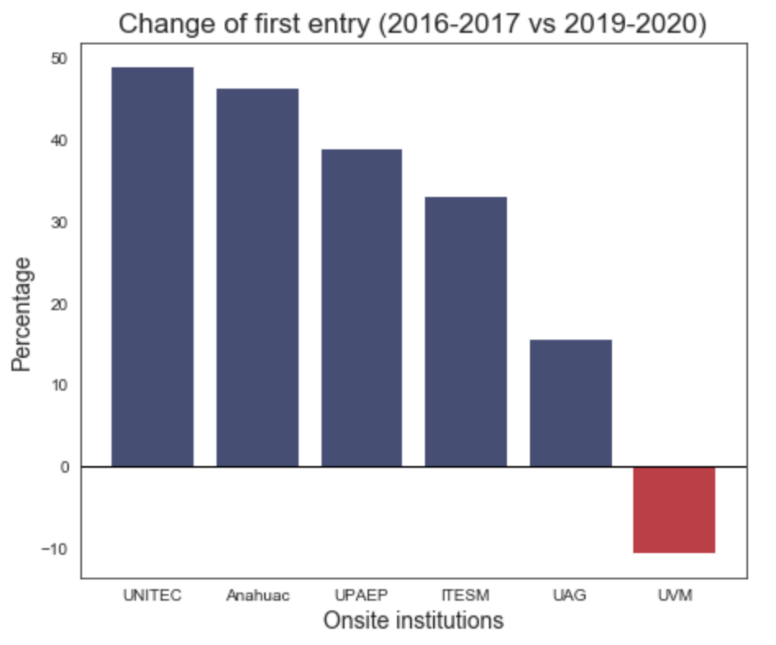
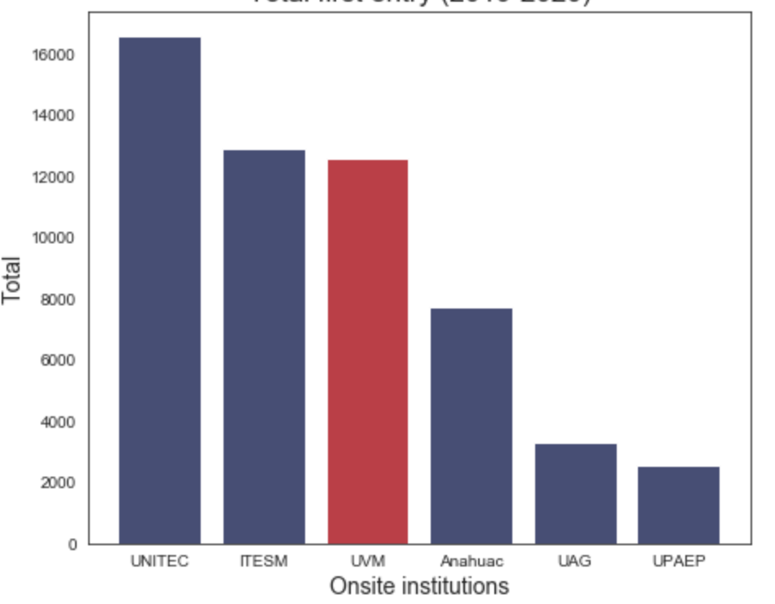
UVM vs top competitors (onsite modality)
Change of “First year” students
From 2016-2017 to 2019-2020
Total “First year” students
In 2019-2020
"New Applicants” at UVM’s onsite learning has decreased.
Nonetheless, UVM is the 3rd private institution with the largest number of “New Applicants” in onsite learning.

Slide 8
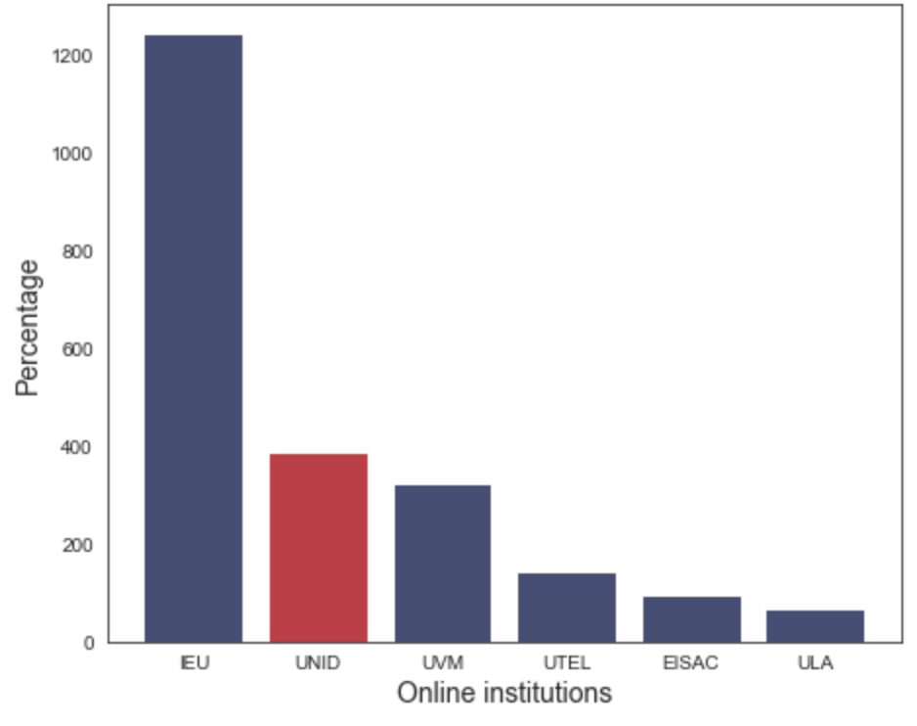
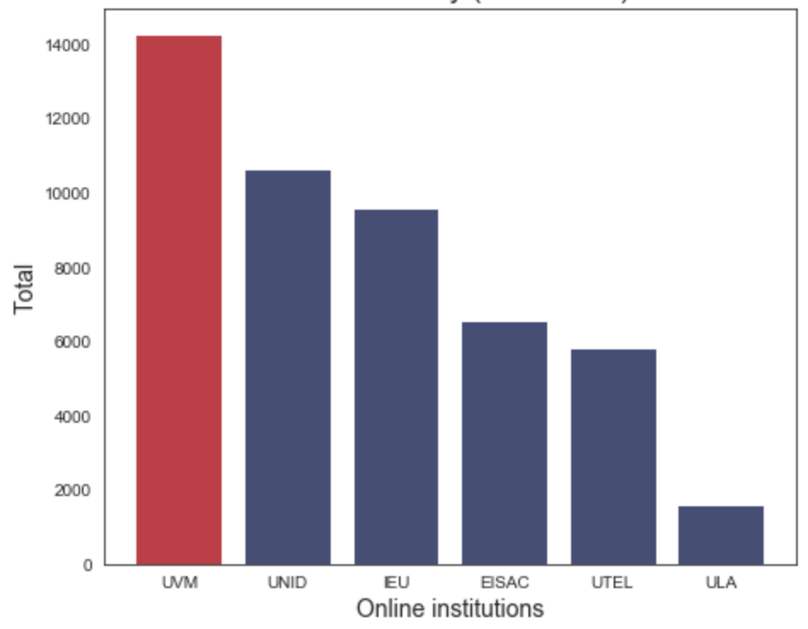
UVM vs top competitors (online modality)
Change of “First year” students
From 2016-2017 to 2019-2020
Total “First year” students
In 2019-2020
"New Applicants” at UVM’s online learning is increasing.
UVM is the 1st private institution with the largest number of “New Applicants” in online learning.

