Slide 1
graph databases
idwall tech talk
05 09 18

Slide 2
graphs

Slide 3
graphs
edge
vertice
vertice

Slide 4
graph theory

Slide 5
graph theory
ordered pair G = (V, E), where V is a set of vertices and E is a set of edges
undirected graph
directed graph
properties
  clustering coefficient
  betweenness centrality
algorithms

Slide 6
examples
chess
roads
computer networks
social networks
internet
artificial neural networks
...

Slide 7
graph databases

Slide 8
graph databases
relational dbs
  are about constraints
  they get rigid when representing relationships
  indirect relationships are hard
  make it hard to answer things you didn’t expect

Slide 9
graph databases
relational dbs
  are about constraints
  they get rigid when representing relationships
  indirect relationships are hard
  make it hard to answer things you didn’t expect
graph dbs
  are about relationships

Slide 10
graph databases
relational dbs
  are about constraints
  they get rigid when representing relationships
  indirect relationships are hard
  make it hard to answer things you didn’t expect
id:123
first_name: Mariana
last_name: Jó
graph dbs
  are about relationships
  have nodes with
    properties, just like {key: “value”}
id:42
name: IDwall

Slide 11
graph databases
n:Person
relational dbs
  are about constraints
  they get rigid when representing relationships
  indirect relationships are hard
  make it hard to answer things you didn’t expect
id:123
first_name: Mariana
last_name: Jó
graph dbs
  are about relationships
  have nodes with
    properties, just like {key: “value”}
    labels, to define types of things
m:Company
id:42
name: IDwall

Slide 12
graph databases
n:Person
relational dbs
  are about constraints
  they get rigid when representing relationships
  indirect relationships are hard
  make it hard to answer things you didn’t expect
id:123
first_name: Mariana
last_name: Jó
graph dbs
  are about relationships
  have nodes with
    properties, just like {key: “value”}
    labels, to define types of things
  they are connected by relationships
m:Company
id:42
name: IDwall

Slide 13
graph databases
n:Person
relational dbs
  are about constraints
  they get rigid when representing relationships
  indirect relationships are hard
  make it hard to answer things you didn’t expect
id:123
first_name: Mariana
last_name: Jó
graph dbs
  are about relationships
  have nodes with
    properties, just like {key: “value”}
    labels, to define types of things
  they are connected by relationships
    which can have type, direction and properties
r:WORKS_AT
since: 2016
m:Company
id:42
name: IDwall

Slide 14
graph databases
n:Person
relational dbs
  are about constraints
  they get rigid when representing relationships
  indirect relationships are hard
  make it hard to answer things you didn’t expect
id:123
first_name: Mariana
last_name: Jó
graph dbs
  are about relationships
  have nodes with
    properties, just like {key: “value”}
    labels, to define types of things
  they are connected by relationships
    which can have type, direction and properties
  let you add relationships at your will
  graph dbs are simpler
r:WORKS_AT
since: 2016
m:Company
id:42
name: IDwall
Notes:
PERFORMANCE

Slide 15
graphdb examples
social networks (twitter, linkedin, facebook, …)
recommendation systems
logistics
fraud detection
...

Slide 16
neo4j
Notes:
Never used neo4j for real

Slide 17
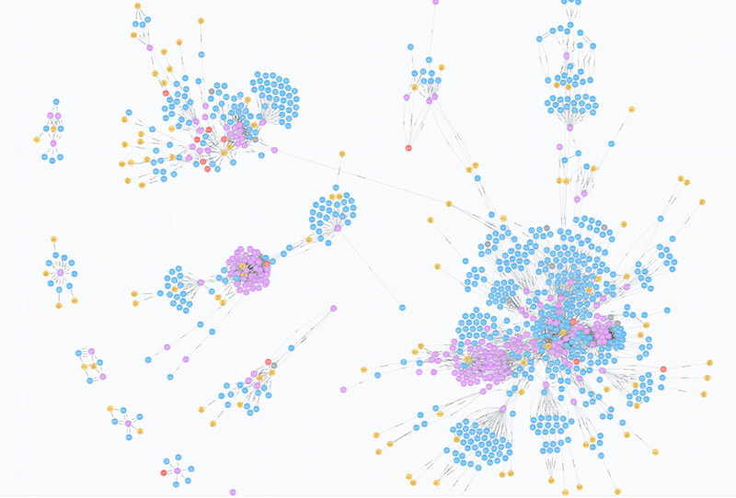
neo4j
desktop demo

Slide 18
cypher

Slide 19
cypher
(nodes)
  () | (:Person) | (p:Person)
  p.name

Slide 20
cypher
(nodes)
  () | (:Person) | (p:Person)
  p.name
[relationships]
  --> | -[:WORKS_AT]-> | -[r:WORKS_AT]->
  -[{since:2016}]->

Slide 21
cypher
(nodes)
  () | (:Person) | (p:Person)
  p.name
[relationships]
  --> | -[:WORKS_AT]-> | -[r:WORKS_AT]->
  -[{since:2016}]->
MATCH (node:Label) RETURN node.property
MATCH (node1:Label1)-->(node2:Label2)
WHERE node1.propertyA = {value}
RETURN node2.propertyA, node2.propertyB

Slide 22
cypher
(nodes)
  () | (:Person) | (p:Person)
  p.name
[relationships]
  --> | -[:WORKS_AT]-> | -[r:WORKS_AT]->
  -[{since:2016}]->
MATCH (p:Person)-->(c:Company)
WHERE p.first_name = {“Mariana”}
RETURN c.name

Slide 23
cypher
(nodes)
  () | (:Person) | (p:Person)
  p.name
[relationships]
  --> | -[:WORKS_AT]-> | -[r:WORKS_AT]->
  -[{since:2016}]->
MATCH (p:Person {name:”Mariana”})-->(c:Company)
RETURN c.name
demo!

Slide 24
references & stuff
Graph databases will change your freaking life. https://www.youtube.com/watch?v=3vleFxDGoEs
Build Intelligent Fraud Prevention with ML and Graphs. https://www.youtube.com/watch?v=QkQLIDFlkyc
Stop complex fraud in its tracks. https://www.youtube.com/watch?v=kSZHFlBDIfM
Study: IDwall in graphs. https://idwall.atlassian.net/wiki/spaces/~mariana/pages/31686703/Study+IDwall+in+graphs
Analyzing Panama Papers with Neo4j. https://neo4j.com/blog/analyzing-panama-papers-neo4j/
Navegando por grafos com Python. https://www.youtube.com/watch?v=BWp_2xeVzoc
Graph Databases Book, Ian Robinson, Jim Webber and Emil Eifrem O’Reilly. https://neo4j.com/graph-databases-book/?ref=home
Graph of Thrones. https://www.lyonwj.com/2016/06/26/graph-of-thrones-neo4j-social-network-analysis/

Slide 25
flw vlw

