Slide 1

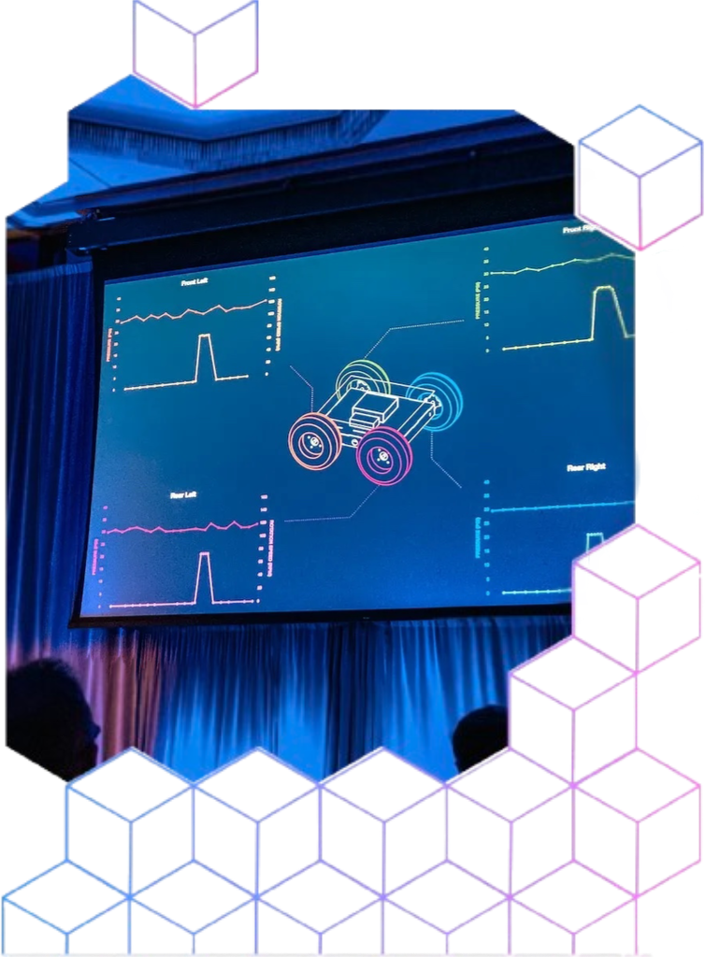
FROM CLAIMS TO CHARTS: Visualizing Innovation with PatentsView
Mariana Soares
CS5764 Information Visualization
Virginia Tech

Slide 2

Introduction to the Patents Dataset
  Patents offer legal protection for an invention (usually 20 years)
  Claims define the legal boundaries of the invention
  Single patents will have multiple claims to cover variations of the invention
Dataset information:
Date Range: January 1, 2024 - June 30, 2025
Duration: 18 months (6 quarters)
Total unique patents: 554,777
US unique patents: 226,878

Slide 3
How I Built the Final Dataset
Merged several of the PatentsView datasets into one combined table:
    Merge method: patents merged by patent_id using left joins;
    Aggregation rules: keep first assignee type and locations; organizations concatenated
    Bias risk: 'first' entities may misrepresent all actors; missing data can skew technologies or time periods

Slide 4
Feature Engineering
Technology categories:
  Mapped CPC codes to respective fields Physics, Electronics, etc.
  Created AI bucket (G06N, G06F, G06T, etc.)
Grouping features:
  Extracted year, quarters, months
  Extracted US region (West, Northeast, etc.) from state
  Created continent groups from country
Structural features:
  Derived patent complexity score (from claims + figures)
  Mapped academic institutions from assignee name and extracted from companies

Slide 5
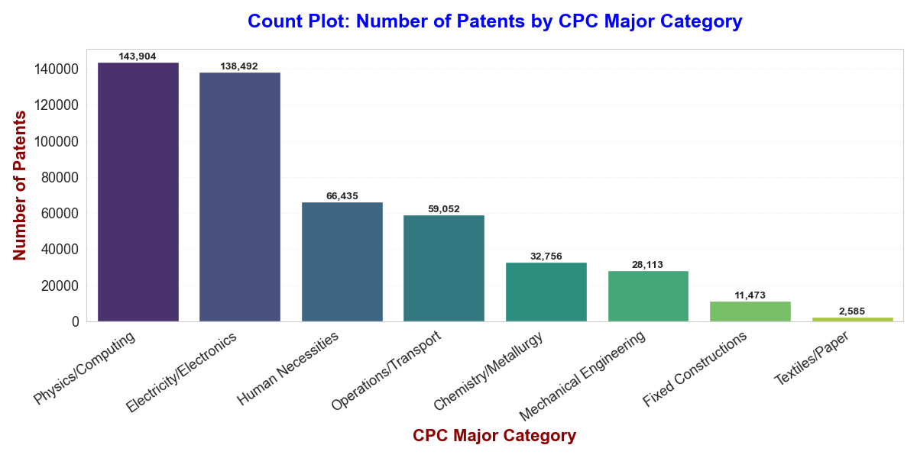

Slide 6
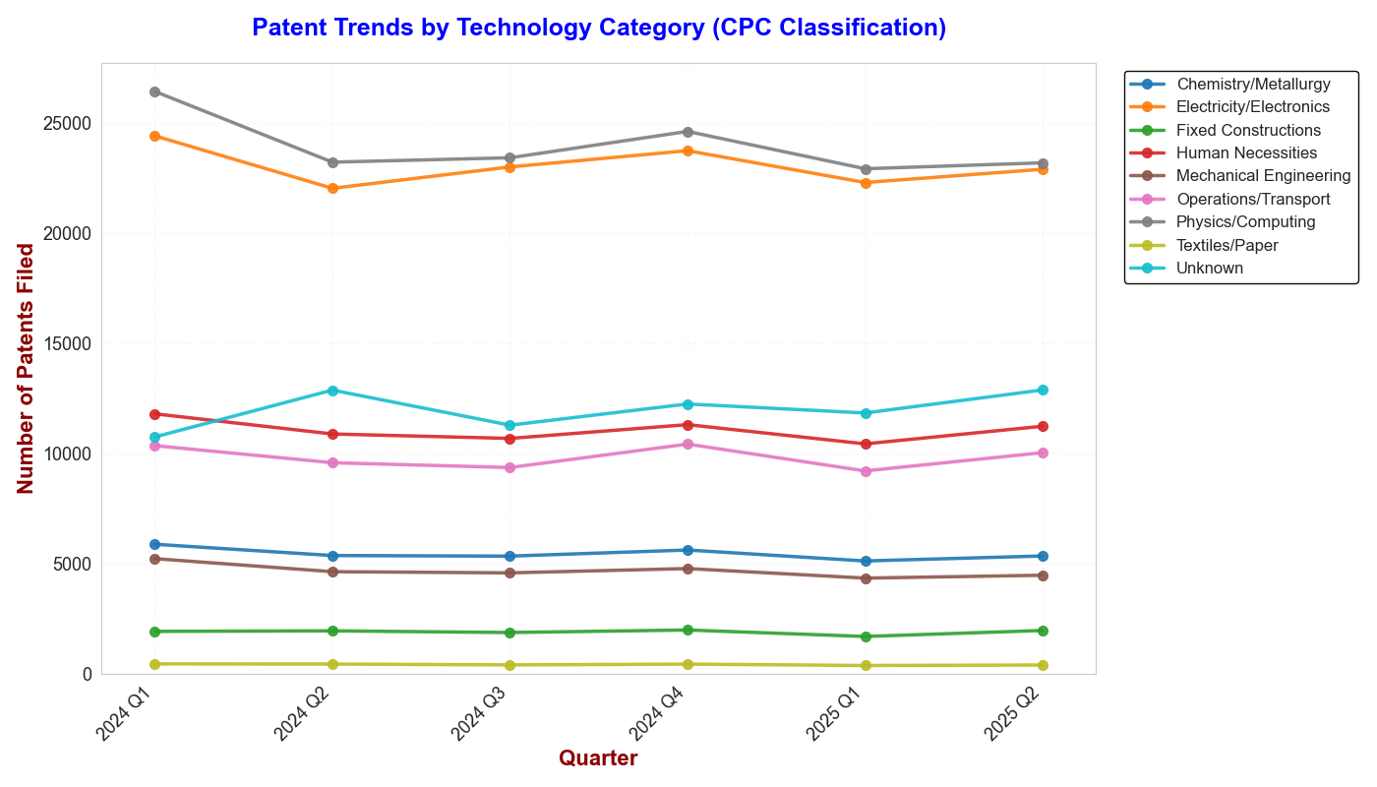
Patent activity is stable across quarters, with Electronics and Computing dominating

Slide 7
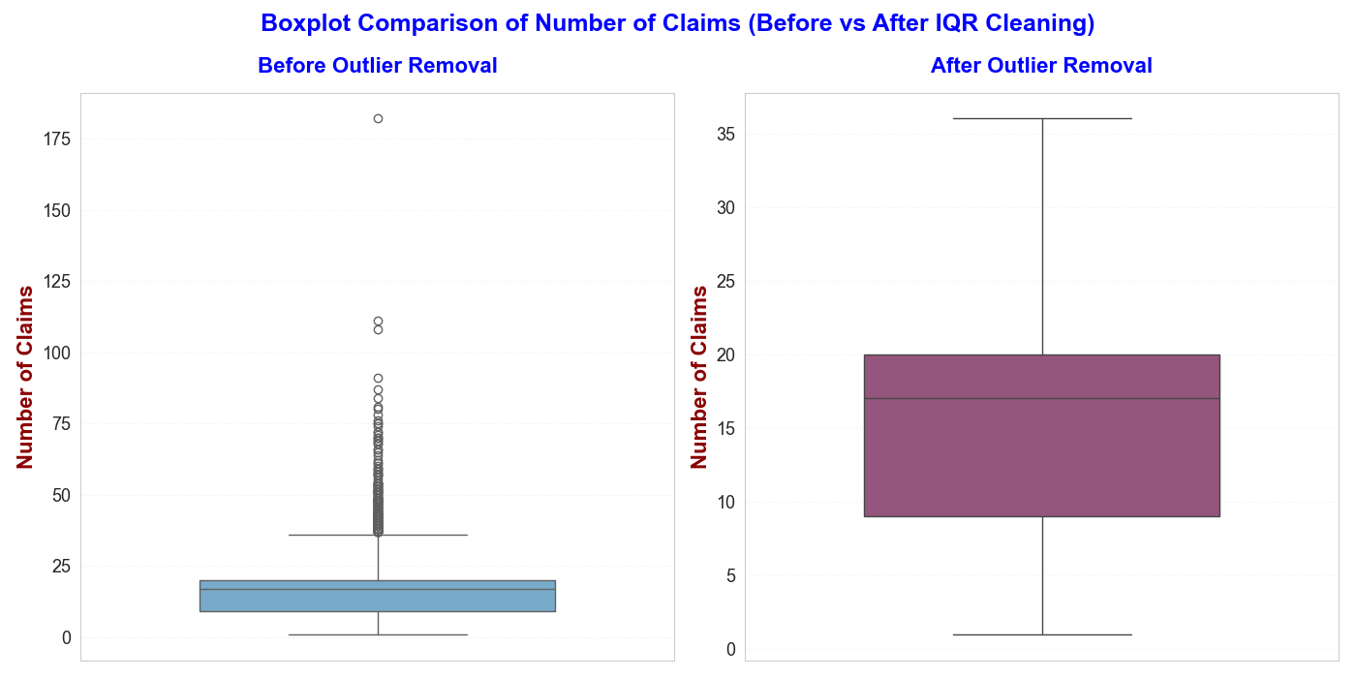
After removing extreme outliers, the distribution of claim counts becomes much clearer and more realistic, with the central range now representing typical patents rather than being stretched by rare high-claim cases.

Slide 8
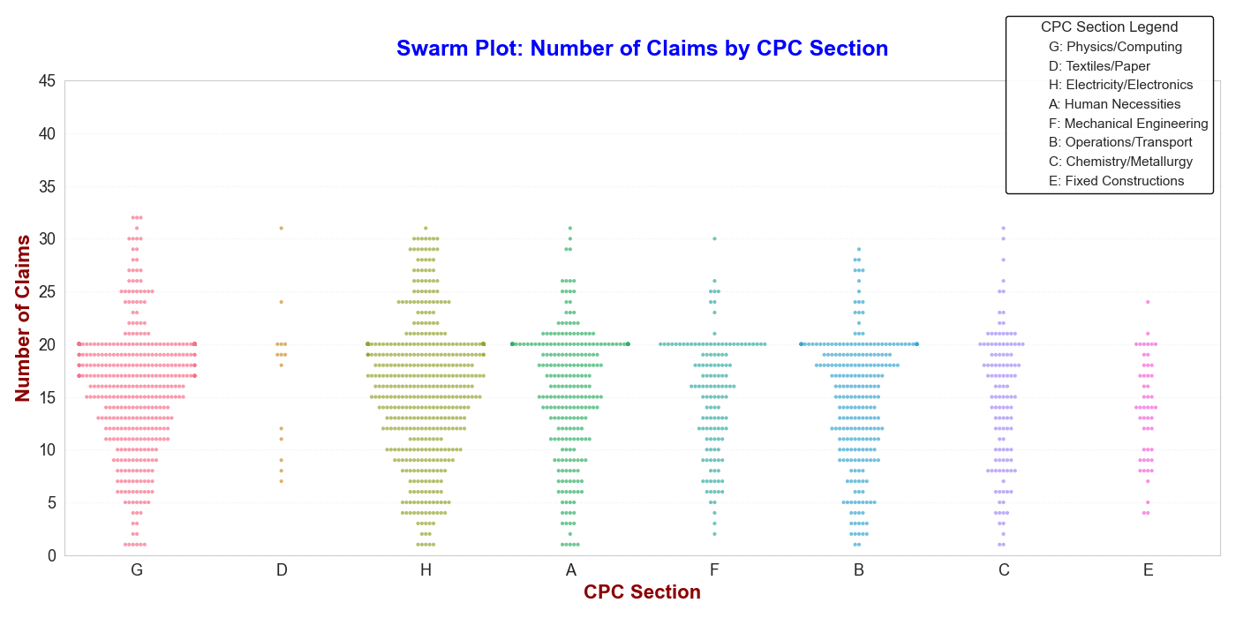

Slide 9
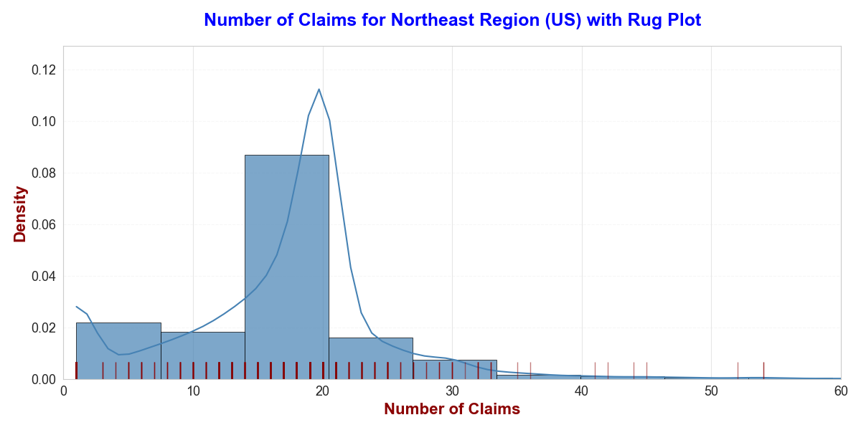
This rug plot shows the distribution of the number of claims for Northeast patents.
Each tick marks an individual patent’s claim count so you can see both the overall shape and the exact locations where patents are concentrated.
The density curve is a smoothed estimate of the underlying distribution of values.

Slide 10
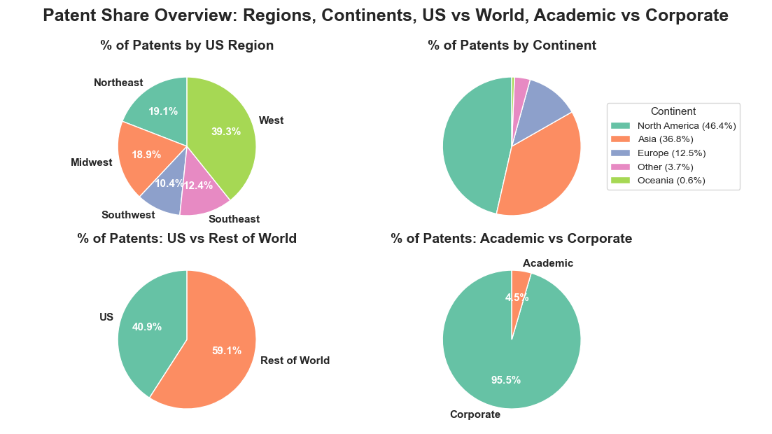

Slide 11
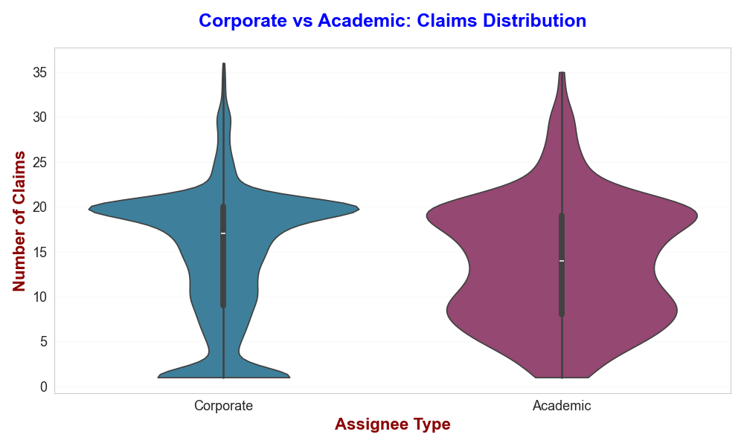
Violin plot shows the full distribution of the number of claims for corporate versus academic patents, where each “violin” represents how claim counts are spread within that group (its typical values, spread, and tails)

Slide 12
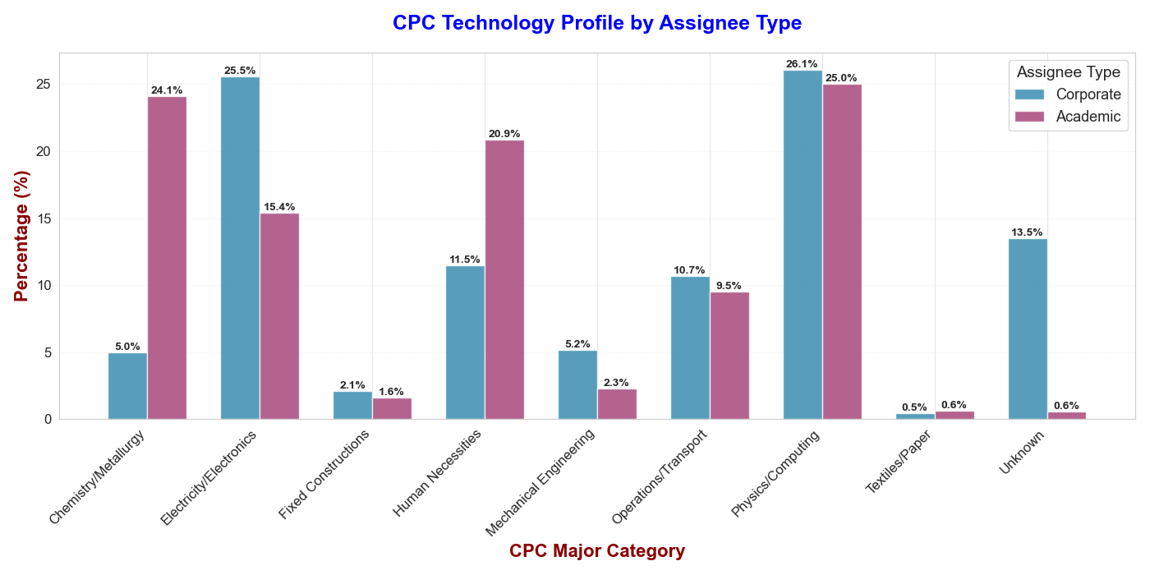
Corporate innovation skews toward computing and electronics, while academia leans toward human-centric and chemical technologies

Slide 13
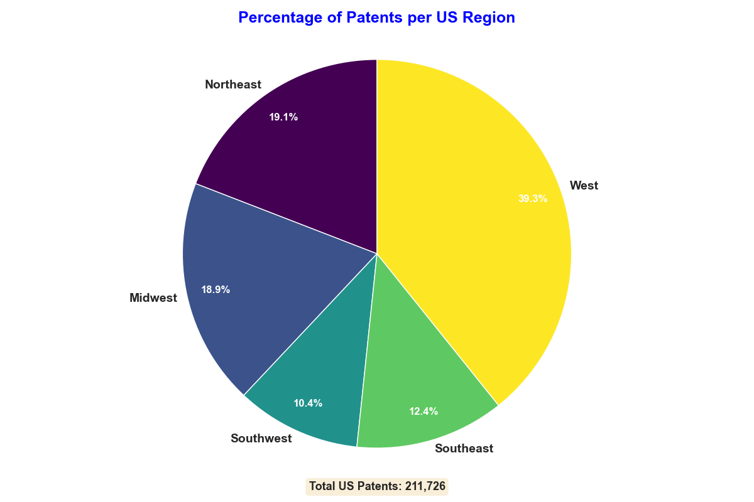

Slide 14
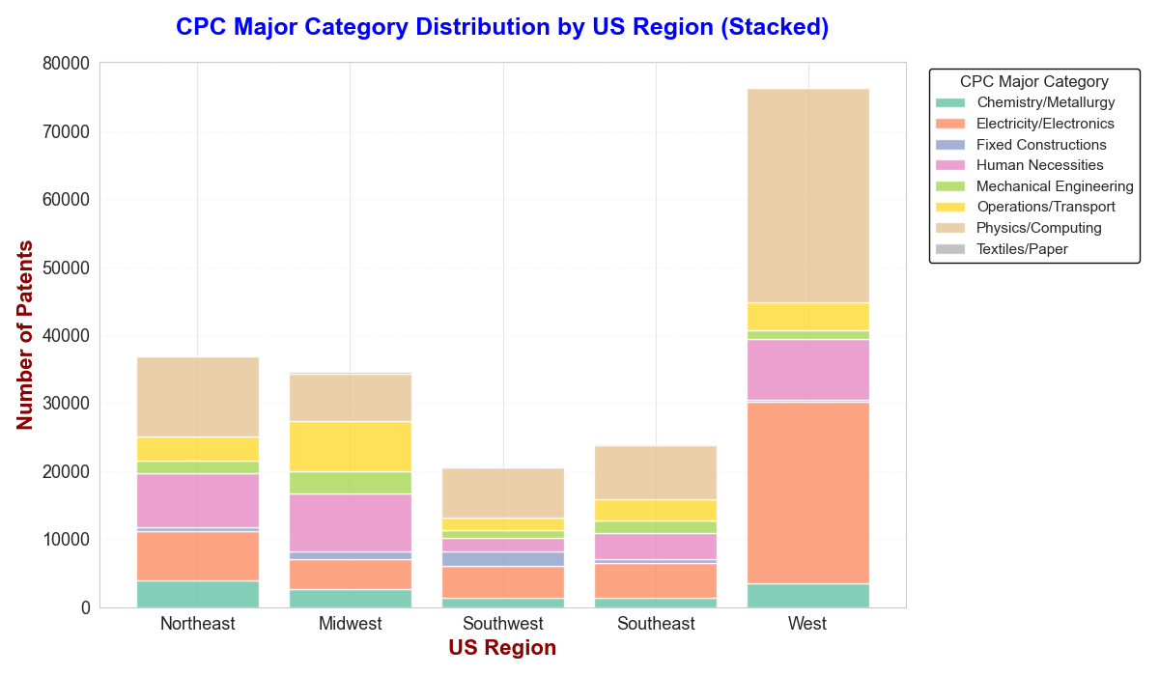

Slide 15
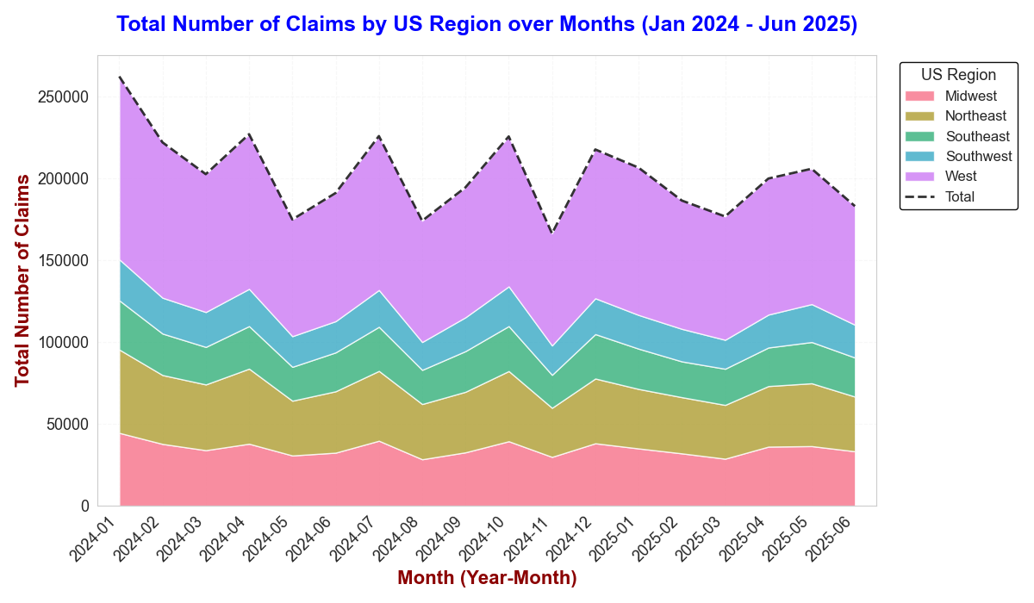
All regions show the same monthly pattern, but the West’s high volume dominates the national claim trend.

Slide 16
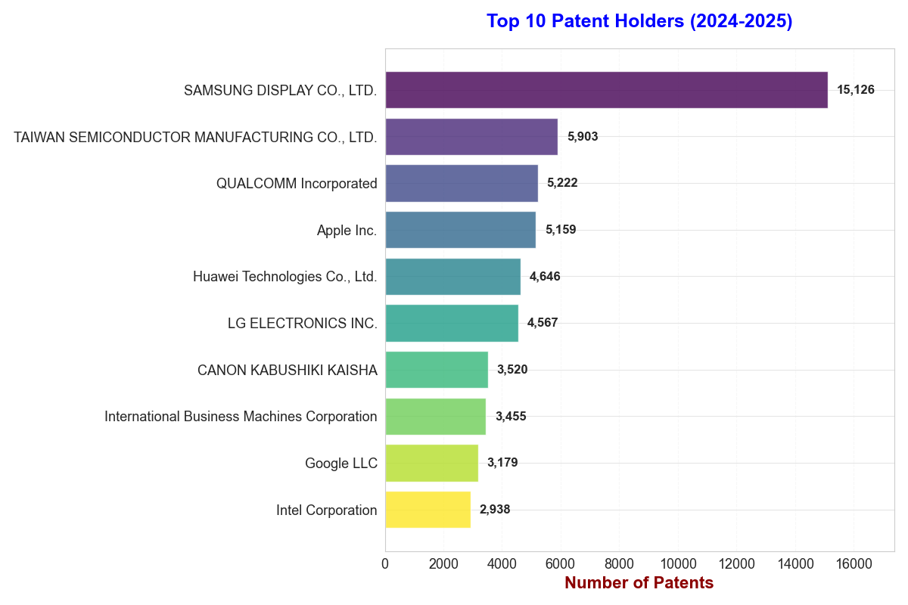
The top patent holders are dominated by major electronics and semiconductor companies, with Samsung Display far ahead of the rest

Slide 17
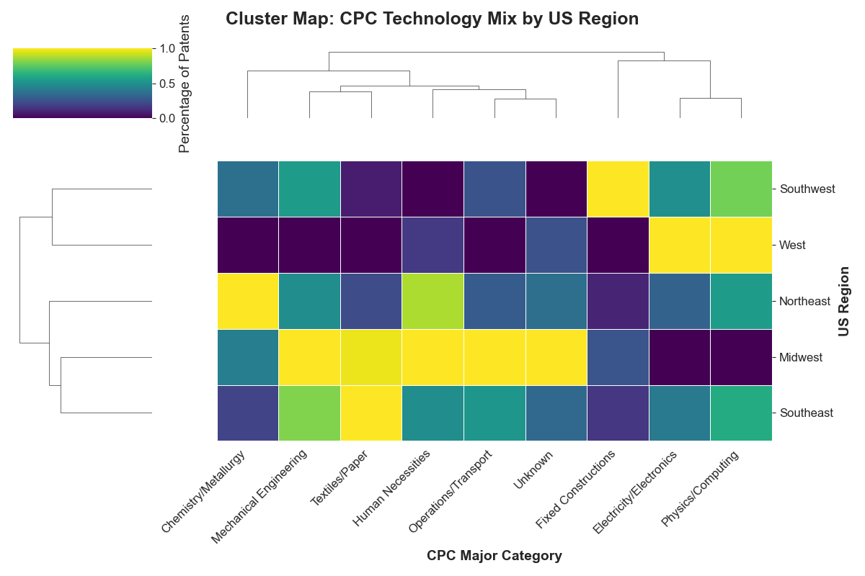
Cluster map shows that regions share similar technology profiles, with the West and Northeast clustering together on electronics and computing, while the Midwest and Southeast lean more toward human-necessities and mechanical technologies

Slide 18
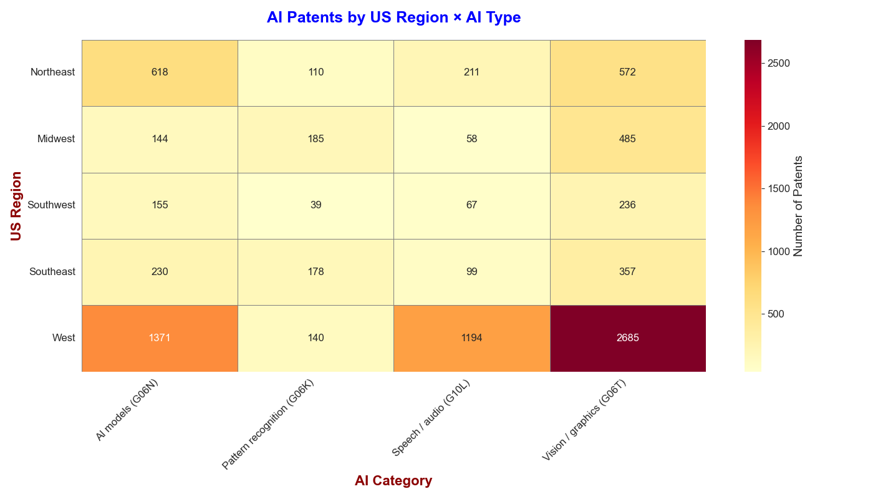
Although the West leads by a wide margin in nearly every AI domain, the Midwest shows a relative strength in pattern recognition

Slide 19
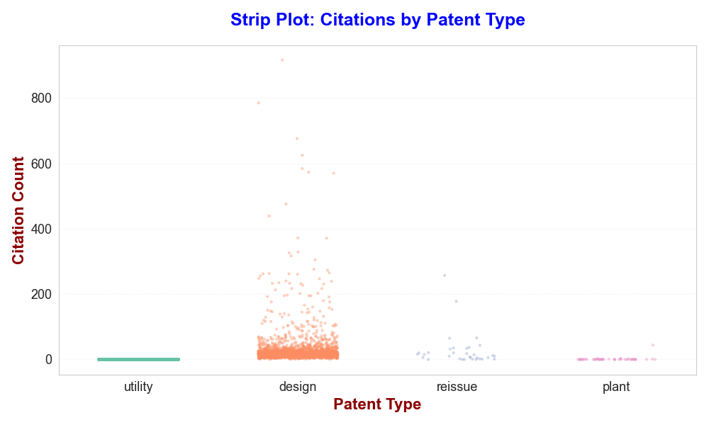
In this dataset, citation counts for utility patents were set to zero, still design patents show a much wider spread of citations than reissue or plant patents.

Slide 20
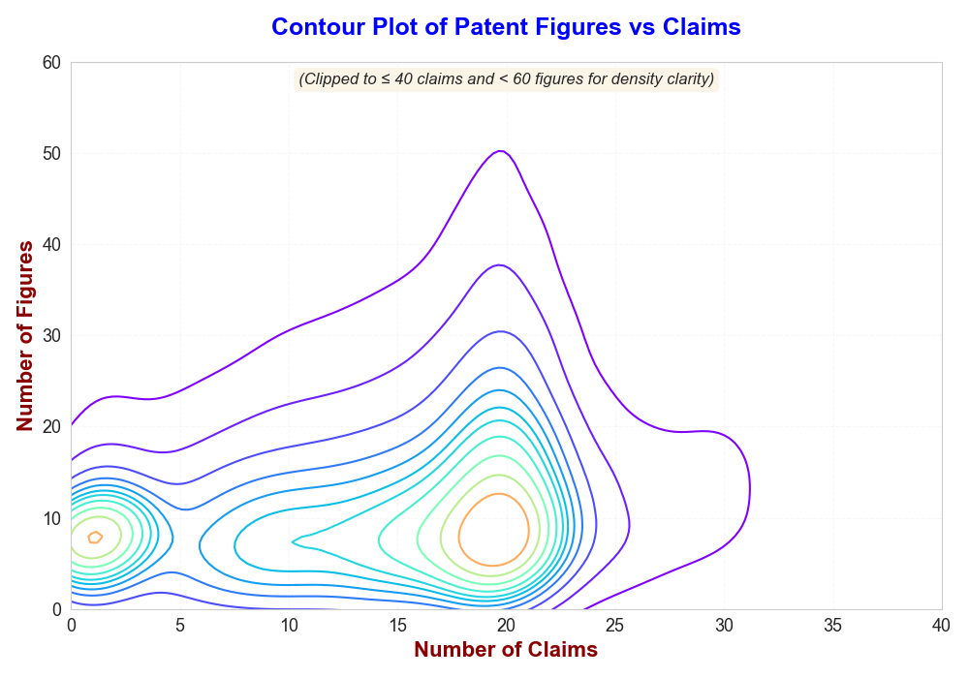
This contour plot shows that patents with more claims also tend to include more figures, suggesting increasing technical detail as claim count grows

Slide 21
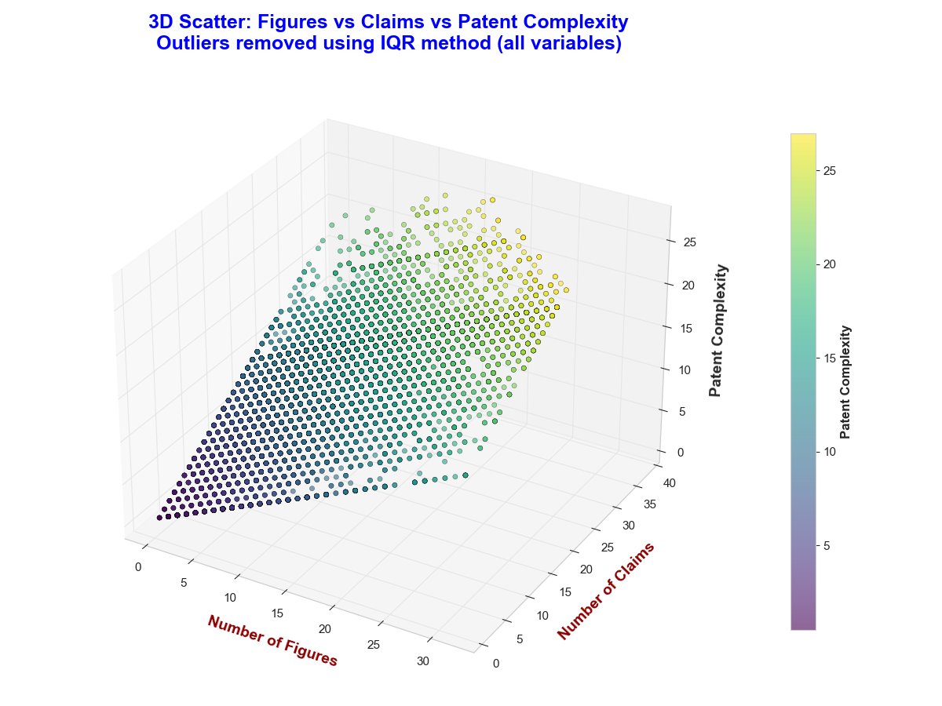
I developed the complexity measure under the assumption that as claims and figures increase, so does the underlying technical and structural complexity of the patent

Slide 22
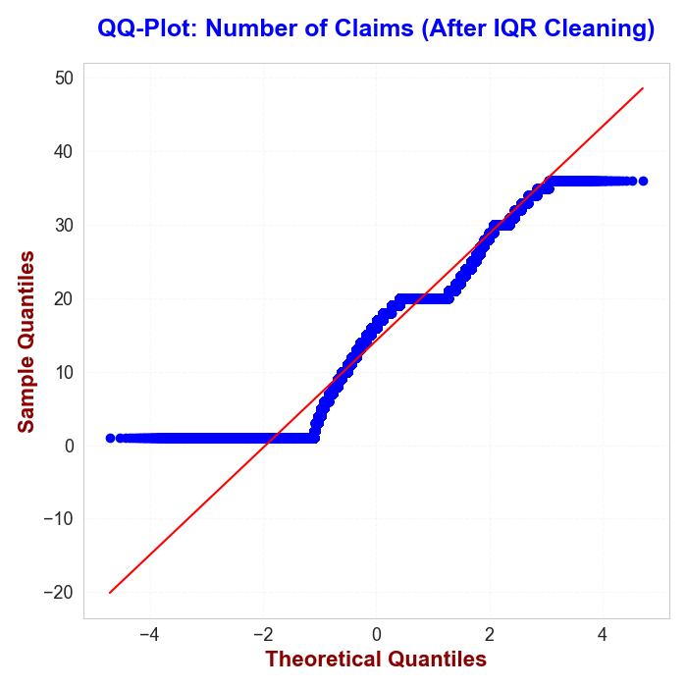
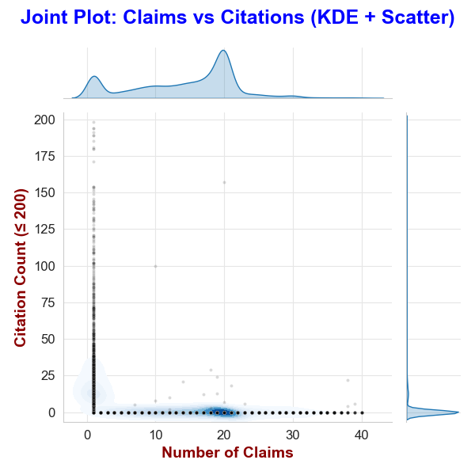
These plots show that even after outlier cleaning, claim counts remain non-normal and weakly related to citation counts, which cluster heavily at low values

Slide 23
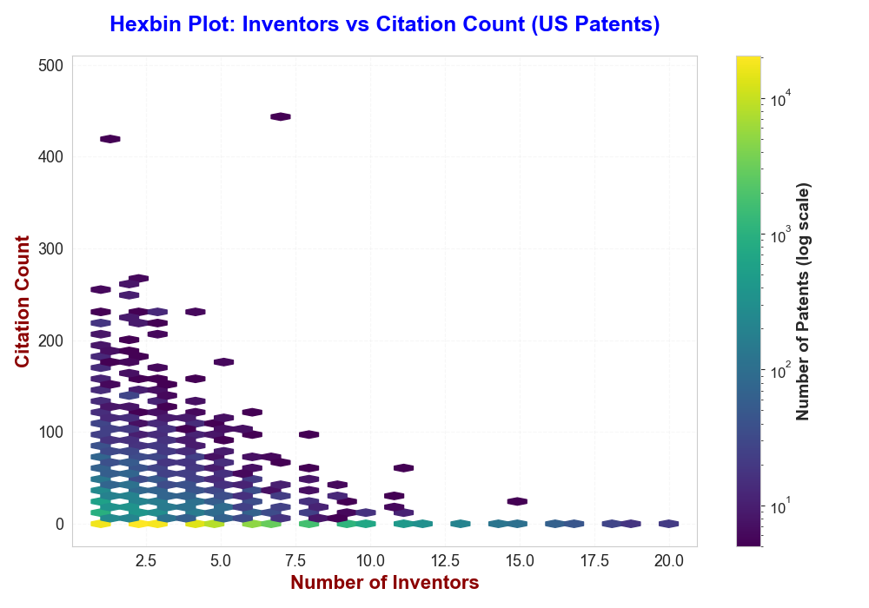
This hexbin plot shows that most patents have few inventors and relatively low citation counts, with no strong linear relationship between the two

Slide 24
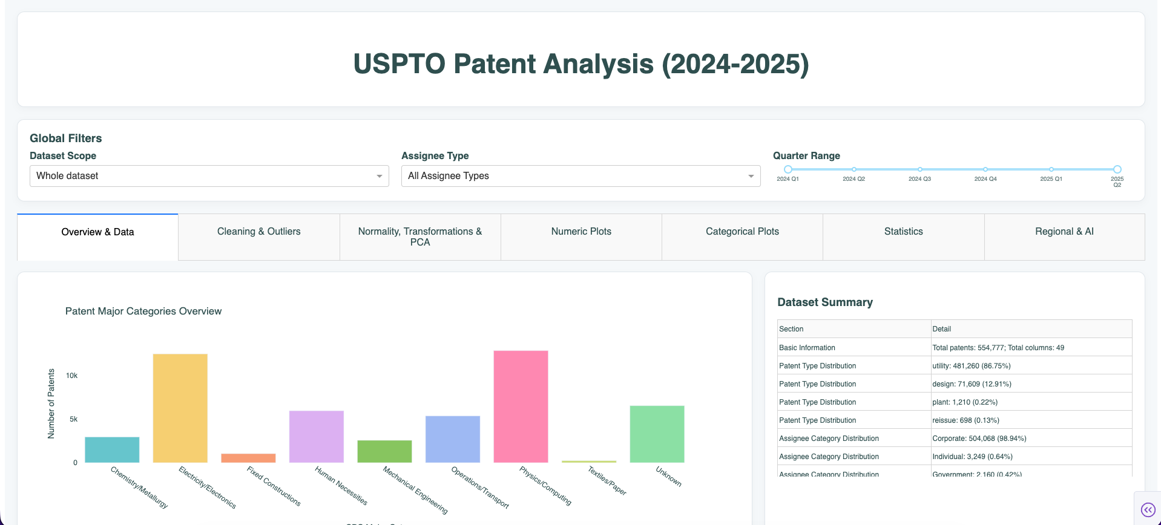
Link to Dashboard
Random sample of 50K Observations for performance
https://dashapp-349070754265.us-east1.run.app/

