Slide 1
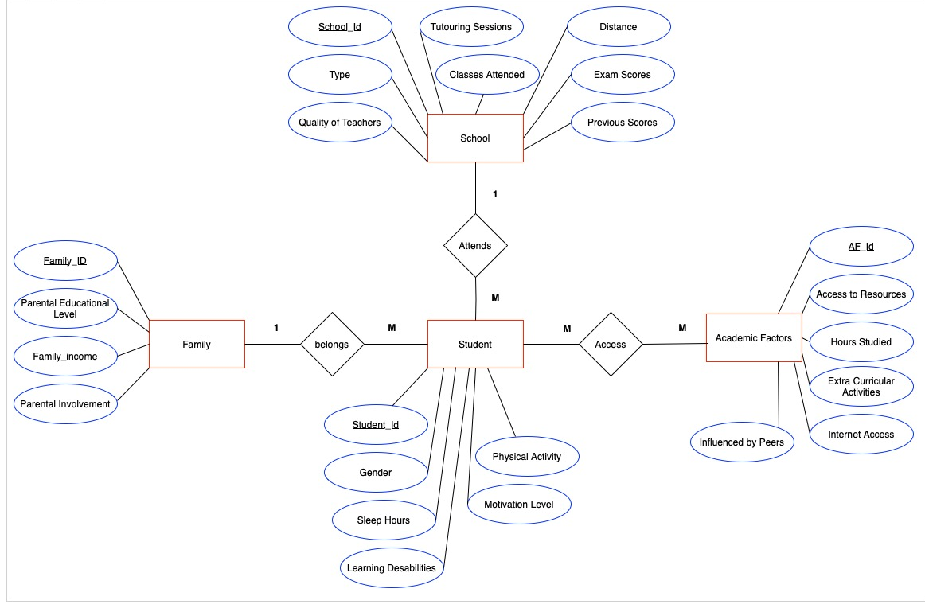
Objective 2
Based on the ER Diagram, a schema and the tables were created;
The original CSV dataset was split into four different ones, with the added primary and foreign keys;
These new CSV files were ingested in the newly created databases and tables via copy statements;
All the *.sql and *.csv files are in the group GIT.

Slide 2
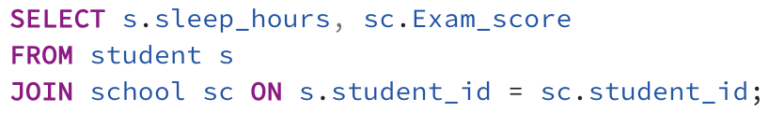
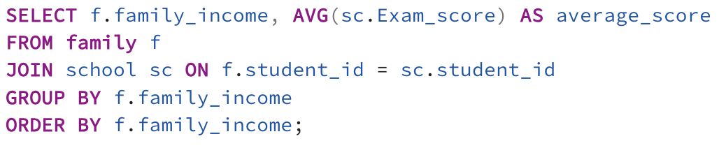
Objective 3
Most of our queries were basic, where we generated results based on the different factors (present in the table entities) sided by the students' exam scores.
When necessary, operations were used in the queries to take filtered data.

