Slide 1

Final Project Presentation
Mariana Ramirez

Slide 2
Live Demo
http://www.marianareginaramirez.com/si339_final_project/index.html

Slide 3
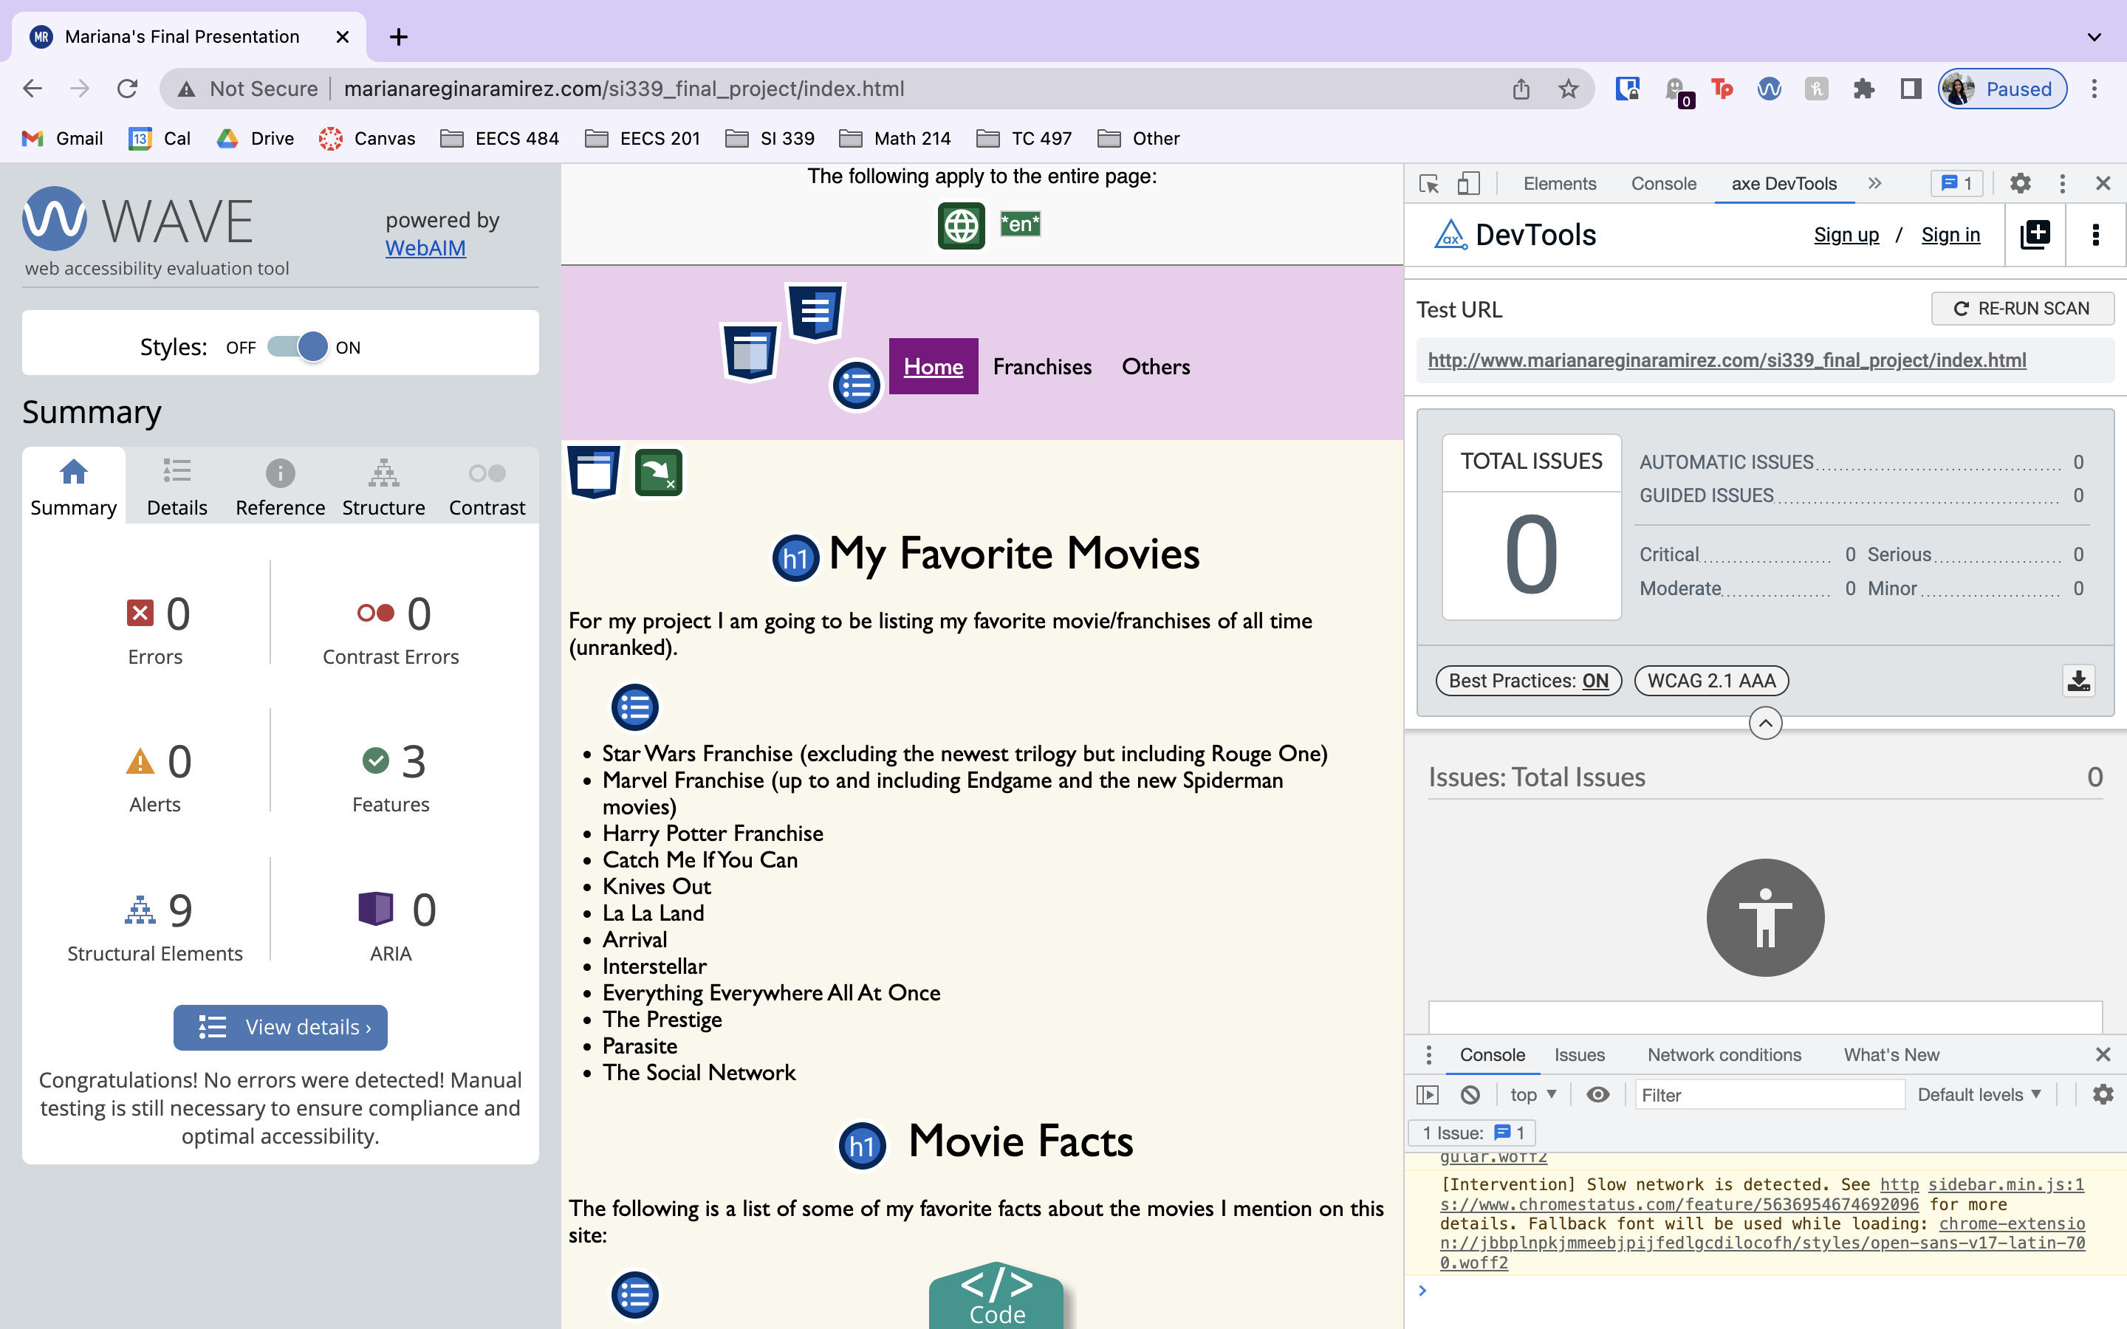
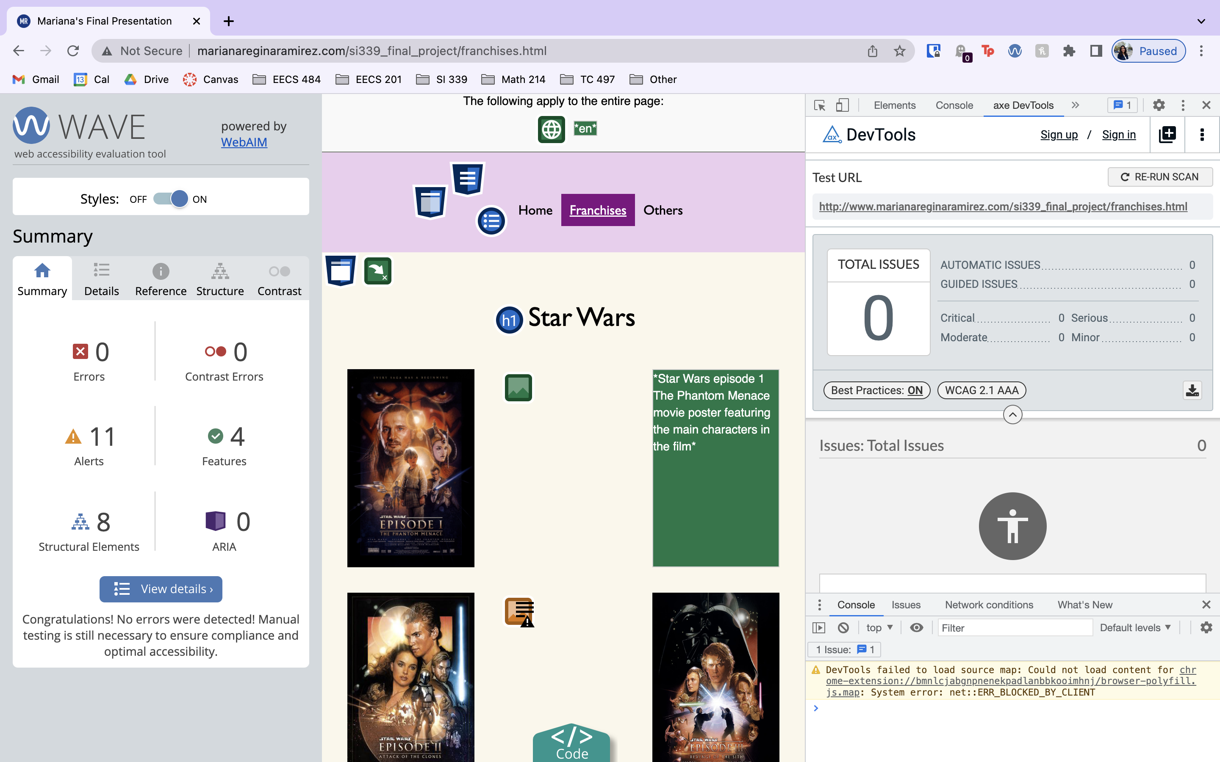
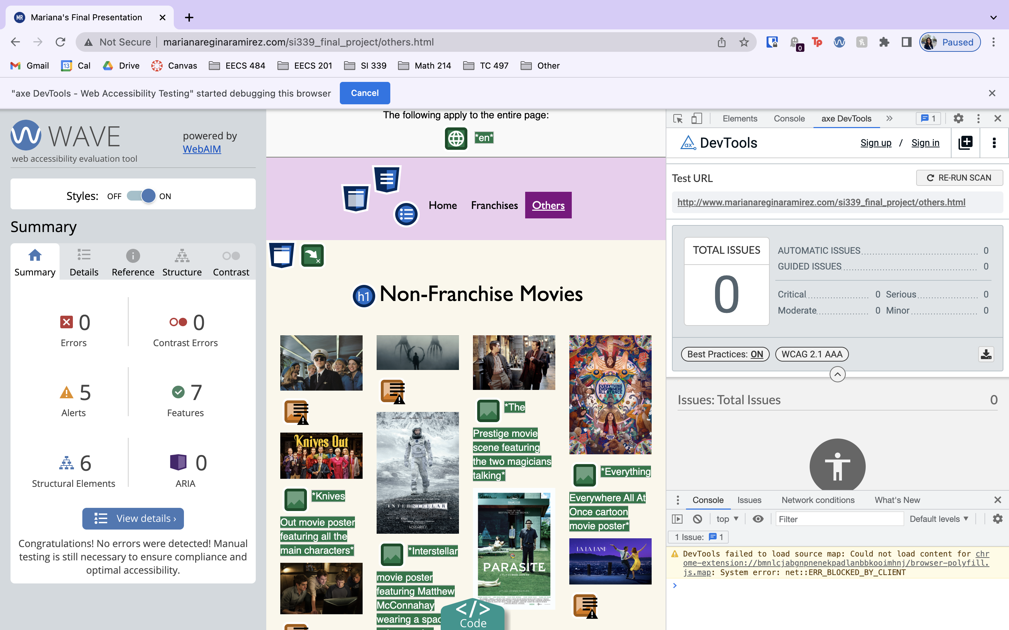
Accessibility

Slide 4
Extras
Movie facts

Slide 5
Thank you!

