Slide 1
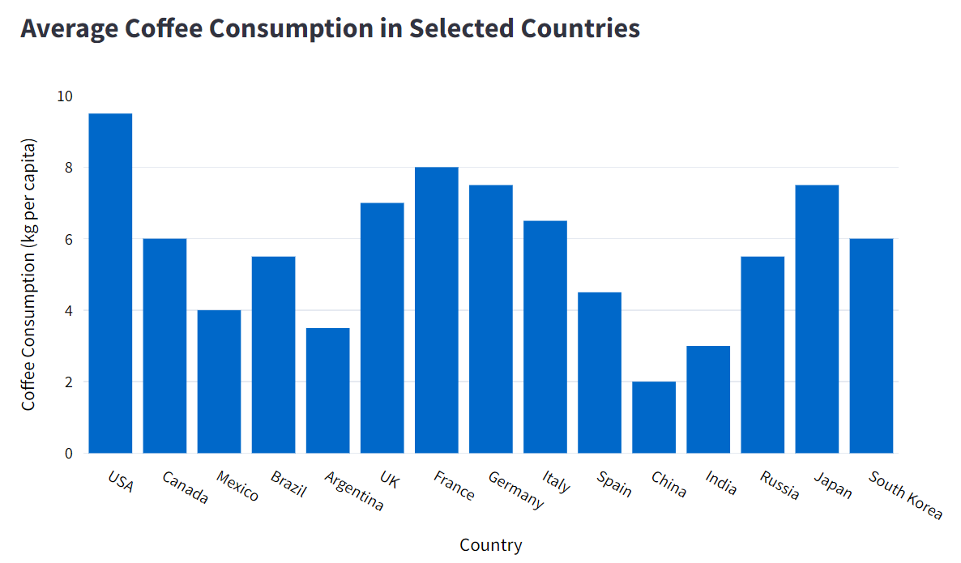
Data source: the author (2024). This is a fictional example created for educational purposes only. Data is fictional and should not be used for any actual analysis.

Slide 2
Title: provides a brief description/hint of the chart content.
Data source: the author (2024). This is a fictional example created for educational purposes only. Data is fictional and should not be used for any actual analysis.

Slide 3
X-axis: represents categories or intervals (typically time).
Data source: the author (2024). This is a fictional example created for educational purposes only. Data is fictional and should not be used for any actual analysis.

Slide 4
Y-axis: shows the value corresponding to the categories or time intervals.
Data source: the author (2024). This is a fictional example created for educational purposes only. Data is fictional and should not be used for any actual analysis.

Slide 5
Bars: Represent data values as rectangular bars. The height of each bar is proportional to the value it represents.
Data source: the author (2024). This is a fictional example created for educational purposes only. Data is fictional and should not be used for any actual analysis.

Slide 6
Source/Footnotes: explains the origin of the information and/or provide additional information.
Data source: the author (2024). This is a fictional example created for educational purposes only. Data is fictional and should not be used for any actual analysis.

Slide 7
Data source: the author (2024). This is a fictional example created for educational purposes only. Data is fictional and should not be used for any actual analysis.

Slide 8
Retrieve Value: in France, the consumption of coffee is around 8 kg per capita.
Data source: the author (2024). This is a fictional example created for educational purposes only. Data is fictional and should not be used for any actual analysis.

Slide 9
Make Comparisons: The average coffee consumption in Russia is almost 2x higher than in India.
Data source: the author (2024). This is a fictional example created for educational purposes only. Data is fictional and should not be used for any actual analysis.

Slide 10
Find Minimum Value: the country with the lowest consumption of coffee is China.
Data source: the author (2024). This is a fictional example created for educational purposes only. Data is fictional and should not be used for any actual analysis.

Slide 11
Find Maximum Value: the country with the highest consumption of coffee is USA.
Data source: the author (2024). This is a fictional example created for educational purposes only. Data is fictional and should not be used for any actual analysis.

Slide 12
Determine Range: The average coffee consumption varies approx. between 2 and 9.8 kg per capita.
Data source: the author (2024). This is a fictional example created for educational purposes only. Data is fictional and should not be used for any actual analysis.

Slide 13
Well done! You completed the module “Bar Chart”. To keep learning, select other modules on the left side bar.
Data source: the author (2024). This is a fictional example created for educational purposes only. Data is fictional and should not be used for any actual analysis.

Slide 14
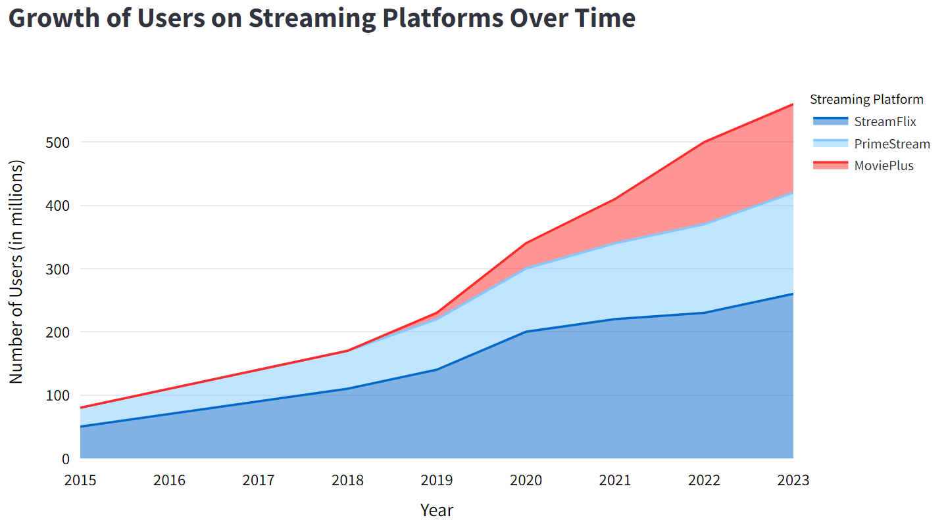
Data source: the author (2024). This is a fictional example created for educational purposes only. Data is fictional and should not be used for any actual analysis.

Slide 15
Title: provides a brief description/hint of the chart content.
Data source: the author (2024). This is a fictional example created for educational purposes only. Data is fictional and should not be used for any actual analysis.

Slide 16
X-axis: represents categories or intervals (typically time).
Data source: the author (2024). This is a fictional example created for educational purposes only. Data is fictional and should not be used for any actual analysis.

Slide 17
Y-axis: shows the value corresponding to the interval.
Data source: the author (2024). This is a fictional example created for educational purposes only. Data is fictional and should not be used for any actual analysis.

Slide 18
Shaded Areas: represents the data value.
Data source: the author (2024). This is a fictional example created for educational purposes only. Data is fictional and should not be used for any actual analysis.

Slide 19
Color Legend: Shows the category that each color in the chart represents.
Data source: the author (2024). This is a fictional example created for educational purposes only. Data is fictional and should not be used for any actual analysis.

Slide 20
Source/Footnotes: explains the origin of the information and/or provide additional information.
Data source: the author (2024). This is a fictional example created for educational purposes only. Data is fictional and should not be used for any actual analysis.

Slide 21
Data source: the author (2024). This is a fictional example created for educational purposes only. Data is fictional and should not be used for any actual analysis.

Slide 22
Retrieve Total Value: the number of users on streaming platforms is around 500 millions in 2022
Data source: the author (2024). This is a fictional example created for educational purposes only. Data is fictional and should not be used for any actual analysis.

Slide 23
Retrieve Partial Value: "PrimeStream" had around 100 million users in 2020.
How to find partial values in a staked chart?
In a stacked area chart, each layer adds to the one below. To find the value for a platform (e.g., "PrimeStream" in 2020), subtract the "Streamflix" layer below it from the total height at "PrimeStream.""
Data source: the author (2024). This is a fictional example created for educational purposes only. Data is fictional and should not be used for any actual analysis.

Slide 24
Make Comparisons: In 2020, the number of users on StreamFlix is double the number of users on PrimeStream.
Data source: the author (2024). This is a fictional example created for educational purposes only. Data is fictional and should not be used for any actual analysis.

Slide 25
Find Minimum Value: 2015 has the lowest number of users across all streaming platforms.
Data source: the author (2024). This is a fictional example created for educational purposes only. Data is fictional and should not be used for any actual analysis.

Slide 26
Find Maximum Value: the number of users is growing through the years and achieved its maximum in 2023.
Data source: the author (2024). This is a fictional example created for educational purposes only. Data is fictional and should not be used for any actual analysis.

Slide 27
Determine Range: The total number of users varies between 80 to 550 million.
Data source: the author (2024). This is a fictional example created for educational purposes only. Data is fictional and should not be used for any actual analysis.

Slide 28
Find Trends: From 2015 to 2023 the number of users has increased across all streaming platforms.
Data source: the author (2024). This is a fictional example created for educational purposes only. Data is fictional and should not be used for any actual analysis.

Slide 29
Well done! You completed the module “Area Chart”. To keep learning, select other modules on the left side bar.
Data source: the author (2024). This is a fictional example created for educational purposes only. Data is fictional and should not be used for any actual analysis.

Slide 30
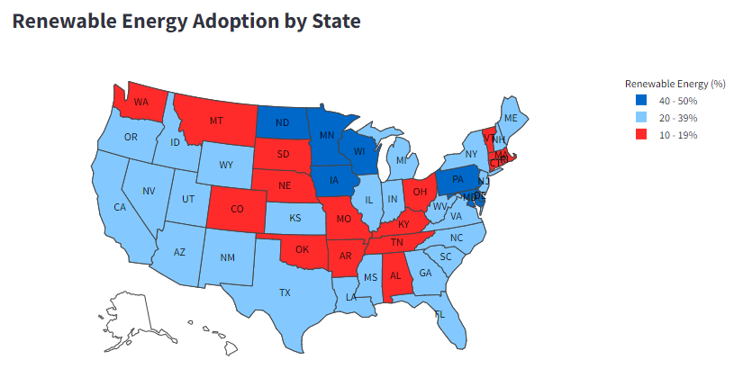
Data source: the author (2024). This is a fictional example created for educational purposes only. Data is fictional and should not be used for any actual analysis.

Slide 31
Title: provides a brief description/hint of the chart content.
Data source: the author (2024). This is a fictional example created for educational purposes only. Data is fictional and should not be used for any actual analysis.

Slide 32
Geographical Areas: Represent a location such as countries or states.
Data source: the author (2024). This is a fictional example created for educational purposes only. Data is fictional and should not be used for any actual analysis.

Slide 33
Color Legend: Represents the value of data.
Data source: the author (2024). This is a fictional example created for educational purposes only. Data is fictional and should not be used for any actual analysis.

Slide 34
Source/Footnotes: explains the origin of the information and/or provide additional information.
Data source: the author (2024). This is a fictional example created for educational purposes only. Data is fictional and should not be used for any actual analysis.

Slide 35
Data source: the author (2024). This is a fictional example created for educational purposes only. Data is fictional and should not be used for any actual analysis.

Slide 36
Retrieve Value: 20-39% of the energy produced in KS is renewable.
Data source: the author (2024). This is a fictional example created for educational purposes only. Data is fictional and should not be used for any actual analysis.

Slide 37
Make Comparisons: KS has a higher adoption of renewable energy than AL.
Data source: the author (2024). This is a fictional example created for educational purposes only. Data is fictional and should not be used for any actual analysis.

Slide 38
Well done! You completed the module “Maps”. To keep learning, select other modules on the left side bar.
Data source: the author (2024). This is a fictional example created for educational purposes only. Data is fictional and should not be used for any actual analysis.

Slide 39
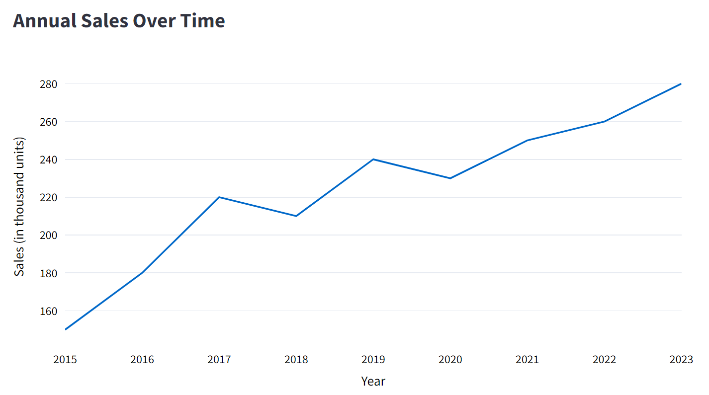
Data source: the author (2024). This is a fictional example created for educational purposes only. Data is fictional and should not be used for any actual analysis.

Slide 40
Title: provides a brief description/hint of the chart content.
Data source: the author (2024). This is a fictional example created for educational purposes only. Data is fictional and should not be used for any actual analysis.

Slide 41
X axis: represents categories or intervals (typically time).
Data source: the author (2024). This is a fictional example created for educational purposes only. Data is fictional and should not be used for any actual analysis.

Slide 42
Y-axis: shows the value corresponding to the interval.
Data source: the author (2024). This is a fictional example created for educational purposes only. Data is fictional and should not be used for any actual analysis.

Slide 43
Line: Connects individual data points, showing trends over an interval.
Data source: the author (2024). This is a fictional example created for educational purposes only. Data is fictional and should not be used for any actual analysis.

Slide 44
Source/Footnotes: explains the origin of the information and/or provide additional information.
Data source: the author (2024). This is a fictional example created for educational purposes only. Data is fictional and should not be used for any actual analysis.

Slide 45
Data source: the author (2024). This is a fictional example created for educational purposes only. Data is fictional and should not be used for any actual analysis.

Slide 46
Retrieve Value: The number of sales in 2019 was approx. 240 thousand units.
Data source: the author (2024). This is a fictional example created for educational purposes only. Data is fictional and should not be used for any actual analysis.

Slide 47
Make Comparisons: The annual sales in 2019 is higher than in 2018.
Data source: the author (2024). This is a fictional example created for educational purposes only. Data is fictional and should not be used for any actual analysis.

Slide 48
Find Minimum Value: the lowest annual sales was in 2015.
Data source: the author (2024). This is a fictional example created for educational purposes only. Data is fictional and should not be used for any actual analysis.

Slide 49
Find Maximum Value: the number of users is growing through the years and achieved its maximum in 2023.
Data source: the author (2024). This is a fictional example created for educational purposes only. Data is fictional and should not be used for any actual analysis.

Slide 50
Determine Range: The total number of units sold is in the range of 150 thousand to 280 thousand.
Data source: the author (2024). This is a fictional example created for educational purposes only. Data is fictional and should not be used for any actual analysis.

Slide 51
Find Trends: From 2020 to 2023 there is an increasing trend in sales.
Data source: the author (2024). This is a fictional example created for educational purposes only. Data is fictional and should not be used for any actual analysis.

Slide 52
Well done! You completed the module “Line Chart”. To keep learning, select other modules on the left side bar.
Data source: the author (2024). This is a fictional example created for educational purposes only. Data is fictional and should not be used for any actual analysis.

Slide 53
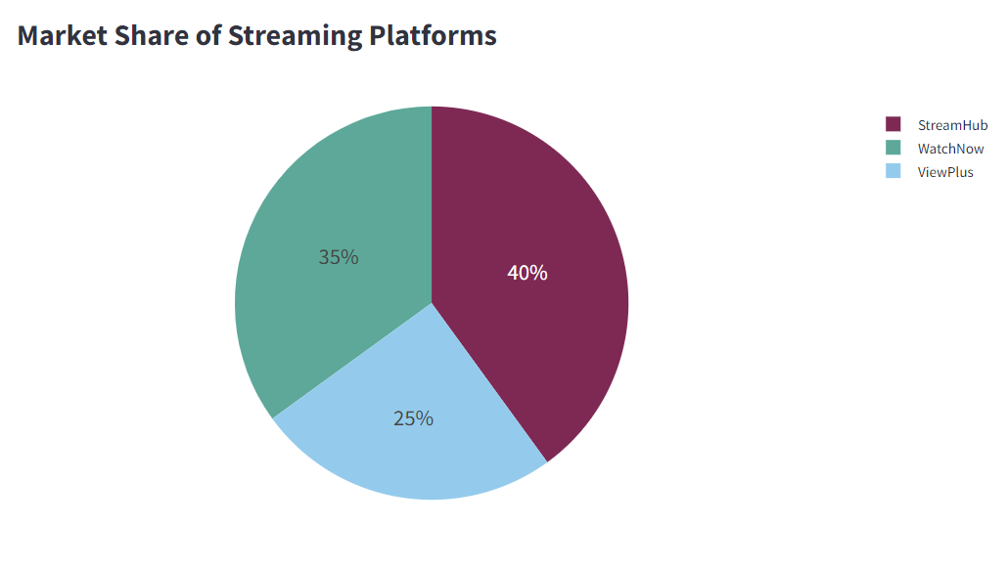
Data source: the author (2024). This is a fictional example created for educational purposes only. Data is fictional and should not be used for any actual analysis.

Slide 54
Title: provides a brief description/hint of the chart content.
Data source: the author (2024). This is a fictional example created for educational purposes only. Data is fictional and should not be used for any actual analysis.

Slide 55
Color Legend: Explains what each slice represents.
Data source: the author (2024). This is a fictional example created for educational purposes only. Data is fictional and should not be used for any actual analysis.

Slide 56
Labels: Typically show percentages or values within each slice.
Data source: the author (2024). This is a fictional example created for educational purposes only. Data is fictional and should not be used for any actual analysis.

Slide 57
Slices: Each slice represents a portion of the whole.
Data source: the author (2024). This is a fictional example created for educational purposes only. Data is fictional and should not be used for any actual analysis.

Slide 58
Source/Footnotes: explains the origin of the information and/or provide additional information.
Data source: the author (2024). This is a fictional example created for educational purposes only. Data is fictional and should not be used for any actual analysis.

Slide 59
Data source: the author (2024). This is a fictional example created for educational purposes only. Data is fictional and should not be used for any actual analysis.

Slide 60
Retrieve Value: WatchNow has 35% market share.
Data source: the author (2024). This is a fictional example created for educational purposes only. Data is fictional and should not be used for any actual analysis.

Slide 61
Make Comparisons: WatchNow has a higher market share than ViewPlus.
Data source: the author (2024). This is a fictional example created for educational purposes only. Data is fictional and should not be used for any actual analysis.

Slide 62
Find Minimum Value: ViewPlus has the lowest market share between the three streaming platforms.
Data source: the author (2024). This is a fictional example created for educational purposes only. Data is fictional and should not be used for any actual analysis.

Slide 63
Find Maximum Value: StreamHub has the highest market share between the three streaming platforms.
Data source: the author (2024). This is a fictional example created for educational purposes only. Data is fictional and should not be used for any actual analysis.

Slide 64
Well done! You completed the module “Pie Chart”. To keep learning, select other modules on the left side bar.
Data source: the author (2024). This is a fictional example created for educational purposes only. Data is fictional and should not be used for any actual analysis.

Slide 65
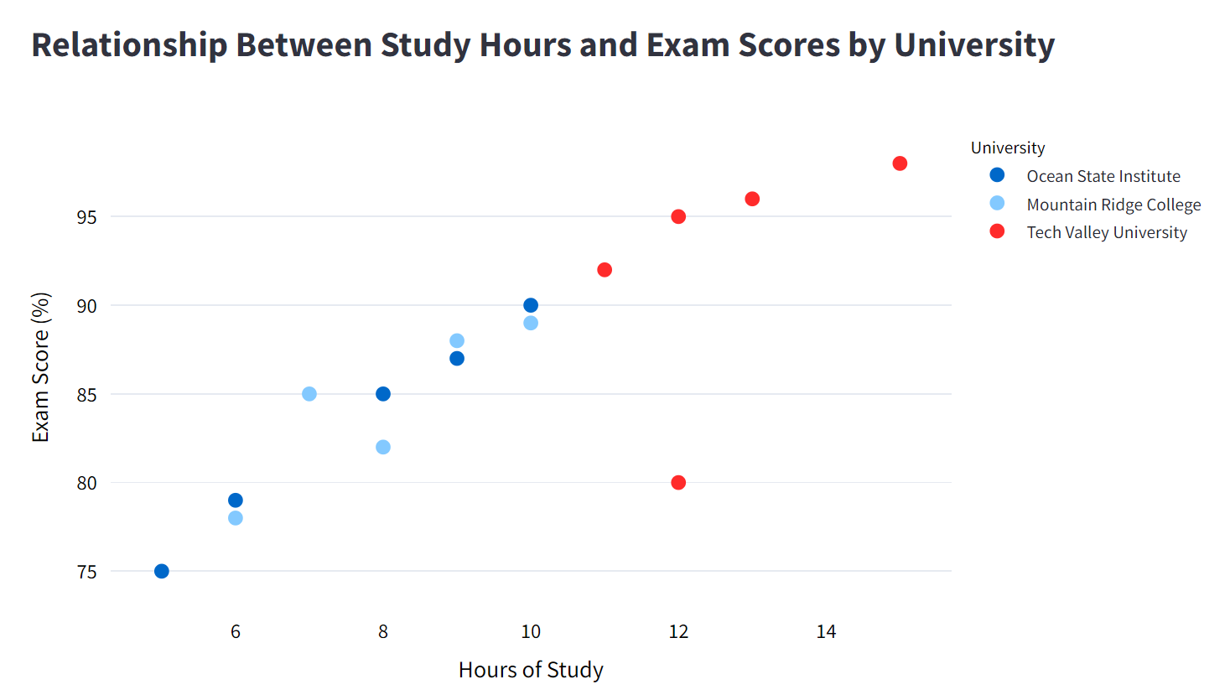
Data source: the author (2024). This is a fictional example created for educational purposes only. Data is fictional and should not be used for any actual analysis.

Slide 66
Title: provides a brief description/hint of the chart content.
Data source: the author (2024). This is a fictional example created for educational purposes only. Data is fictional and should not be used for any actual analysis.

Slide 67
X axis: represents the first numeric variable.
Data source: the author (2024). This is a fictional example created for educational purposes only. Data is fictional and should not be used for any actual analysis.

Slide 68
Y-axis: represents the second numeric variable.
Data source: the author (2024). This is a fictional example created for educational purposes only. Data is fictional and should not be used for any actual analysis.

Slide 69
Points: Represent individual data values as dots.
Data source: the author (2024). This is a fictional example created for educational purposes only. Data is fictional and should not be used for any actual analysis.

Slide 70
Color Legend: Explains categories if different colored dots are used.
Data source: the author (2024). This is a fictional example created for educational purposes only. Data is fictional and should not be used for any actual analysis.

Slide 71
Source/Footnotes: explains the origin of the information and/or provide additional information.
Data source: the author (2024). This is a fictional example created for educational purposes only. Data is fictional and should not be used for any actual analysis.

Slide 72
Data source: the author (2024). This is a fictional example created for educational purposes only. Data is fictional and should not be used for any actual analysis.

Slide 73
Retrieve Value: one student from Tech Valley University studied for 11 hours for the exam and scored 92%.
Data source: the author (2024). This is a fictional example created for educational purposes only. Data is fictional and should not be used for any actual analysis.

Slide 74
Find Minimum Value: the student with the lowest score (75) has studied 5 hours in total and belongs to the Ocean State Institute.
Data source: the author (2024). This is a fictional example created for educational purposes only. Data is fictional and should not be used for any actual analysis.

Slide 75
Find Maximum Value: the student with the highest score (96) has studied 15 hours in total and belongs to Tech Valley University.
Data source: the author (2024). This is a fictional example created for educational purposes only. Data is fictional and should not be used for any actual analysis.

Slide 76
Determine Range: The exam scores vary between 75% and 97%.
Data source: the author (2024). This is a fictional example created for educational purposes only. Data is fictional and should not be used for any actual analysis.

Slide 77
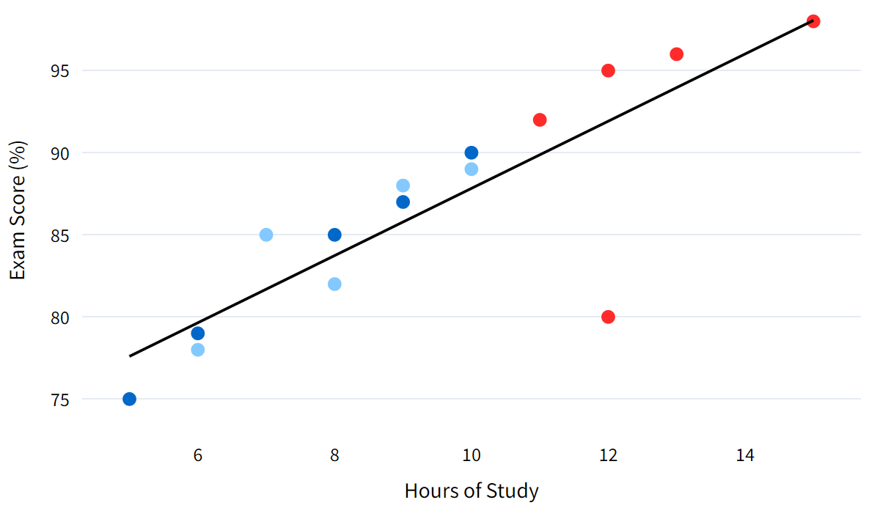
Find Trends: Overall, we observe that a higher dedicated time of study is correlated to a higher exam score.
Data source: the author (2024). This is a fictional example created for educational purposes only. Data is fictional and should not be used for any actual analysis.

Slide 78
Find Outliers: this student from Tech Valley University represents an outlier. Even though he had a high amount of study time, his score is low compared to other students with a similar amount of study time.
What exactly is an outlier?
An outlier is a data point that stands out because it’s very different from other data points. In this chart, it’s a student who studied for many hours but still scored lower than expected compared to others with similar study times.
Data source: the author (2024). This is a fictional example created for educational purposes only. Data is fictional and should not be used for any actual analysis.

Slide 79
Well done! You completed the module “Scatter Plot”. To keep learning, select other modules on the left side bar.
Data source: the author (2024). This is a fictional example created for educational purposes only. Data is fictional and should not be used for any actual analysis.

Slide 80
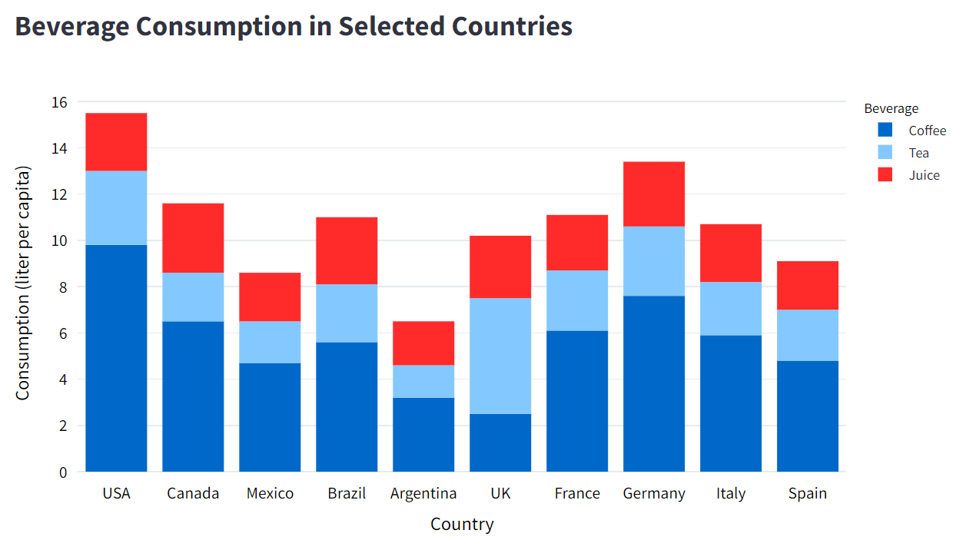
Data source: the author (2024). This is a fictional example created for educational purposes only. Data is fictional and should not be used for any actual analysis.

Slide 81
Title: provides a brief description/hint of the chart content.
Data source: the author (2024). This is a fictional example created for educational purposes only. Data is fictional and should not be used for any actual analysis.

Slide 82
X-axis: represents categories or intervals (typically time).
Data source: the author (2024). This is a fictional example created for educational purposes only. Data is fictional and should not be used for any actual analysis.

Slide 83
Y-axis: shows the value corresponding to the interval.
Data source: the author (2024). This is a fictional example created for educational purposes only. Data is fictional and should not be used for any actual analysis.

Slide 84
Bars: Represent data values as rectangular bars. The height of each bar is proportional to the value it represents.
Data source: the author (2024). This is a fictional example created for educational purposes only. Data is fictional and should not be used for any actual analysis.

Slide 85
Color Legend: Shows the category that each color in the chart represents.
Data source: the author (2024). This is a fictional example created for educational purposes only. Data is fictional and should not be used for any actual analysis.

Slide 86
Source/Footnotes: explains the origin of the information and/or provide additional information.
Data source: the author (2024). This is a fictional example created for educational purposes only. Data is fictional and should not be used for any actual analysis.

Slide 87
Data source: the author (2024). This is a fictional example created for educational purposes only. Data is fictional and should not be used for any actual analysis.

Slide 88
Retrieve Partial Value: The consumption of tee in UK is around 5 liter per capita.
How to find partial values in a staked chart?
In a stacked bar chart, each layer adds to the one below. To find the value for a specific category (e.g., “Tea" in UK), subtract the “Coffee” layer below it from the total height at “Tea.""
Data source: the author (2024). This is a fictional example created for educational purposes only. Data is fictional and should not be used for any actual analysis.

Slide 89
Make Comparisons: The consumption of Tea is double the consumption of Coffee in UK.
Data source: the author (2024). This is a fictional example created for educational purposes only. Data is fictional and should not be used for any actual analysis.

Slide 90
Well done! You completed the module “Stacked Bar Chart”. To keep learning, select other modules on the left side bar.
Data source: the author (2024). This is a fictional example created for educational purposes only. Data is fictional and should not be used for any actual analysis.

Slide 92
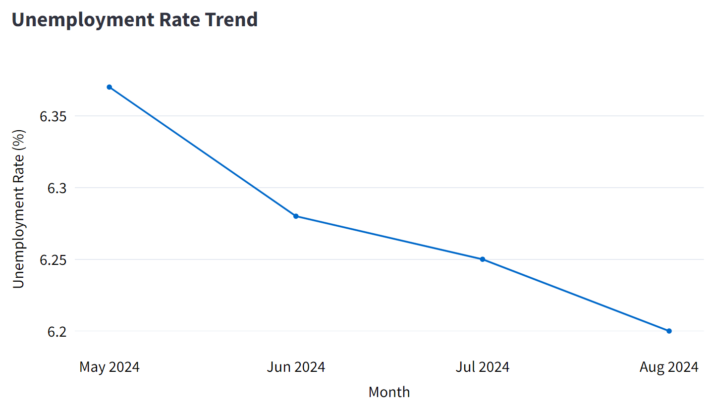


Slide 93
The chart shows the unemployment rate from May to August 2024, suggesting a continuous decline in unemployment.

Slide 94
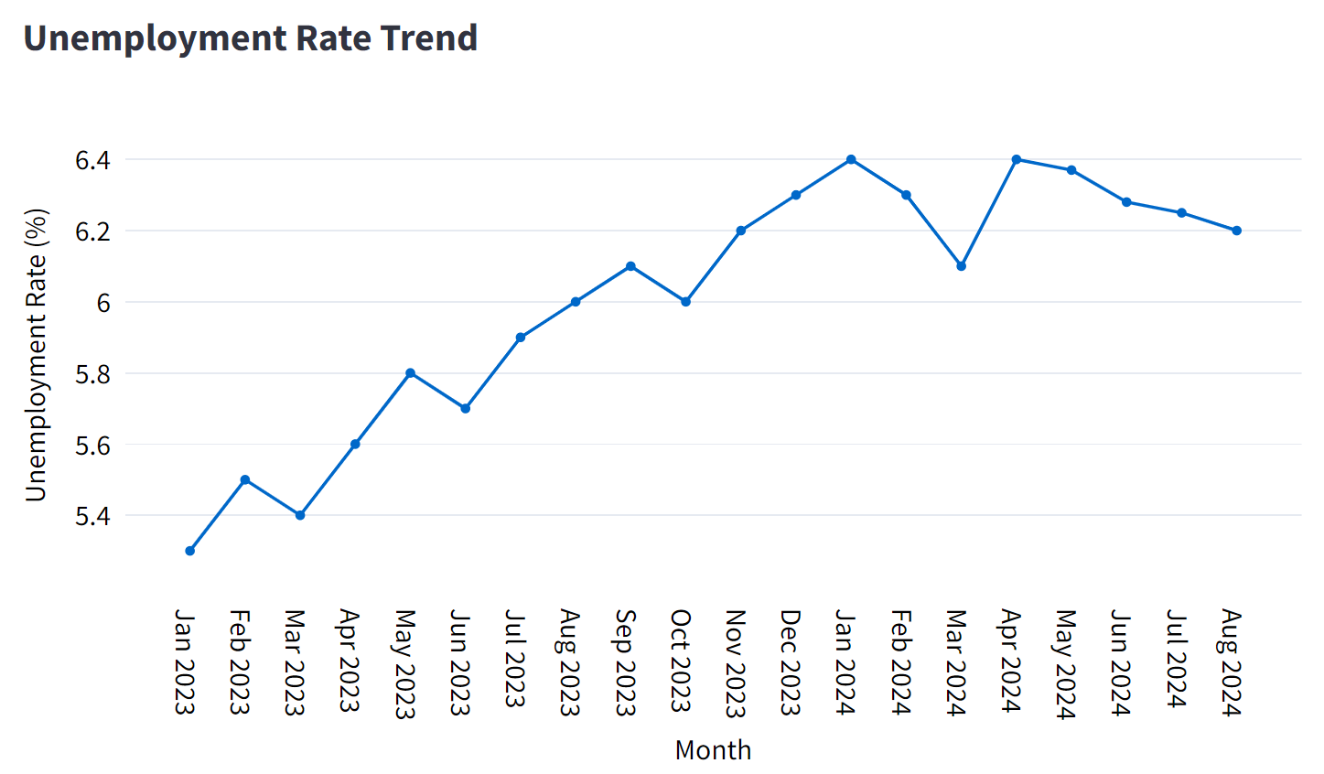
The chart shows the unemployment rate from May to August 2024, suggesting a continuous decline in unemployment.

Slide 95
The chart shows the unemployment rate from May to August 2024, suggesting a continuous decline in unemployment.
Here’s the full unemployment data from the past 2 years.

Slide 96
The chart shows the unemployment rate from May to August 2024, suggesting a continuous decline in unemployment.
Here’s the full unemployment data from the past 2 years.
It shows an increasing trend with fluctuations, followed by a recent decline.

Slide 97
The chart shows the unemployment rate from May to August 2024, suggesting a continuous decline in unemployment.
Here’s the full unemployment data from the past 2 years.
It shows an increasing trend with fluctuations, followed by a recent decline.
This visualization hides the fact that unemployment rates have increased overall in recent years.

Slide 98
The chart shows the unemployment rate from May to August 2024, suggesting a continuous decline in unemployment.
Here’s the full unemployment data from the past 2 years.
It shows an increasing trend with fluctuations, followed by a recent decline.
This visualization hides the fact that unemployment rates have increased overall in recent years.

Slide 99
Well done! You completed the module “Cherry Picking”. To keep learning, select other modules on the left side bar.

Slide 101
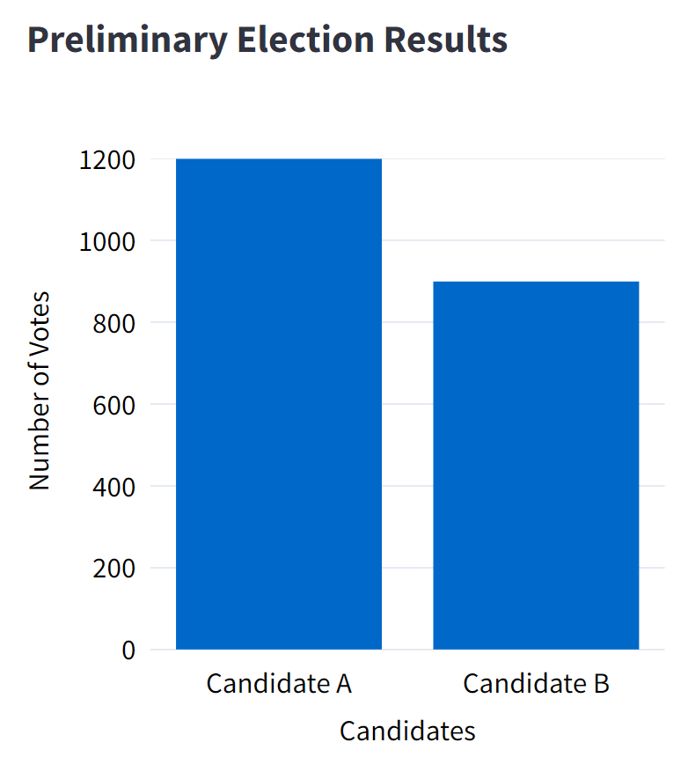

Slide 102
This chart shows early results from an election.

Slide 103
This chart shows early results from an election.
The chart doesn’t make it clear that half of the votes are still missing, leading viewers to believe that the result is almost certain.

Slide 104
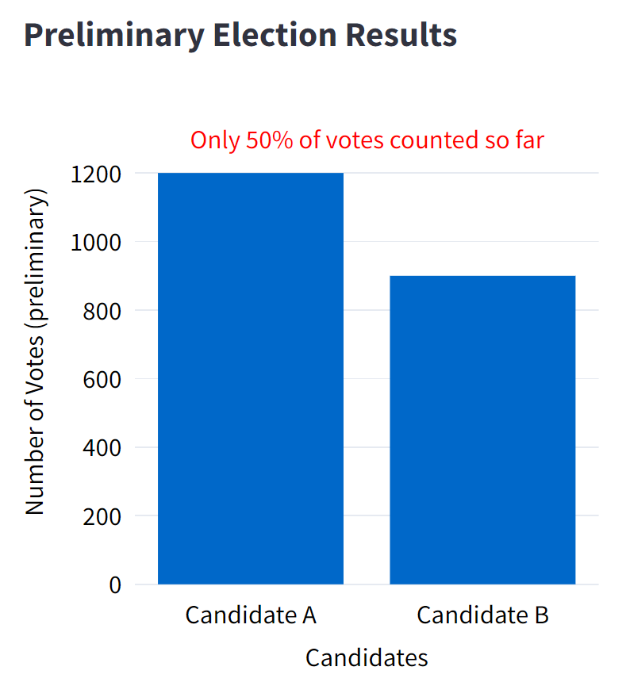
This chart shows early results from an election.
The chart doesn’t make it clear that half of the votes are still missing, leading viewers to believe that the result is almost certain.

Slide 105
A better chart would indicate that only 50% of the votes have been counted, showing that the result is still uncertain and may change.
This chart shows early results from an election.
The chart doesn’t make it clear that half of the votes are still missing, leading viewers to believe that the result is almost certain.

Slide 106
A better chart would indicate that only 50% of the votes have been counted, showing that the result is still uncertain and may change.
This chart shows early results from an election.
The chart doesn’t make it clear that half of the votes are still missing, leading viewers to believe that the result is almost certain.

Slide 107
Well done! You completed the module “Concealed Uncertainty”. To keep learning, select other modules on the left side bar.

Slide 109
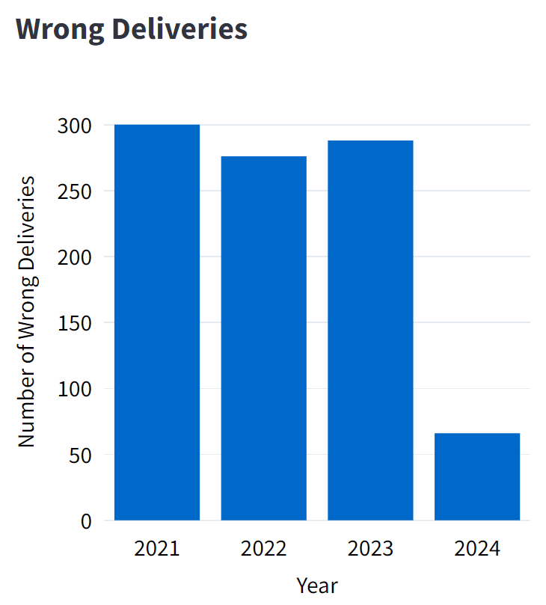

Slide 110
The chart below shows the total number of wrong deliveries per year for a delivery company from 2021 to 2024.

Slide 111
The chart below shows the total number of wrong deliveries per year for a delivery company from 2021 to 2024.
It suggests a sharp decline in 2024, but the chart hides the fact that 2024 only includes 3 months of data.

Slide 112
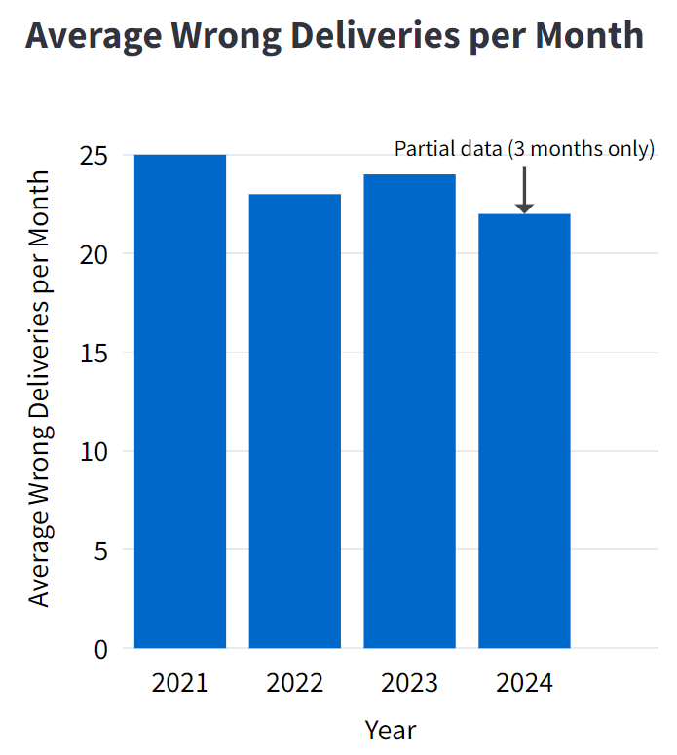
The chart below shows the total number of wrong deliveries per year for a delivery company from 2021 to 2024.
It suggests a sharp decline in 2024, but the chart hides the fact that 2024 only includes 3 months of data.

Slide 113
The chart below shows the total number of wrong deliveries per year for a delivery company from 2021 to 2024.
It suggests a sharp decline in 2024, but the chart hides the fact that 2024 only includes 3 months of data.
A better chart shows the average number of wrong deliveries per month instead of yearly totals.

Slide 114
The chart below shows the total number of wrong deliveries per year for a delivery company from 2021 to 2024.
Adding an annotation would make it clear that only partial data is being considered in 2024.
It suggests a sharp decline in 2024, but the chart hides the fact that 2024 only includes 3 months of data.
A better chart shows the average number of wrong deliveries per month instead of yearly totals.

Slide 115
The chart below shows the total number of wrong deliveries per year for a delivery company from 2021 to 2024.
Adding an annotation would make it clear that only partial data is being considered in 2024.
It suggests a sharp decline in 2024, but the chart hides the fact that 2024 only includes 3 months of data.
A better chart shows the average number of wrong deliveries per month instead of yearly totals.

Slide 116
Well done! You completed the module “Concealed Uncertainty”. To keep learning, select other modules on the left side bar.

Slide 118
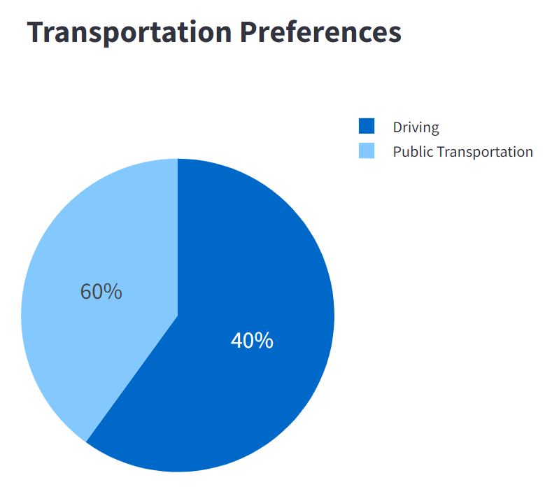

Slide 119
The pie chart shows the preferred mode of transportation in a given city.

Slide 120
The pie chart shows the preferred mode of transportation in a given city.
The annotation incorrectly states that 40% of people prefer to drive, when in fact driving occupies more than 50% in the chart.

Slide 121
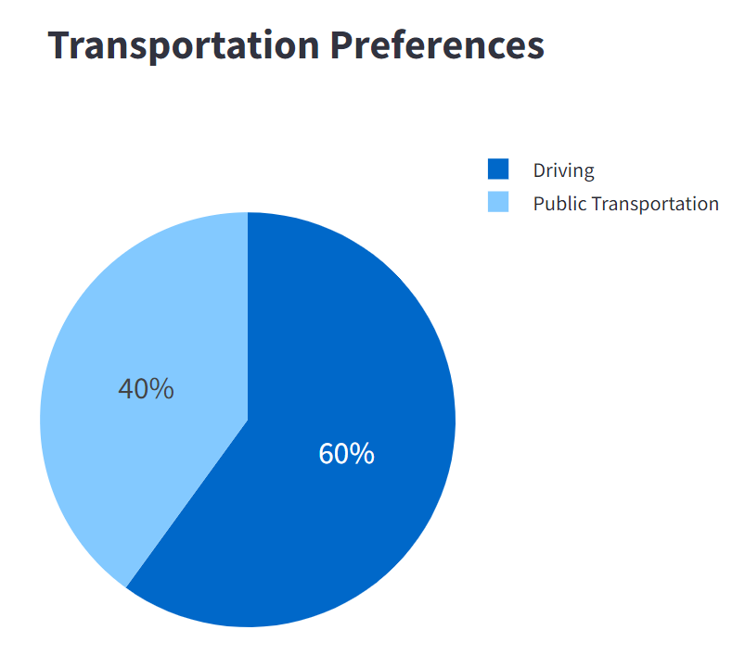
The pie chart shows the preferred mode of transportation in a given city.
The annotation incorrectly states that 40% of people prefer to drive, when in fact driving occupies more than 50% in the chart.

Slide 122
The pie chart shows the preferred mode of transportation in a given city.
The annotation incorrectly states that 40% of people prefer to drive, when in fact driving occupies more than 50% in the chart.
A correct chart would label the true proportions, giving viewers an accurate understanding of the data.

Slide 123
The pie chart shows the preferred mode of transportation in a given city.
The annotation incorrectly states that 40% of people prefer to drive, when in fact driving occupies more than 50% in the chart.
A correct chart would label the true proportions, giving viewers an accurate understanding of the data.

Slide 124
Well done! You completed the module “Misleading Annotation”. To keep learning, select other modules on the left side bar.

Slide 126
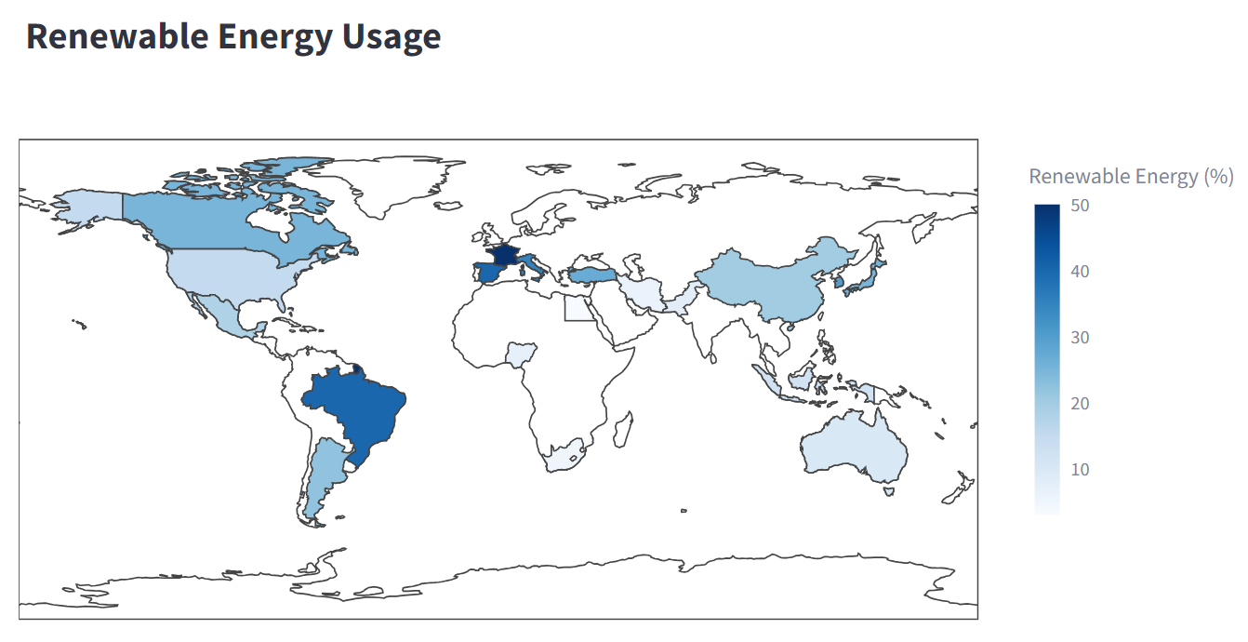

Slide 127
The map below shows the percentage of renewable energy usage in various countries

Slide 128
The map below shows the percentage of renewable energy usage in various countries
The colors used in the map make it difficult to distinguish whether the country has a low percentage of renewable energy or whether the data is missing.

Slide 129
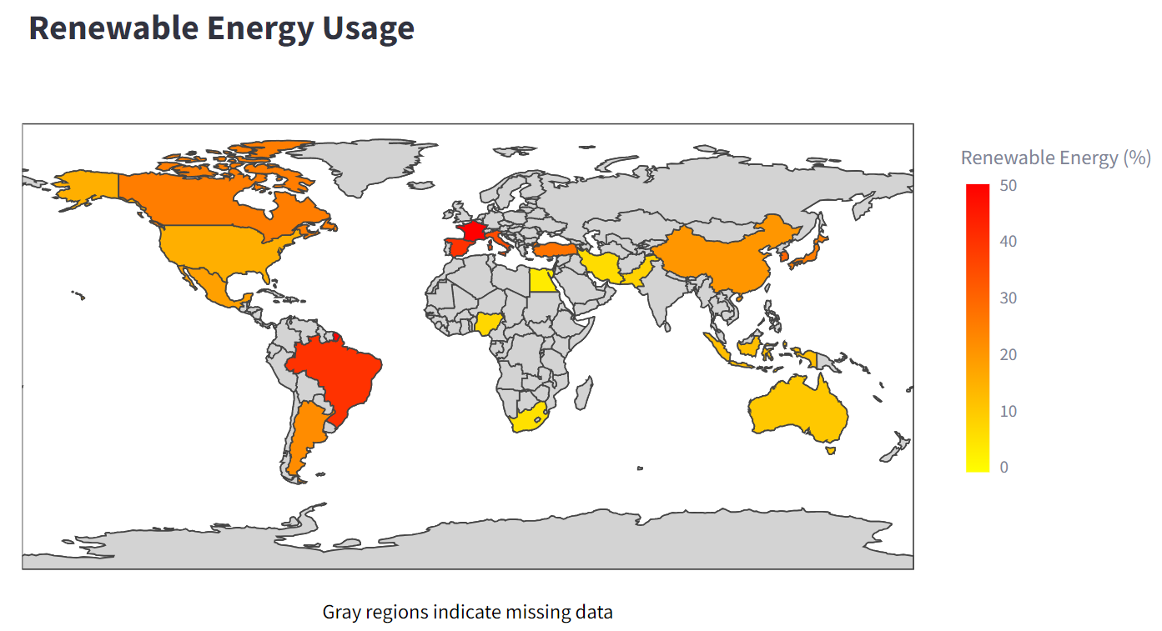

The map below shows the percentage of renewable energy usage in various countries
The colors used in the map make it difficult to distinguish whether the country has a low percentage of renewable energy or whether the data is missing.

Slide 130
The map below shows the percentage of renewable energy usage in various countries
A better visualization would either include missing data or clearly indicate that some countries do not have available data.
The colors used in the map make it difficult to distinguish whether the country has a low percentage of renewable energy or whether the data is missing.

Slide 131
The map below shows the percentage of renewable energy usage in various countries
A better visualization would either include missing data or clearly indicate that some countries do not have available data.
The colors used in the map make it difficult to distinguish whether the country has a low percentage of renewable energy or whether the data is missing.
A different color might also help to distinguish between low values and missing data.

Slide 132
The map below shows the percentage of renewable energy usage in various countries
A better visualization would either include missing data or clearly indicate that some countries do not have available data.
The colors used in the map make it difficult to distinguish whether the country has a low percentage of renewable energy or whether the data is missing.
A different color might also help to distinguish between low values and missing data.

Slide 133
Well done! You completed the module “Missing Data”. To keep learning, select other modules on the left side bar.

Slide 135
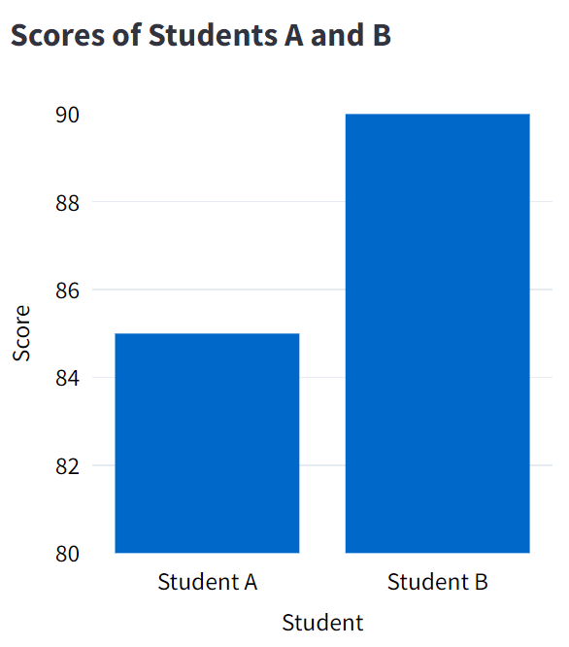

Slide 136
This bar chart presents the scores for Student A and Student B.

Slide 137
This bar chart presents the scores for Student A and Student B.
Because the y-axis is truncated, the small difference of 6 points between the students' scores appears much more dramatic than it should.

Slide 138
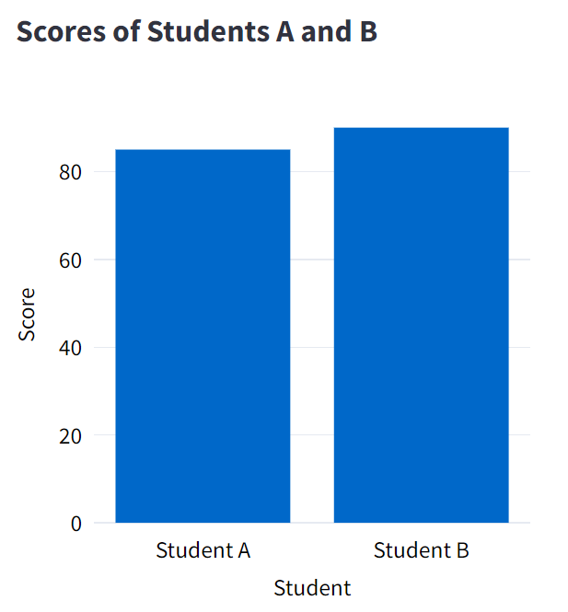
This bar chart presents the scores for Student A and Student B.
Because the y-axis is truncated, the small difference of 6 points between the students' scores appears much more dramatic than it should.

Slide 139
This bar chart presents the scores for Student A and Student B.
The y-axis for a Bar or Area Chart should always start from zero.
Because the y-axis is truncated, the small difference of 6 points between the students' scores appears much more dramatic than it should.

Slide 140
This bar chart presents the scores for Student A and Student B.
The y-axis for a Bar or Area Chart should always start from zero.
Because the y-axis is truncated, the small difference of 6 points between the students' scores appears much more dramatic than it should.
When the data are presented correctly, we see that the difference in performance between the two students is not significant.

Slide 141
This bar chart presents the scores for Student A and Student B.
The y-axis for a Bar or Area Chart should always start from zero.
Because the y-axis is truncated, the small difference of 6 points between the students' scores appears much more dramatic than it should.
When the data are presented correctly, we see that the difference in performance between the two students is not significant.

Slide 142
Well done! You completed the module “Truncated Axis”. To keep learning, select other modules on the left side bar.

Slide 144
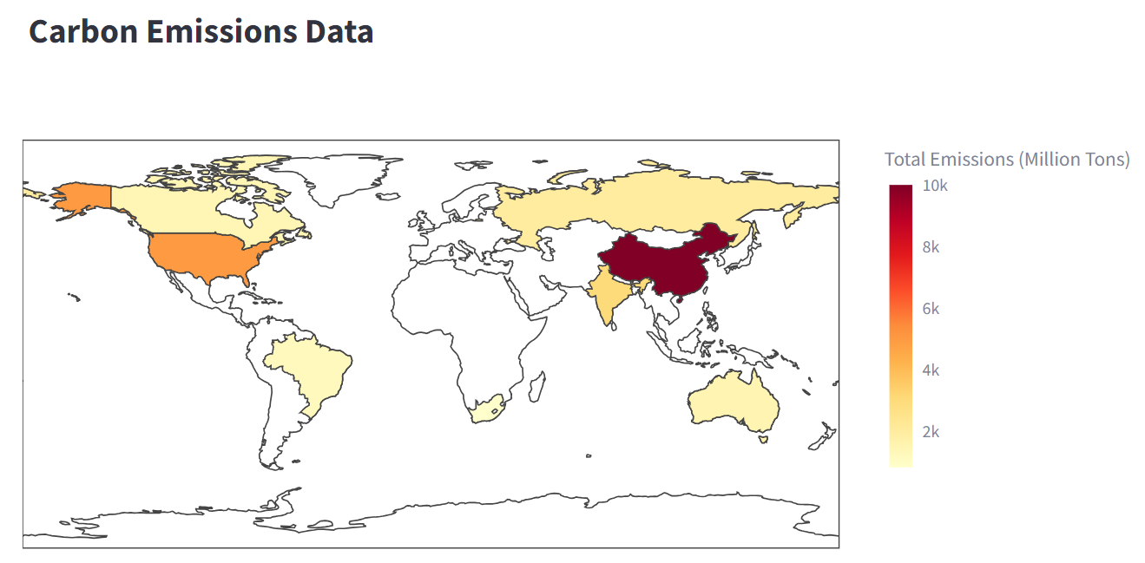

Slide 145
The map below shows the total carbon emissions of various countries.

Slide 146
The map below shows the total carbon emissions of various countries.
Countries with larger populations or bigger economies will naturally have higher total emissions, but this doesn’t mean they have higher emissions per capita.

Slide 147
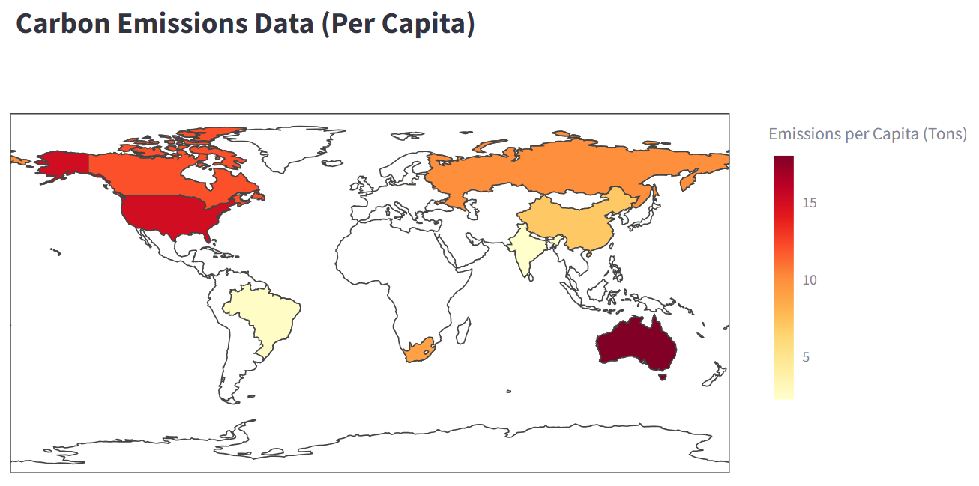
The map below shows the total carbon emissions of various countries.
Countries with larger populations or bigger economies will naturally have higher total emissions, but this doesn’t mean they have higher emissions per capita.

Slide 148
The map below shows the total carbon emissions of various countries.
A correct visualization would normalize the data by showing emissions per capita.
Countries with larger populations or bigger economies will naturally have higher total emissions, but this doesn’t mean they have higher emissions per capita.

Slide 149
The map below shows the total carbon emissions of various countries.
A correct visualization would normalize the data by showing emissions per capita.
Countries with larger populations or bigger economies will naturally have higher total emissions, but this doesn’t mean they have higher emissions per capita.
This allows for a fair and meaningful comparison between countries, if the goal of the map is to give an accurate representation of which countries are the biggest polluters.

Slide 150
The map below shows the total carbon emissions of various countries.
A correct visualization would normalize the data by showing emissions per capita.
Countries with larger populations or bigger economies will naturally have higher total emissions, but this doesn’t mean they have higher emissions per capita.
This allows for a fair and meaningful comparison between countries, if the goal of the map is to give an accurate representation of which countries are the biggest polluters.

Slide 151
Well done! You completed the module “Missing Normalization”. To keep learning, select other modules on the left side bar.

Slide 153
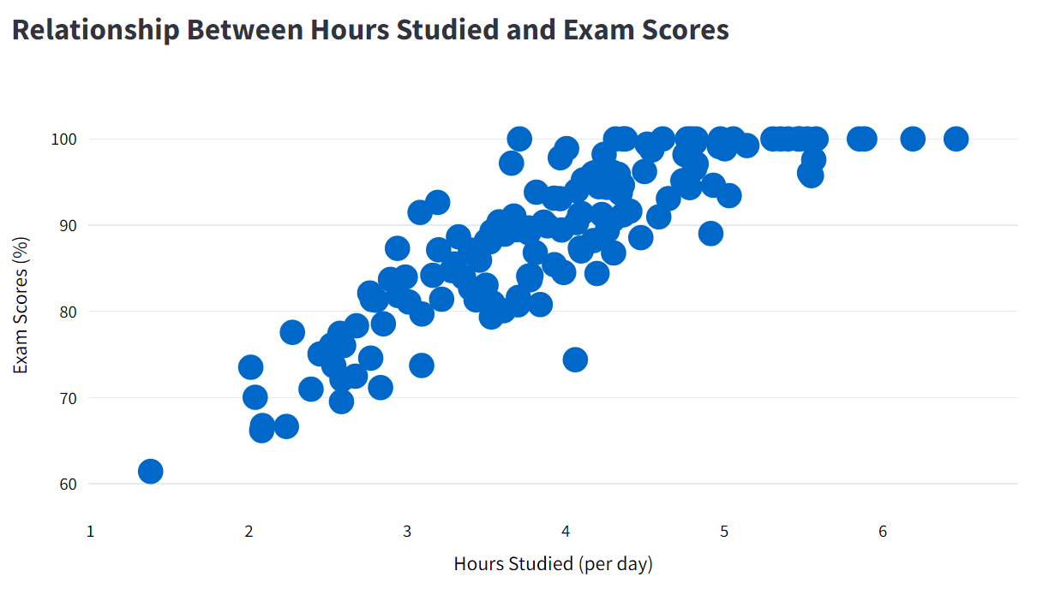

Slide 154
The scatter plot below shows the relationship between hours studied per day and exam scores.

Slide 155
The scatter plot below shows the relationship between hours studied per day and exam scores.
Due to the high density of data points, it is hard to visualize individual data points.

Slide 156
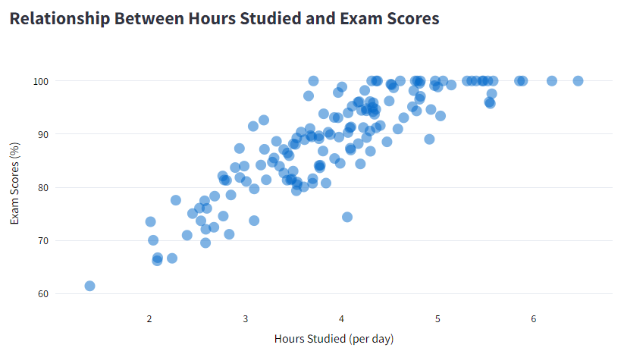
The scatter plot below shows the relationship between hours studied per day and exam scores.
Due to the high density of data points, it is hard to visualize individual data points.

Slide 157
The scatter plot below shows the relationship between hours studied per day and exam scores.
Due to the high density of data points, it is hard to visualize individual data points.
A better visualization would add some opacity and decrease the markers to help the viewer to distinguish different data points.

Slide 158
The scatter plot below shows the relationship between hours studied per day and exam scores.
Due to the high density of data points, it is hard to visualize individual data points.
A better visualization would add some opacity and decrease the markers to help the viewer to distinguish different data points.

Slide 159
Well done! You completed the module “Overplotting”. To keep learning, select other modules on the left side bar.

Slide 161
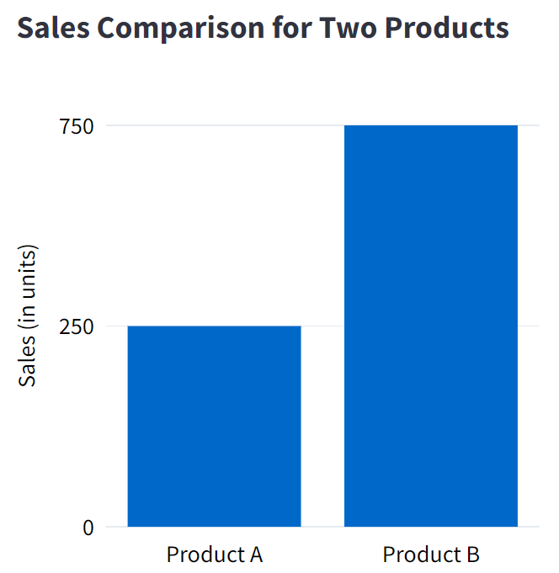

Slide 162
The bar chart below shows the sales of two products, A and B.

Slide 163
The bar chart below shows the sales of two products, A and B.
50%
500
50%
250
The y-axis uses non-linear scaling (0-250, 250-750) to make it look like sales of product A are about 50% of sales of product B.

Slide 164
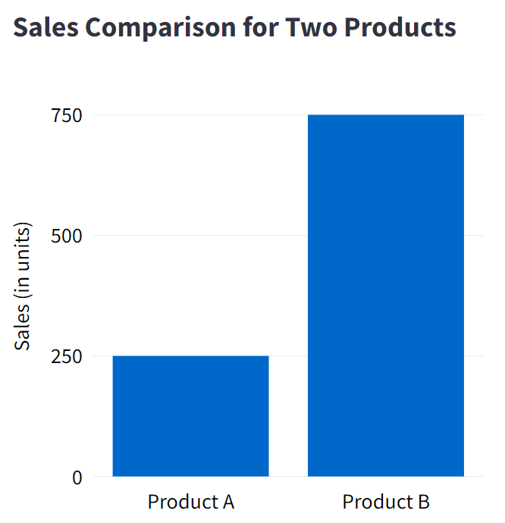
The bar chart below shows the sales of two products, A and B.
50%
500
50%
250
The y-axis uses non-linear scaling (0-250, 250-750) to make it look like sales of product A are about 50% of sales of product B.

Slide 165
The bar chart below shows the sales of two products, A and B.
The corrected bar chart below shows the y-axis using an uniform interval.
50%
250
500
250
50%
250
250
The y-axis uses non-linear scaling (0-250, 250-750) to make it look like sales of product A are about 50% of sales of product B.

Slide 166
The bar chart below shows the sales of two products, A and B.
The corrected bar chart below shows the y-axis using an uniform interval.
50%
33%
250
500
33%
250
50%
250
33%
250
The y-axis uses non-linear scaling (0-250, 250-750) to make it look like sales of product A are about 50% of sales of product B.
The chart still shows that Product B has higher sales than Product A, but the proportional difference is not exaggerated.

Slide 167
The bar chart below shows the sales of two products, A and B.
The corrected bar chart below shows the y-axis using an uniform interval.
50%
33%
250
500
33%
250
50%
250
33%
250
The y-axis uses non-linear scaling (0-250, 250-750) to make it look like sales of product A are about 50% of sales of product B.
The chart still shows that Product B has higher sales than Product A, but the proportional difference is not exaggerated.

Slide 168
Well done! You completed the module “Inappropriate Scale Functions”. To keep learning, select other modules on the left side bar.

Slide 170
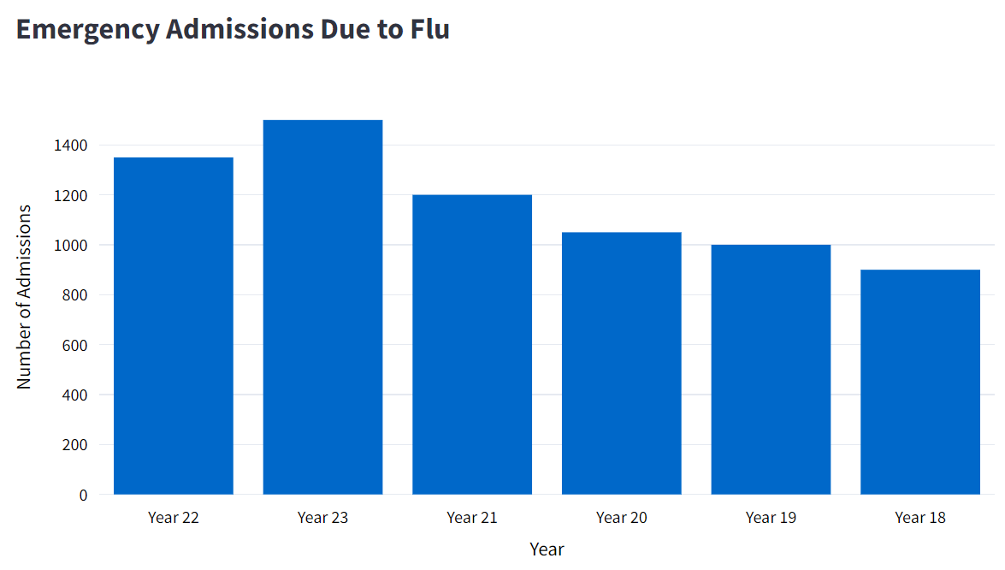

Slide 171
The bar chart below shows the number of admissions in an emergency department over the years.

Slide 172
The bar chart below shows the number of admissions in an emergency department over the years.
The years on the x-axis are intentionally out of order to give the impression that emergency admissions have decreased in recent years.

Slide 173
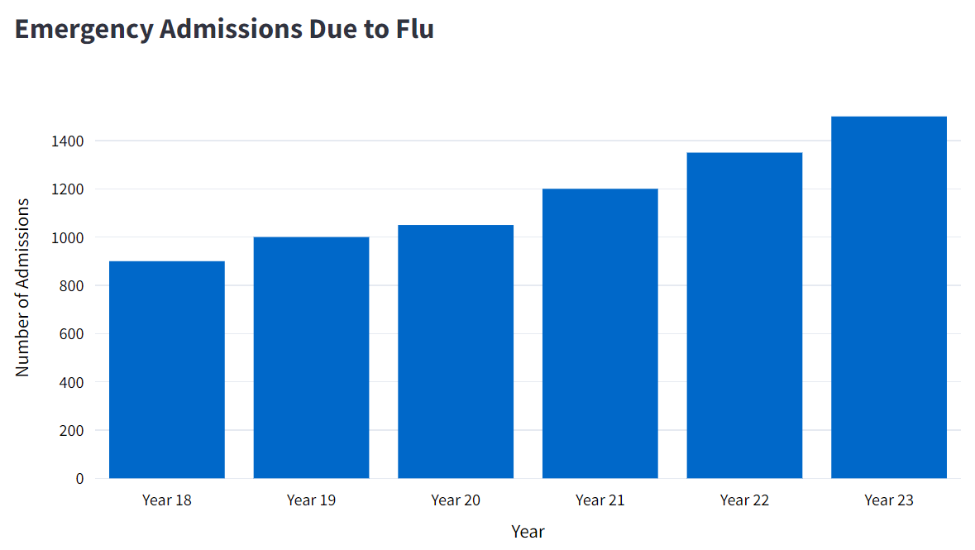
The bar chart below shows the number of admissions in an emergency department over the years.
The years on the x-axis are intentionally out of order to give the impression that emergency admissions have decreased in recent years.

Slide 174
The bar chart below shows the number of admissions in an emergency department over the years.
The x-axis years are presented chronologically.
The years on the x-axis are intentionally out of order to give the impression that emergency admissions have decreased in recent years.

Slide 175
The bar chart below shows the number of admissions in an emergency department over the years.
The x-axis years are presented chronologically.
The years on the x-axis are intentionally out of order to give the impression that emergency admissions have decreased in recent years.
The corrected chart allows viewers to clearly visualize how flu-related emergency admissions have increased over the years.

Slide 176
The bar chart below shows the number of admissions in an emergency department over the years.
The x-axis years are presented chronologically.
The years on the x-axis are intentionally out of order to give the impression that emergency admissions have decreased in recent years.
The corrected chart allows viewers to clearly visualize how flu-related emergency admissions have increased over the years.

Slide 177
Well done! You completed the module “Inappropriate Scale Order”. To keep learning, select other modules on the left side bar.

Slide 179
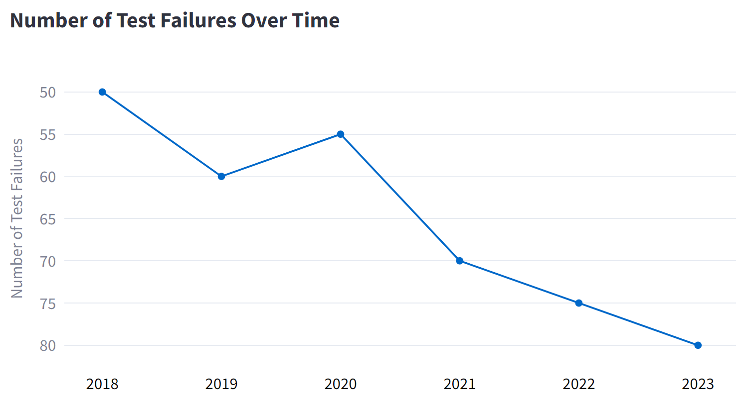

Slide 180
The chart shows the number of test failures over the years.

Slide 181
The chart shows the number of test failures over the years.
The y-axis is inverted to make it appear as if the number of failures has decreased over time.

Slide 182
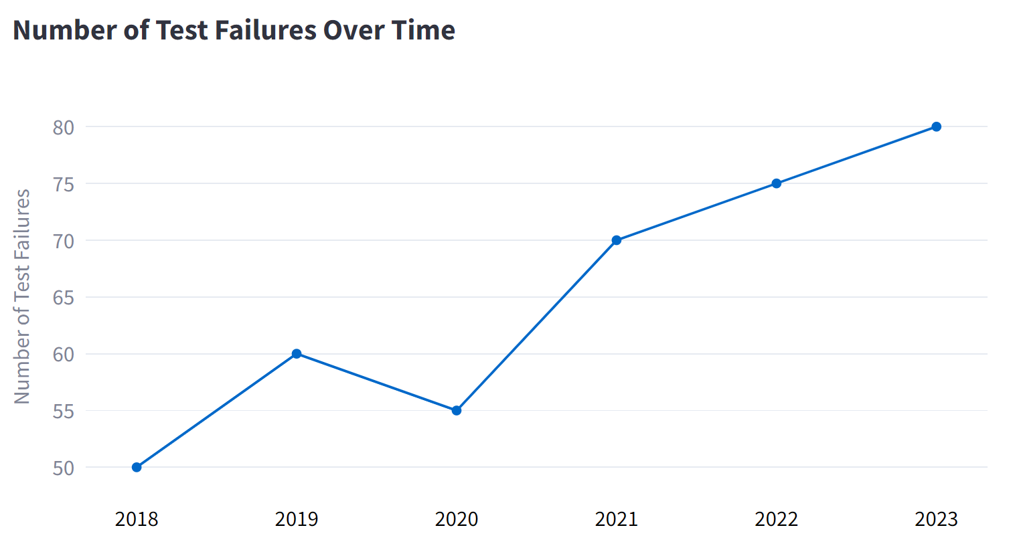
The chart shows the number of test failures over the years.
250
250
250
The y-axis is inverted to make it appear as if the number of failures has decreased over time.

Slide 183
The chart shows the number of test failures over the years.
On the chart below, the y-axis is reordered in a conventional way.
250
250
250
The y-axis is inverted to make it appear as if the number of failures has decreased over time.

Slide 184
The chart shows the number of test failures over the years.
On the chart below, the y-axis is reordered in a conventional way.
250
250
250
The y-axis is inverted to make it appear as if the number of failures has decreased over time.
Now it is easier to identify that the test failures are increasing over the last years.

Slide 185
The chart shows the number of test failures over the years.
On the chart below, the y-axis is reordered in a conventional way.
250
250
250
The y-axis is inverted to make it appear as if the number of failures has decreased over time.
Now it is easier to identify that the test failures are increasing over the last years.

Slide 186
Well done! You completed the module “Inappropriate Scale Direction”. To keep learning, select other modules on the left side bar.

