Slide 1
TOP 10 LEADING CAUSES OF DEATH IN USA (1999-2016)
Jose Luis Bracho
Mariana Chavez
Dwight Mauk
Robert Mabry

Slide 2


Slide 3
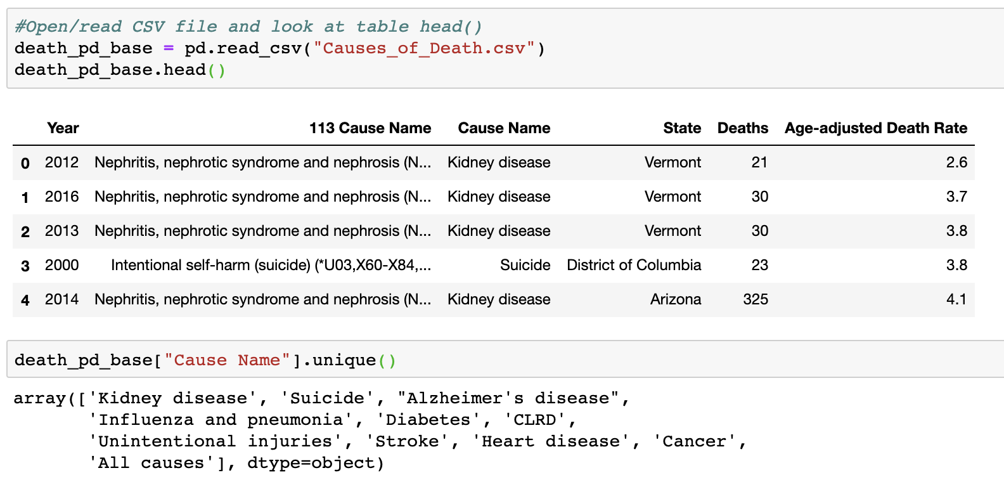

Slide 4
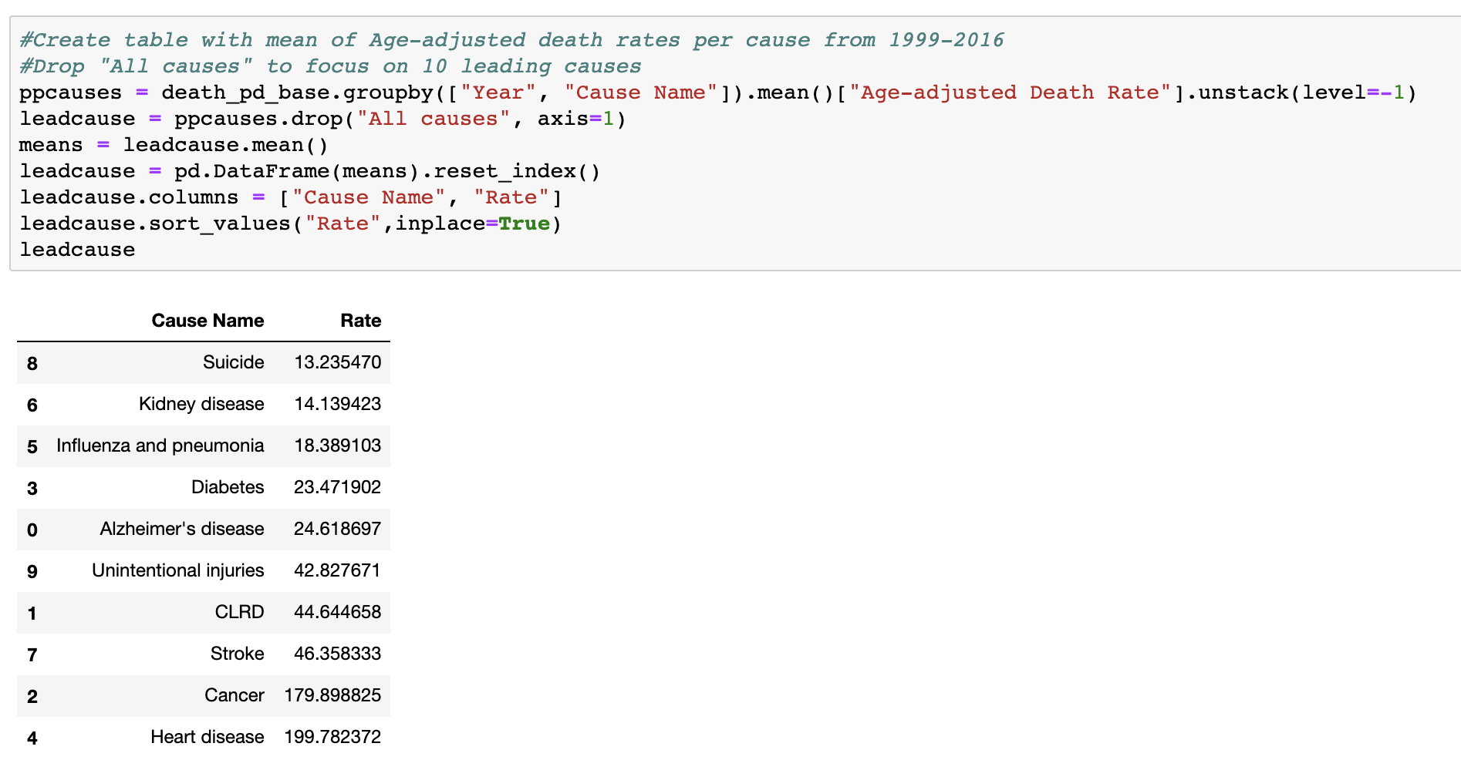

Slide 5
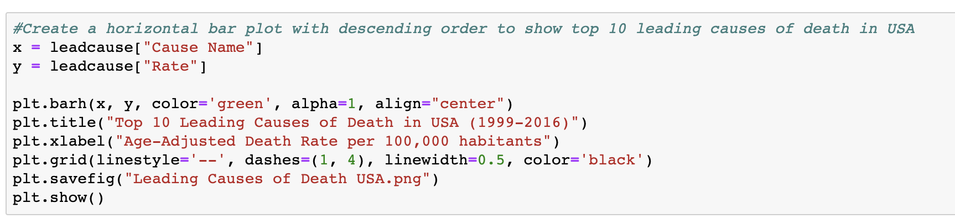
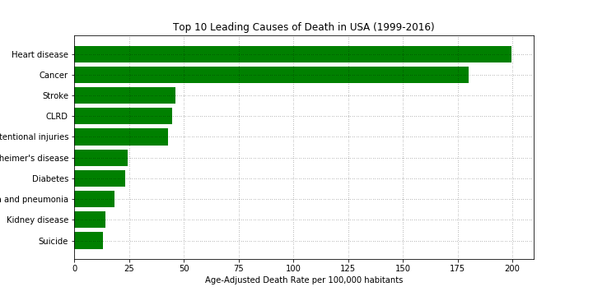

Slide 6
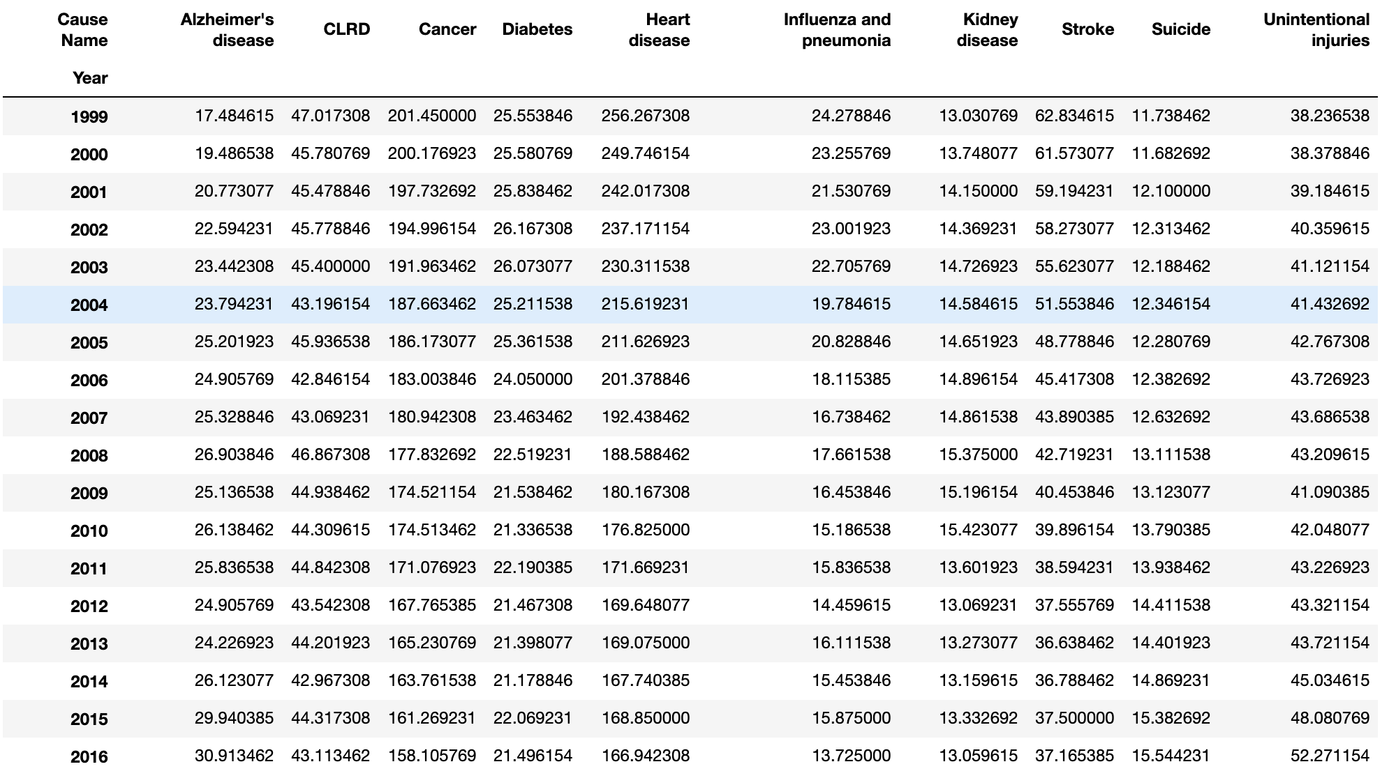

Slide 7
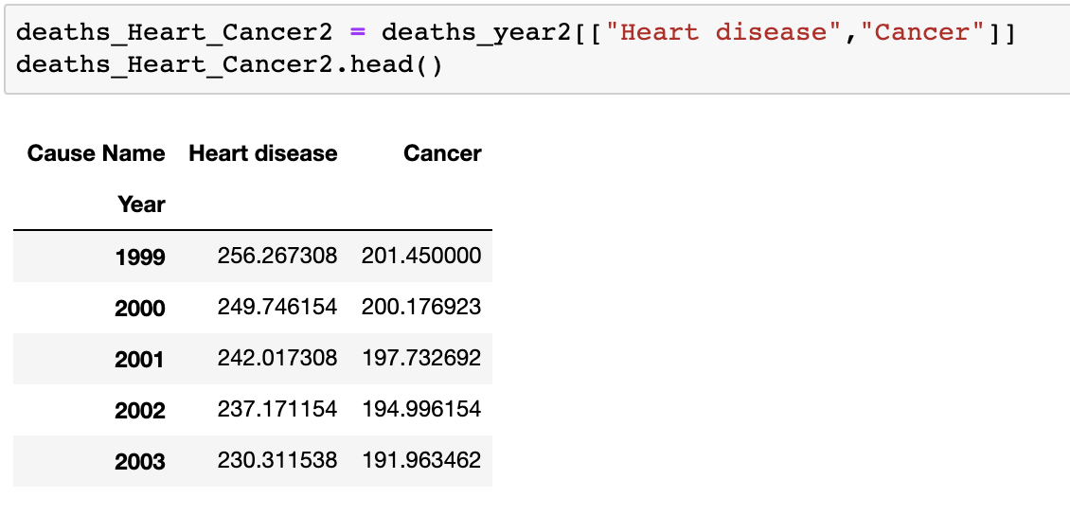
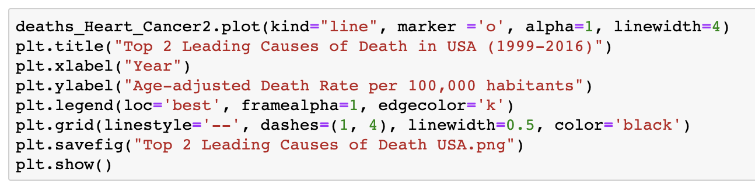

Slide 8
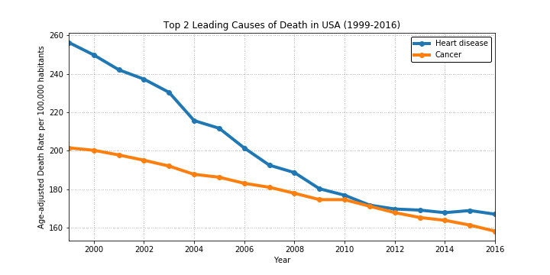

Slide 9
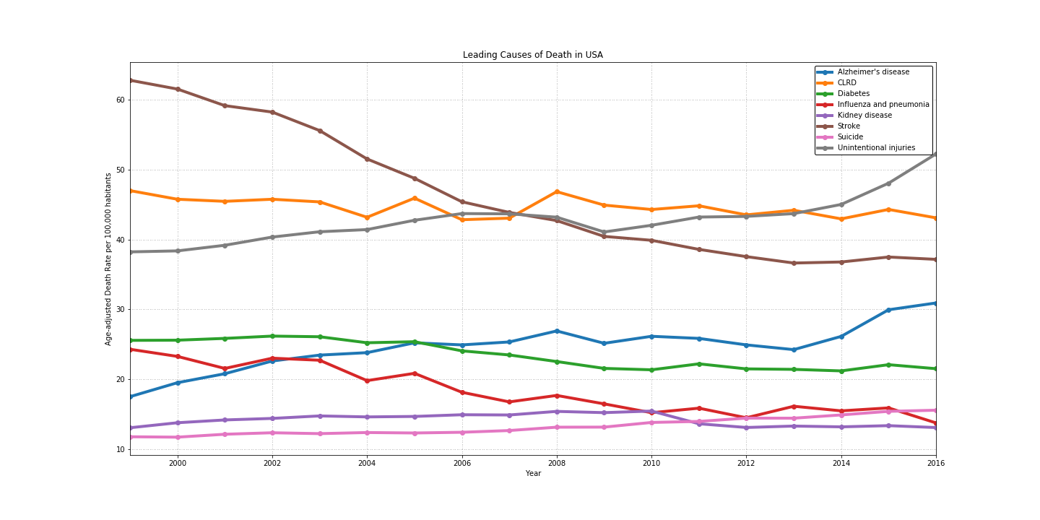

Slide 10
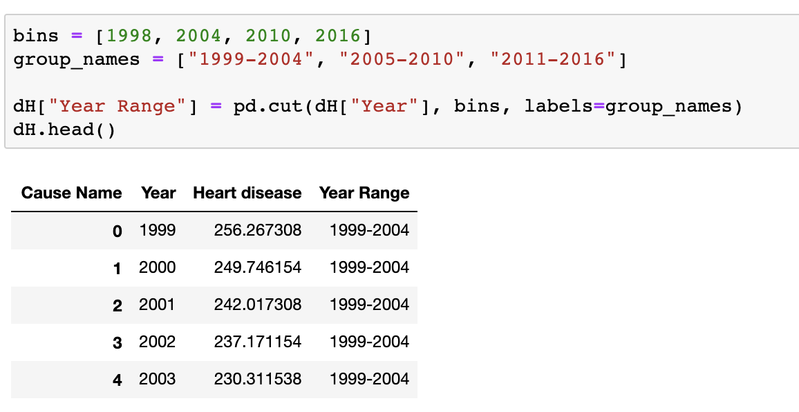
Null Hypothesis #1
- The trend observed on the decrease of death rate for Heart disease and Cancer (meaning, the decrease on age-adjusted death rate per 100,000 habitants) does not represent a significant improvement throughout the years.

Slide 11
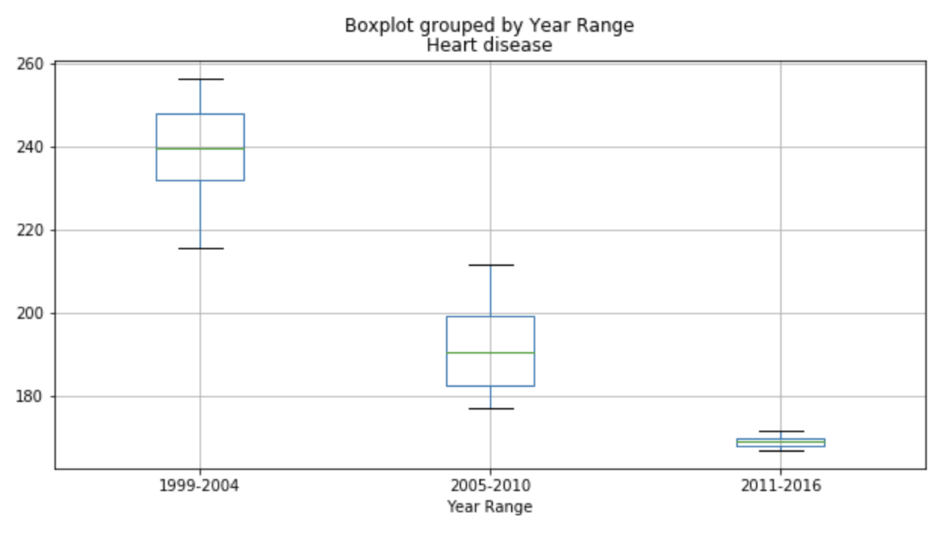
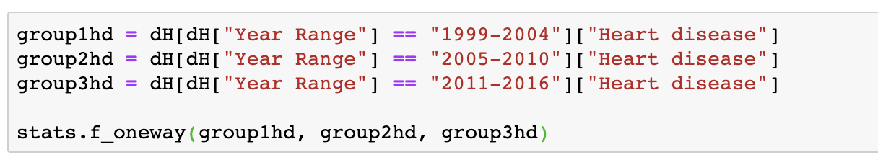
F_onewayResult(statistic=59.02123176539099,pvalue=7.776019794385112e-08)

Slide 12
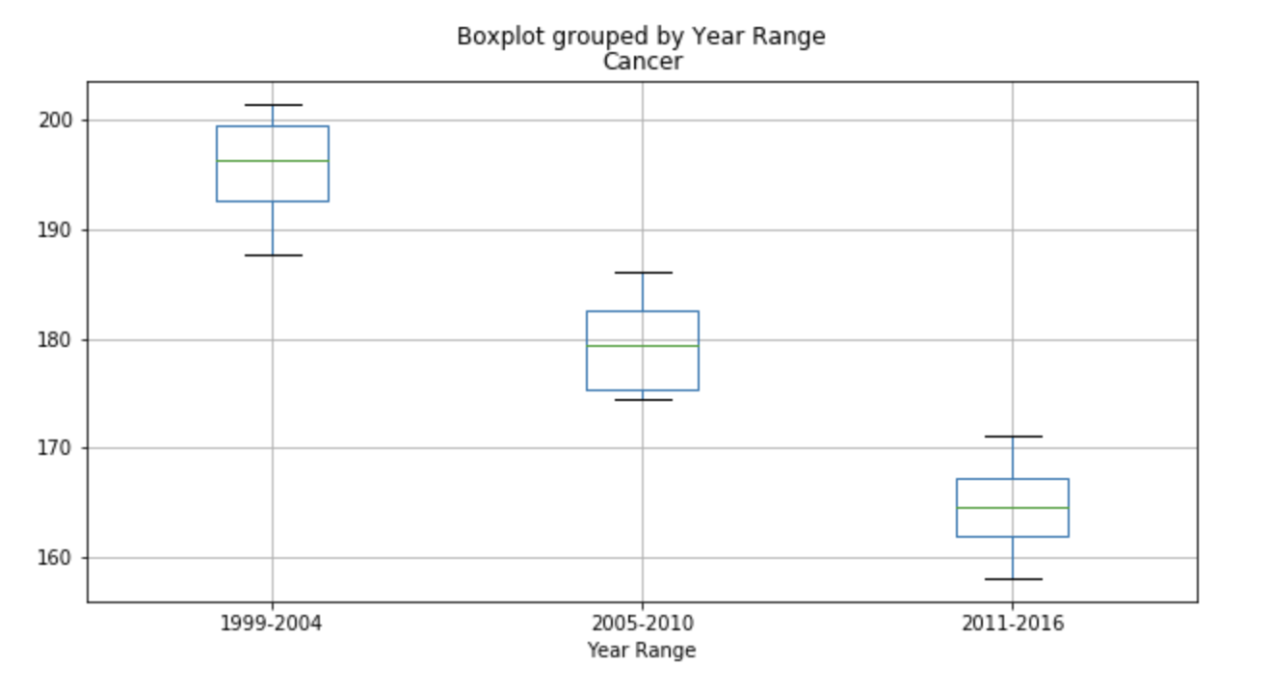
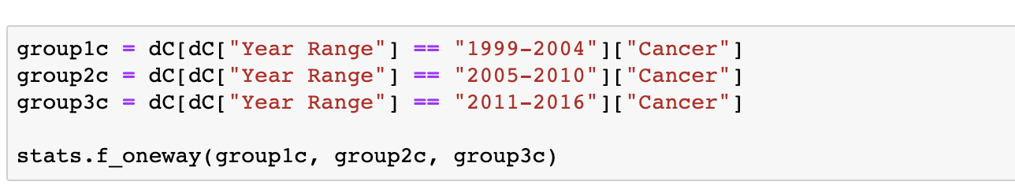
F_onewayResult(statistic=61.63588714863557, pvalue=5.823484514575891e-08)

