Slide 2
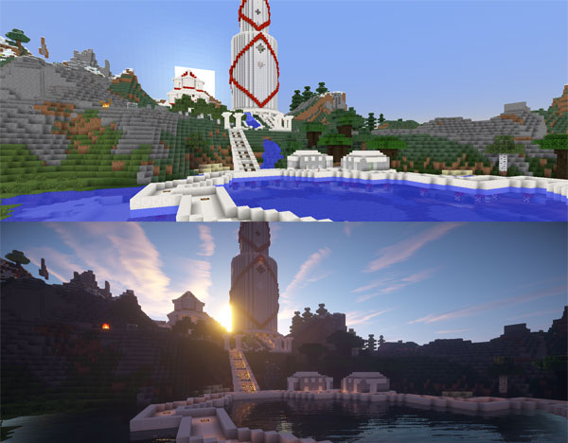
What are shaders?

Slide 3
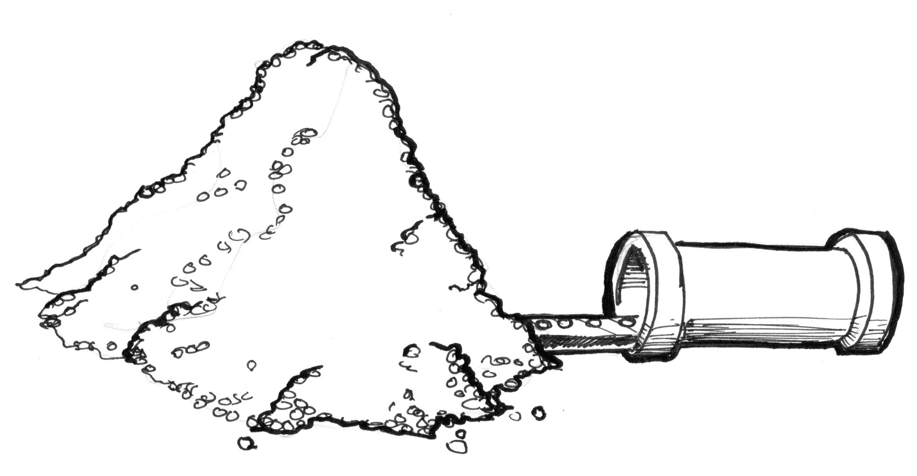
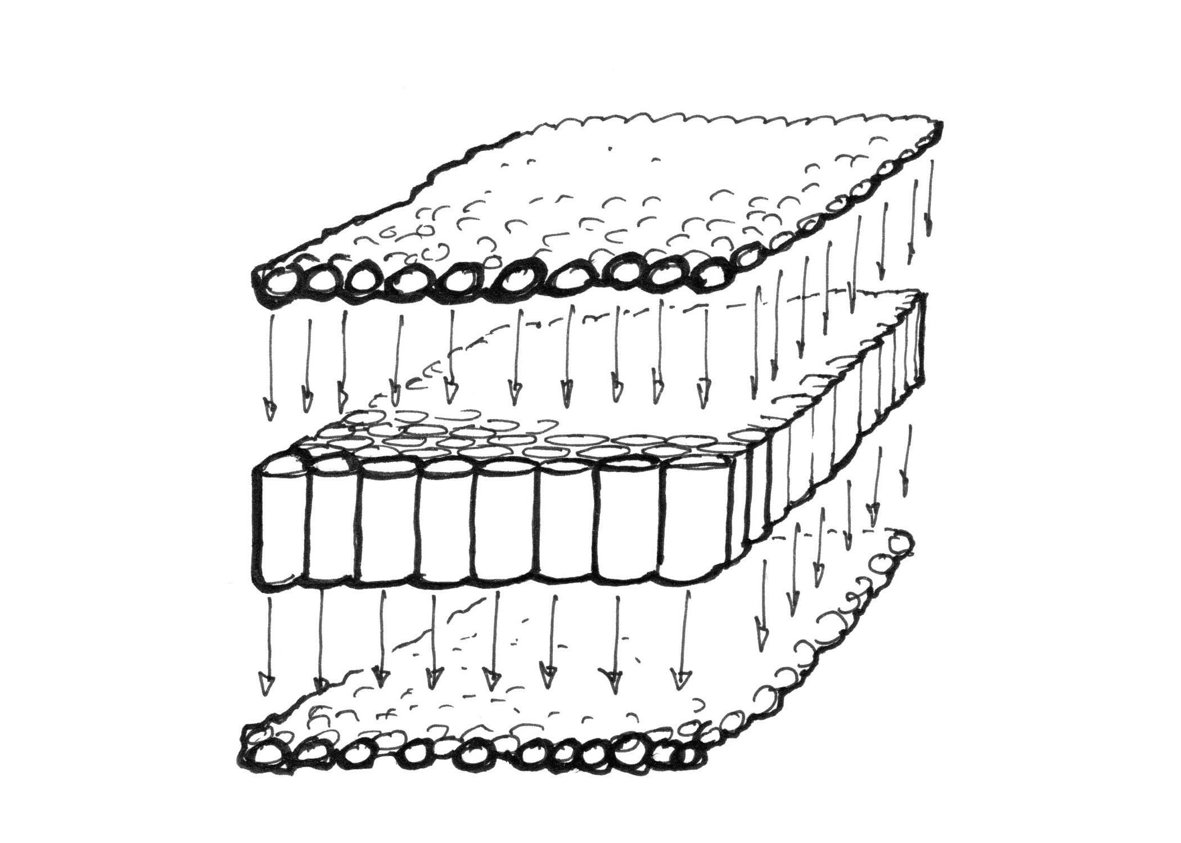

Speed? = Parallel Processing on GPU

Slide 4
Where is a shader in the graphics pipeline?
https://en.wikibooks.org/wiki/Cg_Programming/Programmable_Graphics_Pipeline

Slide 5
Surface vs Vertex and Fragment Shader

Slide 6
Hello World Surface Shader

Slide 7
Hello World Vertex and Fragment Shader

Slide 8
Diffuse Lighting Model

Slide 9
Specular Lighting Model

Slide 10
Snow Shader

Slide 11
Going Low Level: Vertex and Fragment Shader

Slide 12
Shading Glass

Slide 13
Cats! Fur Shader

Slide 14
Conclusion or Where to now?

