Slide 1
Welcome!
[Lab Name]
Department of Psychology
Stanford University
setup
Notes:
Hi, my name is _____!
Ask child: What’s your name? Hello, (child), I’m really excited to do this activity with you today.
Rapport with child if needed: how is your day? Talk about their shirt, etc…

Slide 2
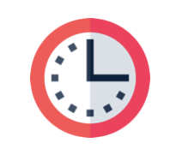


This Activity
X minutes
[What we’ll do in kid-friendly lang]!
What does your child think?
This activity will be recorded.
Notes:
This activity will take about 10 minutes. In this activity, we’ll meet some aliens on a planet far away!
We just want to know what [you/child’s name] thinks! So [mom/dad/parent], if you decide to stay during the activity, that’s totally fine, we just ask that you stay neutral and allow [child] to respond freely. I am happy to answer any questions at the end.
I’m going to record the activity so that we can remember how we played together. Is it OK if I start recording now? you'll hear a robot voice go “this meeting is being recorded” and you can click the blue continue button.
Ok thanks!

Slide 3
Verbal consent
Today’s date is December 18, 2020.
My name is _____________.
I give consent for my child, _________,
to participate in this study.
I understand that I or my child may stop participation at any time.
The IRB determined that the permission of one parent is sufficient for research to be conducted under 45 CFR 46.404, in accordance with 45 CFR 46.408(b).
Notes:
This part is for (parent/guardian): In the scheduling email you received a PDF of information about our research. Do you have any questions about the activities before you provide your consent to participate?
Great, if you could read the bullet point text aloud.
[If yes, answer their questions. Once they are comfortable moving forward, proceed. If they decide they are not comfortable proceeding at this point, thank them so much for considering to participate and ask whether they think they would be interested in participating in the future. Regardless of their response, thank them and wish them a good day. End the meeting.]

Slide 4
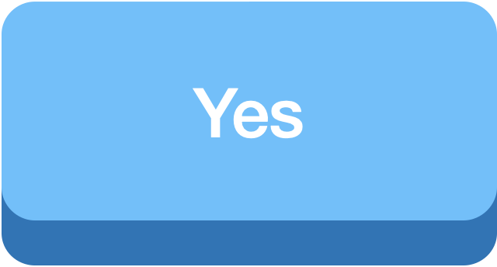

device
device and screen size?
Step 0:
Step 1: Are you in full-screen mode?
Notes:
Now we’ll get your screen set-up. Ask parent: what device are we on today?
What’s the approximate screen size?
CLICK BUTTON to enter response
Are you in full-screen mode?
[If yes:] Great! [Click on ‘Yes’.]
[If parents say “no” or “not sure”:] We’d like the game to be in full screen mode. [Click ‘No’ to proceed to instructions.]

Slide 5
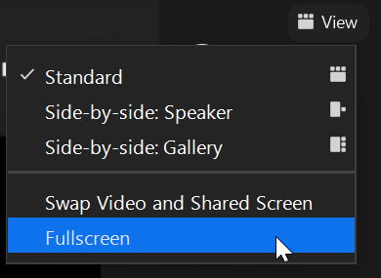
Please enter full screen mode.
Click View at top right > Fullscreen:
Notes:
[If parent responded “no”:] If you could move your mouse over to the top right of the screen, you should a View button. Click View, then click Fullscreen.
[If parent responded “not sure”:] If you could move your mouse over to the top right of the screen, you should a View button. Click View, then click Fullscreen. If it says “Exit fullscreen”, you are already in fullscreen.
Are you in full screen mode now? Great!

Slide 6
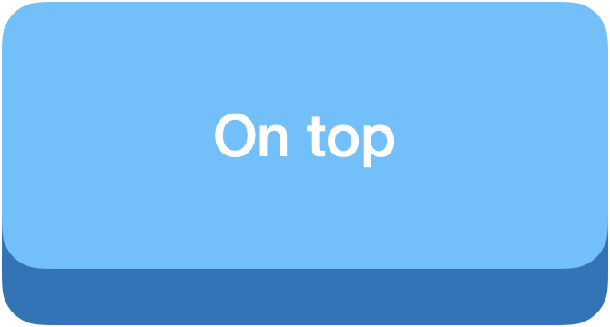
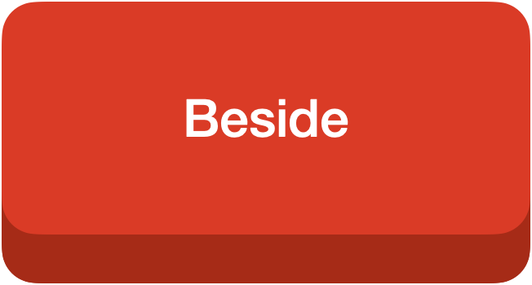
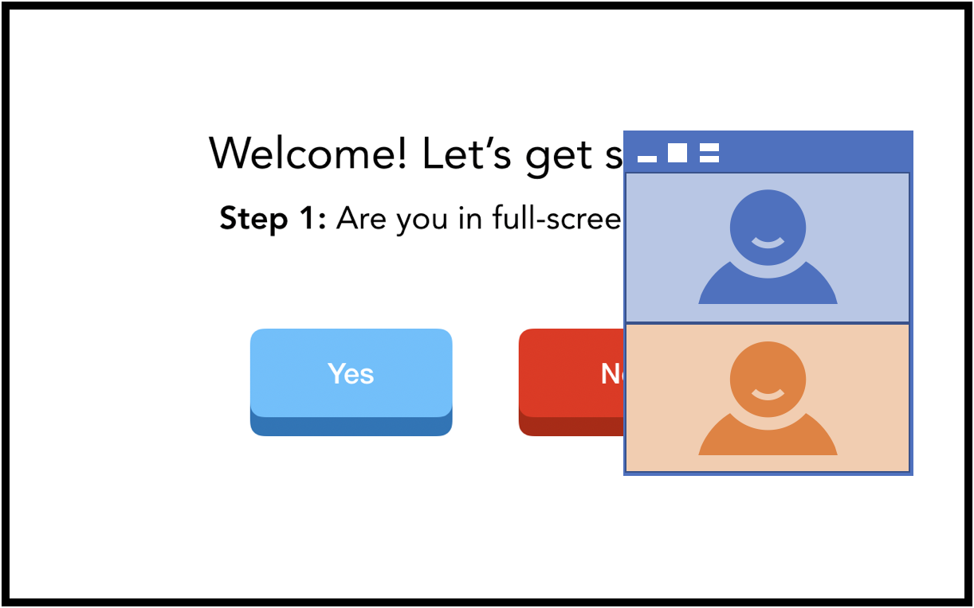
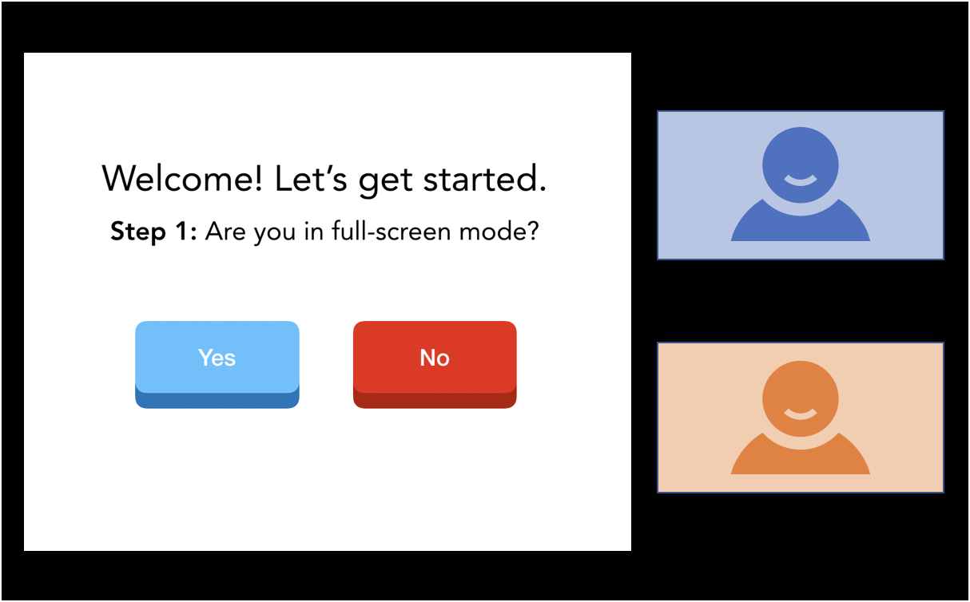
Step 2: Do you see our videos floating on top of the slides or anchored beside the slides?
(you can click and drag our videos)
Notes:
[This slide is to check if participants have videos floating on top of the slides.]
[note: if iPad, videos are stuck on the bottom, they can’t move our videos around, so click “on top” to skip this step.]
Do you see our videos floating on top of the slides, or besides the slides? If you can click and move around our videos, that means we’re on top.
[If “on top:”] Great! [double check:]
[If “beside”:] Ah, that probably means that you are in side-by-side mode. We’d like for our video to float on top of the slides. [Click “beside” to proceed to instructions.]
[If parent is using external monitor:] We’d like to set up your screen so that my video floats on top of the slides. If you’re viewing my video and the slides on separate monitors, would it be okay to disconnect the monitor for now?

Slide 7
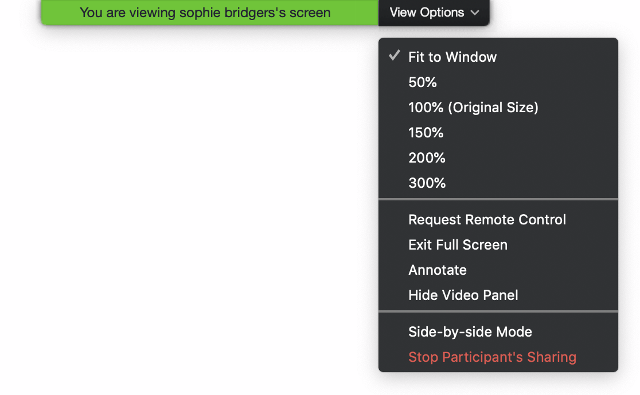
Move your mouse to the top of the screen.
Click View Options.
Side-by-side Mode should be unchecked →
You should see our videos floating on top of this slide.
Notes:
Please move your mouse to the top of the screen and select “View Options,” like in this diagram. You should see an option called “Side-by-side Mode” near the bottom—please make sure that it’s NOT checked.

Slide 8


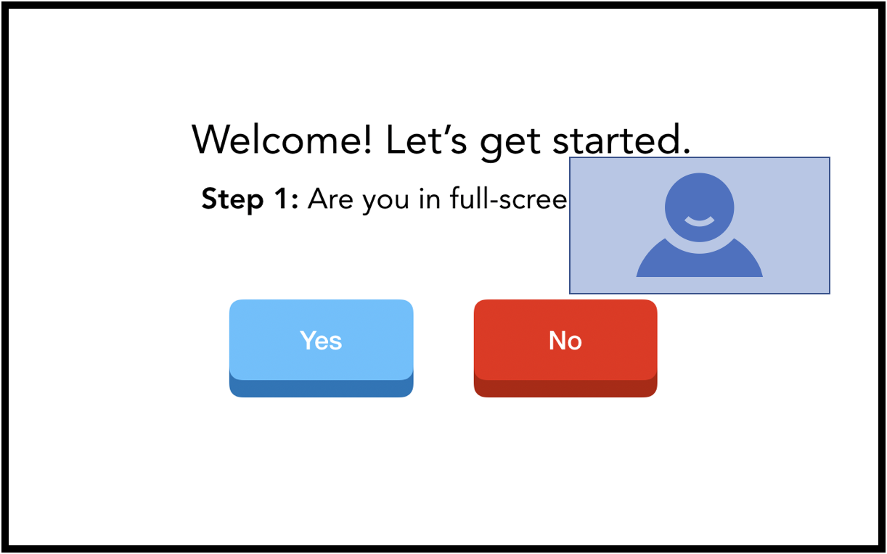

Step 3: Can you see both of our videos on the screen, or just the researcher?
Notes:
[This slide is to check if participants can only see the experimenter’s video on the screen.]
[Researcher: and now do you see both our videos, or just my video?
[If “both”:] We’d like for you to just see my video. [Click ‘Both videos’ to proceed to instructions.]
[If “researcher”:] Perfect! [Click ‘Just Researcher’.]

Slide 9
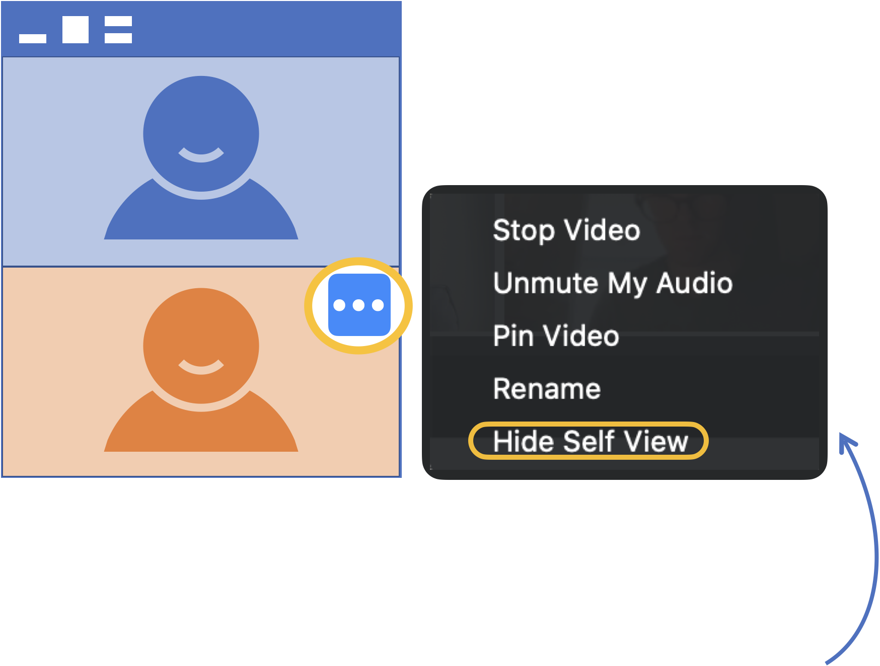
Move your mouse over the upper right corner of your video.
Hover over the blue and white ellipsis.
Select Hide Self View from the dropdown menu that appears.
Notes:
If you move your mouse over your own video, you will see 3 dots. Please click on that, and then click ‘Hide Self-View’.
Do you just see my video now?
[If “yes”: Skip to slide 12]
[If there are other people on the call, the parent might still be able to see their icons:] As I mentioned in the beginning of the game, we have a few researcher assistants sitting in. So we’re also going to hide them.

Slide 10
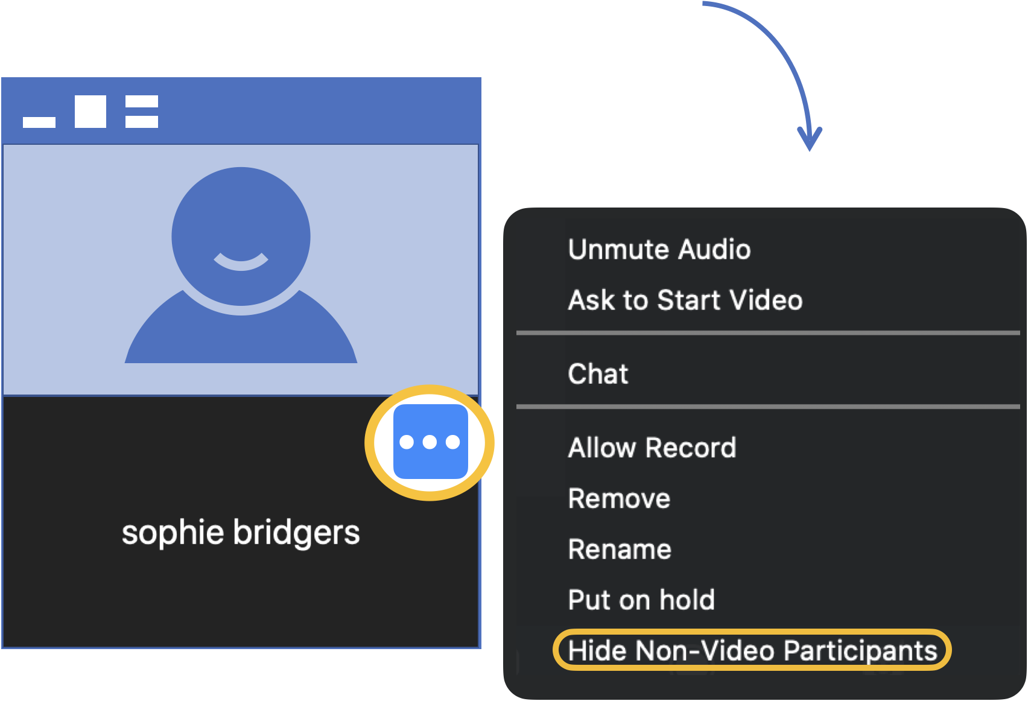
Move your mouse over the upper right corner of the non-video participant.
Hover over the blue and white ellipsis.
Select Hide Non-Video Participants.
Notes:
Could you please move your mouse over to any one of the other participants, click the 3 dots, and select ‘Hide Non-Video Participants’?
[After they’re done:] So do you see just my video now? Wonderful!

Slide 11
video_thumb
Step 4: Move my video here!
Notes:
Alright. Last step: could you move me to top middle of the screen? Thank you!

Slide 12
measure1
Measure 1
(store text in button)
Yes
No
Notes:
Yes vs no?
Measure (key) = slide title (just off-screen to the top; edit there or in View > Outline View)
Response (value) = name of object (edit in Home > Select > Selection Pane)

Slide 13

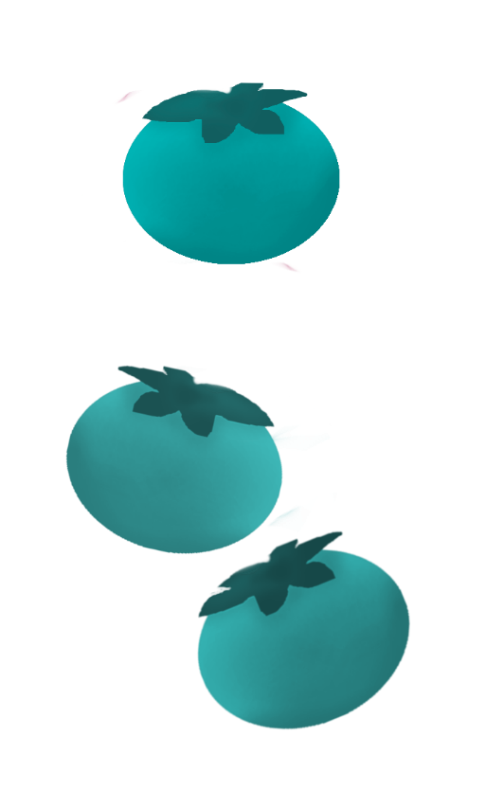
measure2
measure 2
(named objects/shapes/pictures)
Notes:
Pinkberries vs blueberries?
Measure (key) = slide title (just off-screen to the top; edit there or in View > Outline View)
Response (value) = name of object (edit in Home > Select > Selection Pane)

Slide 14
measure3
measure 3
(named objects/shapes/pictures)
Notes:
Blue vs red?
Measure (key) = slide title (just off-screen to the top; edit there or in View > Outline View)
Response (value) = name of object (edit in Home > Select > Selection Pane)

Slide 15
measure4
Measure 4
(named objects/shapes/pictures)
Notes:
Left vs right?
Measure (key) = slide title (just off-screen to the top; edit there or in View > Outline View)
Response (value) = name of object (edit in Home > Select > Selection Pane)

Slide 16
measure5
Measure 5 + follow-up “why?”
(named objects/shapes/pictures)
Notes:
Left vs right?
Measure (key) = slide title (just off-screen to the top; edit there or in View > Outline View)
Response (value) = name of object (edit in Home > Select > Selection Pane)
Why? (manually advance slide)

Slide 17
measure6
Measure 6
(named objects, name = key/measure)
Notes:
Which buttons do you want to press?
Press buttons, then click anywhere else to move on
Measure (key) = name of object (edit in Home > Select > Selection Pane)
Response (value) = “pressed”

Slide 18
measure7_1
Measure 7 (2 step w text)
easy
hard
Notes:
2 step: easy or hard?
Measure (key) = slide title (just off-screen to the top; edit there or in View > Outline View)
Response (value) = name of object (edit in Home > Select > Selection Pane)
Easy -> jump 1 slide
Hard -> jump 2 slides

Slide 19
measure7_2
Measure 7 (2 step w text)
a little easy
very easy
Notes:
2 step: a little easy or very easy?
Measure (key) = slide title (just off-screen to the top; edit there or in View > Outline View)
Response (value) = name of object (edit in Home > Select > Selection Pane)
-> jump 2 slides

Slide 20
measure7_2
Measure 7 (2 step w text)
a little hard
very hard
Notes:
2 step: a little hard or very hard?
Measure (key) = slide title (just off-screen to the top; edit there or in View > Outline View)
Response (value) = name of object (edit in Home > Select > Selection Pane)
-> jump 1 slides

Slide 21
measure8
Measure 8 (open-ended pop-up)
Why do you think X?
type response
Notes:
Open-ended: Why do you think X?
Measure (key) = slide title (just off-screen to the top; edit there or in View > Outline View)
Response (value) = type in response in pop-up window

Slide 22


measure9
save before exit
Measure 9 (LR allocation)
resume after exit
allocation done
April School
May School
reset
Notes:
How many books to each school?
Measure (key) = slide title (just off-screen to the top; edit there or in View > Outline View)
Response (value) = objects whose name starts with “target”: left_right (eg 3_3)
Running using “Share portion of screen” in Zoom: click “save before exit”, click “pause share” in Zoom, exit slideshow, reposition portion of screen to be the slide in regular PowerPoint editing view, click “resume share” in Zoom, move target objects around, click “pause share” in Zoom, start slideshow from current slide, click “resume after exit” and “allocation done” to lock in response, reposition portion of screen, click “resume share” in Zoom
*recommend hiding buttons under wherever your video thumbnail is
*NOTE: reset_allocation_LR currently HARD CODES for this exact number slide (slide number 22), so make sure to manually change its code to reset whatever slide your allocation slide is.

Slide 23
measure10
save before exit
Measure 10 (top bottom allocation)
resume after exit
allocation done
April School
May School
reset
Notes:
How many books to each school?
Measure (key) = slide title (just off-screen to the top; edit there or in View > Outline View)
Response (value) = objects whose name starts with “target”: top_bottom (eg 3_3)
Running using “Share portion of screen” in Zoom: click “save before exit”, click “pause share” in Zoom, exit slideshow, reposition portion of screen to be the slide in regular PowerPoint editing view, click “resume share” in Zoom, move target objects around, click “pause share” in Zoom, start slideshow from current slide, click “resume after exit” and “allocation done” to lock in response, reposition portion of screen, click “resume share” in Zoom
*recommend hiding buttons under wherever your video thumbnail is
*NOTE: reset_allocation_topBottom currently HARD CODES for this exact number slide (slide number 23), so make sure to manually change its code to reset whatever slide your allocation slide is.

Slide 24

Thank you!
Help improve this experience for other parents and children?
Notes:
Before we say goodbye, could I ask you some final questions to help improve our study for future parents and children?

Slide 25
1. Do you have any questions for me?
Notes:
Okay, thanks! First, do either you or your (parent) have any questions about our study?

Slide 26
video
2. How was the video quality?
1
2
3
4
5
Very poor
Moderate
Very good
Notes:
Next, can you tell me how the video quality was throughout the study, from 1 being the worst and 5 being the best?
Could you see me okay?
Measure (key) = slide title (just off-screen to the top; edit there or in View > Outline View)
Response (value) = name of object (edit in Home > Select > Selection Pane)

Slide 27
sound
3. How was the sound quality?
1
2
3
4
5
Very poor
Moderate
Very good
Notes:
How about the sound quality? Could you hear me okay?
Measure (key) = slide title (just off-screen to the top; edit there or in View > Outline View)
Response (value) = name of object (edit in Home > Select > Selection Pane)

Slide 28
fun
4. How fun was the activity?
1
2
3
4
5
Not very fun
Moderately fun
Very fun
Notes:
And how fun was the activity (for your child)?
Measure (key) = slide title (just off-screen to the top; edit there or in View > Outline View)
Response (value) = name of object (edit in Home > Select > Selection Pane)

Slide 29
consent
Participant Recording Options
Please choose a level of consent option for your child’s video.
1. Research Only
Viewed only by our team.
2. Academic/Educational Use
May be presented as examples
at conferences or classes.
3. Public
May be e.g. presented publicly online for
public outreach & dissemination of findings.
Notes:
This last part is for (parent).
Ask parent: how you would like us to use our recording of today’s session? The baseline level of privacy is level 1, research only, which means only the experimenters in our lab will have access to the videos. I’d be happy to describe the 2 additional levels of privacy if you’re interested - they’re really helpful for us but totally optional. Which level of consent would you be comfortable with?
Level 2 allows us to use your child’s video as an example at conferences or classes. Level 3 means your child’s video may be made public.
Measure (key) = slide title (just off-screen to the top; edit there or in View > Outline View)
Response (value) = name of object (edit in Home > Select > Selection Pane)

Slide 30
Thank you for playing my activity and helping science!
Save responses
reset measure9
reset measure10
Notes:
That was our last question – thank you so much for taking the time to participate in our study today!
Click “Save responses” to save responses to excel, conclude the session
Click “reset” to reset allocation measures for next participant

