Slide 1
How should we think about the social world?
Marianna Zhang
Psychology

Slide 2
Notes:
The real world is richly diverse, ambiguous, and multifaceted. People vary in all kinds of ways…

Slide 3
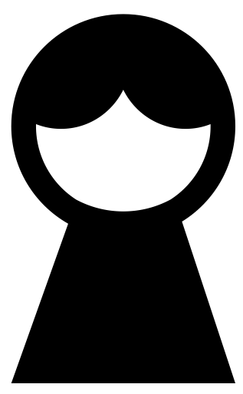
We structure the social world using categories.
men
women
Notes:
To make sense of the complexity of the social world, we organize the world by imposing structure on it, by grouping people into categories.

Slide 4
How do we learn to represent social categories?
as children

Slide 5
How do we learn to represent social categories?
through language
as children
Notes:
How do children learn about social categories from the language we use to describe social categories? In other words, how does the language we use transmit, reify, or shift the way we think about social categories from generation to generation?

Slide 6
how do we / how should we represent social categories?
Notes:
In a current ongoing project with adults…

Slide 7
essentialist
Category members share some internal essence
group essence
typical group properties
Notes:
Unfortunately, psychologists have found that a very common way we think about social categories is to essentialize them, meaning

Slide 8
essentialist
biological
Category members share some internal essence
shared biology (eg XX)
often cached out as shared biology.
typical group properties
Problematic consequences:
decreases perceived differences within group, generalize across entire group (stereotyping)
increases perceived differences between groups
naturalizes group properties as natural/just
Notes:
shared biology: women share XX chromosome, etc
Essentialism has been documented widely among kids and adults
Essentialism is generally problematic, for reasons Fausto-sterling and many other authors have discussed, and psychologists have spent a lot of time documenting the problems with biological essentialism in particular… *move quickly on consequences here
Essentialist narratives have been used to great effect in the service of gender oppression, racial oppression

Slide 9
essentialist
biological
structural
shared biology
Category members share a social position in a system.
shared social position
typical group properties
typical group properties
Notes:
But little work has investigated what a more positive representation might be that we should try to shift people towards, and articulating a more positive rep and understanding how to shift people there will be critical to a feminist project
Joan Scott
Structural - Eg lack of access to resources, discrimination and oppression

Slide 10
Why might structural representations be better?
essentialist
biological
structural
shared biology
shared social position
typical group properties
Notes:
Main aim of this project is to differentiate structural reps from essentialism, and make a case for why structural representations might be better

Slide 11
Are cultural representations essentialist?
essentialist
biological
cultural
structural
shared biology
shared beliefs/ values
shared social position
typical group properties
Notes:
Secondary aim
Eg care about families and caregiving

Slide 12
novel group
Provide people with a representation…
biological
cultural
structural
biologically suited to job
values align well with job
economic discrimination
work low-wage jobs
Compare on…
generalizations across the group in different contexts
acceptability of disparity
perceived differences between groups
group-based vs structural interventions

Slide 13
novel group
biological
cultural
structural
biologically suited to job
values align well with job
economic discrimination
work low-wage jobs
Structural representations could be positive alternatives to essentialism.
hesitate about generalizing across the group in different contexts
judge disparities as less acceptable
perceive groups as less different
propose structural interventions, vs group-based interventions

Slide 15
Why group differences?
Northern Chinese & noodles
Southern Chinese & rice
(climate for growing rice vs wheat)
Japan, Guangdong, New England & seafood (proximity to ocean)
racial minorities in the US & unhealthy foods (food deserts)
foodways
religious groups & food restrictions (halal, kosher…)
East Asian people & lactose intolerance (LCT gene for lactase)
“Our bodies best digest…” (folk biology)
biology
culture
(shared beliefs/values)
structural
(external constraints: eg access/availability)
group diet
Notes:
cuisines develop & adapt to local ecology and resources

Slide 16
Why group differences?
Sherpa people & mountaineering (more hemoglobin)
Japanese women & pearl fishing (more body fat)
women & factory work (“nimble fingers”, “detail-oriented”, docile)
men & tech (“smarter”)
Black people & sports (“stronger”)
Asians & math
(math drills, families value math)
Chinese people & martial arts
(Orientialism, exoticism)
POC & essential workers (language barrier, limited resources, stereotyping, economic discrimination)
biology
culture
(shared beliefs/values)
structural
(external constraints: eg discrimination, opportunity)
occupation
Notes:
Some of these are historical narratives used to limit the opportunities of certain groups, push them into particular occupations

