Slide 1

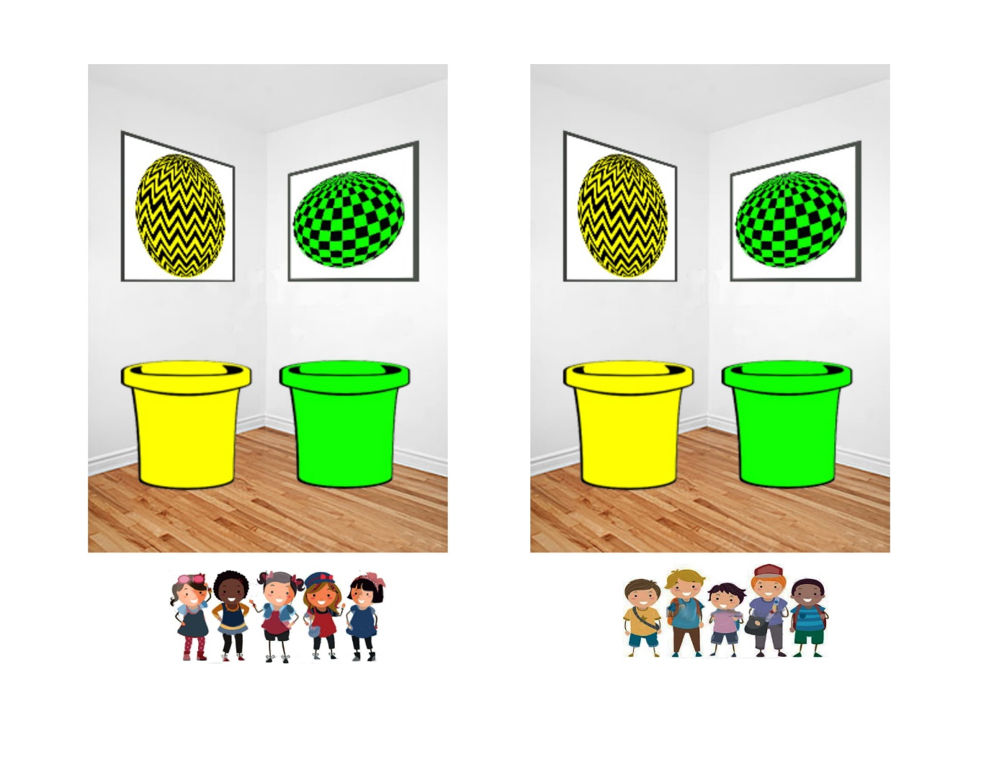
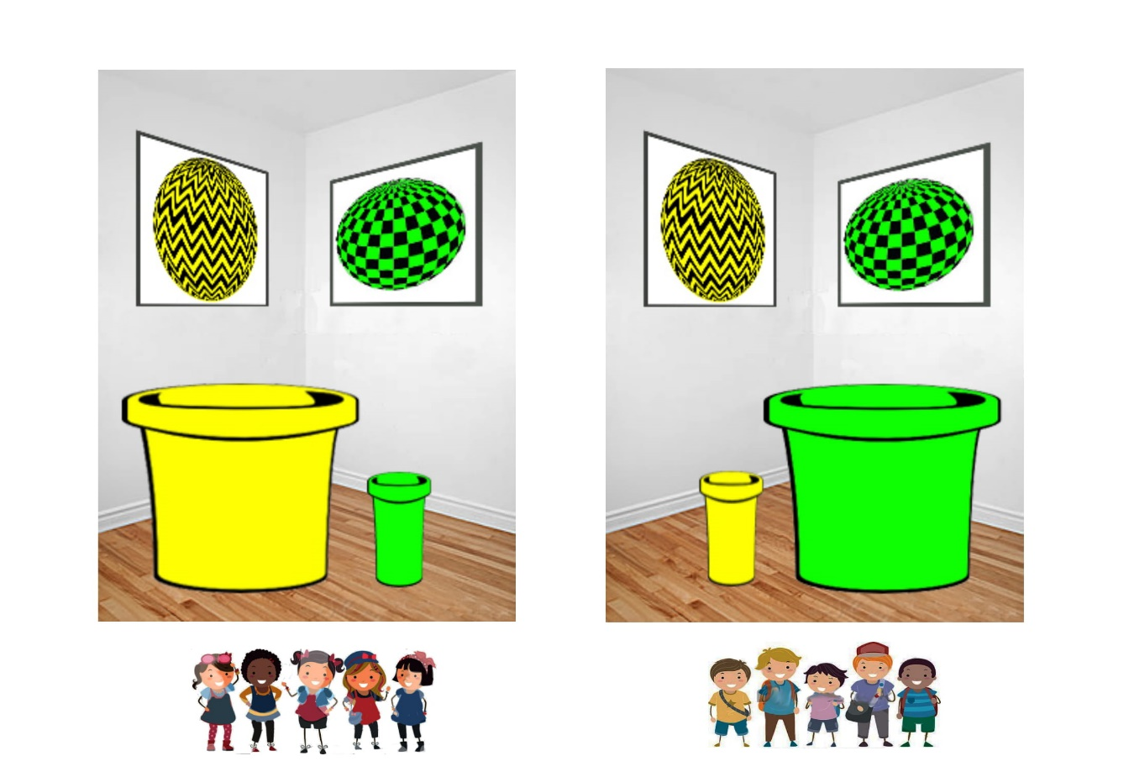
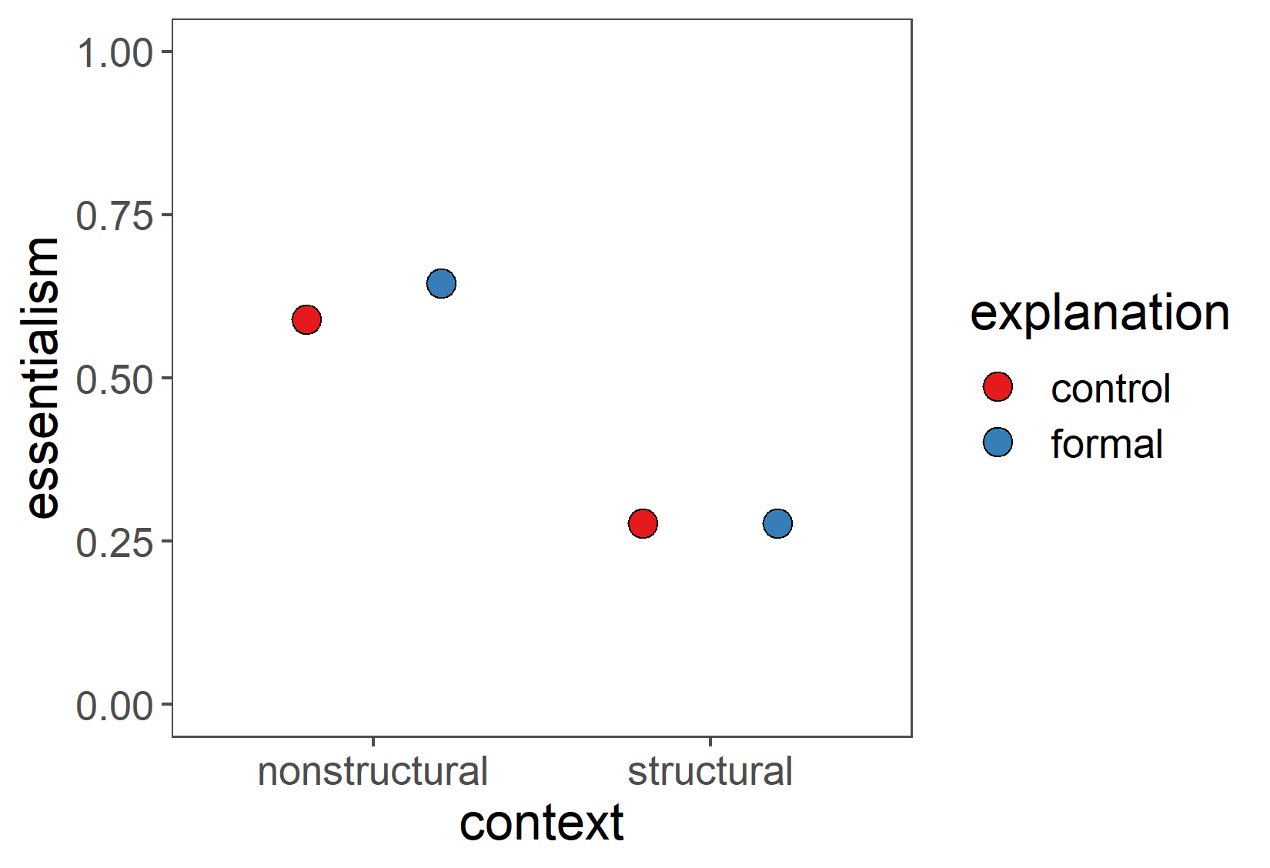
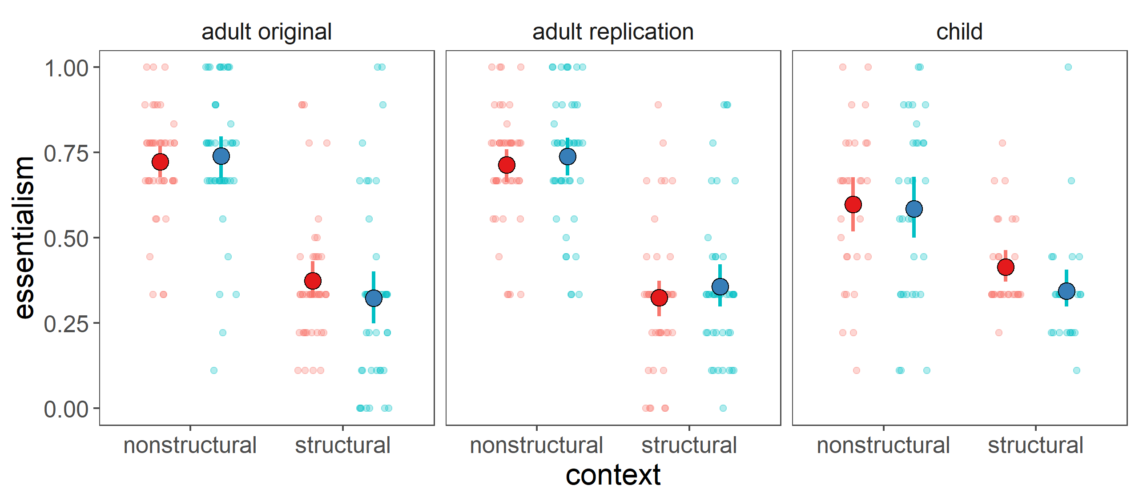

Essentially blocked: the role of structural factors in blocking essentialism
Marianna Y. Zhang & Ellen M. Markman Department of Psychology, Stanford University
What language leads to essentialism?
It has been proposed that formal explanations lead to essentialism…
Essentialism (Gelman, 2004)
there’s an inherent reason why category members have the property
(Gelman et al, 2018, Muradoglu et al, 2019)
Category members all possess an essence that innately produces deep unchangeable similarities.
e.g. gender essentialism
Formal explanations (Prasada & Dillingham, 2006)
…but this may not always be the case.
Individual has _ property because it is a member of _ category.
Structural explanation (Haslanger, 2016)
“Suzy wears pink because she is a girl.”
there’s a structural reason why category members have the property
A category is situated in a broader context where stable external forces (structural factors) operate on category members.
“Suzy didn’t get tenure because she is a woman.”
e.g. gendered socialization/marketing, sexism in academia
Does the availability of information about a structural context modulate whether formal explanations lead to essentialism?
Methods
1) context (Vasilyeva et al, 2018) school w gender-segregated classrooms, toss pebble into bucket to decide game to play
nonstructural | structural
2) statistical information (Vasilyeva et al, 2018)
boys in boys’ classroom play more Green-Ball and girls in girls’ classroom play more Yellow-Ball
3) explanation (Muradoglu et al, 2019)
control “Suzy is a girl. She plays Yellow-Ball.”
formal explanation “Suzy plays Yellow-Ball because she is a girl.”
adults (n=183) replication (n=187)
5-6yo (n=123/192)
2×2 design:
context ×
explanation
classrooms not skewed
classrooms skewed so diff genders likely play diff games
4) measure essentialism
Does Suzy play Yellow-Ball because she likes playing Yellow-Ball (internal preference), or because of the size of the buckets in her classroom (context)? (2 force-choice) | force-choice explanation
(introduce new girl who goes to a different school without buckets) What game will Lucy play? (4 point) | inductive potential without context
(Suzy goes to boys’ classroom) What game will Suzy play today? (4 point) | switched context
4 point scale = Yellow-Ball/Green-Ball × for sure/maybe
essentialism (0-1)
pre-registered predictions
context × explanation interaction
Adults
Contrary to predictions, formal explanations had no effect on essentialism, and no interaction with context.
As predicted, information about a structural context reduces essentialism.
Children
Data collection still ongoing (n=123/192). So far, roughly similar to adults.
Discussion
Future questions
Information about structural context…
powerfully tempers essentialism (Vasilyeva et al, 2018)
may be so strong here that subsequent formal explanations are interpreted in whatever construal the context already established
Contrary to prior work (Muradoglu et al, 2019), formal explanations do not consistently lead to essentialism.
Could information about a structural context block the essentialist effects of other types of language (e.g. generic statements)?
What overhypotheses do children bring to bear on interpreting formal explanations?
How do children naturalistically learn subtle information about structural context?
email marianna.zhang@stanford.edu
web mariannazhang.github.io
project osf.io/zmwcb
lab markmanlab.stanford.edu
Supported by the Regina Casper Stanford Graduate Fellowship in Science & Engineering and Norman H. Anderson Research Award to MYZ..

