Slide 1
Marianna Zhang
Essentially blocked:
Can structural factors block an essentialist interpretation of a formal explanation?
Pilot 2 results
Markman lab meeting
4.4.19
Notes:
Last time: we looked at some data from pilot 1, discussed some worries with the canonical essentialism measures I had been using, came up with some new DVs -> pilot 2

Slide 2
Essentialism
A cognitive bias to believe that:
categories represent real distinctions in the world
category members share an “essence” that gives rise to shared properties that are innate and unchangeable
Cultural variation in what particular social categories children essentialize
The role of social input (e.g. language) in guiding children to essentialize particular categories
Gelman 2003/2004
Notes:
- Speed through the background for this study

Slide 3
Linguistic cues for essentialism
Generics
“Girls play with dolls”, “A girl plays with dolls”
Suggests the property is a non-accidental and central property for that category
Formal explanations?
Rhodes, Leslie, Tworek, 2012; Cimpian & Markman 2009/2011
Notes:
What kinds of language might cue children to essentialize a category?
4yo who heard generic language about a novel social category -> develop essentialist beliefs about that social category
Other linguistic cues – formal explanations?
>Ellen: there isn’t a single syntactic marker that marks something as generic -> recruit other info about predicate, category, etc to decide if something is a generic

Slide 4
Formal explanations
an individual
has a property
because
it is a member of _ category
“Suzy plays with dolls because Suzy is a girl”
Suggests:
having that property is central to what it means to be a category member
there is something inherent about being a category member that gives rise to that property
Prasada & Dillingham 2006/2009; Gelman, Cimpian, Roberts, 2018

Slide 5
Formal explanations can boost essentialism
5,6yo: formal vs control explanation
4 trials = 2 novel behavior, 2 novel behavioral preference
Exp 1: animals: “It flaps its ears to cool off because it is an elephant” → boosted essentialism in 5-6yo
Exp 2: girls: “Margaret likes to eat gooseberries because she is a girl” → boosted essentialism in 6yo, not 5yo
Essentialism DVs: canonical 5-item battery (avg) x 4 trials
Stability in past
Stability in future
[Innateness when environment is switched,
Innateness when family tries to stop property]
Inductive potential
Muradoglu, Marchak, Cimpian, Gelman, submitted to SRCD
Notes:
4 diff animals: Cleans itself with its beak, flaps its ears to cool off, likes to sleep standing up, likes to eat lettuce
4 diff girls: Rides on the white horse on merry-go-rounds, puts her left sock on first, likes books about a country called Switzerland, likes to eat gooseberries -> all 5 DVs after each trial

Slide 6
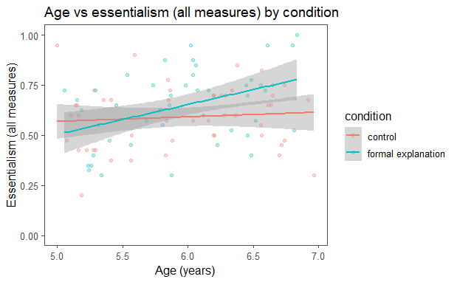
Formal explanations can boost essentialism
5,6yo: formal vs control explanation
4 trials = 2 novel behavior, 2 novel behavioral preference
Exp 2: girls: “Margaret likes to eat gooseberries because she is a girl” → boosted essentialism in 6yo, not 5yo
Muradoglu, Marchak, Cimpian, Gelman, submitted to SRCD
Notes:
4 diff animals: Cleans itself with its beak, flaps its ears to cool off, likes to sleep standing up, likes to eat lettuce
4 diff girls: Rides on the white horse on merry-go-rounds, puts her left sock on first, likes books about a country called Switzerland, likes to eat gooseberries -> all 5 DVs after each trial

Slide 7
Need formal explanations always cue essentialism?
Previous studies: formal explanations always yield an intrinsic essentialist interpretation
But: we sometimes produce formal explanations that suggest a structural interpretation instead of an essentialist interpretation
“I walk in groups late at night because I’m a woman”
“Rosa Parks couldn’t sit in the front of the bus because she was black”
Structural factors
stable extrinsic factors that act on a category by virtue of where the category is situated within a larger structure
e.g. attitudes about women in our society
Haslanger, 2016

Slide 8
Structural contexts can block essentialism
3-6yo, adults: structural vs nonstructural
Structural context – classroom environment skewed
Nonstructural context – classroom environment not skewed
Novel behavior for gender: different genders play different games
Formal explanation rating task → formal explanations rated as apt in both contexts
Essentialism DV: innateness when environment is switched x1 trial → less likely to be innate in structural than non-structural context
Vasilyeva, Gopnik, Lombrozo 2018

Slide 9
Structural contexts can block essentialism
3-6yo, adults: structural vs nonstructural
Structural context – classroom environment skewed
Nonstructural context – classroom environment not skewed
Novel behavior for gender: different genders play different games
Essentialism DV: innateness when environment is switched x1 trial → less likely to be innate (more mutable) in structural than non-structural context
Vasilyeva, Gopnik, Lombrozo 2018

Slide 10
Can structural factors block an essentialist interpretation of a formal explanation?
(Vasilyeva, Lombrozo, & Gopnik, 2018)
5, 6yo from Bing and Tech
All between subjects:
 |  | context
 |  | nonstructural | structural
explanation | control | medium | medium/low
 | formal | high | medium/low
(Muradoglu et al, submitted)
1 trial, 1 novel behavior for gender
Essentialism DVs (averaged)
Pilot 1 DVs
Pilot 2.1, 2.2, 2.3 DVs

Slide 11
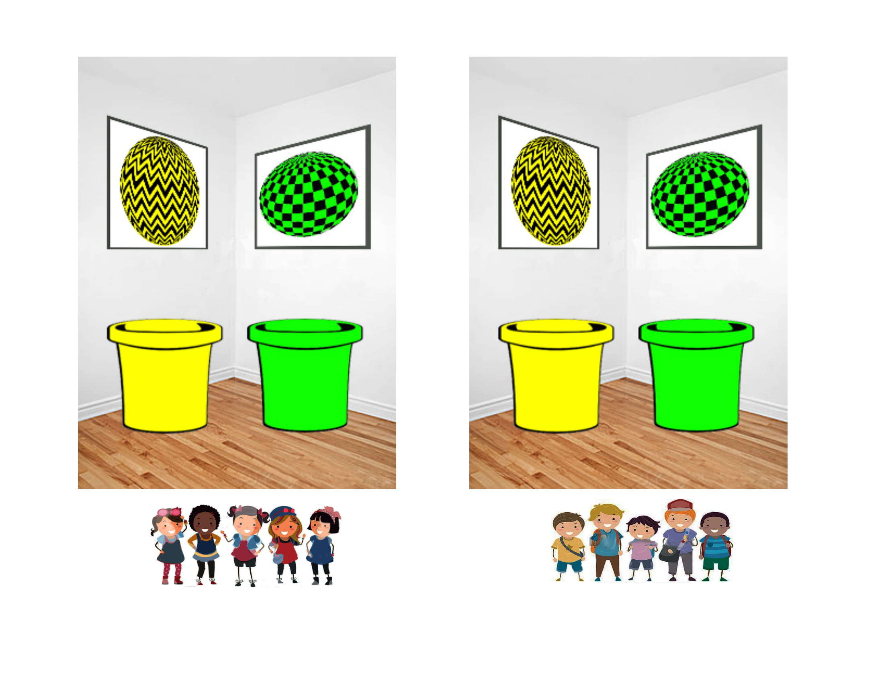
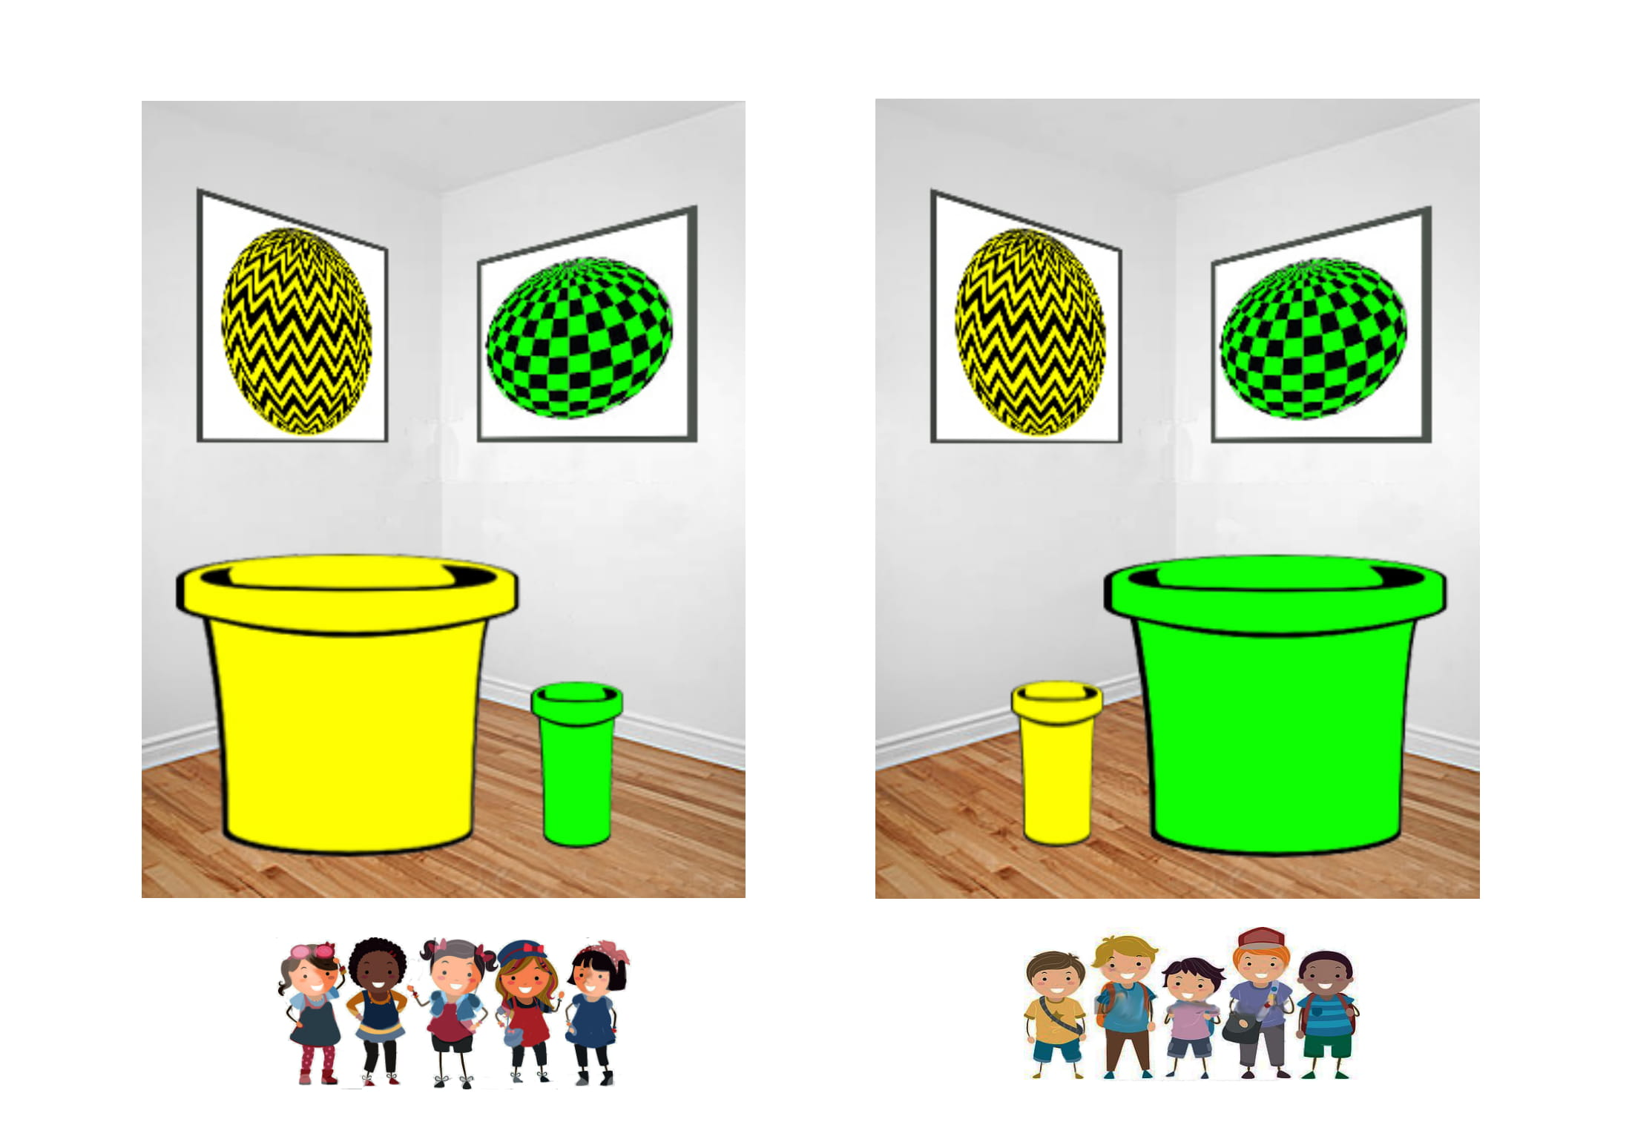
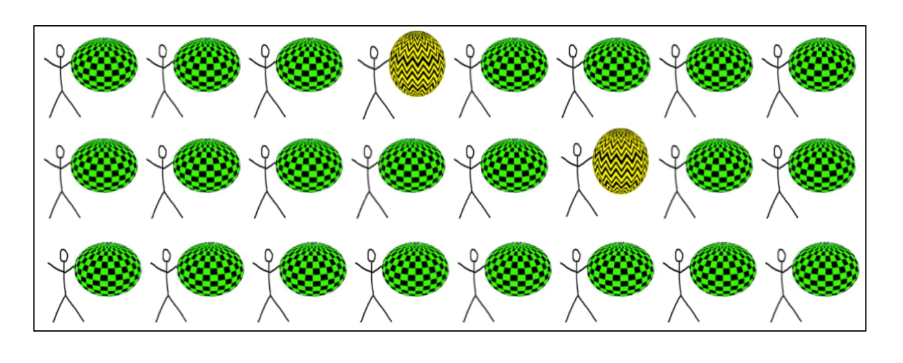
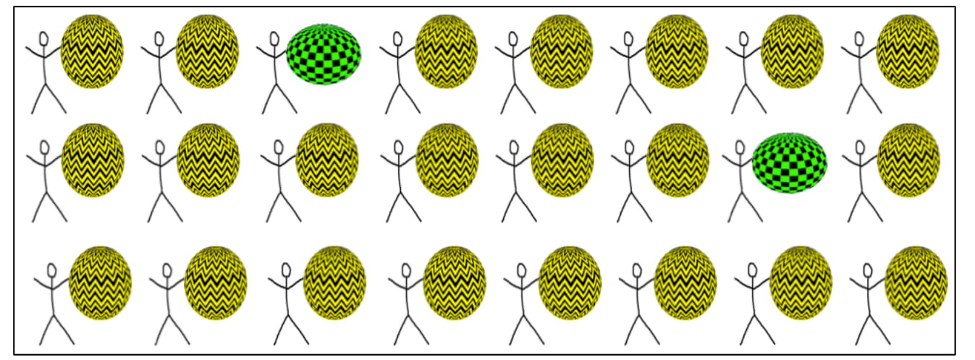
Context manipulation
Vasilyeva, Gopnik, Lombrozo 2018
Nonstructural context
Structural context
Boys in boys classroom
Girls in girls classroom

Slide 12
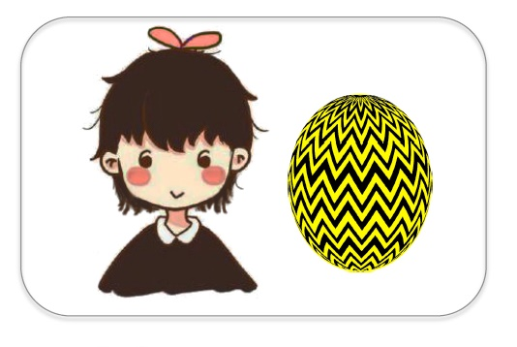
Explanation manipulation
Muradoglu, Marchak, Cimpian, Gelman, submitted to SRCD
Control explanation
Here’s Suzy. She is a girl. She plays Yellow-Ball.
Formal explanation
Here’s Suzy. She plays Yellow-Ball because she is a girl.

Slide 13

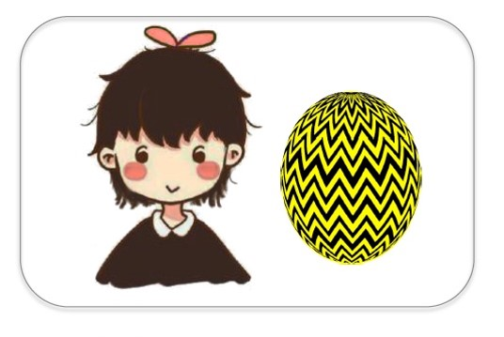







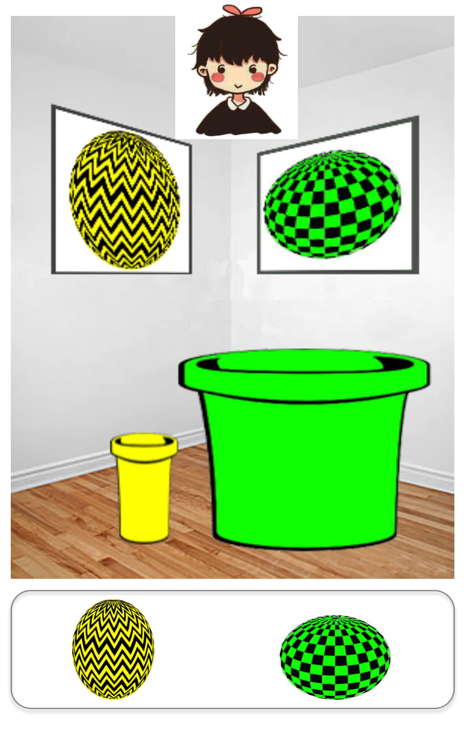
Pilot 1 DVs: 5 canonical essentialism DVs
Stability past | Now, here’s a question for you: Suzy is 8 years old. Do you think she played Yellow-Ball when she was 4 years old? (Y/N)
Stability future | Do you think she will always play Yellow-Ball? (Y/N)
Innateness stop | Would Suzy stop playing Yellow-Ball if her family tried to stop her from playing Yellow-Ball? (Y/N)
Inductive potential | Do you think “just this girl,” “a few girls,” or “a whole lot of girls” play Yellow-Ball?
Innateness switch | [Suzy goes to boys classroom] Which game do you think Suzy will play today? __ For sure __ or maybe __?
--- Muradoglu et al, submitted ---
Vasilyeva et al
Notes:
- Moved innateness switch to the end bc elaborate

Slide 14
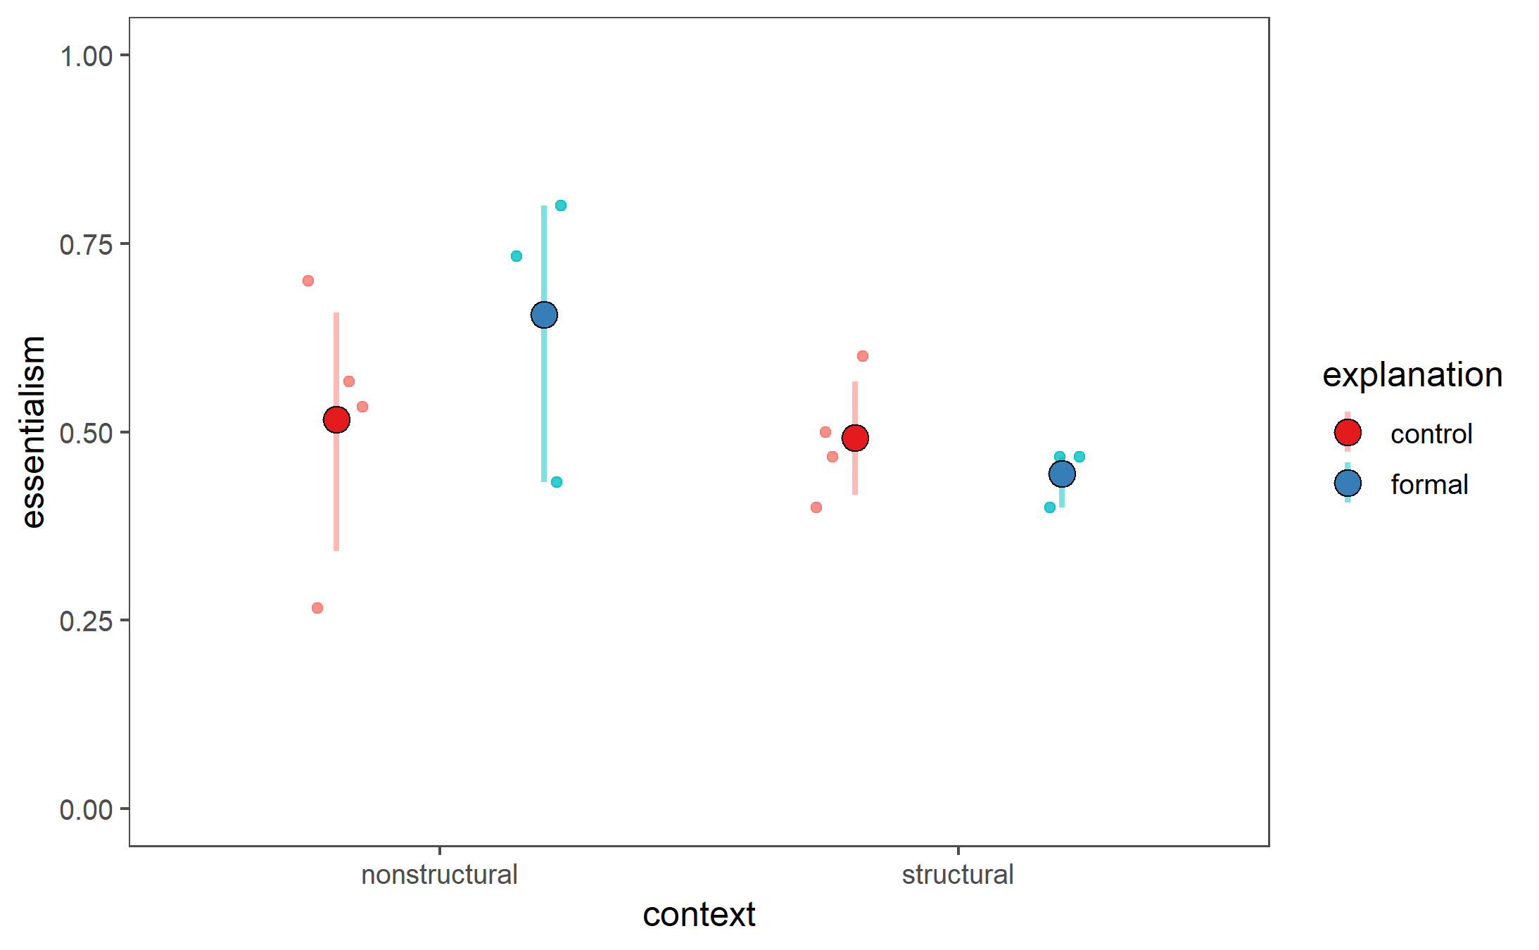
Pilot 1 data
n=14 (excluded 2)
Nonstructural: essentialism boost from formal explanations (cf Muradoglu et al, submitted)
Structural: smaller essentialism boost from formal explanations

Slide 15
A worry with essentialism DVs
 |  | Essentialist | Structural
Stability past | Now, here’s a question for you: Suzy is 8 years old. Do you think she played Yellow-Ball when she was 4 years old? (Y/N) | Yes | Not same school: No Same school: Yes
Stability future | Do you think she will always play Yellow-Ball? (Y/N) | Yes | Not same school: No?
Innateness stop | Would Suzy stop playing Yellow-Ball if her family tried to stop her from playing Yellow-Ball? (Y/N) | No | No?
Inductive potential | Do you think “just this girl,” “a few girls,” or “a whole lot of girls” play Yellow-Ball? | A whole lot | At this school: A whole lot Outside school: ?
Innateness switch | [Suzy goes to boys classroom] Which game do you think Suzy will play today? __ For sure __ or maybe __? | For sure Yellow-Ball | For sure Green-Ball
--- Muradoglu et al, submitted ---
Vasilyeva et al

Slide 16
A worry with essentialism DVs
Formal explanation
 | Essentialist representation | Structural representation
When will an individual exhibit the same property? (stability, innateness) | Always | When structural factors in environment are stable
Will other category members exhibit the same property? (inductive potential) | Always | If they too are experiencing structural factors in environment
Essentialist vs structural best differentiated by environmental change
Adjust wording of DVs / focus only on DVs that involve environmental change?
Notes:
Zoom out: I’ve tried to argue that formal explanations can be interpreted in 2 different ways based on bg knowledge about situation at hand – essentialist or structural
We want to tease apart these two different ways of thinking
Challenge because these two ways of thinking can produce similar responses on our 5-item essentialism battery -> battery is canonically used, but may not have enough specificity to identity essentialism

Slide 17
Pilot 2.1 DVs (n=4 all structural)
 |  | Essentialist | Structural
Force-choice explanation | (indiv) So, Suzy plays Yellow-Ball a lot at her school. Is it because Suzy likes playing Yellow-Ball, or is it because of the size of the buckets in her classroom? (group) So, the girls in the girls’ classroom play Yellow-Ball a lot at their school, and the boys in the boys’ classroom play Green-Ball a lot at their school. Is it because girls and boys like playing with different balls, or is it because of the buckets in their classrooms? | Preference | Buckets
Inductive potential – new category member | Here’s Lucy. Lucy is a girl who doesn’t go to Kiki school. She goes to another school. (show the balls, no buckets) What game do you think Lucy will play? ___ For sure __ or maybe __? | Yellow-Ball | Chance
Normative | (group) Would it be okay or not okay for girls to play Green-Ball? (indiv) Here’s Katie. Katie is a girl who plays Green-Ball. Is it okay or not okay for Katie to play Green-Ball? (okay/not okay) | Not okay | Okay
Innateness switch | [Suzy goes to boys classroom] Which game do you think Suzy will play today? ___ For sure __ or maybe __? | For sure Yellow-Ball | For sure Green-Ball
-------------------- New ---------------------
Vasilyeva et al
Notes:
New dvs we had made last lab meeting, ran them in this order

Slide 18
Pilot 2.2 DVs (n=9, excluded another 2)
 |  | Essentialist | Structural
Force-choice explanation | (indiv) So, Suzy plays Yellow-Ball a lot at her school. Is it because Suzy likes playing Yellow-Ball, or is it because of the size of the buckets in her classroom? (group) So, the girls in the girls’ classroom play Yellow-Ball a lot at their school, and the boys in the boys’ classroom play Green-Ball a lot at their school. Is it because girls and boys like playing with different balls, or is it because of the buckets in their classrooms? | Preference | Buckets
Inductive potential – new category member | Here’s Lucy. Lucy is a girl who doesn’t go to Kiki school. She goes to another school. (show the balls, no buckets) What game do you think Lucy will play? ___ For sure __ or maybe __? | Yellow-Ball | Chance
Normative | (group) Would it be okay or not okay for girls to play Green-Ball? (indiv) Here’s Katie. Katie is a girl who plays Green-Ball. Is it okay or not okay for Katie to play Green-Ball? (okay/not okay) | Not okay | Okay
Innateness switch | [Suzy goes to boys classroom] Which game do you think Suzy will play today? ___ For sure __ or maybe __? | For sure Yellow-Ball | For sure Green-Ball
-------------------- New ---------------------
Vasilyeva et al

Slide 19
Pilot 2.3 DVs (n=7)
 |  | Essentialist | Structural
Force-choice explanation | (indiv) So, Suzy plays Yellow-Ball a lot at her school. Is it because Suzy likes playing Yellow-Ball, or is it because of the size of the buckets in her classroom? (group) So, the girls in the girls’ classroom play Yellow-Ball a lot at their school, and the boys in the boys’ classroom play Green-Ball a lot at their school. Is it because girls and boys like playing with different balls, or is it because of the buckets in their classrooms? | Preference | Buckets
Inductive potential – new category member | Here’s Lucy. Lucy is a girl who doesn’t go to Kiki school. She goes to another school. (show the balls, no buckets) What game do you think Lucy will play? ___ For sure __ or maybe __? | Yellow-Ball | Chance
Normative | (group) Would it be okay or not okay for girls to play Green-Ball? (indiv) Here’s Katie. Katie is a girl who plays Green-Ball. Is it okay or not okay for Katie to play Green-Ball? (okay/not okay) | Not okay | Okay
Innateness switch | [Suzy goes to boys classroom] Which game do you think Suzy will play today? ___ For sure __ or maybe __? | For sure Yellow-Ball | For sure Green-Ball
-------------------- New ---------------------
Vasilyeva et al

Slide 20
Pilot 2 design summary
 | 2.1 | 2.2 | 2.3
 | n=4 (all structural) | n=9, excluded another 2 (4yo) | n=7
Force-choice explanation | group | indiv | indiv, “the size”
Inductive potential – new category member | 2 responses |  | 4 responses
Normative | indiv | group
Innateness switch | same
Essentialism measure = average of…
All DVs
Innateness switch only (cf Vasilyeva et al)
All DVs excluding normative
Normativity may not be part of essentialism per se
----------- New ------------
Vasilyeva et al
Notes:
Note that 2.2 and 2.3 are very similar, so I’ll show some plots with data combined from both versions, where the inductive potential responses from 2.2 are coded as the midpoint between the two lateral points from 2.3

Slide 21
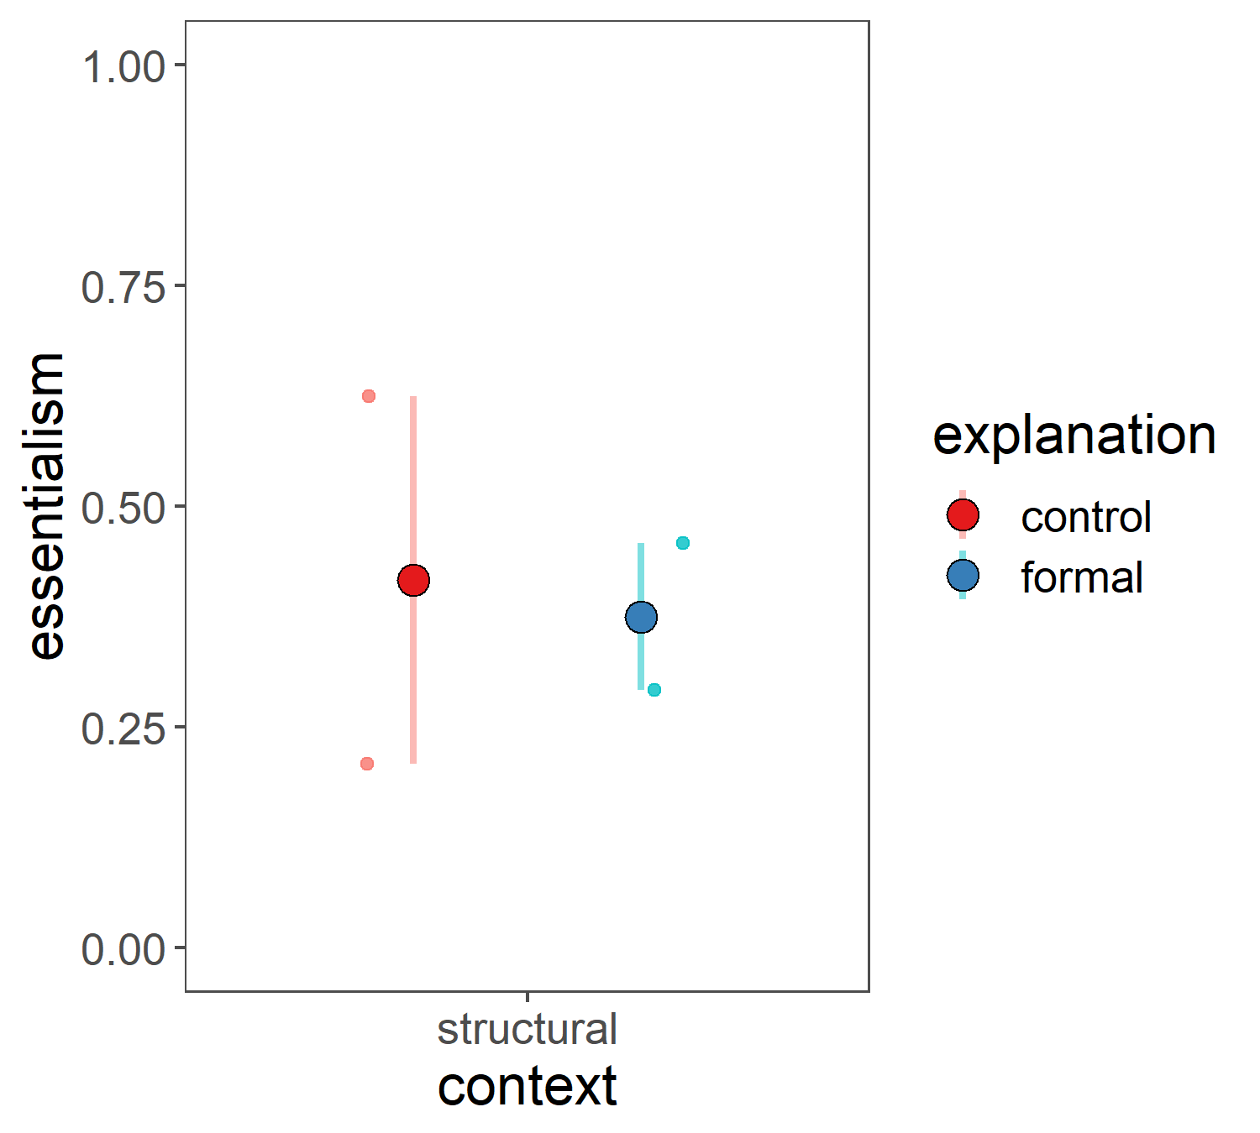
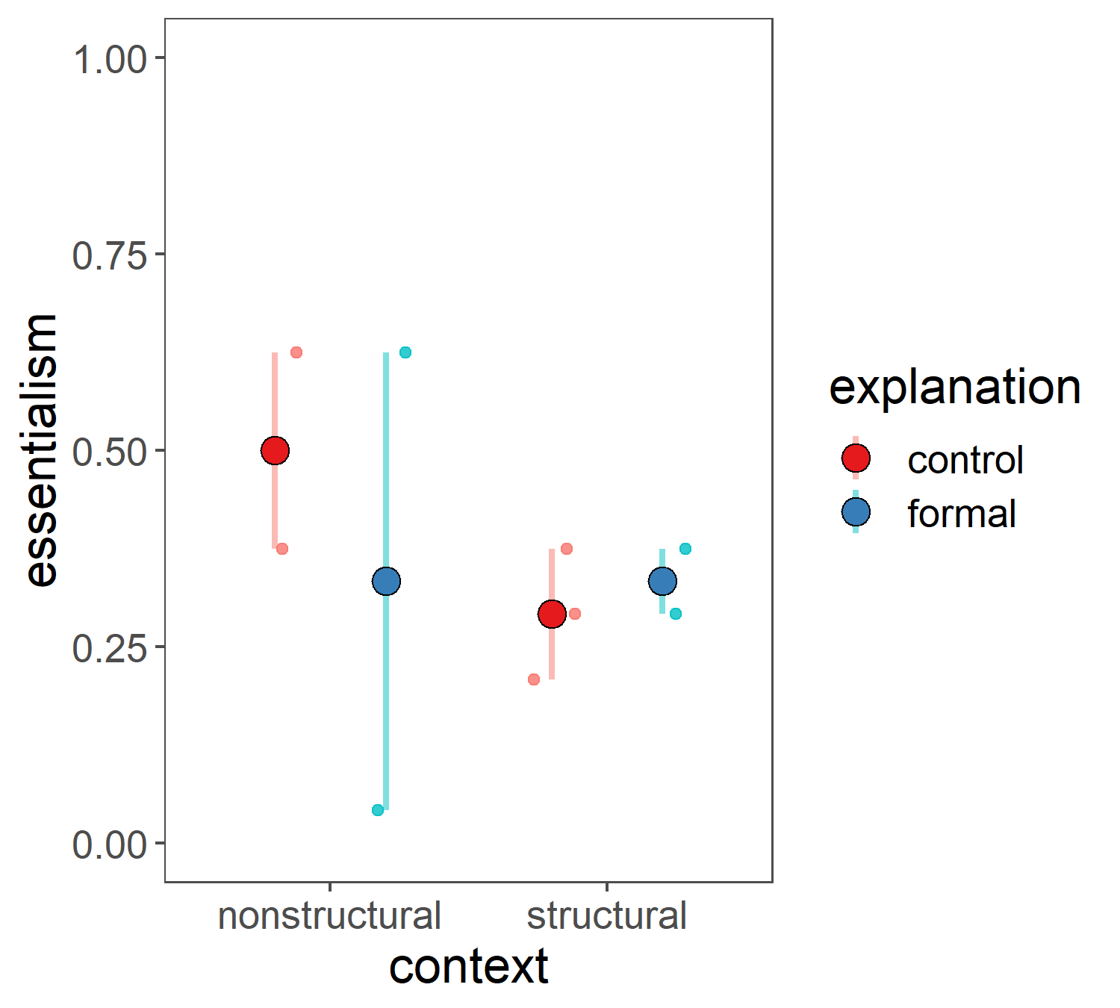
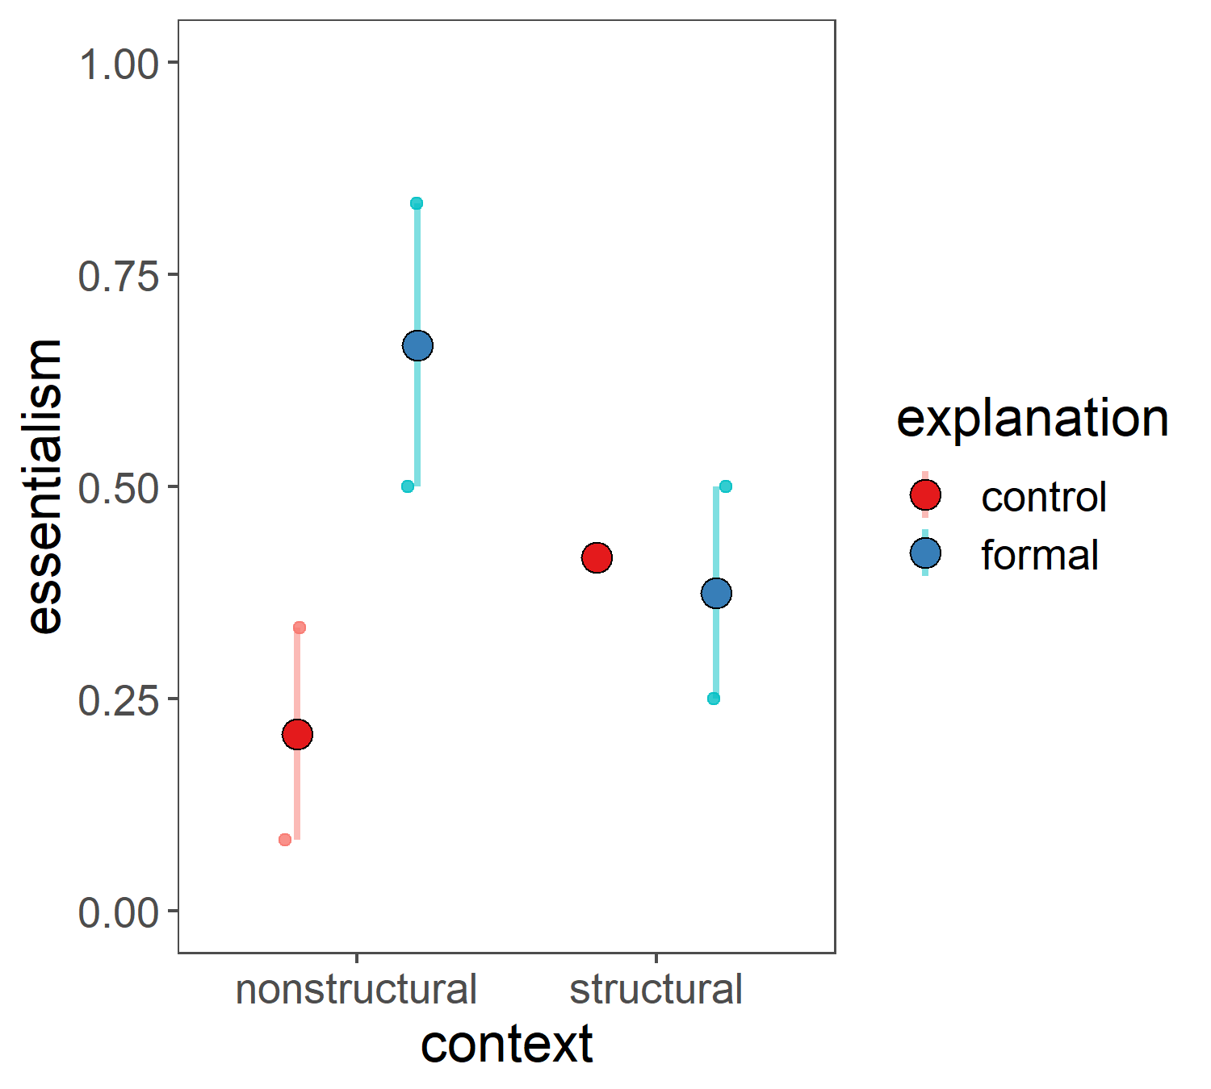
Pilot 2 results: 2.1 vs 2.2 vs 2.3 (all DVs)
 | 2.1 | 2.2 | 2.3
 | n=4 (all structural) | n=9 | n=7
Force-choice explanation | group | indiv | indiv, “the size”
Inductive potential | 2 responses |  | 4 responses
Normative | indiv | group
Innateness switch | same
Trending as predicted
Trending as predicted

Slide 22
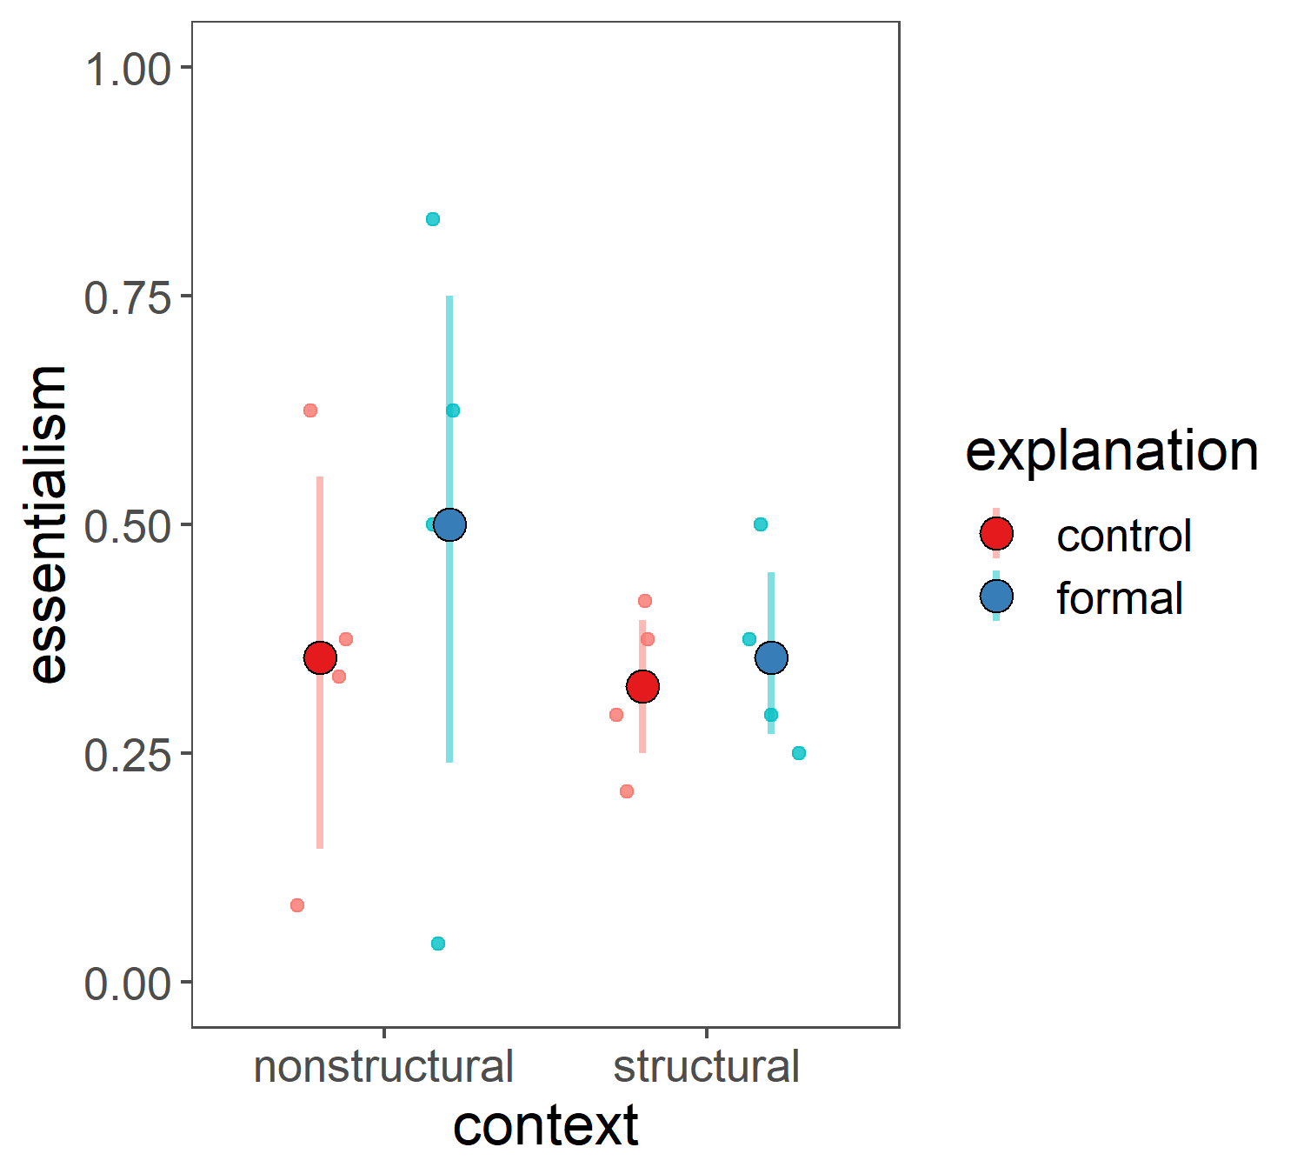
Pilot 2 results: 2.1 vs 2.2+2.3 (all DVs)
 | 2.1 | 2.2 | 2.3
 | n=4 (all structural) | n=9 | n=7
Force-choice explanation | group | indiv | indiv, “the size”
Inductive potential | 2 responses |  | 4 responses
Normative | indiv | group
Innateness switch | same
Trending as predicted
Unlike Vasilyeva et al, control: nonstr = str?

Slide 23
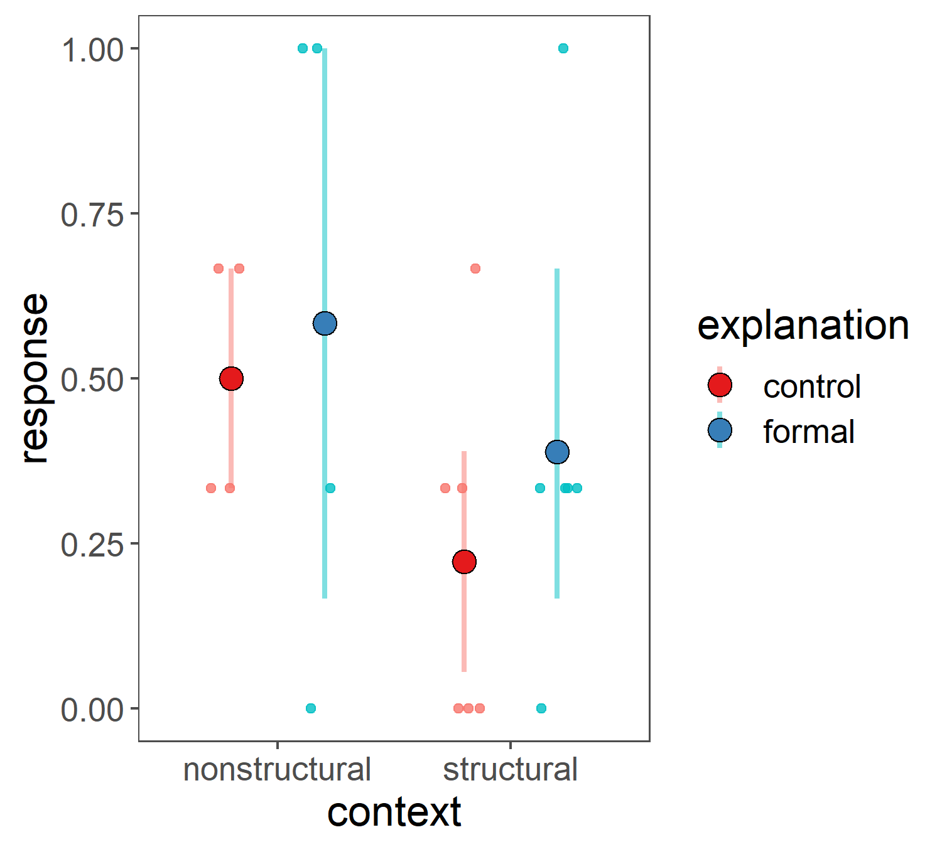
Pilot 2 results: 2.1 + 2.2 + 2.3 (innateness switch only)
 | 2.1 | 2.2 | 2.3
 | n=4 (all structural) | n=9 | n=7
Innateness switch | same
Trending like Vasilyeva et al, control: nonstr > str

Slide 24
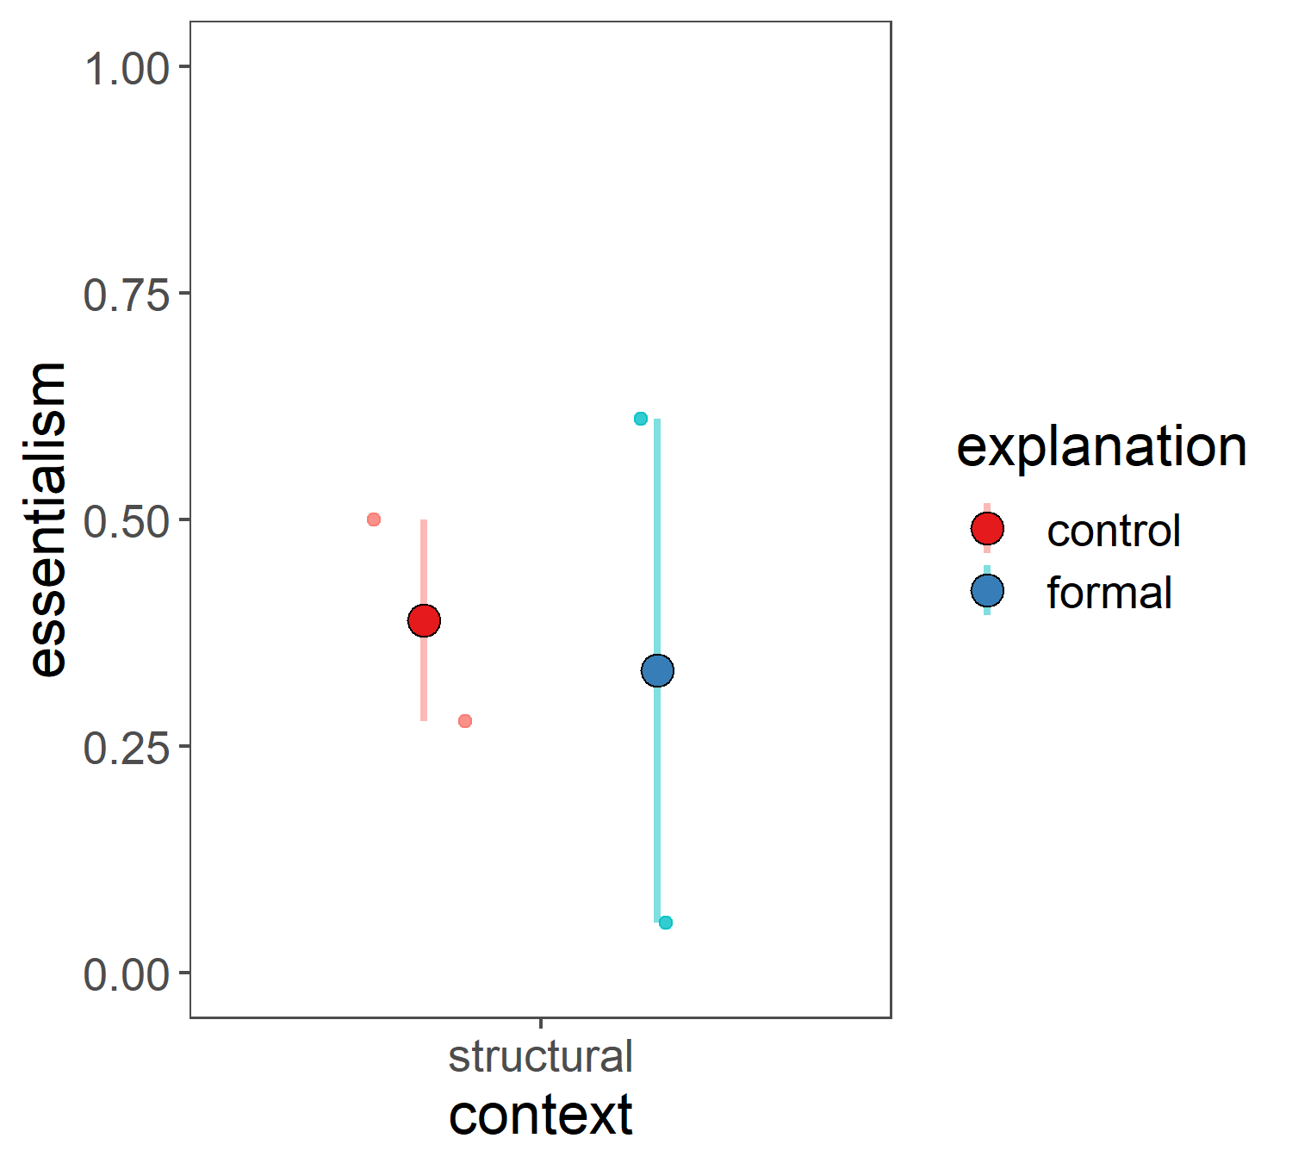
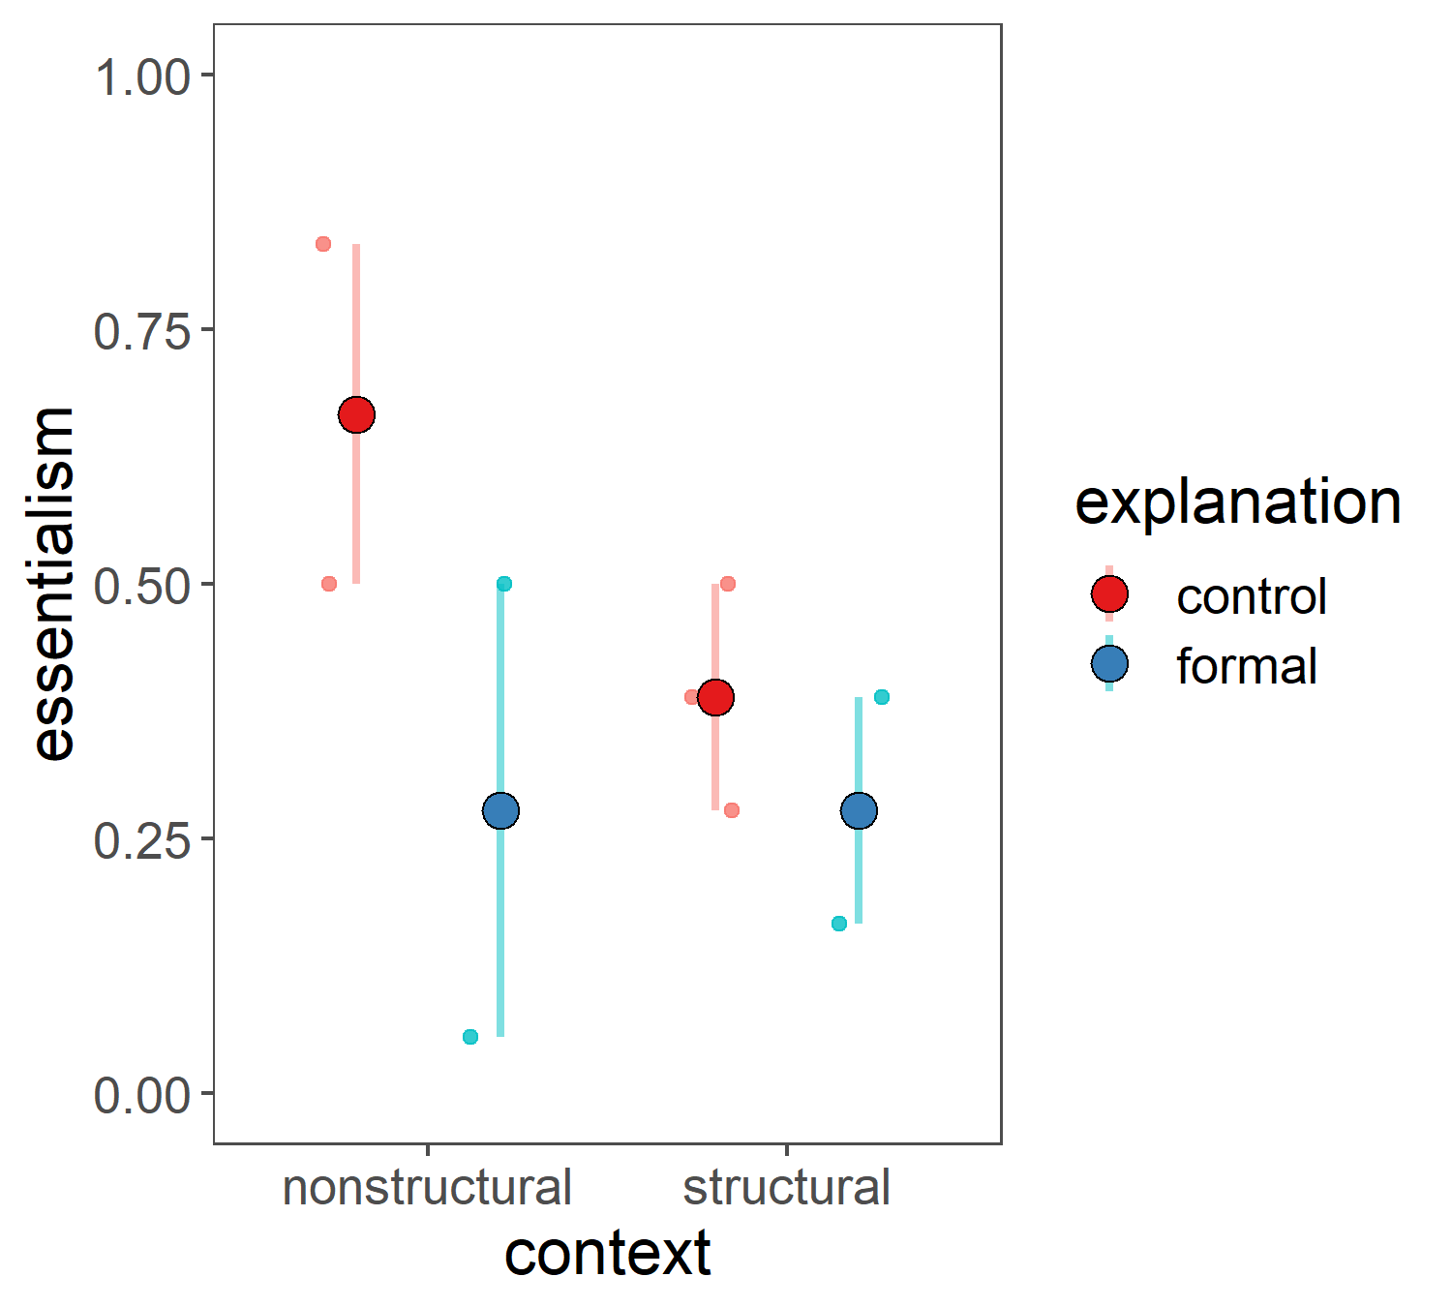
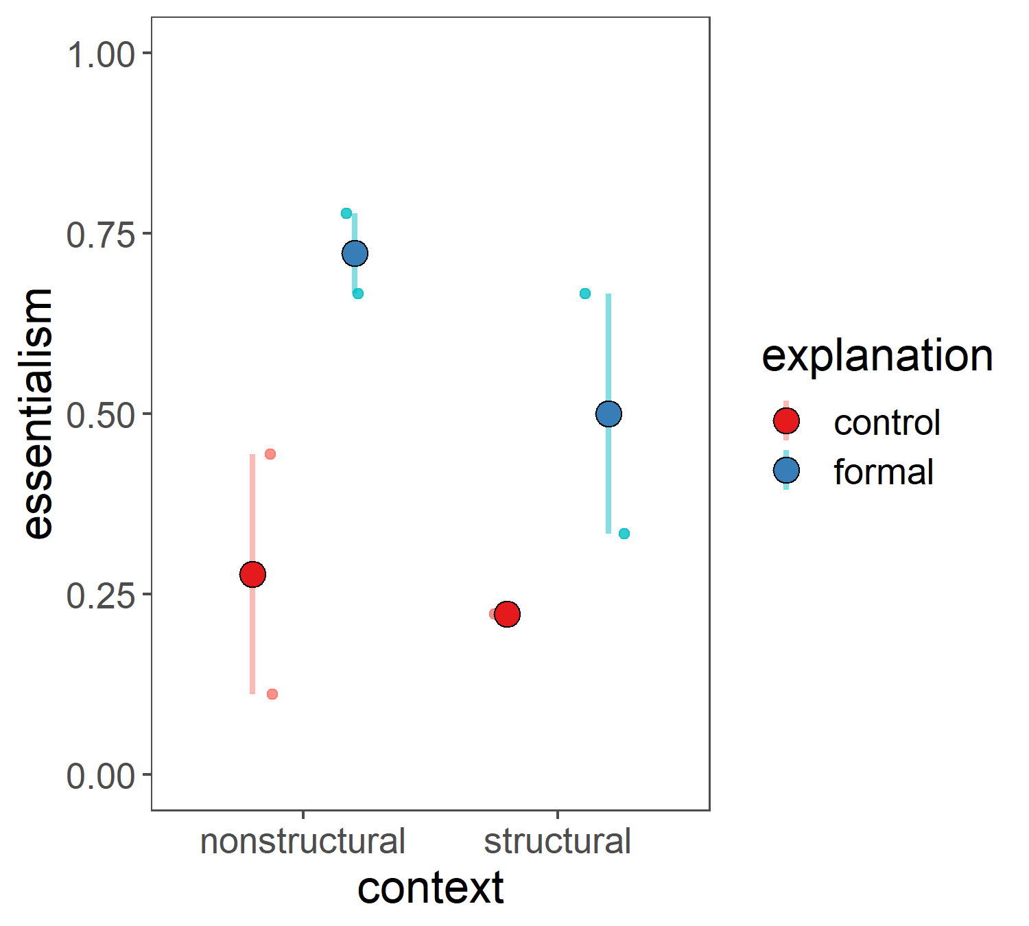
Pilot 2 results: 2.1 vs 2.2 vs 2.3 (all DVs but normative)
 | 2.1 | 2.2 | 2.3
 | n=4 (all structural) | n=9 | n=7
Force-choice explanation | group | indiv | indiv, “the size”
Inductive potential | 2 responses |  | 4 responses
Innateness switch | same
?
Essentialism boost persists?

Slide 25
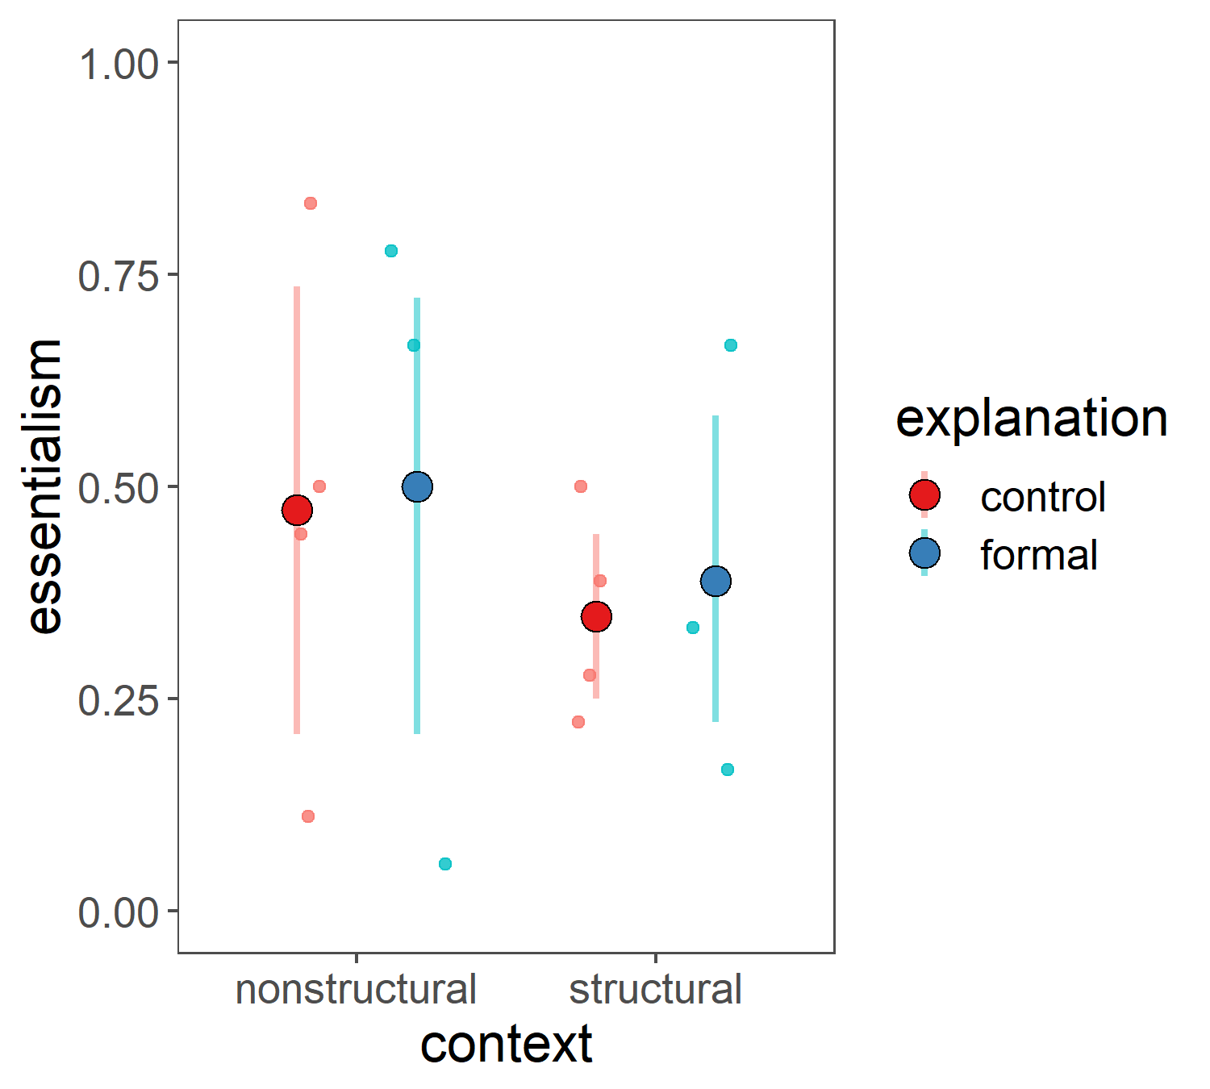
Pilot 2 results: 2.1 vs 2.2+2.3 (all DVs but normative)
 | 2.1 | 2.2 | 2.3
 | n=4 (all structural) | n=9 | n=7
Force-choice explanation | group | indiv | indiv, “the size”
Inductive potential | 2 responses |  | 4 responses
Innateness switch | same
Not much of an essentialist boost in either context

Slide 26
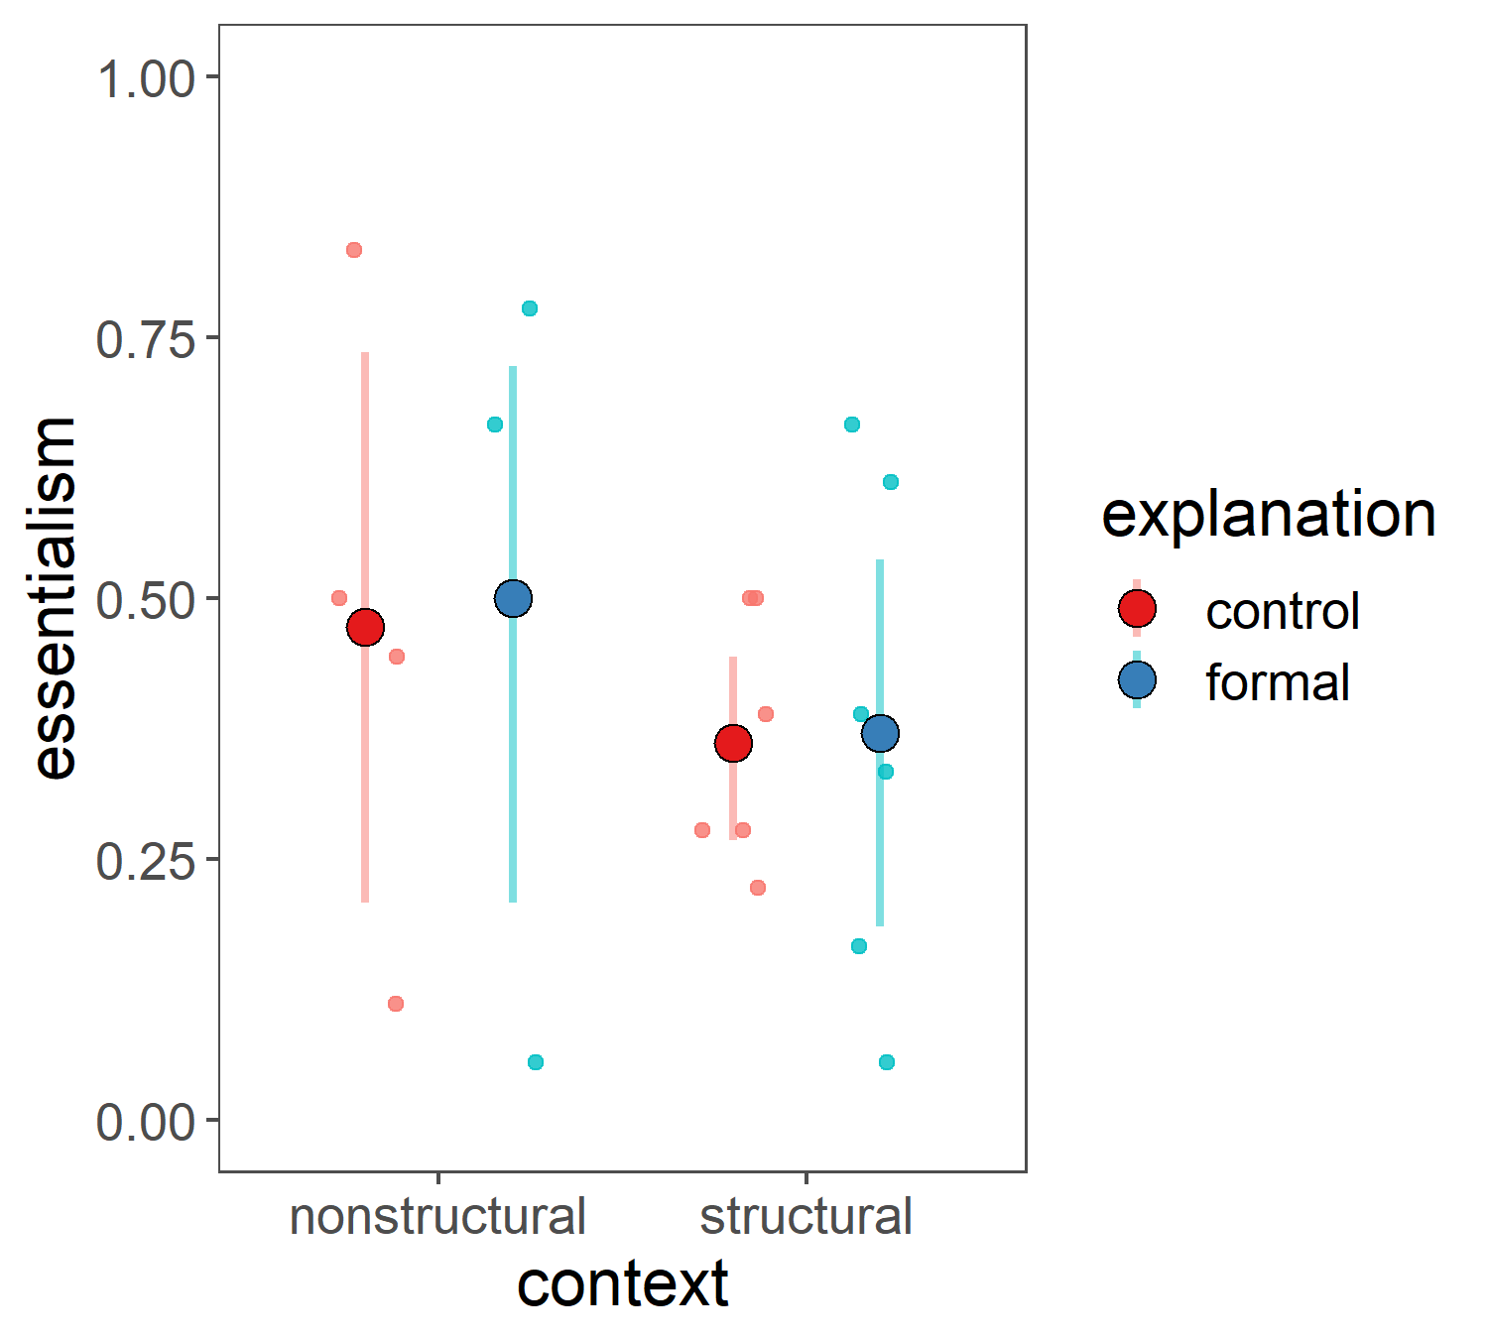
Pilot 2 results: 2.1 vs 2.2+2.3 (all DVs but normative)
 | 2.1 | 2.2 | 2.3
 | n=4 (all structural) | n=9 | n=7
Force-choice explanation | group | indiv | indiv, “the size”
Inductive potential | 2 responses |  | 4 responses
Innateness switch | same
Not much of an essentialist boost in either context

Slide 27
Pilot 2 takeaways
In average of all 4 new DVs…
Seeing pattern from Muradoglu et al (who used 5 canonical DVs)– formal explanations boost essentialism in nonstructural context
Seeing my predicted pattern – formal explanations boost essentialism to a lesser extent in structural context than in the nonstructural context
In innateness switch only…
Seeing pattern from Vasilyeva et al (who used innateness switch) – structural context lowers essentialism, vs nonstructural context
Normativity item as part of essentialism battery, or as separate item for exploratory analysis?

Slide 29
Power analysis
(Vasilyeva, Lombrozo, & Gopnik, 2018)
 |  | context
 |  | nonstructural | structural
explanation | control | {mean, sd} | {mean, sd}
 | formal | {mean, sd} | {mean, sd}
(Muradoglu et al, 2019)
Pull mean, sds from prior studies for 3 out of 4 cells
Set remaining cell (structural formal) equal to structural control
Simulate lots of datasets of n sample size
Run ANOVA for context * explanation interaction on each dataset
Calculate power for n

Slide 30
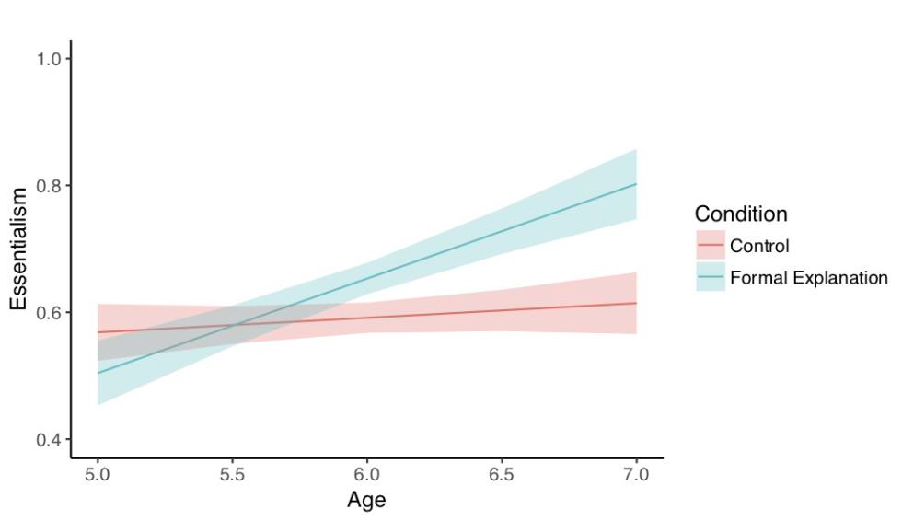
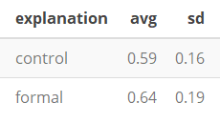
Power analysis
(Vasilyeva, Lombrozo, & Gopnik, 2018)
 |  | context
 |  | nonstructural | structural
explanation | control | {0.59, 0.16} | {mean, sd}
 | formal | {0.64, 0.19} | {mean, sd}
(Muradoglu et al, 2019)
of subject average of 5 DVs
Although the main effect of condition was not significant, p = .11, the condition by age interaction was, p = .044. Six-year-olds, but not 5-year olds, showed higher essentialism for properties introduced via formal explanations (ps = .011 and .999, respectively; see Figure 2). Children also gave more essentialist responses with age, p = .003.

Slide 31
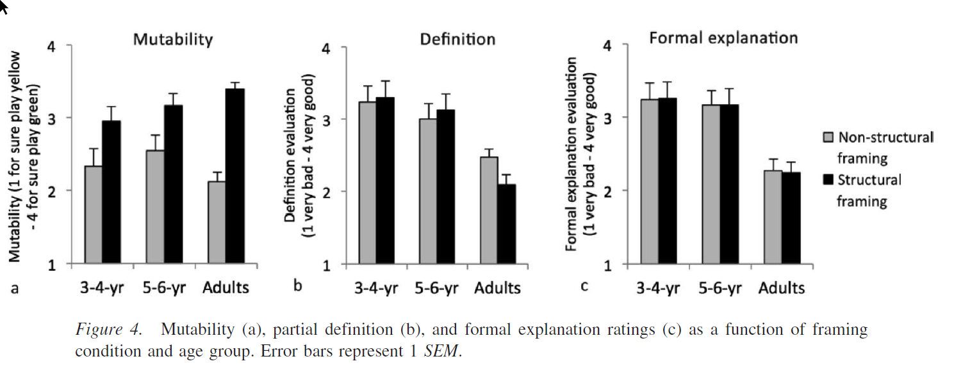
Power analysis
(Vasilyeva, Lombrozo, & Gopnik, 2018)
 |  | context
 |  | nonstructural | structural
explanation | control | {0.59, 0.16} | {mean, sd}
 | formal | {0.64, 0.19} | {mean, sd}
(Muradoglu et al, 2019)
1 DV | M_mut | SE_mut
nonstructural | 2.50 | 0.17
structural | 3.17 | 0.19
Innateness switch
For the mutability judgment task… an ANOVA with framing condition and age group as between-subjects factors revealed the predicted main effect of framing, F(1, 85) = 8.95, p = .004, partial_eta_p_sq = .095, with no main effect of age group, F(1, 85) = 1.05, p = .309, nor interaction, F(1, 85) = .01, p = .984. Similarly, adults rated the target property as more mutable under the structural than nonstructural framing, t(65) = 8.04, p = .001, d = 2.00.
0
1

Slide 32
Power analysis
(Vasilyeva, Lombrozo, & Gopnik, 2018)
 |  | context
 |  | nonstructural | structural
explanation | control | {0.59, 0.16} | {0.28, 0.30}
 | formal | {0.64, 0.19} | {mean, sd}
(Muradoglu et al, 2019)
1 DV | M_mut | SE_mut | M_innateness | SE_innateness | SD_innateness
 |  |  | =1 - (M_mut-1)/(4-1) | =SE_mut / (4-1) | =SE_innateness * sqrt(n=24)
nonstructural | 2.50 | 0.17 | 0.50 | 0.06 | 0.30
structural | 3.17 | 0.19 | 0.28 | 0.06 | 0.30
Innateness switch
For the mutability judgment task… an ANOVA with framing condition and age group as between-subjects factors revealed the predicted main effect of framing, F(1, 85) = 8.95, p = .004, partial_eta_p_sq = .095, with no main effect of age group, F(1, 85) = 1.05, p = .309, nor interaction, F(1, 85) = .01, p = .984. Similarly, adults rated the target property as more mutable under the structural than nonstructural framing, t(65) = 8.04, p = .001, d = 2.00.
0
1

Slide 33
Power analysis
(Vasilyeva, Lombrozo, & Gopnik, 2018)
 |  | context
 |  | nonstructural | structural
explanation | control | {0.59, 0.16} | {0.28, 0.30}
 | formal | {0.64, 0.19} | {0.28, 0.30}
(Muradoglu et al, 2019)

Slide 35
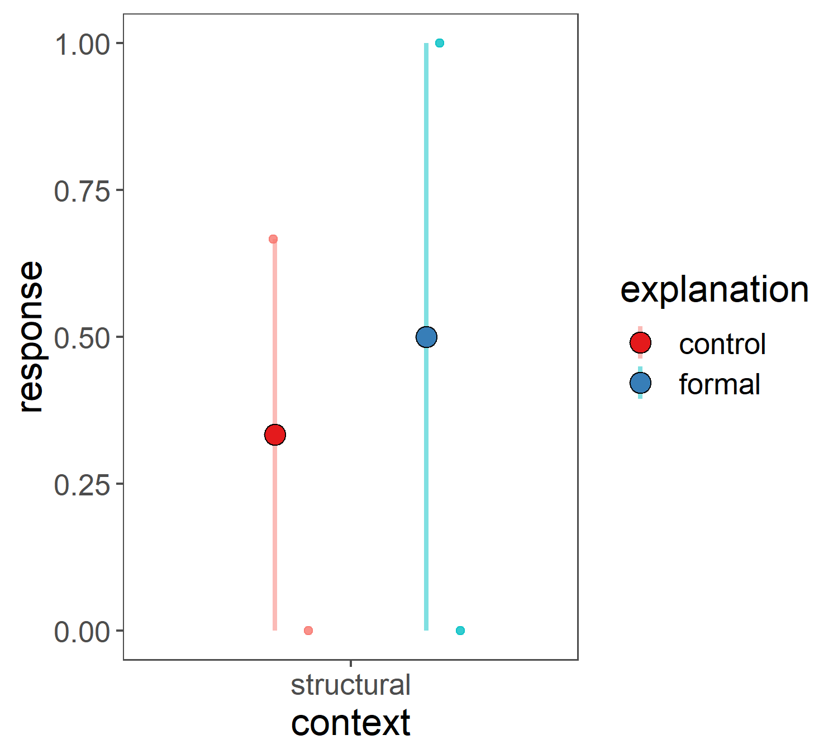
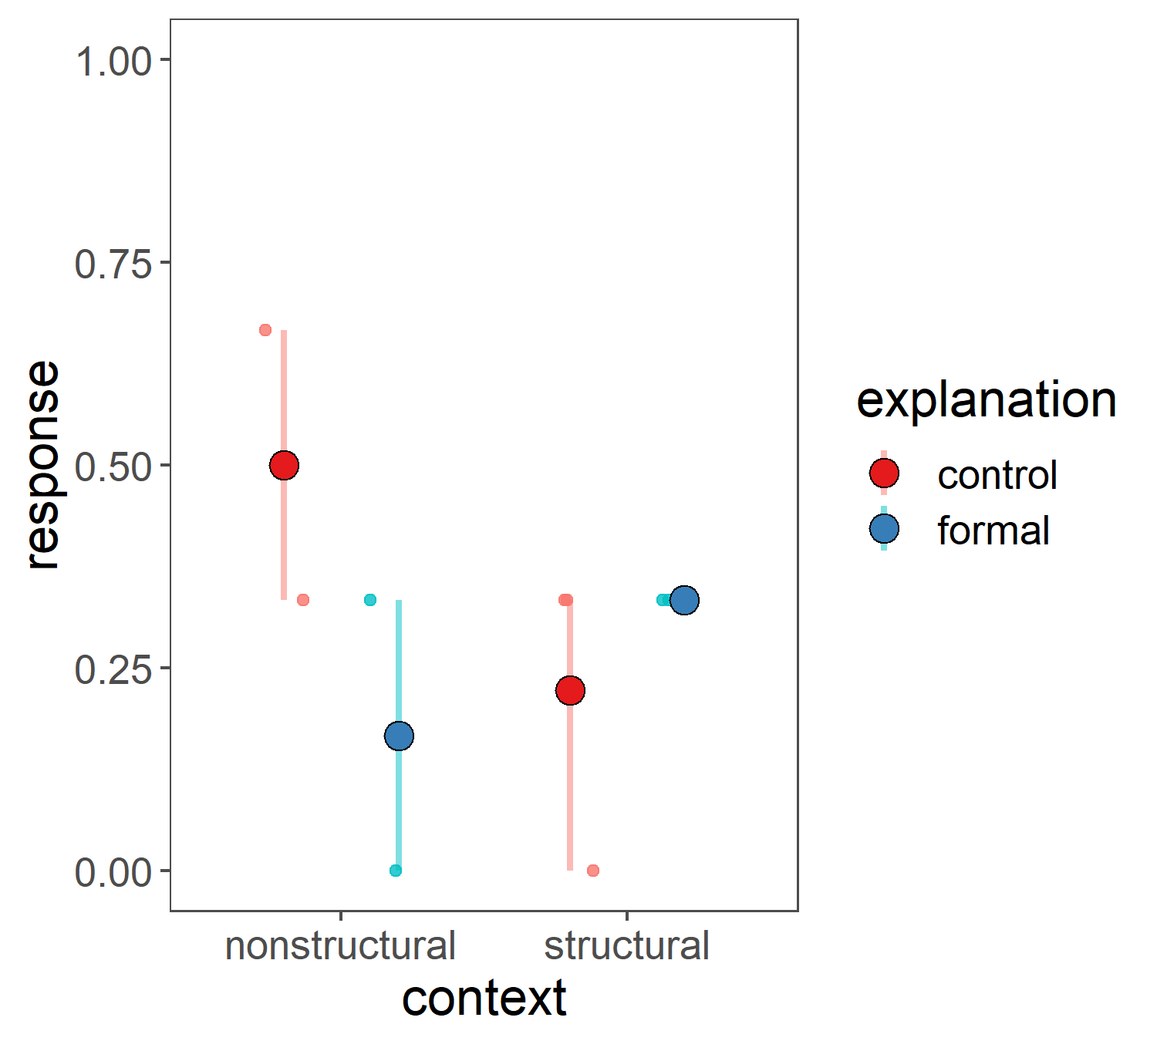
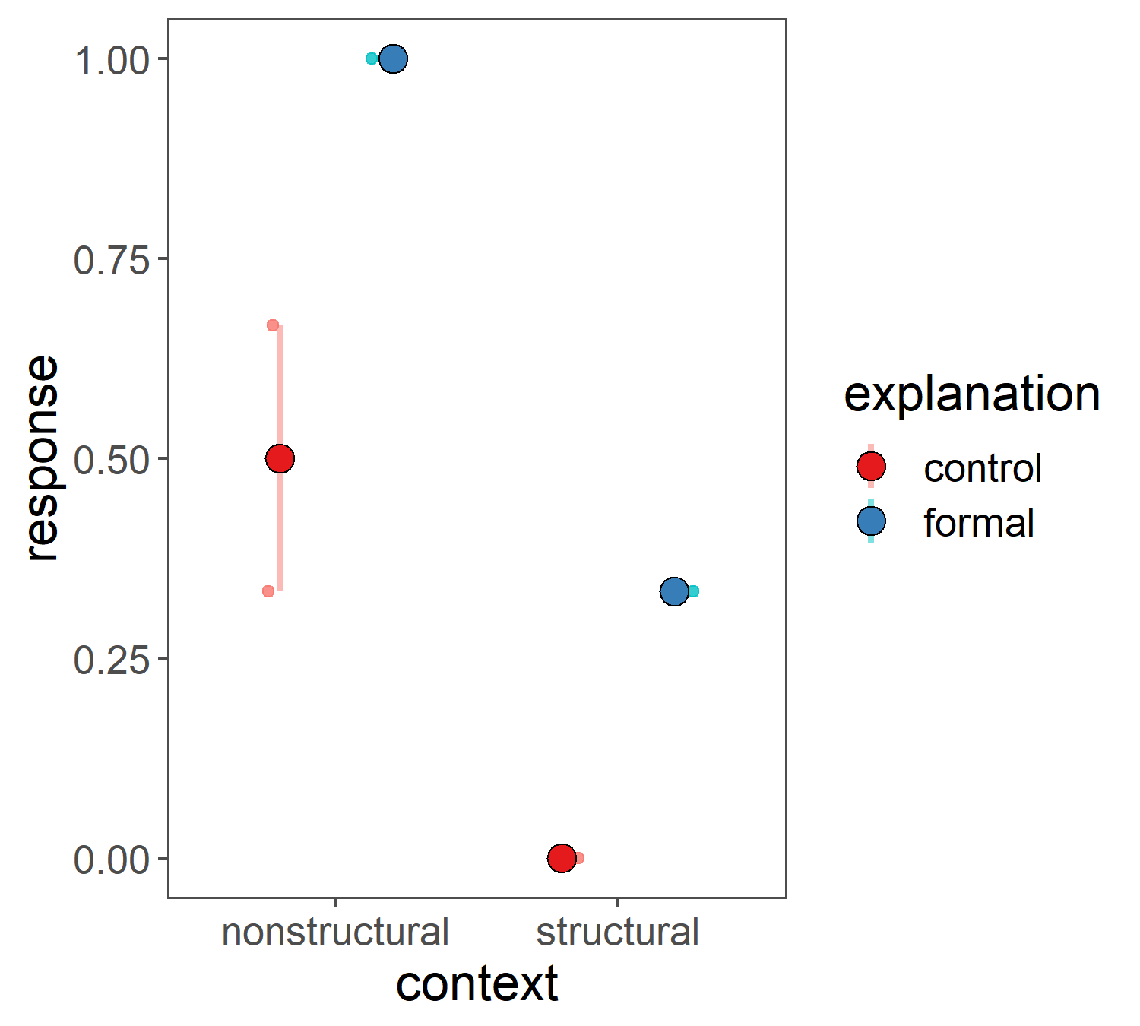
Pilot 2 results: 2.1 vs 2.2 vs 2.3 (innateness switch only)
 | 2.1 | 2.2 | 2.3
 | n=4 (all structural) | n=9 | n=7
Innateness switch | same
Trending like Vasilyeva et al, control: nonstr > str
Trending like Vasilyeva et al, control: nonstr > str
Notes:
Because the wording for this item is the same, might make sense to pool all together

