Slide 1
Marianna Zhang
Essentially blocked:
Can structural factors block an essentialist interpretation of a formal explanation?
Markman lab meeting
2.28.19
Notes:
Quickly speed through the background of the study again, just to remind you all
Pilot data!
thoughts on revising study design

Slide 2
Essentialism
A cognitive bias to believe that:
categories represent real distinctions in the world
category members share an “essence” that gives rise to shared properties that are innate and unchangeable
Cultural variation in what particular social categories children essentialize
The role of social input (e.g. language) in guiding children to essentialize particular categories
Gelman 2003/2004
Notes:
- Speed through the background for this study

Slide 3
Linguistic cues for essentialism
Generics
“Girls play with dolls”, “A girl plays with dolls”
Suggests the property is a non-accidental and central property for that category
Formal explanations?
Rhodes, Leslie, Tworek, 2012; Cimpian & Markman 2009/2011
Notes:
What kinds of language might cue children to essentialize a category?
4yo who heard generic language about a novel social category -> develop essentialist beliefs about that social category
Other linguistic cues – formal explanations?
>Ellen: there isn’t a single syntactic marker that marks something as generic -> recruit other info about predicate, category, etc to decide if something is a generic

Slide 4
Formal explanations
an individual
has a property
because
it is a member of _ category
“Suzy plays with dolls because Suzy is a girl”
Suggests:
having that property is central to what it means to be a category member
there is something inherent about being a category member that gives rise to that property
Prasada & Dillingham 2006/2009; Gelman, Cimpian, Roberts, 2018

Slide 5
Formal explanations can boost essentialism
5,6yo: formal vs control explanation
4 trials = 2 novel behavior, 2 novel behavioral preference
Exp 1: animals: “It flaps its ears to cool off because it is an elephant” → boosted essentialism in 5-6yo
Exp 2: girls: “Margaret likes to eat gooseberries because she is a girl” → boosted essentialism in 6yo, not 5yo
Essentialism DVs: canonical 5-item battery (avg) x 4 trials
Stability in past
Stability in future
[Innateness when environment is switched,
Innateness when family tries to stop property]
Inductive potential
Muradoglu, Marchak, Cimpian, Gelman, submitted to SRCD
Notes:
4 diff animals: Cleans itself with its beak, flaps its ears to cool off, likes to sleep standing up, likes to eat lettuce
4 diff girls: Rides on the white horse on merry-go-rounds, puts her left sock on first, likes books about a country called Switzerland, likes to eat gooseberries -> all 5 DVs after each trial

Slide 6
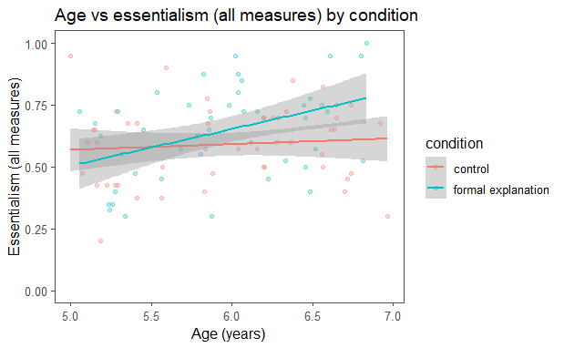
Formal explanations can boost essentialism
5,6yo: formal vs control explanation
4 trials = 2 novel behavior, 2 novel behavioral preference
Exp 2: girls: “Margaret likes to eat gooseberries because she is a girl” → boosted essentialism in 6yo, not 5yo
Muradoglu, Marchak, Cimpian, Gelman, submitted to SRCD
Notes:
4 diff animals: Cleans itself with its beak, flaps its ears to cool off, likes to sleep standing up, likes to eat lettuce
4 diff girls: Rides on the white horse on merry-go-rounds, puts her left sock on first, likes books about a country called Switzerland, likes to eat gooseberries -> all 5 DVs after each trial

Slide 7
Need formal explanations always cue essentialism?
Previous studies: formal explanations always yield an intrinsic essentialist interpretation
But: we sometimes produce formal explanations that suggest a structural interpretation instead of an essentialist interpretation
“I walk in groups late at night because I’m a woman”
“Rosa Parks couldn’t sit in the front of the bus because she was black”
Structural factors
stable extrinsic factors that act on a category by virtue of where the category is situated within a larger structure
e.g. attitudes about women in our society
Haslanger, 2016

Slide 8
Structural contexts can block essentialism
3-6yo, adults: structural vs nonstructural
Structural context – classroom environment skewed
Nonstructural context – classroom environment not skewed
Novel behavior for gender: different genders play different games
Formal explanation rating task → formal explanations rated as apt in both contexts
Essentialism DV: innateness when environment is switched x1 trial → less likely to be innate in structural than non-structural context
Vasilyeva, Gopnik, Lombrozo 2018

Slide 9
Structural contexts can block essentialism
3-6yo, adults: structural vs nonstructural
Structural context – classroom environment skewed
Nonstructural context – classroom environment not skewed
Novel behavior for gender: different genders play different games
Essentialism DV: innateness when environment is switched x1 trial → less likely to be innate (more mutable) in structural than non-structural context
Vasilyeva, Gopnik, Lombrozo 2018

Slide 10
Can structural factors block an essentialist interpretation of a formal explanation?
(Vasilyeva, Lombrozo, & Gopnik, 2018)
5, 6yo from Bing and Tech
All between subjects:
 |  | context
 |  | nonstructural | structural
explanation | control | medium | medium/low
 | formal | high | medium/low
(Muradoglu et al, submitted)
1 trial, 1 novel behavior for gender
Essentialism DVs: canonical 5-item battery (avg)
Stability in past
Stability in future
Innateness when family tries to stop property
Inductive potential
Innateness when environment is switched
(Muradoglu et al, submitted)
(Vasilyeva, Lombrozo, & Gopnik, 2018)

Slide 11
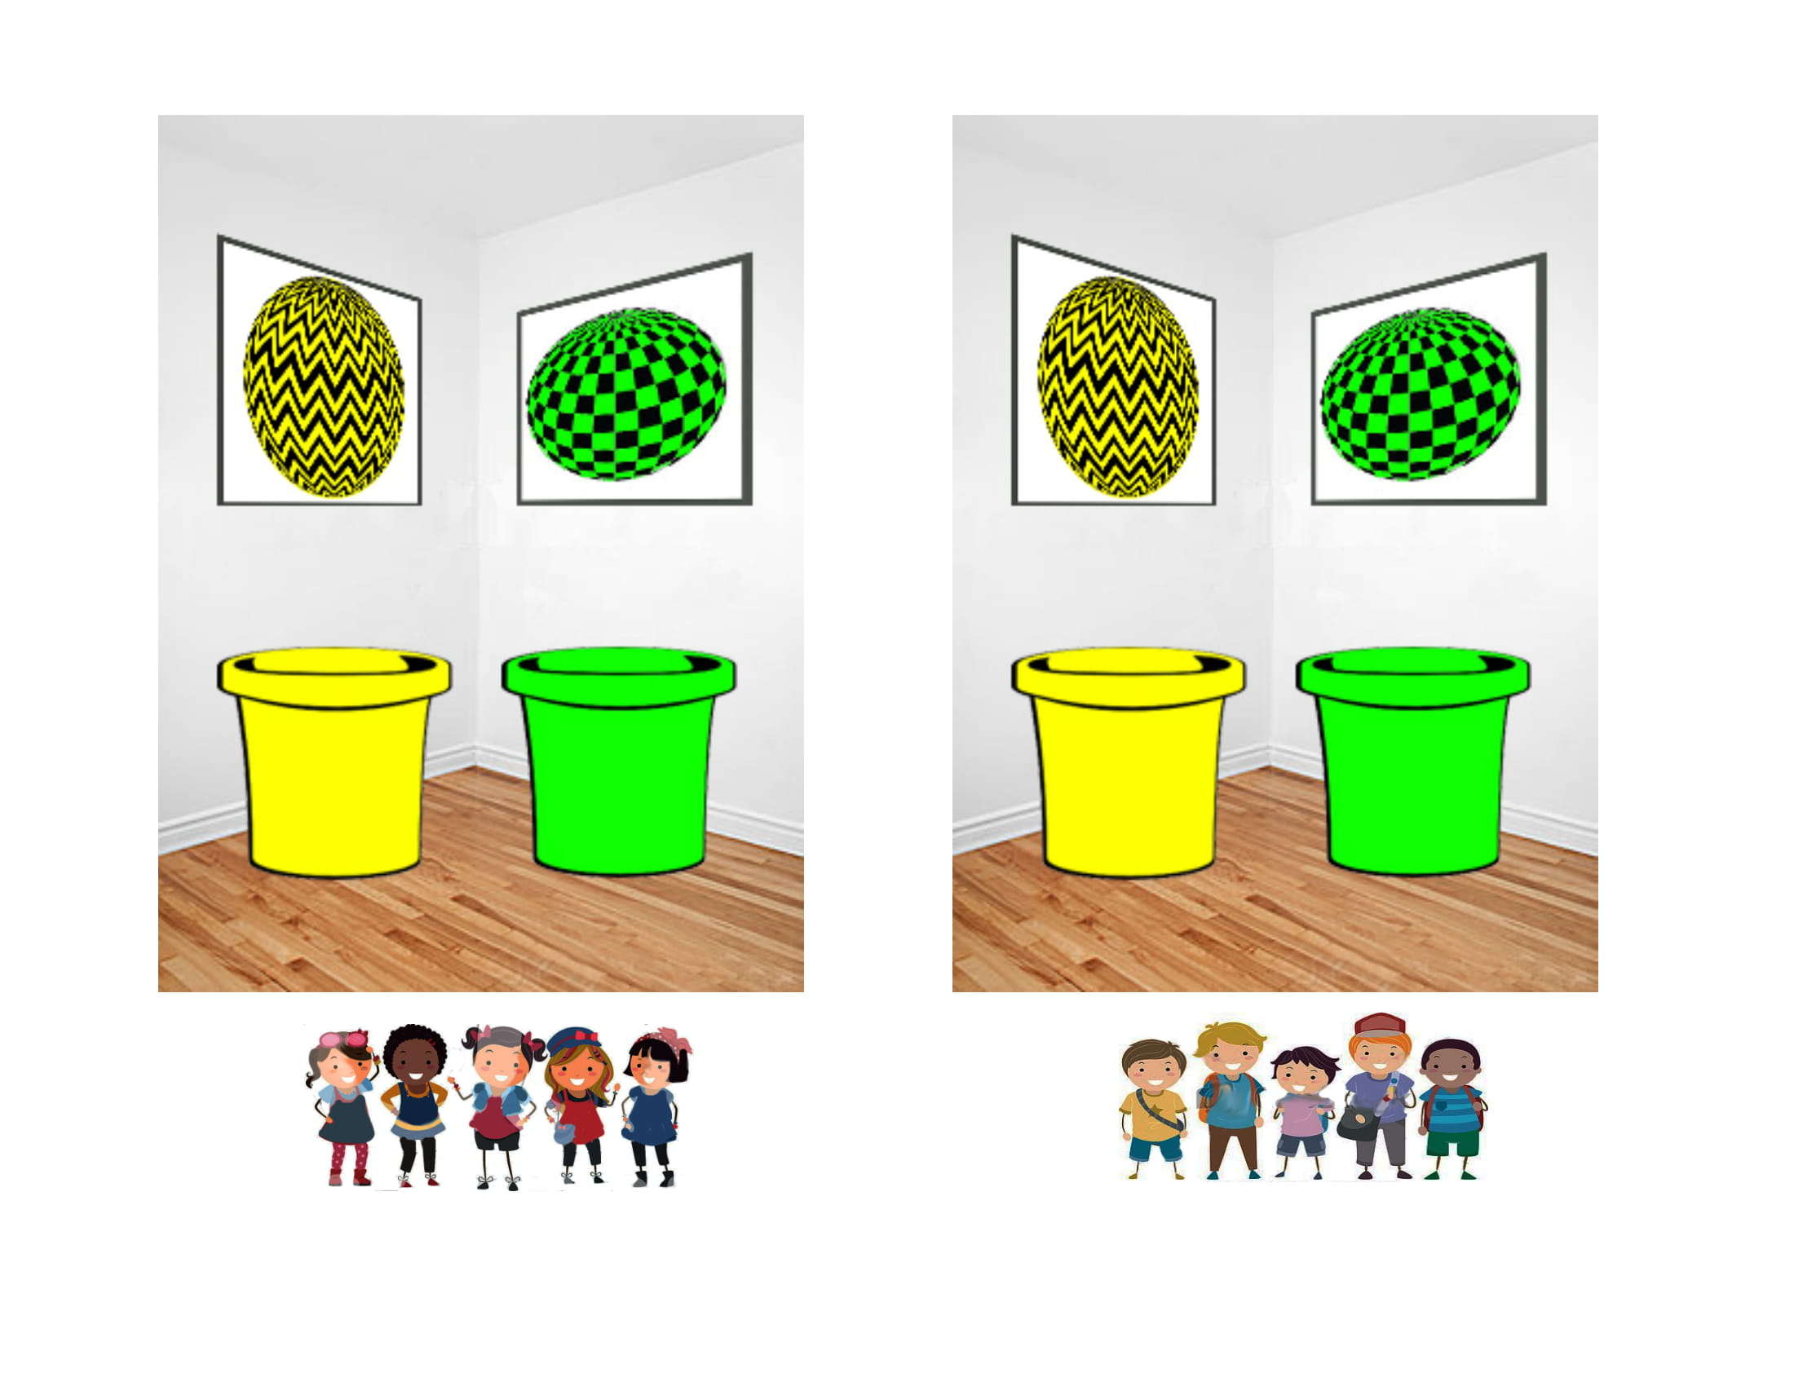
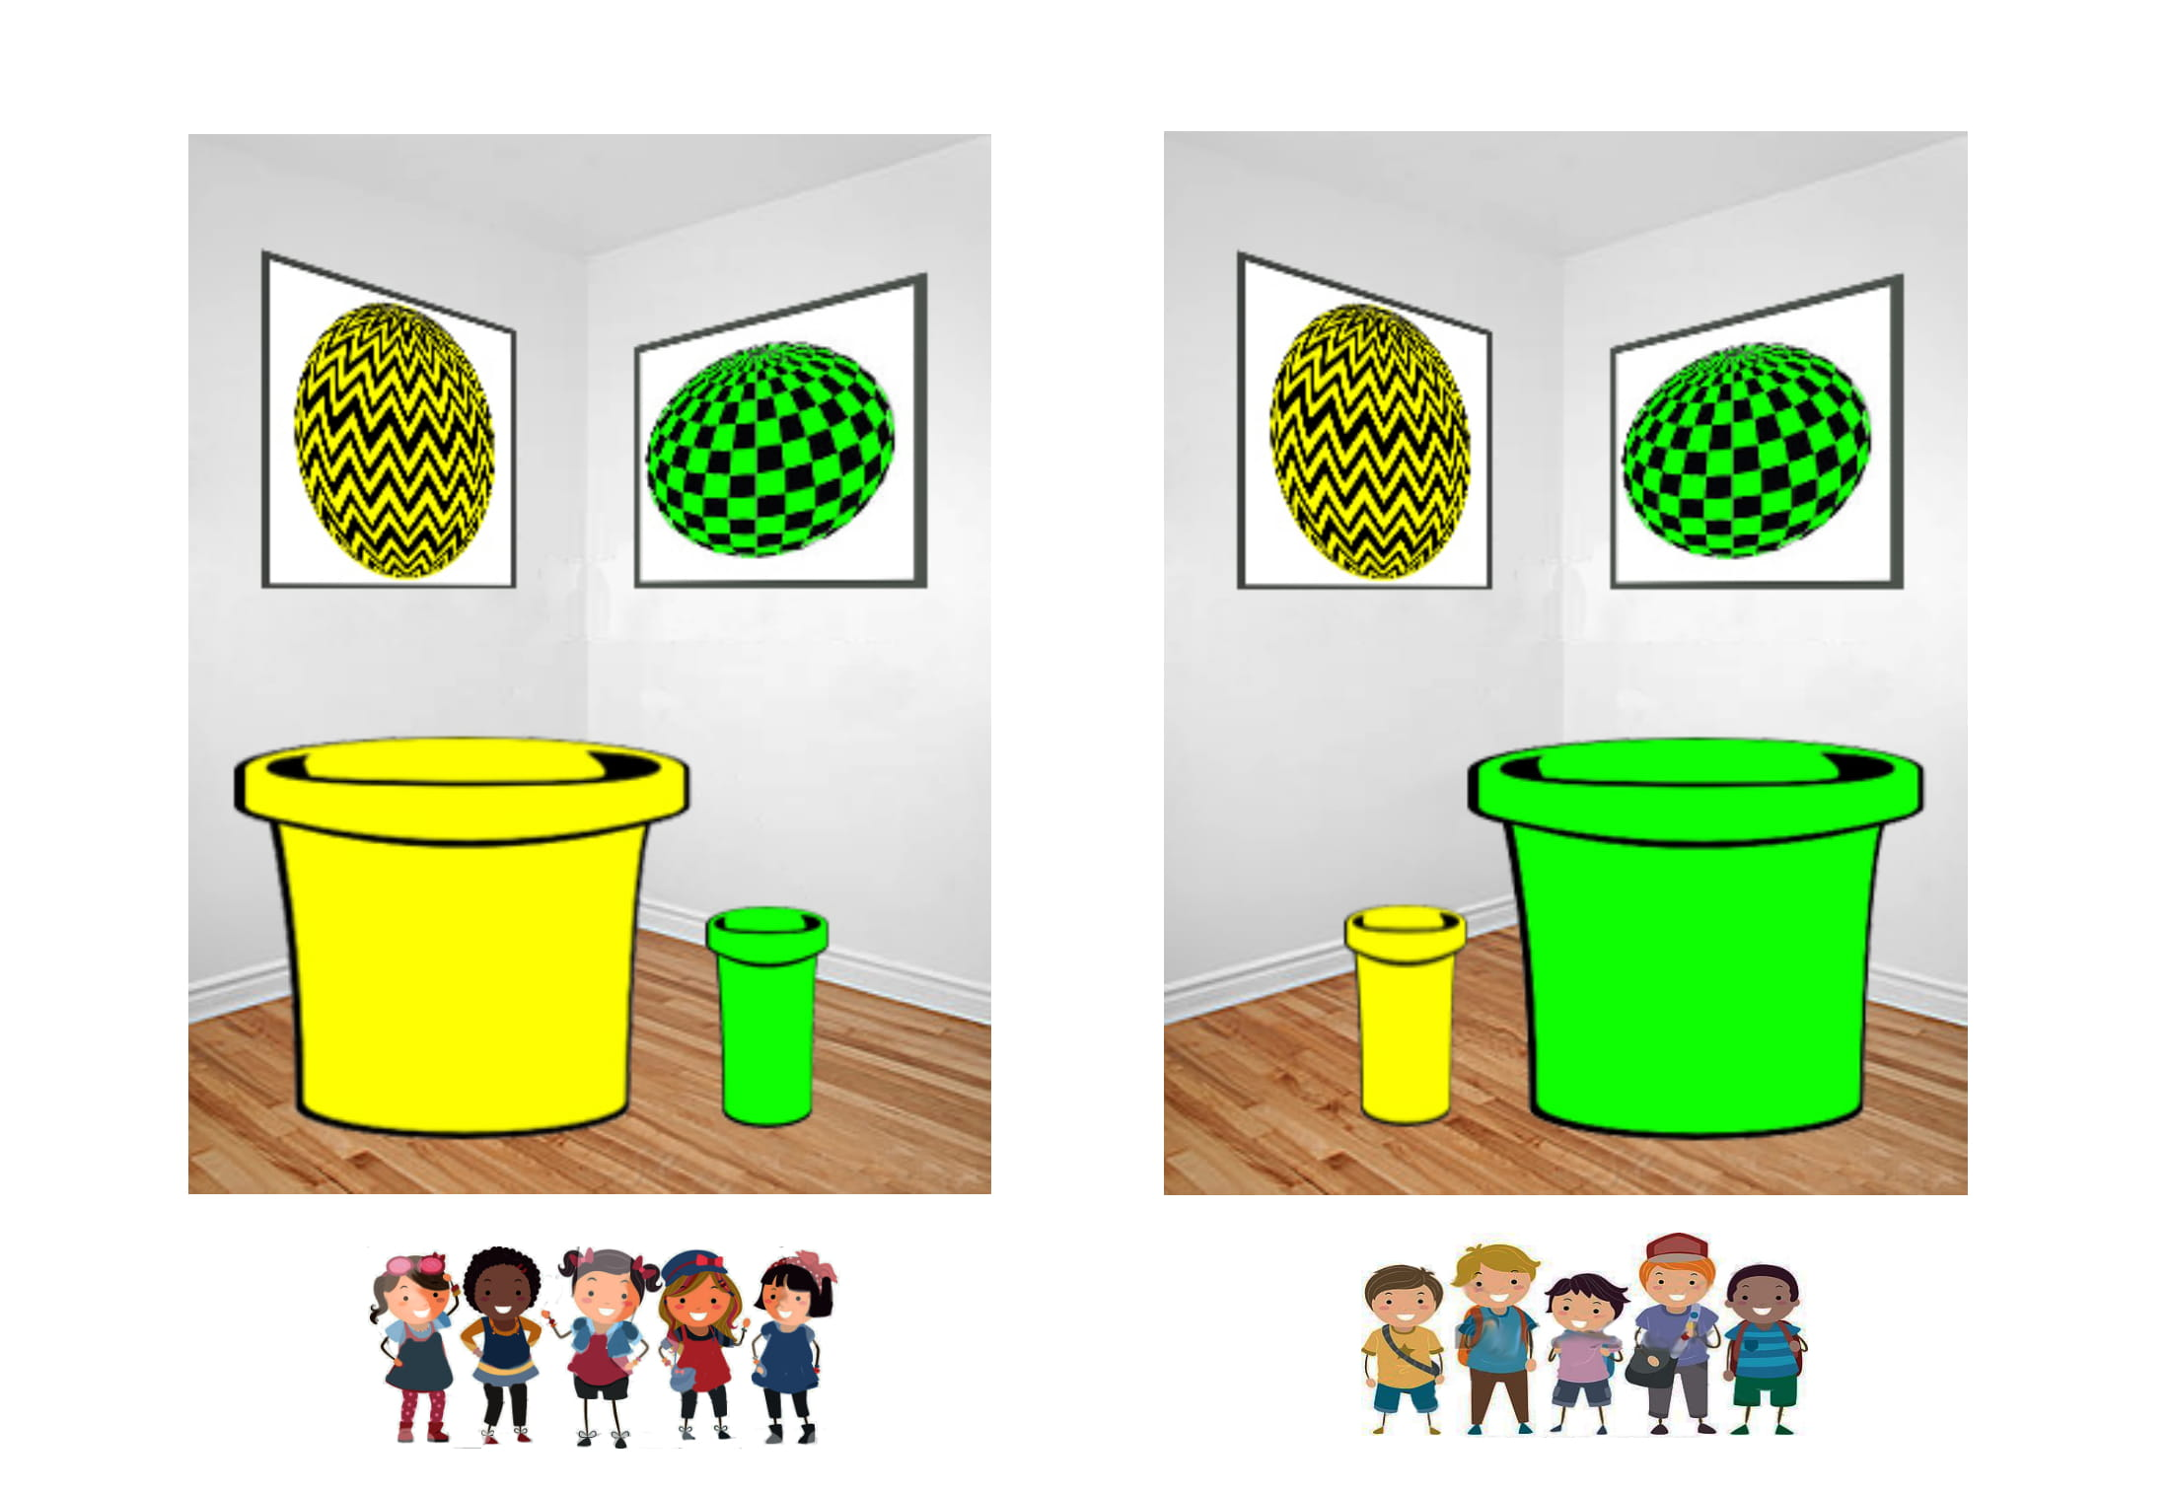
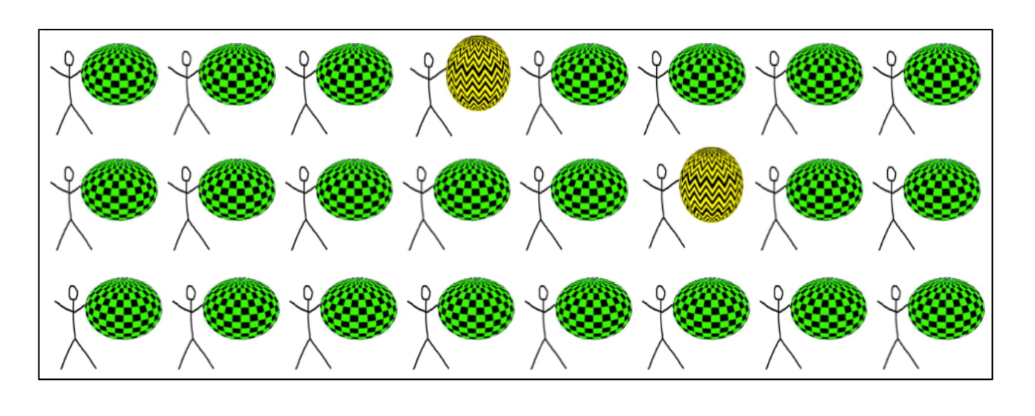
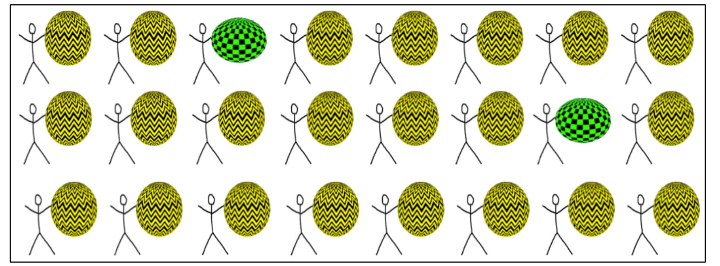
Context manipulation
Vasilyeva, Gopnik, Lombrozo 2018
Nonstructural context
Structural context
Boys in boys classroom
Girls in girls classroom

Slide 12
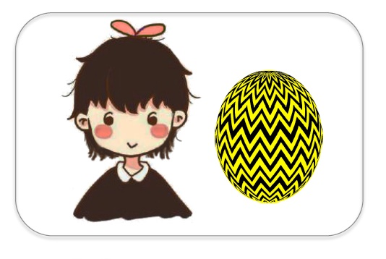
Explanation manipulation
Muradoglu, Marchak, Cimpian, Gelman, submitted to SRCD
Control explanation
Here’s Suzy. She is a girl. She plays Yellow-Ball.
Formal explanation
Here’s Suzy. She plays Yellow-Ball because she is a girl.

Slide 13

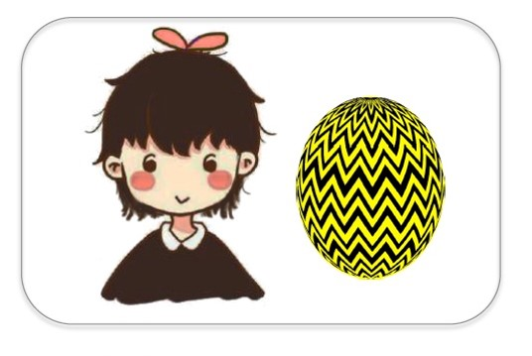







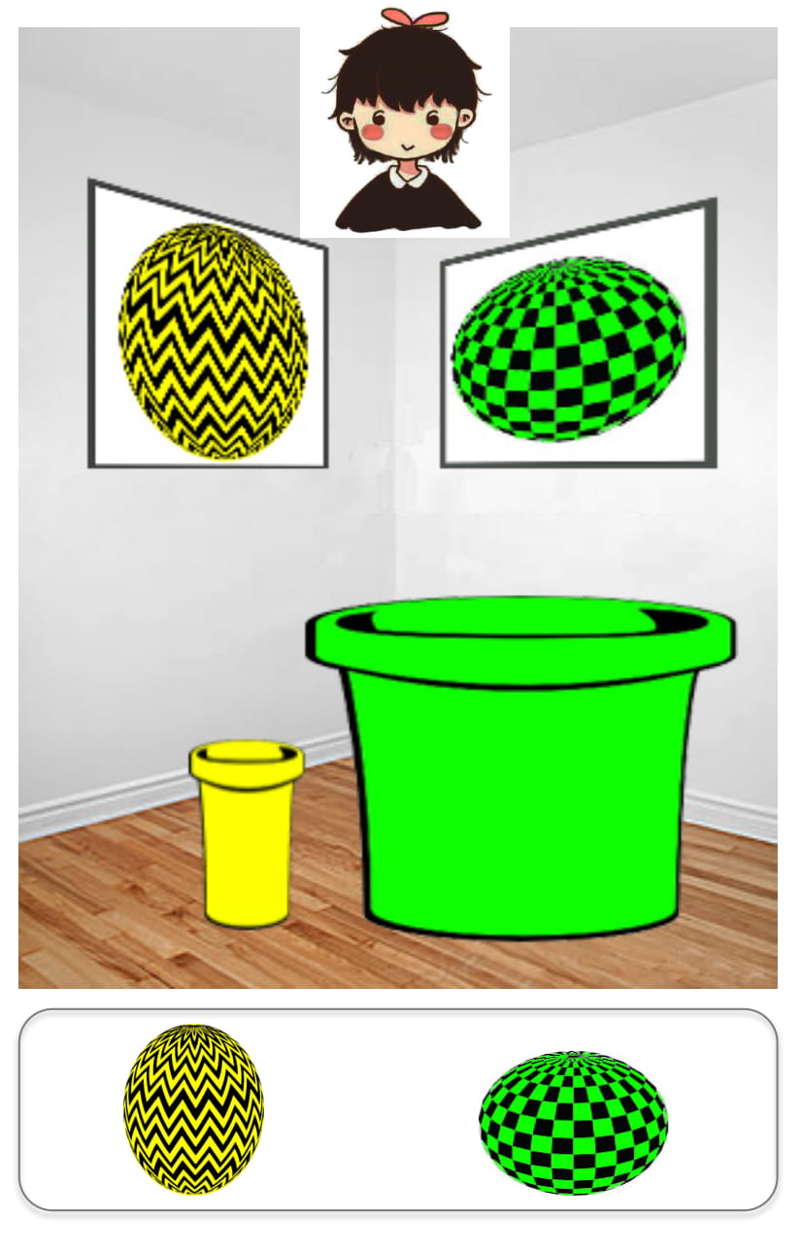
5 canonical essentialism DVs (avg)
Stability past | Now, here’s a question for you: Suzy is 8 years old. Do you think she played Yellow-Ball when she was 4 years old? (Y/N)
Stability future | Do you think she will always play Yellow-Ball? (Y/N)
Innateness stop | Would Suzy stop playing Yellow-Ball if her family tried to stop her from playing Yellow-Ball? (Y/N)
Inductive potential | Do you think “just this girl,” “a few girls,” or “a whole lot of girls” play Yellow-Ball?
Innateness switch | [Suzy goes to boys classroom] Which game do you think Suzy will play today? __ For sure __ or maybe __?
--- Muradoglu et al, submitted ---
Vasilyeva et al
Notes:
- Moved innateness switch to the end bc elaborate

Slide 14
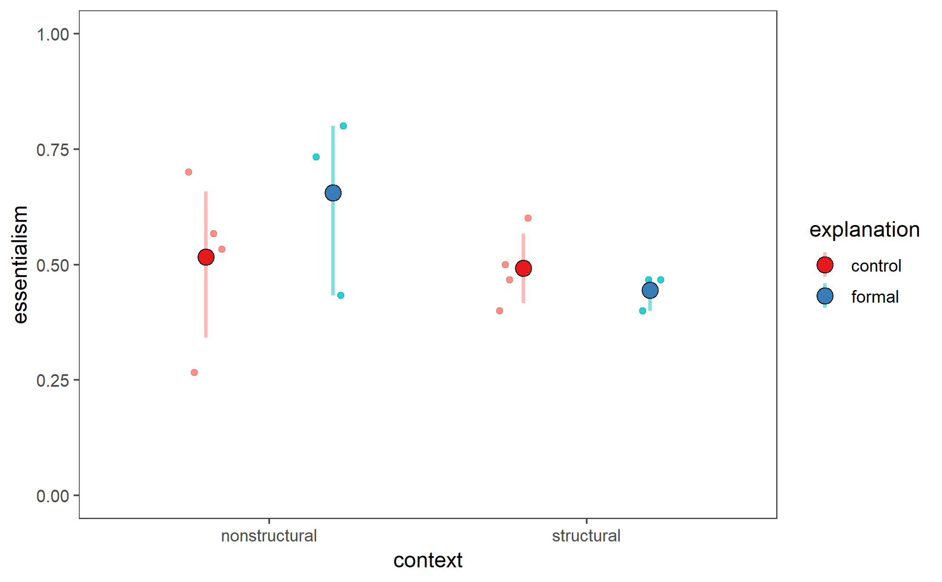
Pilot data
n=14 (excluded 2)
Nonstructural: essentialism boost from formal explanations (cf Muradoglu et al, submitted)
Structural: essentialism boost blocked

Slide 15
A worry with essentialism DVs
Formal explanation
 | Essentialist representation | Structural representation
When will an individual exhibit the same property? (stability, innateness) | Always | When structural factors in environment are stable
Will other category members exhibit the same property? (inductive potential) | Always | If they too are experiencing structural factors in environment
Essentialist vs structural best differentiated by environmental change
Adjust wording of DVs / focus only on DVs that involve environmental change?
Notes:
Zoom out: I’ve tried to argue that formal explanations can be interpreted in 2 different ways based on bg knowledge about situation at hand – essentialist or structural
We want to tease apart these two different ways of thinking
Challenge because these two ways of thinking can produce similar responses on our 5-item essentialism battery -> battery is canonically used, but may not have enough specificity to identity essentialism

Slide 16
A worry with essentialism DVs
 |  | Essentialist | Structural
Stability past | Now, here’s a question for you: Suzy is 8 years old. Do you think she played Yellow-Ball when she was 4 years old? (Y/N) | Yes | Not same school: No Same school: Yes
Stability future | Do you think she will always play Yellow-Ball? (Y/N) | Yes | Not same school: No?
Innateness stop | Would Suzy stop playing Yellow-Ball if her family tried to stop her from playing Yellow-Ball? (Y/N) | No | No?
Inductive potential | Do you think “just this girl,” “a few girls,” or “a whole lot of girls” play Yellow-Ball? | A whole lot | At this school: A whole lot Outside school: ?
Innateness switch | [Suzy goes to boys classroom] Which game do you think Suzy will play today? __ For sure __ or maybe __? | For sure Yellow-Ball | For sure Green-Ball
--- Muradoglu et al, submitted ---
Vasilyeva et al

Slide 17
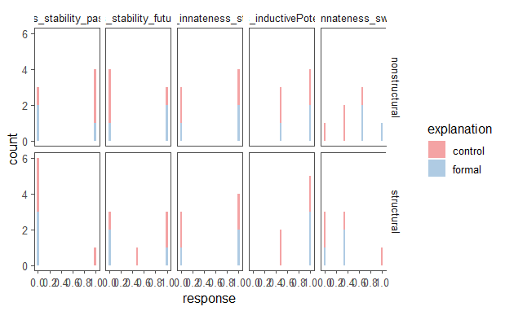
Pilot data by DV
Stability past | Stability future | Innateness stop | Inductive potential | Innateness switch

Slide 18
Ideas for changing study design
Ditch innateness stop DV – not differentiating, seems irrelevant
Add force-choice / open-ended explanation DV
Fiddle with stability and inductive potential wording to better tease apart essentialist vs structural thinking via environmental change
Shift from behavior to behavioral preference
eg “Suzy plays Yellow-Ball” to “Suzy likes to play Yellow-Ball”
Move to partially or totally within-subjects to maximize data/power
eg context – recess activity vs classroom activity
Notes:
- Ideas from meeting with Mike and Ellen yesterday

Slide 19
Add open-ended expl DV
 |  | Essentialist | Structural
Force-choice explanation | So, the girls in the girls’ classroom play Yellow-Ball a lot at their school, and the boys…. Is it because the girls like Yellow-Ball, or is it because it’s easier to throw the pebble in the yellow bucket? | Preference | Buckets
Stability past | Now, here’s a question for you: Suzy is 8 years old. Do you think she played Yellow-Ball when she was 4 years old? (Y/N) | Yes | Not same school: No Same school: Yes
Stability future | Do you think she will always play Yellow-Ball? (Y/N) | Yes | Not same school: No
Inductive potential | Do you think “just this girl,” “a few girls,” or “a whole lot of girls” play Yellow-Ball? | A whole lot | At this school: A whole lot Outside school: ?
Innateness switch | [Suzy goes to boys classroom] Which game do you think Suzy will play today? __ For sure __ or maybe __? | For sure Yellow-Ball | For sure Green-Ball
Vasilyeva
--- Muradoglu et al, submitted ---
Vasilyeva

Slide 20
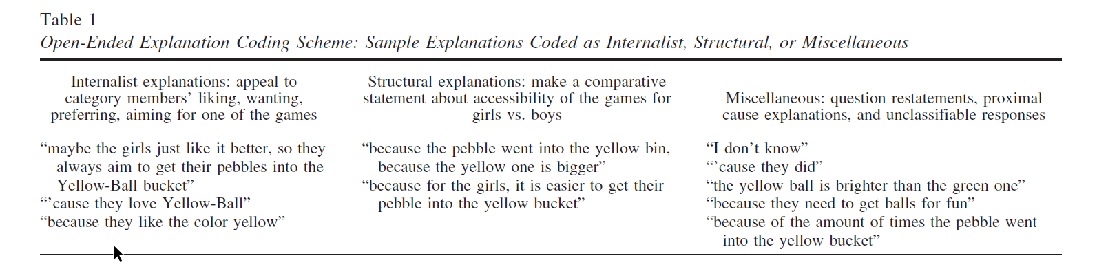
Add open-ended expl DV
Figure 2. Distribution of internalist and structural explanations generated in response to question about why girls play Yellow-Ball, as a function of framing condition and age group. Error bars represent 1 SEM.
Vasilyeva, Gopnik, Lombrozo 2018

Slide 21
Environmental change
 |  | Essentialist | Structural
Force-choice explanation | So, the girls in the girls’ classroom play Yellow-Ball a lot at their school, and the boys…. Is it because the girls like Yellow-Ball, or is it because it’s easier to throw the pebble in the yellow bucket? | Preference | Buckets
Stability past | Now, here’s a question for you: Suzy is 8 years old. Do you think she played Yellow-Ball when she was 4 years old? (Y/N) | Yes | Not same school: No Same school: Yes
Stability future | Do you think she will always play Yellow-Ball? (Y/N) | Yes | Not same school: No
Inductive potential | Outside of Kiki school, do you think “just this girl,” “a few girls,” or “a whole lot of girls” in the world play Yellow-Ball? | A whole lot | A few girls
Innateness switch | [Suzy goes to boys classroom] Which game do you think Suzy will play today? __ For sure __ or maybe __? | For sure Yellow-Ball | For sure Green-Ball
Vasilyeva
--- Muradoglu et al, submitted ---
Vasilyeva

Slide 22
New DVs!
 |  | Essentialist | Structural
Force-choice explanation | So, Suzy plays Yellow-Ball a lot at her school. Is it because Suzy likes playing Yellow-Ball, or is it because of the buckets in her classroom? (counter-balance this order?) OR So, the girls in the girls’ classroom play Yellow-Ball a lot at their school, and the boys in the boys’ classroom play Green-Ball a lot at their school. Is it because girls and boys like playing with different balls, or is it because of the buckets in their classrooms? | Preference | Buckets
Inductive potential – new category member | Here’s Lucy. Lucy is a girl who doesn’t go to Kiki school. She goes to another school. (show the balls, no buckets) What game do you think Lucy will play? ___ For sure __ or maybe __? | Yellow-Ball | Chance
Normative | Would it be okay or not okay for girls to play Green-Ball? OR Here’s Katie. Katie is a girl who plays Green-Ball. Is it okay or not okay for Katie to play Green-Ball? (okay/not okay) | Not okay | Okay
Innateness switch | [Suzy goes to boys classroom] Which game do you think Suzy will play today? ___ For sure __ or maybe __? | For sure Yellow-Ball | For sure Green-Ball
------------ New -------------
Vasilyeva et al

Slide 23
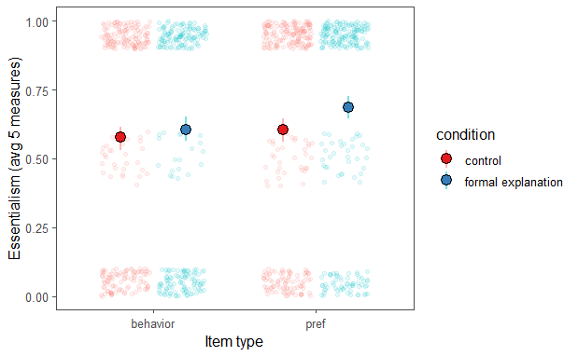
behavior vs behavioral preference
Behavioral preference has higher avg essentialism than behavior (F(1, 1856) = 5.88, p = 0.015)
No interaction of item type and condition on essentialism (F(1, 1856) = 1.36, p = 0.24)
Muradoglu, Marchak, Cimpian, Gelman, submitted to SRCD
Notes:
Reanalysis of Muradoglu et al data for gender
Behavior properties - rides on the white horse on merry-go-rounds, puts her left sock on first
Behavioral preference - likes books about a country called Switzerland, likes to eat gooseberries
No interaction of item type and condition on essentialism -> should be ok shifting to behavioral preference? Will just bring everyone up the same

