Slide 1
DenMARK - Semantics!
22 October 2015

Slide 2
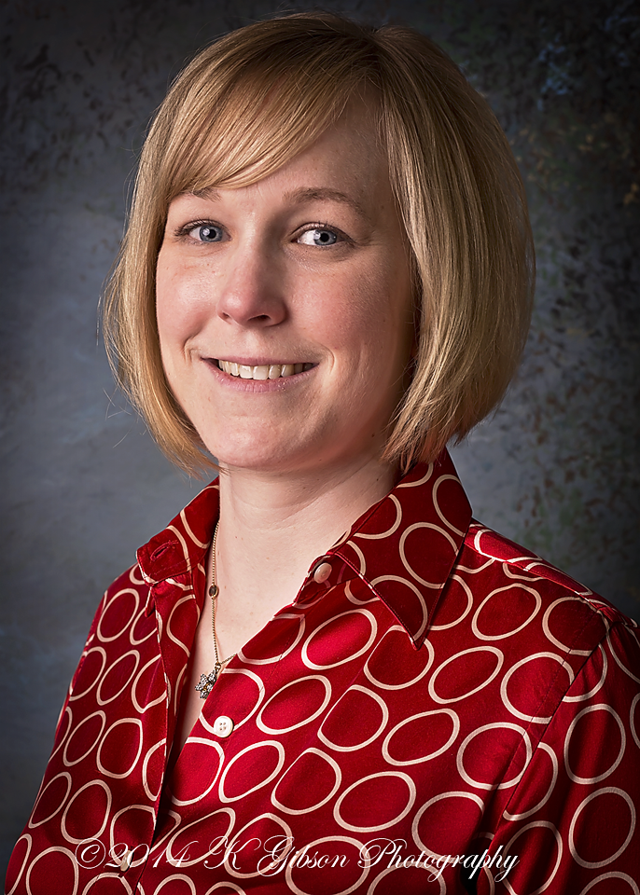
Today’s Presenter
Marianne Myers
Senior Field Engineer at MarkLogic
Previously:
Software Engineer at Northrop Grumman
QA Engineer at Vericept
Alumna of Colorado School of Mines and University of Arizona
Fun fact – Saw Autechre last weekend after being a fan for ~20 years
@mariannemyers

Slide 3
What you’ll see today
Let’s build a sample application that has contact data using the Vanguard team’s Slush Generator
We’ll ingest RDF triples about a recent semantic web conference using MarkLogic Content Pump (mlcp)
Then we’ll build a widget to show what roles the person has at the conference using a SPARQL query
In the end – you’ll see JSON data as the focus, with triples complementing it

Slide 4
What I skipped…
MacPro-2663:code mmyers$ mkdir meetup
MacPro-2663:code mmyers$ cd meetup/
MacPro-2663:meetup mmyers$ ls
MacPro-2663:meetup mmyers$ slush marklogic-node contacts
[slush] Using slushfile /usr/local/lib/node_modules/slush-marklogic-node/slushfile.js
[10:01:25] Starting 'marklogic-node:checkForUpdates'...
checking for latest version
[10:01:25] Finished 'marklogic-node:checkForUpdates' after 640 ms
[10:01:25] Starting 'marklogic-node:init'...
[?] MarkLogic version? (Use arrow keys)
❯ 8
7
6
5
MacPro-2663:meetup mmyers$ slush marklogic-node contacts
[slush] Using slushfile /usr/local/lib/node_modules/slush-marklogic-node/slushfile.js
[10:12:56] Starting 'marklogic-node:checkForUpdates'...
checking for latest version
[10:12:56] Finished 'marklogic-node:checkForUpdates' after 318 ms
[10:12:56] Starting 'marklogic-node:init'...
[?] MarkLogic version? 8
[?] MarkLogic Host? localhost

Slide 5
More of what I skipped…
[?] MarkLogic Admin User? admin
[?] Note: consider keeping the following blank, you will be asked to enter it at appropriate commands.
[?] MarkLogic Admin Password? admin
[?] Node app port? 9070
[?] MarkLogic App/Rest port? 8040
Retrieving Roxy script
Got Roxy script
chmod done; appName=contacts; mlVersion=8; appType=rest; branch=master
Spawning Roxy new command: ./ml new contacts --server-version=8 --app-type=rest --branch=master
Creating new Application: contacts...
Cloning into 'contacts'...
No initial source code is provided for non-MVC apps. You can capture code from a REST application, or add your own code.
done
done running ml new
Configuring Roxy
[10:13:22] Finished 'marklogic-node:init' after 26 s
[10:13:22] Starting 'marklogic-node:generateSecret'...
[10:13:22] Finished 'marklogic-node:generateSecret' after 209 μs
[10:13:22] Starting 'marklogic-node:configGulp'...
[10:13:22] Finished 'marklogic-node:configGulp' after 374 μs
[10:13:22] Starting 'marklogic-node:npmInstall'...

Slide 6
Now onto the demo!

