Slide 1
Chat implemented by using AKKA paradigm
Implementation of a GUI Chat/Chatroom
relying on AKKA paradigm
in a distributed system.

Slide 2
AKKA Paradigm
Actor Model: concurrency is message-based and asynchronous.
Location Transparency: no difference between local and remote actors.
Fault-Tolerance & Self-Healing: each actor is supervisioned by its parent.

Slide 3
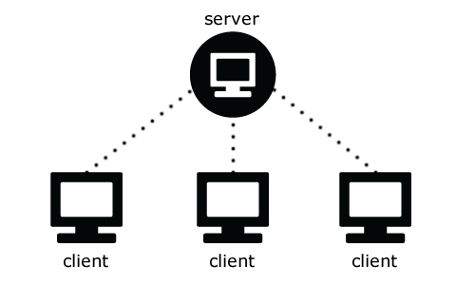
Architecture
Clients and Server are Remote Actors w.r.t. others.

Slide 4
Chatroom Behavior
Client sends a LoginRequest to the Server
Server handles the LoginRequest (ack/reject)
Client sends a message (to the Server)
Server relays to all the available Clients
Client Sends a LogoutRequest (disconnect/exit)
Server handles the LogoutRequest

Slide 5
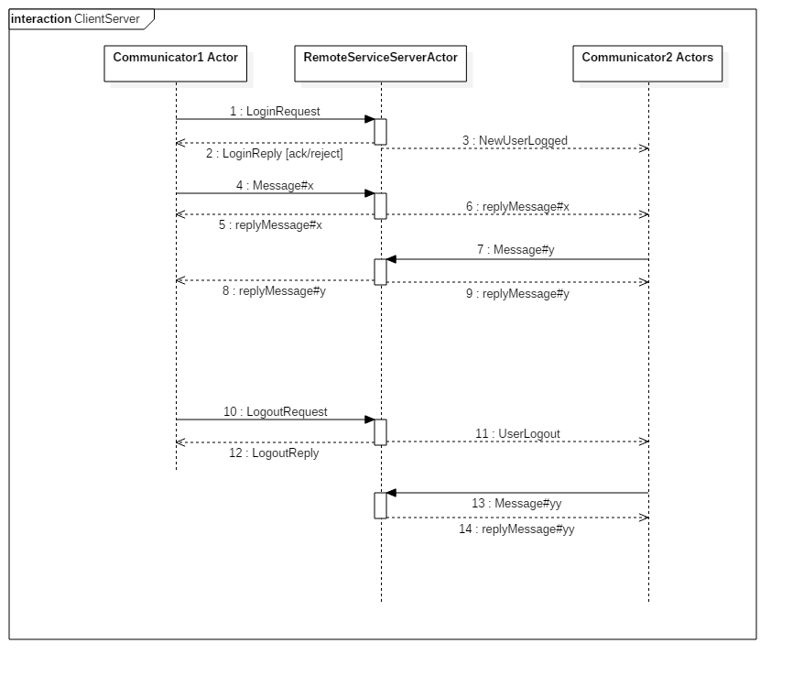

Slide 6
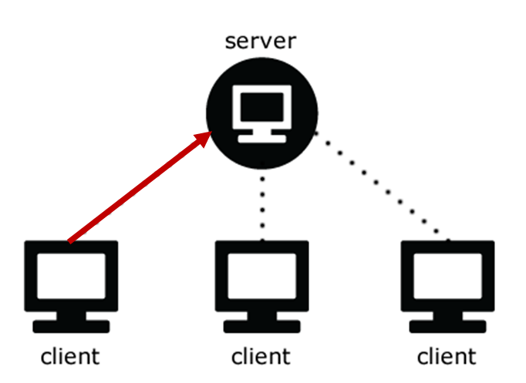
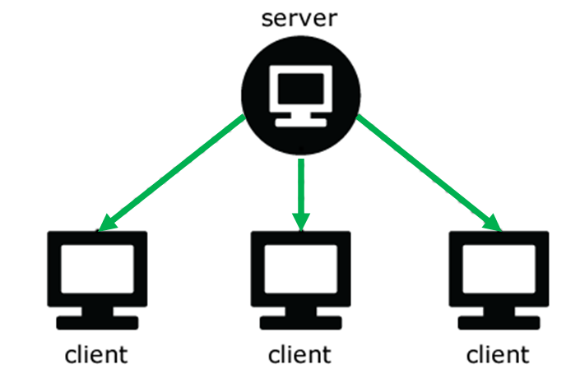

Slide 7
Chat 1 to 1 Behavior
Using the keywords /query nickname it’s possible to start a chat 1to1 with another Client
Client1 creates a SubActor and sends a RequestChat1to1 to the server
Server creates a SubActor that handles the communication and sends a Request to the Client2
Client2 creates a SubActor to support the Chat
When a Client abandons the chat all the SubActor related to that Client are killed.

Slide 8
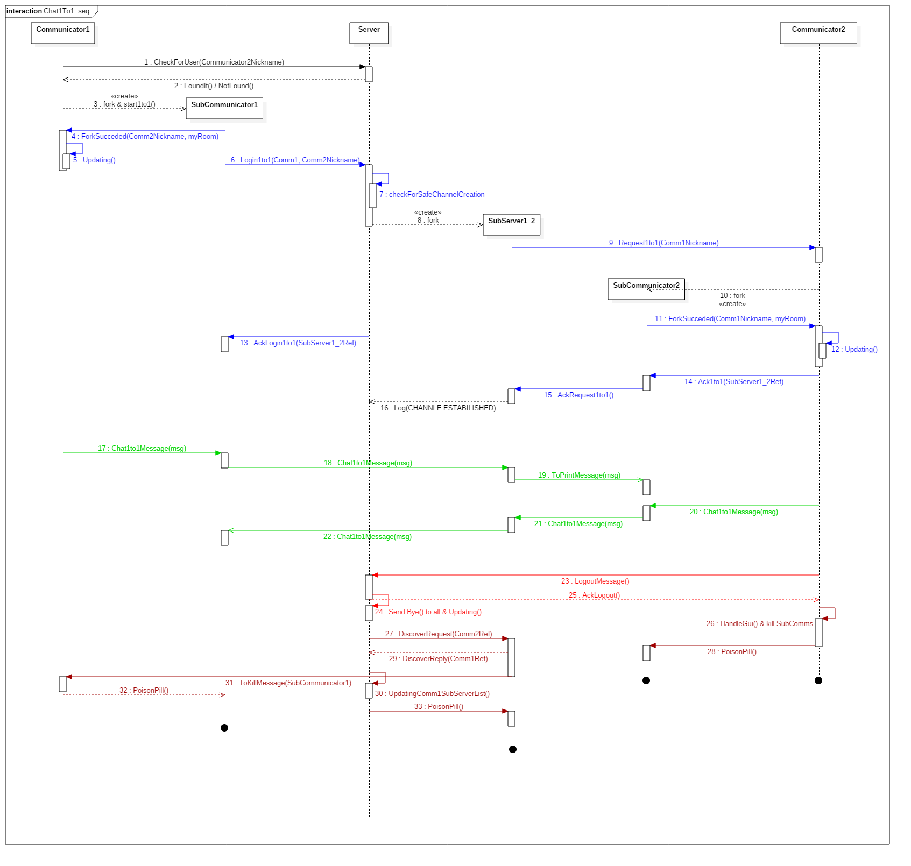

Slide 9
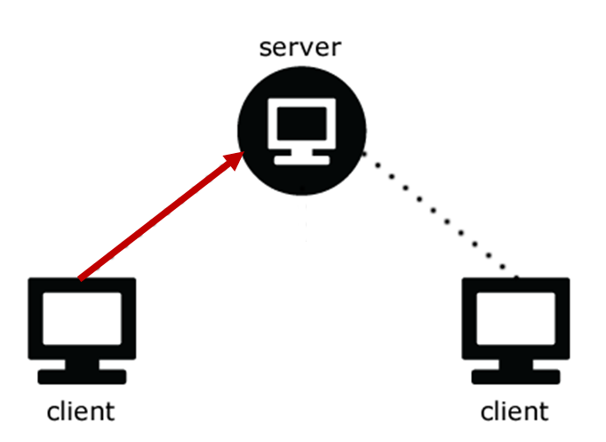
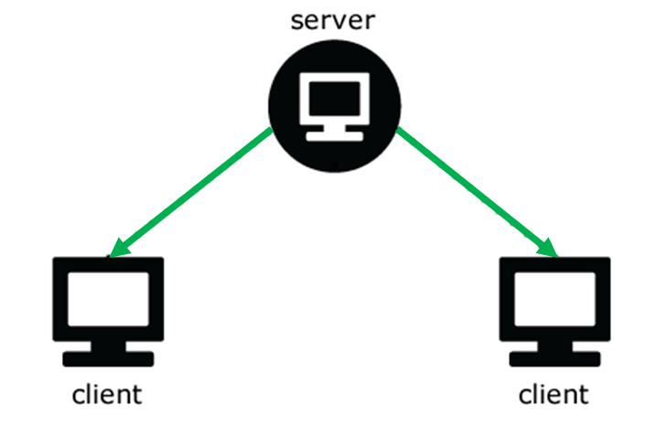

Slide 10
Conclusion
Actor paradigm provides a very efficient way to deal with message-driven applications based on the JVM.
At the same time the characteristics of being elastic and decentralized, extensible and resilient by design, make the deployment much easier for the programmer.

