Slide 1

PROJECT – THE CARREFOUR
Mariano Basile Angelo Buono Corrado De Sio

Slide 2
ASSESS THE EFFECTIVENESS OF TWO DIFFERENT CHECKOUT POLICIES ENFORCED IN A SUPERMARKET
More in detail:
a) Make a single queue and send the head-of-line to the first idle till (assuming a supermarket has n tills).
b) Allow each open till to manage its own (FIFO) queue. In this case, customers are expected to queue up at the till with the shortest queue (ties are broken arbitrarily). Under option a) it's necessary to take into account that a customer in order to reach the first idle till - say till j - spends j*Δ units of time during which the till remains idle.

Slide 3
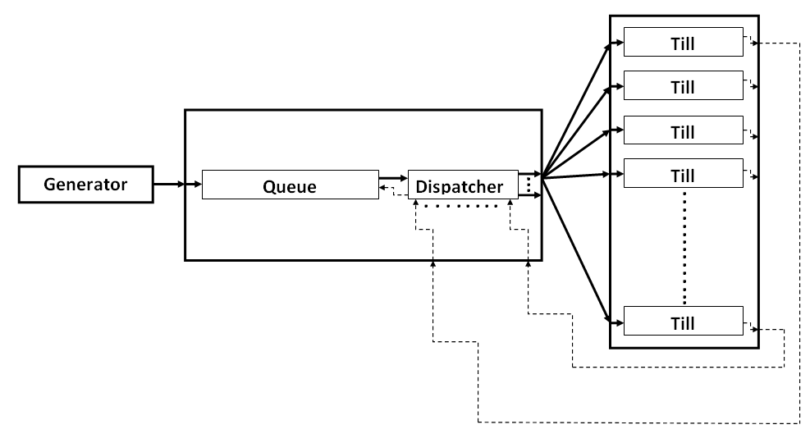
POLICY MODEL (A)
Policy A: One single queue and N tills. Delay equals to j*Δ units of time in order to reach (say) till #j.

Slide 4
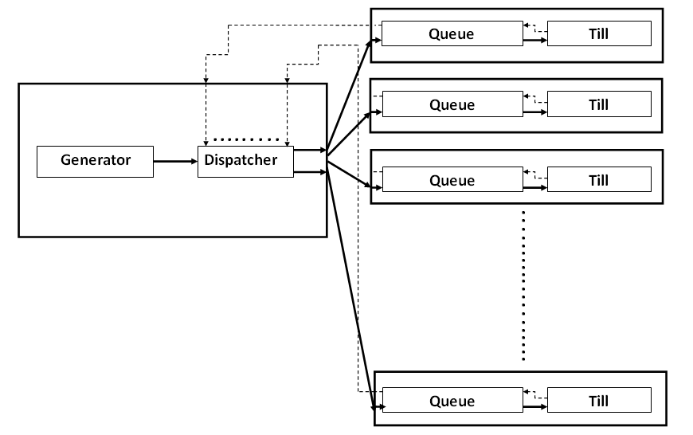
POLICY MODEL (B)
Policy B:
Each till has its own queue.

Slide 5
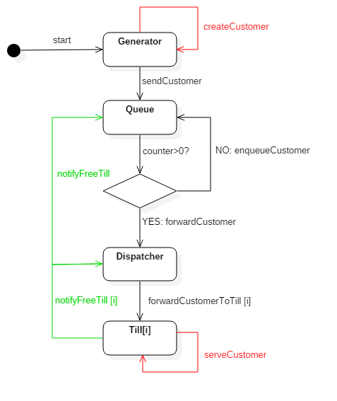
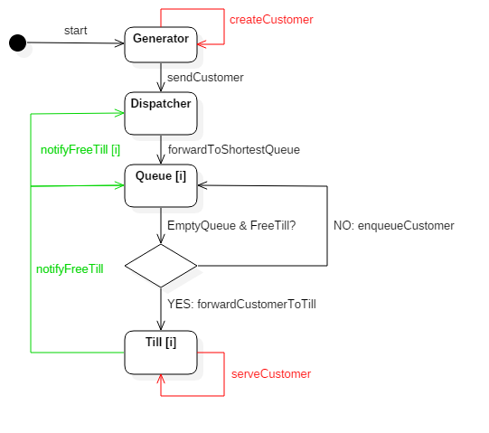
IMPLEMENTATION
Policy A
Policy B

Slide 6
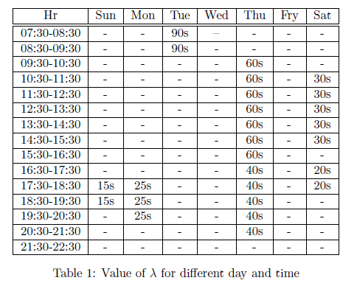
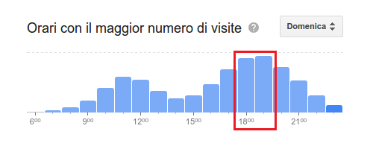
PARAMETERS, FACTORS (AND GOOGLE DATA)
FACTORS:
Arrival Rate (mean value)
Service Rate (mean value, standard deviation)
PARAMETERS:
Number of Tills
Delay
We relied on some data provided by Google: this data show information about past visits at the Carrefour located in San Giuliano Terme ,(Pisa). Our idea was to use this data in order
to calibrate in a real manner our simulations. Data covered a whole week visit.

Slide 7
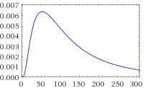
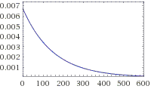
PDFs
Lognormal Distribution of Service Times (4.664061704, 0.832554611)
Exponential Distribution of Service Times (1/150)

Slide 8
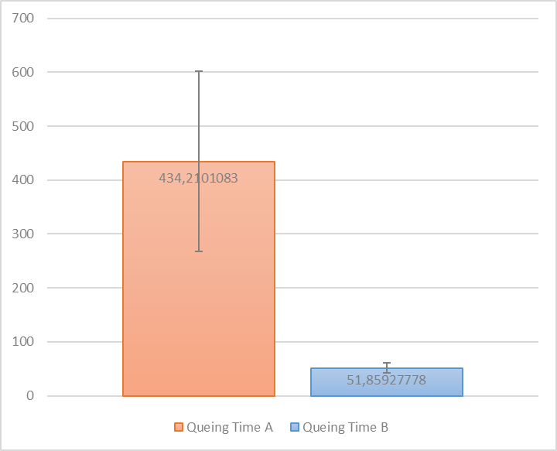
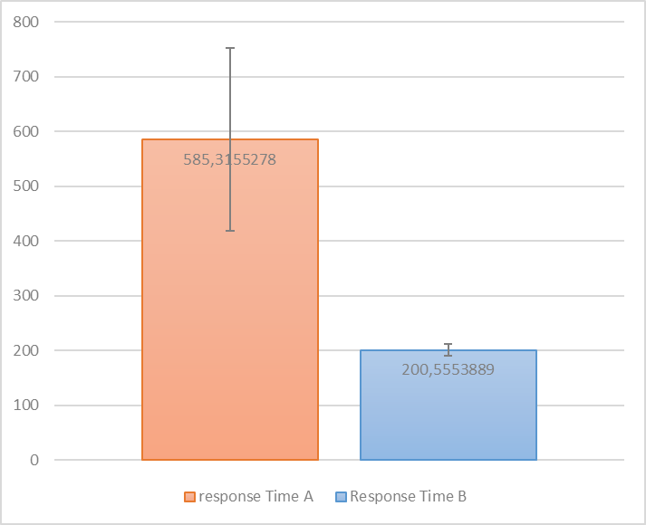
Exponential Distribution Of Inter-arrival Times Exponential Distribution Of Service Demands
Calibration: λ = 15s μ = 150s n = 12
Δ = 4s
Calibration: λ = 15s μ = 150s n = 12
Δ = 4s
E[Wa] | E[Wb] | E[Wa] / E[Wb] | E[Ra] | E[Rb] | E[Ra] / E[Rb]
434,21 | 51,85 | 8,37 | 585,31 | 200,55 | 2,91

Slide 9
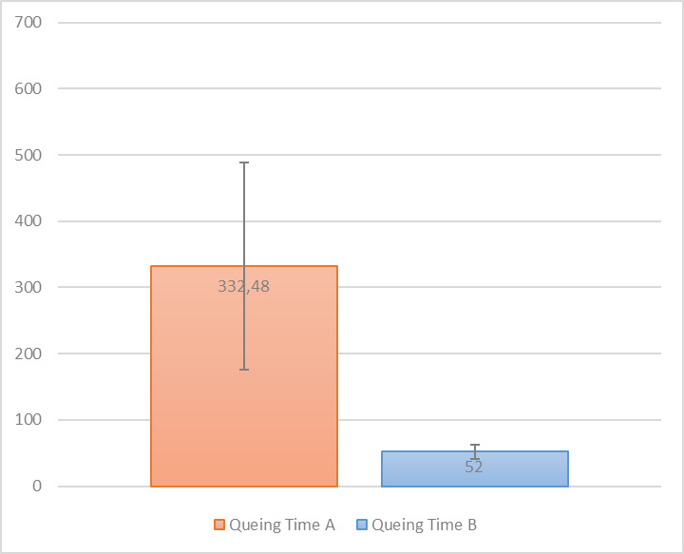
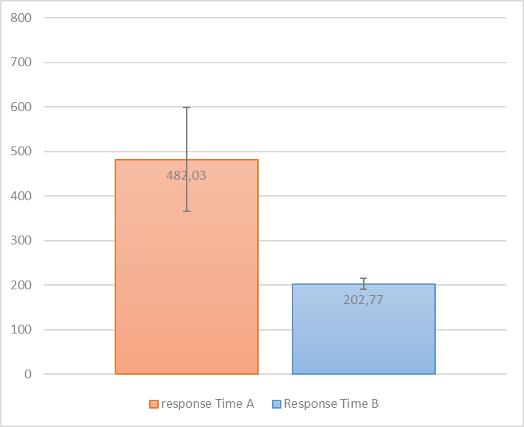
Exponential Distribution Of Inter-arrival Times Lognormal Distribution Of Service Demands
Calibration: λ = 15s μ = 4.66s
σ = 0.83s n = 12
Δ = 4s
Calibration: λ = 15s μ = 4.66s
σ = 0.83s n = 12
Δ = 4s
E[Wa] | E[Wb] | E[Wa] / E[Wb] | E[Ra] | E[Rb] | E[Ra] / E[Rb]
332,48 | 52 | 6,39 | 482,03 | 202,77 | 2,38

Slide 10
CONCLUSION
As soon as the flow of the incoming customers grows up which in turn means as soon as the expected value of the exponential distribution of inter-arrival times decreases, in order to have a positive recurrent system ( ρ < 1 ) we need to increase n. Under policy a) when n increases Δ delay has a big impact on system's performance. A customer in order to reach the first idle till, suppose till #n, has to waste a time equals to n*Δ, and this means that as n increases this time will increase too.
In the most “critical” simulation Policy A experiences a queueing time 8,37 times greater than Policy B.
(You’ll wait in the queue almost 8 minutes instead of 1 minute!)

