Slide 1

Threat Assessment & Remediation Analysis (tara)
The SAPIENT case of study
Mariano Basile Angelo Buono Corrado De Sio

Slide 2

What does SAPIENT Stand For?
“ Satellite and terrestrial architectures improving performance,
security and safety in ATM ”.
Which are its Objectives?
SAPIENT is a client-server application for air-traffic control aimed
at building a 4D map of environmental conditions of the sky and
sending air-traffic management (ATM) commands to aircrafts.

Slide 3
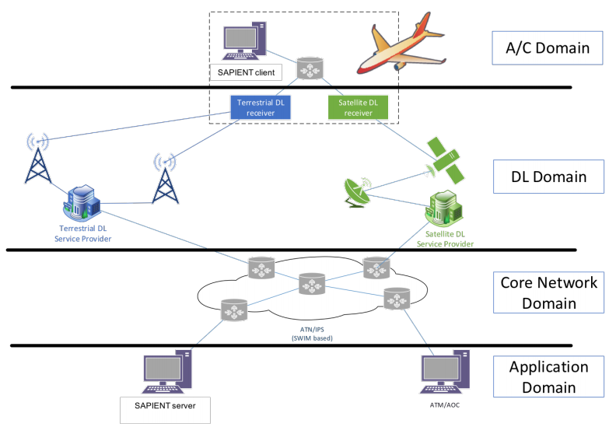
High level System overview

Slide 4
Main Actors Involved
Sapient Server (including Sapient 4D-MAP DB): A SAPIENT server uses monitored data, possibly received from aircrafts, to build a 4D map of environmental conditions of the sky to support air-traffic management (ATM).
ATM/AOC machines: Used to send ATM command to aircrafts.
ATN/IPS network: IPv6 routers, that are used to provide connectivity for the ground network.
Radio channel – Satellite channel: ground-to-air (and viceversa) data links that can be used to transport both SAPIENT and ATM/AOC data.
Airborne router: It is used to provide connectivity for the air-traffic control domain (e.g for the SAPIENT client to let it transmit sensed data).
Sapient client: Usually during a flight a SAPIENT client peer monitors the surrounding conditions of the sky from several viewpoints, including weather and communication quality and then reports sensed data to a SAPIENT.

Slide 5
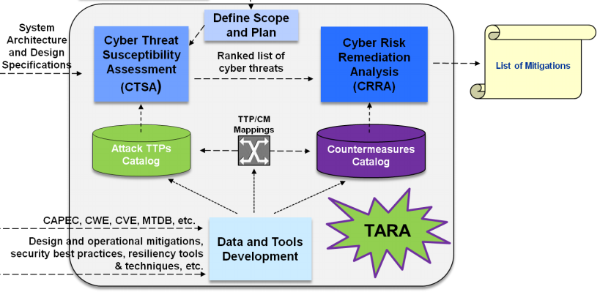
Threat Assessment & Remediation Analysis (tara)
TARA is a methodology to:
Identify, prioritize cyber threats
Respond through the application of countermeasures

Slide 6
Assessment Methodology
TARA assessments are conducted on selected cyber assets.
“A cyber asset is defined as any IT asset used to store, transport, and/or process
information within an enterprise”.
The objectives of a TARA assessment are:
To identify and prioritize high-risk adversarial Tactics, Techniques, Procedures (TTPs);
To identify and prioritize effective countermeasures (CMs) against those TTPs;
To recommend CMs that can reduce the susceptibility of a cyber asset to attacks;
Each TARA assessment is comprised of two analysis steps:
Cyber Threat Susceptibility Assessment (CTSA);
Cyber Risk Remediation Analysis (CRRA);

Slide 7
Cyber Threat Susceptibility Assessment (CTSA)
“CTSA quantitatively assesses a system’s inability to resist to cyber
attacks over a range of adversary TTPs.”
CTSA consists of the following steps:
Establish assessment scope;
Identify candidate TTP;
Eliminate implausible TTPs;
Apply scoring model;
Construct the threat matrix;

Slide 8
Establish Assessment Scope (I)
The scope of CTSA is defined in terms of the cyber assets evaluated against a
specified range of TTPs.
The following assumptions have been made on the system:
We do not consider ATM/AOC machines since control towers already made full use. Because of that we can suppose that some form of security already exists.
We’ve assumed the ATN/IPS network is either a private network or the 'public' Internet but in which some secure form of communication have been implemented (e.g VPN, IPSEC, SSL, etc) Appropriate security policies have been applied too.
If the assumption of trusted airline pilots holds then the Sapient client can also be considered a trusted source of information.
The radio channel and the satellite channel transmit info in clear.

Slide 9
Establish Assessment Scope (II)
In our scenario we’ve found:
3 Cyber Assets;
15 TTPs selected from the open source Capec catalog;
(http://capec.mitre.org/).
Cyber Assets Identified:
Sapient Server
Radio channel – Satellite channel
Airborne router

Slide 10
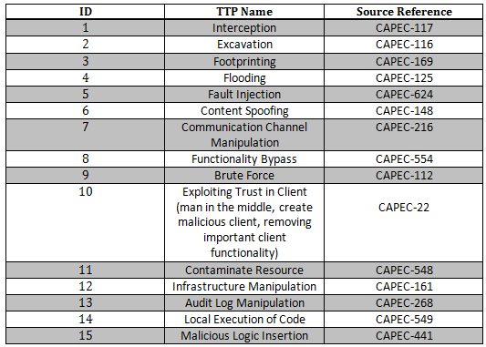
Range of Selected TTPs

Slide 11
TTP Risk Scoring
Candidate TTPs are then ranked using a scoring model.
The TTP scoring model assesses the risk associated with each TTP based on a range of criteria. For each TTP, the score (1 to 5) assigned to each criteria only considers the attack’s success onto the system: NO MATTER WHERE. (i.e. the susceptible cyber assets which may be involved).
The risk score associated to each TTP is then computed as the scores’ average assigned to each TTP’s criteria.
This ranking helps set priorities on where to apply security measures to reduce the system’s susceptibility to cyber attack.

Slide 12
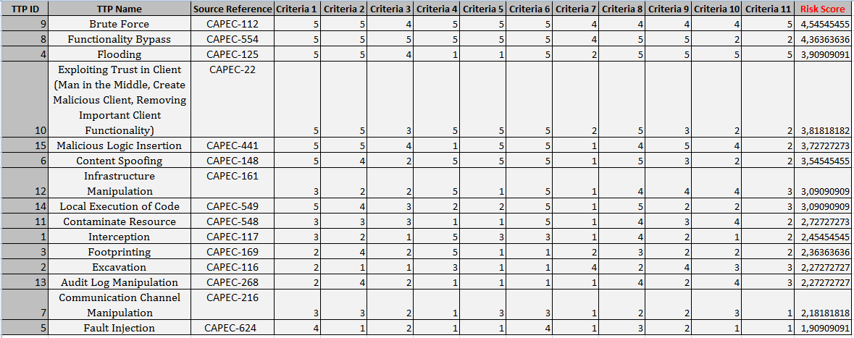
Sapient TTP Risk Scoring

Slide 13
Sapient Threat Matrix
CTSA produces a Threat Matrix: “ The latter is generated by using the (already computed) TTP Risk Scoring, which lists plausible TTPs ranked by decreasing risk score and their mapping to cyber assets as a function of adversary type (External, Insider, Trusted Insider) . If a cyber asset is susceptible to a TTP, its risk score is transferred to that cyber asset”.
The Threat Matrix is also useful to tabulate an aggregate susceptibility to cyber attacks for each cyber asset considered in the assessment.
This matrix is used in the follow-on Cyber Risk Remediation Analysis (CRRA) to identify potential mitigation strategies to address TTP susceptibilities.

Slide 14
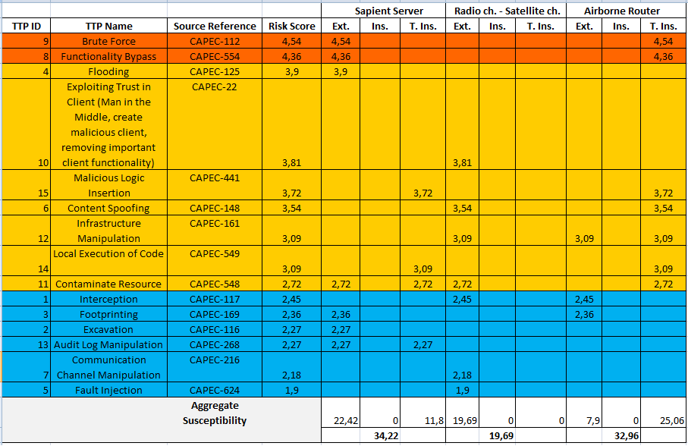
Sapient Threat Matrix

Slide 15
Cyber Risk Remediation Analysis (CRRA)(I)
“ Cyber Risk Remediation Analysis (CRRA) is an approach for selecting
countermeasures (CMs) to reduce a cyber asset’s susceptibility to attack over a
range of TTPs.”
CRRA is performed separately for each cyber asset and consists of
the following steps:
Select which TTPs to mitigate
Identify plausible countermeasures
Assess countermeasure merit
Identify an optimal CM solution
Prepare recommendations

Slide 16
Cyber Risk Remediation Analysis
(CRRA)(II)
The first step is to select a list of TTPs to mitigate.
CRRA employs a TTP/CM mapping table to represent the many-to-many
mapping between TTPs and countermeasures (CMs).
In a TTP/CM mapping table, each row corresponds to a countermeasure and each column corresponds to a TTP. Each mapping of CM to TTP is characterized by the mitigation effectiveness of the CM.
A 2-character notation is used to represent mitigation effectiveness within the mapping table, where the first character signifies the type of mitigation from the list: (N)eutralize, (D)etect, (L)imit and (R)ecover. The second character represents the degree of effectiveness from the list: (L)ow, (M)edium, (H)igh, and (V)ery high.

Slide 17
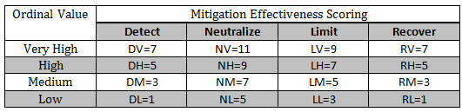
Cyber Risk Remediation Analysis
(CRRA)(III)
The objective of CRRA is to identify an optimal list of CMs for a
specified range of TTPs:
The approach calculates a utility/cost (U/C) ratio for each CM and uses these U/C ratios to rank CMs based on their relative merit.
To assess the utility of each CM, a score is assigned to each mitigation effectiveness:
The utility of each CM can now be calculated by summing the scores over the range of TTPs mitigated.
The cost of a CM should consider the cost to develop, integrate, and maintain the CM over the operational life of the system. The cost’s valuation is mapped to a linear scale of [1...5] in order to be used to calculate U/C ratios.

Slide 18
Cyber Risk Remediation Analysis
(CRRA)(IV)
A CM Ranking Table can facilitate the calculation of U/C ratios over the range of CMs identified in a TTP/CM mapping table:
The table is constructed by inverting the contents of the TTP/CM mapping table and adding some columns to tabulate the CM merit scoring.
The last step to construct this table is to order the rows by decreasing U/C ratio.
An optimal CM solution is the set of CMs that provides effective mitigation over a specified range of TTPs at the lowest cost.
What constitutes "effective mitigation" is determined by a CM selection strategy. A CM selection strategy establishes a basis for filtering the range of potential solutions.
For example, a CM selection strategy could require that the following conditions hold:
At least one highly effective CM must be selected for TTP. (it is the one that has been chosen for SAPIENT)
Less effective CMs may be combined to satisfy #1.
A Detect CM is required for TTPs that have no Neutralize CMs.

Slide 19
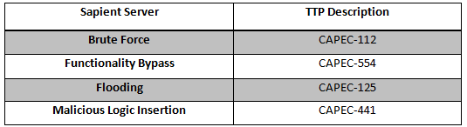
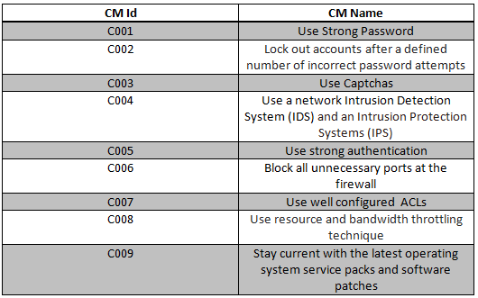
Applying CRRA To Sapient:
Sapient Server (I)
TTPs to mitigate:
Candidate CMs:

Slide 20
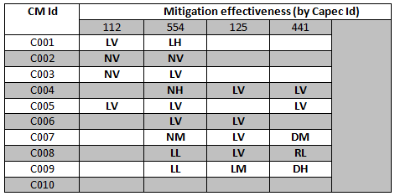
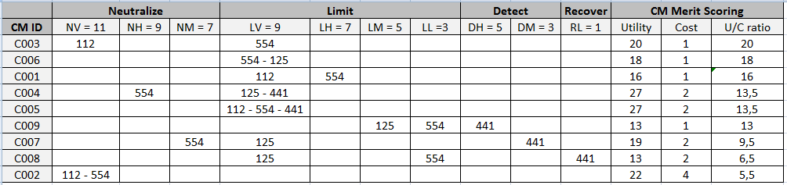
Applying CRRA To Sapient:
Sapient Server (II)
TTP/CM Mapping table:
CM Ranking Table:

Slide 21

Applying CRRA To Sapient:
Sapient Server (III)
Identify an Optimal CM solution set :
Tara Recommendations:
Use strong authentication mechanism: This countermeasure is high effective at limiting functionaly bypass attacks, malicious logic insertion (malicious software insertion) and brute force attacks too.
Use strong passwords: This is another common countermeasure which results very effective at limiting brute force attacks.
Use a network Intrusion Detection System (IDS) and an Intrusion Protection Systems (IPS): This countermeasure is high effective at limiting functionaly bypass attacks, flooding attacks and malicious logic insertion (again malicious software insertion) attacks too.
Block all unnecessary ports at the firewall: This countermeasure is high effective at limiting functionaly bypass attacks and flooding attacks too.

Slide 22
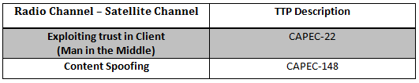

Applying CRRA To Sapient:
Radio channel – satellite Channel (I)
TTPs to mitigate:
Candidate CMs:

Slide 23


Applying CRRA To Sapient:
Radio channel – satellite Channel (II)
TTP/CM Mapping table:
CM Ranking Table:

Slide 24

Applying CRRA To Sapient:
Radio channel – satellite Channel (III)
Identify an Optimal CM solution set :
Tara Recommendations:
Use criptography: This countermeasure is high effective at neutralizing Man in the Middle and Content Spoofing attack. If data are encrypted after leaving the ATN/IPS network, the attacker can still intercept them but cannot read it or alter it.
Use Hashed Message Authentication Codes (HMACs): This countermeasure is also high effective at neutralizing Man in the Middle and Content Spoofing attack. If an attacker alters the message, the recalculation of the HMAC at the recipient fails and the data can be rejected as invalid.

Slide 25
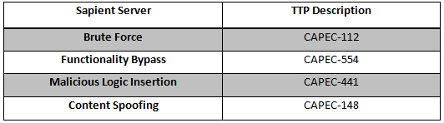
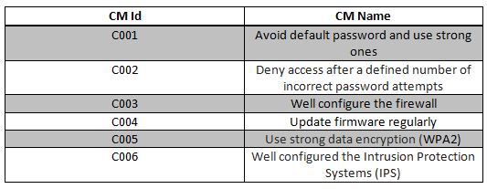
Applying CRRA To Sapient:
Airborne Router (I)
TTPs to mitigate:
Candidate CMs:

Slide 26
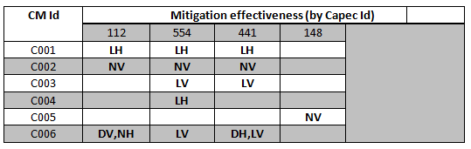
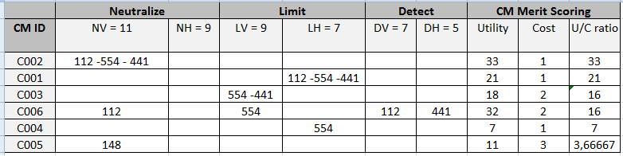
Applying CRRA To Sapient:
Airborne Router (II)
TTP/CM Mapping table:
CM Ranking Table:

Slide 27

Applying CRRA To Sapient:
Airborne Router (III)
Identify an Optimal CM solution set :
Tara Recommendations:
Avoid default password. Use strong ones: This countermeasure is high effective at limiting Brute Force attacks for password cracking. Using default login (username/password combination), gives the attacker a head start.
Deny access after a defined number of incorrect password attempts: Apply lockout policies limit the number of retry attempts that can be used to guess the password.
Use strong data encryption: This countermeasure is high effective at neutralizing Content Spoofing attacks. A data encryption protocol as WPA2 allows to encrypt data as it travels in and out of the airborne, making it much more difficult to be read or altered by an attacker.
Well configured the Intrusion Protection Systems (IPS).

