Slide 1
SBLWT: A Secure Blockchain Lightweight Wallet Based on Trustzone Weiqi Dai; Jun Deng; Qinyuan Wang; Changze Cui; Deqing Zou; Hai Jin
Paper Analysis
EECE 7390 – Computer Hardware Security
Mariano Marufo da Silva

Slide 2
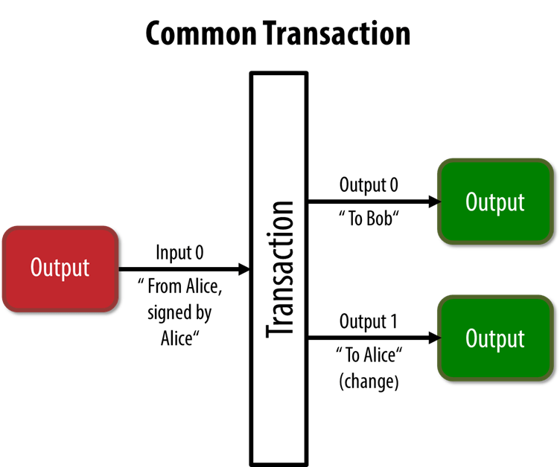
Anatomy of a Bitcoin Transaction
Antonopoulos, Andreas M. Mastering Bitcoin: Programming the open blockchain. " O'Reilly Media, Inc.", 2017.
Notes:
Simplest BTC Tx
Created in Alice’s wallet, using:
Alice’s unspent address (output from a previous transaction)
Bob’s Address
Alice’s change address
Signed by Alice with her private key

Slide 3
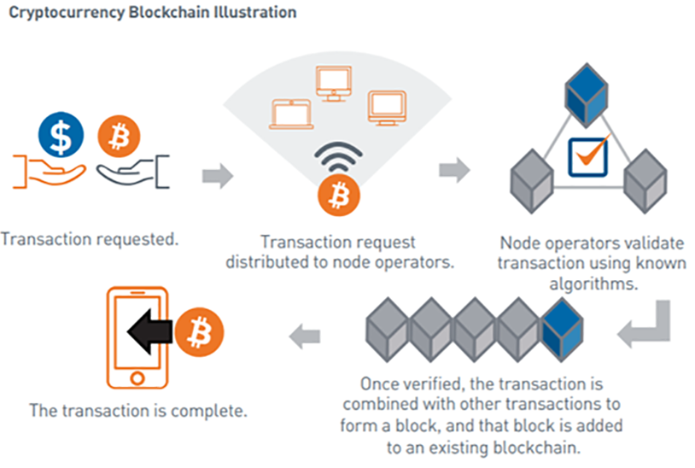
Anatomy of a Bitcoin Transaction
Adapted from: https://blogs.cfainstitute.org/investor/2021/06/22/down-the-rabbit-hole-a-cryptocurrency-primer/
Notes:
Blockchain: sequence of blocks that contain all the transactions in the bitcoin network.

Slide 4
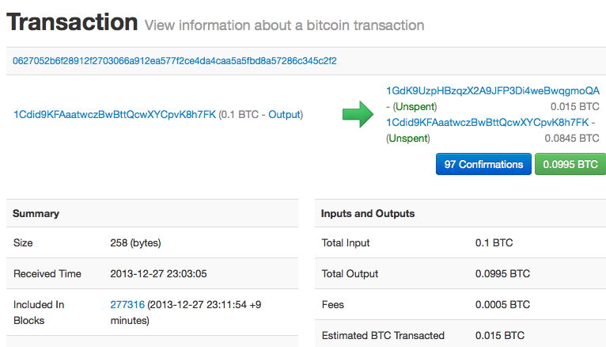
Anatomy of a Bitcoin Transaction
Antonopoulos, Andreas M. Mastering Bitcoin: Programming the open blockchain. " O'Reilly Media, Inc.", 2017.
Notes:
Example from a blockchain explorer.

Slide 5
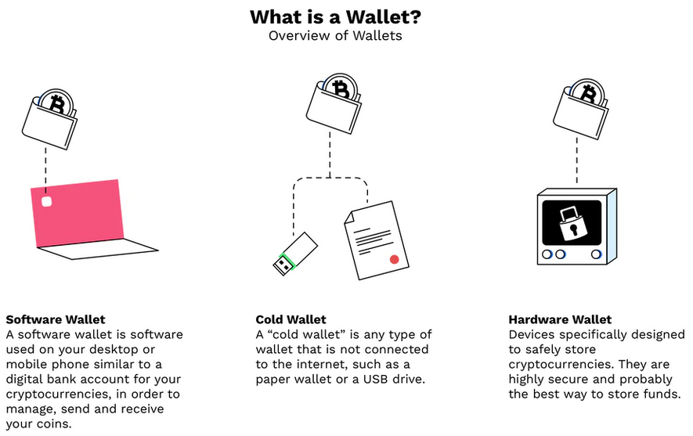
Bitcoin Wallets
Adapted from: https://www.bitpanda.com/academy/en/lessons/what-is-a-wallet-and-how-do-i-get-one/
Notes:
Wallets are used to easily view and transact the user’s bitcoins.
Main functions:
Safely create and store private keys
Safely create and store addresses
Display user’s balance
Sign and verify transactions
Private keys (stored in and handled by the wallets) provide control/ownership: “Not your keys, not your coins”. Private keys security is extremely important.

Slide 6
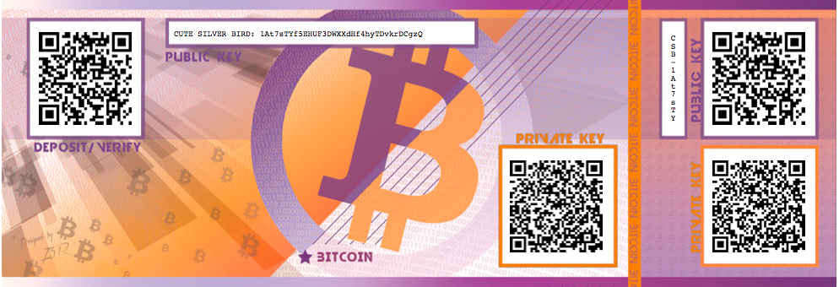
Bitcoin Wallets
Antonopoulos, Andreas M. Mastering Bitcoin: Programming the open blockchain. " O'Reilly Media, Inc.", 2017.
Notes:
Paper wallets, now legacy, but we can see: address, private key

Slide 7
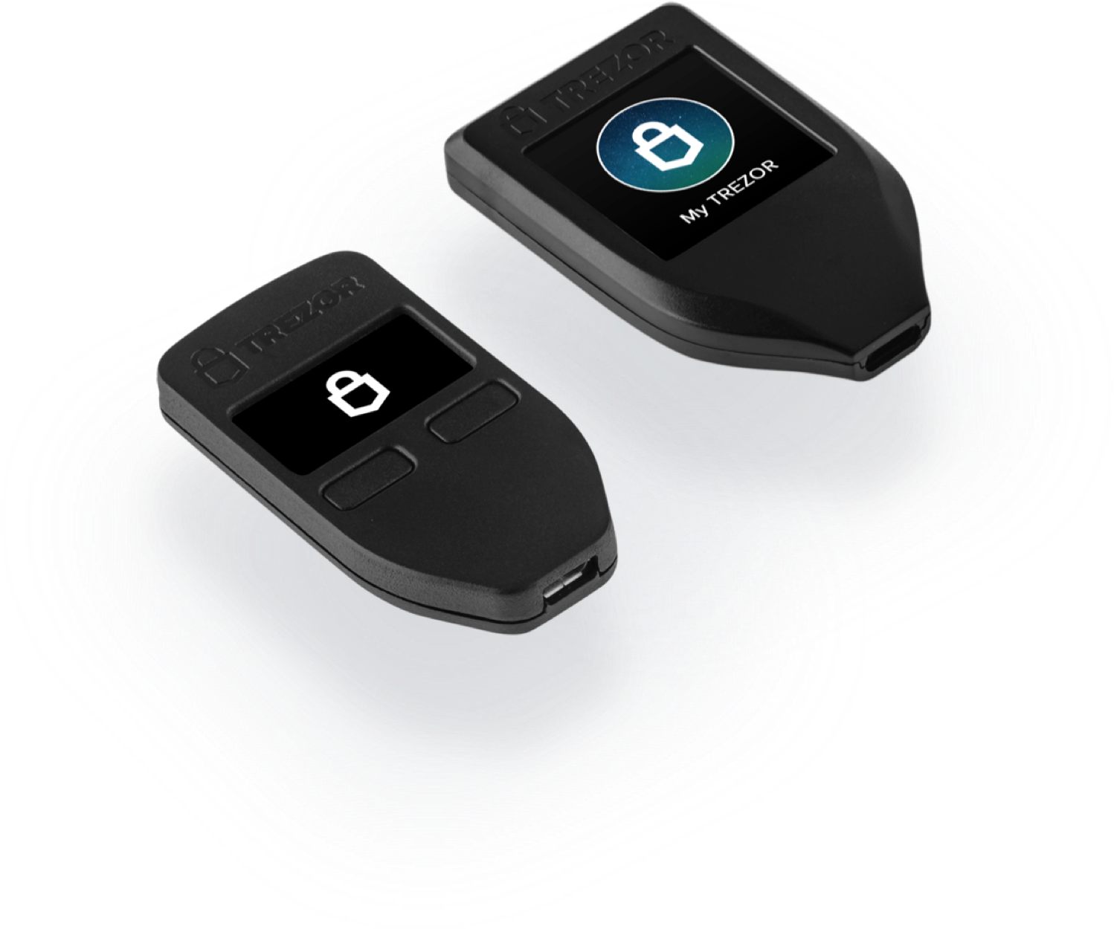
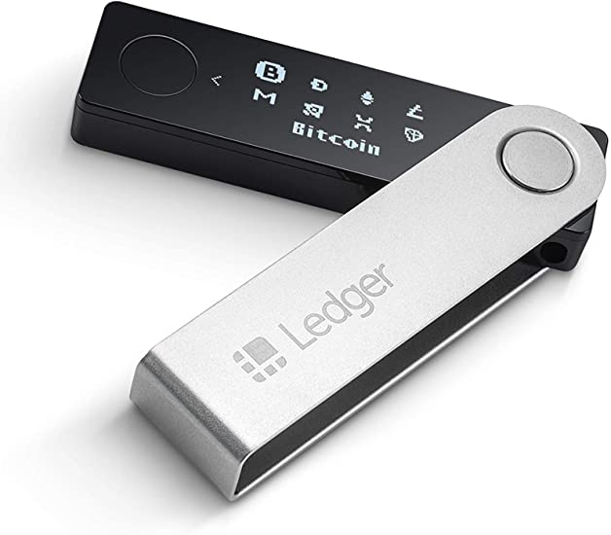
Hardware Wallets
Private Keys are generated offline, in the device, and they never leave it
Connected to the user’s computer (connected to the bitcoin network) to send transactions:
It creates the transaction and signs it (using the private key) and sends it to the computer
The computer broadcasts the transaction to the bitcoin network

Slide 8
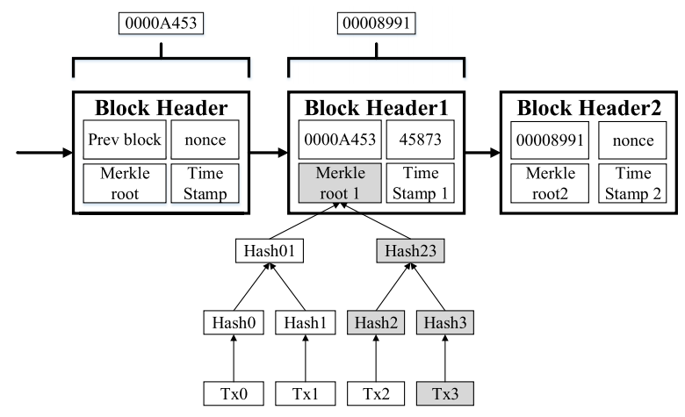
Merkle Trees
Notes:
A block (1 MB) contains mainly transactions (most of the size), plus a block header (81 bytes).
Merkle tree: each leaf is a transaction, which are hashed and the hashes are hashed together forming a tree. The root of the hashes (Merkle root) is stored in the block header.

Slide 9
Software Wallets: full vs. lightweight nodes
Node | Full | Lightweight (SPV)
Storage
Security
Size

Slide 10
Software Wallets: full vs. lightweight nodes
Node | Full | Lightweight (SPV)
Storage | Complete Blockchain | Only block headers
Security
Size
Notes:
SPV wallets store only the block headers.

Slide 11
Software Wallets: full vs. lightweight nodes
Node | Full | Lightweight (SPV)
Storage | Complete Blockchain | Only block headers
Security | Trustless | Requires info from a third party full-node
Size
Notes:
SPV wallets: During a transaction they request to the remote full-node the Merkle branch linking the transaction to the block where it is located.
To verify the provided information, it then compares the Merkle root provided by the full-node with the one stored locally in its block header.

Slide 12
Software Wallets: full vs. lightweight nodes
Node | Full | Lightweight (SPV)
Storage | Complete Blockchain | Only block headers
Security | Trustless | Requires info from a third party full-node
Size | 360 GB | ~100 MB

Slide 13
Software Wallets: full vs. lightweight nodes
Node | Full | Lightweight (SPV)
Storage | Complete Blockchain | Only block headers
Security | Trustless | Requires info from a third party full-node
Size | 360 GB | ~100 MB
SPV Wallets are more portable, but:

Slide 14
Software Wallets: full vs. lightweight nodes
Node | Full | Lightweight (SPV)
Storage | Complete Blockchain | Only block headers
Security | Trustless | Requires info from a third party full-node
Size | 360 GB | ~100 MB
SPV Wallets are more portable, but:
Privacy risk when the wallet requests info to the full-node

Slide 15
Software Wallets: full vs. lightweight nodes
Node | Full | Lightweight (SPV)
Storage | Complete Blockchain | Only block headers
Security | Trustless | Requires info from a third party full-node
Size | 360 GB | ~100 MB
SPV Wallets are more portable, but:
Privacy risk when the wallet requests info to the full-node
Private keys storage is cryptographically protected, but they may still be stolen when using them

Slide 16
Software Wallets: full vs. lightweight nodes
Node | Full | Lightweight (SPV)
Storage | Complete Blockchain | Only block headers
Security | Trustless | Requires info from a third party full-node
Size | 360 GB | ~100 MB
SPV Wallets are more portable, but:
Privacy risk when the wallet requests info to the full-node
Private keys storage is cryptographically protected, but they may still be stolen when using them
An attacker could tamper the transaction’s output address and send the money to their own wallet

Slide 17
SBLWT
Secure Blockchain Lightweight Wallet Based on Trustzone
Design Objectives
More portable than Hardware Wallets and safer than SPV Wallets
Notes:
Hardware Wallets are safe but users need to carry an extra device, SPV wallet is convenient but not totally safe.

Slide 18
SBLWT
Secure Blockchain Lightweight Wallet Based on Trustzone
Design Objectives
More portable than Hardware Wallets and safer than SPV Wallets
Private Keys should be isolated and protected
Their generation and storage should be safe and reliable

Slide 19
SBLWT
Secure Blockchain Lightweight Wallet Based on Trustzone
Design Objectives
More portable than Hardware Wallets and safer than SPV Wallets
Private Keys should be isolated and protected
Their generation and storage should be safe and reliable
Addresses: should be real and valid
Their generation and display should be isolated and secure

Slide 20
SBLWT
Secure Blockchain Lightweight Wallet Based on Trustzone
Design Objectives
More portable than Hardware Wallets and safer than SPV Wallets
Private Keys should be isolated and protected
Their generation and storage should be safe and reliable
Addresses: should be real and valid
Their generation and display should be isolated and secure
Transaction: their verification process should be protected
Verification should be kept away from the Rich OS and guarantee the secrecy of the block headers
Notes:
Secrecy?? They are public…

Slide 21
Threat Model
Rich OS or its applications could be malicious

Slide 22
Threat Model
Rich OS or its applications could be malicious
Threats:
Stealing and tampering sensitive resources (private/public keys, transactions, addresses, etc.)

Slide 23
Threat Model
Rich OS or its applications could be malicious
Threats:
Stealing and tampering sensitive resources (private/public keys, transactions, addresses, etc.)
Tampering the static image of SBLWT

Slide 24
Threat Model
Rich OS or its applications could be malicious
Threats:
Stealing and tampering sensitive resources (private/public keys, transactions, addresses, etc.)
Tampering the static image of SBLWT
Denial-of-Service Attack

Slide 25
Assumptions
Information obtained from the full-nodes is reliable

Slide 26
Assumptions
Information obtained from the full-nodes is reliable
Trustzone is secure and reliable

Slide 27
Assumptions
Information obtained from the full-nodes is reliable
Trustzone is secure and reliable
Both sides (sender & receiver) of the transaction have a trusted execution environment with Trustzone

Slide 28
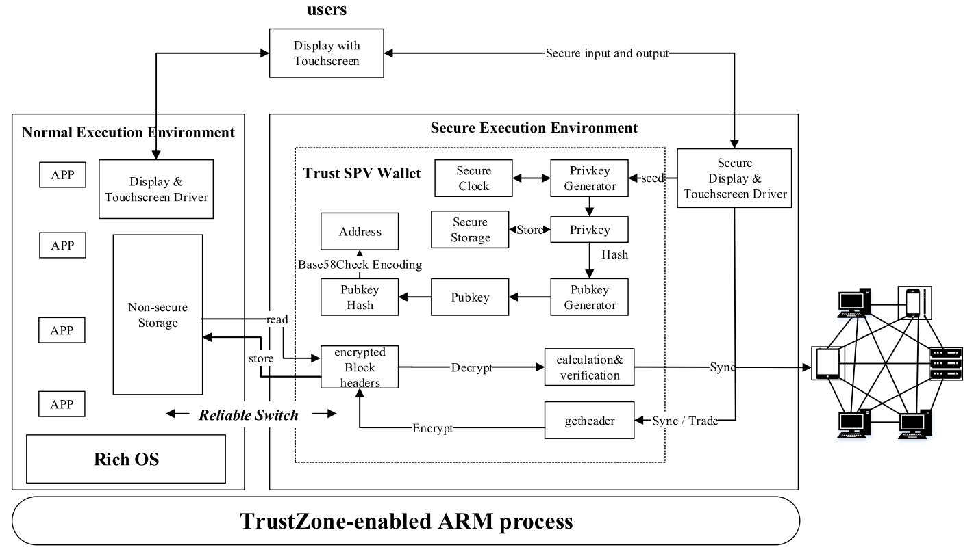
SBLWT: System Overview
Trustzone
Notes:
Trustzone: architecture that separates HW/SW resources into 2 parts: secure (SEE) and insecure/vulnerable (NEE).
SBLWT uses Trustzone for the protection of the private keys, the addresses, the sync with full-nodes and transaction verification.
OS and general Apps run in the NEE, where storage is vulnerable to attackers. SBLWT wallet runs in the SEE, providing protection against a compromised OS.

Slide 29
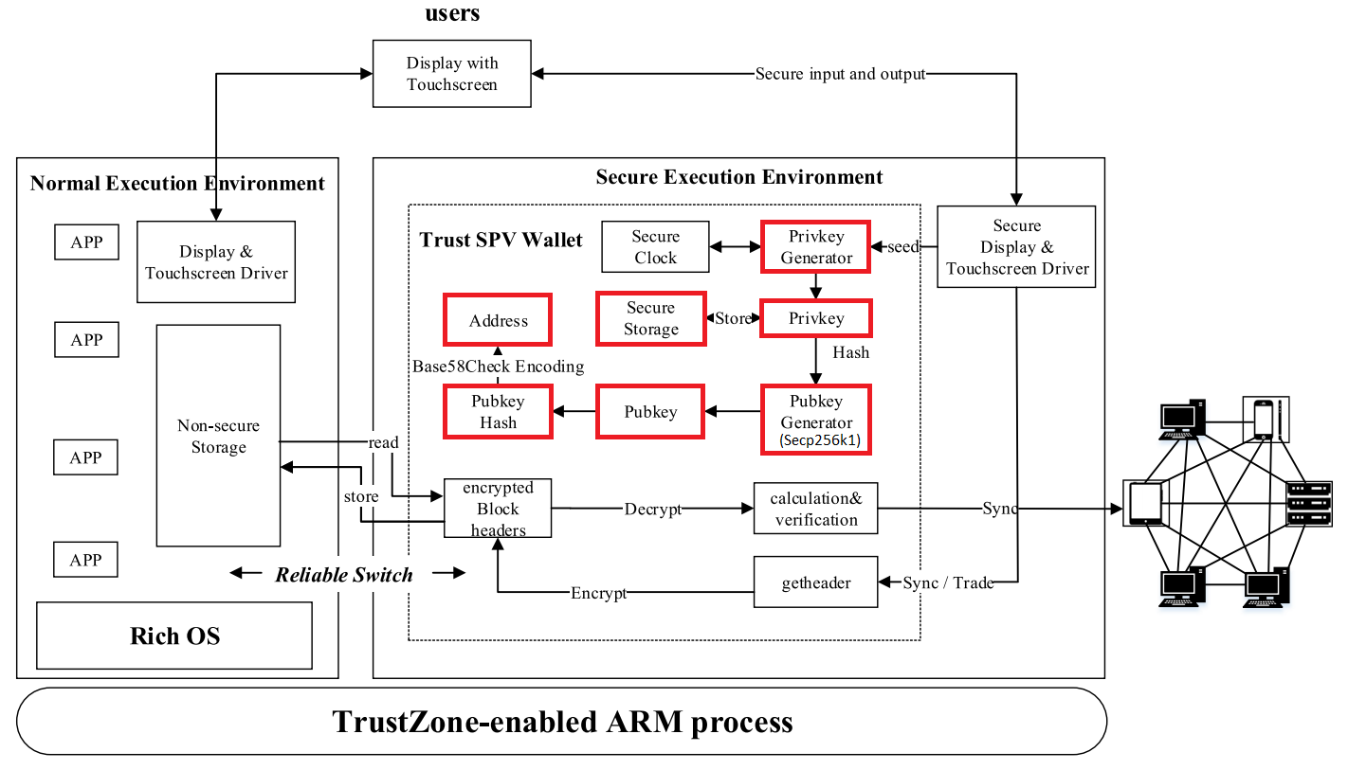
SBLWT: System Overview
Keys & Address generation
Notes:
PrivKey: used to generate the Private Keys, which are stored in secure permanent storage.
PubKey generator: through Secp256k1 (elliptic curve) the Public Key is generated.
Address: public key is double hashed and Base58Check (binary to text encoding) generates the address. The address stays in the SEE.
Q: how to generate multiple addresses from the same private key??

Slide 30
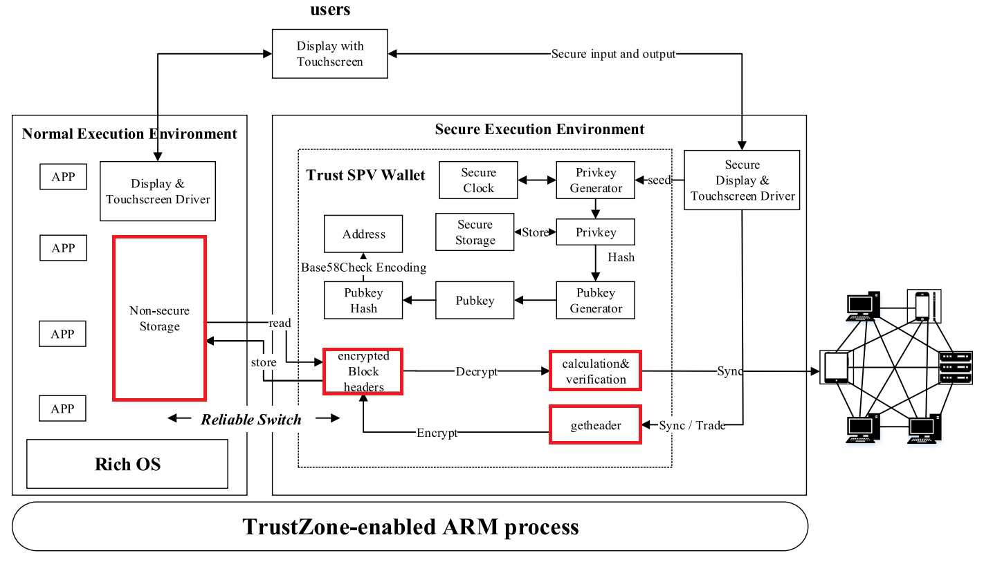
SBLWT: System Overview
Transaction request
Notes:
Transaction request:
- getheader: downloads the related block headers from the full-node.
- encrypt the block headers
- store encrypted block headers in non-secure storage in NEE
- calculation & verification: the system computes the merkle tree and checks that its merkle root matches the one stored in local block headers
- transaction is signed and broadcasted to the Bitcoin network

Slide 31
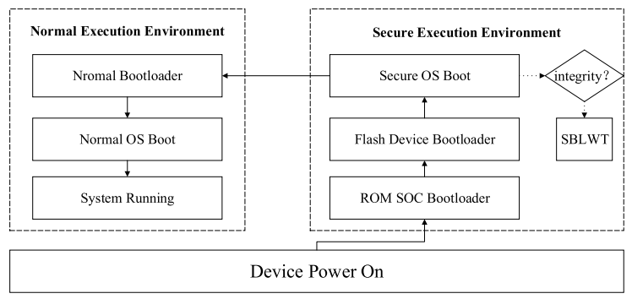
Secure Booting
SBLWT boots in the secure memory and before the Rich OS => it is safe even if Rich OS is malicious.

Slide 32
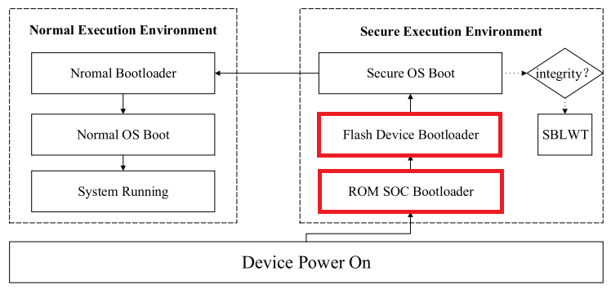
Secure Booting
Booting Sequence
ROM and Flash Device Bootloaders are executed (initializing memory controllers, etc).

Slide 33
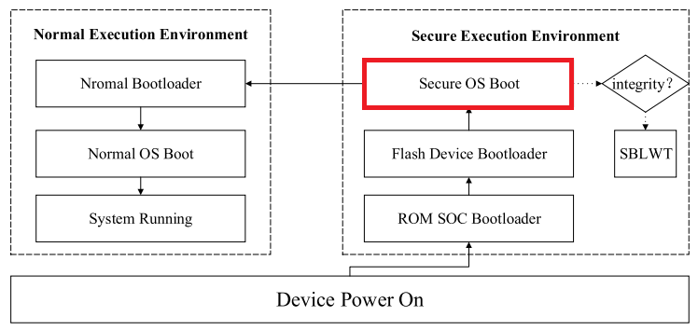
Secure Booting
Booting Sequence
Secure boot items are loaded from the secure permanent storage to the secure memory, to control the SEE.
Secure OS starts and SBLWT is loaded into the secure memory.

Slide 34
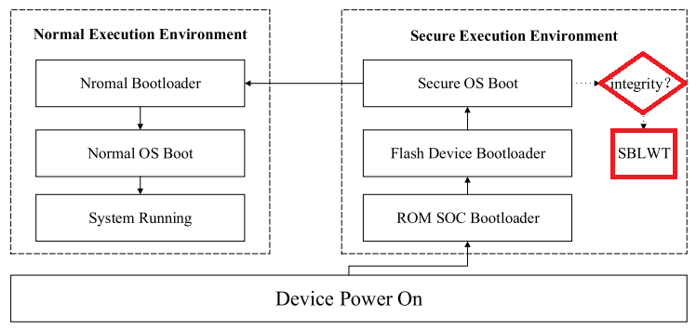
Secure Booting
Booting Sequence
To make sure SBLWT is not corrupted/malicious, its integrity is checked by calculating its hash and comparing it to a stored signature.

Slide 35
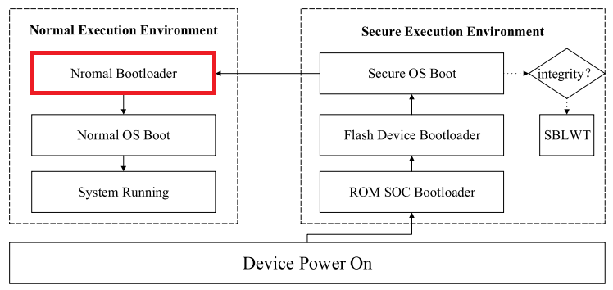
Secure Booting
Booting Sequence
System switched to NEE.
Normal bootloader is loaded.

Slide 36
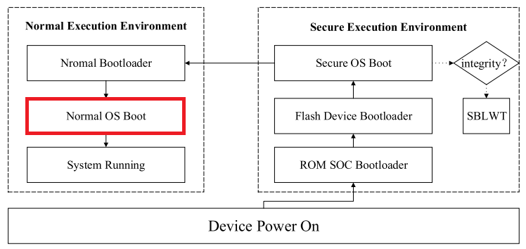
Secure Booting
Booting Sequence
Rich OS is started

Slide 37
Reliable Switching
Safe and reliable switching environment is required for safe transactions

Slide 38
Reliable Switching
Safe and reliable switching environment is required for safe transactions
Software interrupts are not safe: if the Rich OS is malicious, it may tamper them

Slide 39
Reliable Switching
Safe and reliable switching environment is required for safe transactions
Software interrupts are not safe: if the Rich OS is malicious, it may tamper them
Whenever a transaction/synchronization is requested:

Slide 40
Reliable Switching
Safe and reliable switching environment is required for safe transactions
Software interrupts are not safe: if the Rich OS is malicious, it may tamper them
Whenever a transaction/synchronization is requested:
A hardware interrupt (NMI, Non-Maskable Interrupt) is triggered instead

Slide 41
Reliable Switching
Safe and reliable switching environment is required for safe transactions
Software interrupts are not safe: if the Rich OS is malicious, it may tamper them
Whenever a transaction/synchronization is requested:
A hardware interrupt (NMI, Non-Maskable Interrupt) is triggered instead
Rich OS in the NEE is suspended

Slide 42
Reliable Switching
Safe and reliable switching environment is required for safe transactions
Software interrupts are not safe: if the Rich OS is malicious, it may tamper them
Whenever a transaction/synchronization is requested:
A hardware interrupt (NMI, Non-Maskable Interrupt) is triggered instead
Rich OS in the NEE is suspended
System switches to SEE

Slide 43
Reliable Switching
Safe and reliable switching environment is required for safe transactions
Software interrupts are not safe: if the Rich OS is malicious, it may tamper them
Whenever a transaction/synchronization is requested:
A hardware interrupt (NMI, Non-Maskable Interrupt) is triggered instead
Rich OS in the NEE is suspended
System switches to SEE
System restores the secure OS and SBLWT (stored in secure storage)

Slide 44
Reliable Switching
Safe and reliable switching environment is required for safe transactions
Software interrupts are not safe: if the Rich OS is malicious, it may tamper them
Whenever a transaction/synchronization is requested:
A hardware interrupt (NMI, Non-Maskable Interrupt) is triggered instead
Rich OS in the NEE is suspended
System switches to SEE
System restores the secure OS and SBLWT (stored in secure storage)
Transaction/synchronization process is performed

Slide 45
Reliable Switching
Safe and reliable switching environment is required for safe transactions
Software interrupts are not safe: if the Rich OS is malicious, it may tamper them
Whenever a transaction/synchronization is requested:
A hardware interrupt (NMI, Non-Maskable Interrupt) is triggered instead
Rich OS in the NEE is suspended
System switches to SEE
System restores the secure OS and SBLWT (stored in secure storage)
Transaction/synchronization process is performed
The context of SBLWT (private key, address, etc) is stored in the secure storage, and the block headers are encrypted in the non-secure storage

Slide 46
Reliable Switching
Safe and reliable switching environment is required for safe transactions
Software interrupts are not safe: if the Rich OS is malicious, it may tamper them
Whenever a transaction/synchronization is requested:
A hardware interrupt (NMI, Non-Maskable Interrupt) is triggered instead
Rich OS in the NEE is suspended
System switches to SEE
System restores the secure OS and SBLWT (stored in secure storage)
Transaction/synchronization process is performed
The context of SBLWT (private key, address, etc) is stored in the secure storage, and the block headers are encrypted in the non-secure storage
System switches back to NEE

Slide 47
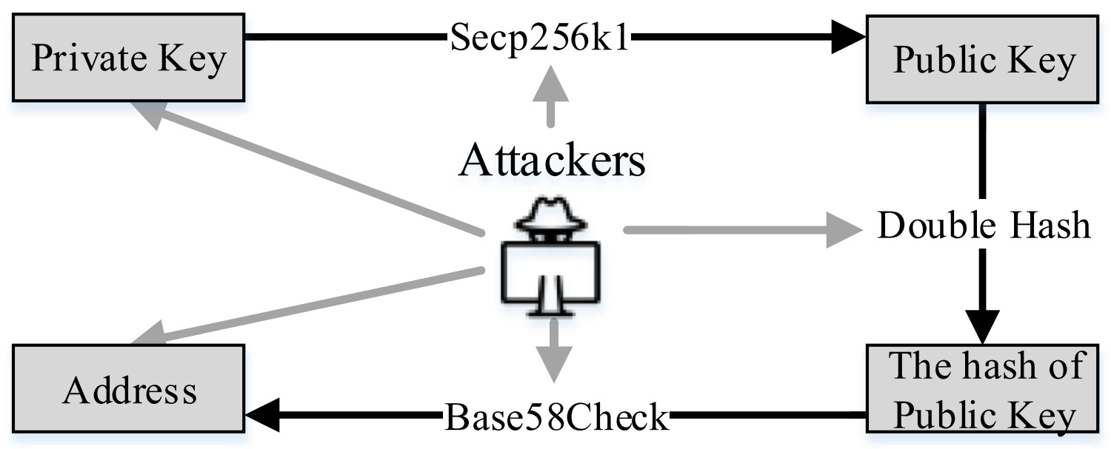
Secure Keys and Reliable Addresses
Multiple Threats
Notes:
Attackers can:
read the private key from memory (or the seed used to generate it)
modify the code that generates the private/public keys/addresses and users could be using a malicious one generated by the attackers.
modify the address that is displayed to the user or tamper it when users enter it or copy to clipboard.

Slide 48
Secure Keys and Reliable Addresses
Secure persistent storage: can only be accessed by SBLWT and not by the compromised Rich OS.

Slide 49
Secure Keys and Reliable Addresses
Secure persistent storage: can only be accessed by SBLWT and not by the compromised Rich OS.
Seed is stored in secure persistent storage.

Slide 50
Secure Keys and Reliable Addresses
Secure persistent storage: can only be accessed by SBLWT and not by the compromised Rich OS.
Seed is stored in secure persistent storage.
Private key generation code is stored in secure persistent storage.

Slide 51
Secure Keys and Reliable Addresses
Secure persistent storage: can only be accessed by SBLWT and not by the compromised Rich OS.
Seed is stored in secure persistent storage.
Private key generation code is stored in secure persistent storage.
Private keys are stored in secure persistent storage.

Slide 52
Secure Keys and Reliable Addresses
Secure persistent storage: can only be accessed by SBLWT and not by the compromised Rich OS.
Seed is stored in secure persistent storage.
Private key generation code is stored in secure persistent storage.
Private keys are stored in secure persistent storage.
Public key generation code is stored in secure persistent storage.

Slide 53
Secure Keys and Reliable Addresses
Secure persistent storage: can only be accessed by SBLWT and not by the compromised Rich OS.
Seed is stored in secure persistent storage.
Private key generation code is stored in secure persistent storage.
Private keys are stored in secure persistent storage.
Public key generation code is stored in secure persistent storage.
Address generation code for the is stored in secure persistent storage.

Slide 54
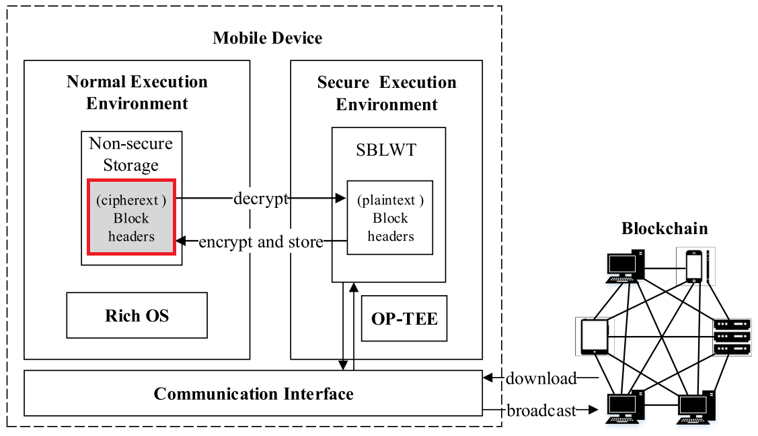
Secure Sync and Verification
TCB (Trusted Computing Base) should be kept as small as possible.
Notes:
TCB (Trusted Computing Base: set of all HW/SW components critical to security).
Small to reduce costs and security risks.

Slide 55
Secure Sync and Verification
TCB (Trusted Computing Base) should be kept as small as possible.
Block headers are stored encrypted in the non-secure storage in the NEE.

Slide 56
Secure Sync and Verification
TCB (Trusted Computing Base) should be kept as small as possible.
Block headers are stored encrypted in the non-secure storage in the NEE.
Whenever needed, the information is decrypted in SEE.

Slide 57
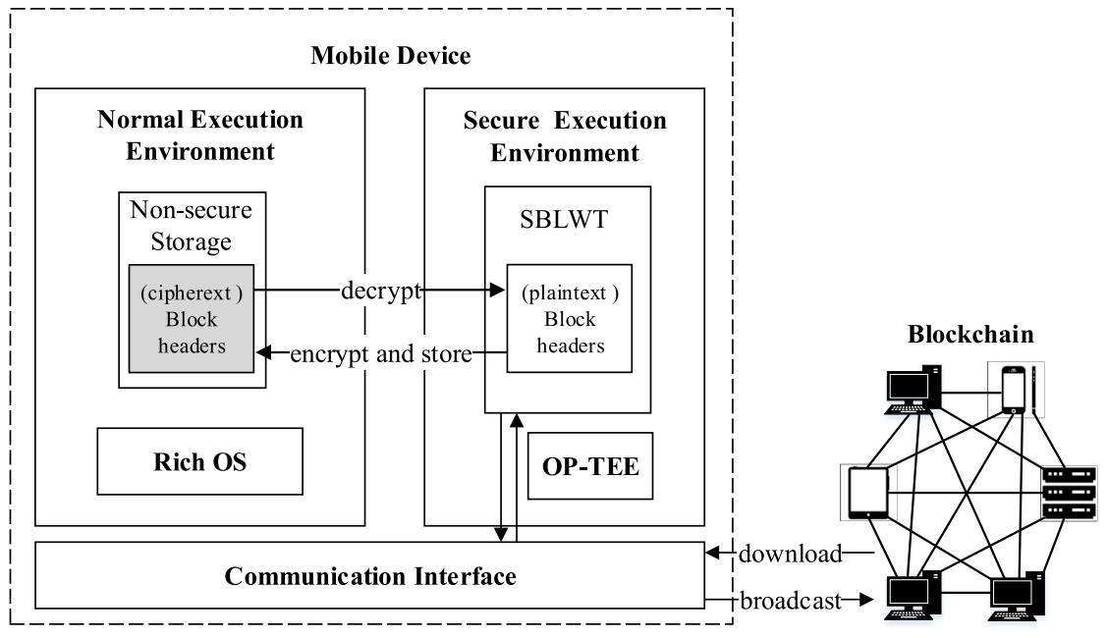
Secure Sync and Verification
Two important functions are implemented in the SBLWT:
Synchronization: keeps information in local database as fresh as on the full-nodes.
Notes:
… when synchronizing the local database with the rest of the nodes, since the system is in SEE, the Rich OS is suspended.

Slide 58
Secure Sync and Verification
Two important functions are implemented in the SBLWT:
Synchronization: keeps information in local database as fresh as on the full-nodes.
Verification: verifies whether the transaction is valid.
Notes:
… to verify it, the system calculates the hash of the information and compares it with the calculated previously before encrypting the SEE.

Slide 59
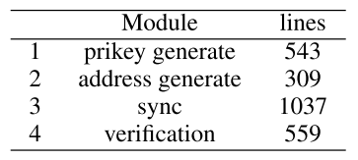
Evaluation
Trusted Computing Base
Notes:
SBLWT was deployed on a Raspberry Pi.
lines??
SBLWT increases the TCB of the secure environment only slightly.

Slide 60
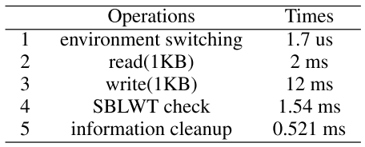
Evaluation
Overhead
Notes:
After an NMI, the environment takes only 1.7 us to switch (extremely negligeble)
Checks the integrity of SBLWT 1.54 ms
Read the local block header and synchronize with remote node to get newest information: 2 ms
Writes back the new block headers: 12 ms
Systems cleansup all the information and returns to Rich OS in NEE: 0.5 ms
This timings have no impact in user’s experience.

Slide 61
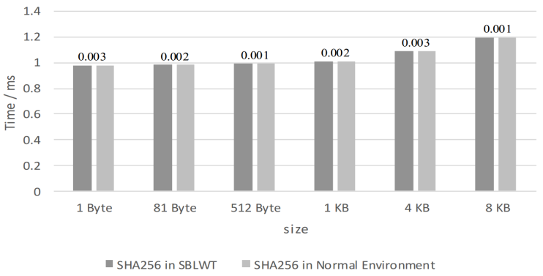
Evaluation
Speed comparision
Notes:
1000 experiments were performed to test SHA-256 on different sizes of data. The time overhead in SBLWT is negligible (3 us at most).

Slide 62
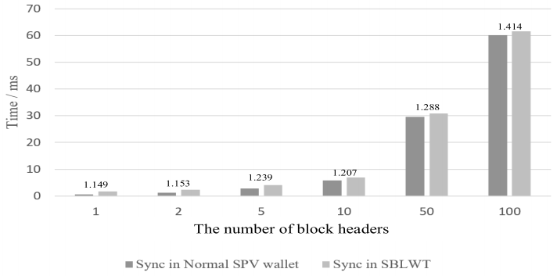
Evaluation
Sync comparision
Notes:
Experiments were also performed to compare the synchronization time of different number of block headers.
In SBLWT, due to the encryption, decryption and environment switching, the synchronization time is slightly larger than for a normal SPV/lightweight wallet.
Note: the time difference is always approximately the same, independently of the number of block headers. => for a larger number of block headers, the difference proportion of the synchronous time gets smaller.

Slide 63
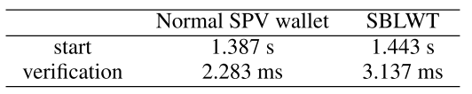
Evaluation
Start and verify time comparision
Notes:
1000 experiments were also performed to test the overhead of the booting and verification time, comparing btw SBLWT and a normal SPV/lightweight wallet.
The overhead in SBLWT is mainly due to the system switching to SEE and restoring the secure OS and the SBLWT.
For a verification, the overhead is significantly larger because SBLWT needs to decrypt the blocks stored in non-secure storage. However, as all costs are small, it doesn’t impact the user experience.

Slide 64
Security Analysis
Secure Booting
Secure OS starts and SBLWT is loaded into the secure memory

Slide 65
Security Analysis
Secure Booting
Secure OS starts and SBLWT is loaded into the secure memory
SBLWT image could be malicious

Slide 66
Security Analysis
Secure Booting
Secure OS starts and SBLWT is loaded into the secure memory
SBLWT image could be malicious
Before loading it, its signature is validated to check code and data are reliable

Slide 67
Security Analysis
Information Leakage
Rich OS or its applications could be malicious

Slide 68
Security Analysis
Information Leakage
Rich OS or its applications could be malicious
All SBLWT tasks are performed in SEE

Slide 69
Security Analysis
Information Leakage
Rich OS or its applications could be malicious
All SBLWT tasks are performed in SEE
All temporary information (including CPU registers) are cleaned up before switching back to NEE

Slide 70
Security Analysis
Information Leakage
Rich OS or its applications could be malicious
All SBLWT tasks are performed in SEE
All temporary information (including CPU registers) are cleaned up before switching back to NEE
Malicious OS or Apps cannot access sensitive information

Slide 71
Security Analysis
Denial-of-Service Attack
For a transaction/synchronization: system switches to SEE
Notes:
DOS attack: Most serious threat of the design.
First type of DOS attack:

Slide 72
Security Analysis
Denial-of-Service Attack
For a transaction/synchronization: system switches to SEE
Attackers can intercept the request through Rich OS vulnerabilities

Slide 73
Security Analysis
Denial-of-Service Attack
For a transaction/synchronization: system switches to SEE
Attackers can intercept the request through Rich OS vulnerabilities
Reliable switching uses NMI interrupts, which cannot be bypassed by compromised Rich OS

Slide 74
Security Analysis
Denial-of-Service Attack
For a transaction/synchronization: system switches to SEE
Attackers can intercept the request through Rich OS vulnerabilities
Reliable switching uses NMI interrupts, which cannot be bypassed by compromised Rich OS
The handler of NMI is in SEE, attackers cannot manipulate it

Slide 75
Security Analysis
Denial-of-Service Attack
For a transaction/synchronization: system switches to SEE
Attackers can intercept the request through Rich OS vulnerabilities
Reliable switching uses NMI interrupts, which cannot be bypassed by compromised Rich OS
The handler of NMI is in SEE, attackers cannot manipulate it
SBLWT is not vulnerable to interception DOS attacks

Slide 76
Security Analysis
Denial-of-Service Attack
Attackers could delete SBLWT’s binary code from permanent storage by Rich OS vulnerabilities
Notes:
Second type of DOS attack:

Slide 77
Security Analysis
Denial-of-Service Attack
Attackers could delete SBLWT’s binary code from permanent storage by Rich OS vulnerabilities
SBLWT is stored in secure permanent storage.

Slide 78
Security Analysis
Denial-of-Service Attack
Attackers could delete SBLWT’s binary code from permanent storage by Rich OS vulnerabilities
SBLWT is stored in secure permanent storage.
SBLWT is not vulnerable to delete DOS attacks

Slide 79
Security Analysis
Denial-of-Service Attack
Block headers cannot be stored in permanent secure storage (it would make the TCB too large)

Slide 80
Security Analysis
Denial-of-Service Attack
Block headers cannot be stored in permanent secure storage (it would make the TCB too large)
If block headers are directly stored in non-secure (NEE) storage, attackers could tamper their information

Slide 81
Security Analysis
Denial-of-Service Attack
Block headers cannot be stored in permanent secure storage (it would make the TCB too large)
If block headers are directly stored in non-secure (NEE) storage, attackers could tamper their information
Block headers are encrypted before being stored in NEE storage

Slide 82
Security Analysis
Denial-of-Service Attack
Block headers cannot be stored in permanent secure storage (it would make the TCB too large)
If block headers are directly stored in non-secure (NEE) storage, attackers could tamper their information
Block headers are encrypted before being stored in NEE storage
Encryption/Decryption is performed in SEE

Slide 83
Security Analysis
Denial-of-Service Attack
Block headers cannot be stored in permanent secure storage (it would make the TCB too large)
If block headers are directly stored in non-secure (NEE) storage, attackers could tamper their information
Block headers are encrypted before being stored in NEE storage
Encryption/Decryption is performed in SEE
SBLWT is not vulnerable to delete block headers DOS attacks

Slide 84
Future Work
Although iPhones use ARM processors, they do not support Trustzone

Slide 85
Future Work
Although iPhones use ARM processors, they do not support Trustzone
iPhones have an extra processor (Secure Enclave) to handle security

Slide 86
Future Work
Although iPhones use ARM processors, they do not support Trustzone
iPhones have an extra processor (Secure Enclave) to handle security
SBLWT will be extended to iPhones

Slide 87

Questions?

