Slide 1

Unsupervised Domain Adaptation for Synthetic to Real Images
Group name: S2R
Members: Yukui Luo NUID: 001532578
Mariano Marufo da Silva NUID: 001586729

Slide 2
Outline
Reference paper and code, experiment reproduction (Adversarial Methods)
Unsupervised Domain Adaptation by Backpropagation (RevGrad)
Adversarial Domain Adaptation with Domain Mix-up (VAE-GAN)
Task1: MNIST to MNIST-M
Methods
Experiment results
Task2: MNIST to SVHN
Methods
Experiment results

Slide 3
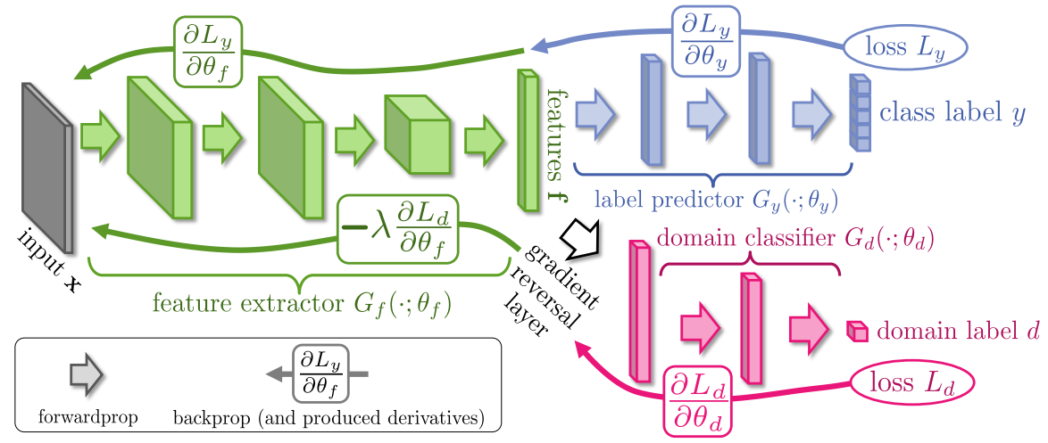
Unsupervised Domain Adaptation by Backpropagation (RevGrad) [1]
Source dataset with labels
Target dataset without labels
Training a classification model for target dataset
Composed of 3 Networks:
Label Predictor: optimized to classify the inputs (used during training and testing)
Domain Classifier: optimized to determine if input belongs to source or target domain (only used during training, for optimizing the feature extractor)
Feature extractor: optimized to minimize the Label Predictor loss, and maximize the Domain Classifier loss (used during training and testing)
During training: similar to a GANs mini-max game between the Feature Extractor and Domain Classifier, so the FE matches the feature space distributions of the source and target domain (i.e. make the features domain invariant).
[1] Ganin, Y. and Lempitsky, V., 2015, June. Unsupervised domain adaptation by backpropagation. In International conference on machine learning (pp. 1180-1189). PMLR.

Slide 4
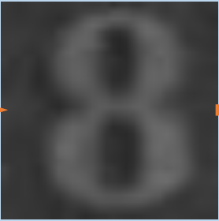
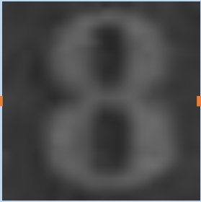
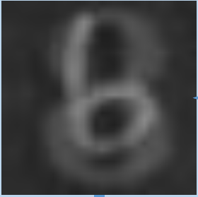
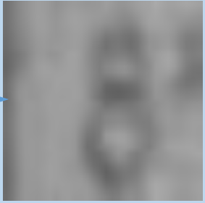
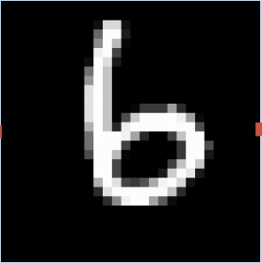
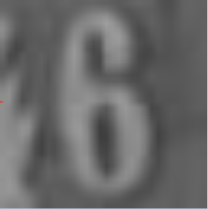





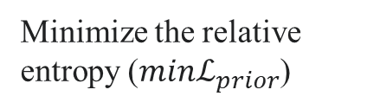



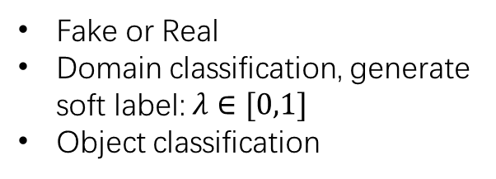

Adversarial Domain Adaptation with Domain Mix-up (GAN method) [2]
Feature-level mix-up
Source
input
$$z$$
Discriminator
$$λ$$
$$x$$
fs
$$z$$
$$\tilde{x}$$
Fake or Real
Domain classification, generate soft label: $λ∈[0,1]$
Object classification
$$1−λ$$
ft
Feature
extractor
(CNN)
Generator
Target
Input
Generated
images
Pixel-level mix-up
Minimize the relative entropy ($minℒ_{prior}$)
Mix-up method:
Pixel-level mix-up
Feature-level mix-up
relative entropy
pixel-likelihood
[2] Xu, M., Zhang, J., Ni, B., Li, T., Wang, C., Tian, Q. and Zhang, W., 2020, April. Adversarial domain adaptation with domain mixup. In Proceedings of the AAAI Conference on Artificial Intelligence (Vol. 34, No. 04, pp. 6502-6509).

Slide 5




Result reproduce and our tasks
 | Paper report (target dataset classification accuracy)
 | RevGrad (mix-up) | VAE-GAN (mix-up)
SV>MN | 73.9% | 95.5%
MN>SV | Failed
MN>MN-M | Not report
 | Our reproducing result (use paper code)
SV>MN | 68% | 86.1%
MN>SV | ~20% (failed) | ~10% (failed)
Motivation:
This 2020 paper [2] mentioned: MN > SV is failed, and they never try MN > MN-M.
Challenge:
MNIST is a gray image, and its texture is monotonous, there are infinity possible texture transmission for MNIST dataset. (The main reason to failed.)
In some case: MN > SV represents the synthetic image to real image domain adaption.
Tasks:
Easy task: MN > MN-M: as MN-M is generate from the MN, in order to have a fair training, we cut both training set into two parts to guarantee the MN trainset do not have overlap with MN-M trainset.
Difficult task: MN > SV: We apply Semi-Supervised GAN (SGAN) to MN, and generate SV style fake MN dataset (fake-SV), and then apply it to train SV
SV>MN: The Street View House Numbers (SVHN) dataset as the source, and MNIST dataset as the target dataset.
Texture “up-sampling” UDA problem:
synthetic image
real image
MN: MNIST dataset
SV: SVHN dataset
MN-M: MNIST-M dataset
…

Slide 6


MNIST-M (MN-M) Dataset
Task1: MN > MN-M (RevGrad method)
Proposed in [3] as a variation of MNIST for benchmarking UDA methods
Created by using MNIST digits as a mask and inverting the colors of a background image.
[3] Y. Ganin et al. Domain-Adversarial Training of Neural Networks. JMLR, 17(59):1–35, 2016

Slide 7
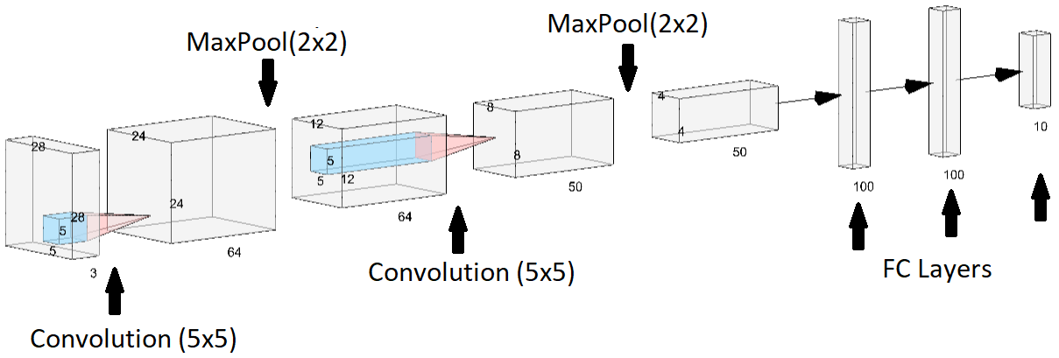
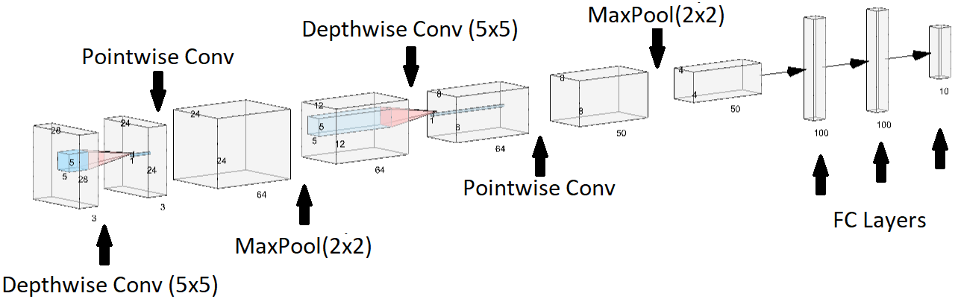
RevGrad Architectures
Task1: MN > MN-M (RevGrad)
Only showing the Feature Extractor (Conv. Layers) and the Label Predictor (FC Layers).
RevGrad (implementation from https://github.com/ChrisAllenMing/Mixup_for_UDA/tree/master/Mixup_RevGrad):
Depthwise Separable RevGrad (our proposal):

Slide 9
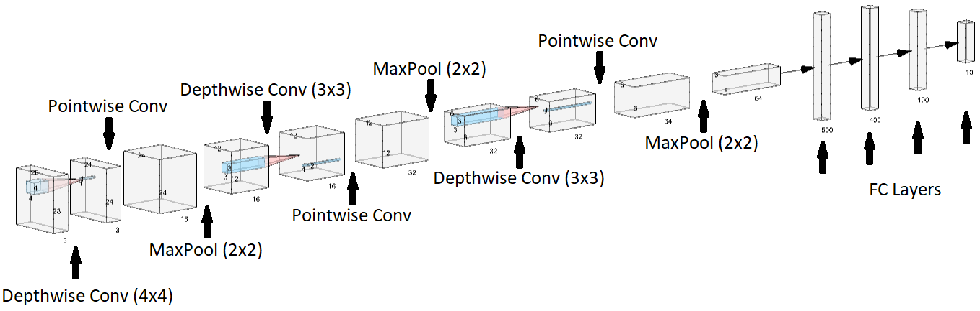
Deeper Depthwise Separable RevGrad
Comparison with Depthwise Separable RevGrad:
1 additional Conv. Layer
1 additional FC Layer
Smaller Conv. Filters
Worse results in MNIST to MNIST_M: 55% (with Mixup) and 47% (without Mixup)

Slide 10
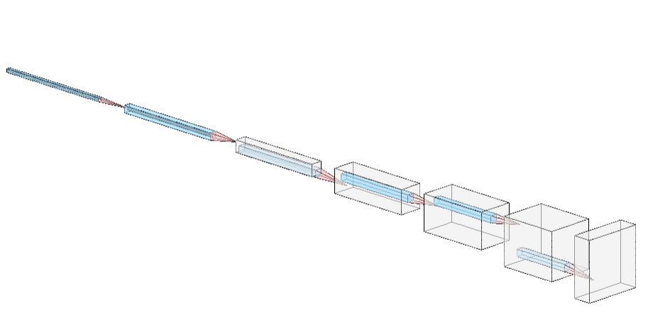
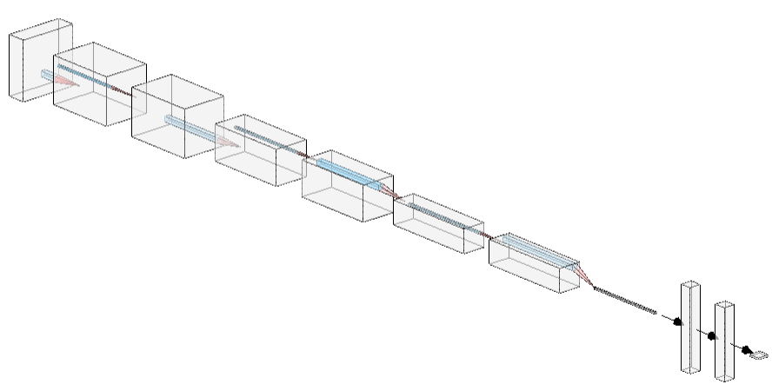
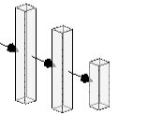
Task1: MN > MN-M (VAE-GAN method)
The feature extraction network is LeNet-5, we remove its’ fully connection layer, and mapping the 2D features to Gaussian distribution.
Generator use 2D transposed convolution operator to generate image from variational mapping.
Discriminator
3*32*32 image
Fake or real
Classification

Slide 11
Result summary:
 | Our report (target dataset classification accuracy)
 | RevGrad | VAE-GAN (mix-up)
MN>MN-M | 86% (maximum) | 73.336%

Slide 12
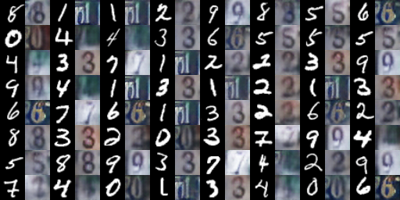
Task2: MN > SV
Stage 1: use (Semi-Supervised GAN) SGAN generate Fake-SV dataset
Fake-SV sample
Source dataset MN
SGAN
Model
Target dataset SV
Source dataset MN
SGAN
Selected SV data with label.
Limited number of SV.
Style transfer
UDA method
RevGrad or VAE-GAN
Stage 2: apply UDA method

Slide 13
Depthwise separable versions achieve the same accuracy as the regular original networks
They need more epochs, but they are actually much faster to train.

Slide 14
RevGrad vs. Depthwise Separable RevGrad
Convolutional Layers:
# Parameters
RevGrad: 5*5*3*64 + 5*5*64*50 = 84800
Depthwise Separable RevGrad: 5*5*3 + 3*64 + 5*5*64 + 64*50 = 5067
# Computations
RevGrad: 5*5*3*24*24*64 + 5*5*64*8*8*50 = 7884800
Depthwise Separable RevGrad: 5*5*24*24*3 + 3*24*24*64 + 5*5*8*8*64+64*8*8*50 = 460992
Models file size:
RevGrad: 1038311 bytes
Depthwise Separable RevGrad: 723094 bytes

Slide 15
Result summary:
 | Our report (target dataset classification accuracy)
 | RevGrad | VAE-GAN (mix-up)
MN>fake-SV>SV | 54% (maximum) | 34.33%
Conclusion:
From our experiment, texture extraction GAN + RevGrad method can achieve better performance in this texture “up-sampling” UDA task
Possible problem:
The selected SV source image cannot cover all SV texture style.
Feature work:
Developing a style extraction method or GAN to extract all SV’s textures and background, and than apply it to the source (MN) dataset.
Integrate the whole system

Slide 16
Thank you !

Slide 18



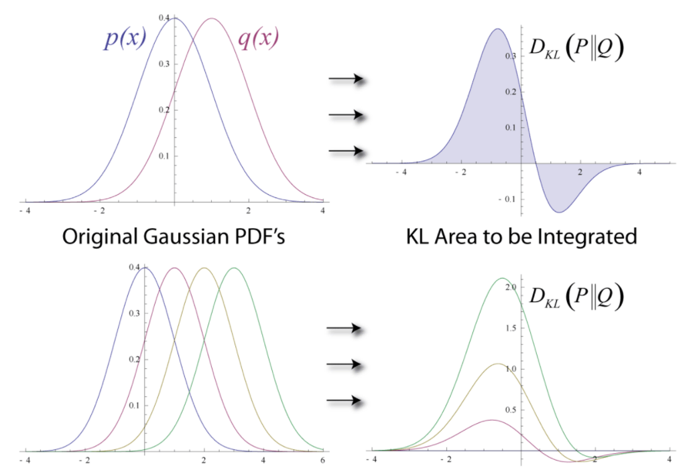

Adversarial Domain Adaptation with Domain Mix-up (GAN method)
Variational Auto Encoder (VAE)-GAN [3]:
Feature extractor is encoder
Generator use as decoder
fs, ft, and feature-level mix-up have been mapped into Gaussian distribution.
GAN
VAE
Minimize the relative entropy ($minℒ_{prior}$)
[3] Larsen, A.B.L., Sønderby, S.K., Larochelle, H. and Winther, O., 2016, June. Autoencoding beyond pixels using a learned similarity metric. In International conference on machine learning (pp. 1558-1566). PMLR.
Notes:
The VAE loss is minus the sum of the expected log likelihood (the reconstruction error) and a prior regularization term

